Slide 1
CS295: Info Quality & Entity Resolution
Course Introduction Slides
Dmitri V. Kalashnikov
University of California, Irvine Spring 2013
Copyright © Dmitri V. Kalashnikov, 2013

Slide 2
Overview
Class organizational issues
Intro to Entity Resolution

Slide 3
Class Organizational Issues
Class Webpage
www.ics.uci.edu/~dvk/CS295.html
Will put these slides there
Class Info
Let’s introduce ourselves
New place & time
DBH 2065 (“ISG Meeting Room”)
Thursdays' only (once a week)
@3:30–5:50PM
Next class : Thu, April 11, 2013 @ 3:30

Slide 4
Class Structure
Student presentation-based class
Students will present publications
Papers cover recent trends (not comprehensive)
Prepare slides
Slides will be collected after presentation
Discussion
Final grade
(30%) Participation
Please do not sit quietly all the time!
(50%) Quality of your presentations and slides
(10%) Attendance
No exams!

Slide 5
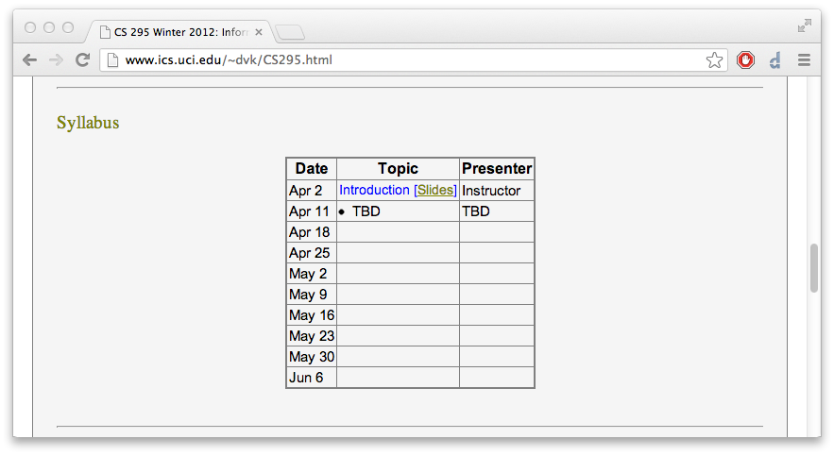
Tentative Syllabus

Slide 6
Presentation
Class Structure
1 student talk per class
2 student talks per course
We are a small class
Please start preparing early!
Everyone reads each paper
Try to read each paper fully
If you cannot
Read to get the main idea of each paper
Read at least the introduction of each paper carefully
Otherwise, you will be lost
Will not be able to participate

Slide 7
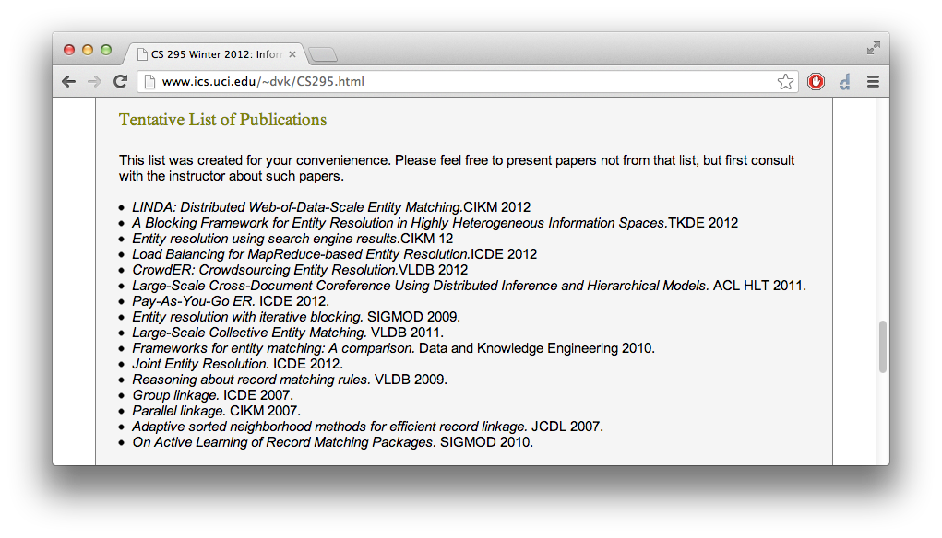
Tentative List of Publications

Slide 8
Papers can be weak
Let me state the obvious…
A lot of papers “out there” are weak
Don’t treat papers as the gospel!
Read everything with critical mind

Slide 9
How to present a paper
Present “high-level” ideas
Try to understand main ideas/concepts well
High-level ideas
Everyone should be able get those ideas from your talk
Present technical detail
Cover techniques in detail
We are trying to learn new techniques and algo’s!
Analyze the paper [if you can]
Think as a researcher!
Discuss what you like about the paper
Criticize the technique
Do you see flaws/weaknesses?
Do you think it can be improved?
Notes:
You should
Present the material in the paper and
Can also contribute your *own* analysis and criticism of the paper.

Slide 10
Presenting Experiments
Presenting experiments
A presentation is incomplete without covering experiments
We want to see experiments!
Explain
Datasets
Setup
Plots (analyze results)
Analyze experiments [if you can]
Explain what do you like about the experiments
Have authors done something unusually well in your view?
Criticize experiments
Large enough data?
Something else should be tested?
Curve trends in plots explained well?
Notes:
You should
Present the material in the paper and
Can also contribute your *own* analysis and criticism of the paper.

Slide 11
Who wants to present next?

Slide 12
Talk Overview
Class organizational issues
Intro to Entity Resolution

Slide 13
Data Processing Flow
Analysis
Decisions
Data
Data
Organizations & People collect large amounts of data
Many types of data
Textual
Semi structured
Multimodal
Analysis
Data is analyzed for a variety of purposes
Automated analysis: Data Mining
Human in the loop: OLAP
Ad hoc
Analysis for Decision Making
Business Decision Making
Etc

Slide 14
Quality of decisions depends on quality of data
Quality of Analysis
Quality of Decisions
Quality of Data
Quality of data is critical
$1 Billion market
Estimated by Forrester Group (2008)
$35.5 Billion for Database and Data integration (IDC 2011)
Data Quality
Very old research area (over 50 years)
But “small”, not organized and structured well
E.g., no comprehensive “big picture” textbook exists yet!

Slide 15
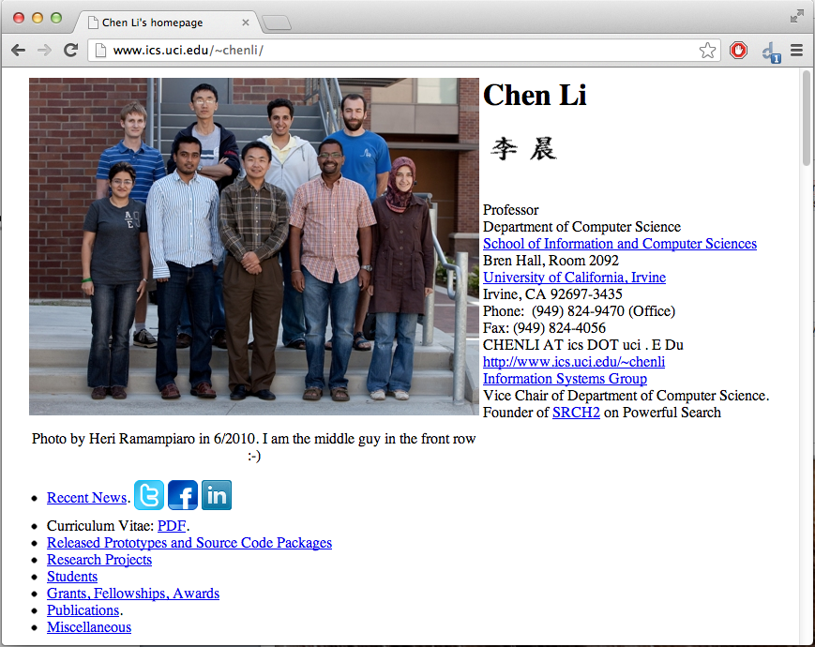
Example Background: a UCI DB Prof. Chen Li

Slide 16
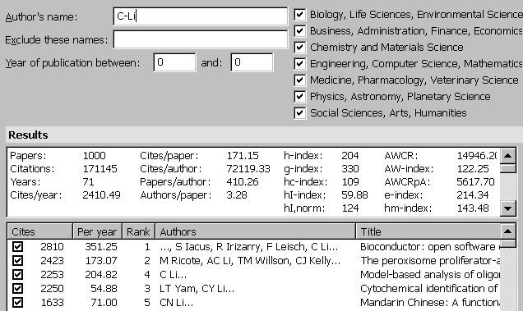
Example of Analysis on Bad Data
Real-life Query: “Find me (in Google Scholar) the paper count of UCI’s Chen Li who is in CS area” - a simple task to do?
- Duplicate papers
- Duplicate authors
- Correlate with pub list on Chen’s homepage?
… impossible: my question was about another Chen Li: our new CS student, he does not have a homepage yet !!!

Slide 17
“Garbage in, Garbage out”
Analysis on bad data can lead to incorrect results
Fix errors before analysis
Or, account for them during analysis
More than 80% of data mining researchers spend >40% of their project time on cleaning and preparation of data.

Slide 18
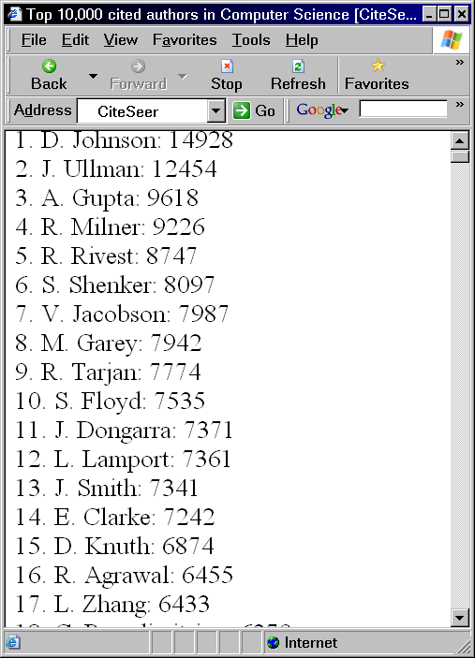
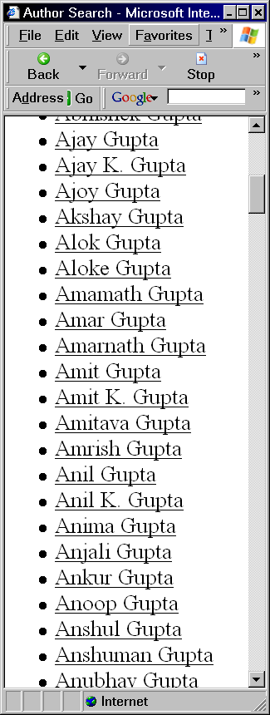
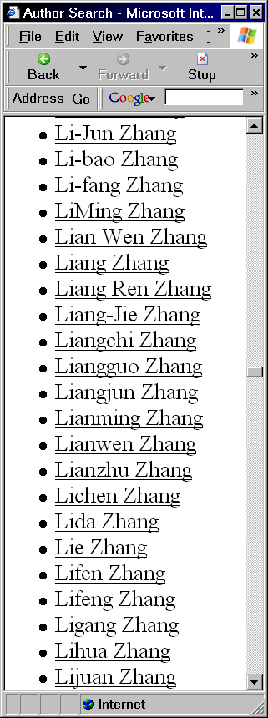
Example of Analysis on Bad Data: CiteSeer
Unexpected Entries
Lets check two people in DBLP
“A. Gupta”
“L. Zhang”
Analysis on bad data can lead to incorrect results.
Fix errors before analysis.
More than 80% of researchers working on data mining projects spend more than 40% of their project time on cleaning and preparation of data.
CiteSeer: Top-k most cited authors
DBLP
DBLP
Notes:
they are in top-20 because there are many of them

Slide 19
*Why* Data Quality Issues Arise?
Ambiguity / Uncertainty
Erroneous data values
Missing Values
Duplication
etc

Slide 20
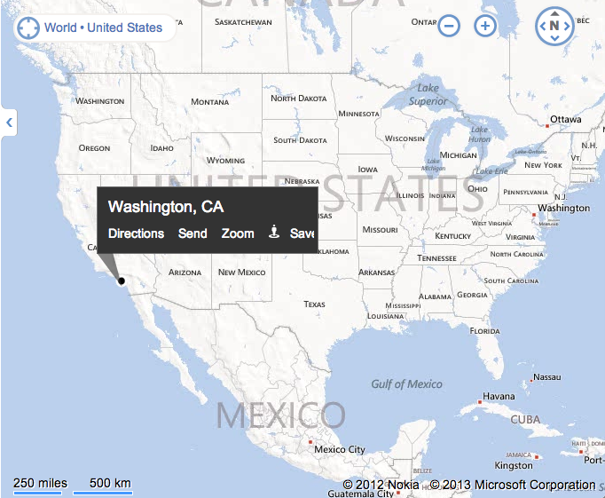
Example of Ambiguity
Ambiguity
Categorical data
Location: “Washington” (???)

Slide 21
Example of Uncertainty
Uncertainty
Numeric data
“John’s salary is between $50K and $80K”
Query: find all people with salary > $70K
Should this query return John?

Slide 22
Example of Erroneous Data
Erroneous data values
<Name: “John Smixth”,
Salary: “Irvine, CA”,
Loc: $50K>

Slide 23
Example of Missing Values
Missing Values
<Name: “John Smixth”,
Salary: null,
Loc: null>

Slide 24
Example of Duplication
Duplication
<1/01/2010, “John Smith”, “Irvine, CA”, 50k>
<6/06/2013, “John Smith”, “CA”, 55k>
Same?
Different?

Slide 25
Inherent Problems vs Errors in Preprocessing
Inherent Problems with Data
The dataset itself contains errors
Like in previous slides
<Name: “John Smixth”, Salary: null, Loc: null>
Errors in Preprocessing
The dataset may (or may not) contain errors
But preprocessing algo (e.g., extraction) introduces errors
Automatic extractors are not perfect
Text: “John Smith lives in Irvine CA at 100 main st, his salary is $25K”
Extractor:
<Person: Irvine, Loc: CA, Salary: $100K, Addr: null>

Slide 26
*When* Data Quality Issues Arise?
Manual entering of data
Inherent data problems
John Smith
2+2 = 5
Jane Smith
Automated generation of DB content
Raw data
Data Preprocessing
- info extraction
- info integration
...
Database
Internet : increased interest in ER. Area will be active for a while!!!
Notes:
Manual entering of data
Automated generation of DB content
Prime reason for DQ issues nowadays
Merging DBs or Data sources
Duplicate information
Inconsistent information
Missing data
Analyzing raw (Internet) data
Over 8 ER submissions to VLDB 2010!
Information Extraction (from text)
Inherent problems with data
E.g. “Washington” – which one?

Slide 27
Recent Increase in Importance of ER
VLDB 2010
Over ~8 data quality papers
SIGMOD 2012
Had several “big data” keynote speakers
All said ER is a key challenge to deal with
Reason?
Analysis of large-scale data from poor sources
Web Pages
Social Media
ER is likely to stay important for a while
My research group may shift to a different research topic

Slide 28
*When* DQ Issues Arise? Present.
Automated generation of DB content
Prime reason for DQ issues nowadays
Analyzing unstructured or semi-structured raw data
Text / Web
Extraction
Merging DBs or Data sources
Duplicate information
Inconsistent information
Missing data
Inherent problems with well structured data
As in the shown examples

Slide 29
Data Flaw wrt Data Quality
Handle
Data Quality
Analysis
Decisions
Raw Data
Two general ways to deal with Data Quality Challenges
Resolve them and then apply analysis on clean data
Classic Data Quality approach
Account for them in the analysis on dirty data
E.g. put data into probabilistic DBMS
Often this approach is not considered to be “Data Quality”

Slide 30
Resolve only what is needed!
Handle
Data Quality
Analysis
Decisions
Raw Data
Data might have many different (types of) problems in it
Solve only those that might impact your analysis
Example
<1, John Smith, “Title 1…”, SIGMxOD>
<2, John Smith, “Title 2…”, SIGIR>
…
Assume task is to simply count papers
Assume the only error - venues can be misspelled
Do not fix venues!!!
You can correctly count papers, no Data Quality algo’s needed!

Slide 31

Entity Resolution (ER)
A very common data quality challenge
Is “J. Smith” in Database1 the same as “John Smith” in DB2?
Is “IBM” in DB1 the same as “IBM” in DB2?
Is face1 in an image the same as face2 in a different image?
ER can be very interesting, like work of a detective!
Looking for clues
But, automated and on data
Goal of ER: Finding which (uncertain) references co-refer

Slide 32

Multiple Variations of ER
Variants of Entity Resolution
Record Linkage [winkler:tr99]
Merge/Purge [hernandez:sigmod95]
De-duplication [ananthakrishna:vldb02,sarawagi:kdd02]
Hardening soft databases [cohen:kdd00]
Reference Matching [mccallum:kdd00]
Object identification [tejada:kdd02]
Identity uncertainty [pasula:nips02, mccallum:iiweb03]
Coreference resolution [ng:acl02]
Fuzzy match and fuzzy grouping [@microsoft]
Name Disambiguation [han:jcdl04, li:aaai04]
Reference Disambiguation [km:siam05]
Object Consolidation [mccallum:kdd03wkshp, chen:iqis05]
Reference Reconciliation [dong:sigmod05]
…
Ironically, most of them co-refer (the same problems)
Communities
Database
Machine learning
Natural Language Processing
“Medical”
Data mining
Information retrieval
…
Often, one community is not fully aware what the others are doing

Slide 33
Lookup and Grouping
Lookup ER
List of all objects is given
Match references to objects
Grouping ER
No list of objects is given
Group references that corefer
33

Slide 34
When ER challenge arises?
Merging multiple data sources (even structured)
“J. Smith” in DataBase1
“John Smith” in DataBase2
Do they co-refer?
References to people/objects/organization in raw data
Who is “J. Smith” mentioned as an author of a publication?
Location ambiguity
“Washington” (D.C.? WA? Other?)
Automated extraction from text
“He’s got his PhD/BS from UCSD and UCLA respectively.”
PhD: UCSD or UCLA?
Natural Language Processing (NLP)
“John met Jim and then he went to school”
“he”: John or Jim?

Slide 35


Heads up: Traditional Approach to ER
“Pairwise, Feature-Based Similarity”
Name Occupation Affiliation Email Collaborators
u
Chen Li
Prof.
UC Irvine
lichen@uci.edu
Z. Xu; A. Behm
?
?
?
?
?
v
C. Li
Professor
UCI
chenli @ ics D uci.edu
Alexander Bëhm
Name Occupation Affiliation Email Collaborators
s (u,v) = f (u,v)
“Similarity function”
“Feature-based similarity”
// Limitations …
(if s(u,v) > t then u,v co-refer)
// Works well for DB key’s
// Edit distance fails…
// Not all algo’s work like that…

Slide 36

Limitation 1: Same people but Different values
“Pairwise, Feature-Based Similarity”
Name Occupation Affiliation Email Collaborators
u
Chen Li
Student
Stanford
chenli@stanford.edu
Jeff Ullman
?
?
?
?
?
v
C. Li
Professor
UCI
chenli @ ics D uci.edu
H. Garcia-Molina
Name Occupation Affiliation Email Collaborators

Slide 37
Limit 2: Different people but same values
“Pairwise, Feature-Based Similarity”
Name LivedIn Affiliation POB Knows
u
Sharad Mehrotra
South CA
UIUC
Sametown, India
Jeff Ullman
?
?
?
?
?
v
Sharad Mehrotra
South CA
UIUC
Sametown, India
Jeff Ullman
Name LivedIn Affiliation POB Knows

Slide 38
Standard ER “Building Blocks”
1. Data Normalization & Parsing
(populating “features”)
2. Blocking Techniques
(the main efficiency part)
3. Problem Representation
(e.g., as a Graph)
Most important
(typically)
4. “Similarity” Computations
5. Clustering / Disambiguation
6. Representing Final Result
7. Measuring Result Quality
Notes:
Looking for clues, trying “connect the dots”, … and all in automated fashion!
Lots of papers exist on each aspect

Slide 39
Block 1: Standardization & Parsing
A simple/trivial step
Standardization
Converting data (attribute values) into the same format
For proper comparison
Examples
“Jun 1, 2013” matches “6/01/13” (into “MM/DD/YYYY”)
“3:00PM” matches “15:00” (into “HH:mm:ss”)
“Doctor” matches “Dr.”
Convert “Doctor” into “Dr.”; “Professor” into “Prof.”, etc
Parsing
Subdividing attributes into proper fields
“Dr. John Smith Jr.” becomes
<PREF: Dr., FNAME: John, LNAME: Smith, SFX: Jr.>

Slide 40
Standard ER “Building Blocks”
1. Data Normalization & Parsing
(populating “features”)
2. Blocking Functions
(the main efficiency part)
3. Problem Representation
(e.g., as a Graph)
Most important
(typically)
4. “Similarity” Computations
5. Clustering / Disambiguation
6. Representing Final Result
7. Measuring Result Quality
Notes:
Looking for clues, trying “connect the dots”, … and all in automated fashion!
Lots of papers exist on each aspect

Slide 41
Block 2: Why do we need “Blocking”?
Dirty “entity set” (say, table)
Need to clean it
Naïve pairwise algo (bad)
//Compare every object to every object
for (i=1; i<n-1; i++)
for (j=i+1; j<=n; j++)
if Resolve(r_i, r_j) = same then
Declare r_i and r_j to be the same
Complexity
n objects, say n=1 Billion=10⁹
Complexity is n(n-1)/2, that is ~10¹⁸ calls to Resolve()
This notebook:
118 GFLOPS = 10¹¹ FLOPS
10⁷ secs= over 115 days
But, Resolve is not 1 FLOP, etc… 1150 – 115,000 days
ID | Attr1 | Attr2 | Attr3
1 | Joe
2 | Jane
… | … | … | …
n | Alice
Notes:
Intel(R) Core(TM) i7-3820QM CPU @ 2.70GHz

Slide 42
Blocking
Blocking
Main efficiency technique in ER
Split R into smaller blocks B_1, B_2, …, B_m // Not really
B_i is a subset of R
Typically |B_i| << |R|
Fast: O(n) or O(n log n) end-to-end, applied on entire R
Meaning of Blocks
All r_j’s that may co-refer with r_i are put in B_i
High recall
“Conservative” function
For an r_j in B_i, it may (or may not!) co-refer with r_i
Low precision is possible
Saving when applying ER
Before blocking: compare r_i with all records in R
After blocking: compare r_i with all records in B_i only
Goal of Blocking: For each object/record r_{i} in R quickly find a (small) set/block B_{i} of all the objects in R that may co-refer with r_{i}.
R
B1
B2
…
Bm
Notes:
Intel(R) Core(TM) i7-3820QM CPU @ 2.70GHz

Slide 43
Types of Blocking
Two main types
Hash-based blocking
Ex: Using Soundex
Sorting-based blocking

Slide 44
Soundex
Soundex (from Wikipedia)
A phonetic algorithm for indexing names by sound, as pronounced in English (1918)
Supported by PostgreSQL, MySQL, MS SQL Server Oracle
Others: NYSIIS, D–M Soundex, Metaphone, Double Metaphone
Algo
Retain the first letter of the name and drop all other occurrences of a, e, i, o, u, y, h, w.
Replace consonants with digits as follows (after the first letter):
b, f, p, v => 1
c, g, j, k, q, s, x, z => 2
d, t => 3
l => 4
m, n => 5
r => 6
Two adjacent letters (in the original name before step 1) with the same number are coded as a single number; also two letters with the same number separated by 'h' or 'w' are coded as a single number, whereas such letters separated by a vowel are coded twice. This rule also applies to the first letter.
Continue until you have one letter and three numbers. If you have too few letters in your word that you can't assign three numbers, append with zeros until there are three numbers.
Name | Soundex
Schwarcenneger | S-625
Shwarzeneger | S-625
Shvarzenneger | S-162
Shworcenneger | S-625
Swarzenneger | S-625
Schwarzenegger | S-625
Notes:
WikiPedia: Soundex was developed by Robert C. Russell and Margaret K. Odell and patented in 1918[7] and 1922.[8] A variation called American Soundex was used in the 1930s for a retrospective analysis of the US censuses from 1890 through 1920.

Slide 45
Hash-Based Blocking
Create hash function such that
If r_i and r_j co-refer then h_i = h_j
Here, h_i is the hash key for r_i
h_i = Hash(r_i)
Hash bucket B_i: all records whose hash key is h_i
For each object r_i
Generate h_i
Map r_i => B_i
Example
For people names
Use FI + Soundex(LName) as the hash key
“Arnold Schwarzenegger” => AS-625

Slide 46
Multiple Blocking Functions at Once
Multiple BFs at the same time
r_i and r_j can be the same
only if they have at least one block in common
Better if BF’s are independent
Use different attributes for blocking
Examples
From [Winkler 1984]
Fst3 (ZipCode) + Fst4 (NAME)
Fst5 (ZipCode) + Fst6 (Street name)
10-digit phone #
Fst3(ZipCode) + Fst4(LngstSubstring(NAME))
Fst10(NAME)
BF4 // #1 single
BF1 + BF4 // #1 pair
BF1 + BF5 // #2 pair
Population
U.S. 315,452,640
World 7,070,769,465
02:43 UTC (EST+5) Mar 08, 2013

Slide 47
Pairwise ER: Best Case vs. Worst Case
Best case
(Almost) everyone is the same
Happens(!!!): paper/tweet de-dup
k-1 steps
O(k)
Worst case
(Almost) everyone is different
Author de-dup
k(k-1)/2 steps
O(k²)
Block of size k

Slide 48
Complexity of Hash-Based Blocking
Complexity of applying blocking
O(n), where n = |R|
Complexity of applying ER after blocking
Resolve each block separately
Let size of a block be k
Worst case: every object is different in a block O(k²)
Best case: almost all objects co-refer in the block Θ(k)
Overall complexity of ER after blocking
Assume R is split into |R|/k blocks of size k
Worst case: |R|/k * k * (k-1)/2 = O(|R| * k)
Best case: |R|/k Θ(k) = Θ (|R|) linear complexity!!!
Your domain might be such that ER is easy & fast for it
Can de-dup 10⁹ papers even on this notebook

Slide 49
Sorting-Based Blocking
Sorted data
Aaaa3
AXaa3
Bbbb2
Cccc1
Dddd4
Xaaa3
Sort:
O(n) - radix sort
O(n log n) – regular sort
For each r_i:
Compare with neighbors only
Window of size k around r_i
O(|R|*k)
Or dynamic window
Cost of ER is linear Θ(|R|) when almost everything in the block (window) is the same
For publication de-dup
For twitter de-dup
Raw data
Aaaa3
Bbbb2
Cccc1
Xaaa3
Dddd4
AXaa3
Sorted inversed data
Cccc1
Bbbb2
Aaaa3
Xaaa3
AXaa3
Dddd4

Slide 50
Blocking: Other Interpretations
Other Meanings of “Blocking”
Example
Challenge: your own technique is very slow
Can be the case for Probabilistic and ML techniques
What do you do now?
Apply somebody else’s (very fast) technique first
To resolve most of the cases
Leave only (few) “tough cases” for yourself to solve
Apply your (slow) technique on these “tough cases”

Slide 51
Standard ER “Building Blocks”
1. Data Normalization & Parsing
(populating “features”)
2. Blocking Functions
(the main efficiency part)
3. Problem Representation
(e.g., as a Graph)
Most important
(typically)
4. “Similarity” Computations
5. Clustering / Disambiguation
6. Representing Final Result
7. Measuring Result Quality
Notes:
Looking for clues, trying “connect the dots”, … and all in automated fashion!
Lots of papers exist on each aspect

Slide 52
Examples of Representations
Table or Collection of Records
Graph

Slide 53
Standard ER “Building Blocks”
1. Data Normalization & Parsing
(populating “features”)
2. Blocking Functions
(the main efficiency part)
3. Problem Representation
(e.g., as a Graph)
Most important
(typically)
4. “Similarity” Computations
5. Clustering / Disambiguation
6. Representing Final Result
7. Measuring Result Quality
Notes:
Looking for clues, trying “connect the dots”, … and all in automated fashion!
Lots of papers exist on each aspect

Slide 54
Inherent Features: Standard Approach
Deciding if two reference u and v co-refer
Analyzing their features
?
J. Smith
John Smith
?
Feature 2
Feature 2
?
u
Feature 3
Feature 3
v
?
js@google.com
sm@yahoo.com
s (u,v) = f (u,v)
“Similarity function”
“Feature-based similarity”
(if s(u,v) > t then u and v are declared to co-refer)

Slide 55
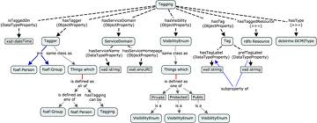
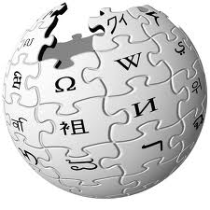


Modern Approaches: Info Used
External Data & Knowledge
Web
Data
Ontologies
(E.g., DMOZ)
Encyclopedias
(E.g., Wikipedia)
Web
(E.g., Search Engines)
Ask a Person
(Might not work well)
Public Datasets
(E.g., DBLP, IMDB)
Internal Data
u
J. Smith
Feature 2
Feature 3
js@google.com
?
?
?
?
v
u
v
John Smith
Feature 2
Feature 3
sm@yahoo.com
Inherent & Context Features
(Condit.) Func. Dependencies
Consistency constraints
Patterns
(E.g., Shopping pattern)
Entity Relationship Graph
(Including Social Network)

Slide 56
Basic Similarity Functions
s (u,v) = f (u,v)
0.8
J. Smith
John Smith
0.2
Feature 2
Feature 2
0.3
u
Feature 3
Feature 3
v
0.0
js@google.com
sm@yahoo.com
How to compare attribute values
Lots of metrics, e.g. Edit Distance, Jaro, Ad hoc
Cross attribute comparisons
How to combine attribute similarities
Many methods, e.g. supervised learning, Ad hoc
How to mix it with other types of evidences
Not only inherent features

Slide 57
Example of Similarity Function
Edit Distance (1965)
Comparing two strings s1 and s2
The min number of edits to transform s1 into s2
Insertions
Deletions
Substitutions
Example:
“Smith” vs. “Smithx” one del is needed.
Dynamic programming solution
Advanced Versions
Learn different costs for ins, del, sub
Some errors are more expensive (unlikely) than others

Slide 58
Standard ER “Building Blocks”
1. Data Normalization & Parsing
(populating “features”)
2. Blocking Functions
(the main efficiency part)
3. Problem Representation
(e.g., as a Graph)
Most important
(typically)
4. “Similarity” Computations
5. Clustering / Disambiguation
6. Representing Final Result
7. Measuring Result Quality
Notes:
Looking for clues, trying “connect the dots”, … and all in automated fashion!
Lots of papers exist on each aspect

Slide 59
Clustering
Lots of methods exists
No single “right” clustering
Speed vs quality
Basic Methods
Hierarchical
Agglomerative
if s(u,v) > t then merge(u,v)
Partitioning
Advanced Issues
How to decide the number of clusters K
How to handle negative evidence & constraints
Two step clustering & cluster refinement
Etc, very vast area

Slide 60
Standard ER “Building Blocks”
1. Data Normalization & Parsing
(populating “features”)
2. Blocking Functions
(the main efficiency part)
3. Problem Representation
(e.g., as a Graph)
Most important
(typically)
4. “Similarity” Computations
5. Clustering / Disambiguation
6. Representing Final Result
7. Measuring Result Quality
Notes:
Looking for clues, trying “connect the dots”, … and all in automated fashion!
Lots of papers exist on each aspect

Slide 61
Representing Results
Ex: algo decides that conferences are the same:
SIGMOD
Proc of SIGMOD
ACM SIGMOD
ACM SIGMOD Conf.
SIGMOD
What to show to the user?
(as the final result)
All of them?
One of them?
Which one?
Some merger/composition of them
E.g. “Proc of ACM SIGMOD Conf.”
Some probabilistic representation?

Slide 62
Standard ER “Building Blocks”
1. Data Normalization & Parsing
(populating “features”)
2. Blocking Functions
(the main efficiency part)
3. Problem Representation
(e.g., as a Graph)
Most important
(typically)
4. “Similarity” Computations
5. Clustering / Disambiguation
6. Representing Final Result
7. Measuring Result Quality
Notes:
Looking for clues, trying “connect the dots”, … and all in automated fashion!
Lots of papers exist on each aspect

Slide 63
Quality Metrics
Purity of clusters
Do clusters contain mixed elements? (~precision)
Completeness of clusters
Do clusters contain all of its elements? (~recall)
Tradeoff between them
A single metric that combines them (~F-measure)
Modern Quality Metrics
Best are based on Pre/Rec/F1

Slide 64
Precision, Recall, and F-measure
Assume
You perform an operation to find relevant (“+”) items
E.g. Google “UCI” or some other terms
R is the ground truth set, or the set of relevant entries
A is the answer returned by some algorithm
Precision
P = |A ∩ R| / |A|
Which fraction of the answer A are correct (“+”) elements
Recall
R = |A ∩ R| / |R|
Which fraction of ground truth elements were found (in A)
F-measure
F = 2/(1/P + 1/R) harmonic mean of precision and recall

Slide 65
Quality Metric: Pairwise F-measure
Example
R = {a1, a2, a5, a6, a9, a10}
A = {a1, a3, a5, a7, a9}
A ∩ R = {a1, a5, a9}
Pre = |A ∩ R| / |A| = 3/5
Rec = |A ∩ R| / |R| = 1/2
Pairwise F-measure
Used to be a very popular metric in ER
But a bad choice in many circumstances!
What is a good choice?
Often B-cubed F-measure, see [Artiles et.al, 2008]
Considers all distinct pairs of objects (r_i,r_j) from R
if (r_i,r_j) co-refer (in the same cluster in GrdTruth) then mark it as “+”
else (in different clusters) as “-”
Now, given any answer A by some ER algo
Can see if (r_i,r_j) is a “+” or a “-” in A
Thus can compute Pre, Rec, F-measure

Slide 66
Questions?
Questions?
Remember, next time
Meeting in DBH 2065, Thu, April 11 @ 3:30 PM

Slide 67

Web People Search (WePS)
1. Query Google with a person name
2. Top-K Webpages
(related to any John Smith)
3. Task: Cluster Webpages
(A cluster per person)
John Smith
Person 1
Person 2
Web domain
Very active research area
Many problem variations
E.g., context keywords
Person 3
Person N
Unknown beforehand

Slide 68
Recall that…
Lookup
List of all objects is given
Match references to objects
Grouping
No list of objects is given
Group references that corefer
WePS is a grouping task

Slide 69
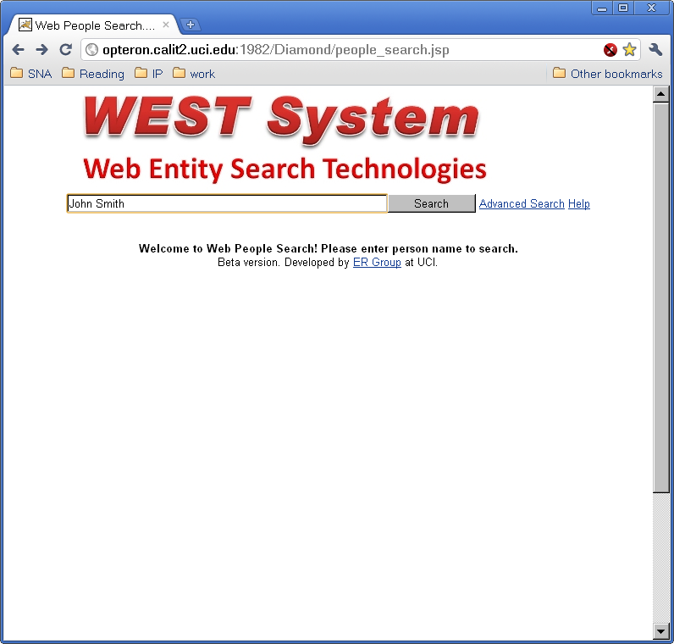
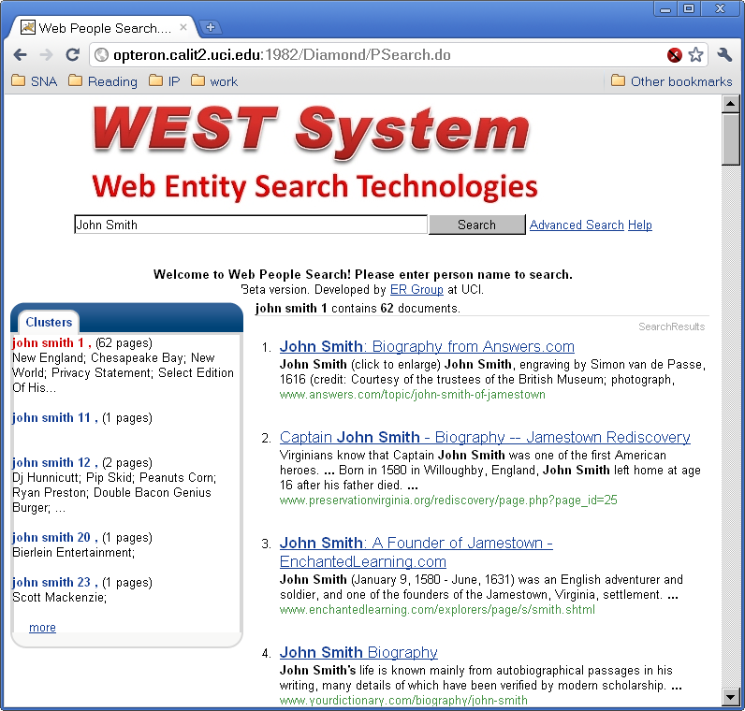
User Interface
User Input
Results

Slide 70
System Architecture
John Smith
Top-K Webpages
Search Engine
Preprocessed Webpages
Auxiliary
Information
Preprocessing
TF/IDF
NE/URL Extraction
ER Graph
Clustering
Results
Postprocessing
Custer Sketches
Cluster Rank
Webpage Rank
Person1
Person2
Person3

