Slide 1

A Unified Framework for Context Assisted Face Clustering
Liyan Zhang, Dmitri V. Kalashnikov, Sharad Mehrotra
Department of Computer Science
University of California, Irvine

Slide 2
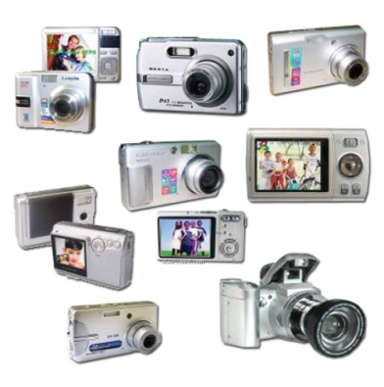

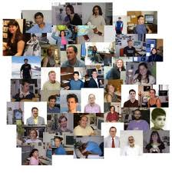
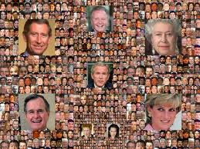



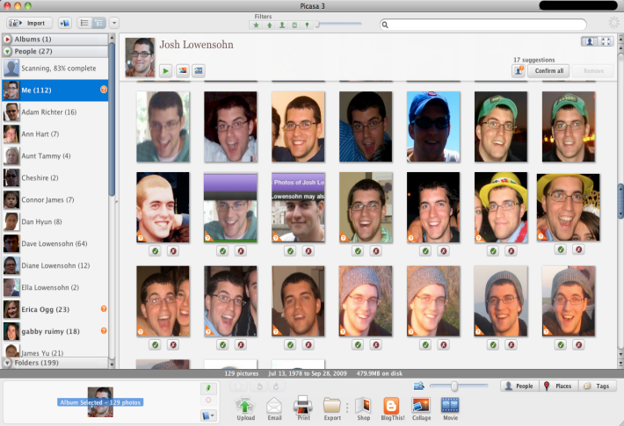
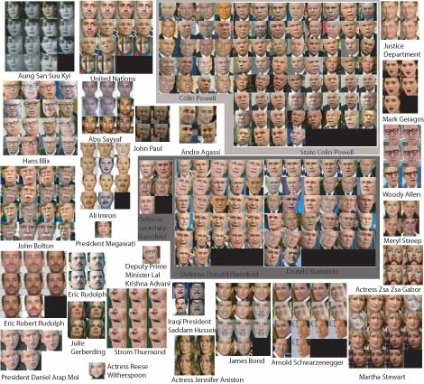
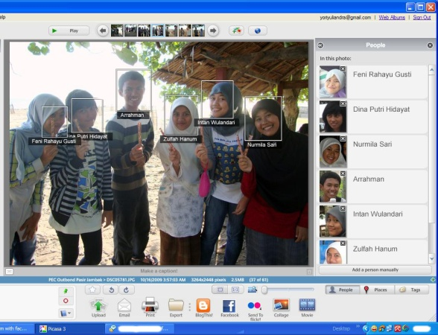
Introduction
Human is Center
Explosion of Media Data
User Feedback
Face Clustering
Face Tagging
Notes:
The prevalence of digital cameras as well as the emergence of online media
web sites such as Flickr, Picasa, Fackbook, Twitter, etc., makes the creation, storage
and sharing of multimedia content much easier than before, which leads
to the explosion of massive media data. As the continue growing of the size of
personal media collections, the problem of media organization, management and
retrieval has become a much more pressing issue. Among most photo collections,
human is usually the focus of images. To better understand and manage these

Slide 3
Outline
Introduction to Face Clustering
Traditional Approaches for Face Clustering
The Proposed Context Assisted Framework
Experimental Results
Conclusions and Future Work

Slide 4
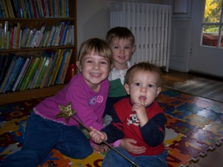
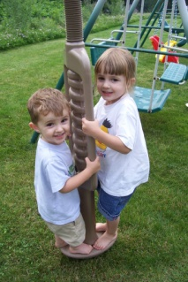
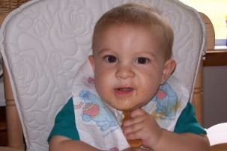

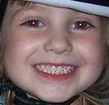

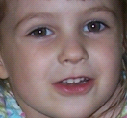
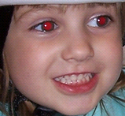


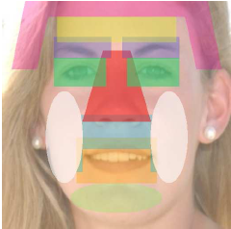


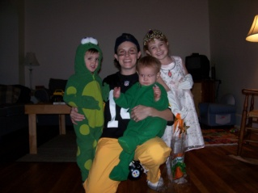
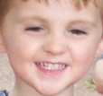
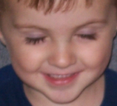
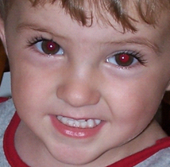
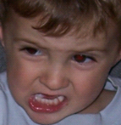

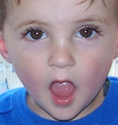
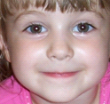
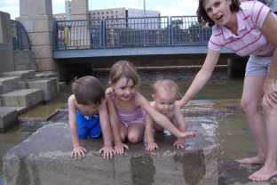
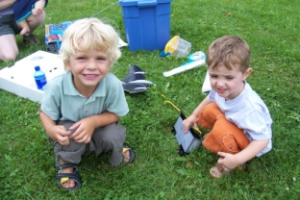
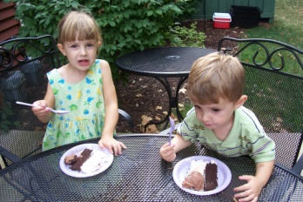
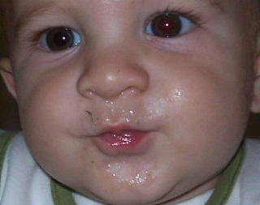
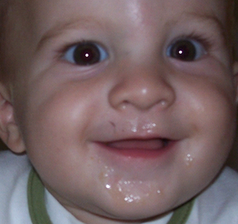
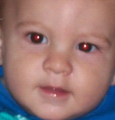
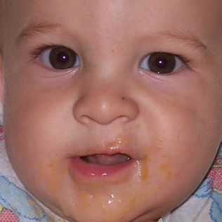
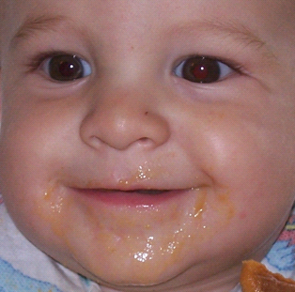


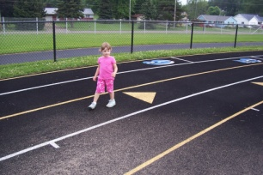
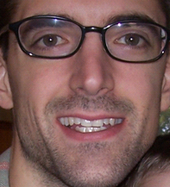
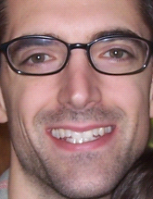






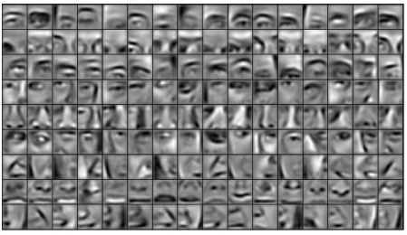
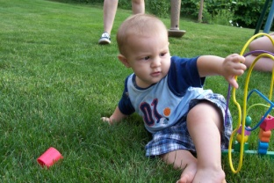
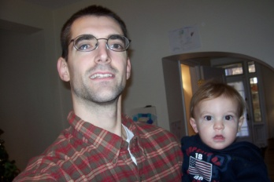
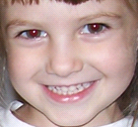


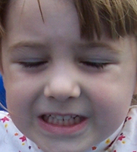



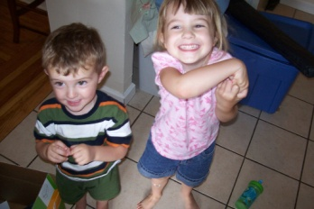

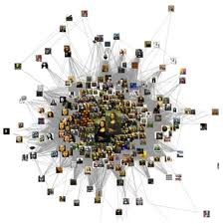
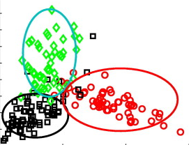

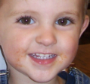
Face Appearance based Approach
Detected Faces
Facial Features
Clustering Results
Clustering Algorithm
Face Similarity Graph
……

Slide 5
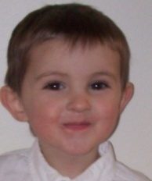
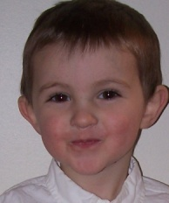

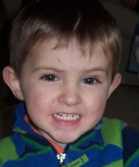
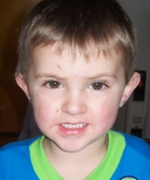

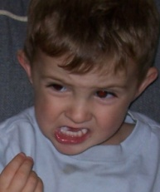
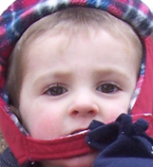
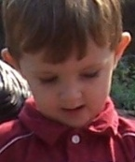
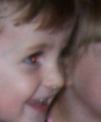
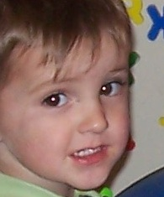

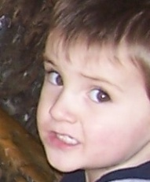







Appearance based Face Clustering Results
Good Clustering Results
High Precision,High Recall
Tight Clustering Threshold
High Precision, Low Recall
loose Clustering Threshold
Low Precision, High Recall
Too Much Merging Work!

Slide 6











Drawbacks of Facial Similarities
Different Pose
Different Expression
Same People Look
Different
Different Illumination
Different Occlusion
Boy
Girl
Girl
Boy
Different People Look
The Same

Slide 7





Context Information Helps
Common Scene:
Geo Location
Captured Time
Image Background
Social Context:
People Co-occur
Human Attributes:
Age
Ethnicity
Gender
Hair
…
Clothing:
Cloth color

Slide 8



Related Work
People Co-occurrence [1]
Clothing [2]
Human Attributes [3]
Prior work
Single
Heterogeneous
Context
Context
Face Level
Cluster Level
[1] Y. J. Lee and K. Grauman. Face discovery with social context. In BMVC, 2011.
Single Context Type
Heterogeneous Context Feature
[2] A. Gallagher and T. Chen. Clothing cosegmentation for recognizing people. In IEEE CVPR, 2008.
[3] N. Kumar and et al. Describable visual attributes for face verification and image search. In IEEE TPAMI, 2011.

Slide 9
The Framework
Initial Clusters : High Precision, Low Recall
Photo Collection
Detected Faces
……
…
cont
Clothing
Human Attributes
People Co-occurrence
Final Clusters: High Precision, High Recall
Common Scene
Iterative Merging
……
……

Slide 10




Context Features Extraction
Same?
Cluster level
Common Scene
Clothing
People Co-occurrence
Human Attributes
Context Similarities
Integrate
Context Constraints
Diff ?

Slide 11













Common Scene
Image captured time, camera model,
image visual features
Common
Scene
Same
people
I1
I2
I3
C1
C2
I1
I2

Slide 12







People Co-occurrence
diff
diff
same

Slide 13

















People Co-occurrence
I1
I2
f 2
f 5
f 1
1
f 4
f 3
1
1
1
f 8
1
f 7
f 6
Cluster Co-Occurrence Graph
1
1
1
1
1
1

Slide 14




Human Attributes
same
diff
73-D
73-D
N. Kumar and et al. Describable visual attributes for face verification and image search. In IEEE TPAMI, 2011.

Slide 15
Human Attributes
Attribute
C5
Attribute
AGE attribute
C5
Attribute
Only One Child
cosine
Similar?
f 1
Attribute
f 2
Attribute
Many Children!
Attribute
f 3
Different Attributes
Different Weights
Bootstrapping:
Learn Weights From Dataset!

Slide 16










Human Attributes
Attribute
C5
Face | Attributes | Label
 |  | C1
 |  | C1
 |  | C1
 |  | ~ C1
 |  | ~ C1
 |  | ~ C1
 |  | ~ C1
 |  | ~ C1
Attribute
Attribute
Train
Classifier
C1 ?
f 1
f 2
f 5
Attribute
Attribute
Attribute
diff
f 4
Attribute
Attribute
f 3
diff
diff
diff
diff
f 8
Attribute
f 7
Attribute
f 6
Attribute

Slide 17







Clothing
Time Sensitive!
Diff
Same
Time slot threshold
Similarity from clothes
Cloth color hist similarity
Time diff
Time diff << S
Time diff >> S

Slide 18
Context Features
  Common Scene
  People Co-occurrence
Cluster-Level Context Similarities
  Human Attributes
  Clothing

Slide 19



Context Features
Time & Location
Diff
Time: t s Indoor
Time: (t+1)s Outdoor
Distinct Attributes
Co-occurred people
Cluster-Level Context Constraints
Diff
Diff

Slide 20














Single Context Feature Fails
People Co-occurrence
Common Scene
Same
Same
Diff
Diff
Co-occurred People
Different Attributes
Different Clothing

Slide 21




Integration is Required
Aggregation?
Context Similarities
Integrate ?
Context Features
Set a rule?
Context Constraints
Y=a +b +c +d +e +…
The importance of features differ with different dataset!
Merge
Learn Rules from Each Dataset!
Not
Merge

Slide 22
How to Learn Rules?
Manually Label
Training Dataset
Learning
Rules
Apply Rules
Context Constraints
Diff Pairs
Automatic Label
Training Dataset
Learning
Rules
Apply rules
Split Initial
clusters
Same Pairs
Bootstrapping
Initial Clusters : High Precision, Low Recall
Photo Collection
Facial Features
Learn from data
Itself!
……
…
cont
Clothing
Human Attributes
People Co-occurrence
Context Similarity
& Constraint
Common Scene

Slide 23




Example of Automatic Labeling
Splitting
Training
pairs | Label
 | Same
 | Same
 | Same
 | Same
 | Same
 | Diff
 | Diff
 | Diff
 | Diff
Diff
same
Cost-sensitive
DTC
diff
same
diff
same
diff
same

Slide 24
1st Splitting—Training--Predicting
Splitting
Training
pairs | Label
 | Same
 | Same
 | Same
 | Same
 | Same
 | Diff
 | Diff
 | Diff
 | Diff
Diff
Predicting
pairs | predict
 | Same
 | Same
 | Same
 | Same
 | Same
 | Diff
 | Same
 | Diff
… | …
( ):
5 same
Cost-sensitive
DTC
( ):
1 same

Slide 25
2nd Splitting—Training--Predicting
Splitting
Training
pairs | Label
 | Same
 | Same
 | Same
 | Same
 | Same
 | Diff
 | Diff
 | Diff
 | Diff
Diff
Predicting
pairs | predict
 | Same
 | Same
 | Same
 | Same
 | Diff
 | Diff
 | Diff
 | Diff
… | …
( ):
4 same
Cost-sensitive
DTC
( ):
0 same

Slide 26
Combine results
pairs | predict
 | Same
 | Same
 | Same
 | Same
 | Same
 | Diff
 | Same
 | Diff
… | …
C1-C3:
5 same
1st Time
C2-C3:
1 same
C1-C3:
9 same
Merge
C1-C3
pairs | predict
 | Same
 | Same
 | Same
 | Same
 | Diff
 | Diff
 | Diff
 | Diff
… | …
C2-C3:
1 same
2nd Time
C1-C3:
4 same
C2-C3:
0 same

Slide 27
Unified Framework
Photo
Album
Extracted
Faces
Context
Features
Iterative Merging
splitting
training
prediction
Facial
Pure
clusters
splitting
training
prediction
Final
Decision
…
splitting
training
prediction
YES
Merge
Pairs?
No
Results

Slide 28









Experiment Datasets
Gallagher
Surveillance
Wedding

Slide 29






Evaluation Metrics
B-cubed Precision and Recall

Slide 30

Performance Comparison
Photo
Album
Context Features
Splitting
Training Predicting
Process
Our Approach:
Merge
Decision
Facial Features
Pure
Clusters
Update
Precision
Recall
Picasa:
Cluster Threshold
50→95
Different
Clusters
Affinity
Propagation:
Context Similarities Aggregation
Facial Similarities
Different Parameter: p
Different
Clusters

Slide 31



Results

Slide 32
Results
High Precision
Higher Recall

Slide 33


Results
High Precision,
662 clusters
31 Real Person,
631 Merging
4 Times
High Precision,
203 clusters
31 Real Person,
172 Merging

Slide 34






Results
Less Clusters
Less Manual Merging

Slide 35
Results

Slide 36
Conclusion and Future Work
Prior work
Future work
Context
Similarity
Efficiency?
User Feedback?
Single
Context
Feature
Break points for precision dropping?
Our Approach
Common
Scene
People
Co-occur
Human
Attributes
Clothing
Context
Similarity
Heterogeneous
Context Features
Bootstrapping
Integration
Iterative
Merging
Context
Constraint
Co-occur
People
Distinct
Attributes
Time &
Space
High precision
High recall

Slide 37
Thank you!
Questions?

