Slide 1
Informatics 122 Software Design II
Lecture 1 Emily Navarro
Duplication of course material for any commercial purpose without the explicit written permission of the professor is prohibited.

Slide 2
Today’s Lecture
Logistics
Getting to know each other
Preview of 122

Slide 3
Today’s Lecture
Logistics
Getting to know each other
Preview of 122

Slide 4
Logistics
http://www.ics.uci.edu/~emilyo/teaching/info122w2015/index.html
Reader:
No discussion
Books/Readings (recommended)
“Design Patterns: Elements of Reusable Object-Oriented Software”
any decent UML introductory book
Lots of good info about both online too

Slide 5
Logistics - Grading
Final grade based upon
Class attendance and participation
Assignments
The final class project
Team evaluations
Grade distribution (will be suitably adjusted with team evaluations)
Design aesthetics: 15%
Design implementation: 15%
Design patterns & refactoring: 15%
Design recovery: 15%
Component reuse: 15%
Final project: 25%

Slide 6
Logistics – Getting Help
Office hours with me Tuesdays 3:50-4:50pm
Or feel free to come up after class
Office hours with Reader??
E-mail is the best way to reach me
Check your UCI email daily
Primary method of class announcements outside of lecture

Slide 7
Cheating
DON’T DO IT!!
Plagiarism = presenting someone else’s work as your own
All assignments are checked thoroughly for plagiarism
Plagiarism consequences
Fail the course
Offense recorded with Student Affairs

Slide 8
Late Work
Late work will not be accepted
Truly extenuating circumstances will be evaluated on a case-by-case basis
Must provide official documentation (e.g., doctor’s note)
Exceptions only granted by the professor
Contact professor as soon as possible
Contact professor with valid reasons
Work hard throughout the quarter, not just at the end!

Slide 9
Today’s Lecture
Logistics
Getting to know each other
Preview of 122

Slide 10
Who are you?
What is your name?
What year of college is this for you?
What is your major?
What do you like to do in your free time?
What was your favorite thing that you did over Christmas break?
Anything else interesting?

Slide 11
Today’s Lecture
Logistics
Getting to know each other
Preview of 122

Slide 12
The Term “Design”
“Design” may refer to an activity
“When I design, I always use a whiteboard first”
We will use: design activity
“Design” may refer to a product
“My design is super elegant, I know it will work”
We will use: design product
“Design” may refer to a field
“Software design is complex”
We will use: design field

Slide 13
Defining Design
“Features of shape, configuration, pattern or ornamentation applicable to an article, being features that, in the finished article, can be judged by the eye, but does not include a method or principle of construction.” [Designs Act, 1906]
“The imaginative jump from present facts to future possibilities” [Page].
“The optimum solution to the sum of true needs of a particular set of circumstances” [Matchett]
“To conceive or plan out in the mind” [Merriam-Webster]
“A plan or protocol for carrying out or accomplishing something” [Merriam-Webster]
…

Slide 14
Defining Design
The realization of an imagined state
To work out a solution in one’s mind
The specification that guides production
The transition from possible solutions to a specific one
To devise a solution to a perceived problem
…

Slide 15
Design fields
Architecture design
Graphic design
Fashion design
Game design
Chip design
Car design
Urban design
Product design
Interior design
…

Slide 16
Design fields
Architecture design
Graphic design
Fashion design
Game design
Chip design
Car design
Urban design
Product design
Interior design
…
Writing
Painting
Sculpting
Music composition
…

Slide 17
Design fields
Architecture design
Graphic design
Fashion design
Game design
Chip design
Car design
Urban design
Product design
Interior design
…
Writing
Painting
Sculpting
Music composition
…
Software design

Slide 18
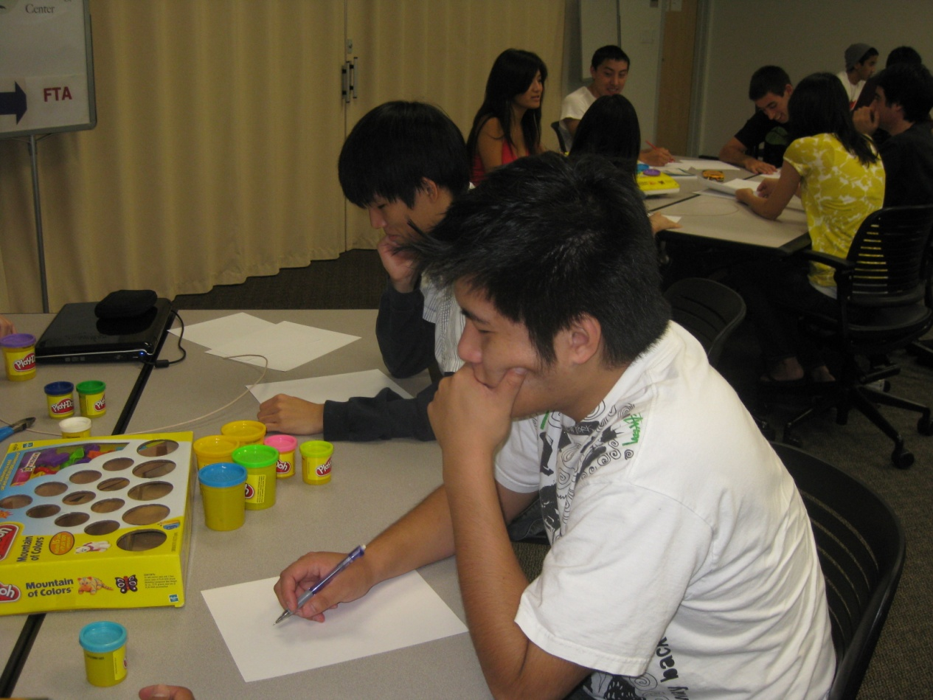
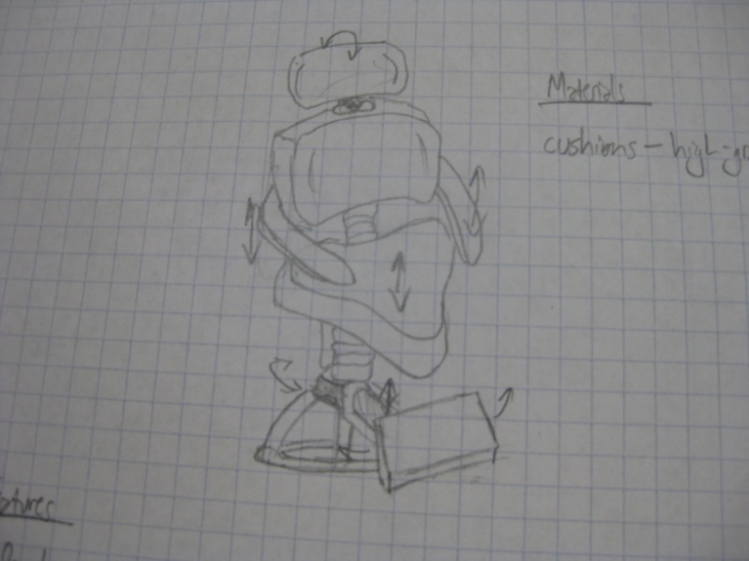
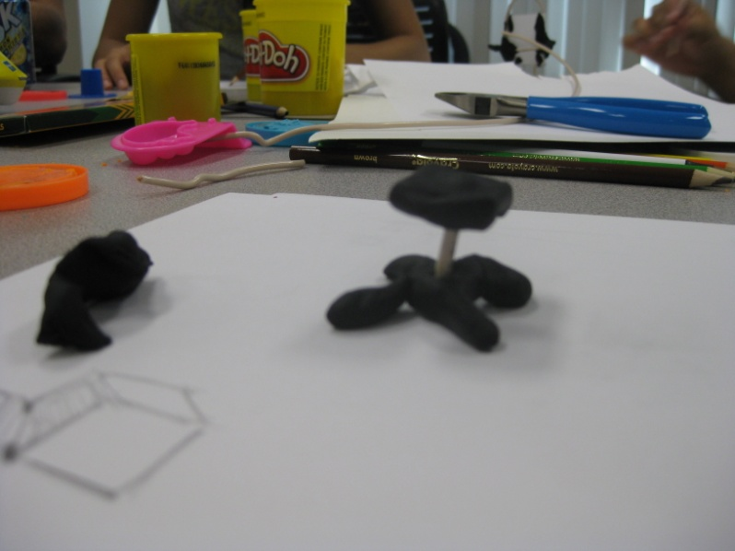
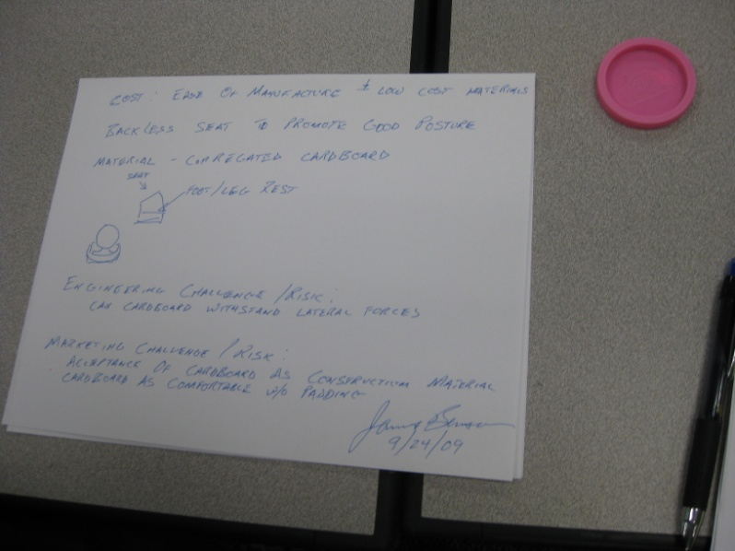
Design

Slide 19
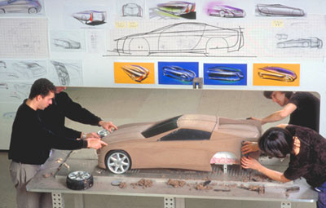
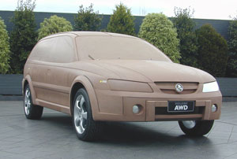
Design

Slide 20
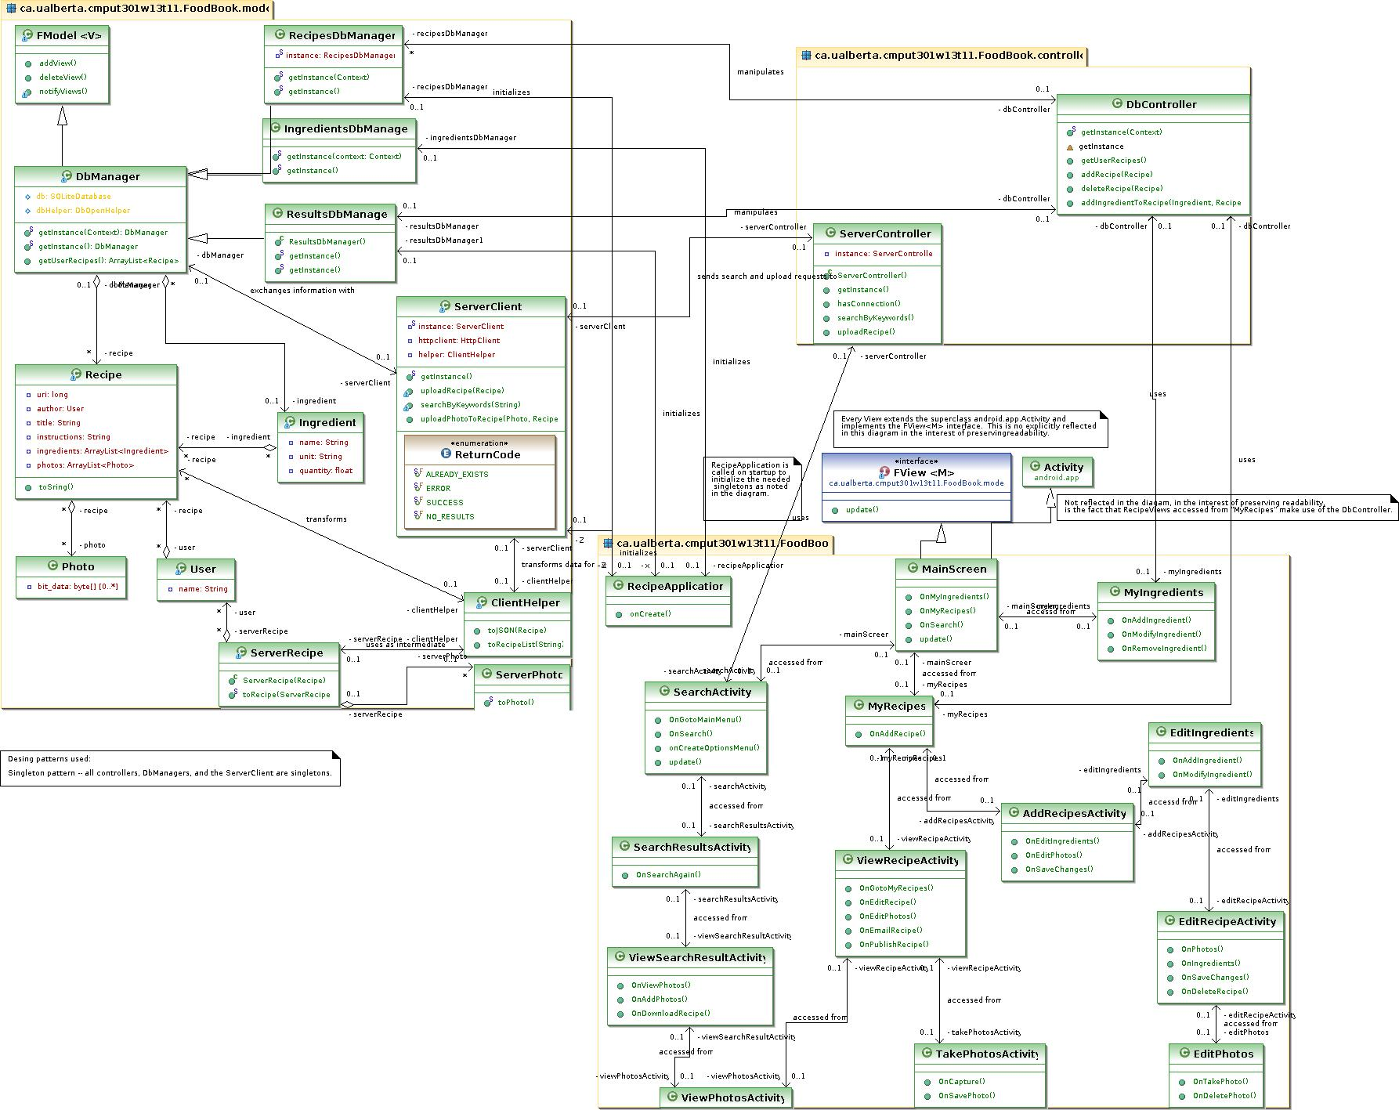
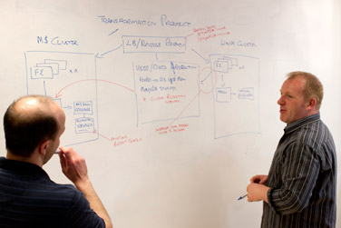
Design

Slide 21
Purpose of designs
Designs to think
Designs to talk
Designs to prescribe

Slide 22
Purpose of designs
Designs to think
Designs to talk
Designs to prescribe
Software designs are developed iteratively
Notes:
Designers do not arrive at a finished design immediately. They design iteratively through a number of different versions. Starts informally, refined by adding information as needed/as it is discovered/determined, to make the design more complete/consistent.

Slide 23
Design
designer
plan
maker
change in the world
other stakeholders
audience
experiences

Slide 24
Design a luxury airplane
designer
plan
maker
change in the world
other stakeholders
audience
experiences

Slide 25
Design a library
designer
plan
maker
change in the world
other stakeholders
audience
experiences

Slide 26
Software design
software designer
source artifacts
compiler
runnable program
other stakeholders
users
experiences

Slide 27
Software Design Goals/Activities
Making system-wide decisions
Architecture, languages, libraries, platforms
Iteratively:
Studying and understanding the problem
Identifying possible solutions
Describing each abstraction used in the solution
Modularizing the task so that multiple people can work on it
Defining modules and their interfaces

Slide 28
Positioning Software Design
Waterfall: once, in between requirements and implementation
“design is a phase”
Incremental: repeatedly, in between requirements and implementation
“design is a phase”
Prototyping: once, in between prototyping/requirements and implementation
“design is a phase”
Spiral: intermittently, when the risks being faced demand it
“design is a phase”
XP: all the time, when coding
“design is in the code”
…

Slide 29
Feasibility and desirability
feasibility
designer
plan
maker
change in the world
other stakeholders
audience
experiences

Slide 30
Feasibility and desirability
feasibility
designer
plan
maker
change in the world
other stakeholders
audience
experiences
desirability

Slide 31
Four types of design
desirability
what is it to accomplish?
how does one interact with it?
feasibility
what is its conceptual core?
what are its implementation details?

Slide 32
Four types of design
what is it to accomplish?
satisfactory experience
how does one interact with it?
change in the world
what is its conceptual core?
plan for realization
what are its implementation details?

Slide 33
Four types of software design
what is it to accomplish?
application design
satisfactory experience
how does one interact with it?
interaction design
change in the world
what is its conceptual core?
architecture design
plan for realization
what are its implementation details?
implementation design

Slide 34
Software Design: Our View in 121 and 122
Application design
Interaction design
Architecture design
Implementation design
Maintenance design
All five types of design take place throughout the software life cycle

Slide 35
Software Design: Our View in 121 and 122
Application design
Interaction design
Architecture design
Implementation design
Maintenance design
All five types of design have their own design methods and representations

Slide 36
Focus of 122
[Application design]
[Interaction design]
[Architecture design]
Implementation design
Maintenance design

Slide 37
Focus: Implementation and Maintenance Design
Nuts and bolts (but still some creative thinking)
Specifying for colleagues (but still relying on colleagues)
Complete specifications
Implementation
In Java
Notes:
Make sure we warn them that some coding is in order

Slide 38
Practice, Practice, Practice…
To learn to navigate this space, and learn to be a designer, it is essential to practice, practice, practice
There is no theory or magic formula that will teach you to be a designer, only theory that
will help you understand what it means to be a designer
provides you with a frame of mind through which you can usefully reflect upon your design activities and design products

Slide 39
Rough Schedule (I)
Create some designs
Present some designs
Discuss some designs
Evaluate others’ designs
Implement those designs
Apply design patterns
Apply design refactoring techniques

Slide 40
Rough Schedule (II)
Reverse engineer a large design
Reuse components
Large scale vs. small scale design
A final design (and implementation) project

Slide 41
No Assignment Today…
…but please refresh your knowledge of UML class diagrams before the next lecture
Be sure to brush up on (or learn) Java!

