Slide 1
Informatics 122
Software Design II
Lecture 10
Emily Navarro
Duplication of course material for any commercial purpose without the explicit written permission of the professor is prohibited.
Portions of the slides in this lecture are adapted from http://www.cs.colorado.edu/~kena/classes/5448/f12/lectures/

Slide 2
Today’s Lecture
More design techniques
Design in the large

Slide 3
Today’s Lecture
More design techniques
Design in the large

Slide 4
More Design Techniques
You may not always be able to use design patterns to start a design
  But you can apply the lessons learned from studying design patterns in ALL your designs
For instance, you can apply a technique called commonality and variability analysis to identify variation in your problem domains
  You can then use design pattern principles to encapsulate that variation and protect your software from future changes

Slide 5
Examine the Problem Domain (I)
One key aspect of design is identifying what elements of the problem domain belong in your solution domain
  Identify the right things to model/track in your software
  Accuracy is important because the next thing to do is identify the relationships between these elements
    Once you have the relationships defined, changes to the design become more difficult

Slide 6
Examine the Problem Domain (II)
Once you have concepts and relationships defined, inserting new concepts and relationships is less easy
  Where do the next concepts fit? How will they be integrated?
  Often requires changing/deleting existing relationships to incorporate new ones
This is why maintenance is so hard!
Notes:
When you are asked to change existing functionality or add new functionality, you must deal with the web of concepts and relationships that already exist in the system

Slide 7
Use Commonality and Variability Analysis (CVA)
CVA attempts to identify the commonalities (generic concepts) and variations (concrete implementations) in a problem domain
Such analysis will produce:
  abstract base classes that can be used to interface with
  concrete implementations in a generic way
  that will enable abstraction, type encapsulation, and polymorphism

Slide 8
Applying CVA to MakeAGraph
Generic Concept | Concrete Variations
Data set | <value, value> pairs
 | <category, value> pairs
Graph representation | axial/XY graphs
 | non-axial graphs
Graph visualizations | scatter plots
 | bar graphs
 | pie charts
These are concrete variations of generic concepts
Generically: Commonality C has variations a, b, c

Slide 9
Using CVA
Take any 2 elements of the problem domain
  And ask
    Is one of these a variation of the other?
    Are both of these a variation of something else?
Iterate there until you start to converge on the commonalities
  Each with their associated variations (which are just concrete elements of the domain)

Slide 10
Potential Problem
Each commonality should be based on one issue
  Beware of collapsing two or more issues into a concept
For MakeAGraph, you might do something like
Generic Concept | Concrete Variations
Graphs | scatter plots (<value, value> data, XY graph)
 | bar graphs (<category, value> data, non XY graph)
 | pie charts (<category, value> data, non XY graph) axial/XY graphs
Here you have collapsed data representation, graph representation, and visualization into a single concept (bad separation of concerns)

Slide 11
Better: One Issue per Concept
Generic Concept | Concrete Variations
Data set | <value, value> pairs
 | <category, value> pairs
Graph representation | axial/XY graphs
 | non-axial graphs
Graph visualizations | scatter plots
 | bar graphs
 | pie charts
Notes:
Look back at original table and show that it is now one issue per concept – more cohesion, lower coupling, better separation of concerns

Slide 12
Translating to Classes
DataSet
Graph
ValValPairs
CatValPairs
AxialGraph
NonAxialGraph
GraphVis
ScatterPlot
BarGraph
PieChart

Slide 13
Identify Relationships
If you are confident that you have identified the major concepts of the domain and their variations, you are then ready to identify the relationships that exist between them
A Graph has one DataSet associated with it
A GraphVis has one Graph associated with it

Slide 14
Translating to Class Diagram
DataSet
Graph
ValValPairs
CatValPairs
AxialGraph
NonAxialGraph
GraphVis
ScatterPlot
BarGraph
PieChart

Slide 15
Comparison of CVA with Design Pattern Approach
The two approaches are synergistic and can be used in tandem
  Design patterns establish relationships between entities in the problem domain
  CVA identifies entities in the problem domain and whether one entity is a variation of another
The difference is that CVA can be used in all design contexts
  whereas the design pattern approach requires that you know of design patterns that match the relationships found in the problem domain

Slide 16
Another Technique: Analysis Matrix
Purpose: to help designers deal with large amounts of variations in a problem domain
Real world domains have lots of variations
  Patients always check into a hospital before they are admitted
    UNLESS it is an emergency
      IN WHICH CASE they go to the emergency room to get stabilized and
        THEN get admitted to the hospital (IF REQUIRED)

Slide 17
Just like in CVA, Find Concepts
When dealing with lots of variations, you still ask the question
  what concept is this “thing” a variation of
To organize this work, you create a matrix
  a concept becomes a “row header”
  a variation is an entry in the matrix
  related variations go in a column
    and the column header groups the variations by a particular scenario relevant to the problem domain
The input to this process are the requirements gathered from the customer

Slide 18
Example: e-commerce System
Packages must be shipped to customers in response to orders
Different rules become active depending on the countries involved in the order
Some requirements:
  Calculate shipping based on the country
  In the US, state and local taxes apply to the orders
  In Canada, use GST and PST for tax
  Use US postal rules to verify addresses
  …

Slide 19
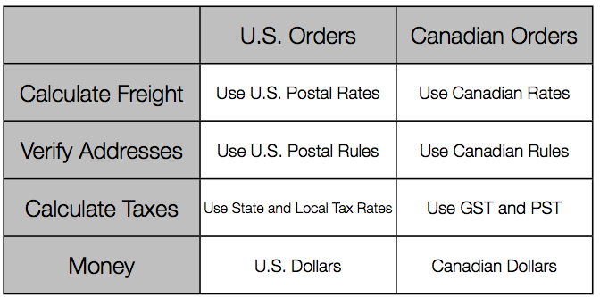
Organize by Matrix

Slide 20
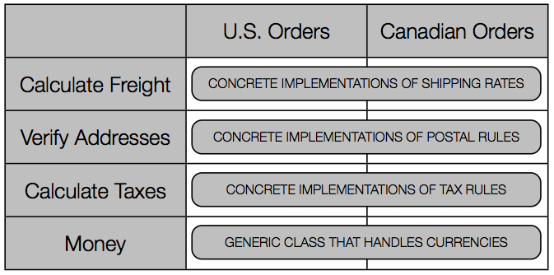
Organize by Matrix

Slide 21
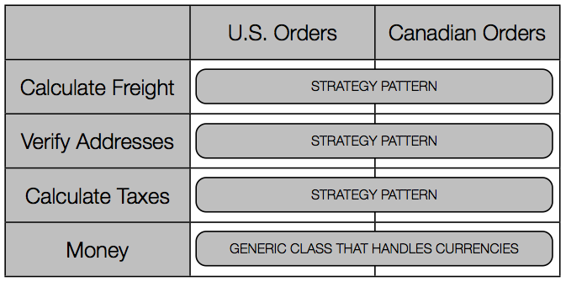
Organize by Matrix

Slide 22
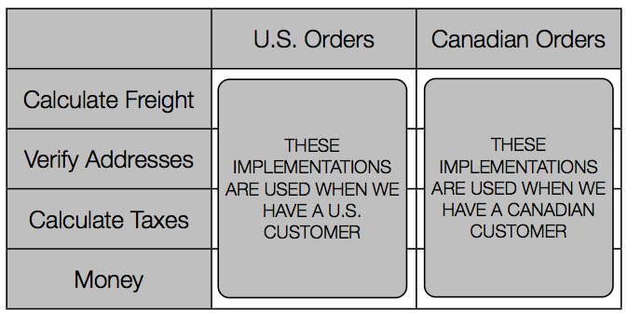
Organize by Matrix

Slide 23
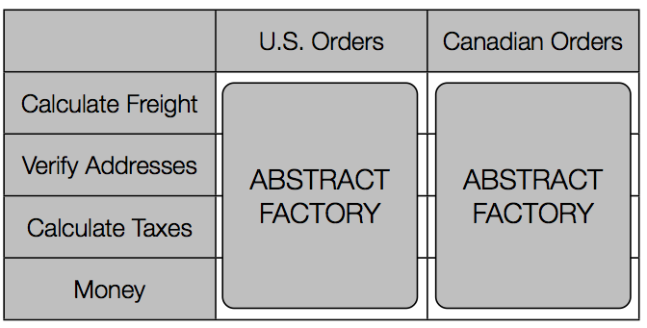
Organize by Matrix

Slide 24
Discussion (I)
This technique gets more useful as the matrix gets bigger
  If you have requirements for a new scenario that adds an additional row (concept) that you have not previously covered
    This indicates that your previous scenarios were incomplete
    You can now go back and fill in the missing pieces

Slide 25
Discussion (II)
Sometimes your special cases will have special cases
  In the US different shippers may have different requirements and different fees
  You can capture this information in another analysis matrix that shares some of the columns and rows of the original but which add additional concepts just for those special situations

Slide 26
Today’s Lecture
More design techniques
Design in the large

Slide 27
Focus of 122
[Application design]
[Interaction design]
[Architecture design]
Implementation design
Maintenance design

Slide 28
Application, Interaction, Architecture Design
Describe what the software system should do
  “How do we fundamentally approach the problem?”
  “What is desirable?”
Identifying stakeholders and goals
Defining how your system will meet these goals at a high level
Creative thinking, incomplete specifications

Slide 29
Purpose of Implementation Design
An implementation design is a road map
An implementation design describes a path from application / interaction / architecture design to the product
An implementation design describes what the implementers should do
An implementation design is a guide towards future change

Slide 30
Maintenance Design
Design Recovery
  How do we understand the design as it exists in the code and documentation?
Design Patterns
  How can we improve simple aspects of the existing design with known “solutions”
Reuse
  How can we leverage what is “out there” in our design?

Slide 31
The “Big Picture”
In the sense of:
  New perspective on some major topics
  The impact of these issues on “big” projects

Slide 32
Two Key Issues in Design-in-the-Large
Unified Design Vision
Representations

Slide 33
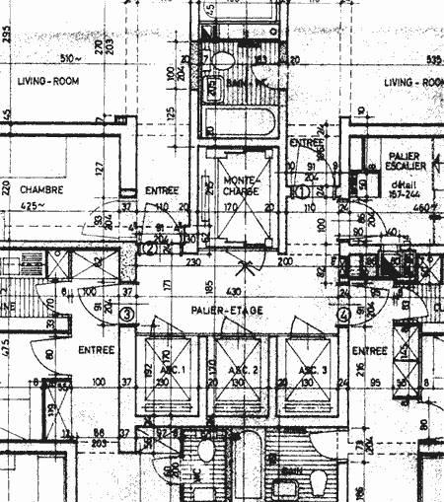
Unified Design Vision

Slide 34
Unified Design Vision: Tough!
How easy was it to understand SimSE?
How did you attempt a unified design vision among your group?
How was a lack of a unified design vision evident in your group?

Slide 35
Unified Design Vision
Design is more than UML
  I hope it’s been obvious from the first assignment
  However, it does help…
In reality, a lot is using conventions, standards, etc.
  The way we design “here”
And lots of interaction, coordination, and communication
And lots of reuse
  Frameworks
  Libraries
  Components

Slide 36
Unified Design Vision
Newer challenges, however, make it more difficult
  Very large scale systems
  Long lived systems
  Global software development

Slide 37
Very Large Scale Systems
Systems of systems
  Defense, financial trading, healthcare, government, energy distribution
Traditional approaches to software engineering are no longer adequate
How can we reduce the complexity of the unified vision?
Notes:
aka ultra large scale systems

Slide 38
Reducing the Complexity of the Unified Vision
Architectural styles
  The cornerstone of the vision is something we all know works and is simple
Architecture description languages
  To provide higher level views
Component-based design, service-oriented architectures
  To partition the system and set boundaries
  We can also reuse large scale design and architecture
Notes:
A Service-Oriented Architecture (SOA) is a design pattern in which software/application components provide services to other software/application components via a protocol, typically over a network and in a loosely-coupled way. The principles of service-orientation are independent of any vendor, product or technology.^{[1]}

Slide 39
Long-lived Systems
How can we guarantee our vision stands the test of time?
  Process enforcement and the IDE
    Tracking issues, lots of reviews, automated code analysis, emergent design, etc.
How can we deal with turnover?
  More documentation, better documentation?
  Training is key!

Slide 40
Global Software Development
How can we guarantee the vision is shared by different groups?
How does communication and coordination occur in distributed environments?
GSD is a hot topic for research and a challenge in the real world
  Supporting with processes and tools
  Improving awareness in IDEs

Slide 41
Representations
How do we represent our system?
  One or many views?
  One or many notations?
  What do they abstract? / What do they emphasize?

Slide 42
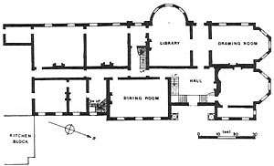
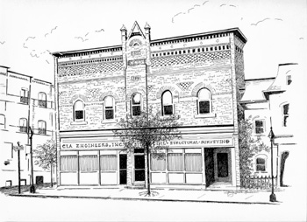
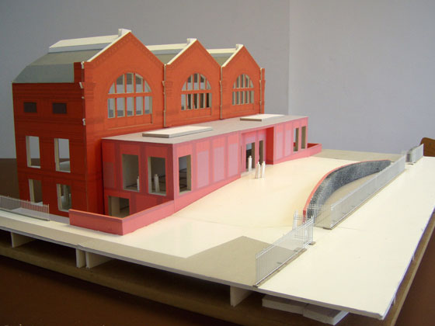
Architecture (Buildings)

Slide 43
Single Representation
Using one single representation of the system
  Serves all purposes
  No chance for inconsistency
  Shared by everyone
    But how can we guarantee interpretations are the same?
Agile approach: code is design
  Recording decisions
  Communication
  Does it scale?

Slide 44
Multiple Views
Some facts…
  “The code is the truth but not the whole truth” [Booch]
  UML is only good for “low-level design”
  Traditional architecture diagrams (boxes and arrows) focus only on high-level functionality

Slide 45
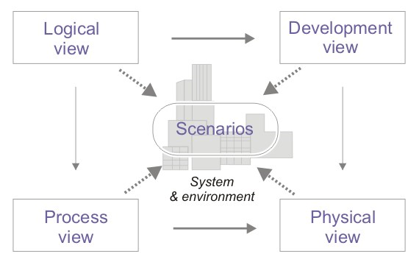
Multiple Views
One possible answer
  4 + 1 Views [Philippe Kruchten]
Notes:
Meant to describe the system from the viewpoints of different stakeholders; based on different types of UML diagrams for each view
Logical view: functionality for end-users (class diagram, communication diagram, sequence diagram)
Development view: programmer’s perspective (component & package diagrams)
Process view: runtime behavior, concurrency, performance, etc. (activity diagram)
Physical view: system engineer’s perspective, topology of software components (deployment diagram)
Scenarios: use cases

Slide 46
Multiple Views
Still leaves many questions
  What level of abstraction is right?
  Takes longer to get to coding; will more change?
  How do we maintain them over time?
There are many challenges
  Translating between different views
  Keeping consistency between different levels of abstraction
  Guaranteeing they are usable
May require
  Language translation
  Additional design decisions
  Lots and lots of consistency checking!

Slide 47
More Approaches to Supporting Design-in-the-Large
Design rationale
Architectural styles
Enterprise frameworks
Product lines

Slide 48
Design Rationale
Listing of decisions made during a design process, along with
  reasons why they were made
  other alternatives considered
  tradeoffs that were evaluated
  any other relevant information
Purpose: to keep a record of this knowledge and communicate it to others
Tools exist for managing design rationale
  In software engineering as well as other disciplines

Slide 49
Architectural Styles
Provide
  “a vocabulary of components and connectors, with constraints on how they can be defined [Shaw, Garlan]”
  a common language with which to describe classes of systems
Peer-to-peer
Pipe and filter
Client-server
C2
REST
…

Slide 50
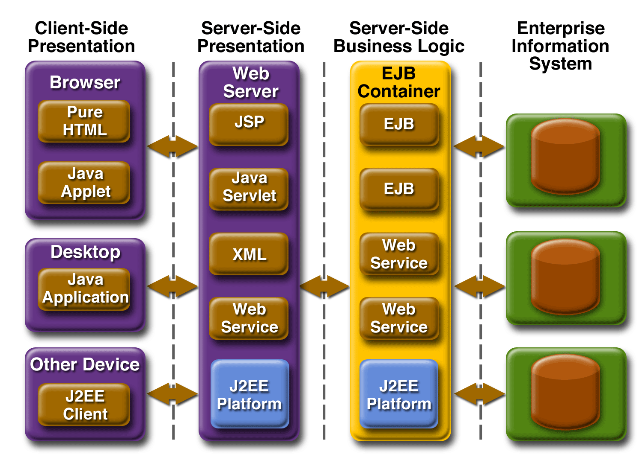
Enterprise Frameworks
Notes:
Purpose: To manage scale and complexity of these huge enterprise systems
Framework provides tools and approaches that help architects abstract from the level of detail that builders work at to bring enterprise design tasks into focus
Frameworks provide structured guidance in three main areas:^{[3]}
1. Descriptions of architecture: how to document the enterprise as a system from several viewpoints
2. Methods for designing architecture: processes that architects follow.
3. Organization of architects: guidance on team structure, skills, management, training, etc.

Slide 51
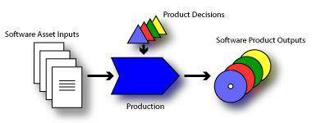
Software Product Lines
Can we use lessons from mass production of physical goods in software?
How can we produce software with minimum (human) effort?
Notes:
SPL = a set of software-intensive systems that share a common managed set of features satisfying a particular market segment, and are developed from a common set of core assets in a prescribed way
Used a lot for electronics (e.g., tvs, phones, etc…. different models, common core functionality with some variations)

Slide 52
Wrapping Up
Maintaining a unified vision of design requires lots of support!
Multiple views will be necessary (unless you’re “agile”)

Slide 53
Bottom Line
There’s more to software design than we can show you firsthand
Senior project’s a start
Once you get “out there” you’ll see it more clearly

Slide 54
Next Time
Reuse Presentations
Reminders
  Submit slide electronically
  Please keep it as close to 1 minute as possible!

