Slide 1
Informatics 122 Software Design II
Portions of the slides in this lecture are adapted from http://www.cs.colorado.edu/~kena/classes/5448/f12/lectures/
Lecture 2 Emily Navarro
Duplication of course material for any commercial purpose without the explicit written permission of the professor is prohibited.

Slide 2
Today’s Lecture
Design aesthetics
UML review
Assignment 1

Slide 3
Aesthetics
“a particular theory or conception of beauty or art : a particular taste for or approach to what is pleasing to the senses and especially sight” [Merriam-Webster]

Slide 4
Design Aesthetics
What makes a given software implementation design “beautiful”?
What is it that makes someone appreciate a particular software implementation design?
What are the qualities that determine whether a particular software implementation design is “good” or “bad”?
What is it, then, that we can strive for in creating a software implementation design that will help others in appreciating it?

Slide 5
Design Aesthetics
Some brainstorming…
Notes:
SAVE BRAINSTORMING FOR NEXT LECTURE!
future changes? extensibility? understandable? efficient? powerful? simple?

Slide 6
Design Aesthetics
Different people will have a different aesthetic appreciation of different designs
as informed by their own, pre-existing knowledge
as informed by their own understanding of the design goals
as informed by their own ideas
Different roles in the software development project may have different aesthetic appreciation of different designs
coder
software performance engineer
software maintenance specialist
software tester
…
Notes:
It’s fuzzy, for sure!

Slide 7
Design Aesthetics
Different people will have a different aesthetic appreciation of different designs
as informed by their own, pre-existing knowledge
as informed by their own understanding of the design goals
as informed by their own ideas
Different roles in the software development project may have different aesthetic appreciation of different designs
coder
software performance engineer
software maintenance specialist
software tester
…
Subjective, as it should be!
Notes:
It’s fuzzy, for sure!

Slide 8
Design Aesthetics
Subjective, as it should be
But we need some kind of shared “language”, some common touchstones that we can use to:
understand the underlying implications of certain designs
understand the intentions of designers
effectively frame our communication about designs

Slide 9
Shared Design Aesthetics
Individual
Project
Organization
School of Thought
Community

Slide 10
But…
…what kind of shared understandings exist?
…where do these shared understandings come from?

Slide 11
Purpose of Implementation Design
An implementation design is a road map
An implementation design describes a path from application / interaction / architecture design to the product
An implementation design describes what the implementers should do
An implementation design is a guide towards future change

Slide 12
Purpose of Implementation Design
An implementation design is a road map
understandable, unambiguous, consistent, helpful, …
An implementation design describes a path from application / interaction / architecture design to the product
correct, complete, concise, verifiable, effective, …
An implementation design describes what the implementers should do
elegant, partitionable, recomposable, resilient, …
An implementation design is a guide towards future change
evolvable, …

Slide 13
More of a Shared Understanding (Not Perfect!)
An implementation design is a road map
understandable, unambiguous, consistent, helpful, …
An implementation design describes a path from application / interaction / architecture design to the product
correct, complete, concise, verifiable, effective, …
An implementation design describes what the implementers should do
elegant, partitionable, recomposable, resilient, …
An implementation design is a guide towards future change
evolvable, …
Notes:
Orange: we all have a bit of a sense of

Slide 14
Less of a Shared Understanding
An implementation design is a road map
understandable, unambiguous, consistent, helpful, …
An implementation design describes a path from application / interaction / architecture design to the product
correct, complete, concise, verifiable, effective, …
An implementation design describes what the implementers should do
elegant, partitionable, recomposable, resilient, …
An implementation design is a guide towards future change
evolvable, …
Notes:
Orange: we have less of a shared sense of
Correctness: adheres to to its specified requirements

Slide 15
Less of a Shared Understanding
An implementation design is a road map
understandable, unambiguous, consistent, helpful, …
An implementation design describes a path from application / interaction / architecture design to the product
correct, complete, concise, verifiable, effective, …
An implementation design describes what the implementers should do
elegant, partitionable, recomposable, resilient, …
An implementation design is a guide towards future change
evolvable, …
The goal of this class is to develop your understanding of these qualities!

Slide 16
Approaches to Date
Enumerate objectives
Define principles
Provide strategies

Slide 17
Approaches to Date
Enumerate objectives
overall process
overall design
individual class design
Define principles
Provide strategies

Slide 18
Objectives for Overall Process
Apply rigor
Separate concerns
modularize
abstract
Anticipate change
Generalize
Work incrementally

Slide 19
Objectives for Overall Design
Strive for grouping related functionality (high cohesion)
Strive for ungrouping semi-related functionality (high cohesion)
Strive for reducing interdependency (low coupling)

Slide 20
Objectives for Class Design
Cohesion
Completeness
Convenience
Clarity
Consistency

Slide 21
Approaches to Date
Enumerate objectives
Define principles
keep it simple, stupid! (KISS)
information hiding
acyclic dependencies
…
Provide strategies

Slide 22
Keep It Simple, Stupid! (KISS)
Nothing should be more complicated than absolutely essential and, even then, everything should be analyzed as to whether it can be done simpler
Notes:
If there is a simple solution, do it!

Slide 23
Information Hiding
Hide design decisions that are most likely to change, thereby protecting other parts of the program from change if the design decision is changed

Slide 24
Acyclic Dependencies
Structure packages (grouping classes and interfaces) of a software system in such a manner that the dependencies among them form a directed acyclic graph (DAG)

Slide 25
Approaches to Date
Enumerate objectives
Define principles
Provide strategies
program to the interface
refactor
apply software patterns
Notes:
So, these are heuristic guidelines people have developed, and are all things you should try to achieve, but how do you achieve them?

Slide 26
Program to the Interface
Program to an interface, not to an implementation
Wrap classes in interfaces as much as possible
List myList = new ArrayList(); // programming to // the List // interface
ArrayList myList = new ArrayList(); // programming // to the // ArrayList // implemen- // tation
Notes:
Top one ensures that you are only calling methods on myList from the List interface. If you later want to change myList to List myList = new TreeList();, you only have to change it in that one spot.
In a small program, may not make a difference, but in a long one it does.

Slide 27
Refactor
(to be discussed in a future lecture)

Slide 28
Apply Software Patterns
(to be discussed in future lectures)

Slide 29
Approaches to Date
Enumerate objectives
Define principles
Provide strategies

Slide 30
Purpose of Implementation Design
An implementation design is a road map
understandable, unambiguous, consistent, helpful, …
An implementation design describes a path from application / interaction / architecture design to the product
correct, complete, concise, verifiable, effective, …
An implementation design describes what the implementers should do
elegant, partitionable, recomposable, resilient, …
An implementation design is a guide towards future change
evolvable, …
The approaches to date help, but much more remains to be done
Notes:
The approaches mentioned help with orange ones, but more remains to be done = your responsibility as a designer to know innately these things = aesthetics

Slide 31
Why Aesthetics?
Aesthetics aims higher than “usable” or “complete” or …
It aims to set a bar for design for which we as professional designers should strive
designs that are elegant
designs that communicate their intent seamlessly
designs that overall exude an air of sophistication that sets them apart from ordinary designs
designs that others will appreciate, for the right reasons

Slide 32
UML Review
UML stands for Unified Modeling Language
UML is a set of notations designed for specifying object-oriented systems
Different types of UML diagrams are used to represent different aspects (structure, behavior, interactions) of a system
Class diagrams
Sequence diagrams
Use case diagrams
Activity diagrams
…

Slide 33
UML Review
UML stands for Unified Modeling Language
UML is a set of notations designed for specifying object-oriented systems
Different types of UML diagrams are used to represent different aspects (structure, behavior, interactions) of a system
Class diagrams
Sequence diagrams
Use case diagrams
Activity diagrams
…
Main diagram for our purposes

Slide 34
UML Class Diagrams
Classes in UML appear as rectangles with multiple sections
The first section contains its name (defines a type)
The second section contains the class’s attributes
The third section contains the class’s methods
Class Name
‘+’ means public visibility
‘-’ means private visibility
-Attribute : Type
-Attribute : Type
+Operation (parameter) : Return Type
+Operation (parameter) : Return Type
+Operation (parameter) : Return Type

Slide 35
Class Diagram Example
Airplane
speed : int
All parts are optional except the class name
getSpeed () : int
setSpeed (int)
This rectangle says that there is a class called Airplane that could potentially have many instances, each with its own and speed variable and methods to access it.

Slide 36
Translation to Code
Class diagrams can be translated into code straightforwardly
Define the class with the specified name
Define specified attributes (assume private access if not specified)
Define specified method skeletons (assume public if not specified)
May have to deal with unspecified information
Types are optional in class diagrams
Class diagrams typically do not specify constructors
Just the class’s public interface

Slide 37
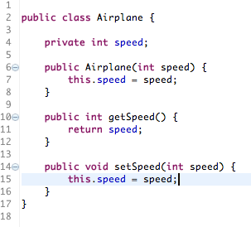
Airplane in Java
Using Airplane
Airplane a = new Airplane(5);
a.setSpeed(10);
System.out.println(“” + a.getSpeed());

Slide 38
Relationships Between Classes
Classes can be related in a variety of ways
Inheritance
Association
Multiplicity
Whole-Part (Aggregation and Composition)
Qualification
Interfaces

Slide 39
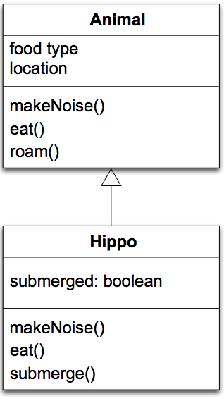
Relationships: Inheritance
One class extends another
Notation: a white triangle on a solid line points to the superclass
The subclass can add attributes
Hippo adds submerged as a new state
The subclass can add behaviors or override existing ones
Hippo is overriding makeNoise() and eat() and adding submerge()

Slide 40
Relationships: Association
One class can reference another (a.k.a. assocation)
Notation: straight line
This (particular) notation is a graphical shorthand that each class contains an attribute whose type is the other class

Slide 41
Roles
Roles can be assigned to the classes that take part in an association
Here, a simplified model of a lawsuit might have a lawsuit object that has relationships to two people, one person playing the role of the defendant and the other playing the role of the plaintiff
Typically, this is implemented via “plaintiff” and “defendant” instance variables inside of the Lawsuit class

Slide 42
Labels
Associations can also be labeled in order to convey semantic meaning to the readers of the UML diagram
In addition to roles and labels, associations can also have multiplicity annotations
Multiplicity indicates how many instances of a class participate in an association

Slide 43
Multiplicity
Associations can indicate the number of instances involved in the relationship
This is known as multiplicity
An association with no markings is “one to one”
An association can also indicate directionality
If so, it indicates that the “knowledge” of the relationship is not bidirectional
Examples on next slide

Slide 44
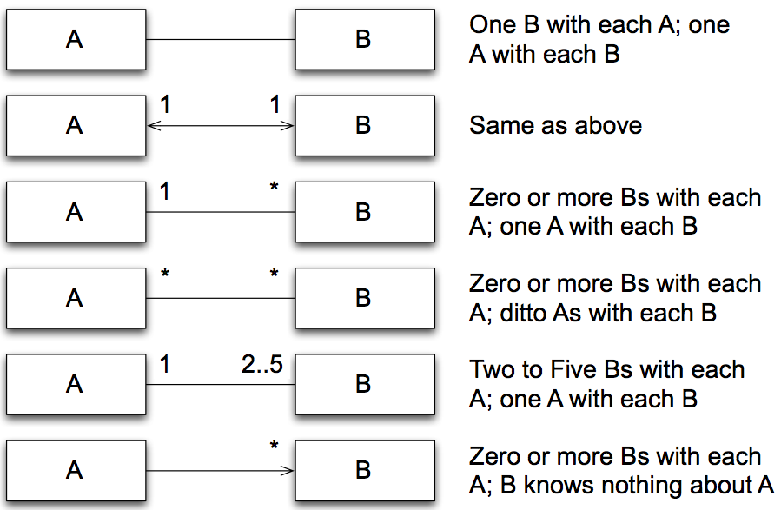
Multiplicity Examples

Slide 45
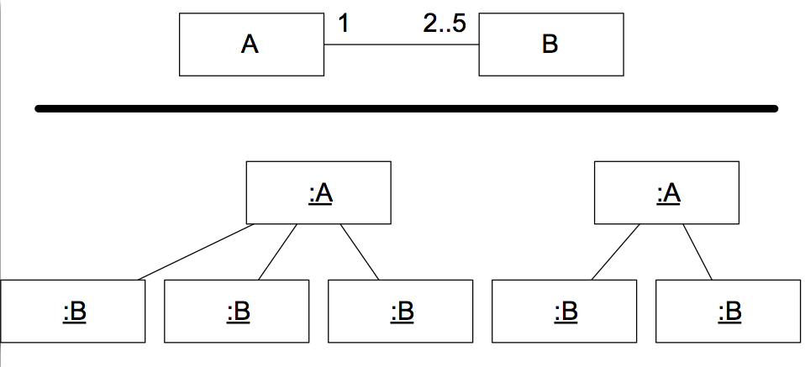
Multiplicity Example

Slide 46
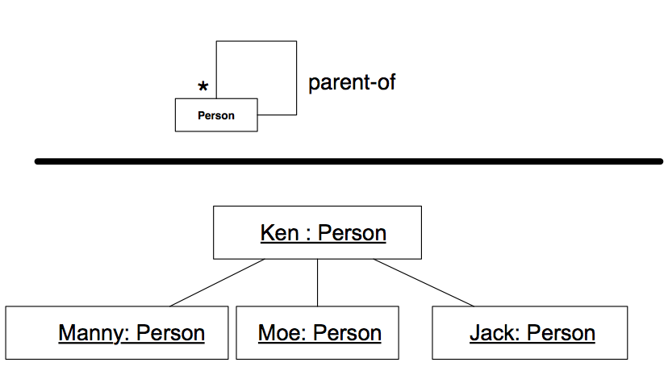
Self Association

Slide 47
Relationships: whole-part
Associations can also convey semantic information about themselves
In particular, aggregations indicate that one object contains a set of other objects
think of it as a whole-part relationship between
a class representing a group of components
a class representing the components themselves
Notation: aggregation is indicated with a white diamond attached to the class playing the container role

Slide 48
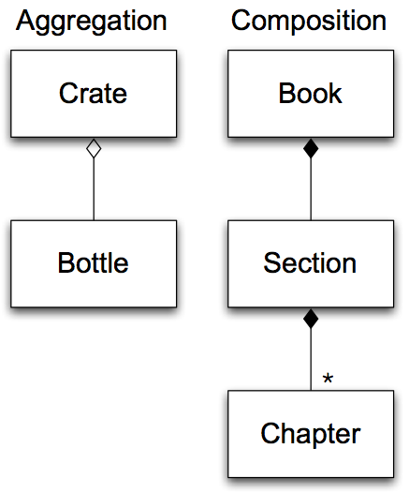
Example: Aggregation
Composition will be defined on the next slide
Note: multiplicity annotations for aggregations/composition is tricky
Some authors assume “one to many” when the diamond is present; others assume “one to one” and then add multiplicity indicators to the other end
House
Room

Slide 49
Semantics of Aggregation
Aggregation relationships are transitive
if A contains B and B contains C, then A contains C
Aggregation relationships are assymetric
if A contains B, then B does not contain A
A variant of aggregation is composition which adds the property of existence dependency
if A composes B, then if A is deleted, B is deleted
A cannot exist independent of B
Composition relationships are shown with a black diamond attached to the composing class

Slide 50
Relationships: Interfaces
A class can indicate that it implements an interface
An interface is a type of class definition in which only method signatures are defined
A class implementing an interface provides method bodies for each defined method signature in that interface
This allows a class to play different roles, with each role providing a different set of services
These roles are then independent of the class’s inheritance relationships
Notation: a hollow triangle shape on the interface end of the dashed line that connects it to one or more implementers

Slide 51
Interface Example
<<interface>>
Noisy
+ makeNoise()
Duck
Baby
+ makeNoise()
+ swim()
+ makeNoise()
+ diaperChange()
Notes:
INTERFACES CANNOT HAVE MEMBER VARIABLES, JUST METHODS! 1/24

Slide 52
First Assignment: MakeAGraph

Slide 53
Important Points to Observe (Process)
Where to start?
The set of nouns in the description of the problem (e.g., graph, scatter plot, x, y pairs, x-axis, y-axis, …)
The set of verbs in the description of the problem (e.g., generate a scatter plot, accept input, …)
Go through some use cases and to further flesh out the flow and object necessary
A little bit of programming?
Work towards completeness
Does my current design account for all possible features?
This is merely a rough and rules of thumb process, but one that tends to help the beginning designer

Slide 54
Important Points to Observe (UML)
Remember, UML is a modeling language, not an implementation language
Therefore do not include implementation details that do not pertain to the design
No need to include/explain things that are assumed and/or self-explanatory
E.g., get and set methods
The purpose of this would be for a programmer to take this design and add whatever methods/attributes necessary to make the design work

Slide 55
A Checklist for the Overall Process
Apply rigor
Separate concerns
modularize
abstract
Anticipate change
Generalize
Work incrementally
Notes:
Reiterate that these remain important

Slide 56
A Checklist for Overall Design
Strive for grouping related functionality (high cohesion)
Strive for ungrouping semi-related functionality (high cohesion)
Strive for reducing interdependency (low coupling)

Slide 57
A Checklist on Class Design
Cohesion
Completeness
Convenience
Clarity
Consistency

Slide 58
A Checklist on Principles and Strategies
Principles
keep it simple, stupid! (KISS)
information hiding
acyclic dependencies
…
Strategies
program to the interface
refactor
apply software patterns
…

