Slide 1
Informatics 122
Software Design II
Lecture 3
Emily Navarro
Duplication of course material for any commercial purpose without the explicit written permission of the professor is prohibited.

Slide 2
Today’s Lecture
Designing for change
Design examples
Assignment 1 continued

Slide 3
Purpose of Implementation Design
An implementation design is a road map
  understandable, unambiguous, consistent, helpful, …
An implementation design describes a path from application / interaction / architecture design to the product
  correct, complete, concise, verifiable, effective, …
An implementation design describes what the implementers should do
  elegant, partitionable, recomposable, resilient, …
An implementation design is a guide towards future change
  evolvable, …

Slide 4
Emphasis: Changeability
An implementation design is a road map
  understandable, unambiguous, consistent, helpful, …
An implementation design describes a path from application / interaction / architecture design to the product
  correct, complete, concise, verifiable, effective, …
An implementation design describes what the implementers should do
  elegant, partitionable, recomposable, resilient, …
An implementation design is a guide towards future change
  evolvable, …
Notes:
Verifiable: are we building the product right?

Slide 5
Changeability
Subtle
Requires foresight and careful balancing
Understandable, unambiguous, consistent, helpful, verifiable, resilient, evolvable…
Notes:
A large focus of design aesthetics is changeability

Slide 6
Your Brainstorming: Changeability
Reusable
Upgradable
Maintainable
Extensible
Separates concerns (modular)
Readable
Organized
Clean
Simple
Understandable
Efficient
Clever
Elegant
Notes:
When you look at all the words you put out last lecture, they largely deal with changeability – 5 explictly, 5 via understandability
The only constant is change – it hard to say what you want software, what you want it to do, you have to make sure it can do other things if it needs to

Slide 7
Changability: Basic Principles
Low Coupling: Reducing interdependency
  Changes don’t propagate
  Reuse is facilitated
High Cohesion: Grouping functionality
  Easier to find things
  Metaphor guides decisions
    e.g., adapter, interpreter, observer
Information Hiding
Notes:
We talked about these last time… you have heard about these in previous courses

Slide 8
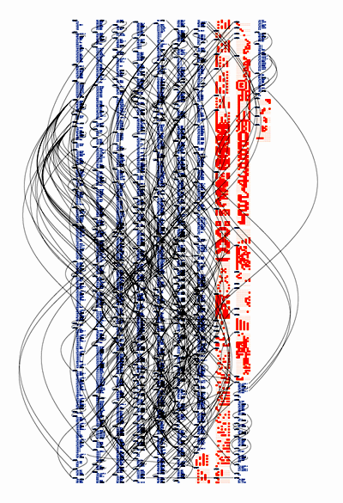
Low Coupling/High Cohesion
vs.
…
Notes:
Which one would you rather maintain?

Slide 9
Information Hiding Made Very Simple
A List class with:
  getArray() : Array
  getElementAt(int i) : Object
Notes:
This example is to demonstrate why info hiding is good

Slide 10
Information Hiding Made Very Simple
A List class with:
  getArray() : Array
  getElementAt(int i) : Object
It’s too slow, so we switch to a hash table
  Everywhere you call getArray needs changing
  Only List is changed (changes propagate exponentially)
Little things like this add up

Slide 11
Why the Emphasis on Changability?
Why not just do it right the first time?
Change abounds…
  During coding
  During use
  Reuse for later projects
Notes:
Ok, lets back out – why should we design for change – its not like we don’t know what we’re doing, why don’t we just do it right the first time?
Design doesn’t always work that way – especially not software design

Slide 12
Why is there so Much Change?
Designs
Outcomes
ok with customer
feasible to build
Notes:
Intersection of ovals is what we are aiming for… not so concrete as this, but good to aim for

Slide 13
Why is there so Much Change?
Engineering
Designs
Outcomes
Physics
Principles
Existing Examples
ok with customer
feasible to build
Notes:
In traditional design disciplines, these things (physics, principles, examples) make the journey from design to outcome relatively straightforward and well-defined, with little change happening

Slide 14
Why is there so Much Change?
Software Engineering
Designs
Outcomes
Physics
Principles
Existing Examples
ok with customer
feasible to build
Notes:
SE has some principles, patterns, etc., but usually building things off of greenfield design again. Makes journey from design to outcome a little trickier, lots of changes

Slide 15
Why is there so Much Change?
Software Engineering
Designs
Outcomes
Physics
Principles
Existing Examples
ok with customer
feasible to build
Notes:
Maybe there are ways it can be interpreted that are not actually desirable

Slide 16
Why is there so Much Change?
Software Engineering
Designs
Outcomes
Physics
Principles
Existing Examples
ok with customer
feasible to build
Notes:
Ok with customer but not feasible = failed development

Slide 17
Why the Emphasis on Changability?
Change abounds…
  During coding
  During use
  Reuse for later projects
You usually just don’t know for sure…
Notes:
As I said last time, you’re going to have to adjust, and you’re not always going to be sure how that’s going to go

Slide 18
Changes During Coding
Refinement of the high level design
Dependencies reveal themselves
  Oh, I need to know [X].
  I can’t access that data?
‘It turns out this class is HUGE’
Need to redesign as you go
Can changes be made within the design?
Notes:
customer doesn’t like it, high level design needs to be changed
What you thought was separate isn’t really
Coding is design

Slide 19
Changes During Use
Potential breakdowns at several levels
  Customers have needs
  Customers make requests
  Operating environments change

Slide 20
Changes During Reuse
A changing of context
…
Notes:
Reuse can be important, but change happens there as well, particularly bc it’s taken from one context into another
We will come back to this later, for now, we’ll point out that this can be important, but that its not always what its cracked up to be

Slide 21
Change Happens
Let’s design for it
Notes:
So hopefully I’ve convinced you: change happens

Slide 22
Our Approach
Lots of examples (3 problems, many solutions, today)
Some overarching lessons
Build up an intuition

Slide 23
Design Examples
Theseus and the Minotaur
Klax
Scrabble

Slide 24
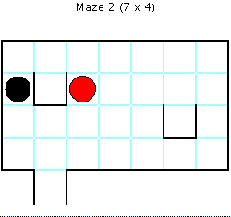
Example #1: Theseus and the Minotaur
Notes:
Guide Theseus (the red circle) to the exit.
Avoid the Minotaur (the black circle).
The Minotaur moves two squares towards you (if possible).
The Minotaur always prefers left/right moves (when available).

Slide 25
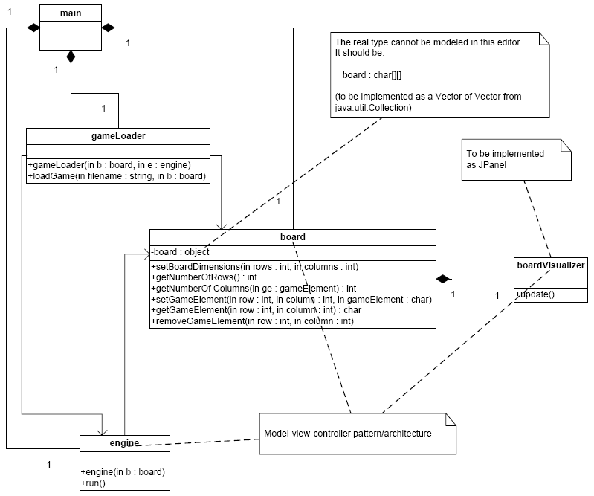
Original Theseus Design
Notes:
Tell about model-view-controller:
controller -> manipulates model -> updates view
user sees view and uses controller
What assumptions are we making about what will remain constant? (board is a multidimensional array of chars, only one game element in each space)
What do you think about this design? How will it hold up to change?

Slide 26
Original Theseus Design
What if we want to add “water” ?

Slide 27
Original Theseus Design
What if we want to add “water”?
?

Slide 28
Original Theseus Design
What if we want to add “water”?
?
How do we fix this?

Slide 29
TntM: Changes
Changing the board size
Adding terrain types
Adding more monsters
Adding a second player
“Intelligent elements”
Notes:
Intelligent elements e.g., trap that makes you die
Most of these changes would require changing all the classes in the original design (as far as one can tell)

Slide 30
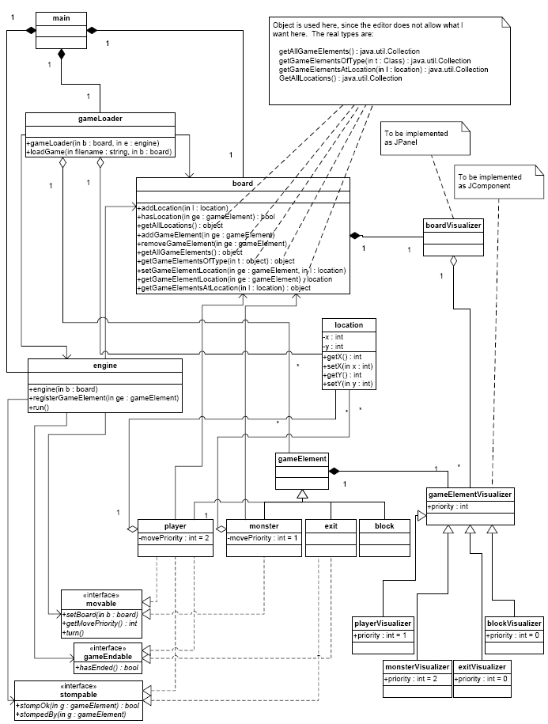

TntM 2
Notes:
location class added groundwork for some of the extra capabilities

Slide 31
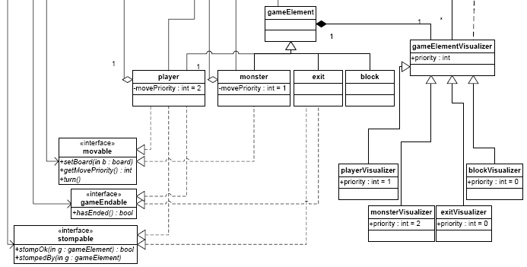
TntM 2: Object Interfaces & Inheritance
Notes:
game elements added separately to the board, placed at a particular location…
still engine, but now there’s a notion of game elements (players, monsters, etc.), along with visualizers that have subclasses for each of these,
now there’s a set of interfaces … behaviors are now encoded in the type of class.
If the player enters a space with a game element of the type endable, we can now say I’m gonna add another type of exit that ends the game e.g, big trap = die… don’t need to change the game engine to deal with that…
move priority = who gets to move first, don’t want to build the hierarchy into the engine… can change priorities and not engine
by encoding a lot in the structure of the design in a generic fashion, programming to interface, separating concerns, information hiding, you get to a design that is more easily changeable…

Slide 32
TntM: Changes
Changing the board size
Adding terrain types
Adding more monsters
Adding a second player
“Intelligent elements”
Notes:
Can we now do each of these things with the new design?

Slide 33
How far is too far?
Changing board size?
Pushable blocks?
Intelligent elements?
Physics challenges?
Notes:
Do we need to take into account all these things? When do I stop? No good answer.

Slide 34
TntM 2
Notes:
So in light of all this, is this a good design?

Slide 35
Aside: Three Degrees of Support
Is it a good solution?
Can they build that solution?
Can that solution be used to make other good solutions?
Notes:
Recapping: is it a good solution means theoretically does it have all the properties, then can the developer use/build it, can it be used to make other solutions (can we reuse parts of it for other purposes)

Slide 36
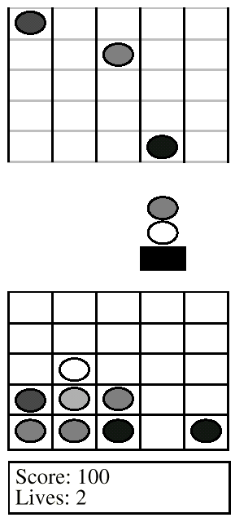
Example: Klax Video Game
KLAX Chute
  Tiles of random colors drop one cell at a time, starting at random times and locations
KLAX Palette
  Palette manipulated to catch tiles coming down the Chute and to drop them into the Well
KLAX Well
  Horizontal, vertical and diagonal sets of three or more consecutive tiles of the same color are removed, and any tiles above them collapse down to fill in the newly-created empty spaces
KLAX Status
  Points scored as sets are formed
  Lives lost as Well or Palette spills over

Slide 37
A Good Klax Design?
Notes:
Let’s think about it differently, in terms of components and connectors

Slide 38
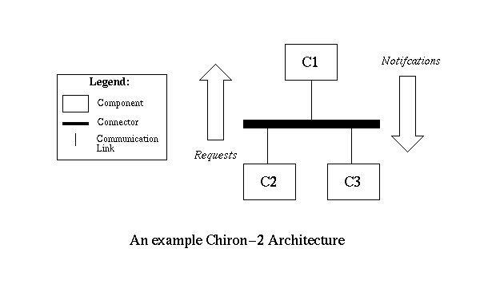
Chiron 2 Architectural Style
Notes:
Let’s think about it differently, in terms of components and connectors

Slide 39
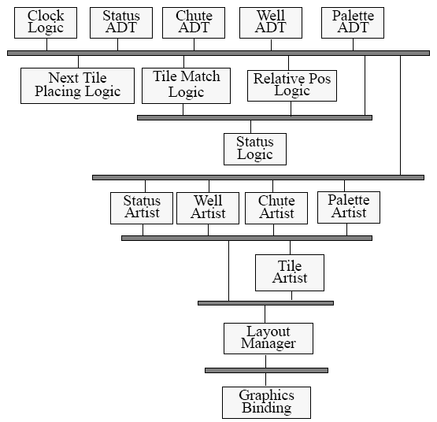
C2 Klax
Notes:
Roughly separated into data, logic, graphics “layers”
Remember that requests go up, notifications go down

Slide 40
Spelling
Klax?

Slide 41
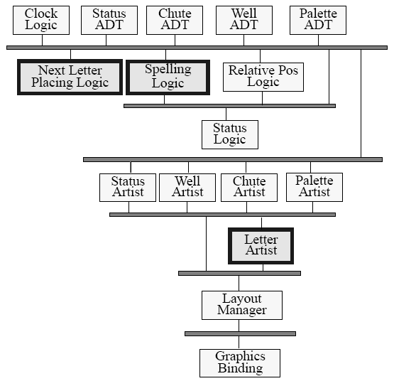
Spelling
Klax?
Notes:
now we have a design that is much more easily changeable than yours… part of the lesson is breaking things down into a much finer grain than thought you needed to

Slide 42
Example #3: Scrabble

Slide 43
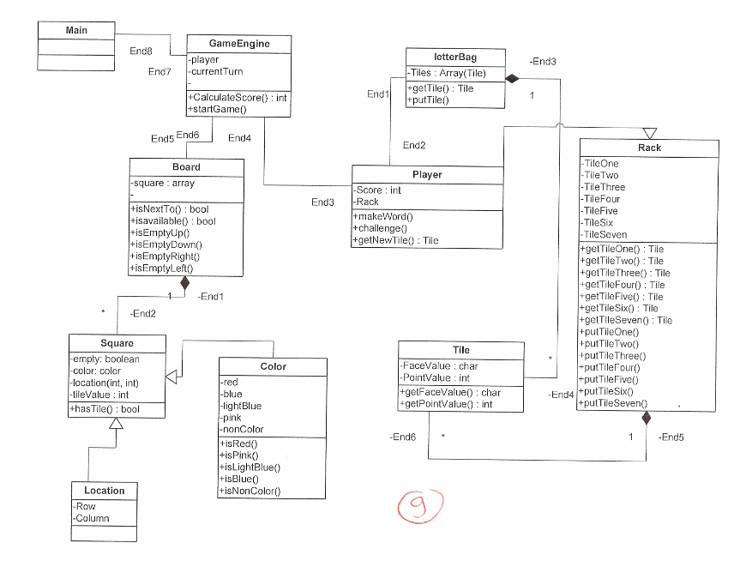
Function Overload
Changes to rack?
Notes:
What do you think about this one?
How do we know when we want tile 1, 2, 3, etc.? What happens if we want to make the capacity of the rack only 5? Or increase to 8?

Slide 44
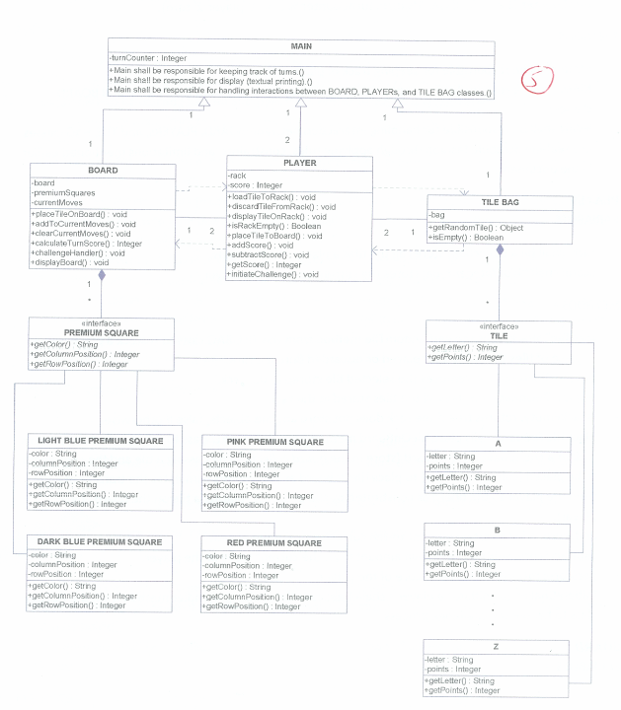
Class Overload
Notes:
Is there anything different about the different premium squares? A separate class for each letter tile?

Slide 45
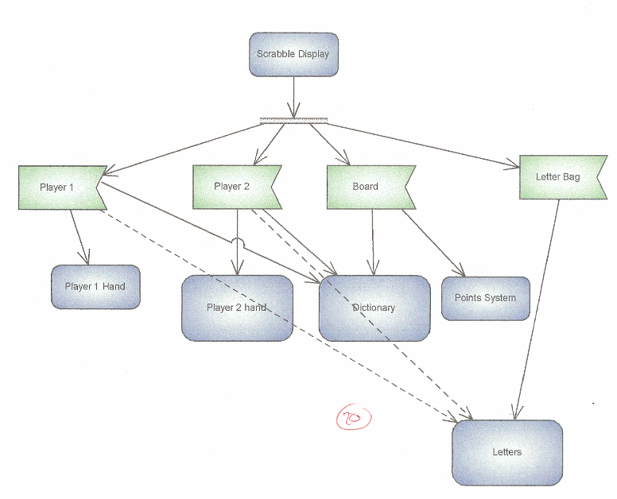
(besides missing details)
Notes:
The player classes – are the 2 players so different they need their own classes?

Slide 46
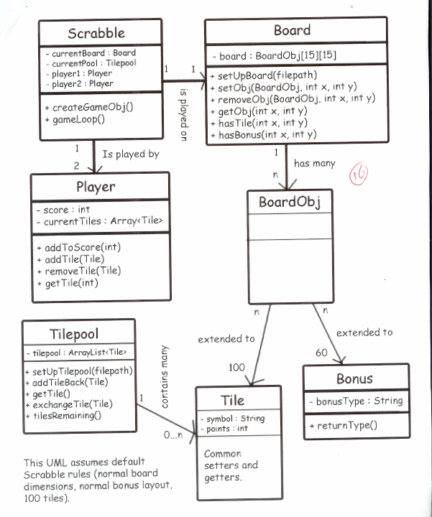
Is this a good design?
Notes:
This one is simple enough to look over a bit before we discuss
what is a board object if it had no methods or variables, does it really abstract anything?
Is a bonus the same as a tile, or a rule of how the board works?

Slide 47
Overengineered?
What change are you designing for?
More types of board objects?
Up to 100/60 different types of tiles/bonuses?
Notes:
Its not that this is wrong, but you need to think about what kind of change you’re designing for (e.g., multiple point values), and whether you need to design for it.
UML assumes default scrabble rules??
100/60 too specific?

Slide 48
Overengineered?
Meanwhile:
Board doesn’t actually work
Populating the tiles is likely a hassle
Tilepool vs. Player.currentTiles
Inelegance lead to problems
Notes:
Doesn’t work: can’t have a tile and a bonus in one place…
populating tiles is coming from a file somewhere
why isn’t the player.currenttiles not just a tile pool?...
I would argue that the desire to create a collection class, and then a boardObject superclass cluttered the design in the designer’s own mind, and lead to a design that didn’t even work NOW, let alone be all that flexible to change.

Slide 49
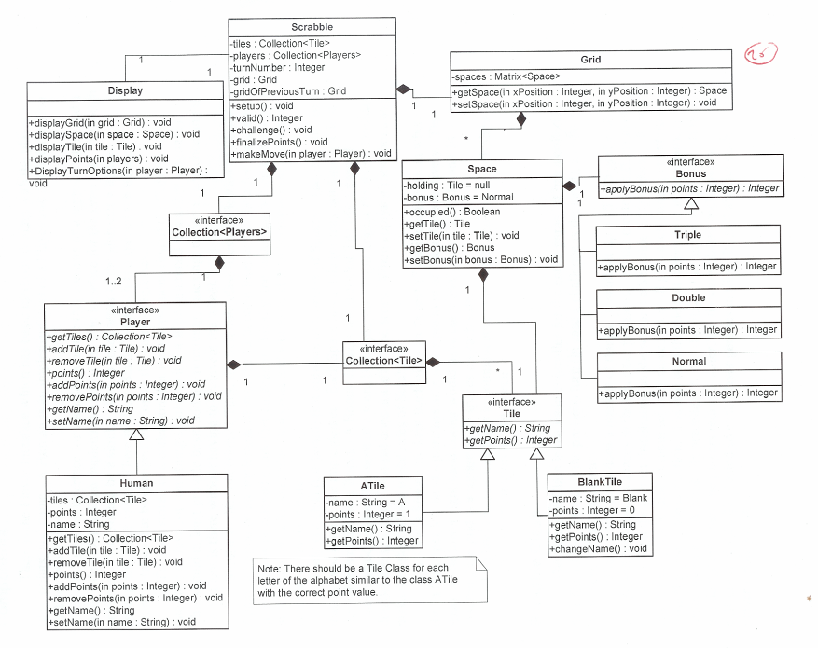
A Nice Approach?
Notes:
this also has tiles a through z…
space is nicely done, holds a tile but also has a y or no for bonus, tells us whether we’re occupied or not…
created the player interface, and then created a human which leaves space for an automated player, but could also argue that it was overengineered as well
What do we know we will have?- Put this in an interface
What variations on that might we see? – Hide this behind the interface

Slide 50
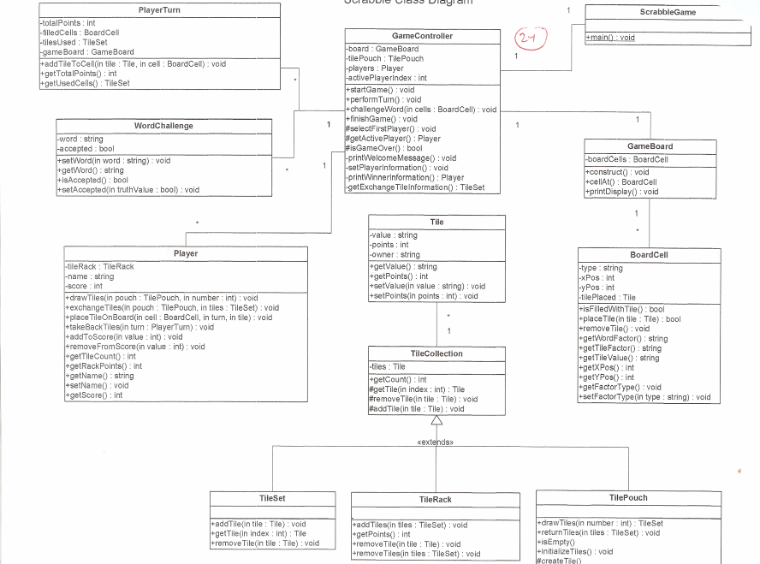
A Nice Approach?
Notes:
do you really need to define separate classes for those, or do you just have a variable tilerack that is a tile collection, tilepouch that is a tile collection, etc. bc they really don’t differ that much… this is worthy of discussion whether this is the right path to go or not. No real right answers.

Slide 51
Scrabble Changeability
Can a design accommodate:
  Changes to letter values?
  Changes to bonus squares?
  AI opponents?
  Different dictionaries?
  Different languages?

Slide 52
Changeability Summary
Designing for change is a matter of:
  Controlling dependency
  Proper encapsulation
  Generalizing where you can
Which changes?
  What are the biggest change risks?
  What kind of program is this, essentially?
  Where is “the line”?
What do we know we will have?
  Put this in an interface
What variations on that might we see?
  Hide this behind the interface

Slide 53
Practically:
What is the core we know will be true?
  What variations on that will we see?
If there’s something that needs to change:
  Can it be changed in one place?
  Does anything else need to be changed when it changes?
Can each class ignore its context?
Discipline
Notes:
Finally, have you ever had that sense when you do something that you know its not the best way to do it in the long run?
You need to listen to that, and sometimes you need to do it right

Slide 54
Inheritance vs. Interfaces
Interfaces allow “multiple inheritance” in Java
Implementing an interface represents the “behaves-like-a” relationship
  Can be used to group unrelated classes
Inheriting from a superclass represents the “is-a” relationship
  Used to reuse data/functionality among related classes
No easy answer!

Slide 55
Interface + Inheritance Example
public class HouseFly extends Insect {
void flyAroundYourHead(){…}
void landOnThings() {…}
}
public class Telemarketer extends Person {
void callDuringDinner() {…}
void continueTalkingWhenYouSayNo() {…}
}
Notes:
Clearly, these two objects have nothing in common in terms of direct inheritance. But, you could say they are both annoying.
Let's say our game needs to have some sort of random thing that annoys the game player when they eat dinner. This could be a HouseFly or a Telemarketer or both -- but how do you allow for both with a single function? And how do you ask each different type of object to "do their annoying thing" in the same way?
The key to realize is that both a Telemarketer and HouseFly share a common loosely interpreted behavior even though they are nothing alike in terms of modeling them. So, let's make an interface that both can implement:

Slide 56
Interface + Inheritance Example (II)
public interface Pest {
void beAnnoying();
}

Slide 57
Interface + Inheritance Example (III)
public class HouseFly extends Insect implements Pest {
void flyAroundYourHead() {…}
void landOnThings() {…}
void beAnnoying() {
flyAroundYourHead();
landOnThings();
}
}

Slide 58
Interface + Inheritance Example (III)
public class TeleMarketer extends Person implements Pest {
void callDuringDinner() {…}
void continueTalkingWhenYouSayNo() {…}
void beAnnoying() {
callDuringDinner ();
continueTalkingWhenYouSayNo();
}
}
Notes:
We now have two classes that can each be annoying in their own way. And they do not need to derive from the same base class and share common inherent characteristics -- they simply need to satisfy the contract of IPest -- that contract is simple. You just have to BeAnnoying. In this regard, we can model the following:

Slide 59
Interface + Inheritance Example (III)
public class DiningRoom {
DiningRoom(Person[] diningPeople, Pest[]
pests) {…}
void serveDinner() {
// when dining people are eating,
// foreach pest in pests
pest.beAnnoying();
}
}

Slide 60
Assignment #1 Continued

Slide 61
Assignment #1 Grading
Initial draft: 15%
Presentation: 15%
Revised draft: 55%
Design review: 15%

