Slide 1
Informatics 122
Software Design II
Lecture 5
Emily Navarro
Duplication of course material for any commercial purpose without the explicit written permission of the professor is prohibited.
Portions of the slides in this lecture are adapted from http://www.cs.colorado.edu/~kena/classes/5448/f12/lectures/

Slide 2
Announcement
Be sure to turn in the original design (created by the designer, not you) with your Assignment 2

Slide 3
Today’s Lecture
Design patterns – part 2 of a 3-part series
  Two patterns:
    Factory Method
    Abstract Factory
Further reflection on MakeAGraph designs

Slide 4
Factory Patterns: The Problem with “new”
Each time we use the “new” command we break encapsulation
  Duck duck = new DecoyDuck();
Even though our variable uses an “interface”, this code depends on “DecoyDuck”
In addition, if you have code that instantiates a particular subtype based on the current state of the program, then the code depends on each concrete class
if (hunting) {
return new DecoyDuck()
} else {
return new RubberDuck()
}
Obvious problems:
needs to be recompiled each time a
dependent changes;
add new classes -> change this code
remove existing classes -> change this
code

Slide 5
PizzaStore Example
We have a pizza store program that wants to separate the process of creating a pizza from the process of preparing/ordering a pizza
Initial code: mixes the two processes (see next slide)

Slide 6
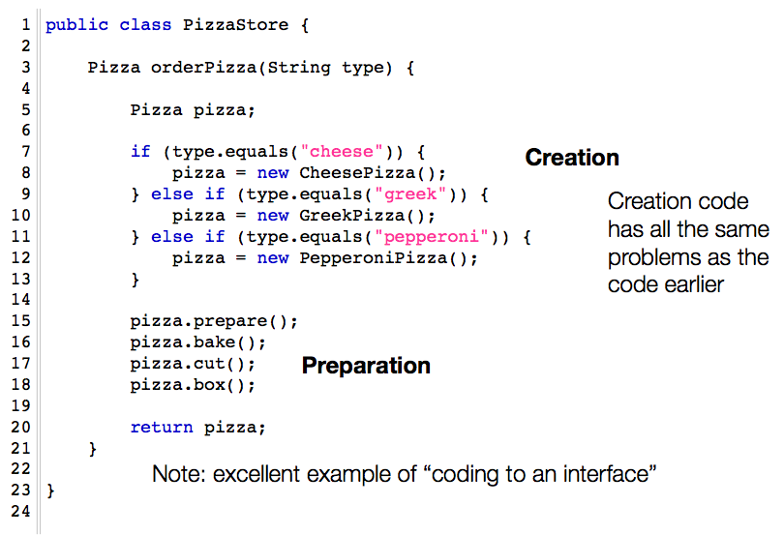

Slide 7
Encapsulate Creation Code
A simple way to encapsulate this code is to put it in a separate class
  That new class depends on the concrete classes, but those dependencies no longer impact the preparation code
    See example next slide

Slide 8
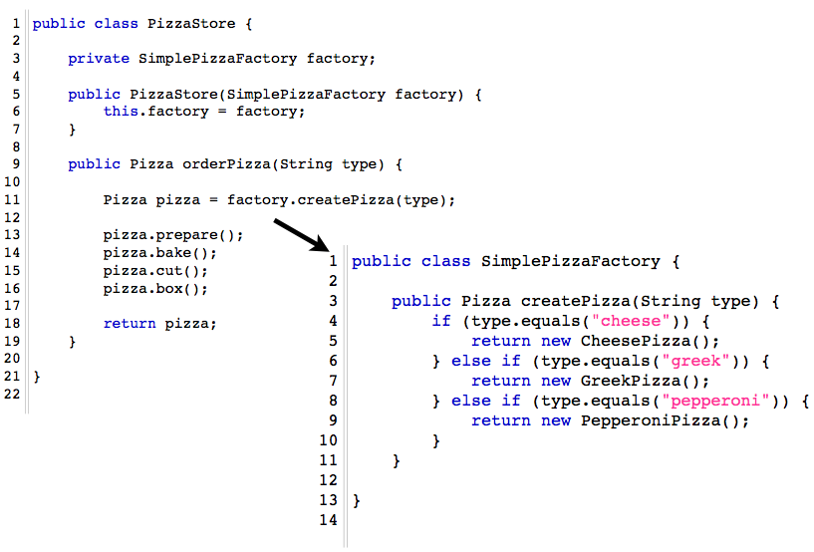

Slide 9
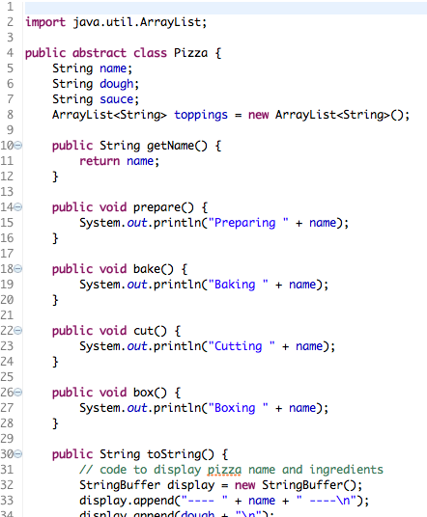

Slide 10
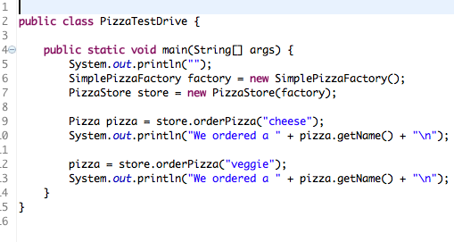
PizzaTestDrive.java
Notes:
So without explicitly calling “new” and depending on the concrete object constructors’ code, we have created concrete objects from this client class.

Slide 11
Demo
Notes:
First

Slide 12
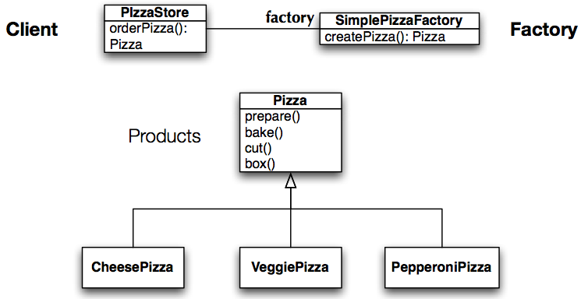
Class Diagram of New Solution
Pizza
While this is nice, it is not as flexible as it can be: to increase flexibility we need to look at two design patterns: Factory Method and Abstract Factory
Notes:
So the pizza creation is taken out of PizzaStore and moved into SimplePizzaFactory. All creation code is isolated and encapsulated within this one class. If new types of pizzas are added or existing ones removed, the only changes need to be in SimplePizzaFactory

Slide 13
Factory Method
To demonstrate the FactoryMethod pattern, the pizza store example evolves
  to include the notion of different franchises
  that exist in different parts of the country (California, New York, Chicago)
Each franchise needs its own factory to match the proclivities of the locals
  However, we want to retain the preparation process that has made PizzaStore such a great success
The Factory Method design pattern allows you to do this by
  placing abstract “code to an interface” code in a superclass
  placing object creation code in a subclass
PizzaStore becomes an abstract class with an abstract createPizza() method
We then create subclasses that override createPizza() for each region

Slide 14
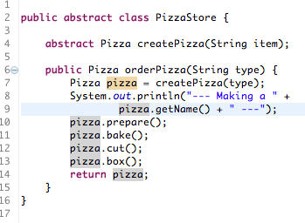
New PizzaStore Class
Factory Method
This class is a (very simple) OO framework. The framework provides one service: “order pizza.”
The framework invokes the createPizza factory method to create a pizza that it can then prepare using a well-defined, consistent process.
A “client” of the framework will subclass this class and provide an implementation of the createPizza method.
Any dependencies on concrete “product” classes are encapsulated in the subclass.
Notes:
In Design Patterns, Gamma et al. provide the following definition of a framework: "A framework is a set of cooperating classes that make up a reusable design for a specific class of software”
This standardizes the pizza preparation/ordering process while allowing variation in the pizza creation process.

Slide 15
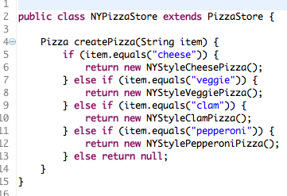
New York Pizza Store
Nice and simple. If you want a NY-style pizza, you create an instance of this class and call orderPizza() passing in the type. The subclass makes sure that the pizza is created using the correct style.
If you need a different style, create a new subclass.

Slide 16
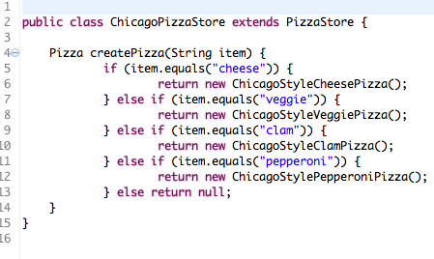
Chicago Pizza Store

Slide 17
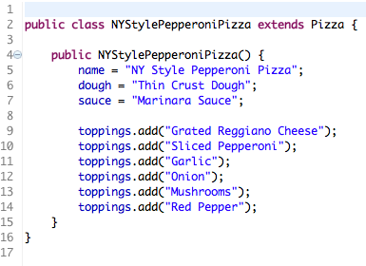
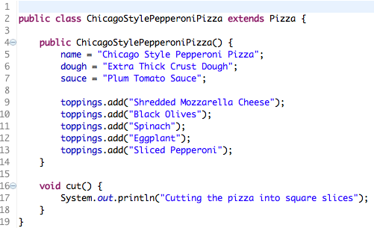
A couple of the concrete product classes

Slide 18
Demo
Notes:
So again, we are able to create a client (PizzaTestDrive) that creates concrete pizza objects without relying on the code of those concrete classes (no calls to “new”).

Slide 19
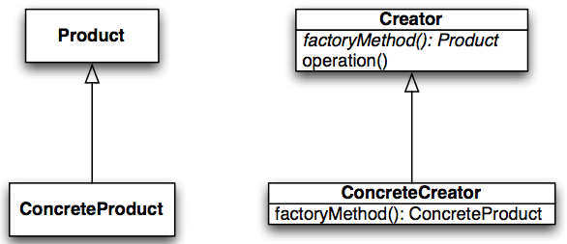
Factory Method: Definition and Structure
The Factory Method design pattern defines an interface for creating an object, but lets subclasses decide which class to instantiate. Factory Method lets a class defer instantiation to subclasses.
Factory Method leads to the creation of parallel class hierarchies; ConcreateCreators produce instances of ConcreteProducts that are operated on by Creators via the Product interface
Notes:
Product = Pizza
ConcreteProduct = ChicagoStyleCheesePizza, NYStyleVeggiePizza, etc.
Creator = PizzaStore
factoryMethod = createPizza
operation = orderPizza
ConcreteCreator = NYPizzaStore, ChicagoPizzaStore
Show parallel class hierarchy on the board

Slide 20
How about a Duck Factory?
<<interface>>
FlyBehavior
fly()
flyBehavior
quackBehavior
<<interface>>
QuackBehavior
quack()
Duck
swim()
display()
setFlyBehavior(FlyBehavior)
setQuackBehavior(QuackBehavior)
performFly()
performQuack()
FlyWithWings
fly()
CantFly
fly()
Silence
quack()
Quack
quack()
Squeak
quack()
MallardDuck
display()
RedheadDuck
display()
RubberDuck
display()
DecoyDuck
display()

Slide 21
Moving On
The factory method approach to the pizza store is a big success, allowing our company to create multiple franchises across the country quickly and easily
  But (bad news): we have learned that some of the franchises
    while following our procedures (the abstract code in PizzaStore forces them to)
    are skimping on ingredients in order to lower costs and increase margins
  Our company’s success has always been dependent on the use of fresh, quality ingredients
    So, something must be done!

Slide 22
Abstract Factory to the Rescue!
We will alter our design such that a factory is used to supply the ingredients that are needed during the pizza creation process
  Since different regions use different types of ingredients, we’ll create region-specific subclasses of the ingredient factory to ensure that the right ingredients are used
  But, even with region-specific requirements, since we are supplying the factories, we’ll make sure that ingredients that meet our quality standards are used by all franchises
    They’ll have to come up with some other way to lower costs.

Slide 23
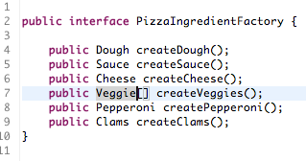
First, we Need a Factory Interface
Note the introduction of more abstract classes: Dough, Sauce, Cheese, etc.

Slide 24
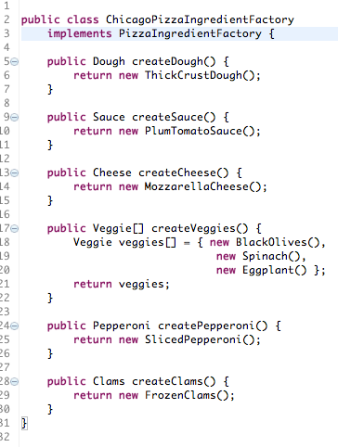
Second, we Implement a Region-Specific Factory
This factory ensures that quality ingredients are used during the pizza creation process…
… while also taking into account the tastes of people in Chicago
But how (or where) is this factory used?

Slide 25
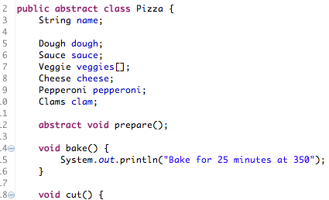
Within Pizza Subclasses… (I)
First, alter the Pizza abstract base class to make the prepare method abstract…

Slide 26
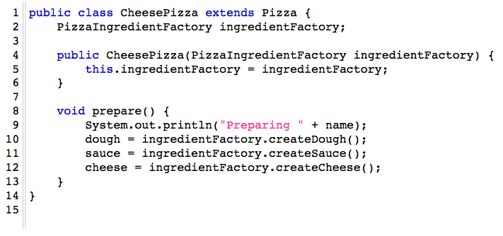
Within Pizza Subclasses… (II)
Then, update pizza subclasses to make use of the factory! Note: we no longer need subclasses like NYCheesePizza and ChicagoCheesePizza because the ingredient factory now handles regional differences

Slide 27
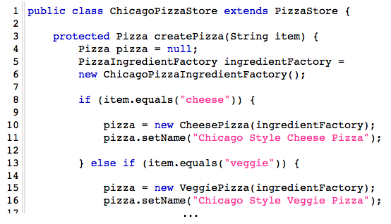
One Last Step…
We need to update our PizzaStore subclasses to create the appropriate ingredient factory and pass it to each Pizza subclass within the createPizza method

Slide 28
Summary: What did we just do?
We created an ingredient factory interface to allow for the creation of a family of ingredients for a particular pizza
This abstract factory gives us an interface for creating a family of products (e.g., NY pizzas, Chicago pizzas)
  The factory interface decouples the client code from the actual factory implementations that produce context-specific sets of products
Our client code (PizzaStore) can then pick the factory appropriate to its region, plug it in, and get the correct style of pizza (Factory Method) with the correct set of ingredients (Abstract Factory)

Slide 29
Demo

Slide 30
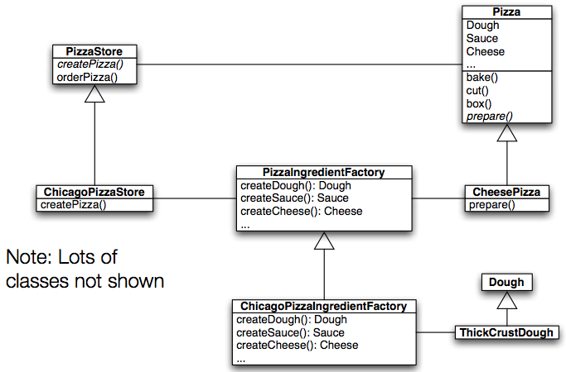
Class Diagram of Abstract Factory Solution

Slide 31
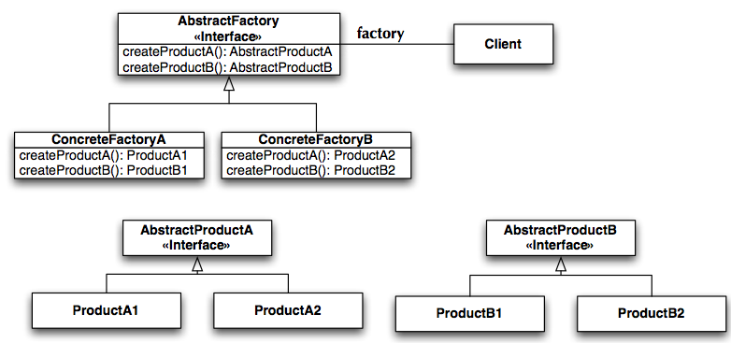
Abstract Factory: Definition and Structure
The Abstract Factory design pattern provides an interface for creating families of related or dependent objects without specifying their concrete classes
Notes:
deals with the problem of creating objects (products) without specifying the exact class of object that will be created.
AbstractFactory = PizzaIngredientFactory
Client = PizzaStore
ConcreteFactories = ChicagoPizzaIngredientFactory, NYPizzaIngredientFactory
AbstractProducts = Dough, Sauce, Cheese, etc.
Products = ThinCrustDough, ThickCrustDough, MarinaraSauce, PlumTomatoSauce, ParmesanCheese, ReggianoCheese, etc.

Slide 32
Abstract Factory Characteristics
Isolates concrete classes
Makes exchanging product families easy
Promotes consistency among products

Slide 33
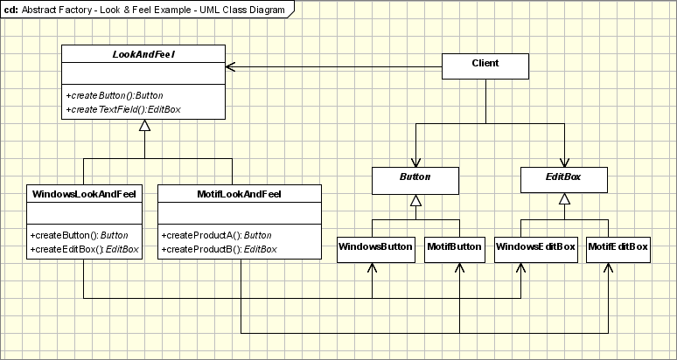
Real Life Example
Notes:
abstract factory = LookAndFeel
concrete factories: WindowsLookAndFeel, MotifLookAndFeel
abstract products: Button, EditBox
concrete products: WindowsButton, MotifButton, WindowsEditBox, MotifEditBox

Slide 34
Back to Design Aesthetics for a Bit…
What makes a given software implementation design “beautiful”?
What is it that makes someone appreciate a particular software implementation design?
What are the qualities that determine whether a particular software implementation design is “good” or “bad”?
What is it, then, that we can strive for in creating a software implementation design that will help others in appreciating it?

Slide 35
Purpose of Implementation Design
An implementation design is a road map
An implementation design describes a path from application / interaction / architecture design to the product
An implementation design describes what the implementers should do
An implementation design is a guide towards future change

Slide 36
Purpose of Implementation Design
An implementation design is a road map
  understandable, unambiguous, consistent, helpful, …
An implementation design describes a path from application / interaction / architecture design to the product
  correct, complete, concise, verifiable, effective, …
An implementation design describes what the implementers should do
  elegant, partitionable, recomposable, resilient, …
An implementation design is a guide towards future change
  evolvable, …

Slide 37
More of a Shared Understanding (Not Perfect!)
An implementation design is a road map
  understandable, unambiguous, consistent, helpful, …
An implementation design describes a path from application / interaction / architecture design to the product
  correct, complete, concise, verifiable, effective, …
An implementation design describes what the implementers should do
  elegant, partitionable, recomposable, resilient, …
An implementation design is a guide towards future change
  evolvable, …
Notes:
Orange: we all have a bit of a sense of

Slide 38
Less of a Shared Understanding
An implementation design is a road map
  understandable, unambiguous, consistent, helpful, …
An implementation design describes a path from application / interaction / architecture design to the product
  correct, complete, concise, verifiable, effective, …
An implementation design describes what the implementers should do
  elegant, partitionable, recomposable, resilient, …
An implementation design is a guide towards future change
  evolvable, …
Notes:
Orange: we have less of a shared sense of
Correctness: adheres to to its specified requirements

Slide 39
Designs Rated Highly By Peers
24
4
25
16
13
Notes:
Caveats: Just because these are rated highly by peers doesn’t mean they are the best designs in the class, or that they correlate with the grades given by us.
If your design is being shown and you want to volunteer any information about it, feel free, but you don’t have to.x

Slide 41
Notes:
Is there no link between a graph and its data?

Slide 43
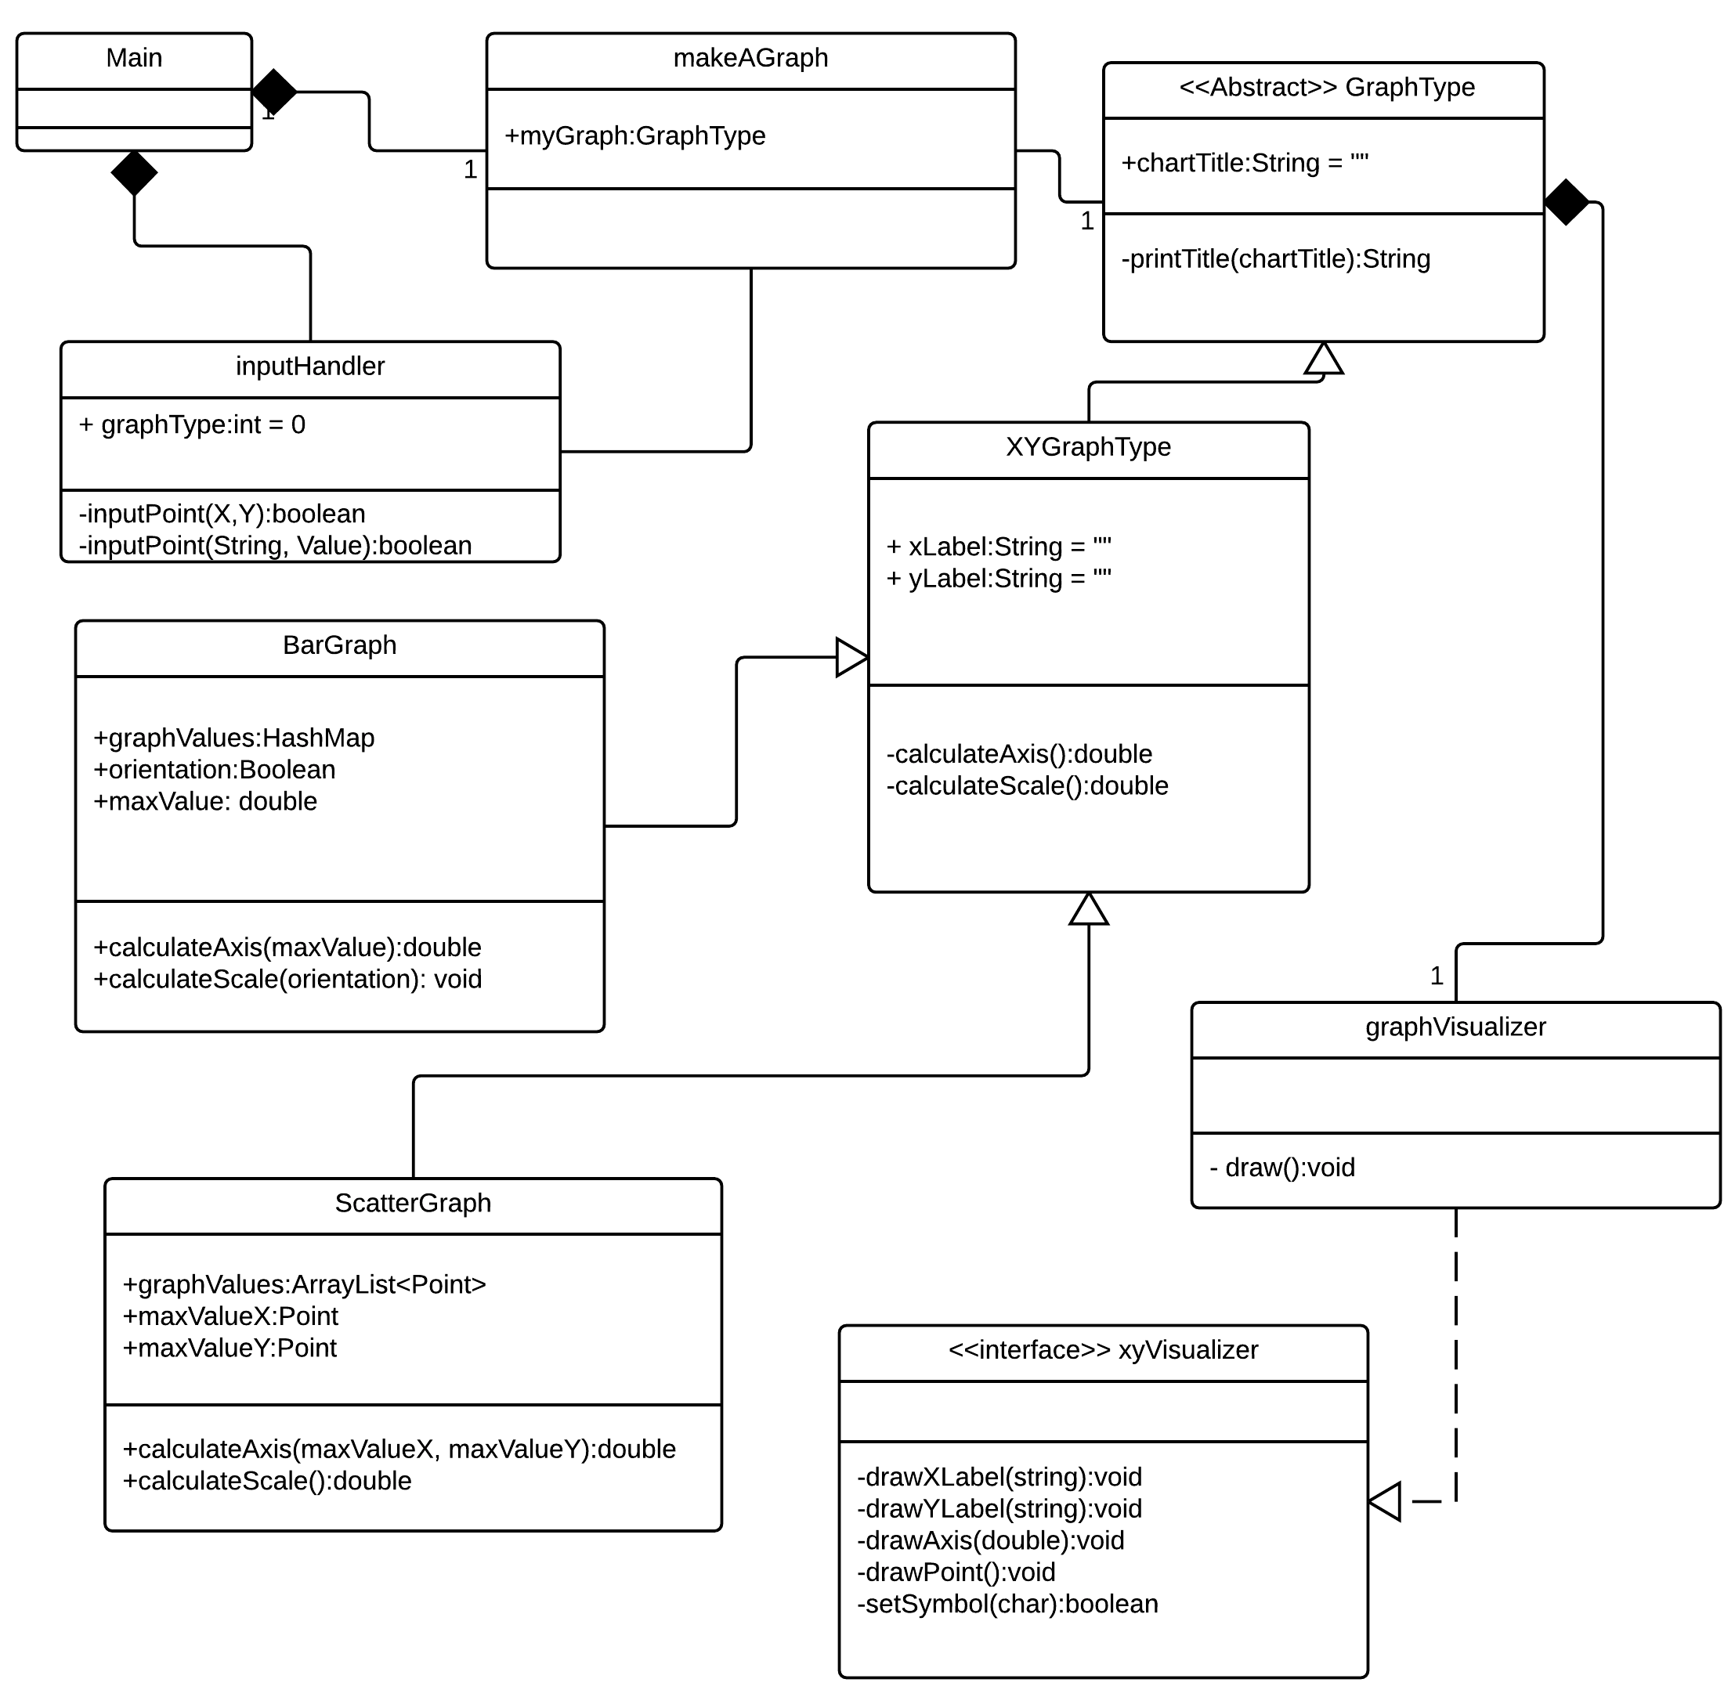

Slide 44
Reflection
What now is a good design?
What now is a bad design?
Have your perceptions of these changed through this assignment?
How do you know that your design does/does not hold up well in the face of change?
What kinds of changes do they hold up well/not so well to?
  Design change examples in the evaluation form
Notes:
Sometimes it helps to have a specific requirements change to try and work into a design (in your eval forms)? Try to think of these kinds of examples on your own when designing.

Slide 45
Reflection: What is the best way to…
Represent a graph?
  scatterplot
  bar graph
  pie chart?
Represent the data?
  scatterplot
  bar graph
  pie chart?
  does a data point need to have its own class? Or can it be a generic list/pairs?

Slide 46
Reflection: What is the best way to…
Create the overall flow of the program?
Get input from the user?
Represent the logic that generates the graph?
  Where is this all done? In one spot? Different classes?

Slide 47
Next Time
More patterns (finishing up design patterns series)!

