Slide 1
Informatics 122
Software Design II
Lecture 6
Emily Navarro
Duplication of course material for any commercial purpose without the explicit written permission of the professor is prohibited.
Portions of the slides in this lecture are adapted from http://www.cs.colorado.edu/~kena/classes/5448/f12/lectures/

Slide 2
Today’s Lecture
Design patterns – part 3 of a 3-part series
  Three patterns:
    Template Method
    Singleton
    Facade
Assignment 3, part 1

Slide 3
Template Method: Definition
The Template Method pattern defines the skeleton of an algorithm in a method, deferring some steps to subclasses. Template Method lets subclasses redefine certain steps of an algorithm without changing the algorithm’s structure
  Template Method defines the steps of an algorithm and allows subclasses to provide the implementation for one or more steps
    Makes the algorithm abstract
      Each step of the algorithm is represented by a method
    Encapsulates the details of most steps
      Steps (methods) handled by subclasses are declared abstract
      Shared steps (concrete methods) are placed in the same class that has the template method, allowing for code re-use among the various subclasses

Slide 4
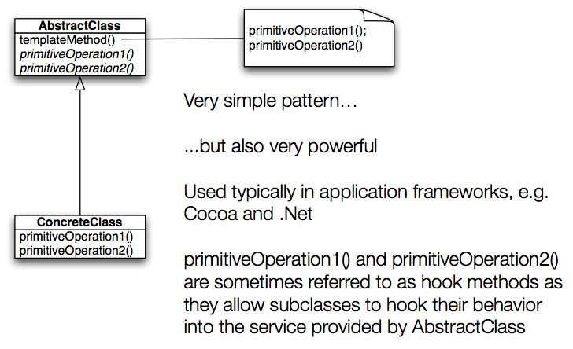
Template Method: Structure

Slide 5
Example: Tea and Coffee
Consider an example in which we have recipes for making tea and coffee at a coffee shop
Coffee
  Boil water
  Brew coffee in boiling water
  Pour coffee in cup
  Add sugar and milk
Tea
  Boil water
  Steep tea in boiling water
  Pour tea in cup
  Add lemon

Slide 6
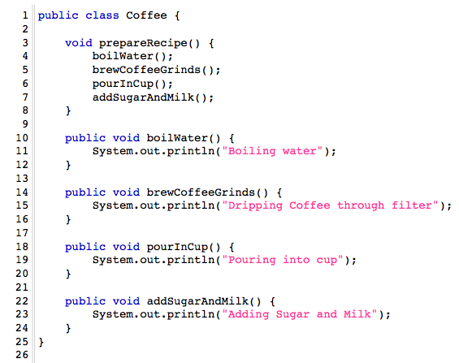
Coffee Implementation

Slide 7
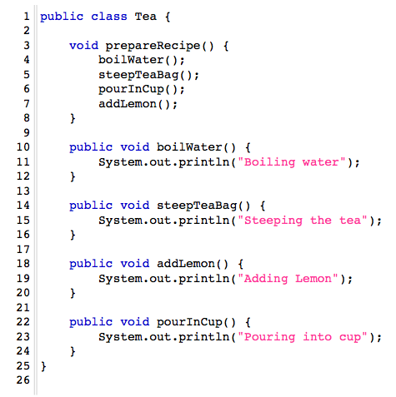
Tea Implementation

Slide 8
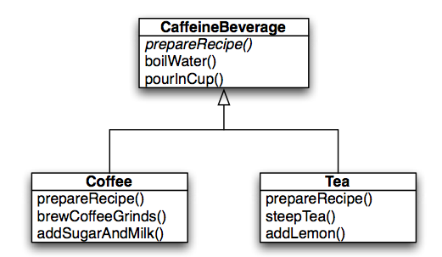
Code Duplication!
We have code duplication occurring in these two classes
  boilWater() and pourInCup() are exactly the same
Let’s get rid of the duplication

Slide 9
Similar Algorithms
The structure of the algorithms in prepareRecipe() is similar for Tea and Coffee
  We can improve our code further by making the code in prepareRecipe() more abstract
    brewCoffeeGrinds() and steepTea() -> brew()
    addSugarAndMilk() and addLemon() -> addCondiments()
Now all we need to do is specify this structure in CaffeineBeverage.prepareRecipe() and make sure we do it in such a way so that subclasses can’t change the structure
  By using the word “final” (see next slide)

Slide 10
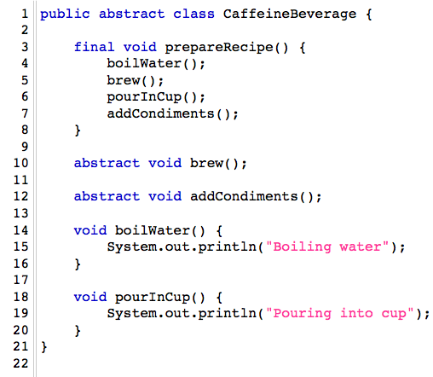
Caffeine Beverage Implementation
Note: use of final keyword for prepareRecipe()
brew() and addCondiments() are abstract and must be supplied by subclasses
boilWater() and pourInCup() are specified and shared across all subclasses

Slide 11
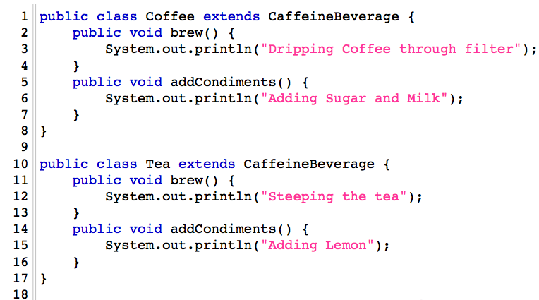
Coffee and Tea Implementations
Nice and simple!

Slide 12
What have we done?
Took two separate classes with separate but similar algorithms
Noticed duplication and eliminated it by adding a superclass
Made steps of algorithm more abstract and specified its structure in the superclass
  Thereby eliminating another “implicit” duplication between the two classes
Revised subclasses to implement the abstract (unspecified) portions of the algorithm… in a way that made sense for them

Slide 13
House Builder Example

Slide 14
Singleton Pattern
Used to ensure that only one instance of a particular class ever gets created and that there is just one (global) way to gain access to that instance
Let’s derive this pattern by starting with a class that has no restrictions on who can create it

Slide 15
Deriving Singleton (I)
public class Ball {
private String color;
public Ball (String color) { this.color = color; }
public void bounce() { System.out.println(“boing!”); }
}
Ball b1 = new Ball (“red”);
Ball b2 = new Ball (“blue”);
b1.bounce();
b2.bounce();

Slide 16
Problem: Universal Instantiation
As long as a client object “knows about” the name of class Ball, it can create instances of Ball
  Ball b1 = new Ball (“orange”);
This is because the constructor is public
  We can stop unauthorized creation of Ball instances by making the constructor private

Slide 17
Deriving Singleton (II)
public class Ball {
private String color;
private Ball(String color) { this.color = color; }
public void bounce() { System.out.println (“boing!”); }
}
// next line now impossible by any method outside of Ball
Ball b2 = new Ball (“red”);

Slide 18
Problem: No Point of Access!
Now that the constructor is private, no class can gain access to instances of Ball
  But our requirements were that there would be at least one way to get access to an instance of Ball
We need a method to return an instance of Ball
  But since there is no way to get access to an instance of Ball, the method CANNOT be an instance method
    This means it needs to be a class method, aka a static method
Notes:
In Java, static denotes class methods and class variables (as opposed to instance methods and instance variables). These methods and variables can be accessed without an instance present. Contrast this to instance methods and instance variables: they must be accessed through an object

Slide 19
Deriving Singleton
public class Ball {
private String color;
private Ball (String color) { this.color = color; }
public void bounce() { System.out.println (“boing!”); }
public static Ball getInstance (String color) {
return new Ball (color);
}
}

Slide 20
Problem: Back to Universal Instantiation
We are back to this problem where any client can create an instance of Ball; instead of saying this:
  Ball b1 = new Ball (“blue”);
they just say
  Ball b1 = Ball.getInstance (“blue”);
Need to ensure only one instance is ever created
  Need a static variable to store that instance

Slide 21
Deriving Singleton (IV)
public class Ball {
private static Ball ball;
private String color;
private Ball (String color) { this.color = color; }
public void bounce () { System.out.println(“boing!”); }
public static Ball getInstance(String color) {
return ball;
}
}

Slide 22
Problem: No instance!
Now the getInstance() method returns null each time it is called
  Need to check the static variable to see if it is null
    If so, create an instance
  Otherwise return the single instance

Slide 23
Deriving Singleton (V)
public class Ball {
private static Ball ball;
private String color;
private Ball (String color) { this.color = color;}
public void bounce() { System.out.println(“boing!”); }
public static Ball getInstance (String color) {
if (ball == null) { ball = new Ball(color); }
return ball;
}
}

Slide 24
Problem: First Parameter Wins
The code on the previous slide shows the Singleton pattern
  private constructor
  private static variable to store the single instance
  public static method to gain access to that instance
    this method creates object if needed; returns it
  ensures that only one instance of Ball is ever created
But what if you want only one instance of each color?
  This code ignores the fact that a parameter is being passed in; so if a “red” ball is created all subsequent requests for a “green” ball are ignored

Slide 25
Solution: Use a Map
The solution to the final problem is to change the private static instance variable to a Map
  private Map<String, Ball> ballRecord = new HashMap…
Then check if the map contains an instance for a given value of the parameter
  this ensures that only one ball of a given color is ever created
  this is a very acceptable variation of the Singleton pattern
  public static Ball getInstance(String color) {
  if (!ballRecord.containsKey(color)) {
  ballRecord.put(color, new Ball(color));
  }
  return ballRecord.get(color);
  }

Slide 26
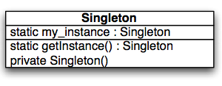
Singleton Pattern: Structure
Singleton involves only a single class (not typically called Singleton). That class is a full-fledged class with other attributes and methods (not shown).
The class has a static variable that points at a single instance of the class.
The class has a private constructor (to prevent other code from instantiating the class) and a static method that provides access to the single instance.
Notes:
Can you use inheritance with a Singleton? Wouldn’t make sense because the very nature of Singleton is “only one” and the purpose of inheritance is to have many.

Slide 27
Singleton Pattern: Real World Examples
Centralized manager of resources
  Window manager
  File system manager
  …
Logger classes
Factories
  Especially those that issue IDs
  Singleton is often combined with Factory Method and Abstract Factory patterns
Notes:
Singletons are often preferred to global variables because: They do not pollute the global name space (or, in languages with namespaces, their containing namespace) with unnecessary variables.^{[7]}
They permit lazy allocation and initialization, whereas global variables in many languages will always consume resources

Slide 28
Façade (I)
“Provide a unified interface to a set of interfaces in a subsystem. Façade defines a higher-level interface that makes the subsystem easier to use.”
  Design Patterns, Gang of Four, 1995
There can be significant benefit in wrapping a complex subsystem with a simplified interface
  If you don’t need the advanced functionality or fine-grained control of the former, the latter makes life easy

Slide 29
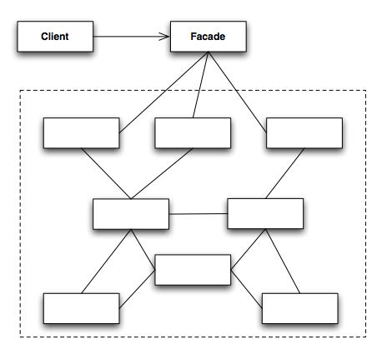
Façade Pattern: Structure

Slide 30
Façade (II)
Façade works best when you are accessing a subset of the system’s functionality
  You can add new features by adding them to the Façade (not the subsystem); you still get a simpler interface
Façade not only reduces the number of methods you are dealing with but also the number of classes
  Imagine having to pull Employees out of Divisions that come from Companies that you pull from a Database
    A Façade in this situation can fetch Employees directly

Slide 31
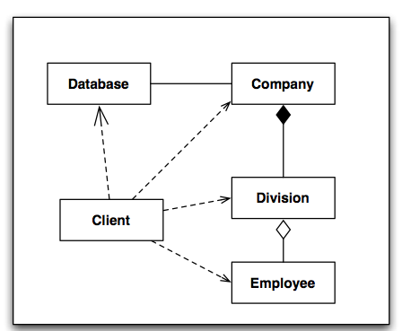
Example (Without a Façade)
Without a Façade, Client contacts the Database to retrieve Company objects. It then retrieves Division objects from them and finally gains access to Employee objects.
It uses four classes.

Slide 32
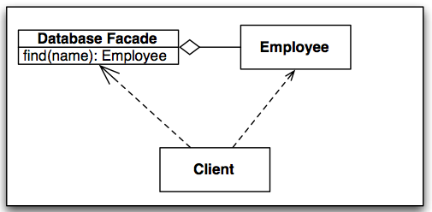
Example (With a Façade)
With a Façade, the Client is shielded from most of the classes. It uses the Database Façade to retrieve Employee objects directly.

Slide 33
Façade Example (I)
Imagine a library of classes with a complex interface and/or complex interrelationships
  Home Theater System
    Amplifier, DvdPlayer, Projector, CdPlayer, Tuner, Screen, PopcornPopper, and TheatreLights
      each with its own interface and interclass dependencies

Slide 34
Façade Example (II)
Imagine steps for “watch movie”
  turn on popper, make popcorn, dim lights, screen down, projector on, set projector to DVD, amplifier on, set amplifier to DVD, DVD on, etc.
Now imagine resetting everything after the movie is done, or configuring the system to play a CD, or play a video game, etc.

Slide 35
Façade Example (III)
For this example, we can place high level methods…
  like “watch movie”, “reset system”, “play cd”
… in a façade object and encode all of the steps for each high level service in the façade; Demo
Client code is simplified and dependencies are reduced
  A façade not only simplifies an interface, it decouples a client from a subsystem of components
Indeed, Façade lets us encapsulate subsystems, hiding them from the rest of the system

Slide 36
Façade vs. Adapter Comparison (I)
To many people, these two patterns (Adapter/Façade) appear to be similar
  They both act as wrappers of a preexisting class
  They both take an interface that we don’t want and convert it to an interface that we can use
With Façade, the intent is to simplify the existing interface
With Adapter, we have a target interface that we are converting to
  In addition, we often want the adapter to plug into an existing framework and behave polymorphically

Slide 37
Façade vs. Adapter Comparison (II)
Superficial difference
  Façade hides many classes
  Adapter hides only one
But
  a Façade can simplify a single, very complex object
  an adapter can wrap multiple objects at once in order to access all the functionality it needs
The key is simplify (façade) vs. convert (adapter)

Slide 38
More Information on Design Patterns…
Patterns
  http://en.wikipedia.org/wiki/Software_pattern
  http://hillside.net/patterns/patterns-catalog
  http://c2.com/ppr/
Interaction design patterns
  http://en.wikipedia.org/wiki/Interaction_design_pattern
Anti-Patterns
  http://en.wikipedia.org/wiki/Anti-pattern#Programming_anti-patterns
And numerous, numerous, numerous books and other online sources

Slide 39
Assignment 3, part 1

Slide 40
Next Time
Refactoring
Assignment 3, part 2

