Slide 1
Informatics 122 Software Design II
Lecture 7
Emily Navarro
Duplication of course material for any commercial purpose without the explicit written permission of the professor is prohibited.
Portions of the slides in this lecture are adapted from http://www.cs.colorado.edu/~kena/classes/5448/f12/lectures/

Slide 2
Today’s Lecture
Refactoring
Introducing the concept
A few examples
Assignment 3, part 2

Slide 3
What is Refactoring?
Refactoring is the process of changing a software system such that
the external behavior of the system does not change
e.g., functional requirements are maintained
but the internal structure of the system is improved
This is sometimes called
“improving the design after it has been written”

Slide 4
(Very) Simple Example
Consolidate duplicate conditional fragments; This
if (isSpecialDeal()) {
total = price * 0.95;
send();
} else {
total = price * 0.98;
send();
}
becomes this
if (isSpecialDeal()) {
total = price * 0.95;
} else {
total = price * 0.98;
}
send();

Slide 5
(Another) Simple Example
Replace magic number with symbolic constant; This
double potentialEnergy(double mass, double height){
return mass * 9.81 * height;
}
becomes this
static final double GRAVITATIONAL_CONSTANT = 9.81;
double potentialEnergy(double mass, double height) {
return mass * GRAVITATIONAL_CONSTANT * height;
}
In this way, refactoring formalizes good programming practices

Slide 6
But, Refactoring is Dangerous!
Although refactoring helps to reduce bugs, it can also introduce new bugs into the code
Manager’s point of view
If my programmers spend time “cleaning up the code” then that’s less time implementing required functionality (and my schedule is slipping as it is!)
To address these concerns
Refactoring needs to be systematic, incremental, and safe

Slide 7
Refactoring is Useful Too
The idea behind refactoring is to acknowledge that it will be difficult to get a design right the first time and, as a program’s requirements change, the design may need to change
refactoring provides techniques for evolving the design in small incremental steps
Benefits
Often code size is reduced after refactoring
Confusing structures are transformed into simpler structures
which are easier to maintain and understand

Slide 8
A “Cookbook” can be Useful
Refactoring: Improving the Design of Existing Code
by Martin Fowler (and Kent Beck, John Brant, William Opdyke, and Don Roberts)
Similar to the Gang of Four’s Design Patterns
Provides “refactoring patterns”
Also
http://www.refactoring.com/catalog/
http://sourcemaking.com/refactoring

Slide 9
Principles in Refactoring
Fowler’s definition
Refactoring (noun)
a change made to the internal structure of software to make it easier to understand and cheaper to modify without changing its observable behavior
Refactoring (verb)
to restructure software by applying a series of refactorings without changing its observable behavior

Slide 10
Principles, continued
The purpose of refactoring is
to make software easier to understand and modify
no functionality is added, but the code is cleaned up, made easier to understand and modify, and sometimes is reduced in size
Contrast this with performance optimization
functionality is not changed, only internal structure;
however, performance optimizations often involve making code harder to understand (but faster!)

Slide 11
Principles, continued
How do you make refactoring safe?
First, use refactoring “patterns”
Fowler’s book (and Website) assigns “names” to refactorings in the same way that the GoF’s book assigned names to patterns
Second, test constantly!
This ties into the agile design paradigm
you write tests before you write the code
after you refactor, you run the tests and check that they all pass
if a test fails, the refactoring broke something but you know about it right away and can fix the problem before you move on

Slide 12
Why Should you Refactor?
Refactoring improves the design of software
without refactoring, a design will “decay” as people make changes to a software system
Refactoring makes software easier to understand
because structure is improved, duplicated code is eliminated, etc.
Refactoring helps you find bugs
Refactoring promotes a deep understanding of the code at hand, and this understanding aids the programmer in finding bugs and anticipating potential bugs
Refactoring helps you program faster
because a good design enables progress

Slide 13
When Should you Refactor?
The Rule of Three
Three “strikes” and you refactor
refers to duplication of code
Refactor when you add functionality
do it before you add the new function to make it easier to add the function
or do it after to clean up the code after the function is added
Refactor when you need to fix a bug
Refactor as you do a code review
Notes:
1st time: just do it
2nd time: wince at the duplication but do it anyway
3rd time: refactor

Slide 14
Problems with Refactoring
Databases
Business applications are often tightly coupled to underlying databases
code is easy to change; databases are not
Changing interfaces (!!)
Some refactorings require that interfaces be changed
if you own all the calling code, no problem
if not, the interface is “published” and can’t change

Slide 15
Refactoring: Where to Start?
How do you identify code that needs to be refactored?
Fowler uses an olfactory analgoy (attributed to Kent Beck)
Look for “Bad Smells” in code
A chapter in Fowler’s book
Several online sources (e.g., http://sourcemaking.com/refactoring/bad-smells-in-code)
They present examples of “bad smells” and then suggest refactoring techniques to apply

Slide 16
Bad Smells in Code
Duplicated code
Bad because if you modify one instance of duplicated code but not the others, you (may) have introduced a bug!
Long method
long methods are more difficult to understand
performance concerns with respect to short methods are largely obsolete

Slide 17
Bad Smells in Code
Large Class
Large classes try to do too much, which reduces cohesion
Long Parameter List
hard to understand, can become inconsistent if the same parameter chain is being passed from method to method
Divergent Change
symptom: one type of change requires changing one subset of methods; another type of change requires changing another subset
e.g., “I have to change these three methods every time I get a new database.”
Related to cohesion

Slide 18
Bad Smells in Code
Shotgun Surgery
a change requires lots of little changes in a lot of different classes
Feature Envy
a method requires lots of information from some other class
Move it closer!
Data Clumps
attributes that clump together (are used together) but are not part of the same class

Slide 19
Bad Smells in Code
Primitive Obsession
characterized by a reluctance to use classes instead of primitive data types
Switch Statements
Switch statements are often duplicated in code; they can typically be replaced by use of polymorphism (let OO do your selection for you!)
Parallel Inheritance Hierarchies
Similar to shotgun surgery; each time I add a subclass to one hierarchy, I need to do it for all related hierarchies
Note: some design patterns encourage the use of parallel inheritance hierarchies (so they are not always bad!)

Slide 20
Bad Smells in Code
Lazy Class
A class that no longer “pays its way”
e.g., may be a class that was downsized by a previous refactoring, or represented planned functionality that did not pan out
Speculative Generality
“Oh, I think we need the ability to do this kind of thing someday”
thus have all sorts of hooks and special cases to handle things that aren’t required
Temporary Field
An attribute of an object is only set/used in certain circumstances;
but an object should need all of its attributes
Notes:
temporary field, e.g., orientation in a scatterplot

Slide 21
Bad Smells in Code
Message Chains
a client asks an object for another object and then asks that object for another object etc.
client depends on the structure of the navigation
any change to the intermediate relationships requires a change to the client
Middle Man
If a class is delegating more than half its responsibilities to another class, do you really need it? Involves trade-offs, some design patterns encourage this (e.g., Decorator)
Inappropriate Intimacy
Pairs of classes that know too much about each other’s implementation details (loss of encapsulation)

Slide 22
Bad Smells in Code
Data Class (information holder)
These are classes that have fields, getting and setting methods for the fields, and nothing else; they are data holders, but objects should be about data AND behavior
Refused Bequest
A subclass ignores most of the functionality provided by its superclass
Subclass may not pass the “IS-A” test
Comments (!)
Comments are sometimes used to hide bad code
“…comments are often used as a deodorant”(!)

Slide 23
The Catalog of Refactoring Patterns
Fowler’s book and Website (http://www.refactoring.com/catalog/) has 72 refactoring patterns
I’m only going to cover a few of the more common ones, including
Extract Method
Replace Temp with Query
Move Method
Replace Conditional with Polymorphism
Introduce Null Object
Separate Query for Modifier
Introduce Parameter Object
Encapsulate Collection
Replace Nested Conditional with Guard Clauses

Slide 24
Extract Method
You have a code fragment that can be grouped together
Turn the fragment into a method whose name explains the purpose of the fragment
Example, next slide

Slide 25
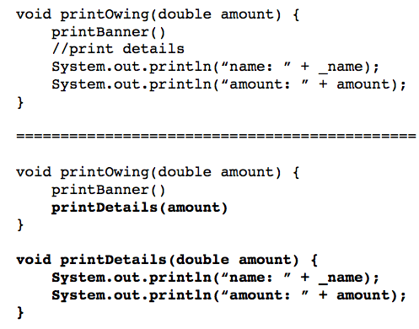
Extract Method, continued
;
;
;

Slide 26
Replace Temp with Query
You are using a temporary variable to hold the result of an expression
Extract the expression into a method;
Replace all references to the temp with an expression
The new method can then be used in other methods
Example, next slide
Notes:
The problem with temps is that they are temporary and local.
Because they can be seen only in the context of the method in which they are used, temps tend to encourage longer methods, because that's the only way you can reach the temp.
By replacing the temp with a query method, any method in the class can get at the information. That helps a lot in coming up with cleaner code for the class.

Slide 27
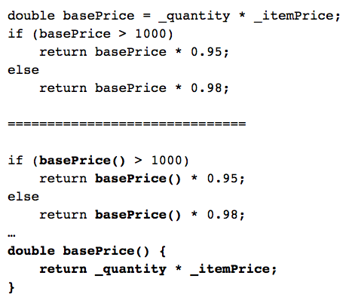
Replace Temp with Query, continued
Notes:
The problem with temps is that they are temporary and local.
Because they can be seen only in the context of the method in which they are used, temps tend to encourage longer methods, because that's the only way you can reach the temp.
By replacing the temp with a query method, any method in the class can get at the information. That helps a lot in coming up with cleaner code for the class.

Slide 28
Move Method (I)
A method is using more features (attributes and operations) of another class than the class on which it is defined
Create a new method with a similar body in the class it uses most. Either turn the old method into a simple delegation, or remove it altogether

Slide 29
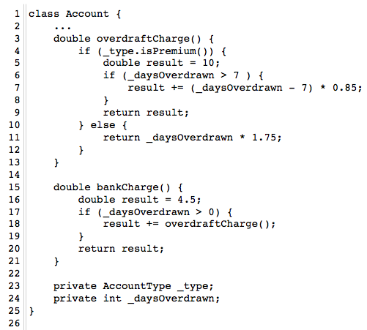
Move Method (II)
A class to manage a bank account. There are currently two types of accounts: standard and premium.
It is anticipated that we will be adding new account types and that each type will have a different rule for calculating an overdraft charge.
As such, we’d like to move the method overdraftCharge() to the AccountType class.

Slide 30
Move Method (III)
When moving a method to a new class, we examine its code to see if it makes use of internal attributes of its original class
In this case, overdraftCharge() makes use of _daysOverdrawn
All such attributes become parameters to the method in its new home. (If the method already had parameters, the new parameters get tacked on to the end of its existing parameter list.)
In this case, _daysOverdrawn will stay in the Account class and be passed as a parameter to AccountType.overdraftCharge().
Note, also, that since we are moving this method to the AccountType class, all calls to its methods that previously required a variable reference can now be made directly
Thus, _type.isPremium()becomes simply isPremium() in the method’s new home

Slide 31
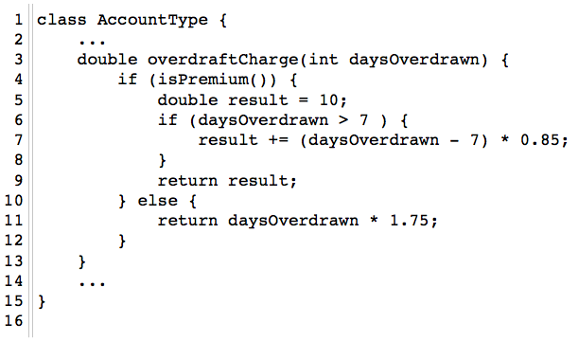
Move Method (IV)
Here is the method in its new home. It has a daysOverdrawn parameter, which is used instead of _daysOverdrawn, throughout the method. _type.isPremium() is now just isPremium(), as advertised.

Slide 32
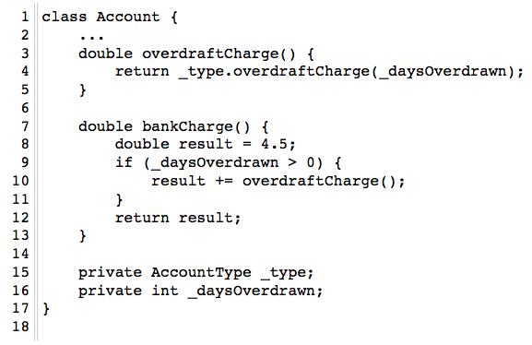
Move Method (V)
Back in the Account class, we update overdraftCharge() to delegate to the overdraftCharge() method in the AccountType class. Or, we could…

Slide 33
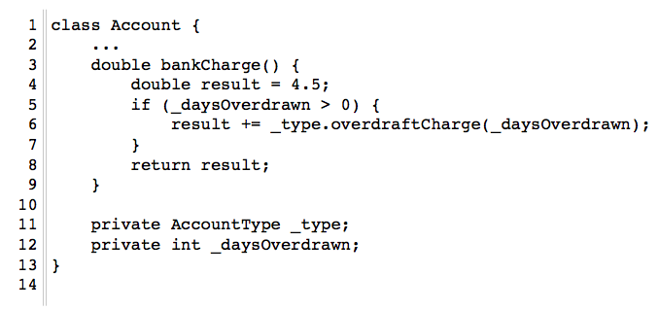
Move Method (VI)
…get rid of the overdraftCharge() method in Account entirely. In that case, we move the call to AccountType.overdraftCharge() to bankCharge()

Slide 34
Replace Conditional with Polymorphism (I)
You have a conditional that chooses different behavior depending on the type of an object
Move each “leg” of the conditional to an overriding method in a subclass. Make the original method abstract.

Slide 35
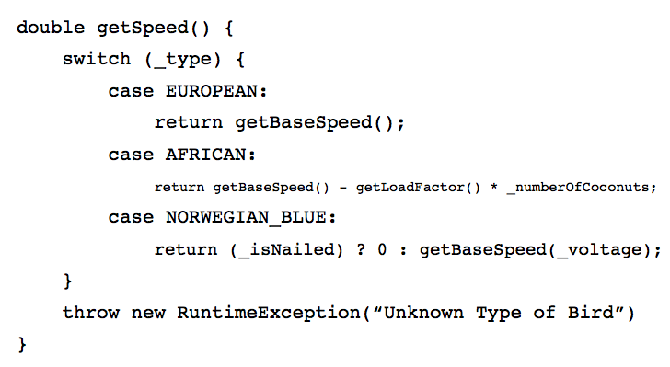
Replace Conditional with Polymorphism (II)

Slide 36
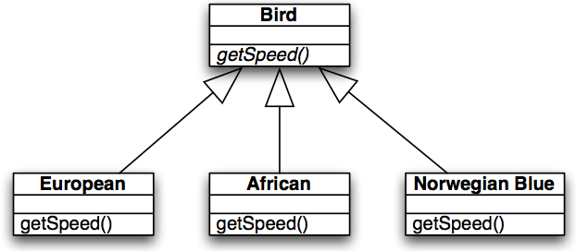
Replace Conditional with Polymorphism (III)
With this configuration, you can now write code that looks like this:
void printSpeed(Bird[] birds) {
for (int i=0; i<birds.length; i++) {
System.out.println(“” + birds[i].getSpeed());
}
}
and everything will work correctly via polymorphism and will be easy to extend: just add a new subclass to support a new type of bird

Slide 37
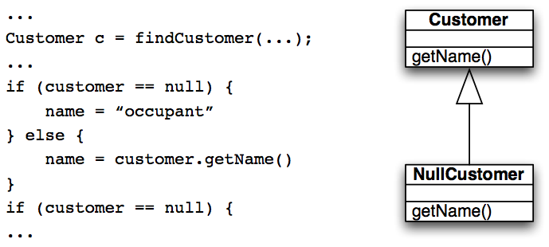
Introduce Null Object (I)
Repeated checks for a null value (see below)
Rather than returning a null value from findCustomer() return an instance of a “null customer” object

Slide 38
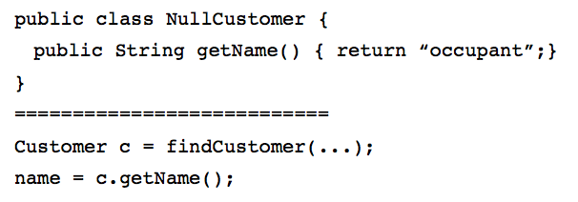
Introduce Null Object (II)
The conditional goes away entirely!

Slide 39
Separate Query for Modifier
Sometimes you will encounter code that does something like this
getTotalOutstandingAndSetReadyForSummaries()
It is a query method but it is also changing the state of the object being called
This change is known as a “side effect” because it’s not the primary purpose of the method
It is generally accepted practice that queries should not have side effects so this refactoring says to split methods like this into:
getTotalOutstanding()
setReadyForSummaries()
Try as best as possible to avoid any side effects in query methods

Slide 40
Introduce Parameter Object
You have a group of parameters that go naturally together
Stick them in an object and pass the object
Imagine methods like
amountInvoicedIn(Date start, Date end);
amountOverdueIn(Date start, Date end);
This refactoring says replace them with something like
amountInvoicedIn(DateRange dateRange);
The new class starts out as a data holder but will likely attract methods to it

Slide 41
Encapsulate Collection
A method returns a collection
Make it return a read-only version of the collection and provide add/remove methods
Student class with
Map getCourses();
void setCourses(Map courses);
Change to
ReadOnlyList getCourses();
addCourse(Course c);
removeCourse(Course c);

Slide 42
Replace Nested Conditional with Guard Clauses
This refactoring relates to the purpose of conditional code
One type of conditional checks for a variation in “normal” behavior
The system will do either A or B; both are considered “normal” behavior
The other type of conditional checks for unusual circumstances that require special behavior; if all of these checks fail then the system proceeds with “normal behavior”
We want to apply this refactoring when we encounter the latter type of conditional
This refactoring is described in Fowler’s book as:
“A method has conditional behavior that does not make clear the normal path of execution; Use guard clauses for all special cases”

Slide 43
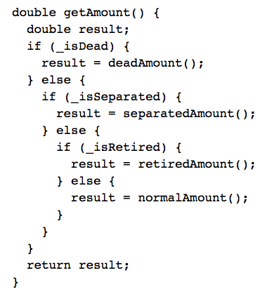
Example (I)
Note: This type of code may be the result of a novice programmer or due to a programming constraint imposed by some companies that a method can only have a single return.
Often this constraint causes more confusion than its worth

Slide 44
Example (II)
With this refactoring, all of the code trying to identify special conditions are turned into one-line statements that determine whether the condition applies and if so handles it.
That’s why these statements are called “guard clauses”
Even though this method has four returns, it is easier to understand than the method before the refactoring

Slide 45
Wrapping Up
Refactoring is a useful technique for making non-functional changes to a software system that result in
better code structures
less code
Many refactorings are triggered via the discovery of duplicated code
The refactorings then show you how to eliminate duplication
Bad Smells
Useful analogy for discovering places in a system “ripe” for refactoring

Slide 46
Assignment 3, Part 2: Refactoring

