Slide 1
Informatics 122
Software Design II
Lecture 8
Emily Navarro
Duplication of course material for any commercial purpose without the explicit written permission of the professor is prohibited.

Slide 2
Today’s Lecture
Design recovery / reverse engineering
Assignment 4 out

Slide 3
Reverse Engineering
Recreating design abstractions from:
  Code
  Existing design documentation (if available)
  Personal experience / general knowledge about problem and application domains
  Talking to people
  (Biggerstaff, 1989)
Notes:
Top things: more obvious, main stuff
bottom things: less obvious… intangible knowledge that you and others have

Slide 4
Design Recovery
We want to understand
  What
  How
  Why
We might need
  Formal specifications
  Dataflows
  Underlying patterns
  Informal knowledge
This might be more than just re-creating…
Notes:
We are casting this wider than reverse engineering… not just what it does, but how it does it and why it does it.
The key point here is this isn’t just “making UML from code”
Last bullet: we are not just recreating the design they used, we are creating what we need, in this case to work with the code in question

Slide 5
Why do we have to do this?
Working with others’ code…
  Debugging
  Maintenance
  Modification
  Reuse
Working with your own code
You will work with code in the absence of a complete design
Notes:
Working with your own – take a look at your MakeAGraph code 2 years from now…
Note that this is a surprisingly everyday situation – that the dream of the clean waterfall is rare indeed – some of this is tips for a big formal recovery, but its also just for little coding moments when you don’t understand the code you’re working with – and even with a perfect situation, there’s always questions you have about the code in front of you that the design won’t answer

Slide 6
Why do we have to do this?
No design
  Lost design
  Build-and-fixed
  Agile methodologies
Design drift
  Common!
Incomprehensible design
Notes:
A design might never have been lost, it might never have been created, it may have ceased to connect to the code, or it may simply be really, really bad
design drift is a lot more common than they might realize; it is actually quite common that people do not go back and update the design when things are changed

Slide 7
Goals of Design Recovery
Recover lost information
Cope with complexity
Generate alternate views
Detect side effects
Facilitate Reuse
  (Chikofsky and Cross, 1990)
Notes:
First 3: We’re trying to recover yes, but we’re also trying to take something super complex and make it understandable – and to do that we may need other ways of looking at it
Note the latter 2 are broader goals, doing things that the initial document might not have handled, but that are important in most of our design recovery situations
side effects = modifications might have been done haphazardly and caused some performance issues or bugs that have been undetected

Slide 8
Design Recovery Tips
Notes:
So that’s the theory of it, what its for, why you need it – here’s some practical advice about how to do it

Slide 9
Object Orientation
Something of an advantage
  Class names, function names
  Established relationships (inheritance, members, etc.)
High cohesion helps
  A holistic sense of purpose

Slide 10
Finding the Structure
Entities
  Classes
  Methods
  Variables
Relationships
  Inheritance
  Member Objects
  Method calls
Notes:
These are simple things to look at in the code that will help you understand things

Slide 11
Approaches
Reverse engineering tools
  E.g. Omondo, AmaterasUML, ArgoUML
Running the program
Eclipse’s References and Declarations
Reading documentation
Reading class names
Talking to people
Code reading
Notes:
Just running the program intermittently can help a lot – this is a real benefit of having running code
Eclipse: you can select something in Eclipse and right click it and select References or Declarations, and it will bring up places where that thing is declared and references in the project – this can help you back-link to the purpose a variable or function serves – very helpful
You can learn a lot from just reading the class/file names, what patterns are used, what sorts of classes you’re using – and it’s a way to see everything at the high level
At the end of the day though its just a matter of looking at the code: important tip: you wont get it all at once, just look it over, figure little questions out first, and you will find it becoming familiar – you just have to put in the time and concentration – this is an act of faith that this exercise is sort of about

Slide 12
Also, remember
Existing artifacts, but also
  Personal experience
  Knowledge about problem
  Knowledge about the context
  Knowledge about solution
Notes:
You can build these – what are they trying to solve? What domain is this used in and what does it interact with? What can you learn from running the program?
The point is, this is a broad, open-ended puzzle, don’t get tooooo focused on the files and code

Slide 13
A (Small) Example
addAllPixels(Image image){
for(int i = 0; i < image.getWidth(); i++){
for(int j = 0; j < image.getHeight(); j++){
Color c = image.getColor(i, j);
addPixel(new Pixel(i, j, c));
addToColumn(i, new Pixel(i, j, c));
updateColorTotals(c);
}}}

Slide 14
We might be able to guess that:
There was a need for a pixel class
Different instances for
  addPixel
  addToColumn
Concerned about speed?
  Not so much about space
Notes:
Why did they have a pixel class? What else does that do?
Why do they need things in columns stored separate from a location? This column thing might be some kind of quick-reference space
Which would make us think they’re not worried about wasting the space – but might need speed
This is after all “pixels”, what do we know about priorities in graphical situations? When are columns of pixels needed in graphics rendering?
As we familiarize ourself with the code, we will likely get a sense for what their patterns are in the design and its implementation – and these signals to us about hidden, underlying rationale will become more clear
Here we see some little hypotheses we can build up, to test them we will go explore these related classes – and we also have some little hints that will help us when we encounter the other classes – just a matter of building it up, little by little

Slide 15
Assignment 4 – Design Recovery

Slide 16
Suggestions for Group Work
Everyone start by taking their own look at the whole system
  Multiple perspectives will be very useful
Work out the high level architecture
Understand program flows
Look out for subtle details

Slide 17
Suggestions for Group Work in General
Chat TODAY about where everyone’s strengths lie
  Divide work accordingly
Communicate daily
Use version control
Let me know as early as possible if there are any problems

Slide 18
Further tips
There are user manuals included with the SimSE download (in the “docs” folder), and SimSE papers on my Website; feel free to consult them
Use representations of classes to organize
Rote completeness is not the answer; will need to be elegant

Slide 19
Detailed Checkout Instructions
Two steps:
  Install Subclipse plug-in for Eclipse
  Check out the SimSE patterns repository
  Note: This assumes you’re using Eclipse and are otherwise comfortable with it.

Slide 20
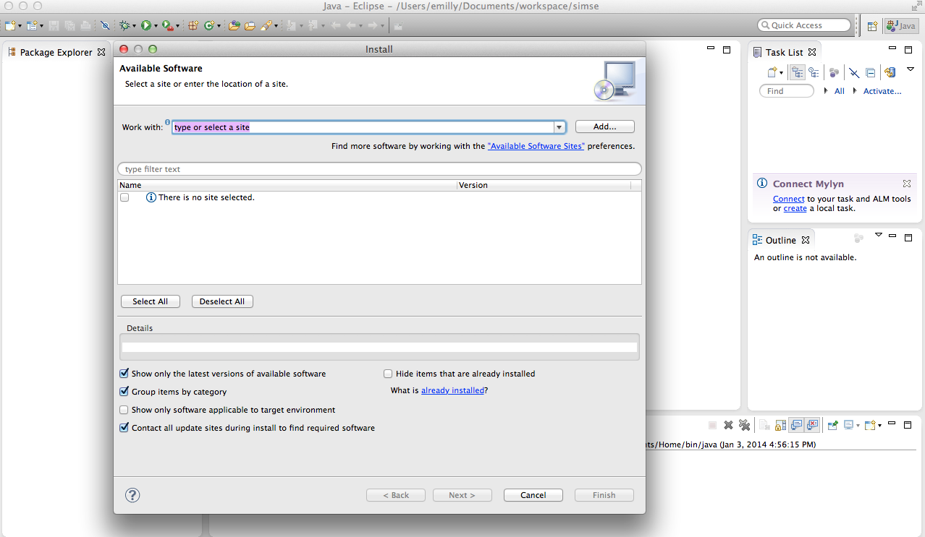
Detailed Checkout Instructions
In Eclipse, go to Help -> Install New Software

Slide 21
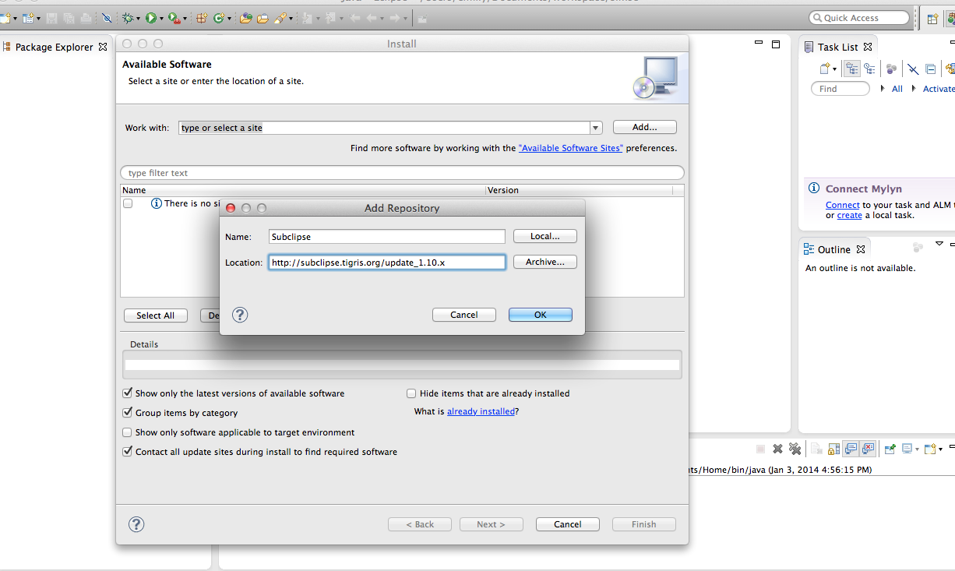
Detailed Checkout Instructions
Click “Add Site”; enter name “Subclipse”; enter location http://subclipse.tigris.org/update_1.10.x

Slide 22
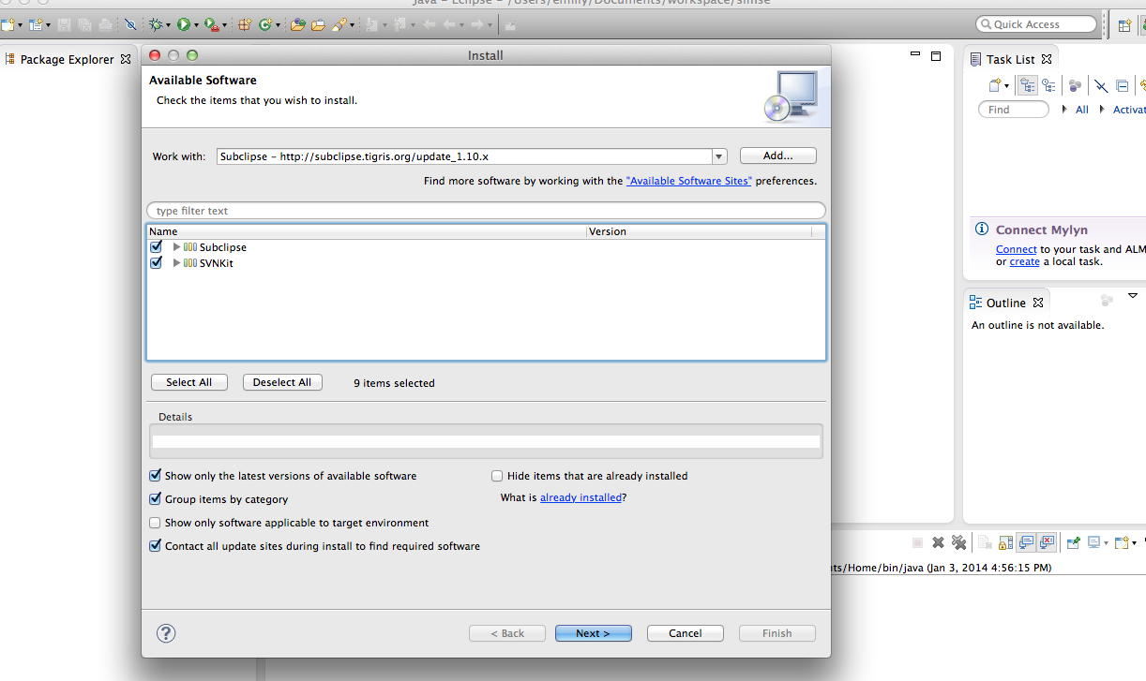
Detailed Checkout Instructions
Hit “OK”; Check the Subclipse main box (also check the SVNKit main box for Mac); Hit “Next”

Slide 23
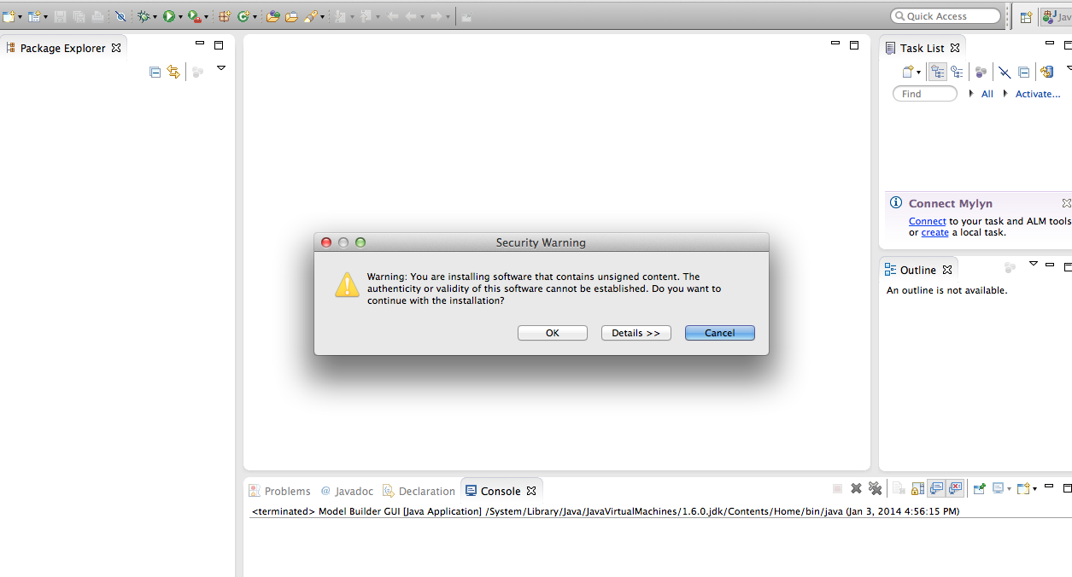
Detailed Checkout Instructions
Agree to all licenses; let the libraries download; click “OK” at this dialogue box

Slide 24
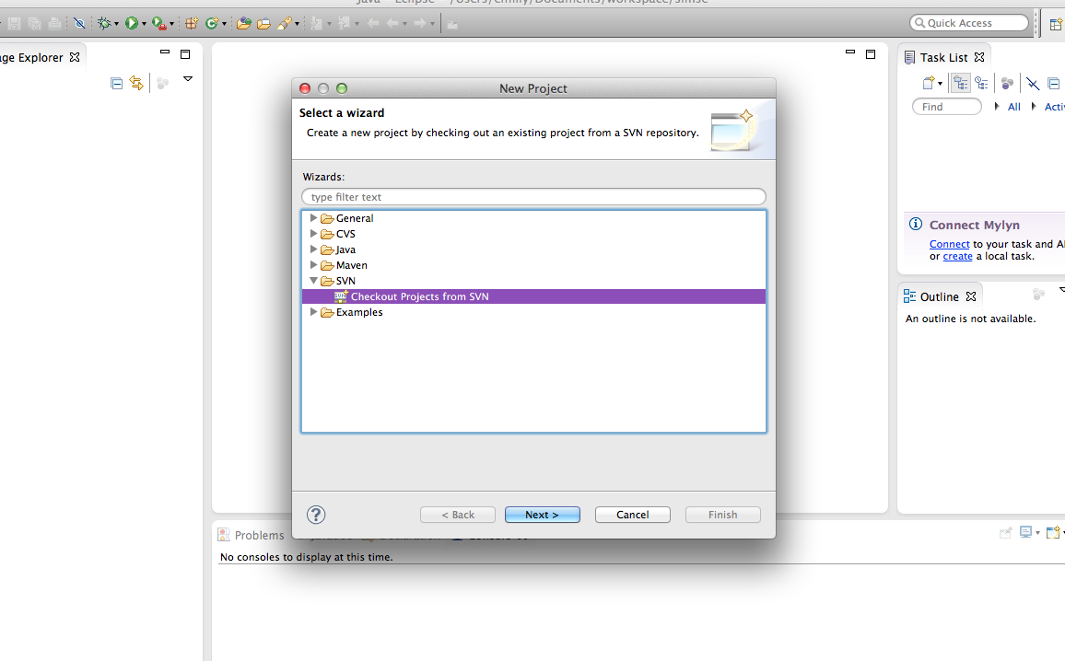
Detailed Checkout Instructions
Make a new Project (NOT Java Project) and choose this:

Slide 25
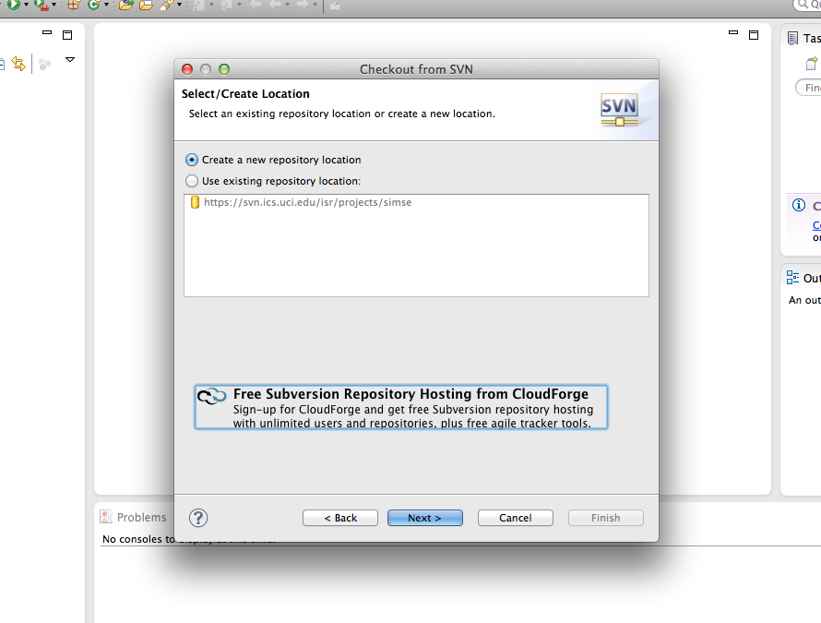
Detailed Checkout Instructions
Make a new repository location

Slide 26
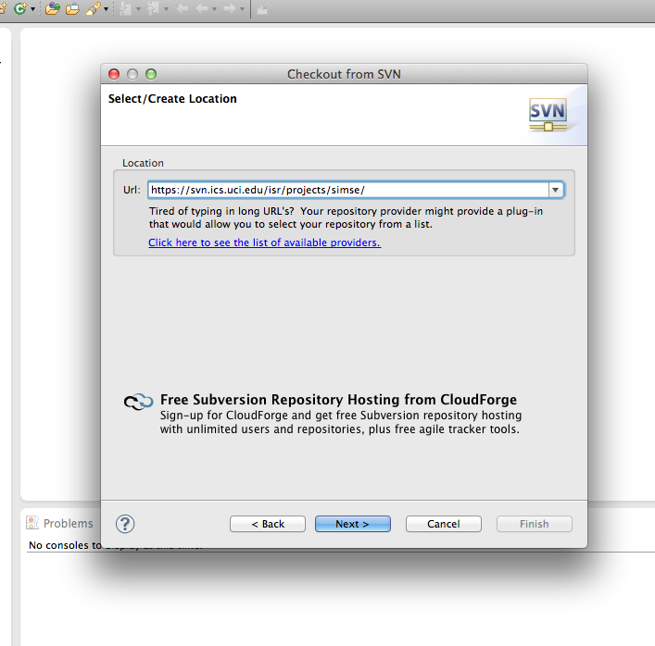
Detailed Checkout Instructions
Enter “https://svn.ics.uci.edu/isr/projects/simsepatterns/” and hit “Next”

Slide 27
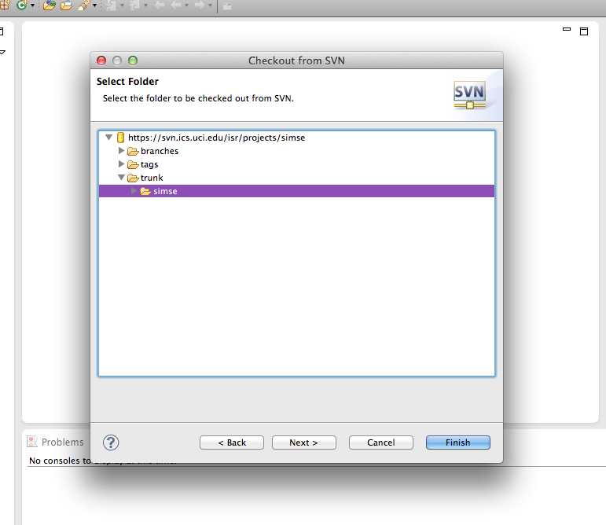
Detailed Checkout Instructions
Select the “simsepatterns” folder and click “Next” (NOT “Finish”)

Slide 28
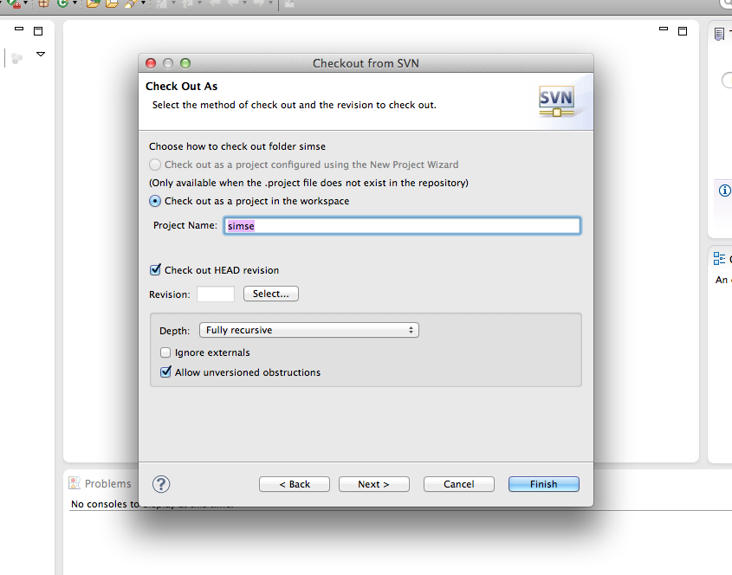
Detailed Checkout Instructions
Check it out in the workspace; give it a name; click “Finish”

Slide 29
Tips
If you are prompted for a username and password, use:
  username: informatics122
  password: simse2014
If you receive any SSL certificate errors, you can safely ignore them
Check out the docs folder included with the download for helpful manuals about how to use SimSE and its tools
  Also see papers on my Website, SimSE Website as mentioned earlier

Slide 30
Team Assignments
Team 1
Erick Kusnadi
Gabriel Blanco
Jason Heckard
Marwan Nazadna
Joseph Lee
Team 2
Anh Nguyen
Luke Fiji
Lamar West
Yang Jiao
Patrick Pan
Team 3
David Lepe
Jason Chiu
Mudassir Mayet
Faraz Ahmad
Anni Liu
Team 4
Alexis Hoshino
Phuong Ho
Tristan Biles
Cheng Zhao
Nathaniel Woo
Team 5
Daniel Yang
Evelyn Luu
Enrique Sandoval
Christian Hernandez
Heath Sias

