Slide 1
Informatics 122 Software Design II
Lecture 9
Emily Navarro
Duplication of course material for any commercial purpose without the explicit written permission of the professor is prohibited.

Slide 2
Today’s Lecture
Component reuse
Assignment 5

Slide 3
Component Reuse – Avoiding “Reinventing the Wheel”
Component reuse is using an already-developed piece of software (usually from a third-party) to provide some type of functionality to your system
rather than developing the functionality yourself from scratch
A true software component is one that has been specifically designed to be reusable
e.g., library, API
Notes:
Library: Collection of all classes and methods stored for re-usability
API: Part of library classes and methods which can be used by a user in his/her code.
A Framework is a larger concept - it will normally contain a number of libraries and APIs to perform common tasks. It exists on a higher conceptual level - it's not just a collection of tools, but also a collection of design patterns, best practices, and methodologies.

Slide 4
A Critical Design Tradeoff
build (and thus design)
buy or get for free (and thus fit into a design)

Slide 5
A Critical Design Tradeoff: Benefits
full control
full understanding flexibility competitive advantage
can be instantaneous
external support
quality
standardization
build (and thus design)
buy or get for free (and thus fit into a design)
Notes:
quality: reused code is often tested code
standardization e.g., maintaining look and feel using widgets

Slide 6
A Critical Design Tradeoff: Drawbacks
build (and thus design)
buy or get for free (and thus fit into a design)
time cost
maintenance
licensing lack of customizability obsolescence urgent bugs
evaluation cost

Slide 7
A Critical Design Tradeoff
full control
full understanding flexibility competitive advantage
can be instantaneous
external support
quality
standardization
build (and thus design)
buy or get for free (and thus fit into a design)
time cost
maintenance
licensing lack of customizability obsolescence urgent bugs evaluation cost

Slide 8
Our Focus Today
full control
full understanding flexibility competitive advantage
can be instantaneous external support
quality
build (and thus design)
buy or get for free (and thus fit into a design)
time cost
maintenance
licensing lack of customizability obsolescence urgent bugs evaluation cost

Slide 9
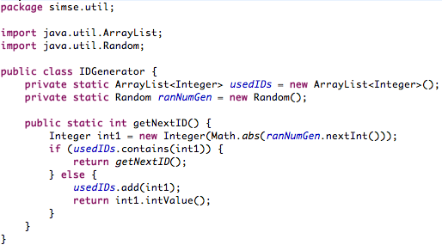
You Practice Software Reuse All The Time!
Notes:
Esp in a language like Java where the language is basically a framework and everything is an object.
Not only in ArrayList, Integer, Random, Math.abs, also in the sheer act of creating a function and calling it in multiple places.

Slide 10
Different Levels of Reuse Granularity
Lines of code
Functions/methods/procedures
Classes (inheritance), interfaces/templates
Modules/Components
Packages
Frameworks
Subsystems
Entire programs
Notes:
components are generally executable and do not need to be compiled. they provide a service independently of the rest of a system
Today, we are focusing on the lower half of the list

Slide 11
A New Kind of Design Decision
Less fine control
More learning and using and applying
Similar to recovery

Slide 12
Architectural Mismatch
Architectural mismatch stems from mismatched assumptions a reusable component makes about the system structure of which it is to be part
Components
functionality
interfaces
behavior
control model
Connectors
protocols
data model
System topology
Construction
dependencies
initialization
Non-functional qualities
e.g., scalability
Difficult to predict a-priori
Notes:
e.g., you want your db to scale to 100,000s of items but the component only scales to 10,000s

Slide 13
Architectural Mismatch
Architectural mismatch stems from mismatched assumptions a reusable component makes about the system structure of which it is to be part
Components
functionality
interfaces
behavior
control model
Connectors
protocols
data model
System topology
Construction
dependencies
initialization
Non-functional qualities
e.g., scalability
How much adaptation is too much adaptation?
Notes:
No real answer… there may come a point in your integration process that you realize it would be better to build it yourself. But hopefully you have come to this point earlier, during the evaluation process.

Slide 14
Architectural Mismatch can Break your System!
In 1996, the first test flight of the Ariane 5 rocket ended in disaster when the launcher went out of control 37 seconds after take off.
The problem was due to a reused component from a previous version of the launcher (the Inertial Navigation System) that failed because assumptions made when that component was developed did not hold for Ariane 5.
The functionality that failed in this component was not required in Ariane 5.

Slide 15
Component Reuse Process
identify preliminary architecture
identify potential places for reuse
establish selection criteria (per place)
update architecture
select component
evaluate components
search for applicable components

Slide 16
Identify Preliminary Architecture
Largely as usual
Familiarity with certain reusable components may influence the architectural choices being made

Slide 17
Identify Potential Places for Reuse
There are components for just about anything
graph layout
database access
regular expression handling
numerical computing
protein visualization
speech recognition
e-mail handling
index and search
maps
geocoding
…
Judiciously mark the architecture in terms of where reusable components may fit in

Slide 18
Establish Selection Criteria (Per Place)
What kind of component does the architecture really need?
functionality
absolutely necessary versus desired functionality
software qualities
How is the component to fit with the rest of the architecture?
some adaptation can be accommodated
Investment
cost
future cost
Reputation
component provider
component itself
Platform, deployment needs, licensing terms, documentation, help available, user base, usability, security, speed, space, stability, portability, scalability…
Notes:
security, speed, space, stability, usability, portability, scalability…

Slide 19
Search for Applicable Component
Google is a wonderful thing
www.google.com
code.google.com
Component repositories
rich in available components
many junk
some decent
occasional gems
Research and professional development literature
Too many is no good
Too few is no good either
although one perfect component would solve the problem

Slide 20
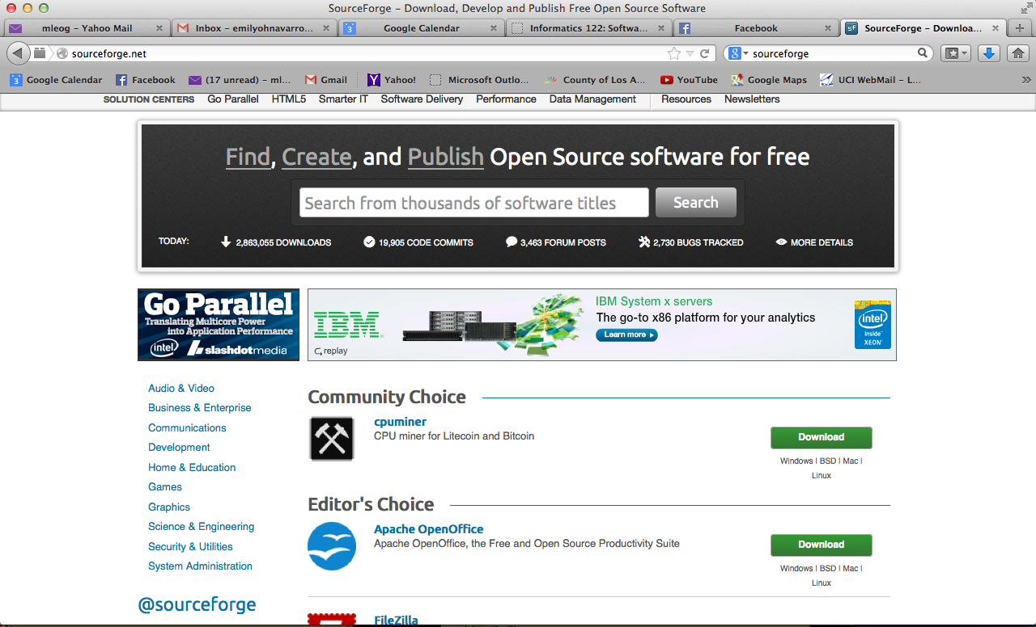
sourceforge.net

Slide 21
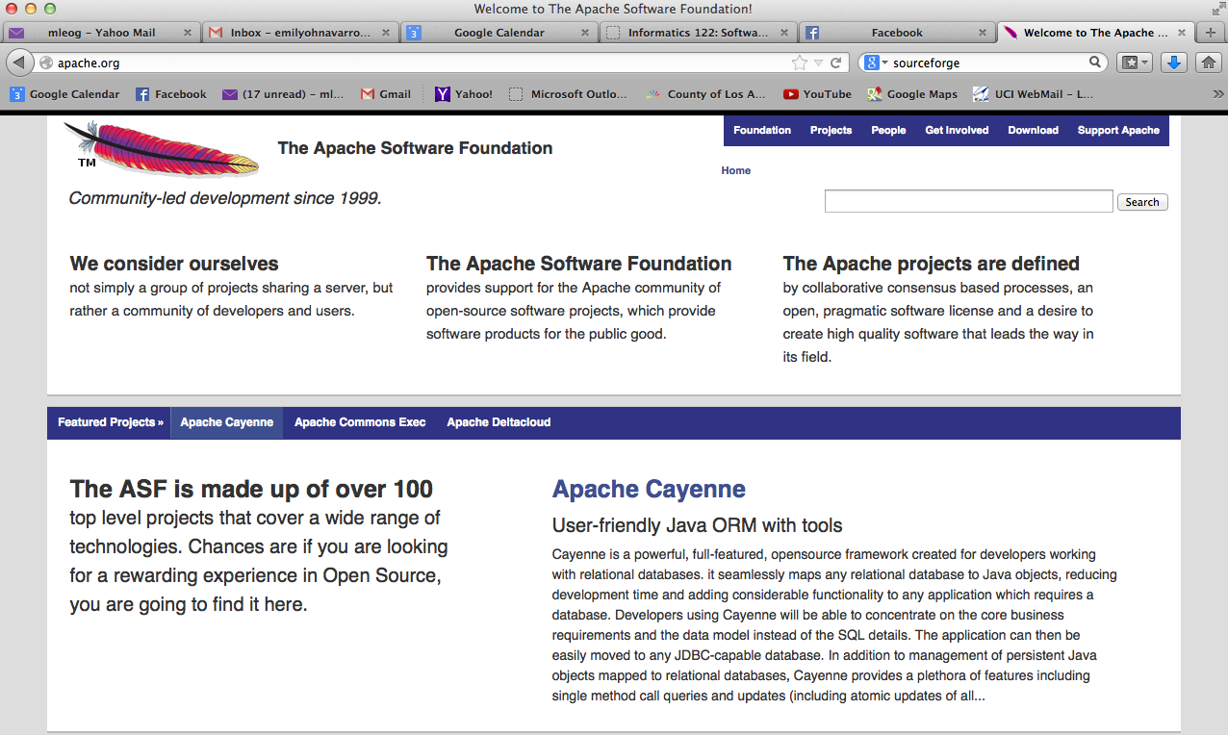
apache.org

Slide 22
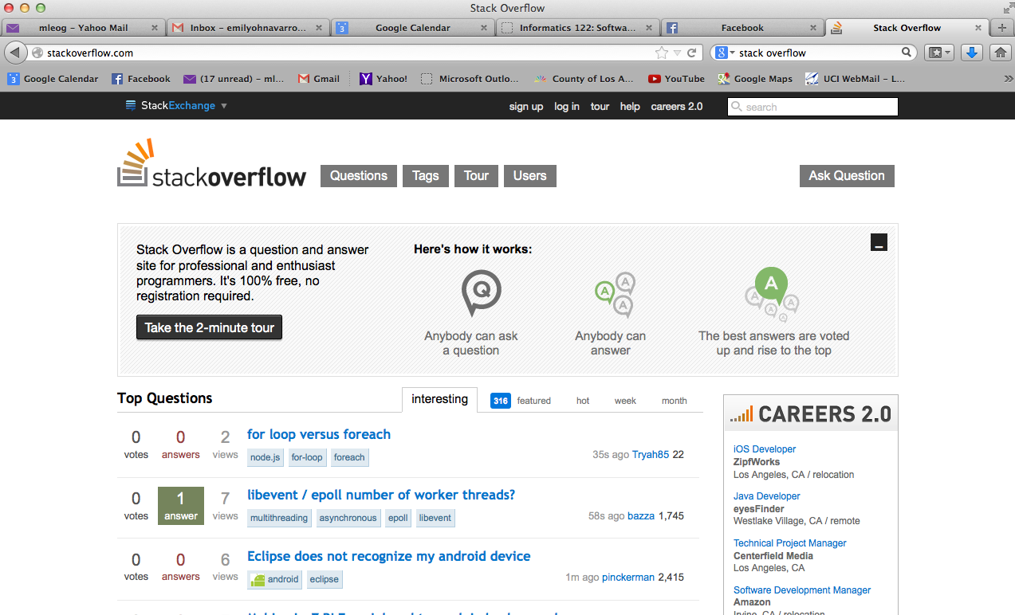
stackoverflow.com
Notes:
can look at if people on SO answer questions about this component, bc if they do then there are more people that are using it

Slide 23
Evaluate Components
Apply selection criteria to each of the components found
matrix of criteria versus component
 | Criteria 1 | Criteria 2 | Criteria 3 | Criteria 4 | Criteria 5
Component A
Component B
Component C
Component D
Component E

Slide 24
Evaluate Components
Additional approaches
trial/evaluation licenses
reading component code
examine sample programs using the component
writing code using the component
Examine the component’s documentation
Analyze architectural impact of the component
Perhaps even “mini integrate” the component

Slide 25
Select Component
Choose the optimum component
understand tradeoffs
be prepared to not choose a component

Slide 26
Update Architecture
Design any adapters necessary to fit the component
Redesign other components as needed
Restructure architecture as needed
Consider implementers
special role for documentation

Slide 27
A Quick Sample Among the Graduate Students
Xalan
Xerces
Lucene
Jung
Kaffe
Bcel
Equip
Jloox
Schematron
GraphViz
Jython
Jgraph
Scriptalicious
Xacml
SWT
JOAL
Jetty
Batik
JmDNS
Darwin Streaming Server
Spook
Mplayer
MySQL
live.com RTP/RTSP
gaim im client
…

Slide 28
Assignment 5

