Slide 1
Informatics 43 – October 2, 2014
Lecture 0-1
Emily Navarro

Slide 2
Today’s Lecture
Course introduction
Getting to know each other
Introduction to software engineering
Software is everywhere
What is software engineering?

Slide 3
Today’s Lecture
Course introduction
Getting to know each other
Introduction to software engineering
Software is everywhere
What is software engineering?

Slide 4
Course Basics
Course: Informatics 43 – Introduction to Software Engineering
Professor: Emily Navarro (emilyo@uci.edu)
Lecture: T Th 5-6:20pm, ELH 100
Discussion: Fridays
Starting in week 1
Course Website: http://www.ics.uci.edu/~emilyo/teaching/info43f2014/index.html

Slide 5
Teaching Staff
Professor: Emily Navarro
TAs
Rohan Achar
Anirudh Sethi
Readers
Yang Feng
Wen Shen
Consuelo Lopez

Slide 6
Course Basics (II)
My office hours
Before or after lecture, by appointment
TA office hours
TBD
Questions and announcements
Email or in class
Class email list
Required textbook
Tsui, Karam, Bernal, "Essentials of Software Engineering," Third Edition

Slide 7
Quizzes
6 quizzes, most Thursdays (see schedule)
Usually held from 6:05-6:20
Additional quizzes may be given without prior notice, and the time and length of the quizzes may change
Quiz answers will be given orally, in class, each Tuesday after a quiz

Slide 8
Grading (I)
Quizzes: 11% (total for all quizzes; each student's lowest quiz score will be dropped)
Test 1: 20%
Test 2: 30%
Three homeworks: 36% (12% each)
Class attendance and participation: 3%
Submitting the EEE course evaluation: 0.5% extra credit

Slide 9
Grading (II)
Performed by TA/reader and professor
Resolve disagreements with the TA/reader first

Slide 10
Cheating
DON’T DO IT!!
Plagiarism = presenting someone else’s work as your own
All assignments are checked thoroughly for plagiarism
Plagiarism consequences
Fail the course
Offense recorded with Student Affairs

Slide 11
Late Work
Late work will not be accepted
Truly extenuating circumstances will be evaluated on a case-by-case basis
Must provide official documentation (e.g., doctor’s note)
Exceptions only granted by the professor
Contact professor as soon as possible
Contact professor with valid reasons

Slide 12
Questions
When in doubt
ask the TA (or reader)
ask the professor(s)
E-mail questions
address properly
sign with your name
answers are (generally) copied to everybody

Slide 13
Rules for Success in Info 43 (I)
Attend every lecture
Take notes
Many quiz and test questions will be drawn from lecture material
Complete the assigned readings
Take notes
Many quiz and test questions will be drawn from readings
Notes:
This is a non-technical course that deals with “fuzzy” concepts so follow the rules, different from other CS courses
Assigned readings both textbook and non-textbook. Non-textbook ones may be challenging so allow sufficient time

Slide 14
Rules for Success in Info 43 (II)
Check your UCI email daily
Primary method of class announcements outside of lecture
Work hard throughout the quarter
Not just at the end!
Notes:
You will be held responsible for all information distributed in this way
Don’t come to me in week 9 and ask what you can do to improve your grade. It will be too late.

Slide 15
Today’s Lecture
Course introduction
Getting to know each other
Introduction to software engineering
Software is everywhere
What is software engineering?

Slide 16
Who am I?

Slide 17
Who are you?
What year of college is this for you?
Notes:
1, 2nd, 3rd, 4th, 5th or more

Slide 18
Who are you?
What is your major?
Notes:
CS, CGS, or ICS
Informatics, Software Engineering, BIM
Engineering or Physical Sciences
Other sciences
Humanities, Social Sciences, Social Ecology, Arts

Slide 19
Who are you?
How much do you love software engineering already?
Notes:
Scale from 1 to 5

Slide 20
Today’s Lecture
Course introduction
Getting to know each other
Introduction to software engineering
Software is everywhere
Definitions

Slide 21
Today’s Lecture
Course introduction
Getting to know each other
Introduction to software engineering
Software is everywhere
What is software engineering?

Slide 22
Software is everywhere: cars
http://spectrum.ieee.org/green-tech/advanced-cars/this-car-runs-on-code/
“New cars now frequently carry 200 pounds of electronics and more than a mile of wiring”
“…if you bought a premium-class automobile recently, it probably contains close to 100 million lines of software code…”

Slide 23
Software is everywhere: cars
“The radio on many cars talks to the automatic transmission over an in-car network”
“The airbag accelerometer, parking lights, GPS navigation, cell phone, and door locks also network so that in a serious accident, the car calls for emergency aid, sends the GPS coordinates of the accident, unlocks the doors, and flashes the car’s lights”
Notes:
Your life depends on SW!

Slide 24
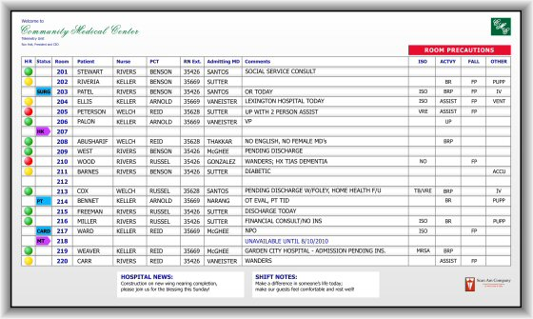
Software is everywhere: medical systems
Notes:
Your life depends on SW!

Slide 25
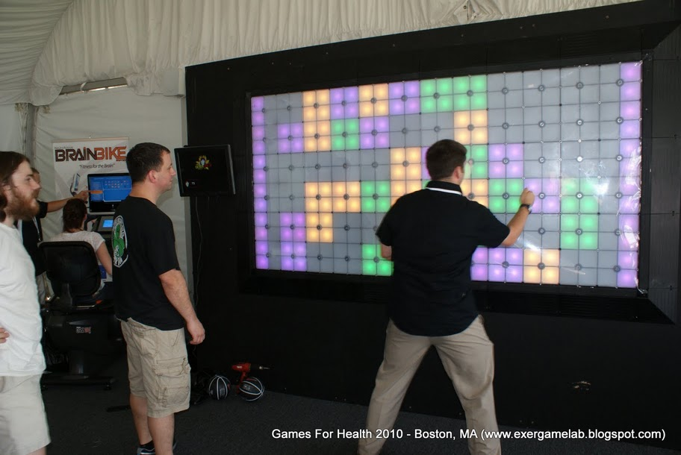
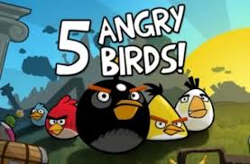
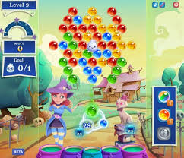
Software is everywhere: games

Slide 26
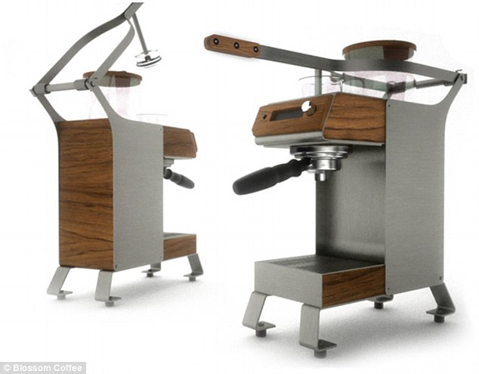
Software is everywhere: bonus

Slide 27
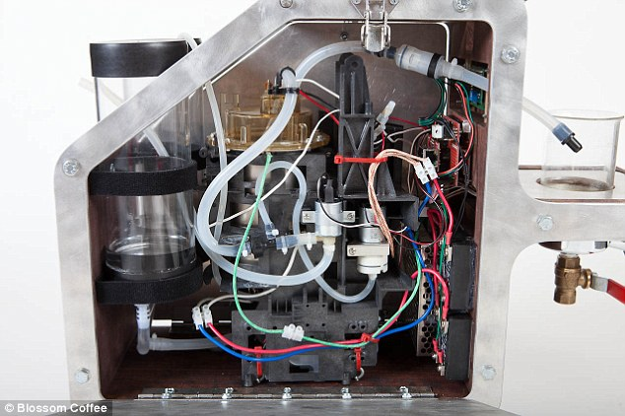
Software is everywhere: bonus
The machine also connects to WiFi and has a camera for a QR scanner. They hope that some day, coffee bags will have a QR code that the machine will recognize and brew appropriately.

Slide 28
Today’s Lecture
Course introduction
Getting to know each other
Introduction to software engineering
Software is everywhere
What is software engineering?

Slide 29
What is Software Engineering?
Software –
Engineering -
Notes:
History of SE: 1968 NATO conference. hardware development accelerating, opportunity to build more complex SW, many of these projects were failing, recognized the need for a structured discipline for creating these larger, more complex SW systems

Slide 30
What is Software Engineering?
Software –
Engineering -
Code
Documentation, user manuals
Designs, specifications
Test cases
Plans and schedules

Slide 31
What is Software Engineering?
Software –
Engineering -
Code
Documentation, user manuals
Designs, specifications
Test cases
Plans and schedules
Skill and knowledge
Application of scientific principles
Trade-offs, cost / benefit analysis
Notes:
Application: taking basic research and making things people want to use or purchase
All of these points are used to make software

Slide 32
Software engineering
“A broad field that touches upon all aspects of developing and supporting a software system.” [Tsui, Karam, Bernal]

Slide 33
Software engineering
“A broad field that touches upon all aspects of developing and supporting a software system.” [Tsui, Karam, Bernal]

Slide 34
Software engineering
“A discipline that deals with the building of software systems which are so large that they are built by a team or teams of engineers.” [Ghezzi, Jazayeri, Mandrioli]

Slide 35
Software engineering
“A discipline that deals with the building of software systems which are so large that they are built by a team or teams of engineers.” [Ghezzi, Jazayeri, Mandrioli]

Slide 36
Software engineering
“Multi-person construction of multi-version software.” [Parnas]
Notes:
multi-person: client, programmers, consumers, management, teams of developers, etc.
multi-version (why do they exist): improve sw, fix bugs, expand number of applications, update UI to match trends of what people like, need to make a deadline, different Oss, different price points (students vs. companies, free version vs. paid version), diff features on diff versions to test out which features are better, specific feature(s) added at the request of a specific client, localization (e.g., french version, currencies)
Why is multi-version necessary? Thinking about client’s needs. This changes the way you develop software.

Slide 37
Software engineering
“Multi-person construction of multi-version software.” [Parnas]
Notes:
multi-person: client, programmers, consumers, management, teams of developers, etc.
multi-version (why do they exist): improve sw, fix bugs, expand number of applications, update UI to match trends of what people like, need to make a deadline, different Oss, different price points (students vs. companies, free version vs. paid version), diff features on diff versions to test out which features are better, specific feature(s) added at the request of a specific client, localization (e.g., french version, currencies)
Why is multi-version necessary? Thinking about client’s needs. This changes the way you develop software.

Slide 38
Software engineering
“A discipline whose aim is the production of fault-free software, delivered on-time and within budget, that satisfies the user’s needs. Furthermore, the software must be easy to modify when the user’s needs change.” [Schach]

Slide 39
Software engineering
“A discipline whose aim is the production of fault-free software, delivered on-time and within budget, that satisfies the user’s needs. Furthermore, the software must be easy to modify when the user’s needs change.” [Schach]
Notes:
not if the user’s needs change. When they change. They change all the time. Before, during, and after development.

Slide 40
What is Software Engineering?
Informatics 43:
The process of constructing software.
Phases of development other than programming.
Principles and qualities of enduring value.

Slide 41
What is Software Engineering?
Informatics 43:
The process of constructing software.
Phases of development other than programming.
Principles and qualities of enduring value.
Also of (lesser) interest (in this course):
Managing & scheduling software development teams.
Making money – business models.
Software’s impact on users, organizations, and society.

Slide 42
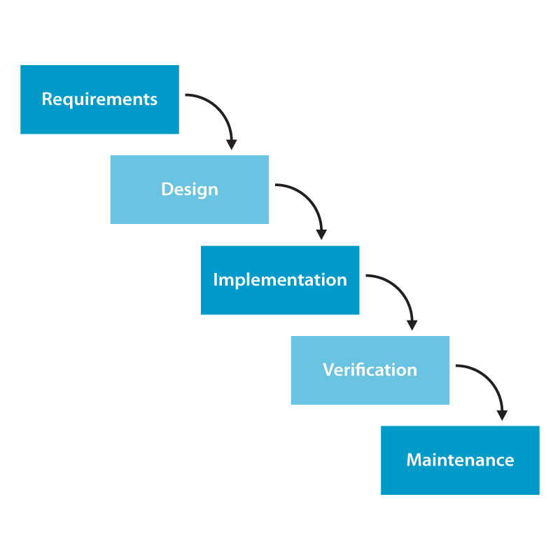
What is Software Engineering?
The process of constructing software.
Notes:
waterfall model: idealization of how things work; not necessarily used in practice
design: structure of the sw
now this is mainly just a summary of the five major types of tasks in SE, not necessarily in this sequential order
other popular methods: prototype, agile: quick requirements, no design, quick implementation w/ verification

Slide 43
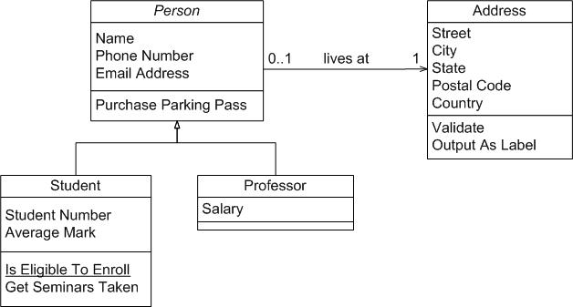
What is Software Engineering?
Phases of development other than programming.
Design:

Slide 44
What is Software Engineering?
Principles and qualities of enduring value.
Reliability
Correctness!
MODULARITY
Adaptability
Efficiency
Consistency
Notes:
Correctness, i.e., correct math
reliability: doesn’t crash, no unexpected glitches
adaptability: works on other Oss, easily maintained and fixed and understandable to other programmers
modularity: take something complicated and break down into smaller, more manageable parts, different modules are designed not to interfere w/ each other (e.g., wheels of car and electrical system) i.e., OO programming – separating a large program into classes;
consistency: between different parts of sw, visual, other sw, features
efficiency: uses resources, e.g., memory, well

Slide 45
Next Time
What is software engineering?
Brooks’ “No Silver Bullet”
Complete assigned readings before Tuesday

