Slide 1
Informatics 43
Introduction to Software Engineering
Lecture 3-2
October 23, 2014
Emily Navarro
Duplication of course material for any commercial purpose without the explicit written permission of the professor is prohibited.
Notes:
Announce change in format for requirements section

Slide 2
Today’s lecture
More essential characteristics of software engineering
Software architecture
Software evolution
Some slides adopted and adopted from “Software Architecture: Foundations, Theory, & Practice” by Taylor, Medvidovic, and Dashofy

Slide 3
Today’s lecture
More essential characteristics of software engineering
Software architecture
Software evolution

Slide 4
More Essential Characteristics
Software engineering concerns the development of large programs
The central theme is mastering complexity
The efficiency with which software is developed is of crucial importance
Software evolves
Regular cooperation between people is an integral part of programming-in-the-large
The software has to support its users effectively
Software engineering is a field in which members of one culture create artifacts on behalf of members of another culture
Software engineering is a balancing act

Slide 5
Three “Essential Ingredients” of Software Engineering
People
  who else would do the work?
  range from novice to very experienced
Processes
  to organize and manage the efforts of individuals
  range from informal to very formal
Tools
  to support the people and the processes
  range from simple to very advanced

Slide 6
People
The single most important factor in the success/failure of a product
Scarce resource
  quality
  suitability
  cost
Many different kinds of people
  managers
  programmers
  technical writers

Slide 7
Processes
Essential to achieve a quality product
Scarce resource
  quality
  suitability
  cost
Many different kinds of processes
  bug tracking
  change approval
  quality assurance

Slide 8
Tools
Needed to support people and processes
Scarce resource
  quality
  suitability
  cost
Many different kinds of tools
  drawing
  analysis
  project management
  source code management

Slide 9
Programming versus software engineering
Small project | Large to huge project
You | Teams
Build what you want | Build what they want
One product | Family of products
Few sequential changes | Many parallel changes
Short-lived | Long-lived
Cheap | Costly
Small consequences | Large consequences
Programming
Software engineering

Slide 10
Today’s lecture
More essential characteristics of software engineering
Software architecture
Software evolution

Slide 11
Software architecture
Requirements
Code

Slide 12
Software architecture
Requirements
Code

Slide 13
An analogy to building architectures
We all live in them
(We think) We know how they are built
  requirements
  design (blueprints)
  construction
  use
This is similar (though not identical) to how we build software

Slide 14
Parallels
Design before build
Satisfaction of customers’ needs
Specialization of labor
Multiple perspectives of the final product
Intermediate points where plans and progress are reviewed

Slide 15
The architect
A distinctive role and character in a project
Very broad training
Amasses and leverages extensive experience
A keen sense of aesthetics
Deep understanding of the domain
  properties of structures, materials, and environments
  needs of customers

Slide 16
Limitations of analogy
Software serves a much broader range of purposes
We know a lot about buildings, much less about software
The nature of software is different from that of building architecture
Software is much more malleable than physical materials
Software is a machine; a building is not

Slide 17
But architecture is still a very powerful tool in software engineering
Giving preeminence to architecture offers the potential for
  intellectual control
  conceptual integrity
  effective basis for knowledge reuse
  effective project communication
  management of a set of variant systems
Limited-term focus on architecture will not yield significant benefits!

Slide 18
Defining software architecture
A software system’s architecture is the set of principal design decisions about the system
Software architecture is the blueprint for a software system’s construction and evolution
Design decisions encompass every facet of the system under development
  structure
  behavior
  interaction
  non-functional properties

Slide 19
“Principal”
“Principal” implies a degree of importance that grants a design decision “architectural status”
  it implies that not all design decisions are architectural
  that is, they do not necessarily impact a system’s architecture
How one defines “principal” will depend on what the stakeholders define as the system goals

Slide 20
Other definitions
Fowler: The highest-level breakdown of a system into its parts; the decisions that are hard to change
Bass, Clements, and Kazman: The structure or structures of a system, which comprises software elements, the externally visible properties of those elements, and the relationships among them
Nataren: The clear definition of multiple components that, when working together, form your system and solve your problem

Slide 21
Email: functional specification
Send and receive messages
Get your own messages, not others’
  Addressing scheme
Store messages
Electronic
Blocks spam

Slide 22
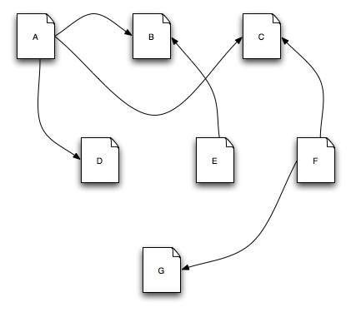
Architecture in action: WWW
This is the Web

Slide 23
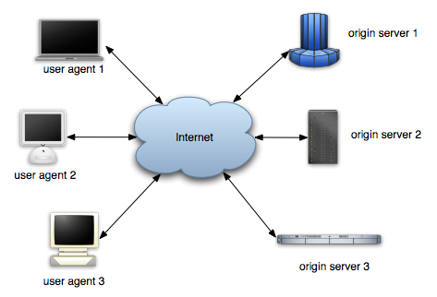
Architecture in action: WWW
So is this

Slide 24
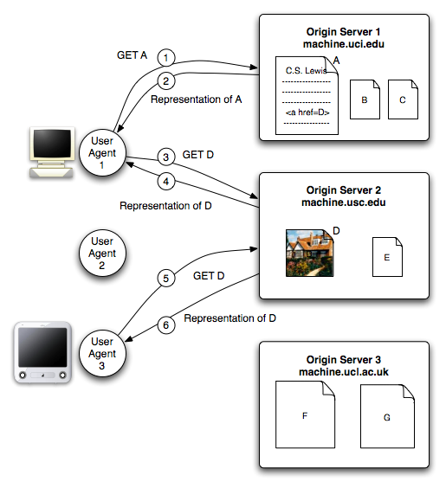
Architecture in action: WWW
And this

Slide 25
WWW in a (Big) Nutshell
The Web is a collection of resources, each of which has a unique name known as a uniform resource locator, or “URL”
Each resource denotes, informally, some information
URI’s can be used to determine the identity of a machine on the Internet, known as an origin server, where the value of the resource may be ascertained
Communication is initiated by clients, known as user agents, who make requests of servers.
  Web browsers are common instances of user agents

Slide 26
WWW in a (big) nutshell (continued)
Resources can be manipulated through their representations
  HTML is a very common representation language used on the Web
All communication between user agents and origin servers must be performed by a simple, generic protocol (HTTP), which offers the command methods GET, POST, etc.
All communication between user agents and origin servers must be fully self-contained (so-called “stateless interactions”)
Notes:
stateless interaction: each request is an independent transaction that is unrelated to any previous request so that the communication consists of independent pairs of request and response.

Slide 27
WWW’s architecture
Architecture of the Web is wholly separate from the code
There is no single piece of code that implements the architecture
There are multiple pieces of code that implement the various components of the architecture
  e.g., different Web browsers

Slide 28
WWW’s architecture (continued)
Stylistic constraints of the Web’s architectural style are not apparent in the code
  the effects of the constraints are evident in the Web
One of the world’s most successful applications is only understood adequately from an architectural vantage point

Slide 29
Software architecture’s elements
A software system’s architecture typically is not (and should not be) a uniform monolith
A software system’s architecture should be a composition and interplay of different elements
  processing
  data, also referred as information or state
  interaction

Slide 30
Software architecture’s elements
A software system’s architecture typically is not (and should not be) a uniform monolith
A software system’s architecture should be a composition and interplay of different elements
  processing
  data, also referred as information or state
  interaction
components
connectors

Slide 31
Components
Elements that encapsulate processing and data in a system’s architecture are referred to as software components
A software component is an architectural entity that
  encapsulates a subset of the system’s functionality and/or data
  restricts access to that subset via an explicitly defined interface
  has explicitly defined dependencies on its required execution context
Components typically provide application-specific services

Slide 32
Connectors
In complex systems interaction may become more important and challenging than the functionality of the individual components
A software connector is an architectural building block tasked with effecting and regulating interactions among components
In many software systems connectors are usually simple procedure calls or shared data accesses
  much more sophisticated and complex connectors are possible
Connectors typically provide application-independent interaction facilities

Slide 33
Examples of connectors
Procedure call connectors
Shared memory connectors
Message passing connectors
Streaming connectors
Distribution connectors
Wrapper/adaptor connectors

Slide 34
Configuration
Components and connectors are composed in a specific way in a given system’s architecture to accomplish that system’s objective
An architectural configuration, or topology, is a set of specific associations between the components and connectors of a software system’s architecture

Slide 35

Example configuration
ship course
procedure call
procedure call
procedure call
ship radar
GPS unit

Slide 36
Prescriptive versus descriptive architecture
A system’s prescriptive architecture captures the design decisions made prior to the system’s construction
  it is the as-conceived or as-intended architecture
A system’s descriptive architecture describes how the system has been built
  it is the as-implemented or as-realized architecture

Slide 37
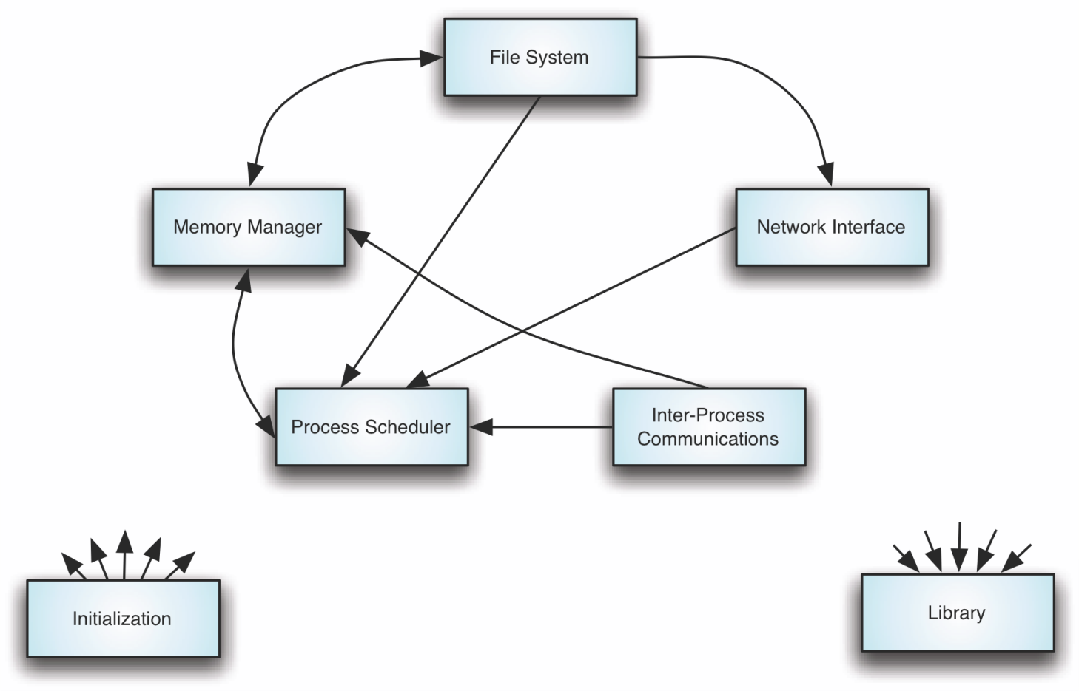
Linux – prescriptive architecture

Slide 38
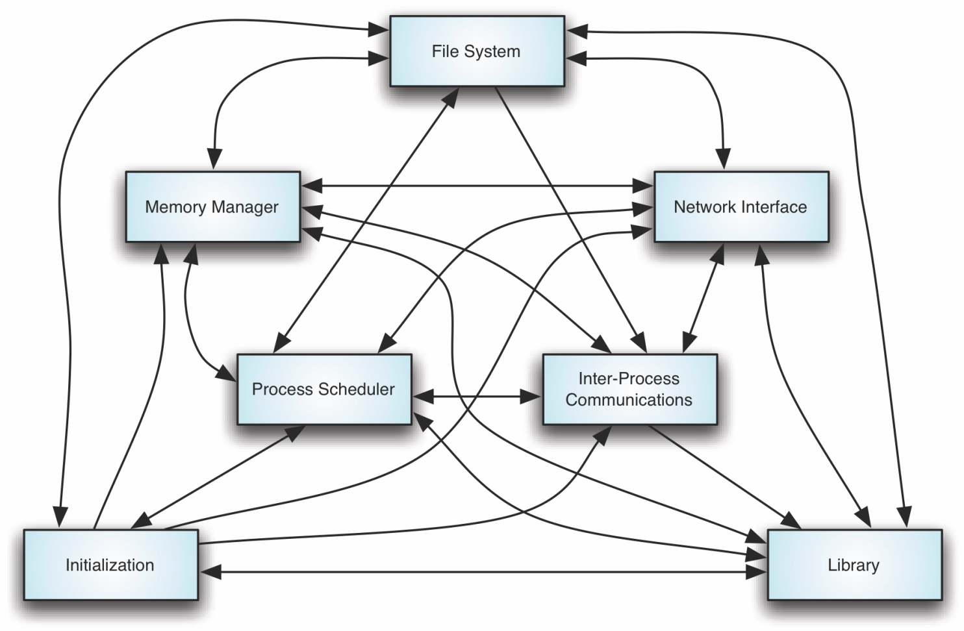
Linux – descriptive architecture

Slide 39
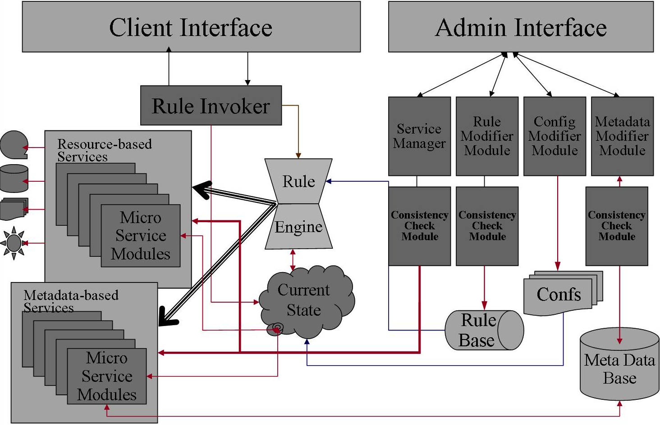
iRODS – prescriptive architecture
Notes:
Open source data management sw

Slide 40
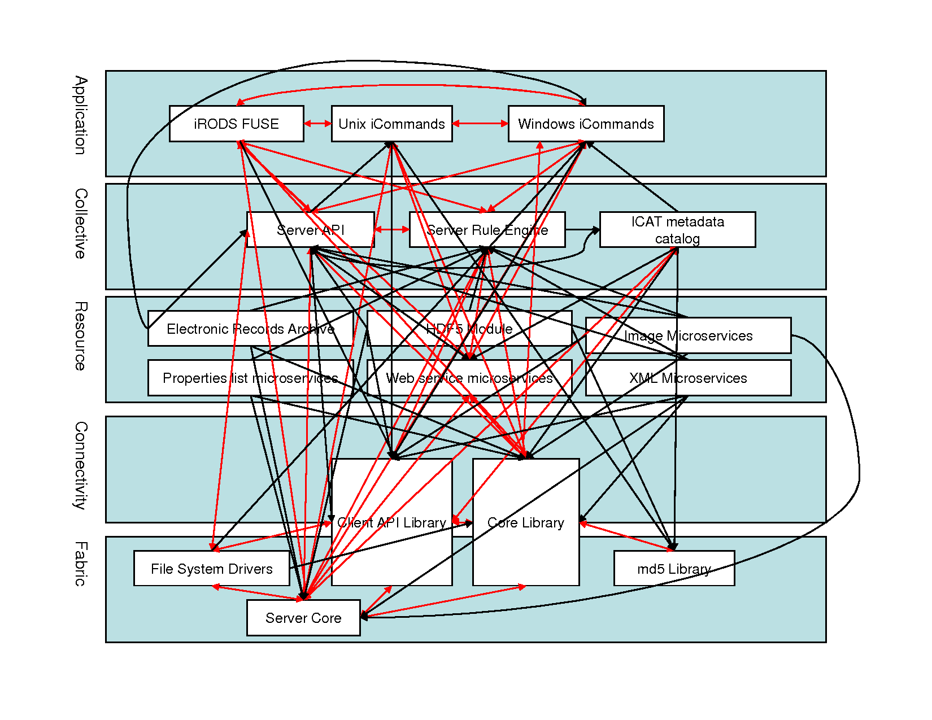
iRODS – descriptive architecture

Slide 41
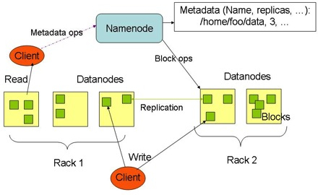
HADOOP – prescriptive architecture

Slide 42
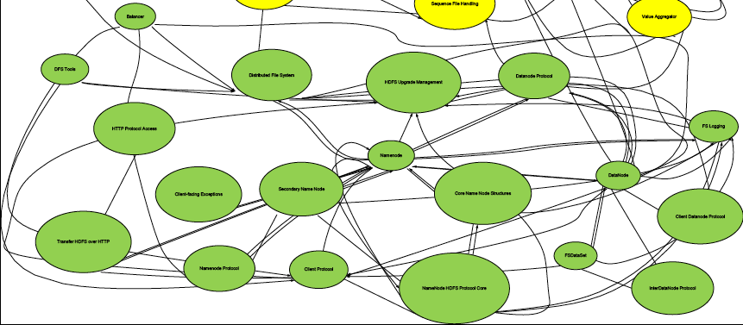
HADOOP – descriptive architecture

Slide 43
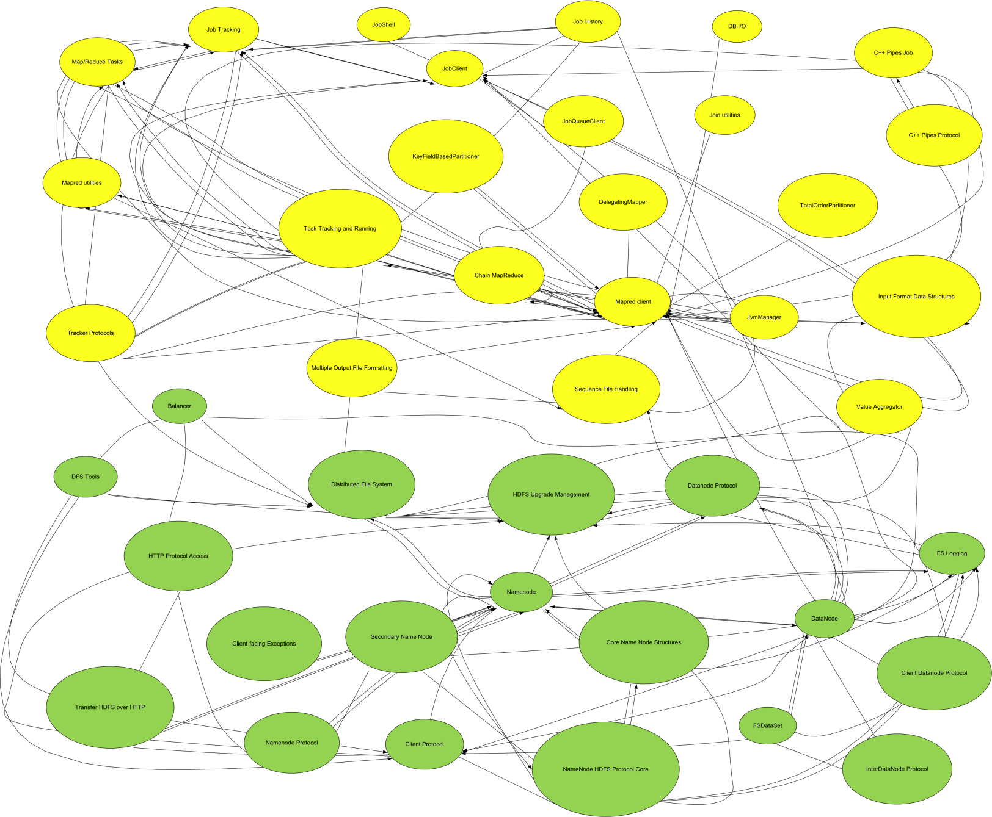
HADOOP + MapReduce

Slide 44
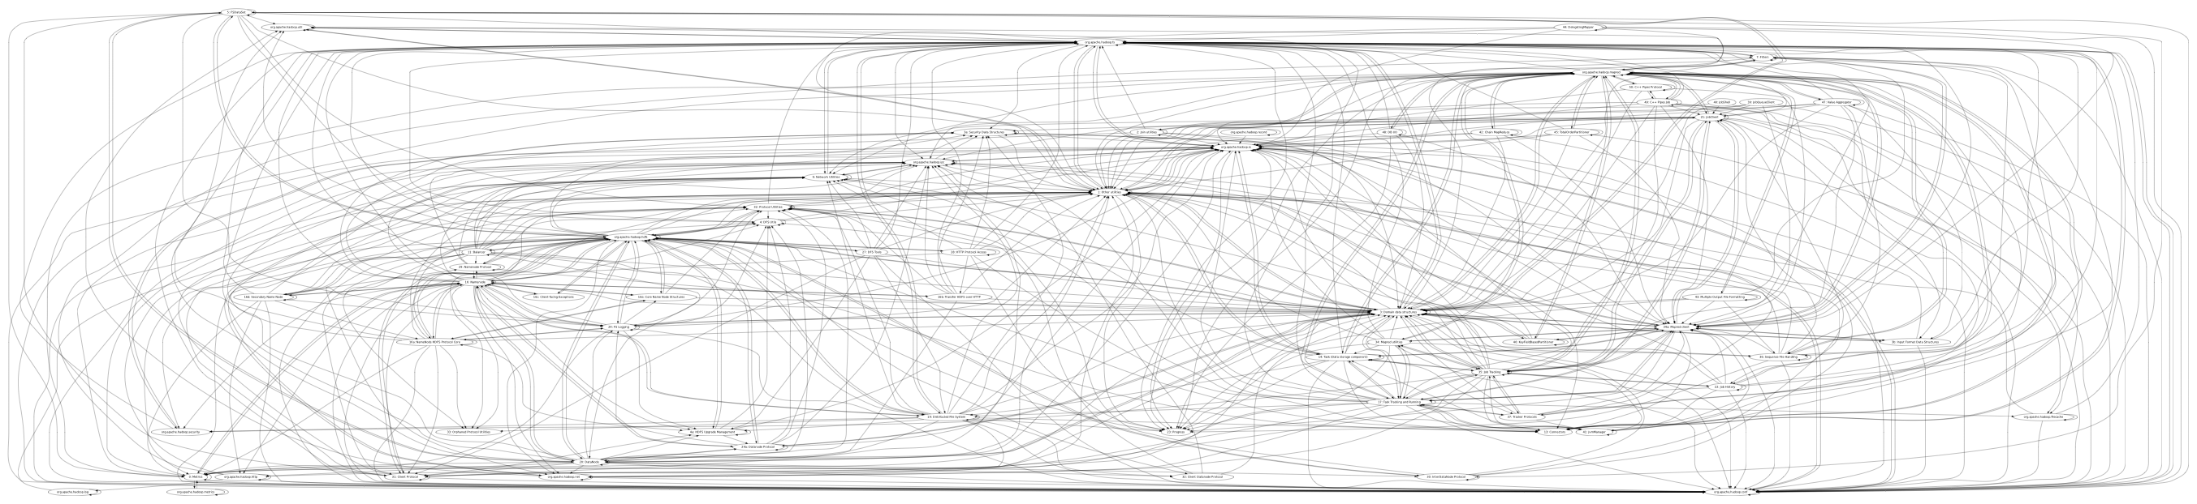
HADOOP – complete architecture

Slide 45
Gap
A gap remains between the prescriptive architecture, which concerns decisions, and the descriptive architecture, which concerns programmatic elements

Slide 46
Architectural evolution
When a system evolves, ideally its prescriptive architecture is modified first
In practice, the system – and thus its descriptive architecture – is often directly modified
This happens because of
  developer sloppiness
  perception of short deadlines which prevent thinking through and documenting
  lack of documented prescriptive architecture
  need or desire for code optimizations
  inadequate techniques or tool support

Slide 47
Today’s lecture
More essential characteristics of software engineering
Software architecture
Software evolution

Slide 48
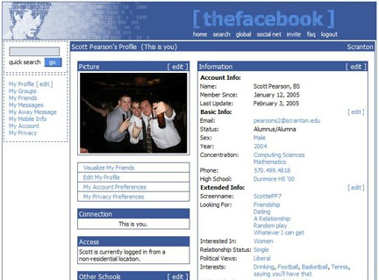
Facebook (2005)
From: http://mashable.com/2011/09/22/facebook-profile-evolution/

Slide 49
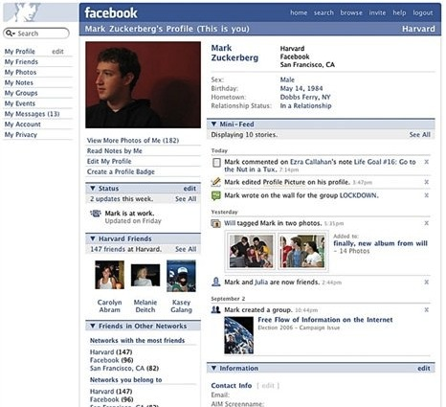
Facebook (2006)

Slide 50
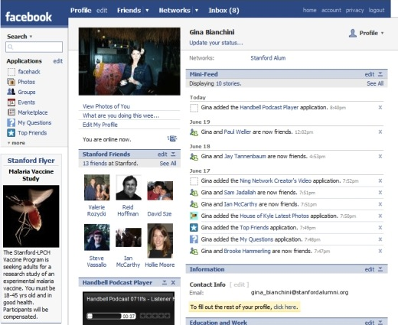
Facebook (2007)

Slide 51
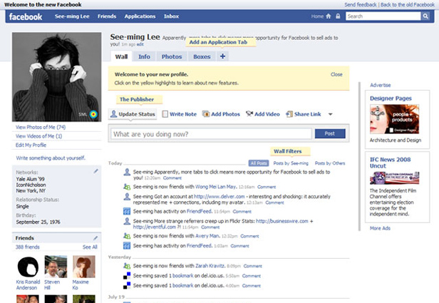
Facebook (2008)

Slide 52
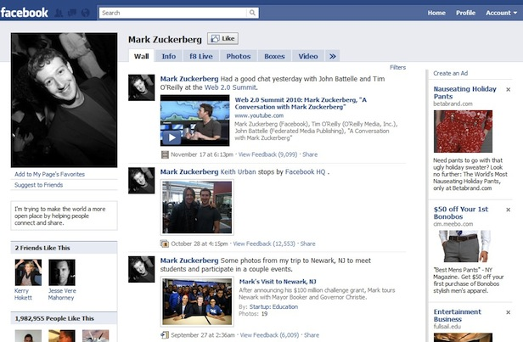
Facebook (2009)

Slide 53
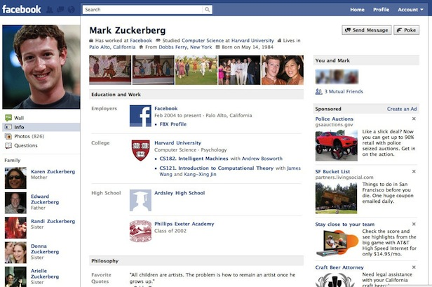
Facebook (2010)

Slide 54
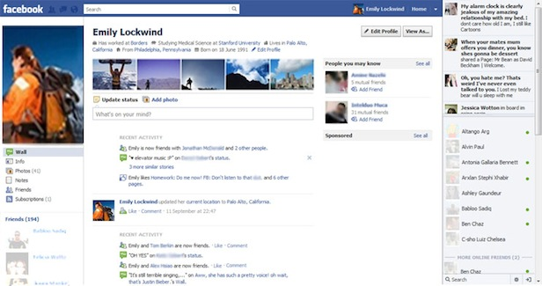
Facebook (2011)

Slide 55
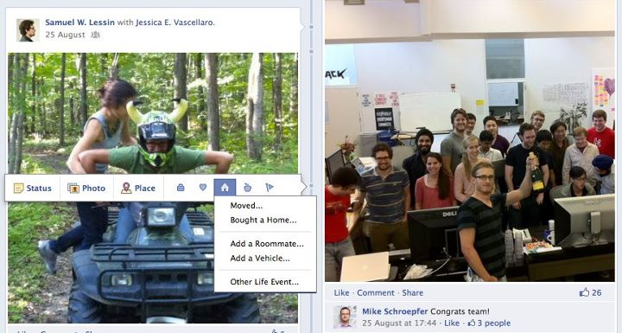
Facebook (2011)

Slide 56

Facebook (2014)

Slide 57
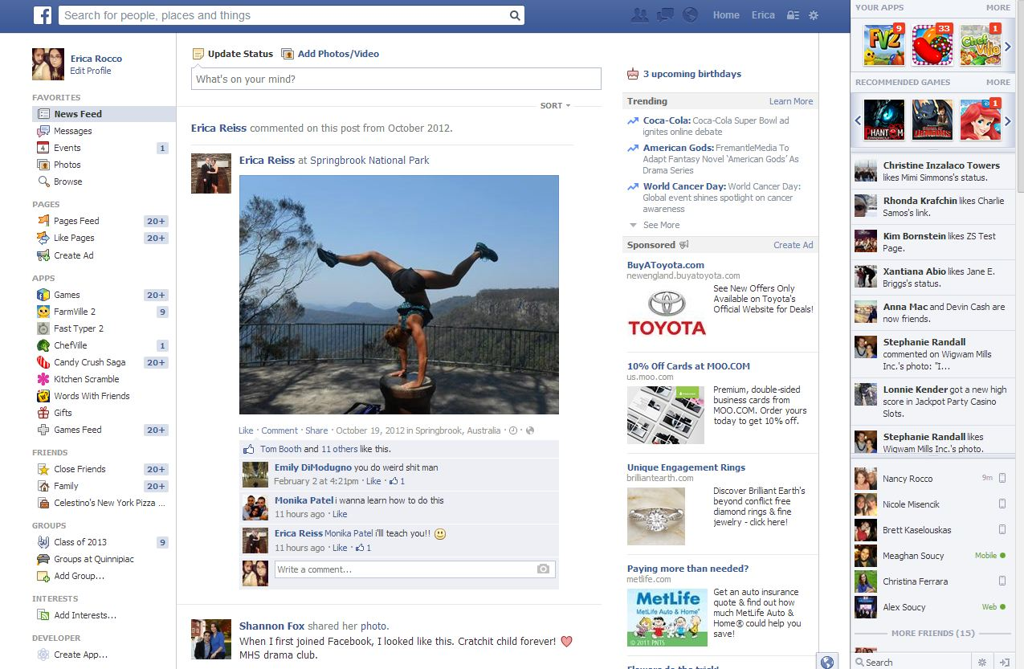
Facebook (2014)

Slide 58
Facebook evolution
User interface
  http://www.grosocial.com/blogposts/Evolution-Facebook-Features
  http://www.youtube.com/watch?v=Nl7igMfeOvo
Architecture
  http://www.infoq.com/presentations/Facebook-Software-Stack
  http://www.infoq.com/presentations/Evolution-of-Code-Design-at-Facebook

Slide 59
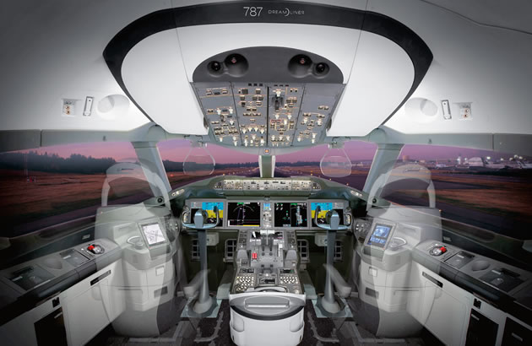
Airplane cockpit (Boeing 787)
From: http://www.boeing.com/commercial/aeromagazine/articles/2012_q1/3/

Slide 60
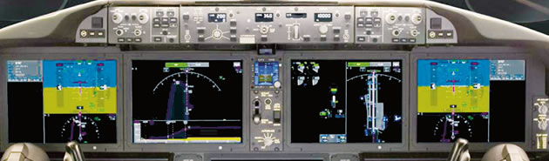
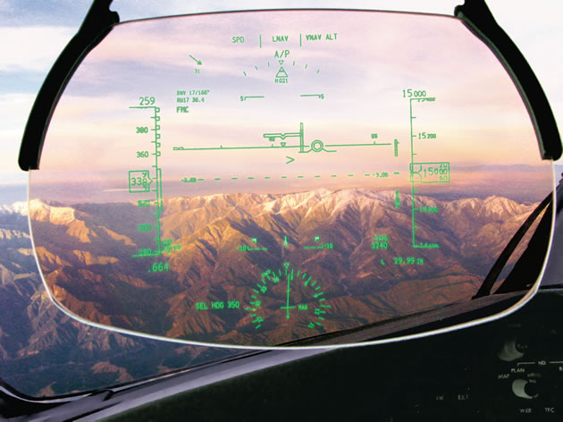
Airplane cockpit (Boeing 787)

Slide 61
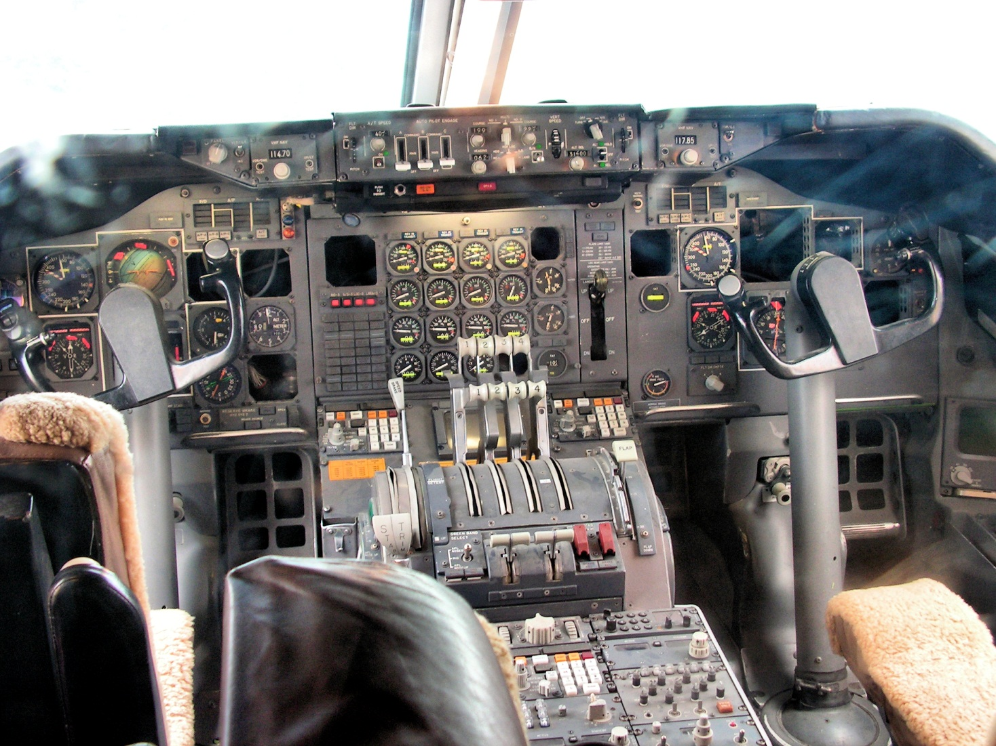
Airline cockpit (Boeing 747)

Slide 62

Airline cockpit (Boeing 747)

Slide 63



Angry Birds

Slide 64
Evolution
Essential part of software development
Must be accommodated as much as possible
Must be planned as much as possible

Slide 65
Next time
More on software architecture
Homework 1 final draft due Tuesday!

