Slide 1
Informatics 43 Introduction to Software Engineering Lecture 4-1
October 28, 2014
Emily Navarro
Duplication of course material for any commercial purpose without the explicit written permission of the professor is prohibited.

Slide 2
Today’s lecture
Quiz Answers
Architectural styles
Evolution
Quiz 3
Some slides adopted and adopted from “Software Architecture: Foundations, Theory, & Practice” by Taylor, Medvidovic, and Dashofy

Slide 3
Today’s lecture
Quiz Answers
Architectural styles
Evolution
Quiz 3

Slide 4
Today’s lecture
Quiz Answers
Architectural styles
Evolution
Quiz 3

Slide 5
Defining software architecture
A software system’s architecture is the set of principal design decisions about the system
Software architecture is the blueprint for a software system’s construction and evolution
Design decisions encompass every facet of the system under development
structure
behavior
interaction
non-functional properties

Slide 6
“Principal”
“Principal” implies a degree of importance that grants a design decision “architectural status”
it implies that not all design decisions are architectural
that is, they do not necessarily impact a system’s architecture
How one defines “principal” will depend on what the stakeholders define as the system goals

Slide 7
Architectural style
Certain design choices regularly result in solutions with superior properties
compared to other possible alternatives, solutions such as this are more elegant, effective, efficient, dependable, evolvable, scalable, and so on
An architectural style is a named collection of architectural design decisions that
are applicable in a given development context
constrain architectural design decisions that are specific to a particular system within that context
elicit beneficial qualities in each resulting system

Slide 8
Architectural style
A pattern of decisions that work well together
A named, commonly used set of components and connectors
Each component/connector has its own job in an architectural style
Notes:
separation of concerns/modularity

Slide 9
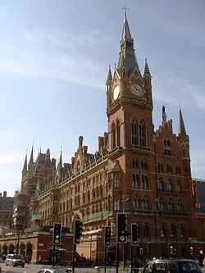
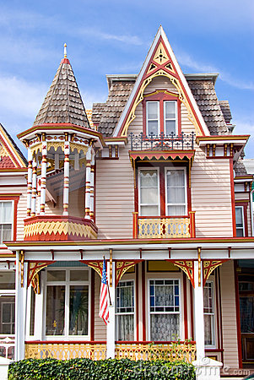
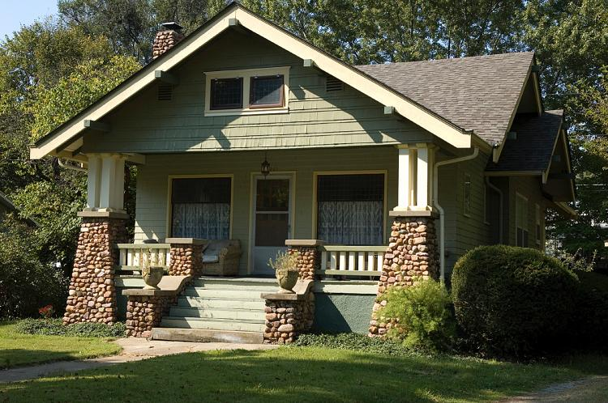
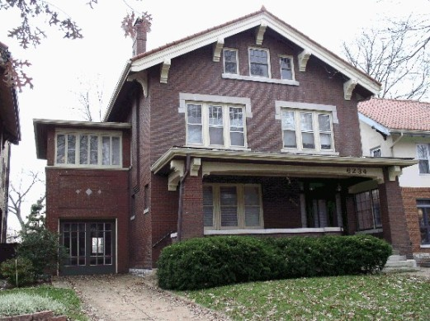
Architectural style
Victorian:
Arts and Crafts:

Slide 10
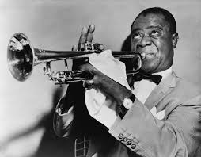
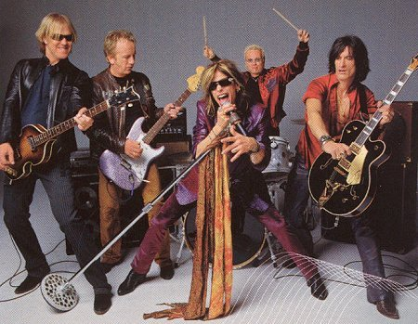
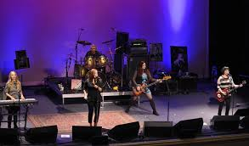
Architectural style?
Jazz:
Rock and Roll:

Slide 11
Style 1: object-oriented
ship course
procedure call
procedure call
procedure call
ship radar
GPS unit

Slide 12
Style 1: object-oriented
Components are objects
Containing all the data and behavior relevant to the object
Connectors are messages and method invocations
Key benefits
Objects expose a certain interface to other objects
Abstraction
An object’s internal representation is hidden from other objects
Anticipation of change
Objects in software are used to model real-world objects
Understandability
Examples
Business applications
Notes:
Business applications in which real-world business objects can be modeled by sw objects

Slide 13
Style 2: model-view-controller
teller
procedure call
rules
procedure call
procedure call
back account
Notes:
back acct: model
rules: controller
teller: view

Slide 14
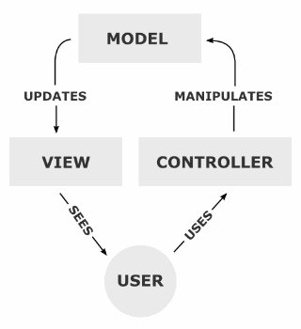
Style 2: model-view-controller
Components are models, views, and controllers
Models store information about the state of the program
View components present information to the user
Controllers allow user to control model/view and tell models (views) to update
Notes:
Model: back-end info, data, business rules, business logic
view: can get info from multiple models
Example: amazon
model: repository/db of all images, information, item count, etc.;
controller: rules for misc. like computing how many stars shows up
view: webpage w/ all sorts of info

Slide 15
Style 2: model-view-controller
Components are models, views, and controllers
Models store information about the state of the program
View components present information to the user
Controllers allow user to control model/view and tell models (views) to update
User interface
Notes:
View/controller often merged

Slide 16
Style 2: model-view-controller
Key benefits:
Decouples model and view – one model can support multiple views
Decouples view and controller – can change the way a view responds to user input
Modularity, anticipation of change
Examples
Websites
Web applications
Notes:
model/view: you might have a game that allows different perspectives (e.g., top-down, forward, etc.), you want all views to be updated when the model changes
view/controller: You might want to change the way the view responds to the keyboard, for example, or have it use a pop-up menu instead of command keys.
Websites: Model=HTML file (contains text to be shown); View=CSS file (contains description of page’s layout); Controller=browser (renders the HTML and CSS as the data we read)

Slide 17
Style 3: client-server
game client 1
game client 2
game client 3
remote call
remote call
remote call
game server

Slide 18
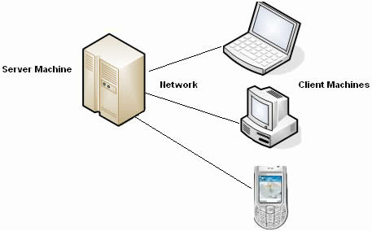
Style 3: client-server
Components are clients and servers
A server has computational resources that it provides to one or more clients
Clients make requests of servers
Generally used in distributed systems
Notes:
Clients request from servers: data, authentication, verification, software updates, etc.

Slide 19
Style 3: client-server
Key benefits
Centralized security
Centralized data access and management
Examples
email
Web browser-based programs
Notes:
Centralized control/security because all data is stored on server

Slide 20
Style 4: layered

Slide 21
Style 4: layered
Components are organized in hierarchical layers
Connectors are protocols of layer interaction
“Multi-level client server:” each layer acts as a
Service: service provider to layers “above”
Client: service consumer of layer(s) “below”
Key benefits
Increasing abstraction levels
Changes in a layer affect at most the adjacent two layers
Anticipation of change
Lower layers are easily reusable
Examples
Operating systems
Networks

Slide 22
Style 4: layered example
Consider a supplier of tennis balls. It has several departments (in no particular order):
Rolling: forms tennis balls from green ooze
Assembly: puts balls into canisters
Receiving: accepts shipments of canisters from Acme Canister Co.
Packaging: packs filled canisters into cardboard boxes
Inventory: stores parts

Slide 23
Which department goes on the top layer of the company’s manufacturing architecture?
Rolling
Assembly
Receiving
Packaging
Inventory

Slide 24
Which department goes on the top layer of the company’s manufacturing architecture?
Rolling
Assembly
Receiving
Packaging
Inventory

Slide 25
Which department goes on the second layer of the company’s manufacturing architecture?
Rolling
Assembly
Receiving
Packaging
Inventory

Slide 26
Which department goes on the second layer of the company’s manufacturing architecture?
Rolling
Assembly
Receiving
Packaging
Inventory

Slide 27
Which department goes on the third layer of the company’s manufacturing architecture?
Rolling
Assembly
Receiving
Packaging
Inventory

Slide 28
Which department goes on the third layer of the company’s manufacturing architecture?
Rolling
Assembly
Receiving
Packaging
Inventory

Slide 29
Which department goes on the fourth layer of the company’s manufacturing architecture?
Rolling
Assembly
Receiving
Packaging
Inventory

Slide 30
Which department goes on the fourth layer of the company’s manufacturing architecture?
Rolling
Assembly
Receiving
Packaging
Inventory

Slide 31
Style 4: layered example
The tennis ball supplier’s organization can be viewed as having a layered architecture:
TOP: Packaging: packs filled canisters into cardboard boxes
Assembly: puts balls into canisters
Inventory: stores parts
BOTTOM
Receiving: accepts shipments of canisters from Acme Canister Co.
Rolling: forms tennis balls from green ooze

Slide 32
Style 5: peer-to-peer
skype 1
stream
stream
skype 2
stream
skype 3

Slide 33
Style 4: peer-to-peer
Components (“peers”) can act as either clients or servers
Data and behavior are distributed among peers
Connectors are network protocols
Key benefits
Highly robust in the face of failure of any given node
Examples
File sharing systems, Skype

Slide 34
Style 6: pipe-and-filter
print records
stream
sort
stream
remove duplicates

Slide 35
Style 6: pipe-and-filter
Components are filters
Transform input data streams into output data streams
Connectors are pipes
Conduits for data streams
Key benefits
Easy filter addition, replacement, and reuse
Possible to hook any two filters together
Examples
UNIX shell
ls invoices | grep -e August | sort
Notes:
list all the invoices that match the pattern “August” in a sorted order

Slide 36
Style 7: publish-subscribe (“pub-sub”)
trader 1
trader 2
trader 3
remote call
remote call
stream
remote call
stock market

Slide 37
Style 7: pub-sub
Components are publishers or subscribers
Subscribers register/deregister to receive specific messages/content
Publishers broadcast messages to subscribers
Connectors are network protocols
Key benefits
Efficient one-way dissemination of information
Scalability
Examples
Stock market
News

Slide 38
Mixing styles is often necessary
trader 1
trader 2
trader 3
remote call
remote call
stream
remote call
stock market server
procedure call
purchasing rules
procedure call
procedure call
stock database
Notes:
pub sub, mvc
stock market server becomes the view

Slide 39
Today’s lecture
Quiz Answers
Architectural styles
Evolution
Quiz 3

Slide 40
Back to evolution
Essential part of software development
Must be accommodated as much as possible
Must be planned as much as possible

Slide 41
Back to evolution
Essential part of software development
Must be accommodated as much as possible
Must be planned as much as possible
Architecture is a key tool in accommodating evolution

Slide 42
Accommodating change
teller
procedure call
rules
procedure call
procedure call
back account
New overdraft rule?

Slide 43
Accommodating change
skype 1
stream
stream
skype 2
stream
skype 3
Another user?

Slide 44
Accommodating change?
list records
stream
sort
stream
remove duplicates
Only records names starting with a letter from the first half of the alphabet?

Slide 45
Accommodating change
trader 1
trader 2
trader 3
remote call
remote call
stream
remote call
stock market server
procedure call
purchasing rules
procedure call
procedure call
Another trader?
stock database

Slide 46
Architectural evolution
When a system evolves, ideally its prescriptive architecture is modified first
In practice, the system – and thus its descriptive architecture – is often directly modified
This happens because of
developer sloppiness
perception of short deadlines which prevent thinking through and documenting
lack of documented prescriptive architecture
need or desire for code optimizations
inadequate techniques or tool support

Slide 47
Today’s lecture
Quiz Answers
Architectural styles
Evolution
Quiz 3

Slide 48
Quiz 3: software architecture
Lectures:
Essential ingredients of SE
Definitions of software architecture
Elements of software architecture
Prescriptive vs. descriptive architectures
Software/architectural evolution
What an architectural style is
The basics of the seven styles presented today
Readings
Architectural styles: only those presented in lecture
Architectural views

Slide 49
Next time
Software process models
Quiz 3
Homework 1 final draft due tonight 11:55pm
Use format given in template!

