Slide 1
Informatics 43 Introduction to Software Engineering Lecture 7-1
November 18, 2014
Emily Navarro
Duplication of course material for any commercial purpose without the explicit written permission of the professor is prohibited.

Slide 2
Today’s Lecture
Go over Test 1 answers
Design phase of software engineering
Designs
Abstraction
Design notations / diagrams
UML diagrams
Other diagrams
Quiz Thursday

Slide 3
Today’s Lecture
Go over Test 1 answers
Design phase of software engineering
Designs
Abstraction
Design notations / diagrams
UML diagrams
Other diagrams
Quiz Thursday

Slide 4
Today’s Lecture
Go over Test 1 answers
Design phase of software engineering
Designs
Abstraction
Design notations / diagrams
UML diagrams
Other diagrams
Quiz Thursday

Slide 5
Design Phase of Software Engineering
Something usually needs to be done after the user’s requirements are specified and before coding starts, especially on larger tasks.
Software design is a creative activity in which the designer makes plans for
how the system will meet the requirements
in an efficient and effective way
Notes:
Can’t just throw the programmers into it and have them start coding without any detailed plans for how they will work together to build the system

Slide 6
Software Design Goals/Activities
Making system-wide decisions
Architecture, languages, libraries, platforms
Iteratively:
Studying and understanding the problem
Identifying possible solutions
Describing each abstraction used in the solution
Modularizing the task so that multiple people can work on it
Defining modules and their interfaces

Slide 7
Approaches to Software Design (Textbook)
Software architecture
Functional decomposition
Relational database design
Object-oriented design and UML
User interface design

Slide 8
Functional Decomposition
Identify tasks/functions, sub-tasks, sub-sub-tasks, etc.
Decomposing tasks/functions/modules/system into smaller tasks/functions/modules
May result in the same sub-sub-task appearing more than once in the tree.
0. BeachBurn Manager
1. Stadium Mgr
2. Ticket Mgr
3. Schedule Mgr
4. Admin
5. Ticket Seller
1.1 Edit sectors
2.1 Print report
3.1 Update schedule
4.1 Update permissions
5.1 Sell tickets
1.2 Login
2.2 Set prices
3.2 Login
4.2 Login
5.2 Refund tickets
2.3 Block seats
5.2 Login
2.4 Login
Notes:
Get down to the smallest building blocks, which are functions/modules, which can then theoretically be composed into the final system

Slide 9
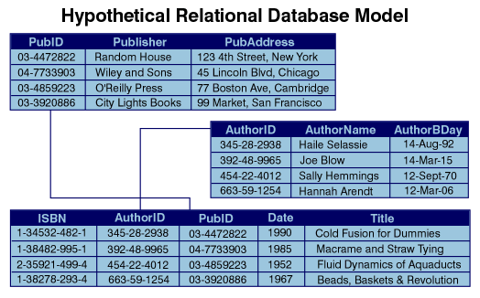
Relational Database Design
Design tables where data is stored and relationships between them

Slide 10
Object-Oriented Design and UML
An “object” contains both data (name, user ID, email) and methods (login, sellTickets, refundTickets)
A “class” is a blueprint for making objects that have the same kinds of data and the same methods

Slide 11
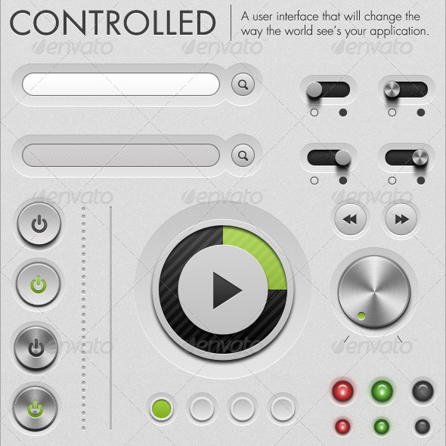
User Interface Design
Flow of interactions, look and feel

Slide 12
Today’s Lecture
Go over Test 1 answers
Design phase of software engineering
Designs
Abstraction
Design notations / diagrams
UML diagrams
Other diagrams
Quiz Thursday

Slide 13
Designs
Notes:
Designs can be quick and dirty sketches, or computer-generated annotated drawings. What might have been the purpose of these designs?

Slide 14
Designs
Notes:
Designs can be scribbles and sketches done on a menu over dinner, things that seemingly resemble no real-world object. What would have been the purpose of these designs? For development? For personal thinking/reflection?

Slide 15
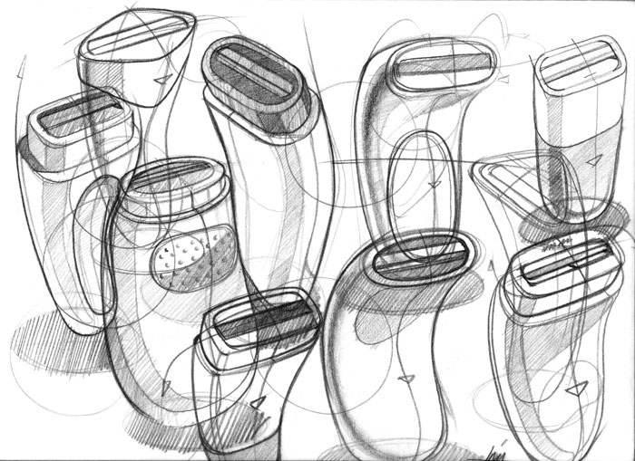
Designs
Notes:
Designs can be artist’s renderings of real-world objects to communicate the look of something

Slide 16
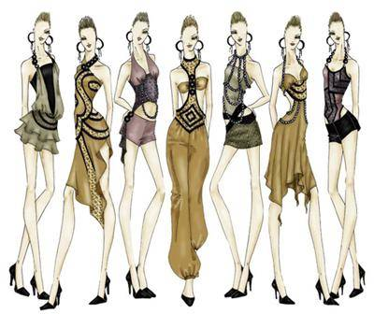
Designs
Notes:
Designs can be artist’s renderings of real-world objects (color) to communicate the look of something

Slide 17
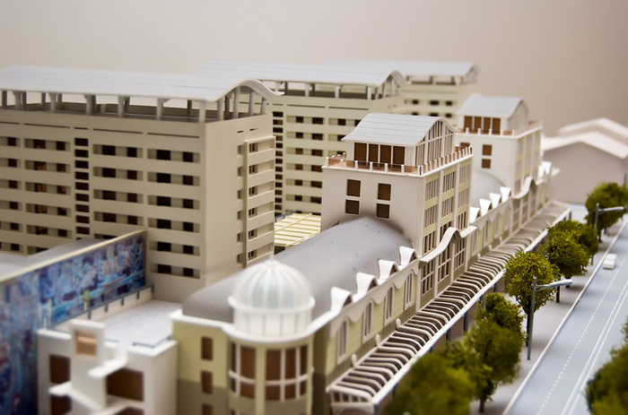
Designs
Notes:
Designs can be very detailed 3D miniature models of the end product

Slide 18
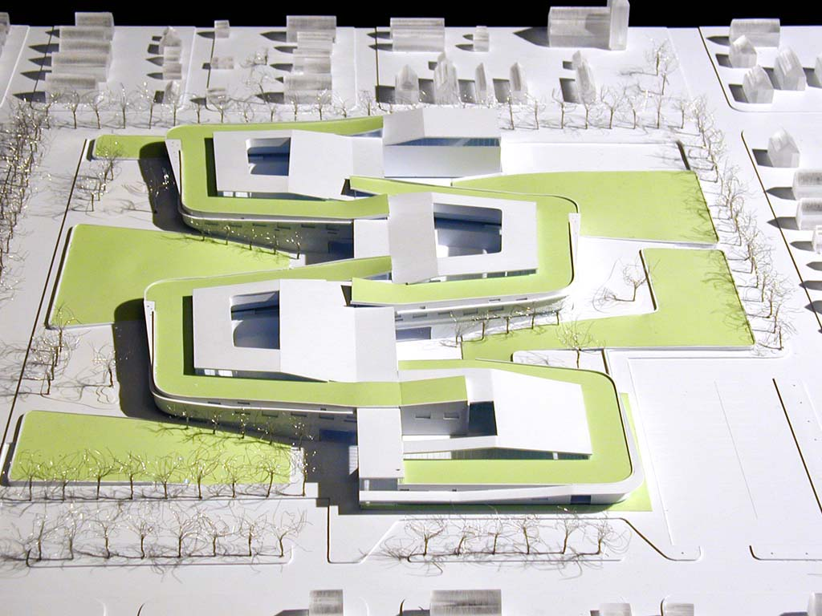
Designs
Notes:
Designs can be less detailed miniature 3D models of the end product
To create an overall, high-level, aerial view, some look and feel

Slide 19
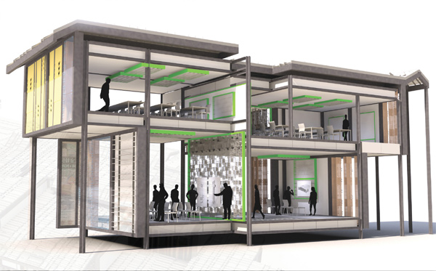
Designs
Notes:
Designs can be artist’s renderings of how the end result will look and how people will interact with it
Purpose: to create a vision, feel, look

Slide 20
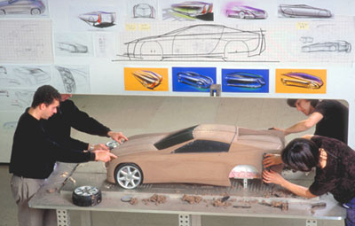
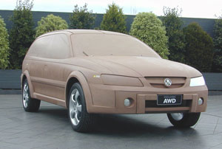
Designs
Notes:
Another 3D miniature model (not detailed) to communicate the look/feel from an exterior view of the car.

Slide 21
Purpose of designs
Designs to think
Designs to talk
Designs to prescribe

Slide 22
Purpose of designs
Designs to think
Designs to talk
Designs to prescribe
Software designs are developed iteratively
Notes:
Designers do not arrive at a finished design immediately. They design iteratively through a number of different versions. Starts informally, refined by adding information as needed/as it is discovered/determined, to make the design more complete/consistent.

Slide 23
Today’s lecture
Go over Test 1 answers
Design phase of software engineering
Designs
Abstraction
Design notations / diagrams
UML diagrams
Other diagrams
Quiz Thursday

Slide 24
Abstraction
Abstractions are formed by reducing the information content of a concept or an observable phenomenon, typically to retain only information which is relevant for a particular purpose
what do I need to know
what do I not need to know
Every design notation supports a certain kind of abstraction

Slide 25
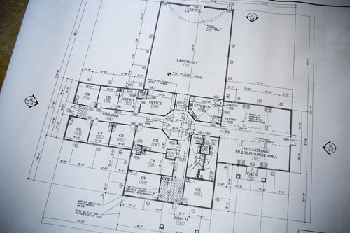
Designs
Notes:
What is the purpose of this one? What does it abstract away?

Slide 26
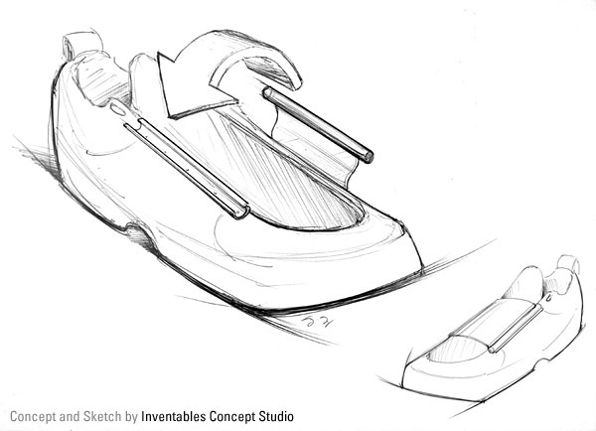
Designs
Notes:
What is the purpose of this one? What does it abstract away?

Slide 27
Designs

Slide 28
Designs

Slide 29
Designs

Slide 30
Designs

Slide 31
Designs
Notes:
What is the purpose of this one? What does it abstract away?

Slide 32
Today’s lecture
Go over Test 1 answers
Design phase of software engineering
Designs
Abstraction
Design notations / diagrams
UML diagrams
Other diagrams
Quiz Thursday

Slide 33
Design Diagrams
It is important to think of a diagram as being a statement in a language that has a syntax
A diagram is a picture
A diagram has to be interpreted
A
B

Slide 34
What might this mean?
A
B

Slide 35
What might this mean?
A
B
A happens before B

Slide 36
What might this mean?
A
B
A happens before B
A uses B

Slide 37
What might this mean?
A
B
A happens before B
A uses B
A calls B

Slide 38
What might this mean?
A
B
A happens before B
A uses B
A calls B
A is composed of B

Slide 39
What might this mean?
A
B
A happens before B
A uses B
A calls B
A is composed of B
B is a result of A

Slide 40
What might this mean?
A
B
A happens before B
A uses B
A calls B
A is composed of B
B is a result of A
A becomes like B

Slide 41
What might this mean?
A
B
A happens before B
A uses B
A calls B
A is composed of B
B is a result of A
A becomes like B
A is necessary for B

Slide 42
What might this mean?
A
B
A happens before B
A uses B
A calls B
A is composed of B
B is a result of A
A becomes like B
A is necessary for B
…
Notes:
You don’t really know what it’s saying, since you don’t have a context, syntax, rules
It’s easy to draw diagrams that make sense to you, but when you show it to someone else they may not know what you’re talking about

Slide 43
Software Development Languages
Different languages are used at different stages:
Requirements Design Coding Testing
English Diagrams/UML Java, Python

Slide 44
Software Development Languages
Different languages are used at different stages:
Requirements Design Coding Testing
English Diagrams/UML Java, Python
Design notations

Slide 45
Today’s lecture
Go over Test 1 answers
Design phase of software engineering
Designs
Abstraction
Design notations / diagrams
UML diagrams
Other diagrams
Quiz Thursday

Slide 46
UML (Unified Modeling Language)
Industry standard for software design/modeling
A set of a dozen or so visual languages for specifying object-oriented systems
Different types of UML diagrams are used to represent different aspects (structure, behavior, interactions) of a system
Class diagrams
Activity diagrams
Sequence diagrams
Use case diagrams
…
Some following slides from
www.cs.drexel.edu/~spiros/teaching/CS575/slides/uml.ppt

Slide 47
UML Class Diagrams
Helps in the decomposition of a system into sub-modules known as classes
UML class diagrams show the classes of the system, their inter-relationships, and the operations and attributes of the classes
Typically used to
model domain concepts
create a detailed, object oriented design of the code

Slide 48
UML Class Diagrams
Helps in the decomposition of a system into sub-modules known as classes
UML class diagrams show the classes of the system, their inter-relationships, and the operations and attributes of the classes
Typically used to
model domain concepts
create a detailed, object oriented design of the code
UML Class Diagrams are the most common way to represent an object-oriented design

Slide 49
Classes
A class is a description of a set of
objects that share the same attributes,
operations, relationships, and semantics.
Graphically, a class is rendered as a
rectangle, usually including its name,
attributes, and operations in separate,
designated compartments.
ClassName
attributes
operations

Slide 50
Class Names
ClassName
The name of the class is the only required tag in the graphical representation of a class. It always appears in the top-most compartment.
attributes
operations

Slide 51
Class Attributes
Person
An attribute is a named property of a
class that describes the object being modeled. In the class diagram, attributes appear in the second compartment just below the name-compartment.
name : String
address : Address
birthdate : Date
ssn : Id
This rectangle says that there is a class called Person that could potentially have many instances, each with its own and name, address, etc. attributes.

Slide 52
Class Attributes (II)
Person
name : String
address : Address
birthdate : Date
ssn : Id
Attributes are usually listed in the form:
attributeName : Type

Slide 53
Class Operations
Person
name : String
address : Address
birthdate : Date
ssn : Id
eat
sleep
work
play
Operations describe the class behavior
and appear in the third compartment.

Slide 54
Depicting Classes
When drawing a class, you needn’t show attributes and operations in every diagram.
Person
Person
Person
name : String
birthdate : Date
ssn : Id
Person
name
address
birthdate
eat()
sleep()
work()
play()
Person
eat
play

Slide 55
Association Relationships
If two classes in a model need to communicate with each other, there must be link between them.
An association line denotes that link.
Student
Instructor

Slide 56
Association Relationships (II)
We can constrain the association relationship by defining the navigability of the association.
Here, a Router object requests services from a DNS object by sending messages to (invoking the operations of) the server.
The direction of the association arrow indicates that the server has no knowledge of the Router.
Router
DomainNameServer

Slide 57
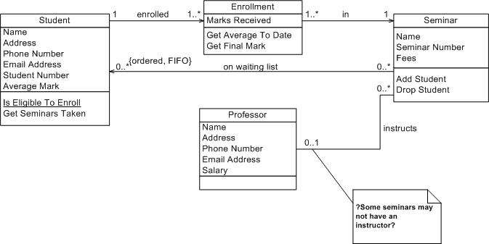
Examples – UML Class Diagrams

Slide 58
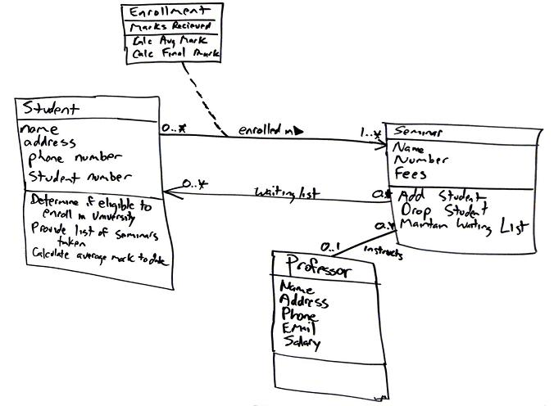
Examples – UML Class Diagrams

Slide 59
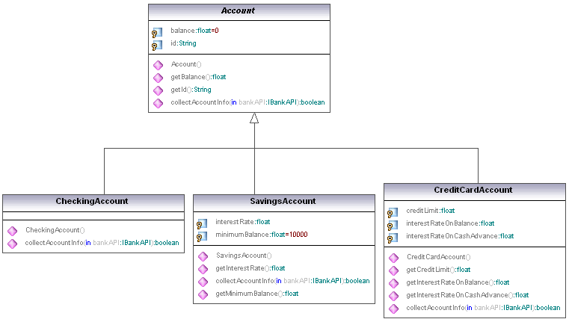
Examples – UML Class Diagrams

Slide 60
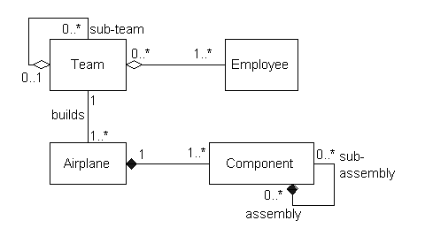
Examples – UML Class Diagrams

Slide 61
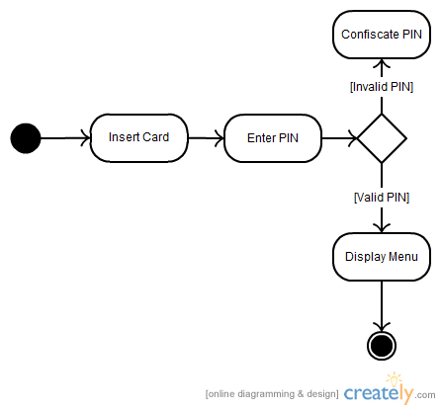
Examples – UML Activity Diagrams
Notes:
Shows workflows of stepwise activities

Slide 62
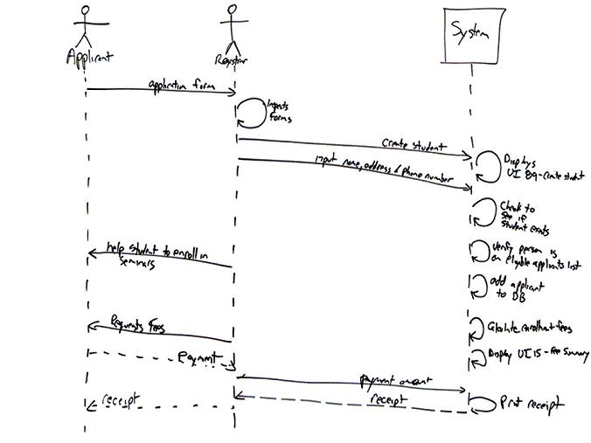
Examples – UML Sequence Diagrams
Notes:
Shows interaction between objects in the sequential order that they occur

Slide 63
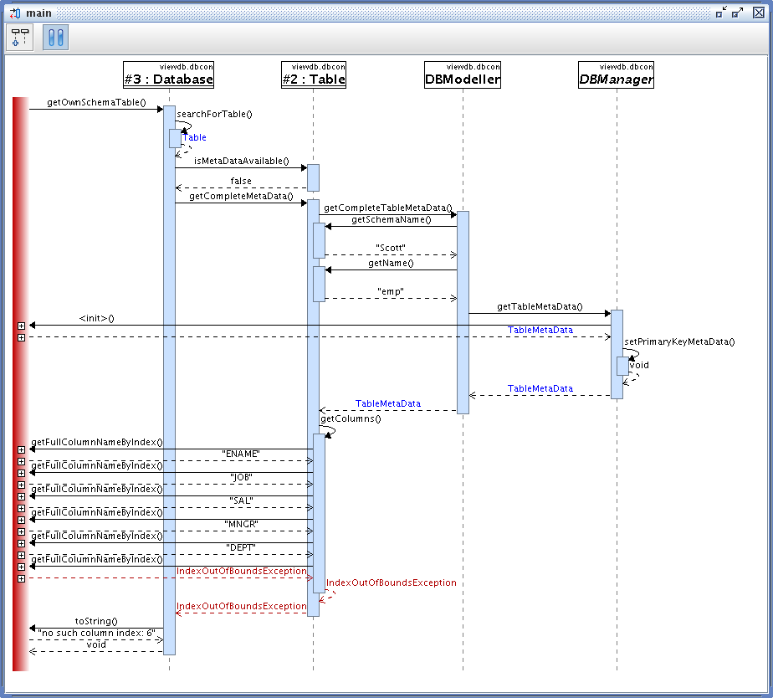
Examples – UML Sequence Diagrams

Slide 64
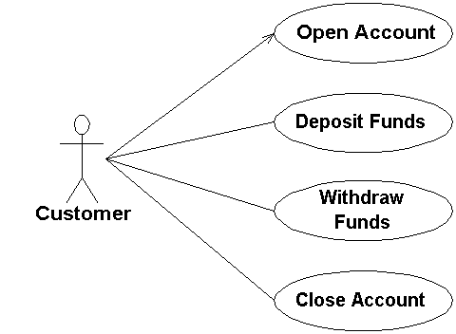
Examples - UML Use Case Diagrams

Slide 65
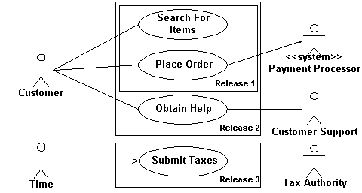
Examples - UML Use Case Diagrams

Slide 66
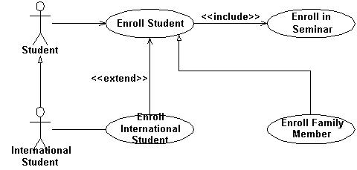
Examples - UML Use Case Diagrams

Slide 67
Today’s lecture
Go over Test 1 answers
Design phase of software engineering
Designs
Abstraction
Design notations / diagrams
UML diagrams
Other diagrams
Quiz Thursday

Slide 68
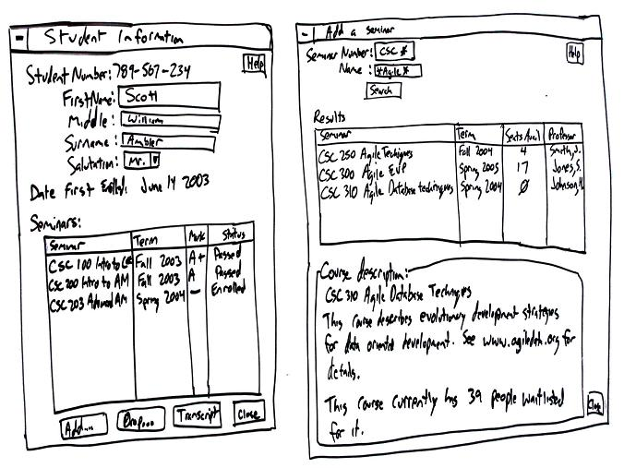
Examples – User Interfaces

Slide 69
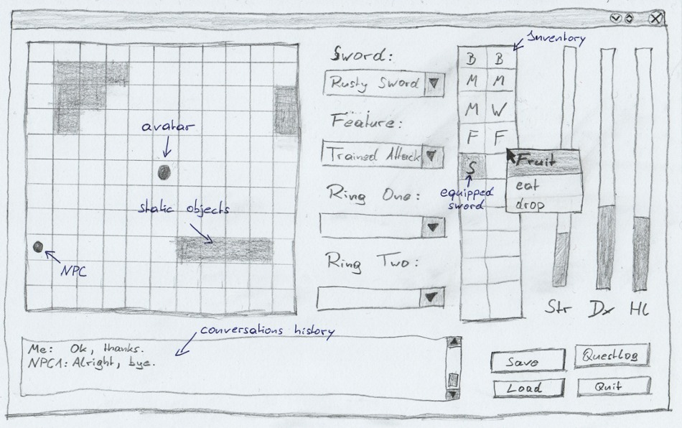
Examples – User Interfaces

Slide 70
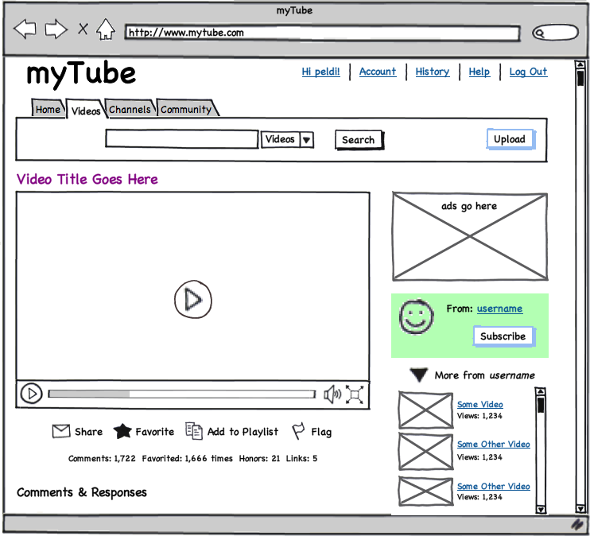
Examples – User Interfaces
[balsamiq]

Slide 71
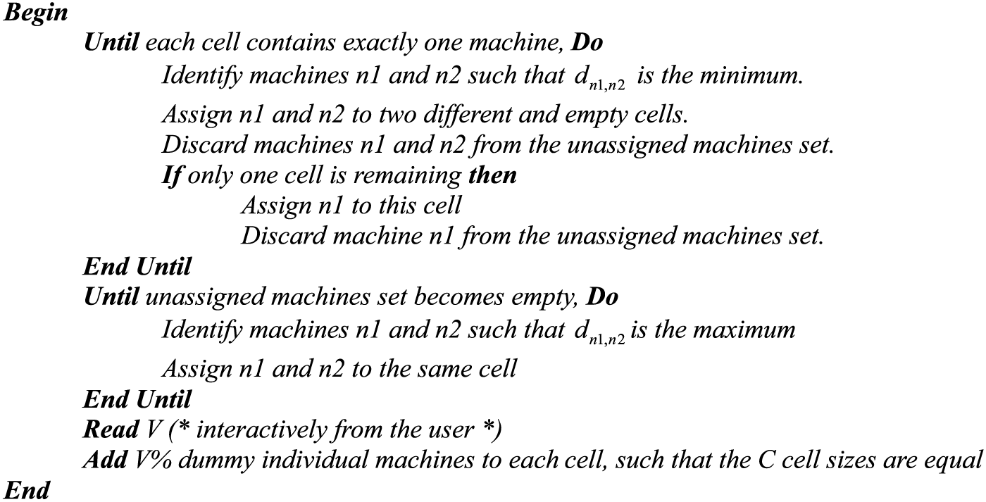
Examples – Pseudo Code

Slide 72
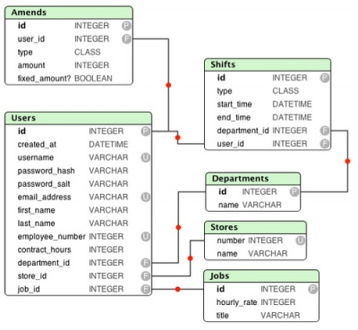
Examples – Entity Relationship Diagrams
Notes:
Shows a data model, usually for the purpose of being implemented in a databse

Slide 73
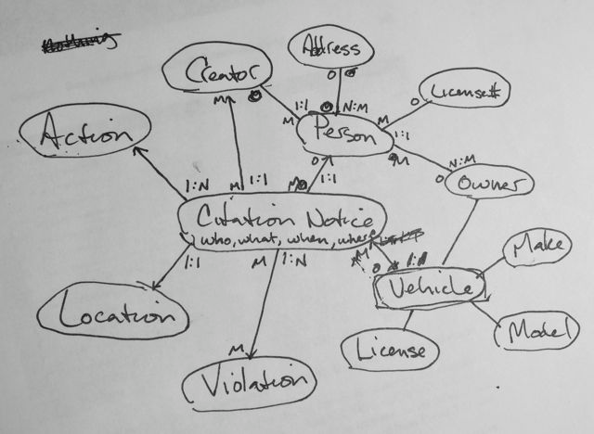
Examples – Entity Relationship Diagrams

Slide 74
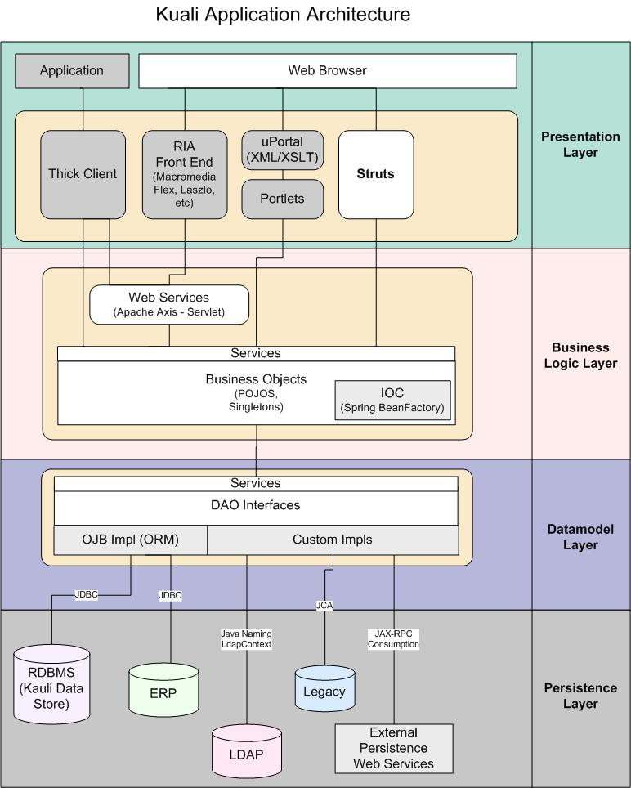
Examples – Architecture Diagrams

Slide 75
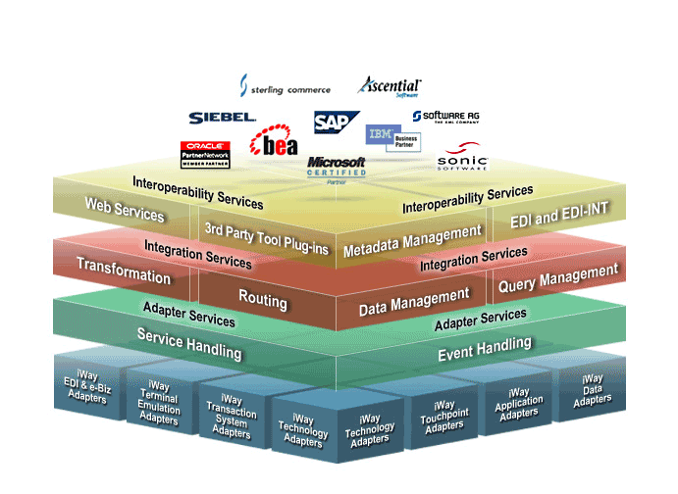
Examples – Architecture Diagrams

Slide 76
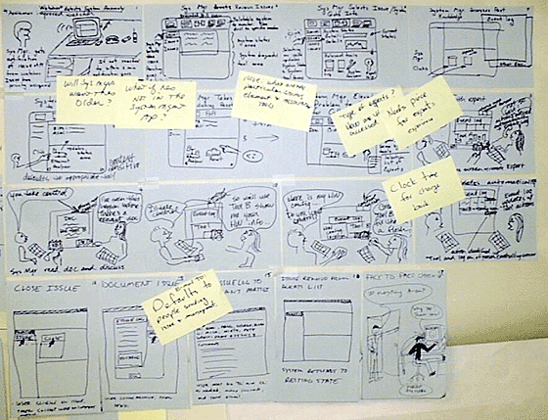
Examples – Storyboard
Notes:
To depict sequences of user interaction in early development, for the purpose of refining requirements with customer or among developers
Started by Walt Disney, used heavily in animation, motion pictures
Cheap, easy to modify
Used in Nordstrom innovation lab video

Slide 77
Examples – Storyboard

Slide 78
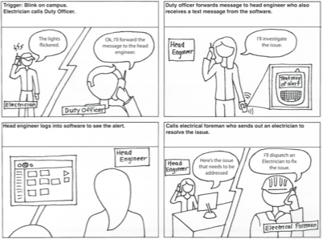
Examples – Storyboard

Slide 79
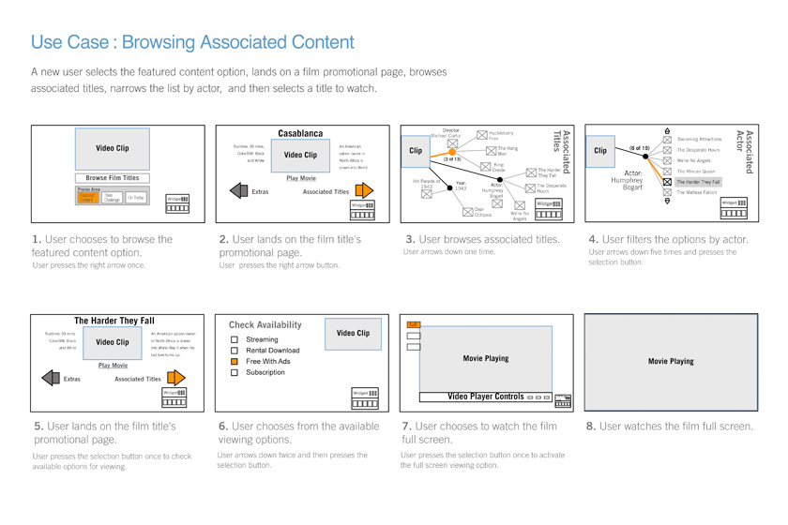
Examples – Storyboard

Slide 80
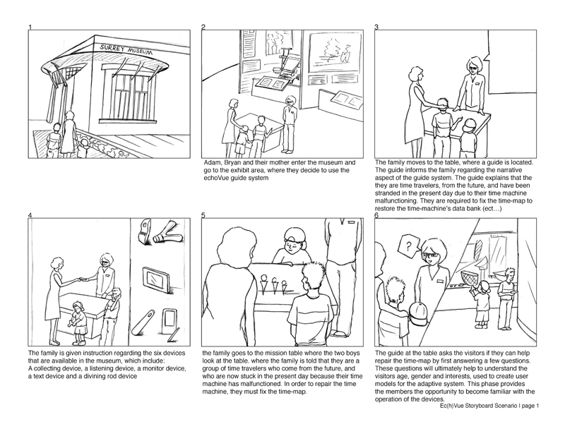
Examples – Storyboard

Slide 81
Today’s lecture
Go over Test 1 answers
Design phase of software engineering
Designs
Abstraction
Design notations / diagrams
UML diagrams
Other diagrams
Quiz Thursday

Slide 82
Quiz Thursday
Today’s lecture
Goals/activities of software design
Approaches to software design
Purposes of designs
Purposes of the different types of diagrams presented
The different parts of a class diagram
Textbook
Whatever is overlapping with lecture

