Slide 1
Informatics 43 Introduction to Software Engineering Lecture 9-1
December 2, 2014
Emily Navarro
Duplication of course material for any commercial purpose without the explicit written permission of the professor is prohibited.

Slide 2
Today’s Lecture
Announcements
White-box (Structural) Testing
Miscellaneous testing topics
More black-box (specification-based) testing examples
Quiz Thursday

Slide 3
Today’s Lecture
Announcements
White-box (Structural) Testing
Miscellaneous testing topics
More black-box (specification-based) testing examples
Quiz Thursday

Slide 4
Announcements
Homework 3
I updated it a few times over the past few days
Refresh/download it again so you have the current version
Due next Tuesday – hard copy in lecture
Homework 2C
Turn in hard copy today in lecture
Homework 2B
Today in lecture is the last chance to turn in your hard copy
Discussion Friday
Hand back papers
Review

Slide 5
Today’s Lecture
Announcements
White-box (Structural) Testing
Miscellaneous testing topics
More black-box (specification-based) testing examples
Quiz Thursday

Slide 6
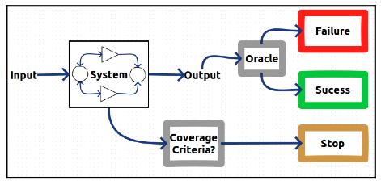
White-box / Structural Testing

Slide 7
White-box / Structural Testing
Use source code to derive test cases
Build a graph model of the system
State test cases in terms of graph coverage
Choose test cases that guarantee different types of coverage
Node/statement coverage
Edge/branch coverage
Loop coverage
Condition coverage
Path coverage
Notes:
Node: Each statement must be executed at least once
Edge: Each branch in a conditional statement must be executed at least once
Loop: Each loop has been executed zero times, once, and more than once
Condition: each boolean condition in a predicate must be executed w/ both true and false values
Path: each path must be executed at least once

Slide 8
Example: Building the program graph
1 | Node getSecondElement() {
2 | Node head = getHead();
3 | if (head == null)
4 | return null;
5 | if (head.next == null)
6 | return null;
7 | return head.next.node;
8 | }
1
2
3
4
5
6
7
Notes:
How many of you don’t know what this means?

Slide 9
Example: Averaging quiz grades!
1 | float quizAverage(float[] scores) {
2 | float min = 99999;
3 | float total = 0;
4 | for (int i = 0 ; i < scores.length ; i++) {
5 | if (scores[i] < min)
6 | min = scores[i];
7 | total += scores[i];
8 | }
9 | total = total – min;
10 | return total / (scores.length – 1);
11 | }
1
2
3
4
5
6
7
8
9
10

Slide 10
Node Coverage
Select test cases such that every node in the graph is visited
Also called statement coverage
Guarantees that every statement in the source code is executed at least once
Selects minimal number of test cases
Test case: { 2 }
1
2
3
4
5
6
7
8
9
10

Slide 11
Edge Coverage
Select test cases such that every edge in the graph is visited
Also called branch coverage
Guarantees that every branch in the source code is executed at least once
More thorough than node coverage
More likely to reveal logical errors
Test case: { 1, 2 }
1
2
3
4
5
6
7
8
9
10

Slide 12
Another White Box Example
1 a = 17
2 read b from console
3 if a < b
4 while a < b-3
5 a = a / (b–50)
6 print a, b
Notes:
Make node graph on board

Slide 13
Another White Box Example
1 a = 17
2 read b from console
3 if a < b
4 while a < b-3
5 a = a / (b–50)
6 print a, b
1
2
3
4
5
6

Slide 14
Another White Box Example
1 a = 17
2 read b from console
3 if a < b
4 while a < b-3
5 a = a / (b–50)
6 print a, b
1
2
3
4
5
6
What test cases are required to make sure every line of code is executed at least once? (Node coverage)

Slide 15
Another White Box Example
1 a = 17
2 read b from console
3 if a < b
4 while a < b-3
5 a = a / (b–50)
6 print a, b
1
2
3
4
5
6
What test cases are required to make sure every line of code is executed at least once? (Node coverage)
b > 17 && b-3 > 17
or, b >= 21

Slide 16
Another White Box Example
1 a = 17
2 read b from console
3 if a < b
4 while a < b-3
5 a = a / (b–50)
6 print a, b
1
2
3
4
5
6
What test cases are required to make sure every line of code is executed at least once? (Node coverage)
Test case: { 21 }

Slide 17
Another White Box Example
1 a = 17
2 read b from console
3 if a < b
4 while a < b-3
5 a = a / (b–50)
6 print a, b
1
2
3
4
5
6
What test cases are required to make sure every branch is taken at least once? (Edge coverage)

Slide 18
Another White Box Example
1 a = 17
2 read b from console
3 if a < b
4 while a < b-3
5 a = a / (b–50)
6 print a, b
1
2
3
4
5
6
What test cases are required to make sure every branch is taken at least once? (Edge coverage)
b > 17, b <= 17
b-3 > 17, b-3 <= 17

Slide 19
Another White Box Example
1 a = 17
2 read b from console
3 if a < b
4 while a < b-3
5 a = a / (b–50)
6 print a, b
1
2
3
4
5
6
What test cases are required to make sure every branch is taken at least once? (Edge coverage)
Test case: { 17, 21 }

Slide 20
Another White Box Example
1 a = 17
2 read b from console
3 if a < b
4 while a < b-3
5 a = a / (b–50)
6 print a, b
1
2
3
4
5
6
What test cases are required to make sure that all possible exceptions are thrown? (Fault injection)

Slide 21
Another White Box Example
1 a = 17
2 read b from console
3 if a < b
4 while a < b-3
5 a = a / (b–50)
6 print a, b
1
2
3
4
5
6
What test cases are required to make sure that all possible exceptions are thrown? (Fault injection)
b – 50 = 0

Slide 22
Another White Box Example
1 a = 17
2 read b from console
3 if a < b
4 while a < b-3
5 a = a / (b–50)
6 print a, b
1
2
3
4
5
6
What test cases are required to make sure that all possible exceptions are thrown? (Fault injection)
Test case: { 50 }

Slide 23
Other Coverage Criteria
Loop coverage
Select test cases such that every loop boundary and interior is tested
Boundary: 0 iterations
Interior: 1 iteration and > 1 iterations
Watch out for nested loops
Less precise than edge coverage
Condition coverage
Select test cases such that all conditions are tested
if (a > b || c > d) …
More precise than edge coverage

Slide 24
Other Coverage Criteria
Path coverage
Select test cases such that every path in the graph is visited
Loops are a problem
0, 1, average, max iterations
Most thorough…
…but is it feasible?

Slide 25
Challenges
White-box/structural testing can cover all nodes or edges without revealing obvious faults
Some nodes, edges, or loop combinations may be infeasible
Unreachable/unexecutable code
“Thoroughness”
A test suite that guarantees edge coverage also guarantees node coverage…
…but it may not find as many faults as a different test suite that only guarantees node coverage

Slide 26
Today’s Lecture
Announcements
White-box (Structural) Testing
Miscellaneous testing topics
More black-box (specification-based) testing examples
Quiz Thursday

Slide 27
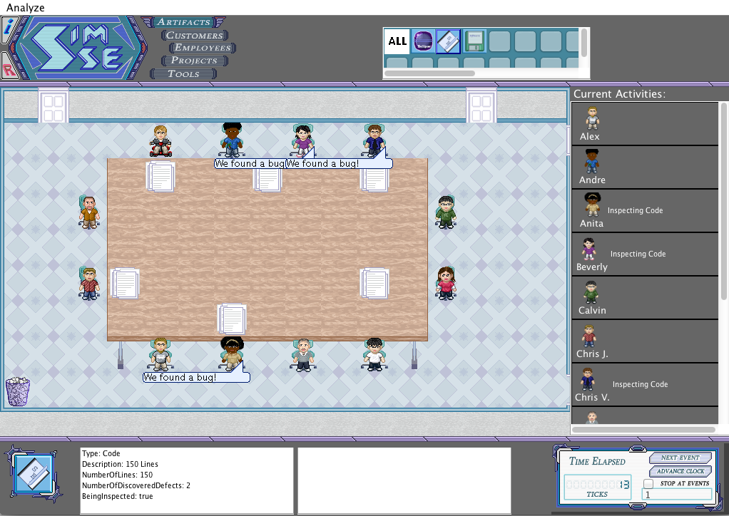
Inspections and Reviews
Humans read documents and look for defects
Surprisingly effective
Many different approaches and levels of details

Slide 28
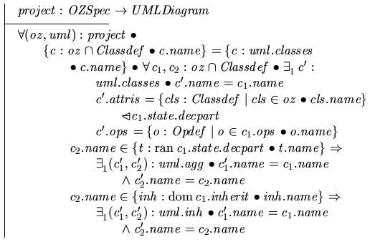
Formal Methods
Proofs of correctness
Note: verification only
Usually done with formal specifications

Slide 29
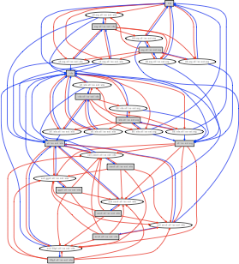
Static Analysis
A computer program analyzes source code and finds defects (without running the code)
Results are reviewed by a person because many “errors” are not errors at all

Slide 30
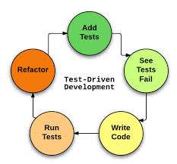
Test-Driven Development (TDD)
Notes:
An application of white-box testing

Slide 31
Test-Driven Development (TDD)
TDD is an effective tool for building reliable software, but not a substitute for other quality control activities
TDD should be combined with other QA activities
TDD usually leads to writing more tests and simpler code
TDD usually achieves at least statement coverage
Test cases in TDD are produced based on the developer’s intuitions and experience, although other techniques may be used

Slide 32
Testing: A Look Back
Quality assurance
Testing
Black-box (Specification-based) Testing
White-box (Structural) Testing
Miscellaneous testing topics
Inspections and reviews
Formal methods
Static analysis
Test-driven development

Slide 33
Testing Topics Not Covered
Combinatorial Testing
Regression Testing
Performance Testing
Load Testing
Debugging
…
Notes:
We just scratched the surface!

Slide 34
Today’s Lecture
Announcements
White-box (Structural) Testing
Miscellaneous testing topics
More black-box (specification-based) testing examples
Quiz Thursday

Slide 35
Example: Hotel Management System
Consider a hotel management system that takes phone numbers as input while gathering data about the guest
Imagine we want to test the “input phone number” function of the system
Specification: Should give a descriptive error message if
input is less than 10 digits
input is more than 20 digits
input contains non-numeric characters
What are the properties about phone numbers that we can exploit to create “valuable” partitions?
length, content (types of characters, number of invalid characters, position of invalid character, relative position of invalid characters)

Slide 36
Input Phone Number 1
Basis: Length
Subdomains | Test Case Input Data | Expected Output
0 | [] | Error – input must be at least 10 characters
< 10 | 12345 987654321 | Error – input must be at least 10 characters Error …
10 | 8583728394 | Success
> 10, < 20 | 13829384756483 2839483647583928378 | Success Success
20 | 28374839584738493847 28374839584738493822 | Success Success
> 20 | 2837483958473849384713829384756483 | Error – input must be less than or equal to 20 characters

Slide 37
Input Phone Number 2
Basis: types of characters
Subdomains | Test Case Input Data | Expected Output
contains - | 543-838-2233 888838-2233 | Error
contain # | #5438382233 1234587#233454 | Error
Contains ( | (543)8382233 (777)8382233 | Error
contains only numbers | 5438382233 523334489283748 | Success Success

Slide 38
Input Phone Number 3
Basis: position of invalid characters
Subdomains | Test Case Input Data | Expected Output
beginning | *2839483784 (8889283748342 | Error Error
middle | 234388#898 248-9989098 | Error Error
end | 283948738A 2987758498! | Error Error

Slide 39
Example: BeachBurn Manager
Imagine we want to test a use case called Set Ticket Prices, in which the ticket manager sets the prices of different tickets in the stadium by choosing a set of rows and assigning them a price
Can set 1, 2, or 3 price sectors
All seats in a row must have the same price
You will test the Set Ticket Prices UC by performing Check Price of Ticket, another UC (that has already been verified to work correctly)
Input
Set of price sectors
Which seat you are checking the price on
Output
Price of ticket

Slide 40
Example: BeachBurn Manager
Example
Input: {Prices set: Rows A-C: $100; Rows D-G: $50; Rows H-I: $25; Ticket checked: E1}
PricesA: Rows A-C: $100; Rows D-G: $50; Rows H-I: $25
Expected output: $50
What possible bases can we use to divide our testing into partitions?
Which sector it lies in (how big, how expensive, how close to front/back, how sold out the sector is)
Where in sector it lies
Where in stadium it lies
How many sectors there are total

Slide 41
Set Ticket Prices 1
Basis: where in the sector it lies
Subdomains | Test Case Input Data | Expected Output
beginning | PricesA, A1 PricesA, D1 | $100 $50
middle | PricesA, H5 PricesA, B7 | $25 $100
end | PricesA, I10 PricesA, B10 | $25 $100

Slide 42
Set Ticket Prices 2
Basis: Which sector it lies in (how close to front)
Subdomains | Test Case Input Data | Expected Output
front | A5 C10 | $100 $100
middle | E4 F2 | $50 $50
back | H9 I1 | $25 $25

Slide 43
Example: Gmail
Imagine we are testing the login functionality of Gmail
Input: username, password
What possible bases can we use to divide our testing into partitions?
whether username is valid (no user matching in system, invalid characters, length)
whether password is valid (length, doesn’t match given username, matches given username)
Two users:
Mary; maryspassword
Joe; joespassword

Slide 44
Login
Basis: whether the password matches a user
Subdomains | Test Case Input Data | Expected Output
pw matches user | Mary, maryspassword Joe, joespassword | Logged in as Mary Logged in as Joe
pw matches another user | Mary, joespassword Joe, maryspassword | Error Error
pw doesn’t match any user | Mary, newpassword Joe, anotherpassword | Error Error

Slide 45
Example: Room Scheduler System
Imagine we are testing a classroom scheduler program that handles M-F scheduling for five classrooms
Room capacities
Room A: 500
Room B: 300
Room C: 100
Room D: 50
Room E: 20
All classes are 1-hour long, once per week, and can be scheduled between 8am-10pm

Slide 46
Example: Room Scheduler System
Input
The current schedule
The number of students in the class to be scheduled
The desired time of the class to be scheduled
Output
A list of available rooms that can hold the number of students, ordered from most appropriate (number of students is as close as possible to room capacity without going over) to least appropriate

Slide 47
Example: Room Scheduler System
Example
Input:
{Current schedule:
Room A: M-F: 8-11am, 2-4pm
Room B: T-F: 9-10am, 5-8pm
Room C: F: 10am-3pm
Room D: M-F: 8am-10pm
Room E: M-F: 10am-5pm, 8pm-10pm;
Num students: 73
Desired time: W 5-6pm}
Expected output: {Room C, Room A}
Room capacities
Room A: 500
Room B: 300
Room C: 100
Room D: 50
Room E: 20

Slide 48
Example: Room Scheduler System
What possible bases can we use to divide our testing into partitions?
Num students
Fullness of schedule (empty, med full, almost full, full)
Time slot (early, midday, late)
Day (early, midweek, late, or M, T, W, Th, F)
Number of result (none, some, lots, all)

Slide 49
Schedule Room 1
Basis: time slot
Subdomains | Test Case Input Data | Expected Output
early | SchA, 88, Wed 8-9am SchA, 350, Th 9-10am | C, B None
midday | SchA, 240, Mon 2-3pm SchA, 18, Fri 3-4pm | B C, B
late | SchA, 499, Tues 9-10pm SchA, 16, Th 8-9p | A C, B, A

Slide 50
Schedule Room 2
Basis: class size
Subdomains | Test Case Input Data | Expected Output
below range | SchA, -5, T 5-6pm SchA, 0, M 3-4pm | Error Error
small | SchA, 3, M 2-3pm SchA, 15, F 11a-12pm | C, B, B, A
medium | SchA, 250, T 1-2p SchA, 200, Th 9-10p | B, A none
large | SchA, 500, M 8-9p | A
above range | SchA, 501, F 3-4p SchA, 10000, T 9-10p | Error Error

Slide 51
What are some possible bases for Homework 3?
Use Case 1 (Schedule band)
Which day
Which time slot
Length of time slot
Name of band
Fullness of schedule
Use Case 2 (Find best available seats)
number of seats desired
desired price range/relationship between upper/lower bound
lower bound
upper bound
how sold out it is
range of prices set
number of seats meeting criteria

Slide 52
Today’s Lecture
Announcements
White-box (Structural) Testing
Miscellaneous testing topics
More black-box (specification-based) testing examples
Quiz Thursday

Slide 53
Quiz Thursday
Testing (Lectures 8-1 and 9-1)
Validation/verification
How do we know when we are done?
Test-driven development
Error, fault, failure
Testing process model
Testing goals
Difference between white-box and black-box testing
Levels of testing (unit, functional/integration, system/acceptance)
Oracles
Test drivers/stubs
Understand node coverage/edge coverage

Slide 54
Test 2 (I)
Designs, Models, Notations (Lecture 7-1)
Goals/activities of software design
Approaches to software design
Purposes of designs
Use of abstraction in design
Purposes of the different types of diagrams presented
The different parts of a class diagram
Textbook
Whatever is overlapping with lecture

Slide 55
Test 2 (II)
User Orientation (Lecture 7-2)
Understand the following user-centered design methods:
Personas
Scenarios
Storyboards
Site maps
UI Mockups
Nielsen’s usability heuristics
Know and understand them
Be able to use them like you did in the discussion assignment

Slide 56
Test 2 (III)
Testing (Lectures 8-1 and 9-1-2)
Validation/verification
How do we know when we are done?
Test-driven development
Error, fault, failure
Testing process model
Testing goals
Difference between white-box and black-box testing
Levels of testing (unit, functional/integration, system/acceptance)
Oracles
Testing matrices/bases/subdomains
Test drivers/stubs
Understand node coverage/edge coverage
Comparative thoroughness of node/edge/path coverage

Slide 57
Test 2 (IV)
Moore’s Law, Project Estimation (Lecture 10-1)
Will go over that Tuesday
Textbook
Whatever overlaps with lecture

