Slide 1
Informatics 43 – October 6, 2015
Lecture 2-1
Emily Navarro

Slide 2
Today’s Lecture
Use Cases
  What and why
  How
  Use case diagrams
  Use case models
  Advanced concepts
  Guidelines
Homework 1
Quiz #1

Slide 3
Today’s Lecture
Use Cases
  What and why
  How
  Use case diagrams
  Use case models
  Advanced concepts
  Guidelines
Homework 1
Quiz #1

Slide 4
What is a Use Case
A textual depiction of a requirement
  Basic functionality/goal
  Any precondition for the functionality
  Flow of events (scenarios) for the functionality
  Any postcondition for the functionality
  Any error condition and alternative flow
Notes:
Goals e.g., creating a login, loggin in, user authorization, etc.
flow: complete and meaningful flow of events
postcondition: captures the contract/guarantees that will hold at the conclusion of the use case

Slide 5
Scenarios
Scenario = a sequence of steps describing an interaction between a “user” and a “system”
A use case describes a set of scenarios/flows that together accomplish a specific user “goal”
Notes:
Each scenario corresponds to a single path or flow through a use case
Single path/flow: e.g., scenario 1: PIN entered successfully. Scenario 2: PIN incorrect. Scenario 3: PIN incorrect 3 times, system boots user out

Slide 6
Example Scenario: Buy a Product*
“The customer browses the catalog and adds desired items to the shopping basket. When the customer wishes to pay, the customer describes the shipping and credit card information and confirms the sale.
The system checks the authorization on the credit card and confirms the sale both immediately as well as with a follow-up email.”
*Adapted from “UML Distilled” by Martin Fowler

Slide 7
Flows
  Basic Flow: “Happy day” scenario
  Previous slide
  Alternative Flow: An alternate way to achieve the goal of the use case
  A returning customer uses stored billing/shipping information
Exception Flow: A scenario in which the goal of the use case is not achieved
  The credit card authorization fails
A use case should capture all possible scenarios—successful and unsuccessful ones
Notes:
A use case is a set of scenarios serving a common goal.
The user does not always succeed but the goal remains
And there are usually multiple scenarios for success and “unsuccess.”

Slide 8
Why Use Cases?
Other Requirements Engineering Methods | Use Cases
May not map well to design/code | Map well to design and implementation constructs (especially object-oriented)
May not translate well to acceptance tests | Make it easy to verify/validate a design and implementation against user goals
Can be difficult for non-experts to understand | Framed in terms of user goals and flows of events, user requests and system responses
Notes:
Why not just the other requirements engineering techniques you learned about?
Use cases attempt to bridge this “understandability gap”
This understandability allows users developers, customers, etc. to come to a common understanding of what the system should do

Slide 9
Why Not Use Cases?
Use cases are not good for specifying
  User interfaces
  Data formats
  Business rules
  Non-functional requirements
Produce use cases in conjunction with other requirements engineering methods
Notes:
Data format: e.g., a customer in our records consists of the following info…
Business rules: e.g., what is a gold, bronze, silver member; an employee in the system for 3 months becomes permanent; etc.

Slide 10
Actor
Represents roles a user of the system can play
Can be a human, machine, or another system
Is not part of the system
Actively interchanges information with the system
Notes:
Another system, e.g., software, hardware, DB

Slide 11
Actor (II)
A use case is initiated by an actor to invoke a certain functionality in the system
A use case is a dialogue between actors and the system

Slide 12
Identifying Actors (I)
Actors are discovered
  In any documents describing system scope/definition
  By talking with customers and domain experts
Useful questions for identifying actors include:
  Who uses the system?
  Who installs the system?
  Who starts up the system?
  Who shuts down the system?
  What other devices and external systems work directly with the system?

Slide 13
Identifying Actors (II)
Additional questions for identifying actors are:
  Who gets information from this system?
  Who provides information to the system?
  Does anything happen automatically at a preset time?
  Who is interested in a certain requirement?
  Where in the organization is the system used?
  Who will benefit from the use of the system?
  Who will support and maintain the system?
  Does the system use an external resource?
  Does one person play several different roles?
  Do several people play the same role?
  Does the system interact with a legacy system?
Notes:
Automatic: e.g., system sends email when bill due
External resource: e.g., travel systems that use other (e.g., orbitz), similarly insurance quoting systems, paypal, UCI net ID
Legacy system: an old system that is outdated in some way. Sometimes they keep them around for various reasons (too critical to take down, old data formats, still works well, etc.), but a new system will use them.

Slide 14




A Variety of Readers
Marketing personnel, human factors engineers, specialty engineers: Approve what the system should do
System engineers: Ensure system requirements are met by the use cases
Reviewers: Examine the flow of events
Software developers: Use as a basis for analysis, design, implementation
System and software testers: Use as basis for test cases
Project leads: Use for project planning
Technical writers: Use for writing the end user’s guide
Notes:
These are not necessarily unique to use cases over req docs, all of these people and all those I told you about before with req docs might read req docs/use cases too. Neither list is exhaustive, just some possible types of people.

Slide 15
Today’s Lecture
Use Cases
  What and why
  How
  Use case diagrams
  Use case models
  Advanced concepts
  Guidelines
Homework 1
Quiz #1

Slide 16
Identifying Use Cases – Useful Questions
What functions will the actor want from the system?
Does the system store information? What actors will create, read, update, or delete that information?
Does the system need to notify an actor about changes in its internal state?
Are there any external events the system must know about? What actor informs the system about those events?
What are the tasks of each actor?
What use cases will support and maintain the system?
Can all functional requirements be performed by the use cases?

Slide 17
Scope of a Use Case
Describe only the events needed to accomplish required behavior of the use case
  In terms of what the system should do, not how it does it
  In terms the audience (customer/stakeholder/other) will understand
The flow of events should describe
  When and how the use case starts and ends
  The interactions (in sequence) between use case and actors
  What data is needed by/exchanged during the use case
  The basic flow (normal sequence) of events for the use case
  Description of any alternative or exceptional flows of events
Notes:
What not how: Using business domain terminology, not implementation terminology

Slide 18
Example Use Case: Buy a Product
Level: Sea Level
Basic Flow (Main Success Scenario)
  Customer browses catalog and selects items to buy
  Customer goes to check out
  Customer fills in shipping information
  System presents full pricing information, including shipping
  Customer fills in credit card information
  System authorizes purchase
  System confirms sale immediately
  System sends confirmation email to customer
Alternative Flow
  3a. Customer is regular (repeat) customer
    1. System displays current shipping, pricing, and billing information
    2. Customer may accept or override defaults, returns to BF at step 6
Notes:
Customer is the main actor here

Slide 19
How to Build a Use Case
Begin by describing the Basic Flow
  Main success scenario
  Sequence of numbered steps
Add variations
  Alternative Flows
    Still achieve the goal successfully
  Exception Flows
    Fail to achieve the goal

Slide 20
Remember…
Each use case has a primary actor
  Has the goal the use case is trying to achieve
  There may be additional, secondary actors
Each step in the use case flow should be a clear, simple statement
  Show who is engaged and involved in the step
  Show the intent of the actor—what the actor wants, not how the system does it
  Therefore do not describe or include UI details in the text of the use case steps

Slide 21
Complexity of a Use Case
Use cases can be as simple as
  a paragraph of informal text
Or as complex as
  template-based forms that remind developers what information to include
What to use depends on the formality level of the project
Notes:
High formality -> formal templates
Mid formality -> templates with some of the fields
Low formality -> paragraphs of text

Slide 22
Use Case Template
Name/title
Description
Revision History
Actors
System Scope
Goal
Level
Assumptions
Relationships
  Includes
  Extends
  Extension Points
Precondition
Trigger Events

Slide 23
Use Case Template (cont’d)
Basic Flow 1 – Title
  Description (steps), etc.
Post conditions
Alternative Flow 1 – Title
  Description (steps)
Alternative Flow 2 – Title
  Description (steps)
Alternative Flow 3 – Title
  Description (steps)
Exception Flow 1 – Title
  Description (steps)
Activity Diagram
User Interface
Special Requirements
  Performance Requirements
  Reports
  Data Requirements
Outstanding Issues
Notes:
Activity diagrams used to visualize business workflow

Slide 24
Today’s Lecture
Use Cases
  What and why
  How
  Use case diagrams
  Use case models
  Advanced concepts
  Guidelines
Homework 1
Quiz #1

Slide 25
Use Case Diagrams
A graphical view of some or all of the actors, use cases, and their interactions identified for a system
Each system typically has a Main Use Case diagram
  A picture of the system boundary (actors) and the major functionality provided by the system (use case packages)
Other use case diagrams may be created as needed
  A diagram showing all the use cases for a selected actor
  A diagram showing all the use cases being implemented in an iteration
  A diagram showing a use case and all of its relationships

Slide 26
ATM Use Case Diagram
System boundary
Use case
Actor
Actor

Slide 27
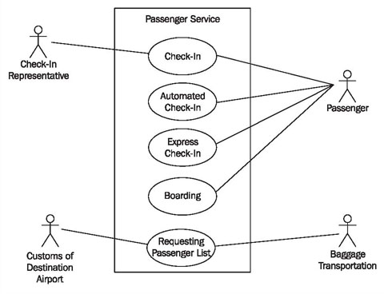
Air Travel Use Case Diagram

Slide 28
Today’s Lecture
Use Cases
  What and why
  How
  Use case diagrams
  Use case models
  Advanced concepts
  Guidelines
Homework 1
Quiz #1

Slide 29
Use Case Model - Definition
Consists of
  Use cases
    Illustrating the system’s intended functions/behaviors
  Actors
    Illustrating the system’s immediate surroundings
  Diagrams
    Illustrating relationships between the system (use cases) and its surroundings (actors)
There will generally be one use case model per system, containing multiple use cases, actors, and diagrams

Slide 30
Use Case Model – Purpose (I)
Used as a unifying thread throughout development
  The same use case model used in requirements is used in design, implementation, and test
Used to identify
  Who will interact with the system and what the system should do
  What interfaces the system should have
Other related requirements documents may be linked
Notes:
Each actor gets an interface to the system
Other related requirements documents covering the things mentioned previously that use cases cannot model

Slide 31
Use Case Model – Purpose (II)
Used to communicate with the end users and domain experts
  Ensures a mutual understanding of the requirements
Used to verify that
  All behavioral (system interaction) requirements have been captured
  Developers have understood the requirements

Slide 32
Today’s Lecture
Use Cases
  What and why
  How
  Use case diagrams
  Use case models
  Advanced concepts
  Guidelines
Homework 1
Quiz #1

Slide 33
Use Cases – Advanced Concepts
Levels of granularity
Use case “includes”
Use case “extends”

Slide 34
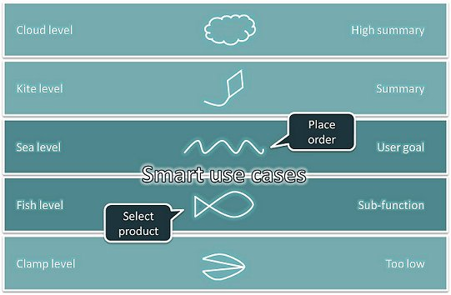
Use Case Levels of Granularity (II)
Notes:
Cockburn
Core use cases are at “sea level”; Can be done at one sitting at a computer (Withdraw money, deposit a check, check balance)
Fish level: Use cases that are included by sea-level use cases (Authorize customer, generate receipt)
Kite level: Show how sea-level use cases fit into larger business context; Cannot be done in one sitting, and may require multiple people, organizations, and systems interacting (Manage ATM operations, manage investments, manage loans)
Clamp level: e.g., put cursor in entry field
This is just one scheme, there are others, and you can establish your own conventions for levels for your project

Slide 35
Use Case “Includes”
One use case includes another use case in its entirety
Analogous to a program calling another or a routine using a subroutine
An application of reuse, modularity, anticipation of change
  Multiple use cases share the same functionality
  This functionality is placed in a separate use case
  Avoids repetition of the same information in multiple use cases
Examples
  Logon/logoff
  User authentication/authorization

Slide 36
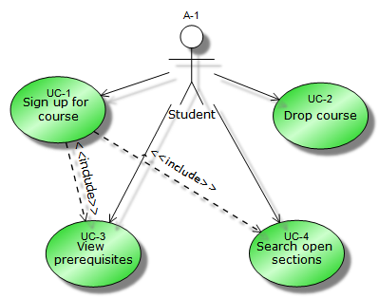
Example: Course Enrollment System

Slide 37
Use Case “Extends”
An extends relationship is used to show
  Optional behavior that is only run under certain conditions
  An “interruption” in the basic flow when the condition comes true
Typically occurs when an alternative flow has gotten too big for a particular use case
Notes:
For example, a use case that monitors the flow of packages on a conveyer belt can be extended by a Trigger Alarm use case if the packages jam

Slide 38
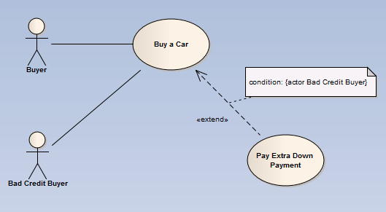
Example: Auto Purchasing System
Notes:
Differing schools of thought as to what “extends” really means and what should happen after the extended UC is finished—go back to main flow, terminate UC, or something else?

Slide 39
Today’s Lecture
Use Cases
  What and why
  How
  Use case diagrams
  Use case models
  Advanced concepts
  Guidelines
Homework 1
Quiz #1

Slide 40
Use Cases: Not so Fast…
If you don’t fully understand the ins and outs of use cases, it is easy to misuse them or turn them into “abuse” cases
Ellen Gottesdiener: “Top Ten Ways Project Teams Misuse Use Cases – and How to Correct Them.” The Rational Edge, June 2002 (Part I), July 2002 (Part II).
Martin Fowler: “Use and Abuse Cases.” Distributed Computing, April 1998.
Doug Rosenberg: “Top Ten Use Case Mistakes.” Software Development, February 2001.
Susan Lilly: “How to Avoid Use Case Pitfalls.” Software Development, January 2000.
Kulak and Guiney: “Use Cases: Requirements in Context.” Second Edition, Addison-Wesley 2003.

Slide 41
Top Misguided Guidelines (Gottesdiener)
Don’t bother with any other requirements representations
  Use cases are the only requirements model you’ll need!
Stump readers about the goal of your use case
  Name use cases obtusely using vague verbs such as “do” or “process”
Include nonfunctional requirements and UI details in your use case text
Use lots of extends and includes in your initial use case diagrams
  This allows you to decompose use cases into tiny units of work
Notes:
Include nonfunction req’s… SEPARATE CONCERNS

Slide 42
Ten Misguided Guidelines (Cont’d)
Don’t involve subject matter experts in creating, reviewing, or verifying use cases
  They’ll only raise questions!
If you involve users in use cases definitions at all, just “do it”
  Why bother to prepare for meetings with the users?
Write your first and only use case draft in excruciating detail
  Why bother iterating with end users when they don’t even know what they want?
Don’t validate or verify your use cases
  That will only cause you to make revisions and do more rework!
Notes:
For meetings w/ users, come prepared with “focus questions” about how they accomplish the tasks they do
Write your first and only use case… INCREMENTALITY
Don’t validate or verify… RIGOR AND FORMALITY

Slide 43
Reminder: Fundamental Principles
Rigor and formality
Separation of concerns
  Modularity
  Abstraction
Anticipation of change
Generality
Incrementality
These principles apply to all aspects of software engineering

Slide 44
Today’s Lecture
Use Cases
  What and why
  How
  Use case diagrams
  Use case models
  Advanced concepts
  Guidelines
Homework 1
Quiz #1

Slide 45
Homework 1
You will specify the requirements for PrivatePractice
  An Electronic Medical Records (EMR) system for maintaining patient records at a small hospital
Homework 1 has been posted
  Along with a template, rubric, and some example requirements documents
  All of the instructions are contained in the prompt and in the template

Slide 46
Homework 1 Use Case Model
There is no template to follow for the use case part, but see samples for acceptable examples

Slide 47
Homework 1 - Client Interview
Client interview will span Thursday, October 8, Tuesday, October 13, and Thursday, October 15
Read the prompt and template
Read the samples
Come prepared with your questions
Research existing similar systems
For this exercise, Neeraj is a “naïve” client who
  knows very little about software engineering
  knows only about his business
  will not answer any questions outside of lecture

Slide 48
Next Time
Client interview
Discussion tomorrow

Slide 49
Today’s Lecture
Use Cases
  What and why
  How
  Use case diagrams
  Use case models
  Advanced concepts
  Guidelines
Homework 1
Quiz #1

