Slide 1
Informatics 43 Introduction to Software Engineering Lecture 10-1
June 2, 2015
Emily Navarro
Duplication of course material for any commercial purpose without the explicit written permission of the professor is prohibited.

Slide 2
Today’s Lecture
Announcements
Miscellaneous testing topics
Moore’s Law
Project estimation
“A Day in the Life of a Software Engineer”

Slide 3
Today’s Lecture
Announcements
Miscellaneous testing topics
Moore’s Law
Project estimation
“A Day in the Life of a Software Engineer”

Slide 4
Announcements
0.5% extra credit for submitting the EEE Course Evaluation
Homework 3 due tonight 11:55pm to EEE
Come to discussion this week to pick up any outstanding quizzes or midterms

Slide 5
Today’s Lecture
Announcements
Miscellaneous testing topics
Moore’s Law
Project estimation
“A Day in the Life of a Software Engineer”

Slide 6
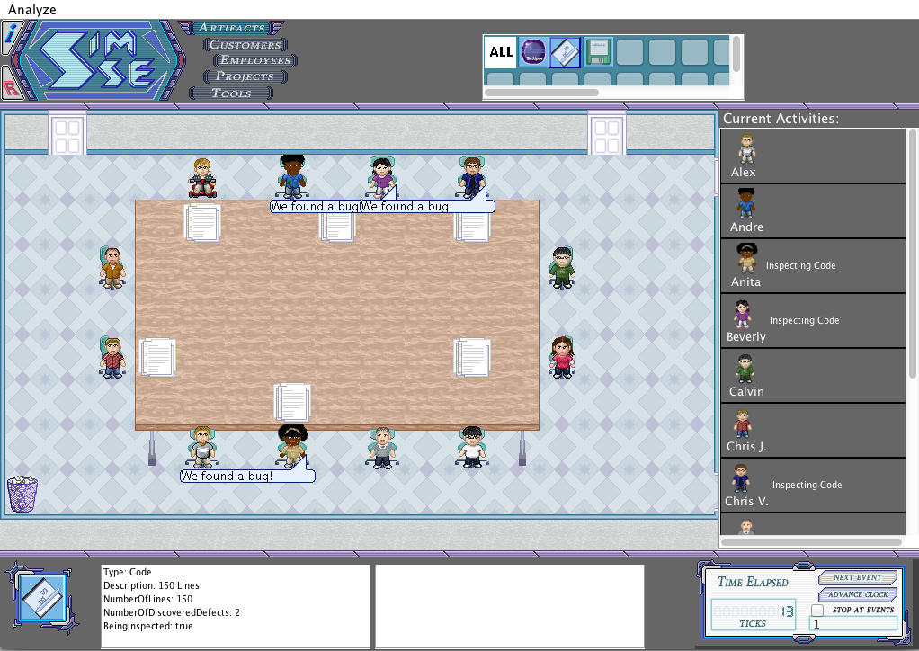
Inspections and Reviews
Humans read documents and look for defects
Surprisingly effective
Many different approaches and levels of details
Notes:
Reviews refer to any error-finding activity that includes humans reading and understanding a document and then analyzing it to find errors
Inspections are when people study a work (does not have to be code) independently, then meet to analyze it in more detail; sometimes checklists are used to help detect common problems

Slide 7
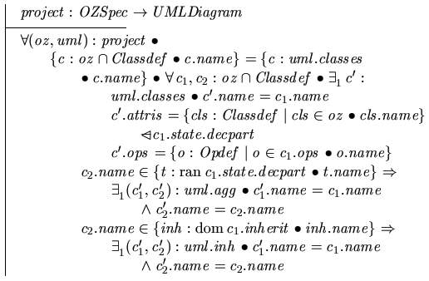
Formal Methods
Proofs of correctness
Note: verification only
Usually done with formal specifications

Slide 8
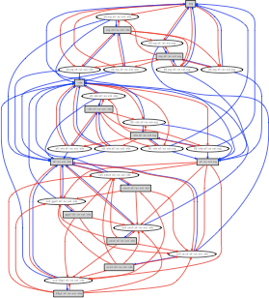
Static Analysis
A computer program analyzes source code and finds defects (without running the code)
Results are reviewed by a person because many “errors” are not errors at all

Slide 9
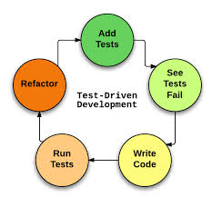
Test-Driven Development (TDD)
Notes:
An application of white-box testing

Slide 10
Test-Driven Development (TDD)
TDD is an effective tool for building reliable software, but not a substitute for other quality control activities
TDD should be combined with other QA activities
TDD usually leads to writing more tests and simpler code
TDD usually achieves at least statement coverage
Test cases in TDD are produced based on the developer’s intuitions and experience, although other techniques may be used

Slide 11
Testing: A Look Back
Quality assurance
Testing
Black-box (Specification-based) Testing
White-box (Structural) Testing
Miscellaneous testing topics
Inspections and reviews
Formal methods
Static analysis
Test-driven development

Slide 12
Testing Topics Not Covered
Combinatorial Testing
Regression Testing
Performance Testing
Load Testing
Debugging
…
Notes:
We just scratched the surface!
Combinatorial: analyzes different combinations of inputs to cover all
Regression testing: testing to uncover new bugs that occur as a result of changes to the sw
Load testing: testing how the system behaves under high demand

Slide 13
Today’s Lecture
Announcements
Miscellaneous testing topics
Moore’s Law
Project estimation
“A Day in the Life of a Software Engineer”

Slide 14
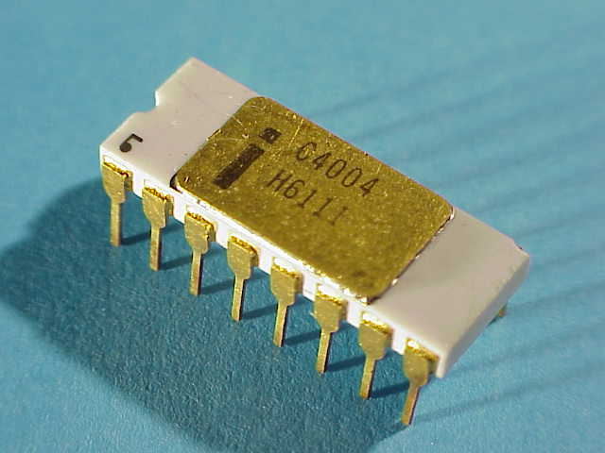
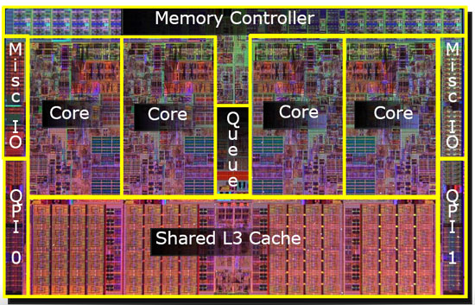
Moore’s Law
The number of transistors on integrated circuits doubles approximately every two years.
Intel P4004 from 1969 2,300 transistors, 108 kHz clock speed
Intel Core i7 from 2010
731,000,000 transistors,
3.06 GHz clock speed
Notes:
Transistors are tiny switches that can be triggered by electric signals. They are the basic building blocks of microchips
Integrated circuit = microchip; functions as computer memory

Slide 15
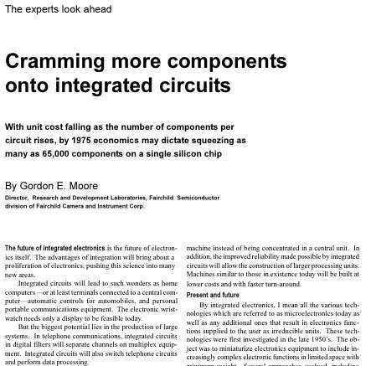
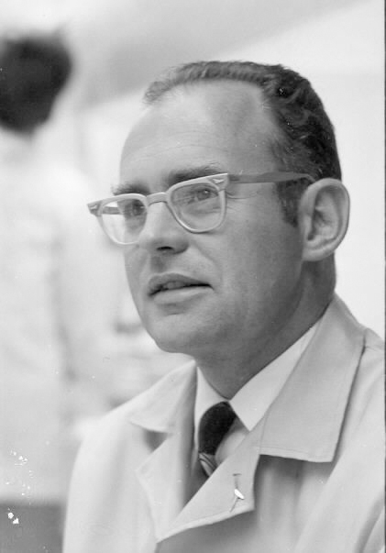
Moore’s Law
Electronics
19 April 1965
Notes:
co-founded Intel
Article that started it all

Slide 16
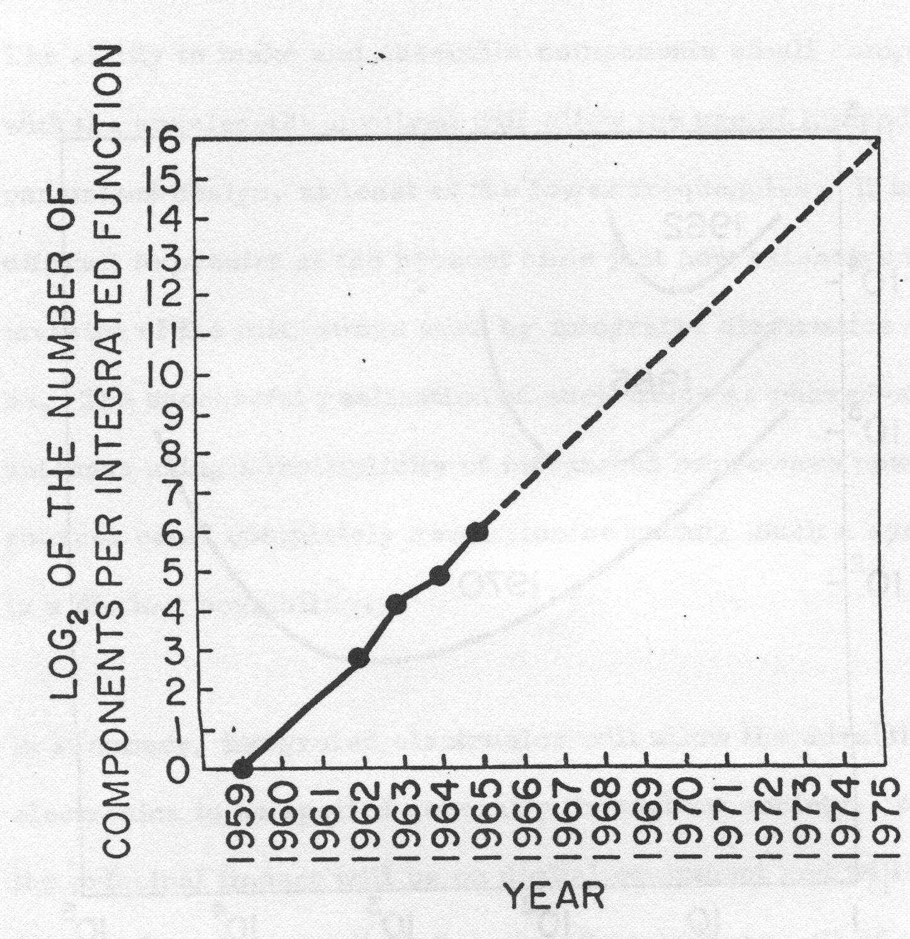
Moore’s Original Data
Gordon Moore
Electronics
19 April 1965
Notes:
Log linear relationship between device complexity and time
Only predicted to 1975

Slide 17
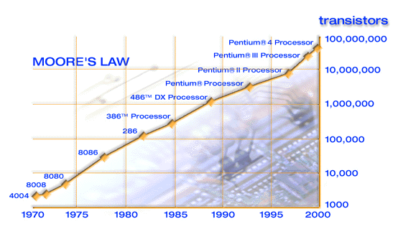
Moore’s Law to 2000
Notes:
Was true through 2000

Slide 18
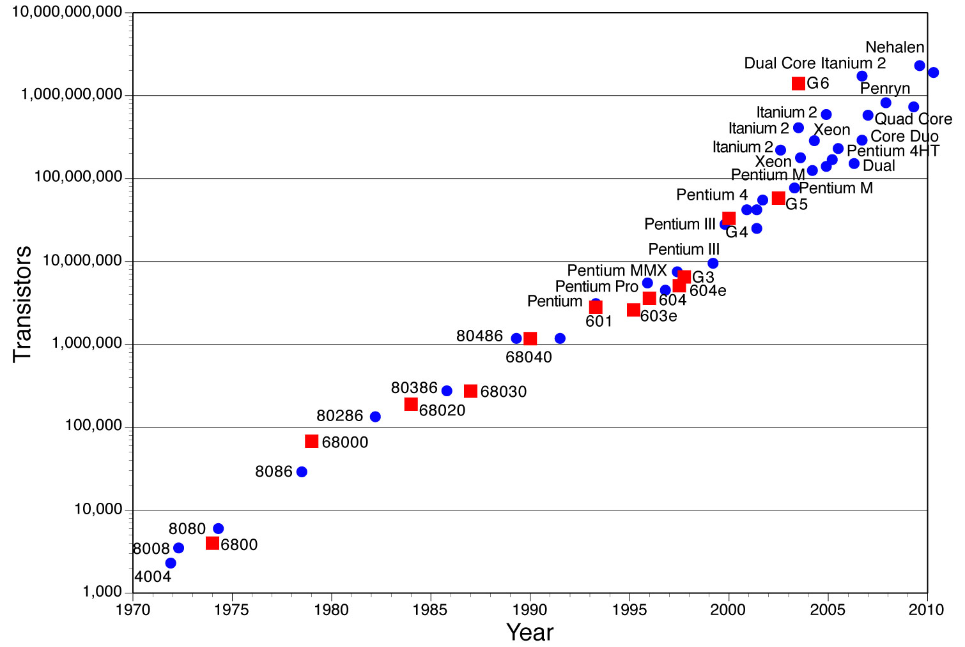
Moore’s Law through 2010
Motorola
Intel
Notes:
Was true through 2010

Slide 19
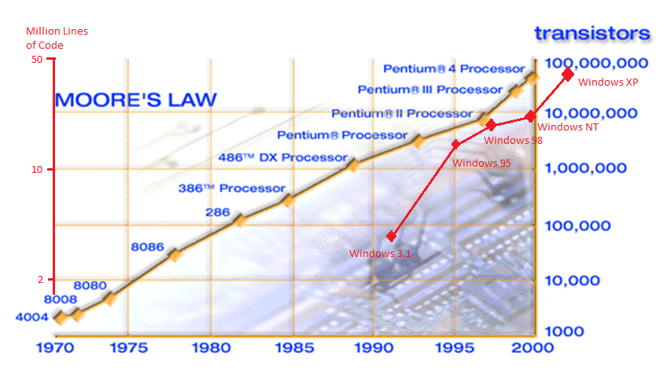
Moore’s Law with MS OS

Slide 20
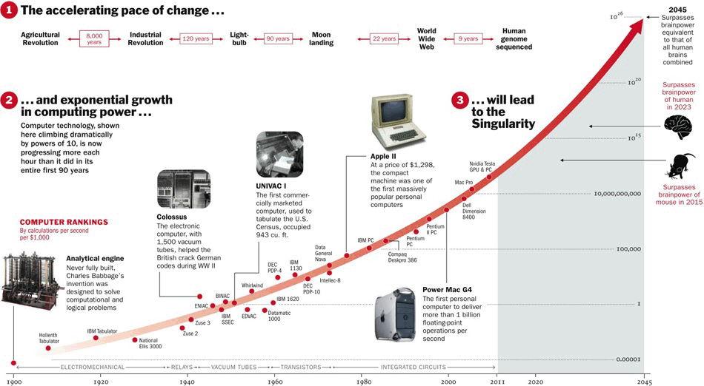
Moore’s Law in the Future?

Slide 21
Moore’s Law
Has held true for almost 50 years
Is so “true” that it guides the semiconductor industry in long-term planning and setting targets for research and development
May have reached its last stages with chips shrinking to the atomic level
But Intel claims they will continue to follow Moore’s Law
Notes:
Gets very difficult to create chips that small!

Slide 22
Is Moore’s Law Dead?
“[T]ransistors can be shrunk further, but they are now getting more expensive. And with the rise of cloud computing, the emphasis on the speed of the processor in desktop and laptop computers is no longer so relevant. The main unit of analysis is no longer the processor, but the rack of servers or even the data centre. The question is not how many transistors can be squeezed onto a chip, but how many can be fitted economically into a warehouse. Moore's law will come to an end; but it may first make itself irrelevant.”

Slide 23
Today’s Lecture
Announcements
Miscellaneous testing topics
Moore’s Law
Project estimation
“A Day in the Life of a Software Engineer”

Slide 24
Project Estimation – Why?
We need to be able to estimate things like how long a project will take, how many people are needed, how much it will cost, etc.
For the purpose of planning, giving bids, etc.

Slide 25
What to estimate
Effort (person-months)
Duration (calendar months)
Cost (dollars)
KLOC (thousands of lines of code)

Slide 26
Estimating a project
Approach 1: Naïve estimation
Take your best guess
Approach 2: Estimation by parts
Bottom-up or top-down, depending on where you start
Approach 3: Re-estimation
As more time is spent on a project, uncertainty decreases
Notes:
Bottom-up: work breakdown structure to estimate all of the lowest level, individual work components
Top-down: More of a holistic approach: Things like basing it on previous history, doing a partial work breakdown structure, expert opinion, etc. Appropriate for initial funding/prioritization/planning decisions

Slide 27
Productivity Rates
Longhorn Project (2003)
16 MLOC, 5000 people, 3 years
1067 LOC/person/year
Grady and Caswell at HP (1987)
~1100 LOC/person/year
Brooks (1975) IBM OS/360
600-800 instructions/person/year in control group

Slide 28
Factors Affecting Productivity Rates
Application domain experience
Process quality
Project size
Negative relationship
Technology support
Working environment

Slide 29
A general estimation formula
Textbook, p. 275:
Units of effort = a + b(size)^{c} + ACCUM(factors)
a = base cost
b = scales the size variable, derived from past projects
c = allows estimated project size to influence the effort
estimation non-linearly
ACCUM = a function, sum or product or ?
factors = other influences on the effort
Notes:
base cost of doing business (minimum cost of any project: administrative, support costs)
factors: personnel, tools, process factors

Slide 30
COCOMO - A Specific Estimation Model (Boehm)
One of the most widely used software estimation models
Predicts effort and schedule based on inputs relating to the size of the software and a number of cost drivers that affect productivity
Steps
Determine project mode (organic/simple, semidetached/intermediate, embedded/difficult)
Estimate the size of project (in KLOC or function points)
Review 15 factors (cost-drivers), and estimate the impact of each on the project
Determine project effort by inserting the estimated values into an effort formula

Slide 31
COCOMO Project Modes
Project mode is based on 8 parameters
The team’s understanding of project objectives
The team’s experience with similar projects
The project’s need to conform with established requirements
The project’s need to conform with established external interfaces
The need to develop the project concurrently with new systems/operational procedures
The project’s need for new technology, architecture, etc.
The project’s need to meet or beat the schedule
Project size
Notes:
Very difficult to choose a category based on these. What if project is small but deadline is tight and soon, or all new technology?

Slide 32
COCOMO Project Modes
Organic Mode
Small teams with good experience working with “less than rigid” requirements
Semidetached Mode
Medium teams with mixed experience working with a mixture of rigid and less than rigid requirements
Embedded Mode
Projects that must be developed within a series of tight constraints
Each mode has its own effort estimation formula

Slide 33
COCOMO Cost Drivers
Product attributes
Required software reliability
Database size
Product complexity
Computer attributes
Execution time constraint
Main memory constraint
Virtual machine complexity
Computer turnaround time
Personnel attributes
Analyst capability
Applications experience
Programmer capability
Virtual machine experience
Programming language experience
Project attributes
Use of modern practice
Use of software tools
Required development schedule

Slide 34
Comparison of Formulas
 | Halstead | Boehm | Walston-Felix
KLOC | E=0.7 KLOC^{1.50} | E=2.4 KLOC^{1.05} | E=5.2 KLOC^{0.91}
1 10 50 100 1000 | 0.7 22.1 247.5 700.0 22,135.9 | 2.4 26.9 145.9 302.1 3,390.1 | 5.2 42.3 182.8 343.6 2,792.6
Coefficients derived using actual project data
Notes:
Halstead and Walston-Felix are other cost esimtation models

Slide 35
What to Measure/Estimate
Lines of code – e.g. delivered lines of executable source code
Function points – count inputs, outputs, files
Feature points – similar to function points, also count algorithms
Object points – count screens, reports, and 3-GL components

Slide 36
Function Points
Analyze specifications and high-level design for
External inputs
External outputs
External inquiries
Internal logical files (e.g. classes, data structures)
External interface files
The result (after plugging them into a formula) is a number of Function Points.
Maybe: person-months = 0.20 * FP^{1.5}

Slide 37
Today’s Lecture
Announcements
Miscellaneous testing topics
Moore’s Law
Project estimation
“A Day in the Life of a Software Engineer”

Slide 38
A Day in the Life of a Software Engineer
https://www.youtube.com/watch?v=vt79JcPfZQA
https://www.youtube.com/watch?v=5fpggknHC2c&index=6&list=PLllx_3tLoo4fd1deqnzvyZrIrJzRdSC6-
https://www.youtube.com/watch?v=H1zD37rcVSQ

Slide 39
“Do Cool Things that Matter”
https://www.youtube.com/watch?v=_YwZEDU9bkA

Slide 40
“How to Get Noticed”
https://www.youtube.com/watch?v=E2dMmdewRxE

