Slide 1
Graph Drawing

Slide 2
Graphs
Vertices
Edges

Slide 3
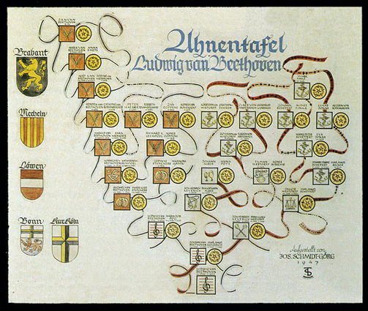
Graphs

Slide 4
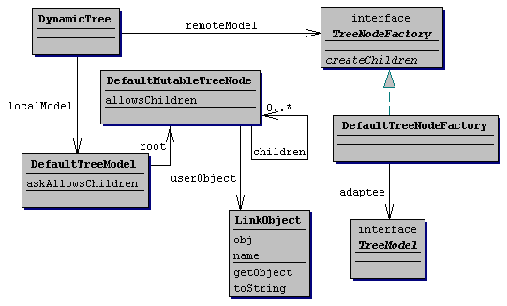
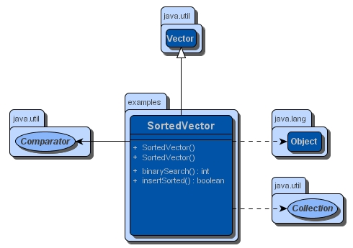
Graphs

Slide 5
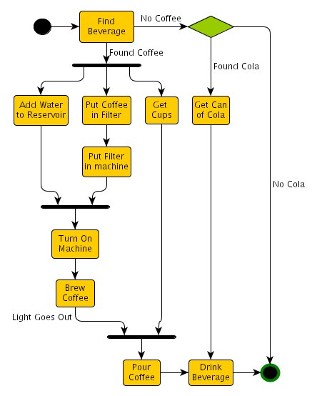
Graphs

Slide 6
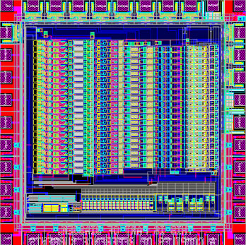
Graphs
Notes:
VLSI / circuit design
First major application of automated graph drawing
Floor planning

Slide 7
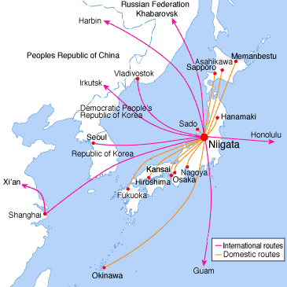
Graphs

Slide 8
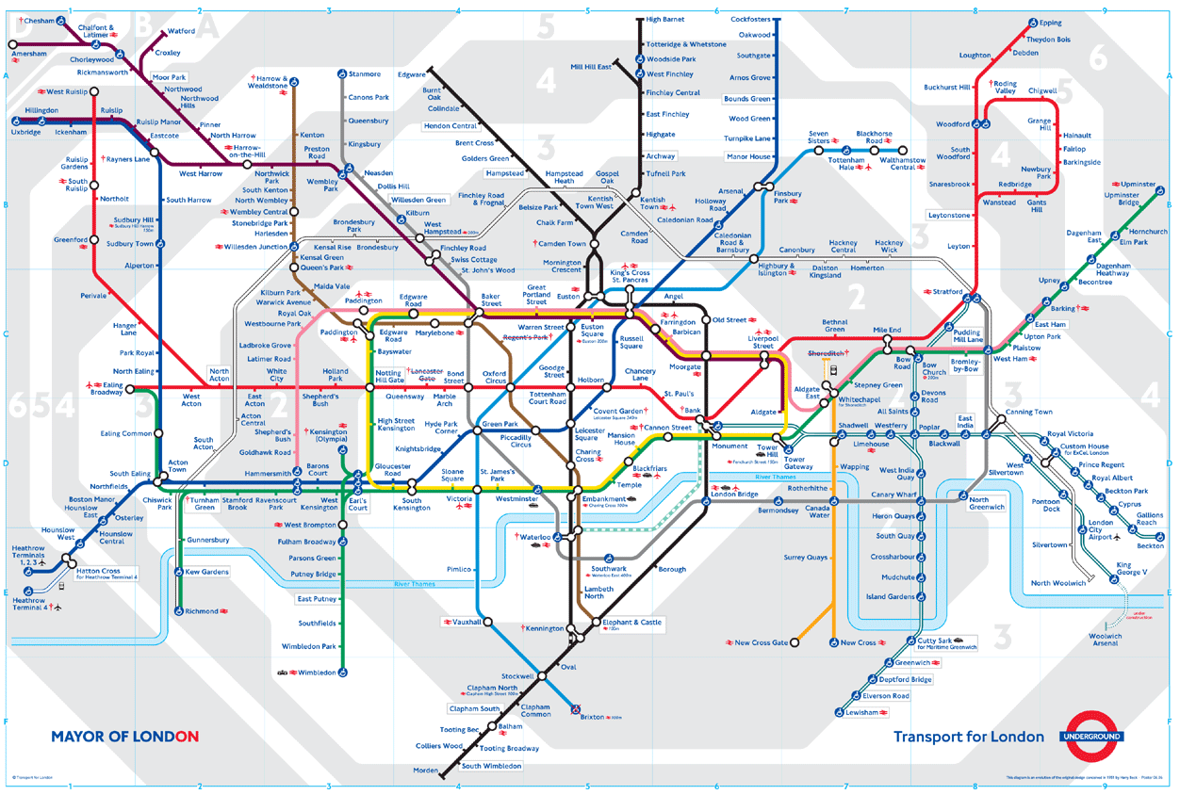
Graphs

Slide 9
Graphs
Vertices
Edges

Slide 10
Graphs
Vertices
Edges

Slide 11
Graphs
Vertices
Edges
Planar Graph
can be drawn in the plane without crossings
(inner) face
outer
face

Slide 12
Graphs
Planar Graph
can be drawn in the plane without crossings
Plane Graph
planar graph with a fixed embedding

Slide 13
Dual graph
The dual G* of a plane graph G
G* has a vertex for each face of G
G* has an edge for each edge e of G
(G*)* = G

Slide 14
Euler’s theorem
Theorem
Let G be a connected plane graph with v vertices, e edges, and f faces. Then v – e + f = 2.
Maximal or triangulated
planar graphs
can not add any edge without crossing
e = 3v - 6

Slide 15
Smallest not-planar graphs
K₅
K_{3,3}

Slide 16
Planarity testing
Theorem [Kuratowski 1930 / Wagner 1937]
A graph G is planar if and only if it does not contain K₅ or K_{3,3} as a minor.
Minor
A graph H is a minor of a graph G, if H can be obtained from G by a series of 0 or more deletions of vertices, deletions of edges, and contraction of edges.
G = (V, E), |V| = n, planarity testing in O(n) time possible.
Notes:
Kuratoswki does not lead to efficient algorithm

Slide 17
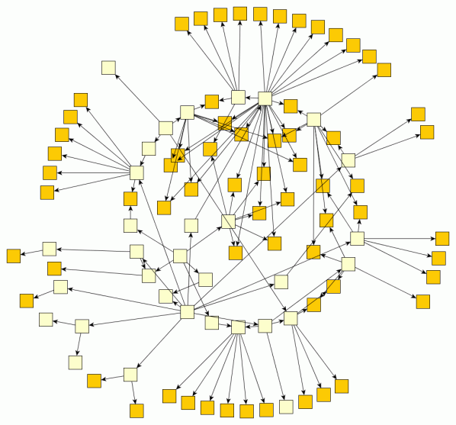
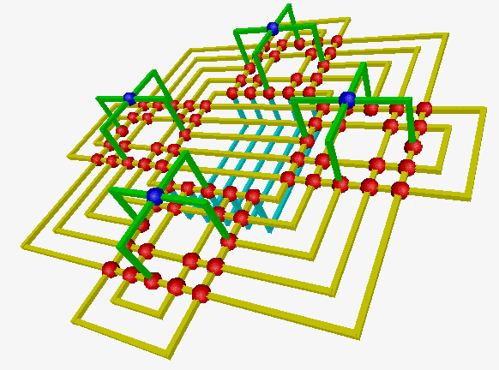
Drawings
Vertices
points, circles, or rectangles
polygons
icons
…
Edges
straight lines
curves
(axis-parallel) polylines
implicitly (by adjacency of rectangles representing vertices)
…
In two or three dimensions

Slide 18
Planar drawings
Vertices points in the plane
Edges curves
No edge crossings

Slide 19
Straightline drawings
Vertices points in the plane
Edges straight lines
Theorem
Every planar graph has a plane embedding where each edge is a straight line.
[Wagner 1936, Fáry 1948, Stein 1951]

Slide 20
Polyline drawings
Vertices points in the plane
Edges polygonal lines
All line segments are axis-parallel
orthogonal drawing (all vertices of degree ≤ 4)

Slide 21
Polyline drawings
Vertices points in the plane
Edges polygonal lines
All line segments are axis-parallel
orthogonal drawing (all vertices of degree ≤ 4)

Slide 22
Box orthogonal drawings
Vertices rectangles (boxes) in the plane
Edges axis-parallel polylines
Arbitrary vertex degree

Slide 23
Rectangular drawings
Vertices points in the plane
Edges vertical or horizontal lines
Faces rectangles
Generalization
box-rectangular drawings

Slide 24
Grid drawings
Vertices points in the plane on a grid
Edges polylines, all vertices on the grid
Notes:
drawing on raster devices
not too many vertices in small area

Slide 25
Grid drawings
Vertices points in the plane on a grid
Edges polylines, all vertices on the grid
Objective
minimize grid size
Notes:
drawing on raster devices
not too many vertices in small area

Slide 26
Visibility drawings
Vertices horizontal line segments
Edges vertical line segments, do not cross (see through) vertices

Slide 27
Quality criteria
Number of crossings (non-planar graphs)
Number of bends (total, per edge)
Aspect ratio (shortest vs. longest edge)
Area (grid drawings)
Shape of faces (convex, rectangles, etc.)
Symmetry (drawing captures symmetries of graph)
Angular resolution (angles between adjacent edges)
Aesthetic quality

Slide 28
Resources
http://www.graphdrawing.org
International Symposium (GD 2016)
Books on Graph Drawing
Takao Nishizeki, Md Saidur Rahman
Planar Graph Drawing
World Scientific, 2004
ISBN: 981-256-033-5

Slide 29
Examples

Slide 30
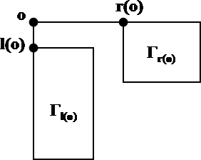
Examples

Slide 31
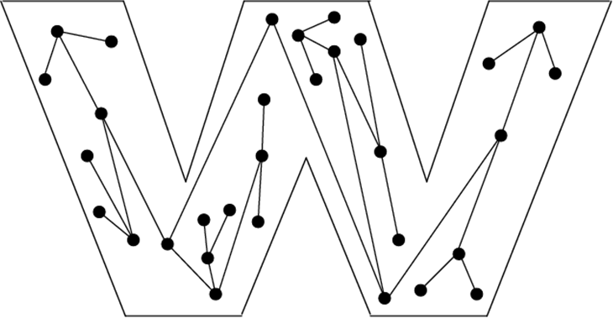
Examples

Slide 32
Examples

