Slide 1
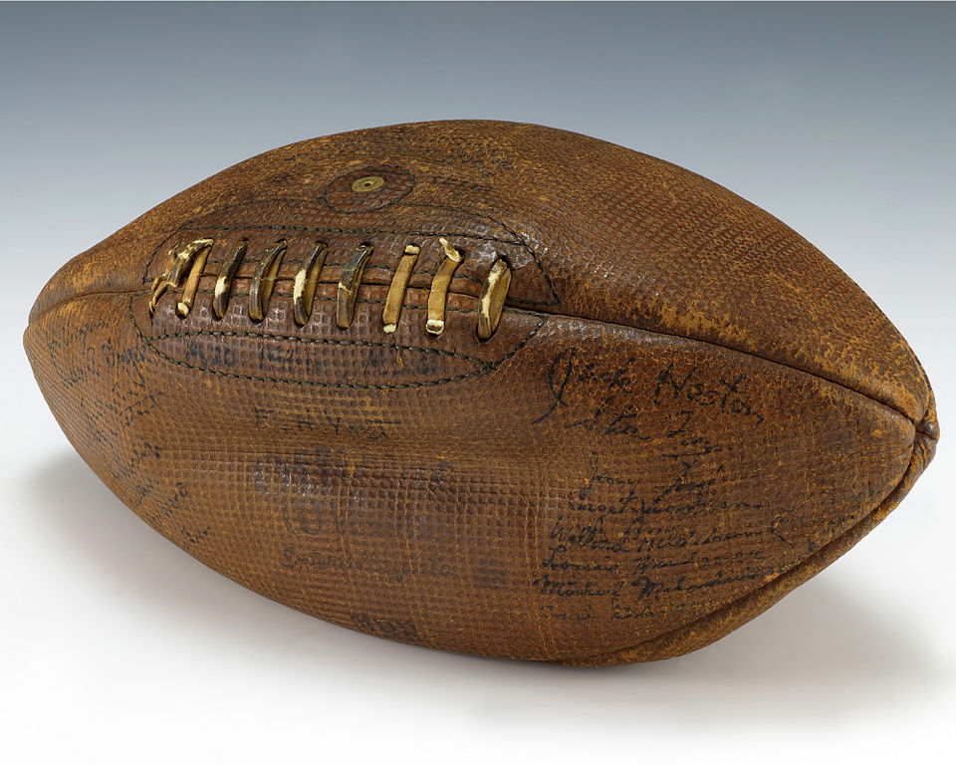
Dynamic Programming:
Game Strategies
Presentation for use with the textbook, Algorithm Design and Applications, by M. T. Goodrich and R. Tamassia, Wiley, 2015
Football signed by President Gerald Ford when playing for University of Michigan. Public domain image.

Slide 2
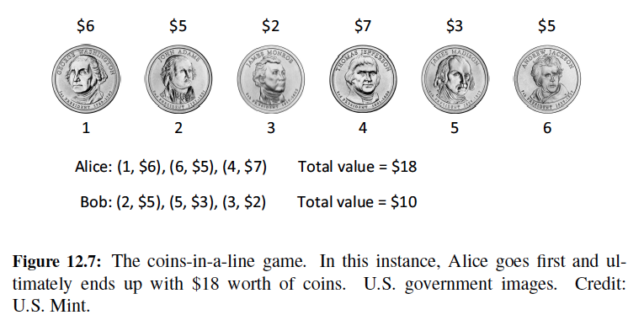
Coins in a Line
“Coins in a Line” is a game whose strategy is sometimes asked about during job interviews.
In this game, an even number, n, of coins, of various denominations, are placed in a line.
Two players, who we will call Alice and Bob, take turns removing one of the coins from either end of the remaining line of coins.
The player who removes a set of coins with larger total value than the other player wins and gets to keep the money. The loser gets nothing.
Alice’s goal: get the most.

Slide 3
False Start 1: Greedy Method
A natural greedy strategy is “always choose the largest-valued available coin.”
But this doesn’t always work:
  [5, 10, 25, 10]: Alice chooses 10
  [5, 10, 25]: Bob chooses 25
  [5, 10]: Alice chooses 10
  [5]: Bob chooses 5
Alice’s total value: 20, Bob’s total value: 30. (Bob wins, Alice loses)

Slide 4
False Start 2: Greedy Method
Another greedy strategy is “choose odds or evens, whichever is better.”
Alice can always win with this strategy, but won’t necessarily get the most money.
Example: [1, 3, 6, 3, 1, 3]
Alice’s total value: $9, Bob’s total value: $8.
Alice wins $9, but could have won $10.
How?

Slide 5
The General Dynamic Programming Technique
Applies to a problem that at first seems to require a lot of time (possibly exponential), provided we have:
  Simple subproblems: the subproblems can be defined in terms of a few variables, such as j, k, l, m, and so on.
  Subproblem optimality: the global optimum value can be defined in terms of optimal subproblems
  Subproblem overlap: the subproblems are not independent, but instead they overlap (hence, should be constructed bottom-up).

Slide 6
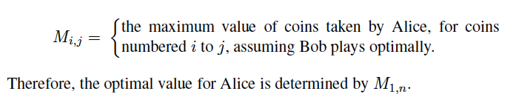
Defining Simple Subproblems
Since Alice and Bob can remove coins from either end of the line, an appropriate way to define subproblems is in terms of a range of indices for the coins, assuming they are initially numbered from 1 to n.
Thus, let us define the following indexed parameter:

Slide 7
Subproblem Optimality
Let us assume that the values of the coins are stored in an array, V, so that coin 1 is of Value V[1], coin 2 is of Value V[2], and so on.
Note that, given the line of coins from coin i to coin j, the choice for Alice at this point is either to take coin i or coin j and thereby gain a coin of value V[i] or V[j].
Once that choice is made, play turns to Bob, who we are assuming is playing optimally.
  We should assume that Bob will make the choice among his possibilities that minimizes the total amount that Alice can get from the coins that remain.

Slide 8
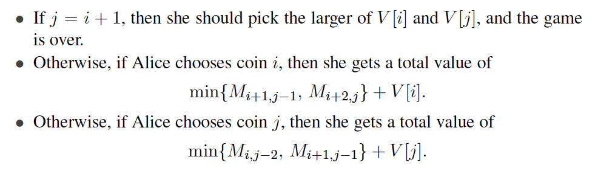

Subproblem Overlap
Alice should choose based on the following:
That is, we have initial conditions, for i=1,2,…,n-1:
And general equation:

Slide 9
Analysis of the Algorithm
We can compute the M_{i,j} values, then, using memoization, by starting with the definitions for the above initial conditions and then computing all the M_{i,j}’s where j − i + 1 is 4, then for all such values where j − i + 1 is 6, and so on.
Since there are O(n) iterations in this algorithm and each iteration runs in O(n) time, the total time for this algorithm is O(n²).
To recover the actual game strategy for Alice (and Bob), we simply need to note for each M_{i,j} whether Alice should choose coin i or coin j.

