Slide 1
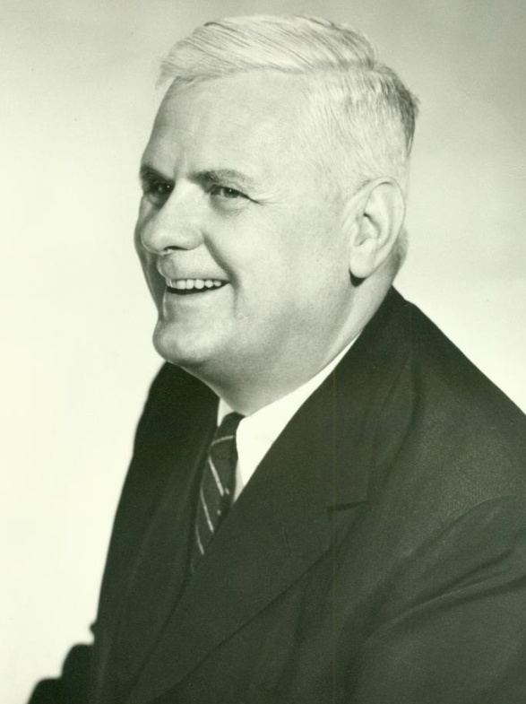
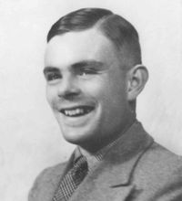
The Church-Turing Thesis and
Turing-completeness
Michael T. Goodrich
Univ. of California, Irvine
Alonzo Church (1903-1995)
Alan Turing (1912-1954)
Some slides adapted from David Evans, Univ. of Virginia, and Antony Galton, Univ. of Exeter

Slide 2
Recall: Turing Machine Definition
. . .
FSM
Infinite tape: Γ*
Tape head: read current square on tape,
write into current square,
move one square left or right
FSM: Finite-state machine:
transitions also include direction (left/right)
final accepting and rejecting states

Slide 3
Types of Turing Machines
Decider/acceptor:
Transducer (more general, computes a function):
w (input string)
Turing Machine
M
yes/no
w (input string)
Turing Machine
M
y (output string)

Slide 4
Church
Alonzo Church, 1936, An unsolvable problem of elementary number theory.
Introduced recursive functions and λ-definable functions and proved these classes equivalent.
“We … define the notion … of an effectively calculable function of positive integers by identifying it with the notion of a recursive function of positive integers.”

Slide 5
Turing
Alan Turing, 1936, On computable numbers, with an application to the Entscheidungs-problem.
Introduced the idea of a Turing machine computable number
“The [Turing machine] computable numbers include all numbers which could naturally be regarded as computable.”

Slide 6
The Church-Turing Thesis
“Every effectively calculable function can be computed by a Turing-machine transducer.”
“Since a precise mathematical definition of the term effectively calculable (effectively decidable) has been wanting, we can take this thesis ... as a definition of it...” – Kleene, 1943.
That is, for every definition of “effectively computable” functions that people have come up with so far, a Turing machine can compute
all such such functions.

Slide 7
Equivalent Statements of the Church-Turing Thesis
“Intuitive notion of algorithms equals Turing machine algorithms.” Sipser, p. 182.
Any mechanical computation can be performed by a Turing Machine
There is a TM-n corresponding to every computable problem
We can model any mechanical computer with a TM
The set of languages that can be decided by a TM is identical to the set of languages that can be decided by any mechanical computing machine
If there is no TM that decides problem P, there is no algorithm that solves problem P.
All of these statements are equivalent to the Church-Turing thesis

Slide 8
Examples of the Church-Turing Thesis
With respect to computational power (i.e., what can be computed):
Making the tape infinite in both directions adds no power
[Soon] Adding more tapes adds no power
[Church] Lambda Calculus is equivalent to TM
[Chomsky] Unrestricted replacement grammars are equivalent to TM
Random-Access Machine (RAM) model is equivalent to a TM
“Some of these models are very much like Turing machines, but others are quite different.”

Slide 9
Turing-Complete Systems
A computer system, C, is Turing-complete if it can simulate a universal Turing machine.
Thus, by the Chuch-Turing Thesis, the computer system, C, can compute any computable function.
So… if you want to show that a computer system can compute anything, you just need to show that it can simulate a Turing machine.

Slide 10
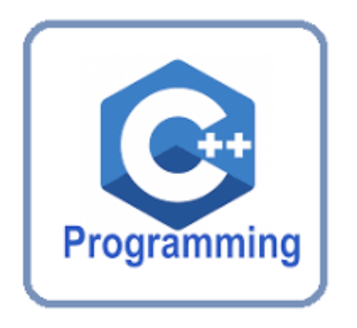
Turing-complete Systems by Design
Programming languages C, C++, Java, Python, Go, Visual Basic, Ruby, Pascal, Fortran, COBOL, …
These are Turing-complete by design.

Slide 11
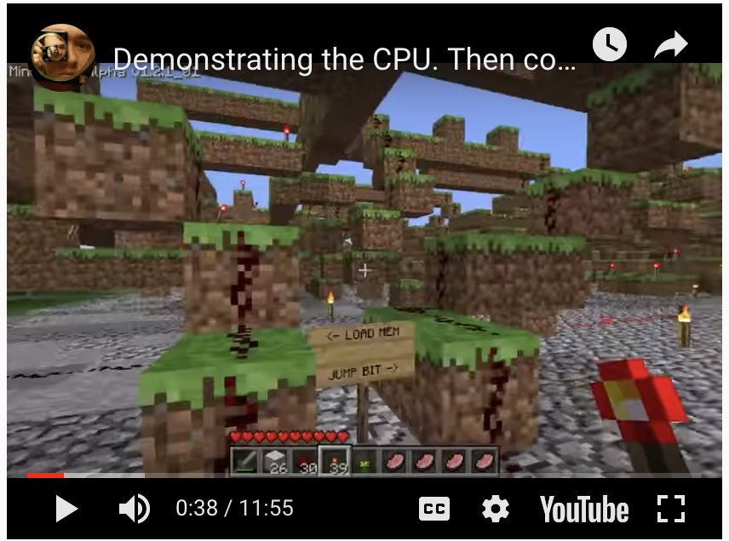
Accidental Turing-complete Systems
Excel
C++ templates
Java generics
Border Gateway Protocol (BGP)
Magic: The Gathering
Minecraft
Minesweeper
Conway’s Game of Life

