Slide 1
Some slides from Reva Freedman, Marty Stepp, Jessica Miller, and Ruth Anderson
Regular Expressions in Unix/Linux/Cygwin
CS 162 – UC-Irvine

Slide 2
Regular Expression (RE) Formal Definition
Basis:
single character, a, is an RE, signifying language {a}.
ε is an RE, signifying language {ε}
∅ is an RE, signifying language ∅
If E₁ and E₂ are REs, then E₁|E₂ is an RE, signifying L(E₁) U L(E₂)
If E₁ and E₂ are REs, then E₁E₂ is an RE, signifying L(E₁) L(E₂), that is, concatenation
If E is an RE, then E* is an RE, signifying L(E)*, that is, Kleene closure, which is the concatenation of 0 or more strings from L(E).
Precedence is the the order of Kleene closure (highest), concatenation, and union (lowest)
Parentheses can be used for grouping and don’t count as characters.

Slide 3
egrep and regexes
egrep "[0-9]{3}-[0-9]{3}-[0-9]{4}" contact.html
egrep searches for a regular expression pattern in a file (or group of files)
grep uses “basic” regular expressions instead of “extended”
extended has some minor differences and additional metacharacters
-i option before regex signifies a case-insensitive match
egrep -i "mart" matches "Marty S", "smartie", "WALMART", ...
command | description
egrep | extended grep; uses regexes in its search patterns; equivalent to grep -E

Slide 4
Metacharacters
any non-metacharacter matches itself
RE Metacharacter | Matches…
. | Any one character, except new line
[a-z] | Any one of the enclosed characters (e.g. a-z)
* | Zero or more of preceding character
? or \? | Zero or one of the preceding characters
+ or \+ | One or more of the preceding characters

Slide 5
more Metacharacters
RE Metacharacter | Matches…
^ | beginning of line
$ | end of line
\char | Escape the meaning of char following it
[^] | One character not in the set
\< | Beginning of word anchor
\> | End of word anchor
( ) or \( \) | Tags matched characters to be used later (max = 9)
| or \| | Or grouping
x\{m\} | Repetition of character x, m times (x,m = integer)
x\{m,\} | Repetition of character x, at least m times
x\{m,n\} | Repetition of character x between m and m times

Slide 6
Wildcards and anchors
. (a dot) matches any character except \n
".oo.y" matches "Doocy", "goofy", "LooPy", ...
use \. to literally match a dot . character
^ matches the beginning of a line; $ the end
"^fi$" matches lines that consist entirely of fi
\< demands that pattern is the beginning of a word; \> demands that pattern is the end of a word
"\<for\>" matches lines that contain the word "for“
Words are made up of letters, digits and _ (underscore)
Notes:
Answer:
egrep "\<C\>" ideas.txt
egrep "^ACT|^Scene" hamlet.txt

Slide 7
Special characters
| means OR
"abc|def|g" matches lines with "abc", "def", or "g"
precedence of ^(Subject|Date) vs. ^Subject|Date:
There's no AND symbol.
() are for grouping
"(Homer|Marge) Simpson" matches lines containing "Homer Simpson" or "Marge Simpson"
\ starts an escape sequence
many characters must be escaped to match them: / \ $ . [ ] ( ) ^ * + ?
"\.\\n" matches lines containing ".\n"

Slide 8
Quantifiers: * + ?
* means 0 or more occurrences
"abc*" matches "ab", "abc", "abcc", "abccc", ...
"a(bc)*" matches "a", "abc", "abcbc", "abcbcbc", ...
"a.*a" matches "aa", "aba", "a8qa", "a!?_a", ...
+ means 1 or more occurrences
"a(bc)+" matches "abc", "abcbc", "abcbcbc", ...
"Goo+gle" matches "Google", "Gooogle", "Goooogle", ...
? means 0 or 1 occurrences
"Martina?" matches lines with "Martin" or "Martina"
"Dan(iel)?" matches lines with "Dan" or "Daniel"
Notes:
Answer:
egrep "\^_*\^" chat.txt

Slide 9
More quantifiers
{min,max} means between min and max occurrences
"a(bc){2,4}" matches "abcbc", "abcbcbc", or "abcbcbcbc"
min or max may be omitted to specify any number
"{2,}" means 2 or more
"{,6}" means up to 6
"{3}" means exactly 3

Slide 10
Character sets
[ ] group characters into a character set; will match any single character from the set
"[bcd]art" matches strings containing "bart", "cart", and "dart"
equivalent to "(b|c|d)art" but shorter
inside [ ], most modifier keys act as normal characters
"what[.!*?]*" matches "what", "what.", "what!", "what?**!", ...
Notes:
Answer:
egrep "[ABCDF][+\-]?" 143.txt

Slide 11
Character ranges
inside a character set, specify a range of characters with -
"[a-z]" matches any lowercase letter
"[a-zA-Z0-9]" matches any lower- or uppercase letter or digit
an initial ^ inside a character set negates it
"[^abcd]" matches any character other than a, b, c, or d
inside a character set, - can sometimes be tricky to match
Try escaping it (use \) or place it last in the brackets
"[+\-]?[0-9]+" matches optional + or -, followed by ≥ one digit
Notes:
Answer:
egrep "[0-9]{3}-[0-9]{3}-[0-9]{4}" contact.html

Slide 12
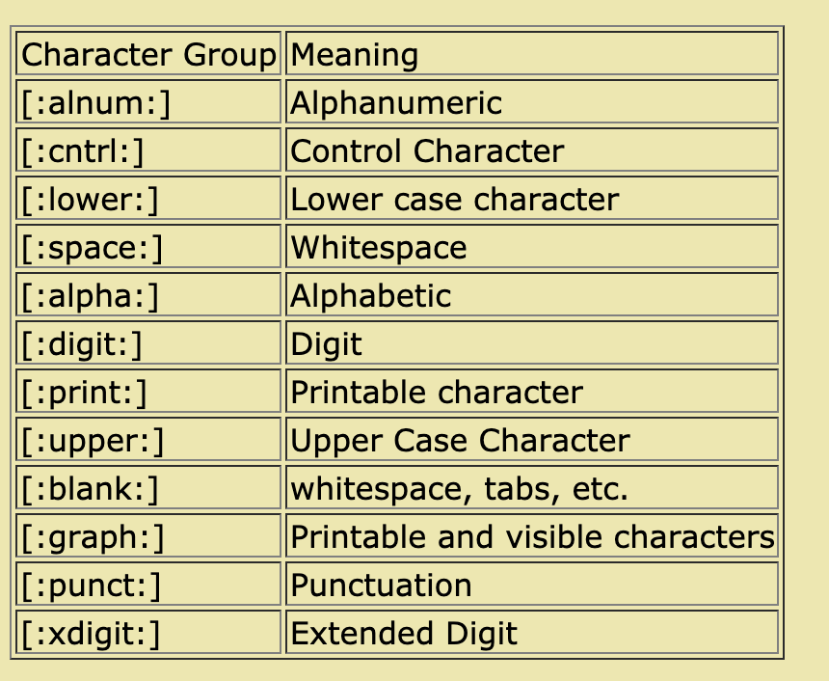
POSIX Character Sets
POSIX added newer, portable ways to describe character sets:
Note that some people use [[:alpha:]] as a notation, but the outer '[...]' specifies a character set.

Slide 13
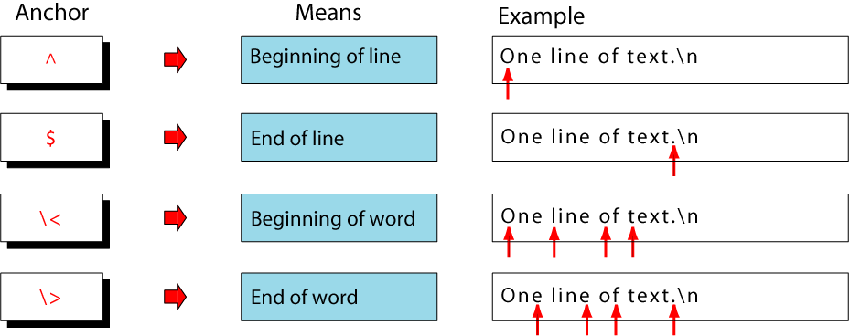
Anchors
Anchors tell where the next character in the pattern must
be located in the text data.

Slide 14
Concatenation Operator
In a sequence operator, if a series of atoms are shown in
a regular expression, there is no operator between them.

Slide 15
Alternation Operator: | or \|
operator (| or \| ) is used to define one
or more alternatives
Note: depends on whether using “egrep” or “grep”

Slide 16
Repetition Operator: {…} or \{…\}
The repetition operator specifies that the atom or expression immediately before the repetition may be
repeated.

Slide 17
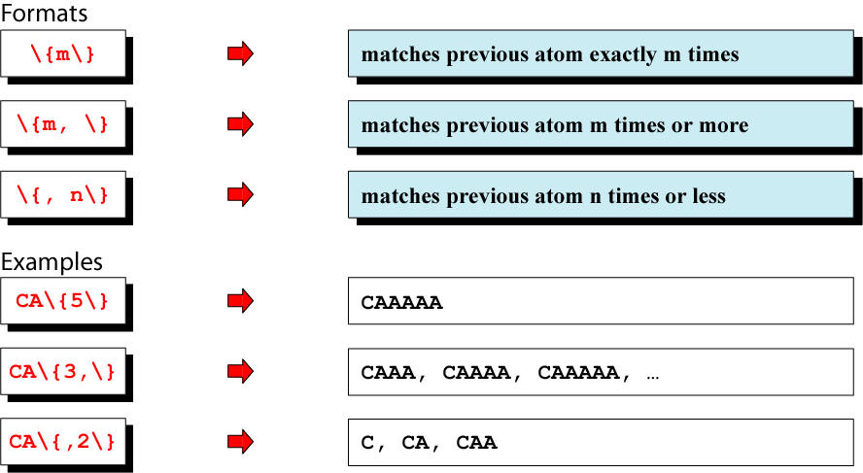
Basic Repetition Forms

Slide 18
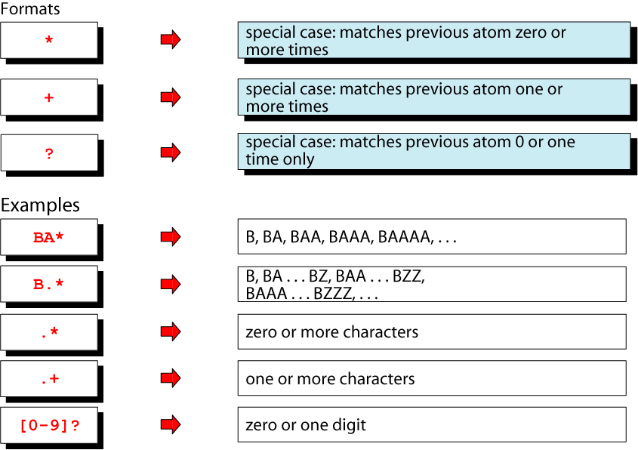
Short Form Repetition Operators: * + ?

Slide 19
Group Operator
In the group operator, when a group of characters is
enclosed in parentheses, the next operator applies to the
whole group, not only the previous characters.
Note: depends on “egrep” or “grep”
- grep uses \( and \)

Slide 20
Grep detail and examples
grep is family of commands
grep (global regular expression print)
common version
egrep (extended grep)
understands extended REs
(| + ? ( ) don’t need backslash)
fgrep (fast grep)
understands only fixed strings, i.e., is faster

Slide 21
Commonly used “grep” options:
-c | Print only a count of matched lines.
-i | Ignore uppercase and lowercase distinctions.
-l | List all files that contain the specified pattern.
-n | Print matched lines and line numbers.
-s | Work silently; display nothing except error messages. Useful for checking the exit status.
-v | Print lines that do not match the pattern.

Slide 22
Example: grep with pipe
% ls -l | grep '^d'
drwxr-xr-x 2 krush csci 512 Feb 8 22:12 assignments
drwxr-xr-x 2 krush csci 512 Feb 5 07:43 feb3
drwxr-xr-x 2 krush csci 512 Feb 5 14:48 feb5
drwxr-xr-x 2 krush csci 512 Dec 18 14:29 grades
drwxr-xr-x 2 krush csci 512 Jan 18 13:41 jan13
drwxr-xr-x 2 krush csci 512 Jan 18 13:17 jan15
drwxr-xr-x 2 krush csci 512 Jan 18 13:43 jan20
drwxr-xr-x 2 krush csci 512 Jan 24 19:37 jan22
drwxr-xr-x 4 krush csci 512 Jan 30 17:00 jan27
drwxr-xr-x 2 krush csci 512 Jan 29 15:03 jan29
% ls -l | grep -c '^d'
10
Pipe the output of the “ls –l” command to grep and list/select only directory entries.
Display the number of lines where the pattern was found. This does not mean the number of occurrences of the pattern.

Slide 23
Example: grep with \< \>
% cat grep-datafile
northwest NW Charles Main 300000.00
western WE Sharon Gray 53000.89
southwest SW Lewis Dalsass 290000.73
southern SO Suan Chin 54500.10
southeast SE Patricia Hemenway 400000.00
eastern EA TB Savage 440500.45
northeast NE AM Main Jr. 57800.10
north NO Ann Stephens 455000.50
central CT KRush 575500.70
Extra [A-Z]****[0-9]..$5.00
Print the line if it contains the word “north”.
% grep '\<north\>' grep-datafile
north NO Ann Stephens 455000.50

Slide 24
Example: grep with a\|b
% cat grep-datafile
northwest NW Charles Main 300000.00
western WE Sharon Gray 53000.89
southwest SW Lewis Dalsass 290000.73
southern SO Suan Chin 54500.10
southeast SE Patricia Hemenway 400000.00
eastern EA TB Savage 440500.45
northeast NE AM Main Jr. 57800.10
north NO Ann Stephens 455000.50
central CT KRush 575500.70
Extra [A-Z]****[0-9]..$5.00
Print the lines that contain either the expression “NW” or the expression “EA”
% grep 'NW\|EA' grep-datafile
northwest NW Charles Main 300000.00
eastern EA TB Savage 440500.45
Note: egrep works with |

Slide 25
Example: egrep with +
% cat grep-datafile
northwest NW Charles Main 300000.00
western WE Sharon Gray 53000.89
southwest SW Lewis Dalsass 290000.73
southern SO Suan Chin 54500.10
southeast SE Patricia Hemenway 400000.00
eastern EA TB Savage 440500.45
northeast NE AM Main Jr. 57800.10
north NO Ann Stephens 455000.50
central CT KRush 575500.70
Extra [A-Z]****[0-9]..$5.00
Print all lines containing one or more 3's.
% egrep '3+' grep-datafile
northwest NW Charles Main 300000.00
western WE Sharon Gray 53000.89
southwest SW Lewis Dalsass 290000.73
Note: grep works with \+

Slide 26
Example: egrep with RE: ?
% cat grep-datafile
northwest NW Charles Main 300000.00
western WE Sharon Gray 53000.89
southwest SW Lewis Dalsass 290000.73
southern SO Suan Chin 54500.10
southeast SE Patricia Hemenway 400000.00
eastern EA TB Savage 440500.45
northeast NE AM Main Jr. 57800.10
north NO Ann Stephens 455000.50
central CT KRush 575500.70
Extra [A-Z]****[0-9]..$5.00
Print all lines containing a 2, followed by zero or one period, followed by a number.
% egrep '2\.?[0-9]' grep-datafile
southwest SW Lewis Dalsass 290000.73
Note: grep works with \?

Slide 27
Example: egrep with ( )
% cat grep-datafile
northwest NW Charles Main 300000.00
western WE Sharon Gray 53000.89
southwest SW Lewis Dalsass 290000.73
southern SO Suan Chin 54500.10
southeast SE Patricia Hemenway 400000.00
eastern EA TB Savage 440500.45
northeast NE AM Main Jr. 57800.10
north NO Ann Stephens 455000.50
central CT KRush 575500.70
Extra [A-Z]****[0-9]..$5.00
Print all lines containing one or more consecutive occurrences of the pattern “no”.
% egrep '(no)+' grep-datafile
northwest NW Charles Main 300000.00
northeast NE AM Main Jr. 57800.10
north NO Ann Stephens 455000.50
Note: grep works with \( \) \+

Slide 28
Example: egrep with (a|b)
% cat grep-datafile
northwest NW Charles Main 300000.00
western WE Sharon Gray 53000.89
southwest SW Lewis Dalsass 290000.73
southern SO Suan Chin 54500.10
southeast SE Patricia Hemenway 400000.00
eastern EA TB Savage 440500.45
northeast NE AM Main Jr. 57800.10
north NO Ann Stephens 455000.50
central CT KRush 575500.70
Extra [A-Z]****[0-9]..$5.00
Print all lines containing the uppercase letter “S”, followed by either “h” or “u”.
% egrep 'S(h|u)' grep-datafile
western WE Sharon Gray 53000.89
southern SO Suan Chin 54500.10
Note: grep works with \( \) \|

Slide 29
Example: fgrep
% cat grep-datafile
northwest NW Charles Main 300000.00
western WE Sharon Gray 53000.89
southwest SW Lewis Dalsass 290000.73
southern SO Suan Chin 54500.10
southeast SE Patricia Hemenway 400000.00
eastern EA TB Savage 440500.45
northeast NE AM Main Jr. 57800.10
north NO Ann Stephens 455000.50
central CT KRush 575500.70
Extra [A-Z]****[0-9]..$5.00
Find all lines in the file containing the literal string “[A-Z]****[0-9]..$5.00”. All characters are treated as themselves. There are no special characters.
% fgrep '[A-Z]****[0-9]..$5.00' grep-datafile
Extra [A-Z]****[0-9]..$5.00

Slide 30
Example: Grep with ^
% cat grep-datafile
northwest NW Charles Main 300000.00
western WE Sharon Gray 53000.89
southwest SW Lewis Dalsass 290000.73
southern SO Suan Chin 54500.10
southeast SE Patricia Hemenway 400000.00
eastern EA TB Savage 440500.45
northeast NE AM Main Jr. 57800.10
north NO Ann Stephens 455000.50
central CT KRush 575500.70
Extra [A-Z]****[0-9]..$5.00
Print all lines beginning with the letter n.
% grep '^n' grep-datafile
northwest NW Charles Main 300000.00
northeast NE AM Main Jr. 57800.10
north NO Ann Stephens 455000.50

Slide 31
Example: grep with $
% cat grep-datafile
northwest NW Charles Main 300000.00
western WE Sharon Gray 53000.89
southwest SW Lewis Dalsass 290000.73
southern SO Suan Chin 54500.10
southeast SE Patricia Hemenway 400000.00
eastern EA TB Savage 440500.45
northeast NE AM Main Jr. 57800.10
north NO Ann Stephens 455000.50
central CT KRush 575500.70
Extra [A-Z]****[0-9]..$5.00
Print all lines ending with a period and exactly two zero numbers.
% grep '\.00$' grep-datafile
northwest NW Charles Main 300000.00
southeast SE Patricia Hemenway 400000.00
Extra [A-Z]****[0-9]..$5.00

Slide 32
Example: grep with \char
% cat grep-datafile
northwest NW Charles Main 300000.00
western WE Sharon Gray 53000.89
southwest SW Lewis Dalsass 290000.73
southern SO Suan Chin 54500.10
southeast SE Patricia Hemenway 400000.00
eastern EA TB Savage 440500.45
northeast NE AM Main Jr. 57800.10
north NO Ann Stephens 455000.50
central CT KRush 575500.70
Extra [A-Z]****[0-9]..$5.00
Print all lines containing the number 5, followed by a literal period and any single character.
% grep '5\..' grep-datafile
Extra [A-Z]****[0-9]..$5.00

Slide 33
Example: grep with [ ]
% cat grep-datafile
northwest NW Charles Main 300000.00
western WE Sharon Gray 53000.89
southwest SW Lewis Dalsass 290000.73
southern SO Suan Chin 54500.10
southeast SE Patricia Hemenway 400000.00
eastern EA TB Savage 440500.45
northeast NE AM Main Jr. 57800.10
north NO Ann Stephens 455000.50
central CT KRush 575500.70
Extra [A-Z]****[0-9]..$5.00
Print all lines beginning with either a “w” or an “e”.
% grep '^[we]' grep-datafile
western WE Sharon Gray 53000.89
eastern EA TB Savage 440500.45

Slide 34
Example: grep with [^]
% cat grep-datafile
northwest NW Charles Main 300000.00
western WE Sharon Gray 53000.89
southwest SW Lewis Dalsass 290000.73
southern SO Suan Chin 54500.10
southeast SE Patricia Hemenway 400000.00
eastern EA TB Savage 440500.45
northeast NE AM Main Jr. 57800.10
north NO Ann Stephens 455000.50
central CT KRush 575500.70
Extra [A-Z]****[0-9]..$5.00
Print all lines ending with a period and exactly two non-zero numbers.
% grep '\.[^0][^0]$' grep-datafile
western WE Sharon Gray 53000.89
southwest SW Lewis Dalsass 290000.73
eastern EA TB Savage 440500.45

Slide 35
Example: grep with x\{m\}
% cat grep-datafile
northwest NW Charles Main 300000.00
western WE Sharon Gray 53000.89
southwest SW Lewis Dalsass 290000.73
southern SO Suan Chin 54500.10
southeast SE Patricia Hemenway 400000.00
eastern EA TB Savage 440500.45
northeast NE AM Main Jr. 57800.10
north NO Ann Stephens 455000.50
central CT KRush 575500.70
Extra [A-Z]****[0-9]..$5.00
Print all lines where there are at least six consecutive numbers followed by a period.
% grep '[0-9]\{6\}\.' grep-datafile
northwest NW Charles Main 300000.00
southwest SW Lewis Dalsass 290000.73
southeast SE Patricia Hemenway 400000.00
eastern EA TB Savage 440500.45
north NO Ann Stephens 455000.50
central CT KRush 575500.70

Slide 36
Example: grep with \<
% cat grep-datafile
northwest NW Charles Main 300000.00
western WE Sharon Gray 53000.89
southwest SW Lewis Dalsass 290000.73
southern SO Suan Chin 54500.10
southeast SE Patricia Hemenway 400000.00
eastern EA TB Savage 440500.45
northeast NE AM Main Jr. 57800.10
north NO Ann Stephens 455000.50
central CT KRush 575500.70
Extra [A-Z]****[0-9]..$5.00
Print all lines containing a word starting with “north”.
% grep '\<north' grep-datafile
northwest NW Charles Main 300000.00
northeast NE AM Main Jr. 57800.10
north NO Ann Stephens 455000.50

Slide 37
Example: egrep with linux.words
/usr/share/dict % egrep -i '^x.*x$' linux.words
Xerox
xerox
xix
xx
xxx
xylanthrax
Print all words that begin and end with ‘x’.

Slide 38
Example: egrep with linux.words
/usr/share/dict % egrep '.*sex.*' linux.words | wc
325 325 3564
Counts all words that have “sex” as a substring
Some of the 325 words:
Essexville
misexample
misexecute
misexecution
misexpectation
misexpend
misexpenditure
misexplain
misexplained
misexplanation

Slide 39
Example: egrep with linux.words
/usr/share/dict % egrep '.*b.*b.*b.*b.*' linux.words
Lists words that have at least 4 b’s in them
Some of the 25 words:
beerbibber
bibble-babble
blood-bedabbled
bubble-bow
bubblebow
bubbybush
bumblebomb
double-bubble
flibbertigibbet
flibbertigibbets
flibbertigibbety
gibble-gabble
gibblegabble
gibble-gabbler
gibblegabbler
hubble-bubble

