Slide 1
Algorithms and Architectures
Michael T. Goodrich
CS 165
Univ. of California, Irvine
Algorithm
Architecture

Slide 2
Computational Models
We often skip this step, but an algorithm description requires a computational model.
There are several computational models, which are based on various computational architectures.
Algorithm
Architecture

Slide 3
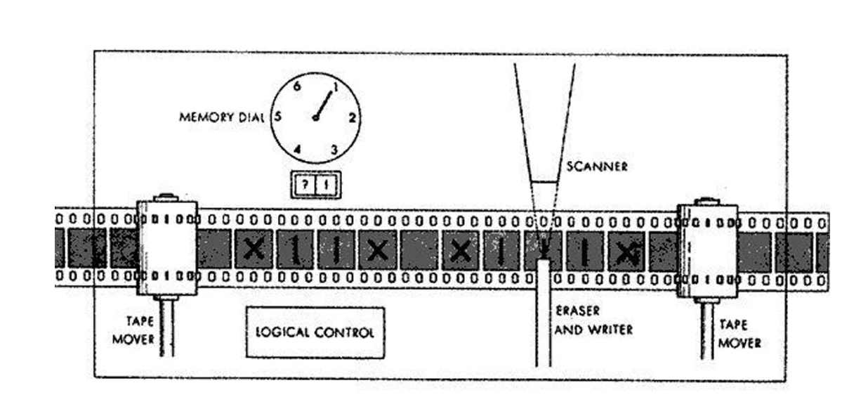
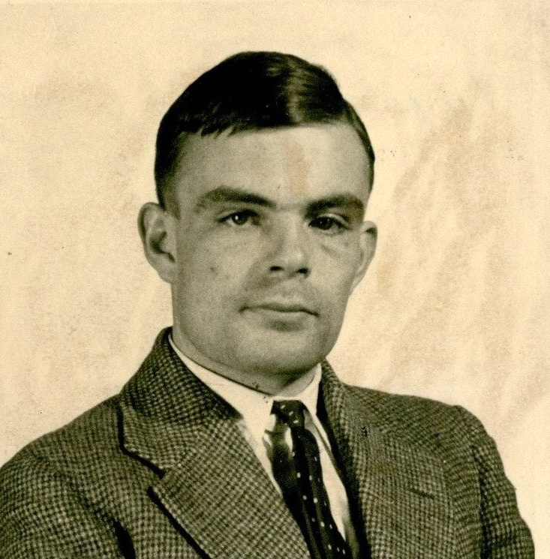
Turing Machine
Mathematical model of computation, 1936
Complexity-theoretic Church–Turing thesis: Any polynomial-time computable function (for any computational model) has a polynomial-time algorithm on a Turing machine.
Alan Turing
https://mediartinnovation.com/2014/05/26/alan-turing-turing-machine-1936/
https://en.wikipedia.org/wiki/Alan_Turing

Slide 4
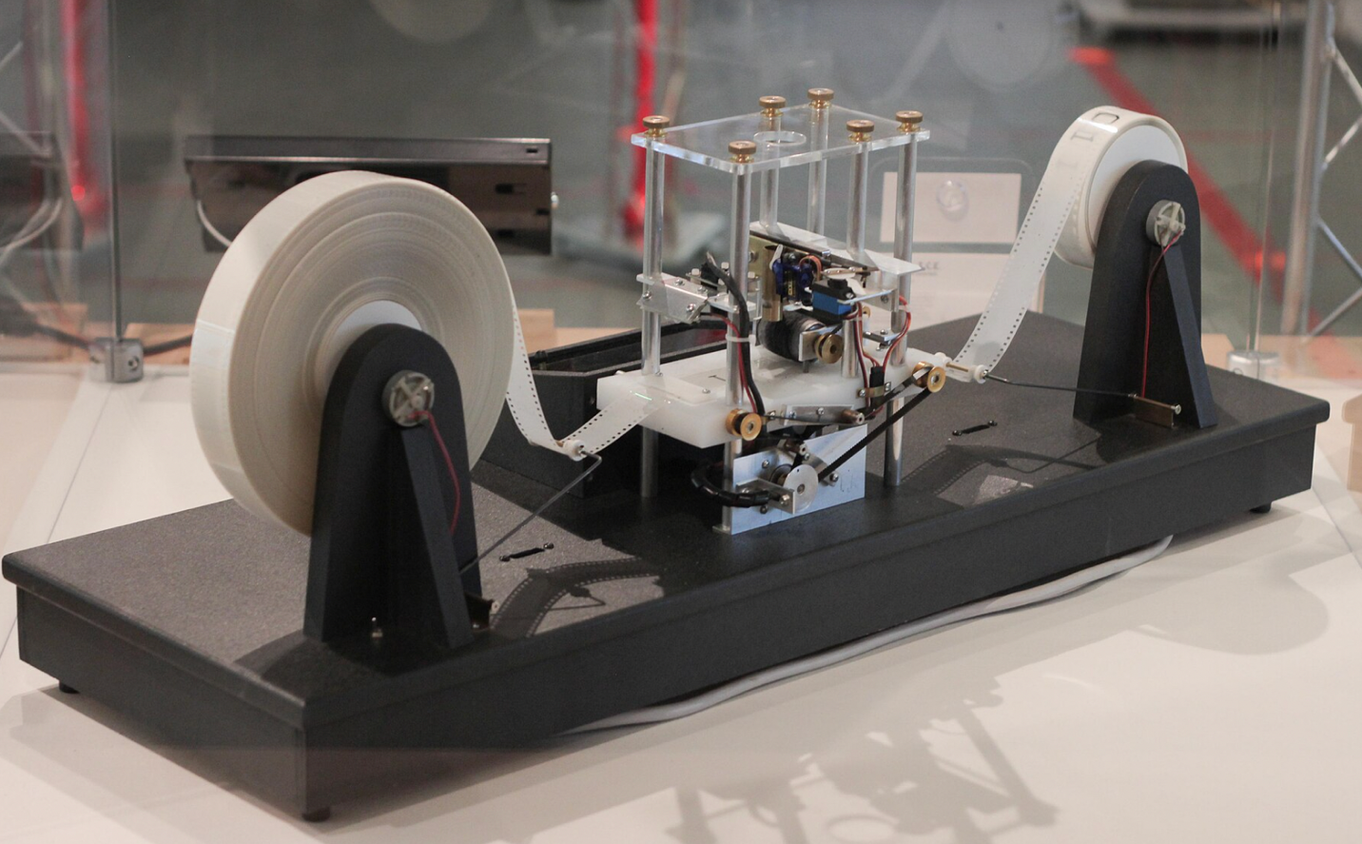
Turing Machine
Not a real-world computer, but imitations exist.
Any computational model/system that can simulate a Turing machine can compute any computable function: Turing-complete.
https://en.wikipedia.org/wiki/Turing_machine
not Alan Turing

Slide 5
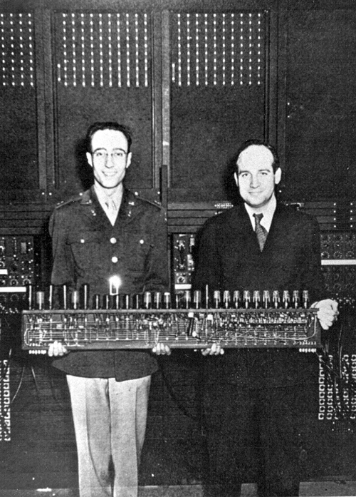
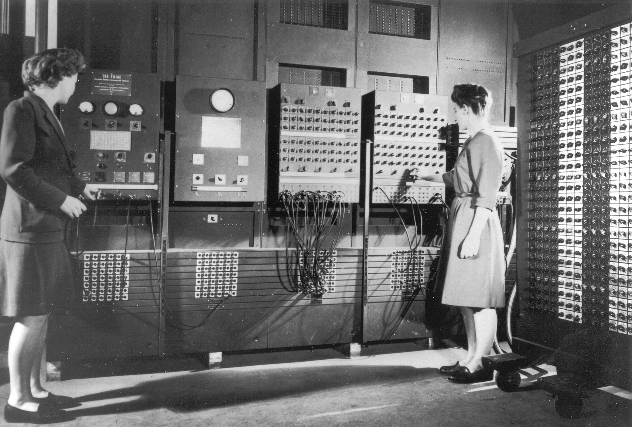
ENIAC
The first programmable, electronic, general-purpose digital computer, completed in 1945.
It was Turing-complete
Presper Eckert and John Mauchly
https://en.wikipedia.org/wiki/ENIAC

Slide 6
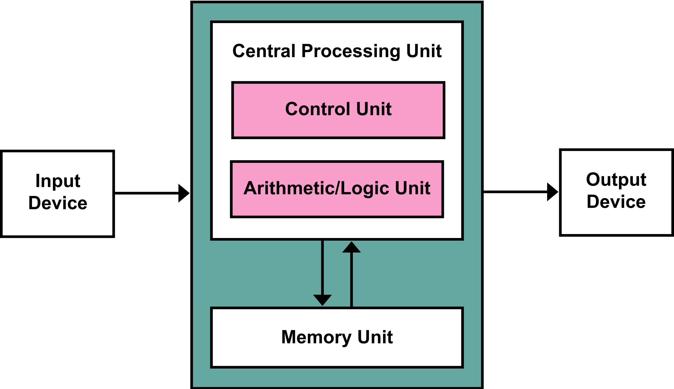
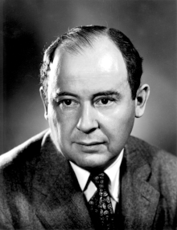
The von Neumann Architecture
ENIAC gave rise to a computational model called the von Neumann Architecture.
Memory stores both data and instructions
John von Neumann
https://en.wikipedia.org/wiki/Von_Neumann_architecture

Slide 7
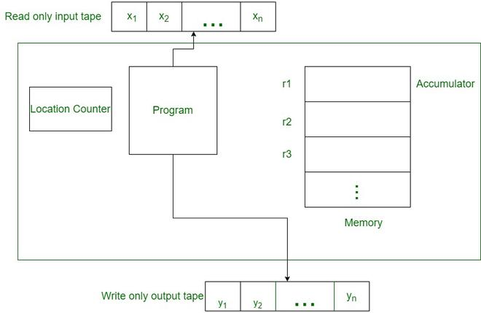
Random Access Machine (RAM)
A refinement of the von Neumann architecture.
https://www.geeksforgeeks.org/what-is-random-access-machine/

Slide 8
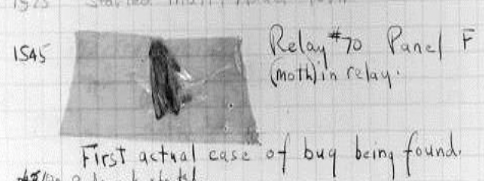
Programming Languages
Machine-independent languages written by humans and compiled into instructions for specific computer architectures.
The FLOW-MATIC programming language she created was later extended to create COBOL, a widely used high-level language for business applications.
Grace Hopper

Slide 9
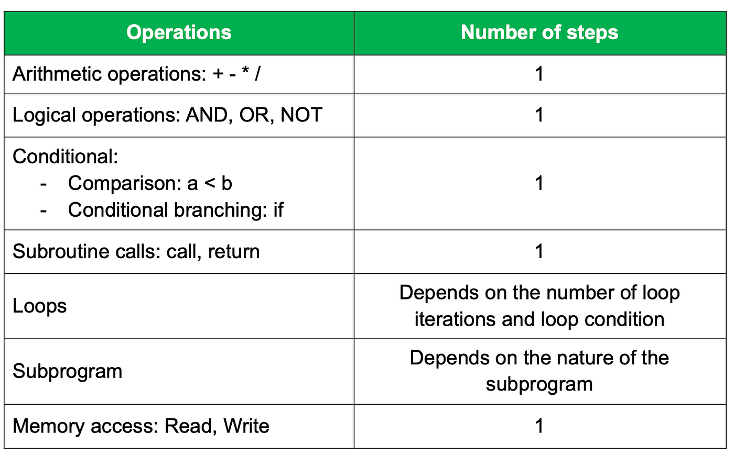
RAM Programming Primitives
Language primitives for the RAM model are based on high-level programming languages, which were defined for the von Neumann architecture.
https://medium.com/@exploreintellect/what-is-the-ram-model-of-computation-a5e4a7ce22b4

Slide 10
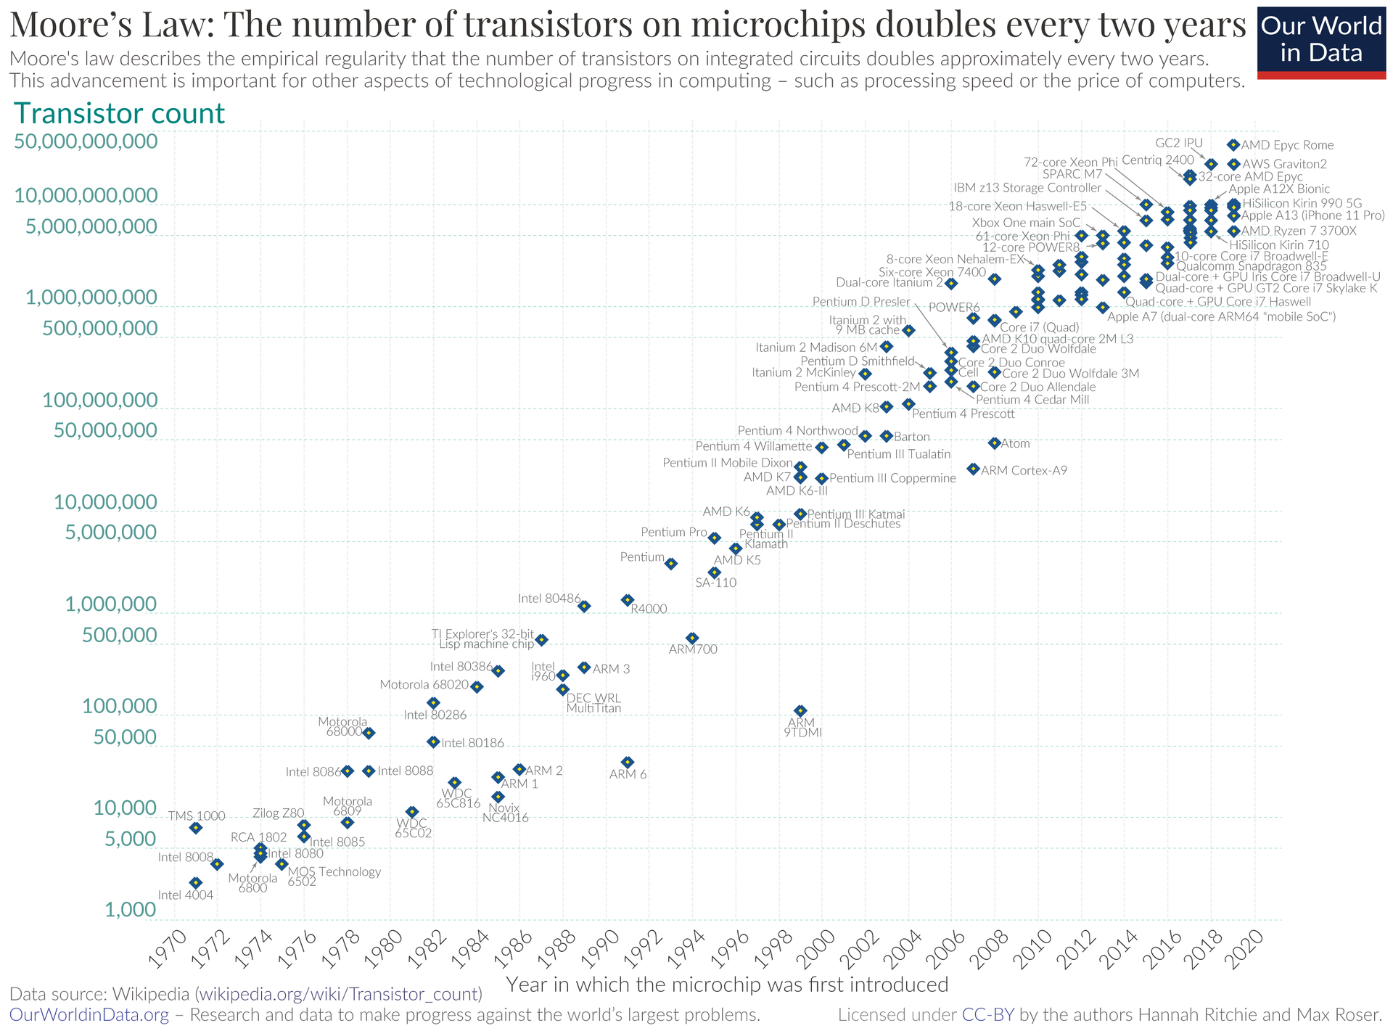
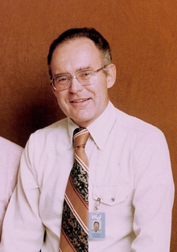
Moore’s Law
Moore’s “law” is the observation that the number of transistors in an integrated circuit doubles about every two years.
Gordon Moore
(Intel co-founder)

Slide 11
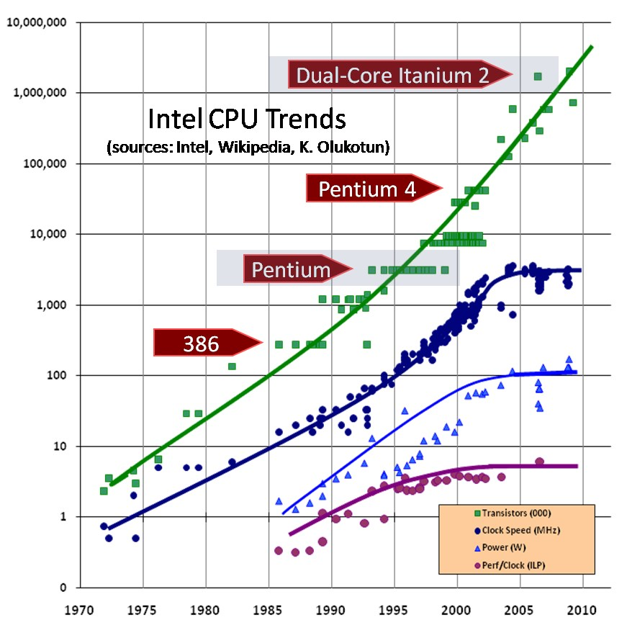
Moore’s Law Misquote
Not clock speed
Grace Hopper gave out “nanoseconds” to prove this point.

Slide 12
Word RAM Model
The word RAM (word random-access machine) model is a model of computation in which a random-access machine can do arithmetic and bitwise operations on a word of w bits in constant time.
Examples: bitwise AND, OR, XOR, MSB
word

Slide 13
Example Word RAM Algorithm
Given two arrays, A and B, of n bits, compute the first bit where A and B differ.
Compute C = A XOR B. Time: O(n/w)
Repeatedly test each word of MSB for equality with 0. Time: O(n/w).
For the first word, c, in C that is not 0, compute MSB(c).
Total running time: O(n/w).

Slide 14
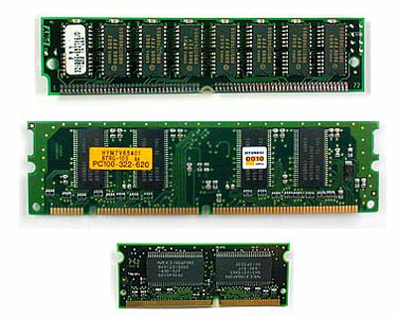
Understanding the Orders of Magnitude
External memory: 10 ms
Internal memory: 10 ns
1 million times slower!

Slide 15
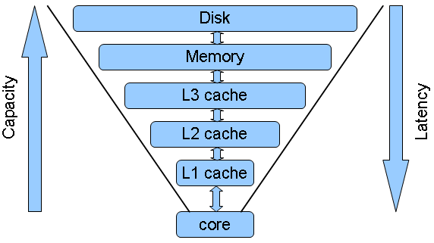
The Memory Hierarchy
The trade-off of size and speed
1 TB
10 ms
4 GB
10 ns
5 ns
0.5 ns

Slide 16
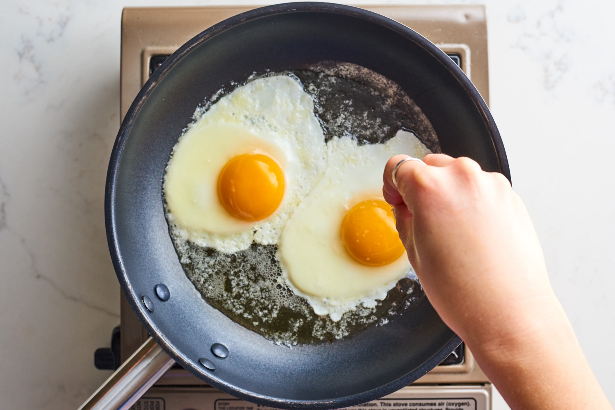
Analogy: Cooking Eggs
Suppose Anna is cooking eggs in in Irvine and wants to add salt and pepper
Suppose it takes her 10 seconds to go to her pantry, get salt and pepper and add them to her eggs

Slide 17
Analogy: Cooking Eggs
If going to her pantry is like a computer going to internal memory, then what would be analogous to going to external memory?

Slide 18
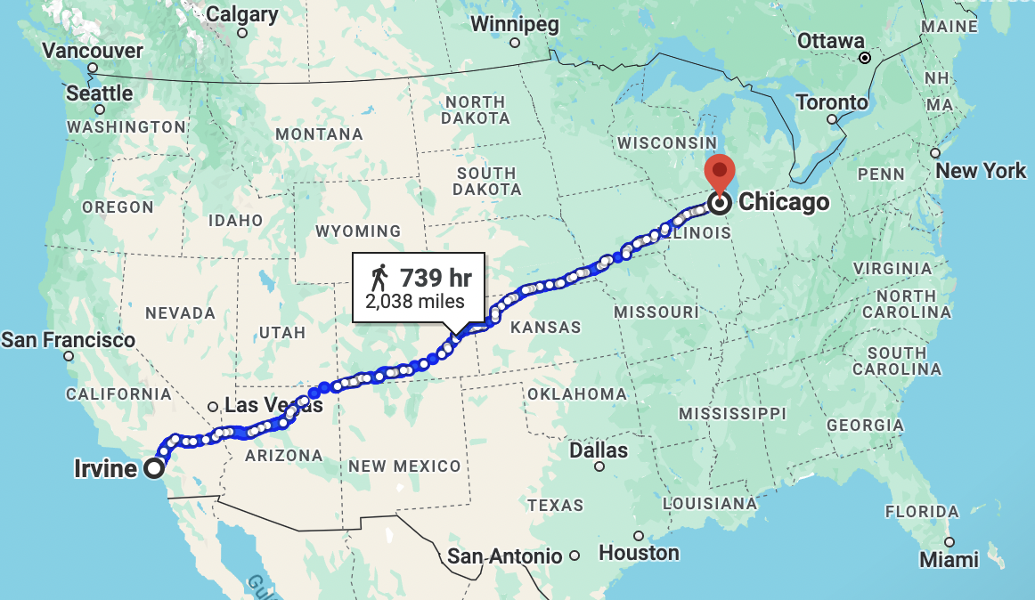
Analogy: Cooking Eggs
If going to her pantry is like a computer going to internal memory, then what would be analogous to going to external memory?
Walking to Chicago, buying salt and pepper, and walking back

Slide 19
External Memory Model
External memory identifies the frontier between the highest two layers in the memory hierarchy for a particular data set.
B = block size
M = “internal” memory size
m = M/B (number of internal blocks)
N = “external” input size
n = N/B (number of input blocks)
The model only counts the number of reads and writes to external memory (I/Os). All other costs are ignored.

Slide 20
B-Trees
A version of the (a,b) tree data structure, which is the best-known method for maintaining a map in external memory, is a “B-tree.”
A B-tree of order d is an (a,b) tree with a = d/2 and b = d.

Slide 21
B-tree I/O Complexity
Proof:
Each time we access a node to perform a search or an update operation, we need only perform a single disk transfer.
Each search or update requires that we examine at most O(1) nodes for each level of the tree.

Slide 22
External-Memory Sorting
Which of these sorting algorithms is good/bad in external memory?
Insertion-sort
Heapsort
Shellsort
Mergesort
Quicksort

Slide 23
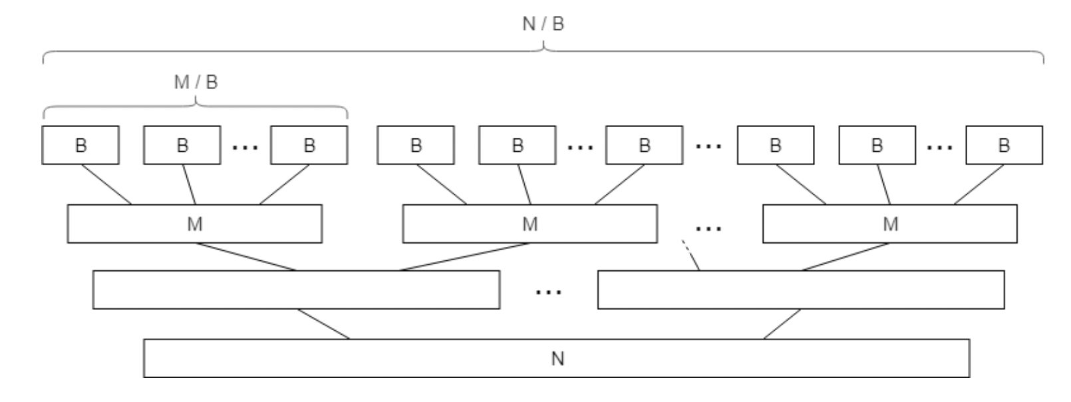
Better External-Memory Sorting
Multi-way Merge-sort:
Merge M/B sorted subarrays instead of 2.
Number of I/Os: O((N/B) log_{M/B} (N/B)).
This is optimal.

Slide 24
Parallel Random Access Machine (PRAM)
Synchronous shared memory model.

Slide 25
PRAM Algorithms
CRCW PRAM can compute OR of n bits in O(1) time with n processors.
CRCW PRAM can compute Min of n numbers in O(1) time with n² processors.
Merge two sorted lists of n elements in O(log n) time with n processors in CREW PRAM.
Sort n numbers in O(log² n) time with n processors by parallel merge-sort in CREW PRAM.

Slide 26
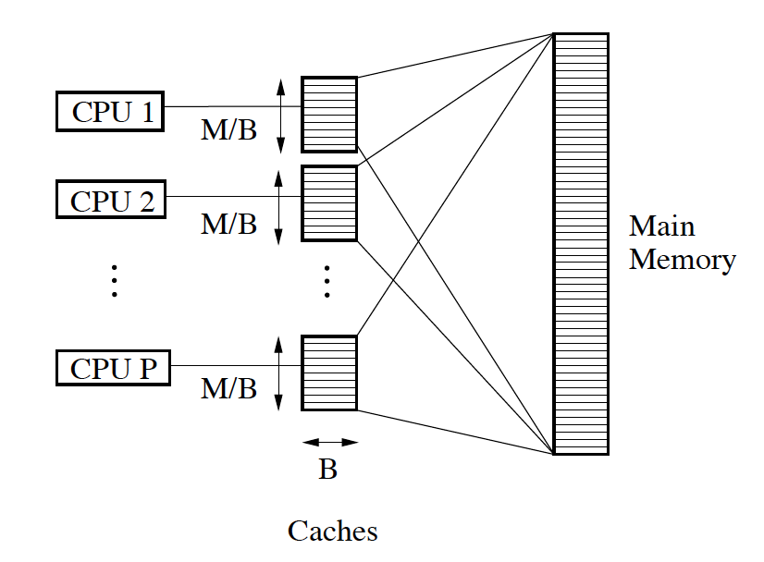
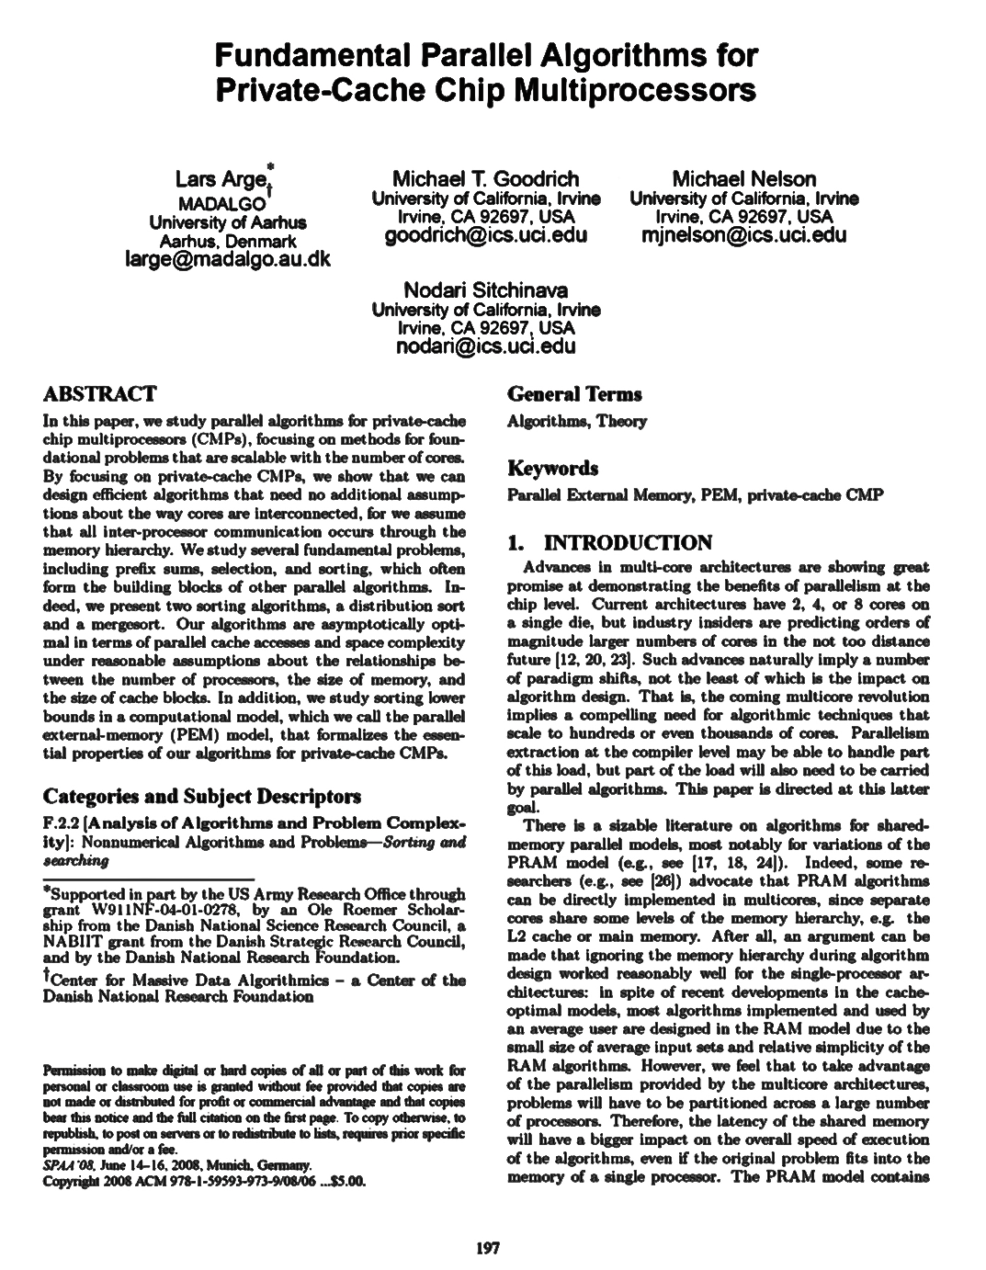
Parallel External Memory (PEM)
In joint work, we defined a parallel external memory model and designed efficient algorithms for it.

Slide 27
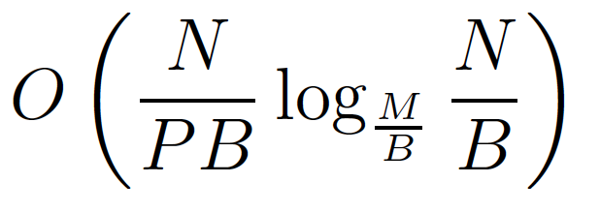
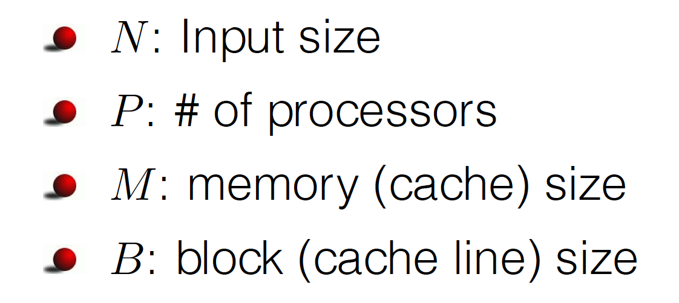
PEM Sorting Result
Sorting with optimal parallel I/O complexity:

