Slide 1
Navigation and Propagation in Networks
Michael Goodrich
Some slides adapted from slides by Jean Vaucher, Panayiotis Tsaparas, Jure Leskovec, and Christos Faloutsos

Slide 2
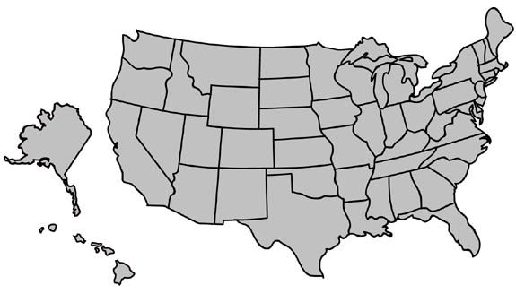
Review:
Milgram’s experiment
MA
NE
Instructions:
Given a target individual (stockbroker in Boston), pass the message to a person you correspond with who is “closest” to the target.

Slide 3
Small world phenomenon: Milgram’s experiment
MA
NE
Outcome:
average chain length was between 5 and 6
“Six degrees of separation”

Slide 4
Small world phenomenon: Milgram’s experiment repeated
email experiment
Dodds, Muhamad, Watts,
Science 301, (2003)
18 targets
13 different countries
60,000+ participants
24,163 message chains
384 reached their targets
average path length 4.0
Source: NASA, U.S. Government; http://visibleearth.nasa.gov/view_rec.php?id=2429

Slide 5
Milgram’s experiment revisited
What did Milgram’s experiment show?
(a) There are short paths in large networks that connect individuals
(b) People are able to find these short paths using a simple, greedy, decentralized algorithm
Small world models take care of (a)
Kleinberg: what about (b)?

Slide 6
Kleinberg’s model
Consider a directed 2-dimensional lattice
For each vertex u add q shortcuts
choose vertex v as the destination of the shortcut with probability proportional to [d(u,v)]^{-r}
when r = 0, we have uniform probabilities

Slide 7
Searching in a small world
Given a source s and a destination t, define a greedy local search algorithm that
knows the positions of the nodes on the grid
knows the neighbors and shortcuts of the current node
knows the neighbors and shortcuts of all nodes seen so far
operates greedily, each time moving as close to t as possible
Kleinberg proved the following
When r=2, an algorithm that uses only local information at each node (not 2) can reach the destination in expected time O(log²n).
When r<2 a local greedy algorithm (1-4) needs expected time Ω(n^{(2-r)/3}).
When r>2 a local greedy algorithm (1-4) needs expected time Ω(n^{(r-2)/(r-1)}).

Slide 8
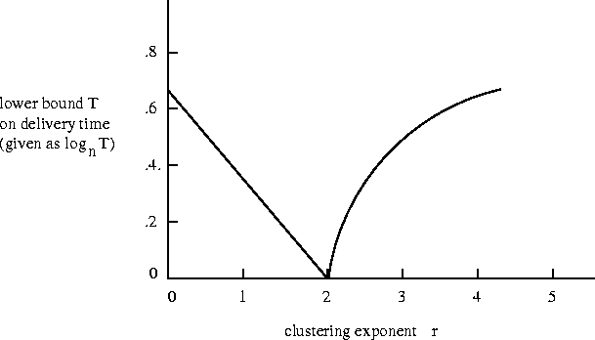
Searching in a small world
For r < 2, the graph has paths of logarithmic length (small world), but a greedy algorithm cannot find them
For r > 2, the graph does not have short paths
For r = 2 is the only case where there are short paths, and the greedy algorithm is able to find them

Slide 9
geographical search when network lacks locality
When r=0, links are randomly distributed, ASP ~ log(n), n size of grid
When r=0, any decentralized algorithm is at least a₀n^{2/3}
When r<2,
expected time at
least α_{r}n^{(2-r)/3}

Slide 10
Overly localized links on a lattice
When r>2 expected search time ~ N^{(r-2)/(r-1)}

Slide 11
geographical small world model
Links balanced between long and short range
When r=2, expected time of a greedy search is at most C (log N)²

Slide 12
Extensions
If there are log n shortcuts, then the search time is O(logn)
we save the time required for finding the shortcut
If we know the shortcuts of log n neighbors the time becomes O(log^{1+1/d}n)

Slide 13
Small Worlds
& Epidemic diseases
The SIR Model
Nodes are living entities
Link is contact
3 States:
Susceptible (Uninfected and not immune)
Infected
Recovered (or dead) and immune

Slide 14
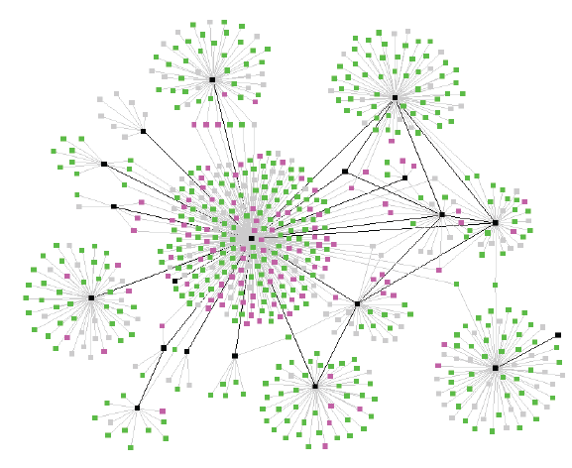
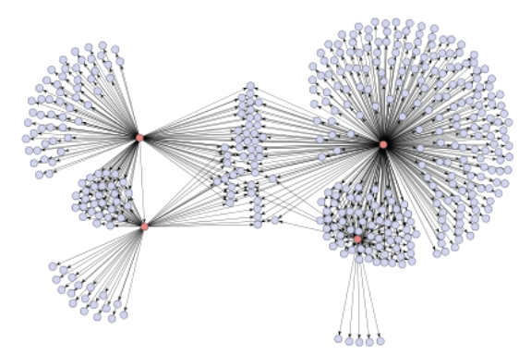
Diffusion in Social Networks
One of the networks is a spread of a disease, the other one is product recommendations
Which is which?

Slide 15
Diffusion in Social Networks
A fundamental process in social networks:
Behaviors that cascade from node to node like an epidemic
News, opinions, rumors, fads, urban legends, …
Word-of-mouth effects in marketing: rise of new websites, free web based services
Virus, disease propagation
Change in social priorities: smoking, recycling
Saturation news coverage: topic diffusion among bloggers
Internet-energized political campaigns
Cascading failures in financial markets
Localized effects: riots, people walking out of a lecture

Slide 16
Failures in networks
Fault propagation or viruses
Scale-free networks are far more resistant to random failures than ordinary random networks
because of most nodes are leaves
But failure of hubs can be catastrophic vulnerable or targets of deliberate attacks
which may make scale-free networks more vulnerable to deliberate attacks
Cascades of failures

Slide 17
Effect of peers & pundits (hubs and authorities)
People’s decisions are affected by what others do and think
Pressure to conform?
Efficient strategy when insufficient knowledge or expertise
Ex: picking a restaurant
Google’s PageRank is a score for influential nodes in a network (the WWW)

