Slide 1
Selected Sorting Algorithms
CS 165: Project in Algorithms
and Data Structures
Michael T. Goodrich
Some slides are from J. Miller, CSE 373, U. Washington

Slide 2
Why Sorting?
Practical application
People by last name
Countries by population
Search engine results by relevance
Fundamental to other algorithms
Different algorithms have different asymptotic and constant-factor trade-offs
No single ‘best’ sort for all scenarios
Knowing one way to sort just isn’t enough
Many to approaches to sorting which can be used for other problems

Slide 3
Problem statement
There are n comparable elements in an array and we want to rearrange them to be in increasing order
Pre:
An array A of data records
A value in each data record
A comparison function
<, =, >, compareTo
Post:
For each distinct position i and j of A, if i < j then A[i] ≤ A[j]
A has all the same data it started with

Slide 4
Insertion sort
insertion sort: orders a list of values by repetitively inserting a particular value into a sorted subset of the list
more specifically:
consider the first item to be a sorted sublist of length 1
insert the second item into the sorted sublist, shifting the first item if needed
insert the third item into the sorted sublist, shifting the other items as needed
repeat until all values have been inserted into their proper positions

Slide 5
Insertion sort
Simple sorting algorithm.
n-1 passes over the array
At the end of pass i, the elements that occupied A[0]…A[i] originally are still in those spots and in sorted order.
2 | 15 | 8 | 1 | 17 | 10 | 12 | 5
0 | 1 | 2 | 3 | 4 | 5 | 6 | 7
after
pass 2
2 | 8 | 15 | 1 | 17 | 10 | 12 | 5
0 | 1 | 2 | 3 | 4 | 5 | 6 | 7
after
pass 3
1 | 2 | 8 | 15 | 17 | 10 | 12 | 5
0 | 1 | 2 | 3 | 4 | 5 | 6 | 7

Slide 6
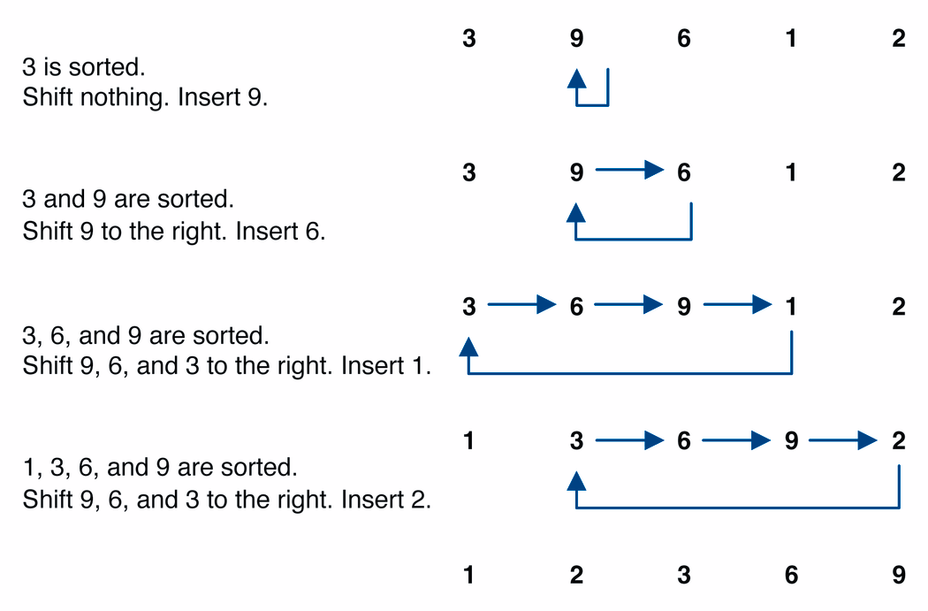
Insertion sort example

Slide 7
Insertion sort code
public static void insertionSort(int[] a) {
for (int i = 1; i < a.length; i++) {
int temp = a[i];
// slide elements down to make room for a[i]
int j = i;
while (j > 0 && a[j - 1] > temp) {
a[j] = a[j - 1];
j--;
}
a[j] = temp;
}
}

Slide 8
Insertion-sort Analysis
An inversion in a permutation is the number of pairs that are out of order, that is, the number of pairs, (i,j), such that i<j but x_{i}>x_{j}.
Each step of insertion-sort fixes an inversion or stops the while-loop.
Thus, the running time of insertion-sort is O(n + k), where k is the number of inversions.

Slide 9
Insertion-sort Analysis
The worst case for the number of inversions, k, is
This occurs for a list in reverse-sorted order.

Slide 10
Insertion-sort Analysis
The average case for k is

Slide 12
Shell sort description
shell sort: orders a list of values by comparing elements that are separated by a gap of >1 indexes
a generalization of insertion sort
invented by computer scientist Donald Shell in 1959
based on some observations about insertion sort:
insertion sort runs fast if the input is almost sorted
insertion sort's weakness is that it swaps each element just one step at a time, taking many swaps to get the element into its correct position

Slide 13
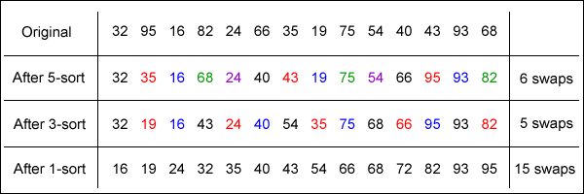
Shell sort example
Idea: Sort all elements that are 5 indexes apart, then sort all elements that are 3 indexes apart, ...

Slide 14
Shell sort code
public static void shellSort(int[] a) {
for (int gap = a.length / 2; gap > 0; gap /= 2) {
for (int i = gap; i < a.length; i++) {
// slide element i back by gap indexes
// until it's "in order"
int temp = a[i];
int j = i;
while (j >= gap && temp < a[j - gap]) {
a[j] = a[j – gap];
j -= gap;
}
a[j] = temp;
}
}
}

Slide 15
Shell sort Analysis
Harder than insertion sort
But certainly no worse than insertion sort
Worst-case: O(n²)
Average-case: ????

Slide 16
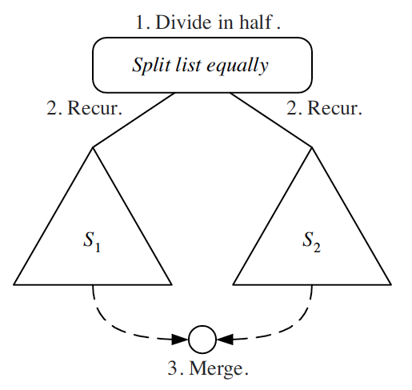
Divide-and-Conquer
Divide-and conquer is a general algorithm design paradigm:
Divide: divide the input data S in two disjoint subsets S₁ and S₂
Recur: solve the subproblems associated with S₁ and S₂
Conquer: combine the solutions for S₁ and S₂ into a solution for S
The base case for the recursion are subproblems of size 0 or 1

Slide 17
Merge-Sort
Merge-sort is a sorting algorithm based on the divide-and-conquer paradigm
It has O(n log n) running time

Slide 18
The Merge-Sort Algorithm
Merge-sort on an input sequence S with n elements consists of three steps:
Divide: partition S into two sequences S₁ and S₂ of about n/2 elements each
Recur: recursively sort S₁ and S₂
Conquer: merge S₁ and S₂ into a unique sorted sequence
Algorithm mergeSort(S):
Input array S of n elements
Output array S sorted
if n > 1 then
(S₁, S₂) ← partition(S, n/2)
mergeSort(S₁)
mergeSort(S₂)
S ← merge(S₁, S₂)

Slide 19
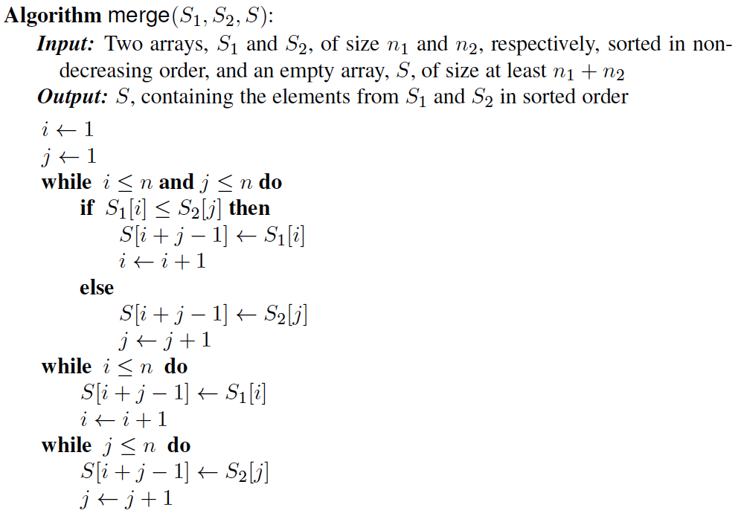
Merging Two Sorted Sequences
The conquer step of merge-sort consists of merging two sorted sequences A and B into a sorted sequence S containing the union of the elements of A and B
Merging two sorted sequences, each with n/2 elements and implemented by means of a doubly linked list, takes O(n) time

Slide 20
Merge-Sort Tree
An execution of merge-sort is depicted by a binary tree
each node represents a recursive call of merge-sort and stores
unsorted sequence before the execution and its partition
sorted sequence at the end of the execution
the root is the initial call
the leaves are calls on subsequences of size 0 or 1
7 2 ⏐ 9 4 → 2 4 7 9
7 ⏐ 2 → 2 7
9 ⏐ 4 → 4 9
7 → 7
2 → 2
9 → 9
4 → 4

Slide 21
Analysis of Merge-Sort
The height h of the merge-sort tree is O(log n)
at each recursive call we divide in half the sequence,
The overall amount or work done at the nodes of depth i is O(n)
we partition and merge 2^{i} sequences of size n/2^{i}
we make 2^{i+1} recursive calls
Thus, the best/worst/average running time of merge-sort is O(n log n)
depth | #seqs | size
0 | 1 | n
1 | 2 | n/2
i | 2^{i} | n/2^{i}
… | … | …

Slide 22
A Hybrid Sorting Algorithm
A hybrid sorting algorithm is a blending of two different sorting algorithms, typically, a divide-and-conquer algorithm, like merge-sort, combined with an incremental algorithm, like insertion-sort.
The algorithm is parameterized with hybridization value, H, and an example with merge-sort and insertion-sort would work as follow:
Start out performing merge-sort, but switch to insertion sort when the problem size goes below H.

Slide 23
A Hybrid Sorting Algorithm
Pseudo-code:
Running time:
Depends on H
Interesting experiments:
H = n^{1/2}
H = n^{1/3}
H = n^{1/4}
Algorithm HybridMergeSort(S, H):
Input array S of n elements
Output array S sorted
if n > H then
(S₁, S₂) ← partition(S, n/2)
HybridMergeSort(S₁, H)
HybridMergeSort(S₂, H)
S ← merge(S₁, S₂)
else
InsertionSort(S)

Slide 24
Hybrid Merge-sort Analysis
Hint: combine the tree-based merge-sort analysis and the insertion-sort analysis…

