Slide 1
Exact Matching Algorithms
Michael T. Goodrich
University of California, Irvine
Some slides adapted from https://www.cs.bgu.ac.il/~dinitz/Course/SS-12/Boyer-Moore-algorithm-Vladimir.pptx

Slide 2
Review: Strings
A string is a sequence of characters (indexed from 0)*
Examples of strings:
Python program
HTML document
DNA sequence
Digitized image
An alphabet Σ is the set of possible characters for a family of strings
Example of alphabets:
ASCII or Unicode
{0, 1}
{A, C, G, T}
Let P be a string of size m
A substring P[i : j] of P is the subsequence of P consisting of the characters with ranks between i and j
A prefix of P is a substring of the type P[0 : i]
A suffix of P is a substring of the type P[i : m − 1]
Given strings T (text) and P (pattern), the pattern matching problem consists of finding a substring of T equal to P
Applications:
Text editors
Search engines
Biological research
*Some people index starting from 1.

Slide 3
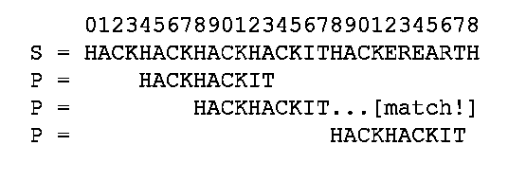
Application: fgrep
Recall that fgrep looks for an exact match of a text string in a file.
So we are interested in fast algorithms for the exact match problem:
Given a text string, T, of length n, and a pattern string, P, of length m, over an alphabet of size k, find the first (or all) places where a substring of T matches P.
Image from https://www.hackerearth.com/practice/notes/exact-string-matching-algorithms/

Slide 4
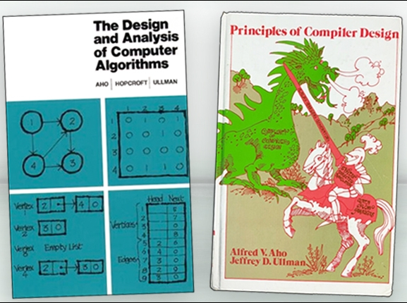
Alfred Aho
1975: Invented fgrep
…*
2020: received the Turing Award
* Also invented text processing techniques used in every modern source-code compiler and co-authored two influential textbooks.
Images from https://awards.acm.org/about/2020-turing

Slide 5
Brute-force Pattern Matching
Algorithm BruteForceMatch(T, P)
Input text T of size n and pattern P of size m
Output starting index of a substring of T equal to P or −1 if no such substring exists
for i ← 0 to n − m
{ test shift i of the pattern }
j ← 0
while j < m ∧ T[i + j] = P[j]
j ← j + 1
if j = m
return i {match at i}
else
break while loop {mismatch}
return -1 {no match anywhere}
The Brute-force (Naïve) pattern matching algorithm compares the pattern P with the text T for each possible shift of P relative to T, until either
a match is found, or
all placements of the pattern have been tried
Brute-force pattern matching runs in time O(nm)
Example of worst case:
T = aaa … ah
P = aaah
may occur in images and DNA sequences

Slide 6
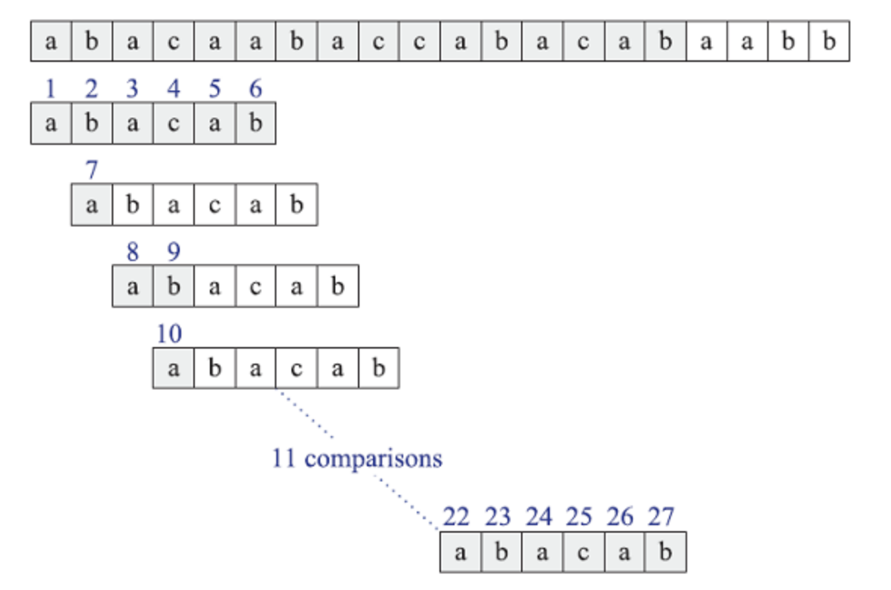
Brute-Force Matching Example
Trying every possible position for a match:

Slide 7
Expected-case Analysis for Brute-force
The worst-case running time for Brute-force algorithm O(mn), but it runs in expected linear time for random strings.
Suppose P and T are strings of m and n characters respectively chosen uniformly and independently at random from an alphabet of size k.
Let X_{i,j} be a random variable that is 1 if and only if P[i] is compared to T[j], and note that probability X_{i,j} is 1 is 1/k^{i} because this occurs when we have i character matches.
By the linearity of expectation, the expected number of comparisons for any T[j] is therefore
1/k + 1/k² + 1/k³ + … + 1/k^{m},
which is at most 2.
Thus, the expected number of comparisons is at most 2n.

Slide 8
Expected-case Analysis for Exact String Matching is Problematic
If a pattern string P and text string T are strings of characters chosen uniformly and independently at random from an alphabet of size k, then the probability that P appears anywhere in T is at most n/k^{m}.
For example, if n=1000, m=10, and k=50, then the probability of a match of P in T is about 1 in 10 trillion!
In this case, a fast (and very accurate) exact matching algorithm is:

Slide 9
The NFA Approach
We can define a simple nondeterministic finite automaton (NFA) for matching a given pattern, P:
Processing the text string, T, with this NFA finds the first (or all) places where the pattern string matches a substring of T.
We can simulate this NFA in O(mn) time, which is no better than the brute-force method!
Image from https://commons.wikimedia.org/wiki/File:Bitap_exact_matching_nfa_diagram.svg

Slide 10
Using this NFA for Pattern Matching
We can convert this NFA into a DFA that has size O(m² + mk) in this same amount of time.
The subset construction doesn’t take exponential time because the number of states in the DFA is the same as in the NFA. Each DFA state corresponds to all the prefixes of the pattern that match up to a given point. There can be O(m) such prefixes, however, and we need a transition for every character, which is why the conversion takes O(m² + mk) time.
With this DFA approach, we can then do pattern matching in O(m² + mk + n) time

Slide 11
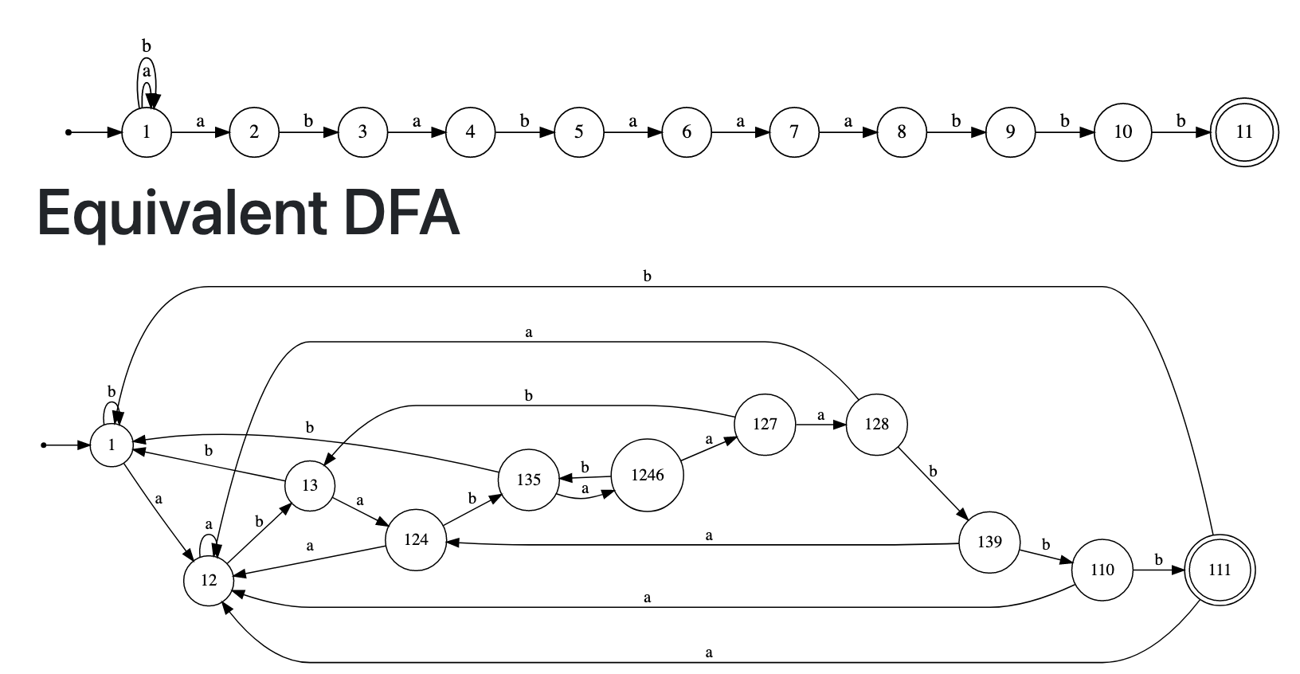
Substring NFA-to-DFA Example
Each state represents all the prefixes of the pattern that match a suffix of
the pattern up to a certain point.
Image produced using https://hritikbhandari.me/NFA-to-DFA-Converter/

Slide 12
Improving Exact Matching
The O(m² + mk) term in the running times for using finite-state machines for exact matching is inefficient.
A well-known algorithm that improves the running time for exact matching is the KMP Algorithm, due to Knuth, Morris, and Pratt.
Knuth-Morris-Pratt’s algorithm compares the pattern to the text in left-to-right, but shifts the pattern more intelligently than the brute-force algorithm.

Slide 13
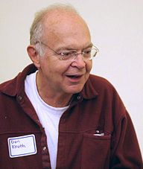
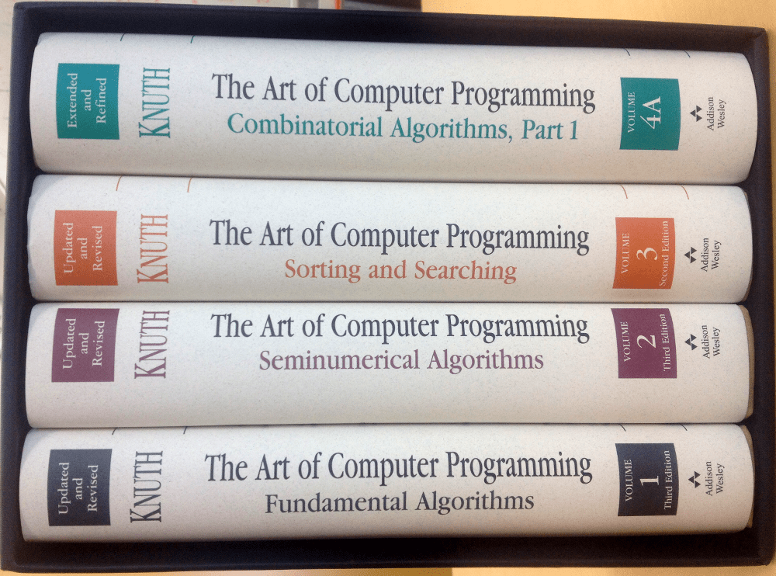
Donald Knuth
1973: Discovered the KMP algorithm (which was also published in a technical report by Morris and Pratt in 1970—all three published a joint paper describing the algorithm in 1977).
1974: Received the Turing Award.
He is also known for his book series, “The Art of Computer Programming,” which formalized and popularized algorithm analysis (e.g., the “big O”).
Image from https://en.wikipedia.org/wiki/Donald_Knuth

Slide 14
The KMP Algorithm
Consider the comparison of a pattern with a text as in the brute-force algorithm.
When a mismatch occurs, what is the most we can shift the pattern so as to avoid redundant comparisons?
Answer: the largest prefix of P[0..j] that is a suffix of P[1..j]
This approach is similar to the NFA-to-DFA approach, but is implemented more efficiently.
.
.
a
b
a
a
b
x
.
.
.
.
.
a
b
a
a
b
a
j
a
b
a
a
b
a
No need to
repeat these
comparisons
Resume
comparing
here

Slide 15
The KMP Failure Function
Knuth-Morris-Pratt’s algorithm preprocesses the pattern to find matches of prefixes of the pattern with the pattern itself
The failure function F(j) is defined as the length of the longest prefix of P[0..j] that is also a suffix of P[1..j]
Knuth-Morris-Pratt’s algorithm modifies the brute-force algorithm so that if a mismatch occurs at P[j] ≠ T[i] and j > 0, we set j ← F(j − 1)
j | 0 | 1 | 2 | 3 | 4 | 5
P[j] | a | b | a | a | b | a
F(j) | 0 | 0 | 1 | 1 | 2 | 3

Slide 16
The KMP Algorithm
The failure function can be represented by an array and can be computed in O(m) time
At each iteration of the while-loop, either
i increases by one, or
the shift amount i − j increases by at least one (observe that F(j − 1) < j)
Hence, there are no more than 2n iterations of the while-loop
Thus, KMP’s algorithm runs in optimal time O(m + n)
Algorithm KMPMatch(T, P)
F ← failureFunction(P)
i ← 0
j ← 0
while i < n
if T[i] = P[j]
if j = m − 1
return i − j { match }
else
i ← i + 1
j ← j + 1
else
if j > 0
j ← F[j − 1]
else
i ← i + 1
return −1 { no match }

Slide 17
Computing the Failure Function
The failure function can be represented by an array and can be computed in O(m) time
The construction is similar to the KMP algorithm itself
At each iteration of the while-loop, either
i increases by one, or
the shift amount i − j increases by at least one (observe that F(j − 1) < j)
Hence, there are no more than 2m iterations of the while-loop
Algorithm failureFunction(P)
F[0] ← 0
i ← 1
j ← 0
while i < m
if P[i] = P[j]
{we have matched j + 1 chars}
F[i] ← j + 1
i ← i + 1
j ← j + 1
else if j > 0 then
{use failure function to shift P}
j ← F[j − 1]
else
F[i] ← 0 { no match }
i ← i + 1

Slide 18
Example
j | 0 | 1 | 2 | 3 | 4 | 5
P[j] | a | b | a | c | a | b
F(j) | 0 | 0 | 1 | 0 | 1 | 2

Slide 19
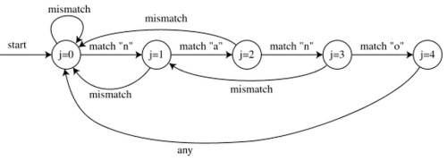
Summary for KMP
Thus, the KMP algorithm runs in O(m+n) time for constant-size alphabets.
The KMP algorithm mimics the NFA-to-DFA algorithm but doesn’t have extra preprocessing time because it builds a failure table for the longest prefix that matches a suffix at each pattern position, rather than encoding all prefixes.
Image from http://www.zrzahid.com/linear-time-string-matching-using-kmp-matching-algorithm/

Slide 20
The Boyer-Moore-Horspool Algorithm
The Boyer-Moore-Horspool algorithm for pattern matching a pattern P of length m in a text of length n is based on the following two simple heuristics:
Reverse-match heuristic: Compare P with a subsequence of T moving backwards
Bad-character heuristic: When a mismatch occurs at T[i] = c
If P contains c, shift P to align the last occurrence of c in P with T[i]
Else, shift P to align P[0] with T[i + 1]
Example:

Slide 21
Last-Occurrence Function
The Boyer-Moore-Horspool algorithm preprocesses the pattern P and the alphabet Σ to build the last-occurrence function L mapping Σ to integers, where L(c) is defined as
the largest index i such that P[i] = c or
−1 if no such index exists
Example:
Σ = {a, b, c, d}
P = abacab
The last-occurrence function can be represented by an array indexed by the numeric codes of the characters
The last-occurrence function can be computed in time O(m + k), where m is the size of P and k is the size of Σ. How?
c | a | b | c | d
L(c) | 4 | 5 | 3 | −1

Slide 22
The Boyer-Moore-Horspool Algorithm
Case 1: j ≤ 1 + l
Algorithm BoyerMooreHorspool(T, P, Σ)
L ← lastOccurenceFunction(P, Σ )
i ← m − 1
j ← m − 1
repeat
if T[i] = P[j]
if j = 0
return i { match at i }
else
i ← i − 1
j ← j − 1
else
{ bad-character-jump }
l ← L[T[i]]
i ← i + m – min(j, 1 + l)
j ← m − 1
until i > n − 1
return −1 { no match }
Case 2: 1 + l ≤ j

Slide 23
Example

Slide 24
Analysis
The Boyer-Moore-Horspool algorithm runs in O(nm + k) time in the worst case
Example of worst case:
T = aaa … a
P = baaa
The worst case may occur in images and DNA sequences but is unlikely in English text
The Boyer-Moore-Horspool algorithm can skip over some comparisons
It runs in O(n/m + m) time in the best case.

Slide 25
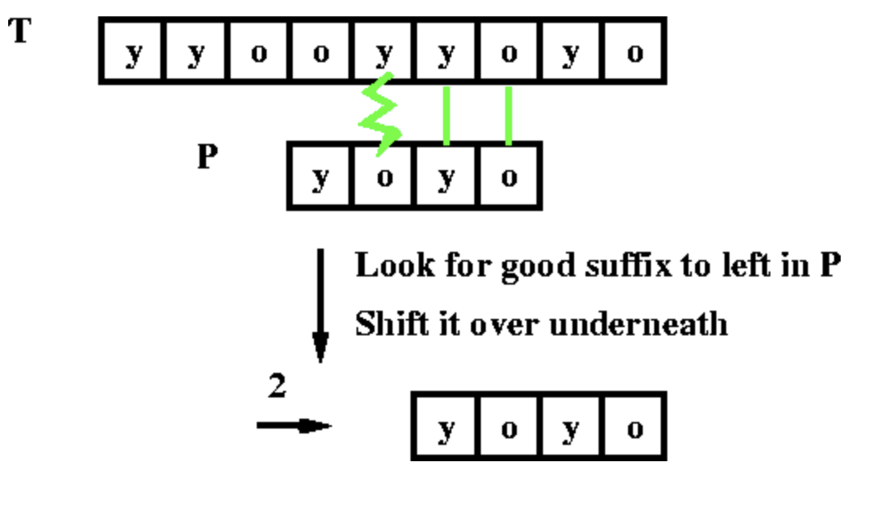
The Boyer-Moore Algorithm
The original Boyer-Moore has another heuristic, the good suffix rule:
When a mismatch occurs, we take the biggest shift possible using the bad character and good suffix rules
Image from https://eecs.wsu.edu/~cook/aa/lectures/l24/node16.html

Slide 26
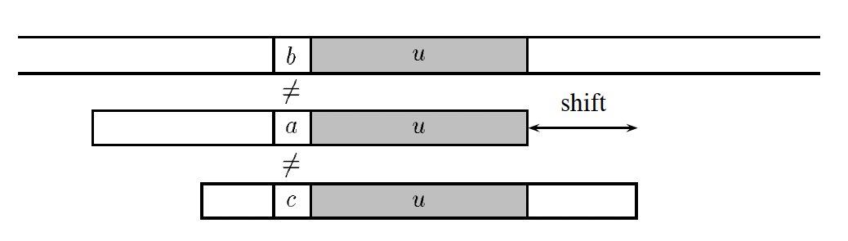
Case 1 for the good suffix rule
Suppose we have already matched a suffix, u, of P, and u appears in P. Then we want a shift that is guaranteed to match u and requires the mismatching character to be different:
T:
P:
P:
Image from https://doi.org/10.1016/S1570-8667(03)00005-4

Slide 27
Case 2 for the good suffix rule
Suppose we have already matched a suffix, u, of P, and u does not appear in P. Then we want a shift such that a prefix v is a suffix of u:
T:
P:
P:
Image from https://doi.org/10.1016/S1570-8667(03)00005-4

Slide 28
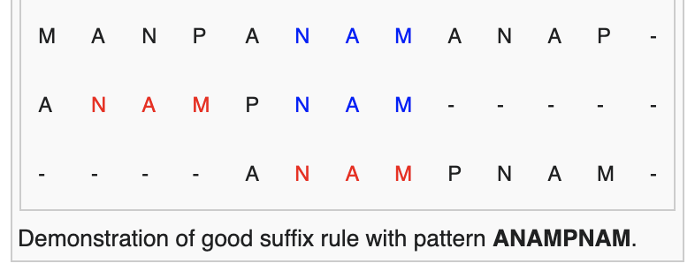
Good Suffix Rule
Definition: Suppose for a given alignment of $P$ and $T$, a substring $t$ of $T$ matches a suffix of $P$, but a mismatch occurs to the next character to the left. Then find, if exists, the rightmost copy $t′$ of $t$ in $P$, such as $t′$ is not a suffix of $P$ and the character to the left of t' in P differs from the character to the left of t in P. Shift $P$ to the right, so that substring $t′$ in $P$ is below substring $t$ in $T$.
Image from https://en.wikipedia.org/wiki/Boyer%E2%80%93Moore_string-search_algorithm

Slide 29
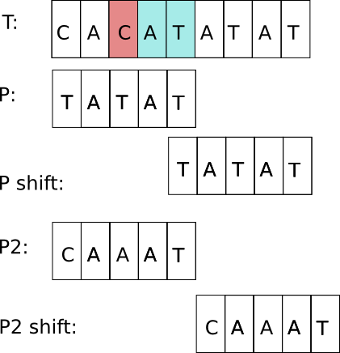
Good suffix rule (cont'd)
If $t′$ does not exist, then shift the left end of $P$ past the left end of $t$ in $T$ by the least amount, so that a prefix of $P$ matches a suffix of t in $T$. If no such shift is possible then shift $P$ by m places to the right.

Slide 30
The good suffix shift table
Define a shift table, MATCH(i), that encodes the good suffix shifts for a pattern, x, of length m.
MATCH(i) = min. s such that Cs(i,s) and Cos(i,s) hold:
Images from https://doi.org/10.1016/S1570-8667(03)00005-4

Slide 31
The bad character shift table
Let x be a pattern of length m.
Define a bad-character shift table, occ[a], for each character, a, in the alphabet for x:
This is just the last occurrence function, L, indexed slightly differently.
It can be computed in the same way as L.
Image from https://doi.org/10.1016/S1570-8667(03)00005-4

Slide 32
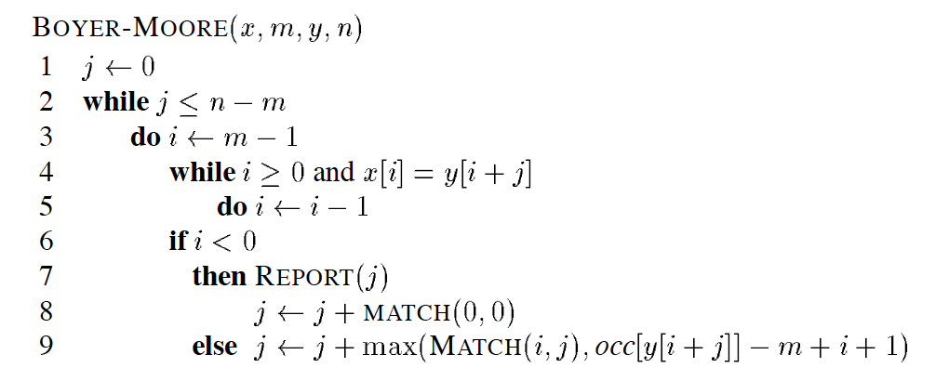
The Boyer-Moore Algorithm
Let x be a pattern of length m and y a text of length n.
j is the location of a possible match.
)
) ,
Algorithm description from https://doi.org/10.1016/S1570-8667(03)00005-4

Slide 33
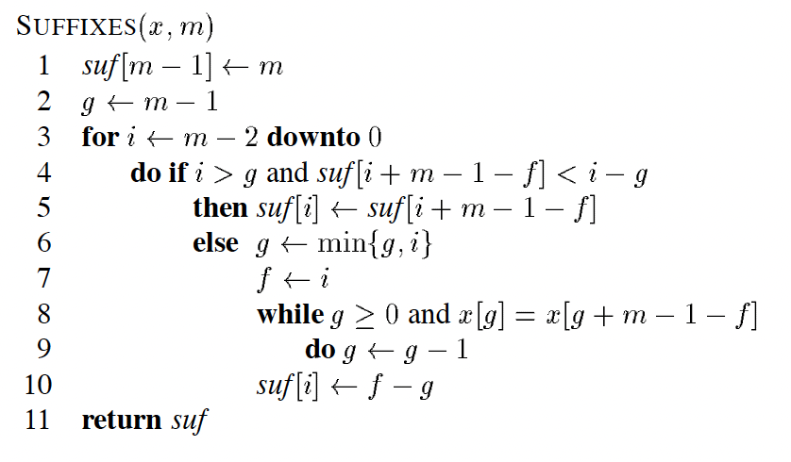
Computing the Suffix table
Compute a table, suf, such that suf[i] is the length of the longest suffix of x ending at position i in x.
We can compute the suf table like the KMP Failure function, but in reverse (j = g+m-1-f):
Algorithm description from https://doi.org/10.1016/S1570-8667(03)00005-4

Slide 34
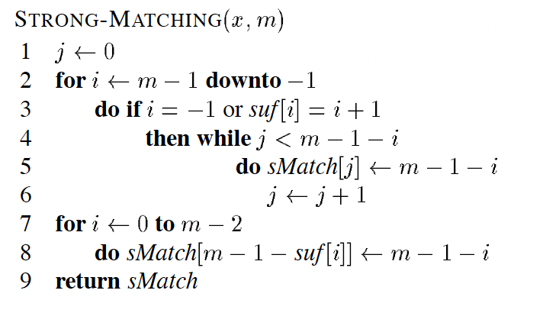
Computing the MATCH table
Given the suffix table, suf, we compute MATCH to be sMatch in the following algorithm:
Algorithm description from https://doi.org/10.1016/S1570-8667(03)00005-4

Slide 35
Summary for the Boyer-Moore Algorithm
The Boyer-Moore algorithm runs in O(n + m) time in the worst case.
It runs in O(n/m + m) time in the best case.
It can be further optimized to find all occurrences of a pattern in a text using at most 1.5n character comparisons.

Slide 36
Experimental Analysis
Since completely random strings are not useful for analyzing exact string-matching algorithms, we need alternatives:
Seeded random strings: Create a random text string, T, of length n (e.g., n=1,000,000), and a random pattern, P, of length m (e.g., m=5, 10, 20, …). Then insert P into T at 1 to100 random locations.
English text: Use a corpus of large English text (e.g., emails) and search for patterns of various lengths (e.g., email addresses, English words, English phrases).

Slide 37
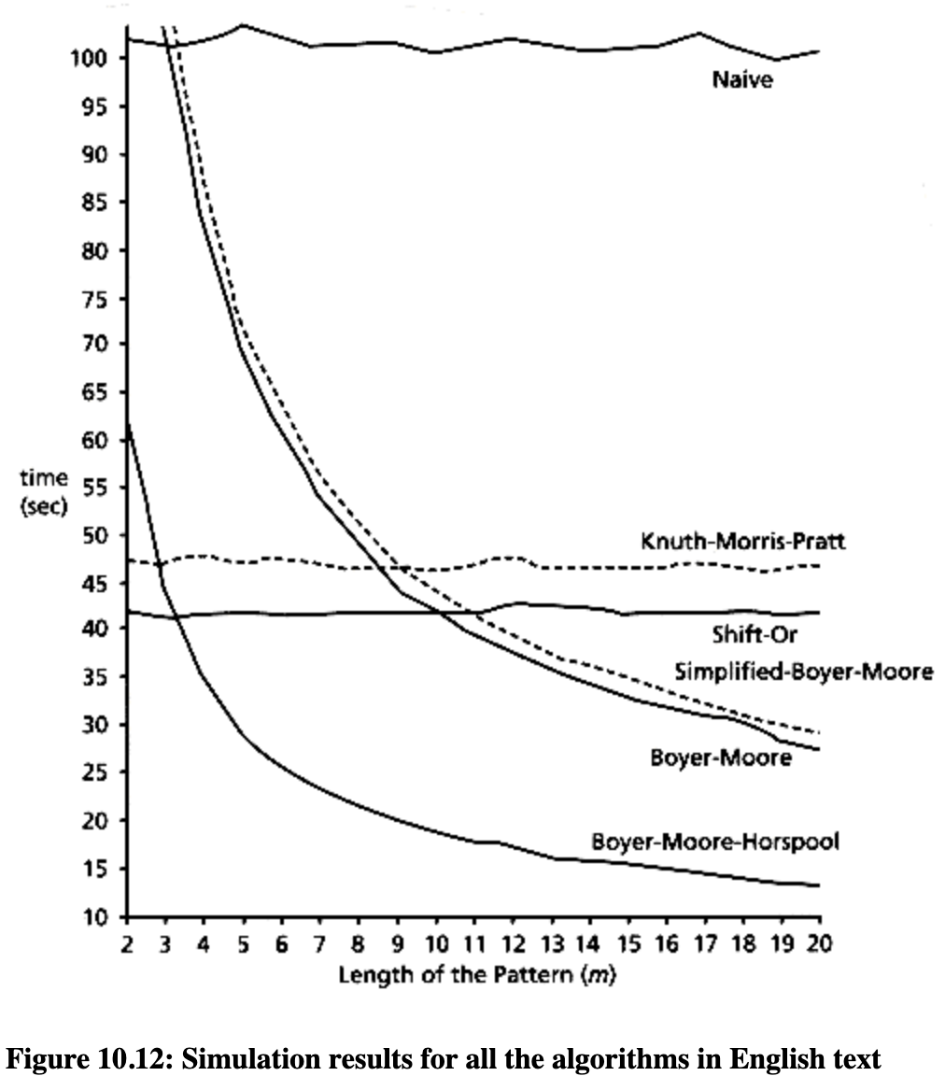
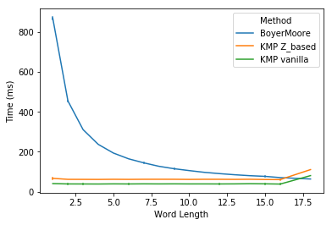
Varying the Pattern Length
One type of experiment: Keep the text size fixed at a reasonably large amount and vary the pattern size.
Images from https://dearxxj.github.io/post/4/, http://orion.lcg.ufrj.br/Dr.Dobbs/books/book5/chap10.htm

Slide 38
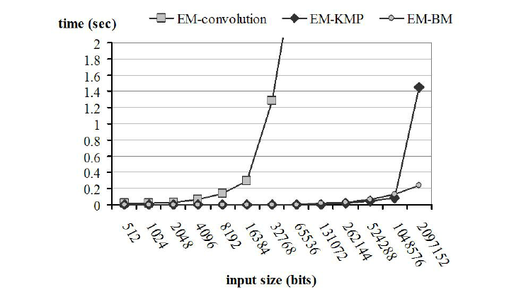
Varying the Text Length
Another type of experiment: Vary the text length, n, with certain pattern lengths (e.g., m=10, 20, 100) or as a function of n (e.g., m=n^{1/2} or m=n/8).
Image from https://www.researchgate.net/figure/A-comparison-of-the-convolution-KMP-and-Boyer-Moore-algorithms-for-the-exact-matching_fig2_220444712

Slide 39
Log-Log Plots
Log-log plots can be useful for experiments involving polynomial running times.

Slide 40
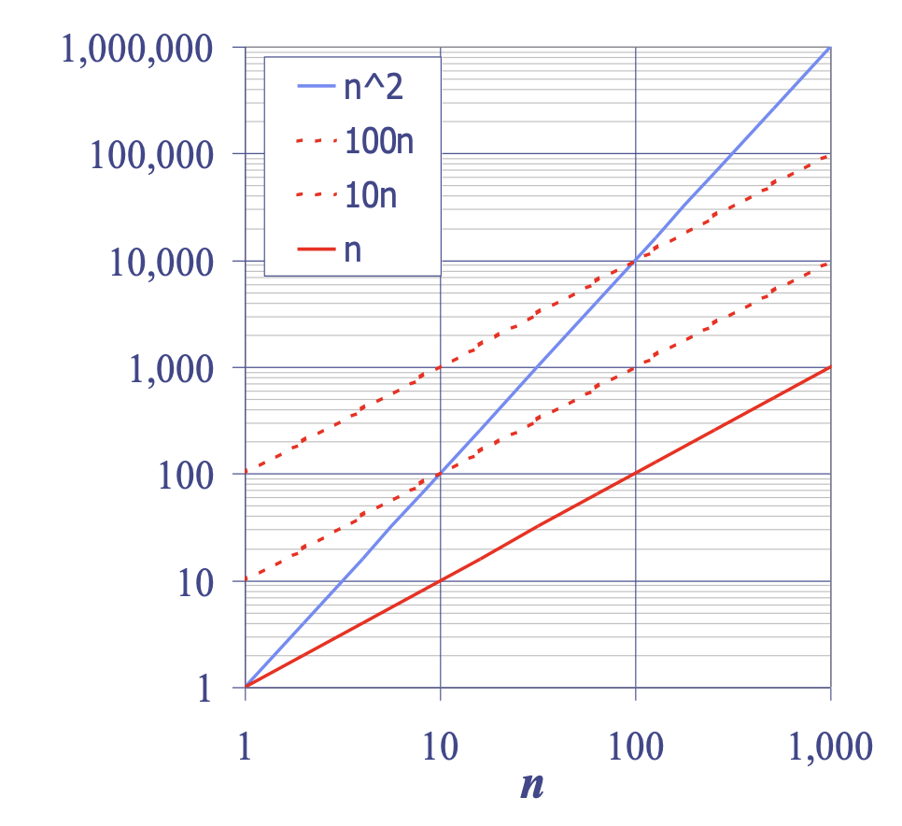
Big-Oh Notation and Log-Log Plots
Given functions f(n) and g(n), we say that f(n) is O(g(n)) if there are positive constants c and n₀ such that
f(n) ≤ cg(n) for n ≥ n₀

