Slide 1
Numerical Exact Matching Algorithms
Michael T. Goodrich
University of California, Irvine

Slide 2
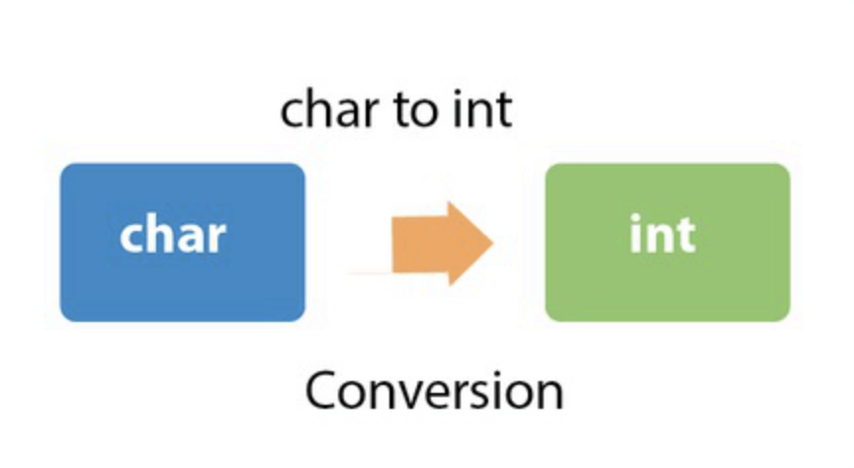
The Duality Principle
Rather than rely only on comparing characters, numerical matching algorithms take advantage of the fact that characters in a string can also be viewed as (binary) numbers.
This concept is often referred to as duality.
Image from https://www.javatpoint.com/java-char-to-int

Slide 3
The Rabin-Karp Algorithm
The Rabin-Karp string searching algorithm calculates a hash value for the pattern, and for each M-character substring of text to be compared.
If the hash values are unequal, the algorithm will calculate the hash value for next M-character sequence.
If the hash values are equal, the algorithm will do a Brute Force comparison between the pattern and the M-character sequence at this location (in case of a hash value collision causing a false match).
In this way, there is only one comparison per text subsequence, and Brute Force is only needed when hash values match.
(Recall that we highlighted Michael Rabin in a previous lecture.)

Slide 4
Richard Karp
1985: Received the Turing Award.
1987: Developed the Rabin-Karp string searching algorithm with Michael Rabin.
He is also known for publishing a landmark paper proving 21 problems to be NP-complete.
He was also the PhD advisor to Dan Gusfield (author of this course’s recommend textbook) and UCI Professor Sandy Irani.
Image from https://en.wikipedia.org/wiki/Richard_M._Karp

Slide 5
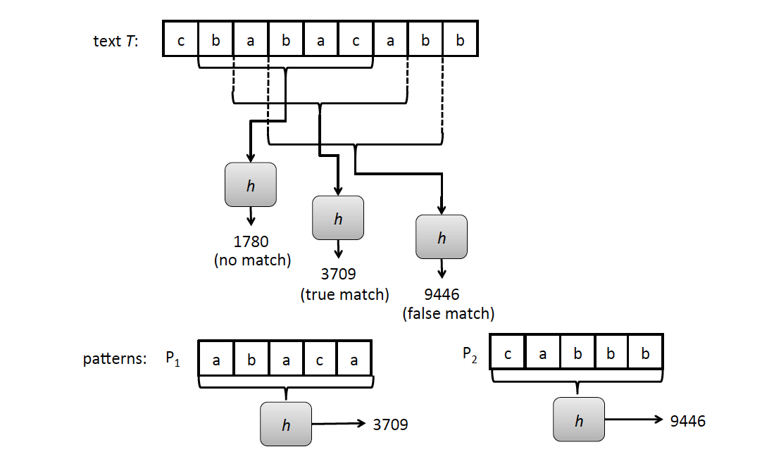
Rabin-Karp Example
Text T = cbabacabb
Pattern P = abaca

Slide 6
Rabin-Karp Algorithm (High Level)
text is n characters long, pattern is m characters long
hash_p=hash value of pattern
hash_t=hash value of first m letters in text
repeat
if (hash_p == hash_t)
do brute force comparison of pattern and selected section of text
hash_t = hash value of next section of text, one character over
until (end of text or brute force comparison == true)
Running time is O(nm) if we recompute hash_t for each substring of m characters in the text, which is no better than brute-force matching!

Slide 7
Rabin-Karp Rolling Hash Function
We can do better by using a rolling hash function, which allows us to compute each hash value from the previous hash value.
Consider an m-character sequence as an m-digit number in base b, where b is the number of letters in the alphabet. The text subsequence t[i : i+m-1] is mapped to the number
Given x(i) we can compute x(i+1) for the next substring t[i+1 : i+M] in constant time:

Slide 8
Polynomial Rolling Hash Function
The original Rabin-Karp algorithm used the a standard polynomial hash function:
This requires 2 multiplications and an addition and subtraction to compute each new hash value.
Multiplications are generally slower than comparing characters, and these multiplications are in the “inner loop” of the algorithm.
So it may be helpful to have a different hash function.

Slide 9
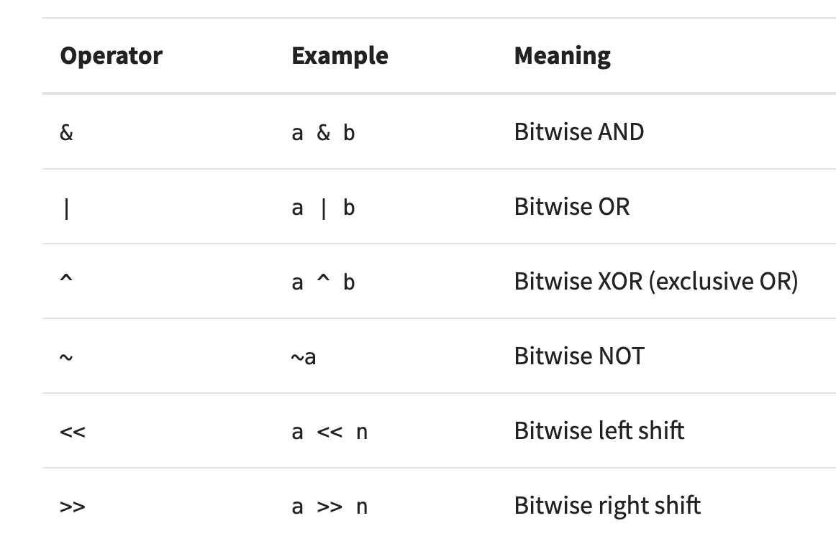
Bitwise Operators
Typical built-in bitwise (bit-parallel) operators, which are faster than multiplication:
Image from https://realpython.com/python-bitwise-operators/

Slide 10
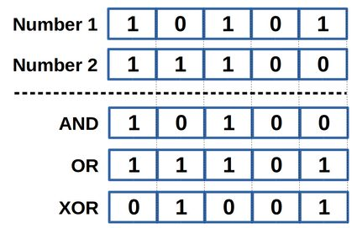
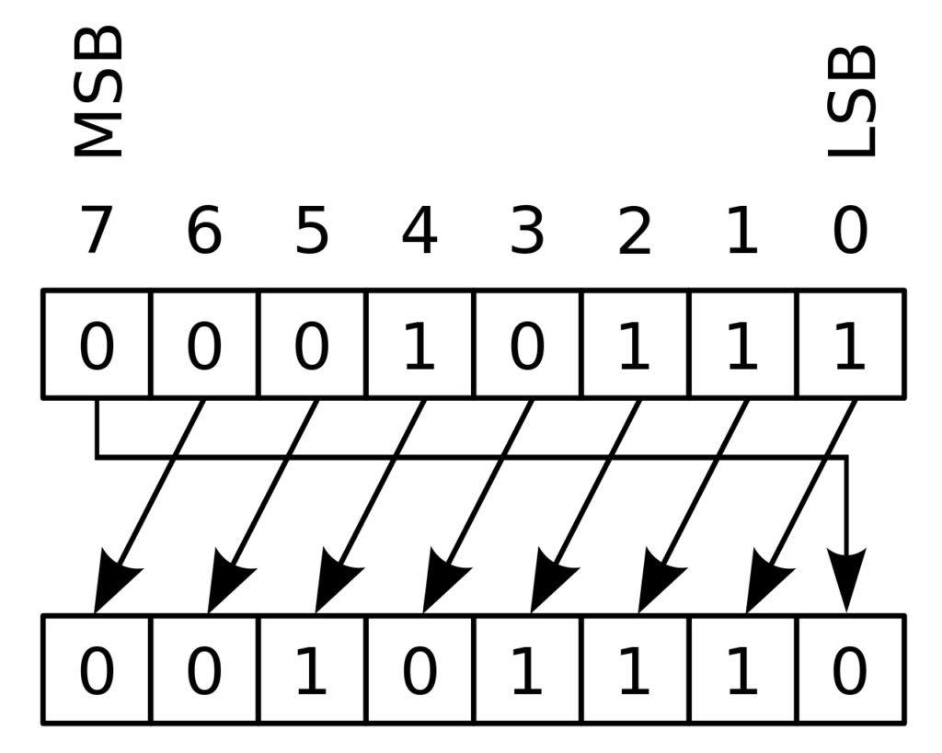
Examples
Bitwise operations:
Cyclic shift by 1 bit:
Note the following:
X AND X =X
X OR X = X
X XOR X = 0
Note that bit vectors are indexed
from right to left.

Slide 11
Typical Syntax for Cyclic Shift
To do a cyclic shift by k bits in C (assumes k < Integer.SIZE):
return (bits << k & MASK) | (bits >> (Integer.SIZE - k))
Cyclic shift by 1 bit:
MASK: 1 1 1 1 1 1 1 0

Slide 12
Cyclic Polynomial Hash Function
Let the function s be a cyclic binary rotation (or circular shift): it rotates the bits by 1 to the left, pushing the leftmost bit around to the first position.
E.g., s(101)=011, s(101)=011.
Define the hash H as follows, where ⊕ is XOR and h is a random hash function (or lookup table):
The new hash value (2 shifts and 2 XORs):

Slide 13
The Rabin-Karp Algorithm
Assumes a shiftHash(f, T, i) function for computing a shifted rolling hash value for position i in T given the hash value, f, for position i-1 in T.
Let H be the hash of the pattern, i.e., H = h(P)
for i ← 0 to n − m do
if i = 0 then // initial hash
f ← h(T[0 : m − 1])
else
f ← shiftHash(f, T, i)
if f == H then
// check P against T[i : i + m − 1]
j ← 0
while j < m and T[i + j] = Pk[j] do
j ← j + 1
if j = m then
return j as a match location

Slide 14
Analysis of the Rabin-Karp Algorithm
We are given a test of length n and a pattern of length m.
Use a hash function that is random enough so the probability of a false match is at most 1/m.
Then the expected running time to find a first match for the pattern (if it exists) is O(n+m).

Slide 15
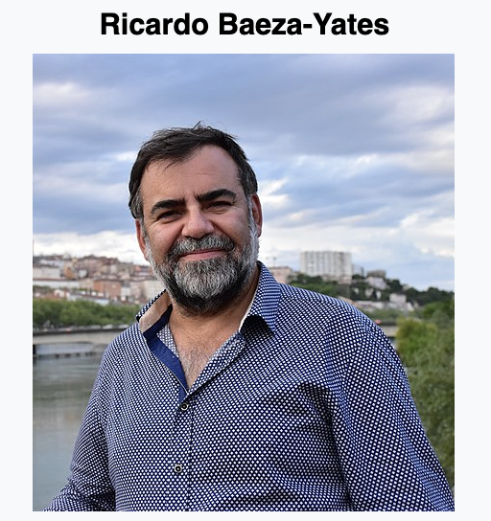
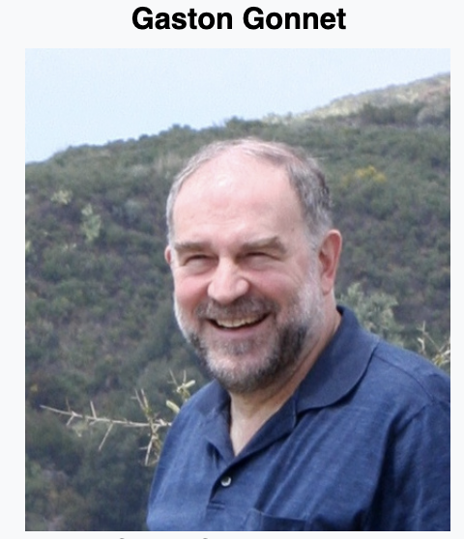
The Bitap (Shift-Or) Algorithm
Described by Ricardo Baeza-Yates and Gaston Gonnet in 1992.
Uses bit-parallel operations to implement the approach of the brute-force algorithm more efficiently for cases when the alphabet and pattern are relatively small.
Images from https://en.wikipedia.org/wiki/Ricardo_Baeza-Yates, https://en.wikipedia.org/wiki/Gaston_Gonnet

Slide 16
The Bitap (Shift-Or) Algorithm
Given a text, T, of length n and a pattern, P, of length m, the bitap (Shift-Or) algorithm performs a type of brute-force search implemented using bitwise operations.
If m < word length, w, and the alphabet is relatively small, then the bitap algorithm is fast.
The word length, w, for a modern computer is typically 32 or 64, but some processors have specialized registers with word lengths of 128, 256, or even 512.
If m is much larger than the word length and/or the alphabet is large, then the bitap algorithm may perform no better than the brute-force algorithm (possibly slower, due to preprocessing steps).

Slide 17
Intuition: Brute-Force Matching
Consider a version of the brute-force matching algorithm where we keep doing comparisons even after finding mismatches, and we use an indicator variable, X, that is initially 0 and we set X to 1 if there is ever a mismatch
X
a
b
a
c
a
a
b
a
c
c
a
b
a
c
a
b
a
a
b
b
0
a
b
a
c
a
b
1
a
b
a
c
a
b
1
a
b
a
c
a
b
1
a
b
a
c
a
b
0
a
b
a
c
a
b
0
a
b
a
c
a
b

Slide 18
Intuition: Brute-Force Matching
Consider a version of the brute-force matching algorithm where we keep doing comparisons even after finding mismatches, and we use an indicator variable, X, that is initially 0 and we set X to 1 if there is ever a mismatch
X
X
a
b
a
c
a
a
b
a
c
c
a
b
a
c
a
b
a
a
b
b
0
1
a
b
a
c
a
b
1
1
a
b
a
c
a
b
1
1
a
b
a
c
a
b
1
1
a
b
a
c
a
b
0
1
a
b
a
c
a
b
0
0
a
b
a
c
a
b

Slide 19
Bitap (Shift-Or) State Vector
At each stage, j, of the algorithm, we maintain a bit-vector, X_{j}, such stat X_{j}[i] = 0 iff there are no mismatches between P[0:i] and T[j-i:j], and otherwise it is 1.
So there is a match at j if X_{j}[m-1] = 0.
For each character, a, in the alphabet, we build a comparison vector, C[a], where C[a][i] = 0 iff P[i]=a.
C[a] shows the result of all the comparisons that would occur in the brute-force algorithm if the next text character is a.

Slide 20
Comparison Vector Preprocessing Alg.
C[a] = 111…1 (of length m) for each a in alphabet
For i = 0 to m-1:
C[P[i]][i] = 0
Suppose P=abacab and the alphabet is {a,b,c,d}.
Then we have the following comparison vectors (recall that bit-vectors are indexed right to left):
C[a] = 101010
C[b] = 011101
C[c] = 110111
C[d] = 111111
b
a
c
a
b
a
(the pattern in reverse)

Slide 21
Shift-Or Matching
Each comparison can be done with a shift and an OR.
X
a
b
a
c
a
a
b
a
c
c
a
b
a
c
a
b
a
a
b
b
1
a
b
a
c
a
b
1
a
b
a
c
a
b
1
a
b
a
c
a
b
1
a
b
a
c
a
b
1
a
b
a
c
a
b
0
a
b
a
c
a
b
a
b
a
c
a
b

Slide 22
Shift-Or Matching
Each comparison can be done with a shift and an OR.
X
a
b
a
c
a
a
b
a
c
c
a
b
a
c
a
b
a
a
b
b
1
shift
a
b
a
c
a
b
C[b]
X
1
1
+
0
1
a
b
a
c
a
b
1
1
+
1
1
a
b
a
c
a
b
1
1
+
1
1
a
b
a
c
a
b
1
1
+
1
1
a
b
a
c
a
b
0
0
+
0
0
a
b
a
c
a
b
0
+
1
1
a
b
a
c
a
b
OR (+)

Slide 23
The Shift-Or Algorithm
X = 0; MASK = 111…1 (of length m)
For j = 0 to n-m:
X = ((X << 1) & MASK) | C[T[j]]
if (X[m-1] == 0) and (j >= m-1) then
output j-m+1 as a match
The running time for preprocessing is O([m/w]k+m), where k is the size of the alphabet and [*] is the ceiling function.
The running time for the main loop is O(n[m/w]), where w is the word size.
Total time is O((n+k)[m/w]+m).

