Slide 1
Multiple Pattern Matching
Michael T. Goodrich
University of California, Irvine

Slide 2
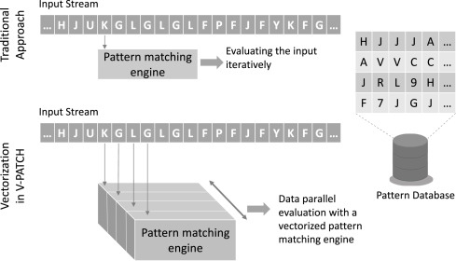
The Multi-Pattern Matching Problem
Given a text, T, of length n and a set of k patterns, P₁, …, P_{k}, each of length at most m, find the first (or each) occurrence of a given pattern in T.
Image from https://www.sciencedirect.com/science/article/abs/pii/S0743731519301984

Slide 3
Multi-Pattern Brute-Force Algorithm
We can run the brute-force algorithm k times.
This would run in O(nmk) time, which is very bad.
k Brute force algs.
Image from https://www.sciencedirect.com/science/article/abs/pii/S0743731519301984

Slide 4
Alternative: Build a Reg. Exp.
Given k patterns, P₁, P₂, …, P_{k}, each of size at most m, build a regular expression:
R = P₁ | P₂ | … | P_{k}
Then, use R to match for any pattern P_{i}.
If we simulate the NFA for R, then this takes O(nmk) time.
This is no better than brute-force!

Slide 5
KMP Algorithm for Multiple Patterns
We can run the KMP algorithm k times.
This would run in O((n+m)k) time, which is better than brute force but still not great.
k diff. KMP algs.
Image from https://www.sciencedirect.com/science/article/abs/pii/S0743731519301984

Slide 6
Recall the Rabin-Karp Algorithm
The Rabin-Karp string searching algorithm calculates a hash value for the pattern, and for each m-character substring of text to be compared.
If the hash values are unequal, the algorithm will calculate the hash value for next m-character sequence, using a rolling hash function
If the hash values are equal, the algorithm will do a Brute Force comparison between the pattern and the m-character sequence at this location (in case of a hash value collision causing a false match).
In this way, there is only one comparison per text subsequence, and Brute Force is only needed when hash values match.

Slide 7
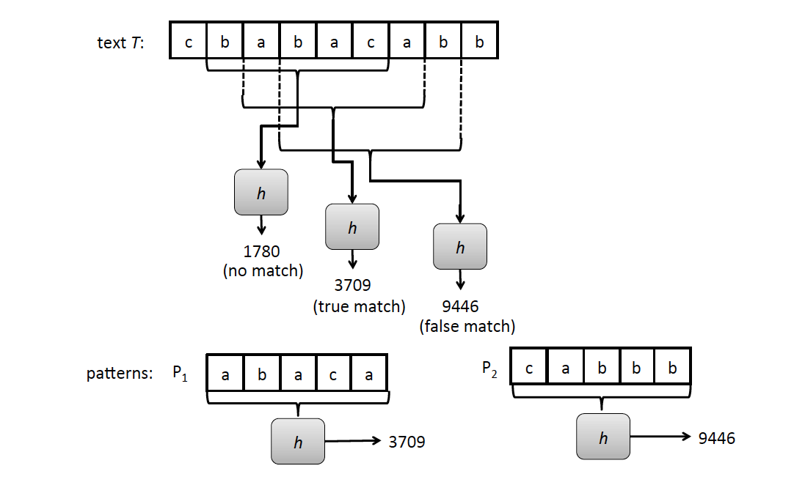
Rabin-Karp for Multiple Patterns
Text T = cbabacabb
Pattern P₁ = abaca, P₂ = cabbb

Slide 8
Hash Tables
The multi-pattern Rabin-Karp algorithm uses hashing in two ways:
It uses the hash function, h, for computing the rolling hash values of the pattern and text substrings.
It uses a hash table, H, for storing key-value pairs.
This provides expected O(1) time insertions and lookups (see any good reference on hash tables for this)
Image from https://www.tutorialspoint.com/data_structures_algorithms/hash_data_structure.htm

Slide 9
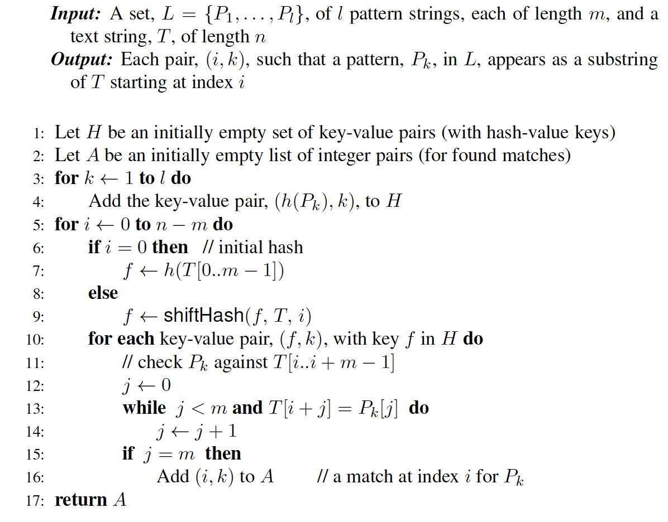
Rabin-Karp for Multiple Patterns
Assumes a shiftHash function for computing a shifted hash value.

Slide 10
Analysis of the Rabin-Karp Multi-Pattern Matching Algorithm
We are given a test of length n, and k patterns, each of length at most m.
Use a hash function, h, that is random enough so the probability of a false match is at most 1/m.
Use a hash table, H, that supports expected O(1) time insertions and lookups.
Building H takes O(km) time, including computing h(P_{i}) for each pattern, P_{i}.
Then the expected running time to find a first match for each pattern (if it exists) is O(n+km).

Slide 11
Tries

Slide 12
Preprocessing Strings
Preprocessing the set of patterns speeds up pattern matching queries
If a document is large, immutable and searched for often (e.g., works by Shakespeare), we may want to preprocess the words in the document, each as a separate pattern
A trie is a compact data structure for representing a set of strings, such as all the words in a document
A tries supports pattern matching queries in time proportional to the pattern size

Slide 13
Standard Tries
The standard trie for a set of strings S is an ordered tree such that:
Each node but the root is labeled with a character
The children of a node are alphabetically ordered
The paths from the external nodes to the root yield the strings of S
Example: standard trie for the set of strings
S = { bear, bell, bid, bull, buy, sell, stock, stop }

Slide 14
Analysis of Standard Tries
A standard trie uses O(n) space and supports searches, insertions and deletions in time O(dm), where:
n total size of all k of the strings in S
m size of the string parameter of the operation
d size of the alphabet

Slide 15
Word Matching with a Trie
insert the words of the text into trie
Each leaf is associated w/ one particular word
leaf stores indices where associated word begins (“see” starts at index 0 & 24, leaf for “see” stores those indices)
s
e
e
a
b
e
a
r
?
s
e
l
l
s
t
o
c
k
!
0
1
2
3
4
5
6
7
8
9
10
11
12
13
14
15
16
17
18
19
20
21
22
23
s
e
e
a
b
u
l
l
?
b
u
y
s
t
o
c
k
!
24
25
26
27
28
29
30
31
32
33
34
35
36
37
38
39
40
41
42
43
44
45
46
b
i
d
s
t
o
c
k
!
b
i
d
s
t
o
c
k
!
47
48
49
50
51
52
53
54
55
56
57
58
59
60
61
62
63
64
65
66
67
68
h
e
a
r
t
h
e
b
e
l
l
?
s
t
o
p
!
69
70
71
72
73
74
75
76
77
78
79
80
81
82
83
84
85
86
87
88
b
h
s
e
i
u
e
e
t
a
l
d
l
y
a
e
l
o
47, 58
36
0, 24
r
l
l
r
l
c
p
6
78
30
69
12
84
k
17, 40,
51, 62

Slide 16
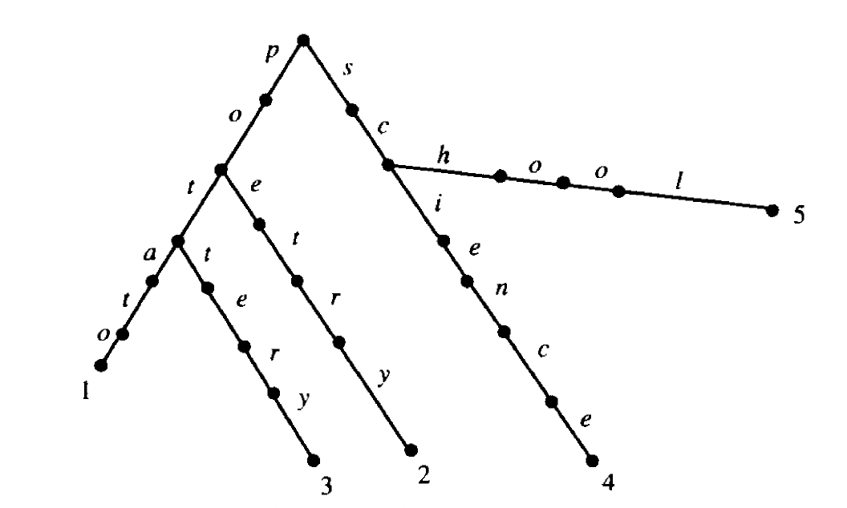
Analysis for Using a Trie for Multiple Patterns
An example trie:
potato
poetry
pottery
school
science
A trie for k patterns can support a search for any one in O(m) time, but you have to start over a new search for each starting position in the text.
Takes O(nm) time, which is the same as a brute-force search for just one pattern.
Efficient for many patterns.

Slide 17
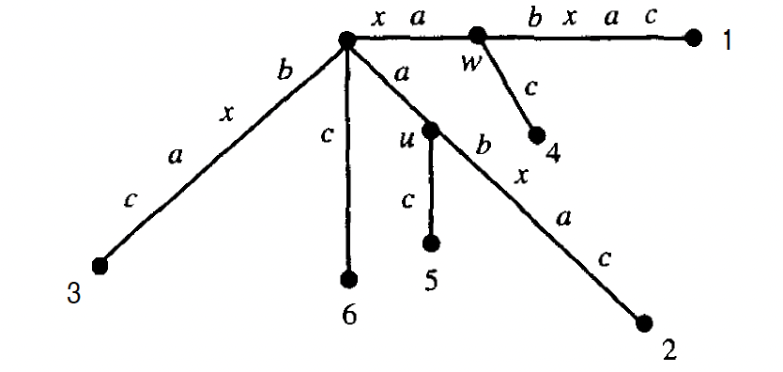
Suffix Tries (Trees)
The suffix trie of a string X is the trie of all the suffixes of X
The suffix trie for the string xabxac:

Slide 18
Analysis of Suffix Tries
Building a suffix trie for a string X of size n
Uses O(n) space
Supports arbitrary pattern matching queries in X in O(m) time, where m is the size of the pattern
Can be constructed in O(n) time (we will discuss how later)

Slide 19
Using a Suffix Trie for Multi-Pattern Matching
Build a suffix trie for the text (not the patterns)
Do a search for each of the k patterns.
Total time: O(n + mk), assuming a linear-time algorithm for constructing a suffix trie (which we will discuss later in this class)

