Slide 1
Pattern Matching with Wildcards
Michael T. Goodrich
University of California, Irvine
Some slides are adapted from https://www.cs.princeton.edu/courses/archive/spr05/cos423/lectures/05fft.pdf

Slide 2
Matching with Wildcards
Recall the pattern matching problem: Given a text, T, of n characters and a pattern, P, of m characters, find all places where P occurs as a substring in T.
Suppose now that T and/or P can contain a wildcard symbol, ”.”, which matches any other character, as in regular expression matching (except we don’t allow repetition, like the *).

Slide 3
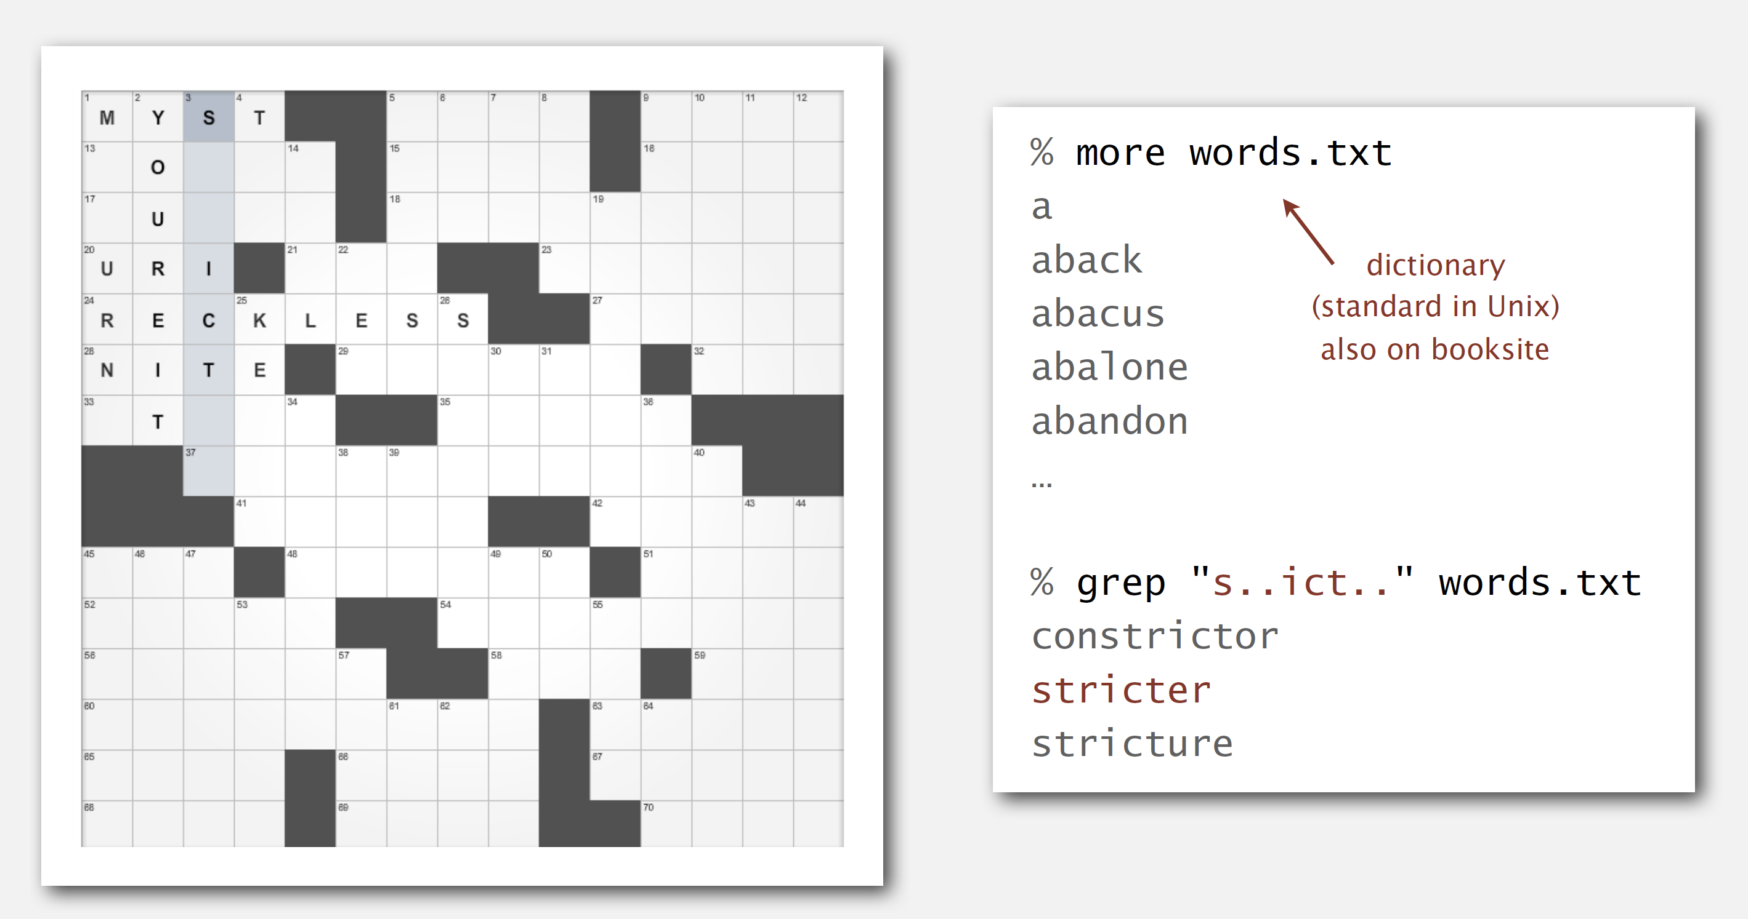
Example
A crossword search:
Image from http://algs4.cs.princeton.edu

Slide 4
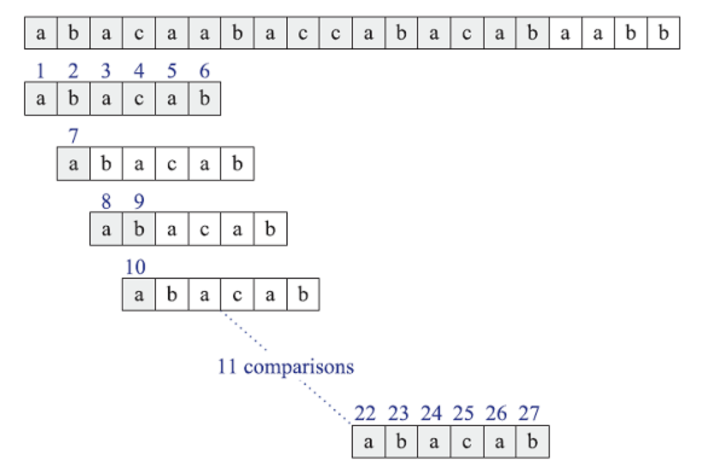
One Solution: Brute-Force
The brute-force algorithm can be adapted to solve this problem – just ignore matches for the wildcard symbol.
Running time: O(nm).

Slide 5
Wildcards Only in the Pattern
If wildcards only appear in the pattern, then we can interpret the pattern as a regular expression of length m and do regular-expression matching of this pattern with text.
Running time: O(nm)
Just as slow as the brute-force algorithm!

Slide 6
Wildcards only in the Pattern w/ Bitap
Recall the bitap algorithm where we keep doing comparisons (in parallel) even after finding mismatches, and we use an indicator variable, X, that is initially 0 and we set X to 1 if there is ever a mismatch:
X
a
b
a
c
a
a
b
a
c
c
a
b
a
c
a
b
a
a
b
b
0
a
b
a
c
a
b
1
a
b
a
c
a
b
1
a
b
a
c
a
b
1
a
b
a
c
a
b
0
a
b
a
c
a
b
0
a
b
a
c
a
b

Slide 7
Wildcards only in the Pattern w/ Bitap
Note that a wildcard in the pattern matches every character. That is, it corresponds to a 0:
X
a
b
a
c
a
a
b
a
c
c
a
b
a
c
a
b
a
a
b
b
0
a
b
a
c
a
b
1
a
b
a
c
a
b
0
a
b
a
c
a
b
1
a
b
a
c
a
b
0
a
b
a
c
a
b
0
a
b
a
c
a
b

Slide 8
Wildcard Bitap (Shift-Or) Vectors
At each stage, j, of the algorithm, we maintain a bit-vector, X_{j}, such stat X_{j}[i] = 0 iff there are no mismatches between P[0:i] and T[j-i:j], and otherwise it is 1. (This is same as before.)
  So there is a match at j if X_{j}[m-1] = 0.
For each character, a, in the alphabet, we build a comparison vector, C[a], where C[a][i] = 0 iff P[i]=a or P[i] is the wildcard symbol.
C[a] shows the result of all the comparisons that would occur in the brute-force algorithm if the next text character is a or a wildcard.

Slide 9
Comparison Vector Preprocessing Alg.
C[a] = 111…1 (of length m) for each a in alphabet
For i = 0 to m-1:
C[P[i]][i] = 0
Suppose P=ab.cab and the alphabet is {a,b,c,d}.
Then we have the following comparison vectors (recall that bit-vectors are indexed right to left):
  C[a] = 101010
  C[b] = 011001
  C[c] = 110011
  C[d] = 111011
b
a
c
a
b
a
(the pattern in reverse)

Slide 10
The Shift-Or Algorithm w/ Wildcards
X = 0; MASK = 111…1 (of length m)
For j = 0 to n-m:
X = ((X << 1) & MASK) | C[T[j]]
if (X[m-1] == 0) and (j >= m-1) then
output j-m+1 as a match
The running time for preprocessing is O([m/w]k+m), where k is the size of the alphabet and [*] is the ceiling function (If you first set the 0’s for wildcards).
The running time for the main loop is O(n[m/w]), where w is the word size.
Total time is O((n+k)[m/w]+m).

Slide 11
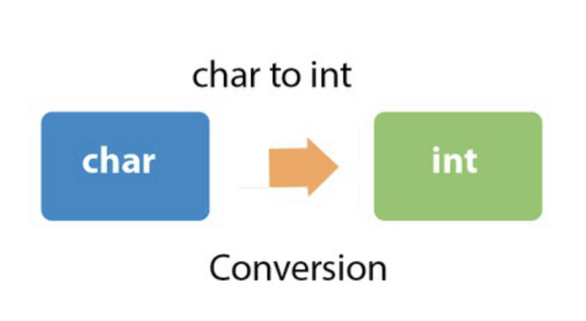
Wildcards in Text and/or Pattern
There is a surprising algorithm based on the Fast Fourier Transform (FFT).
This requires us thinking of strings as being vectors of numbers via duality (again).
Image from https://www.javatpoint.com/java-char-to-int

Slide 12
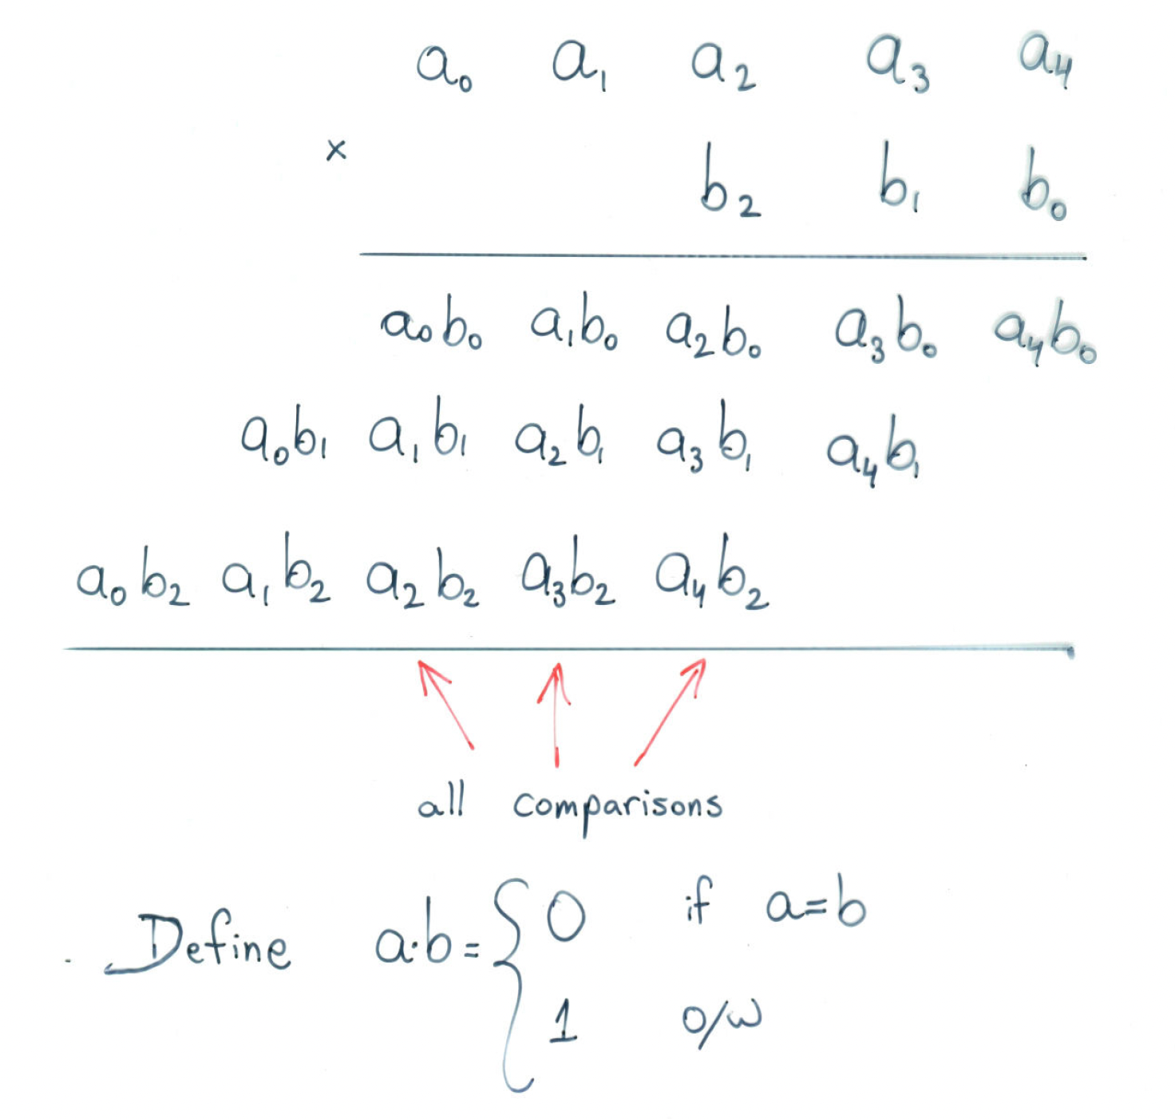
Pattern Matching as Multiplication
We can pad P^{R} with zeros so that it is the same length as T
Then T x P^{R}[i+m] = 0 iff P matches T in location i.

Slide 13
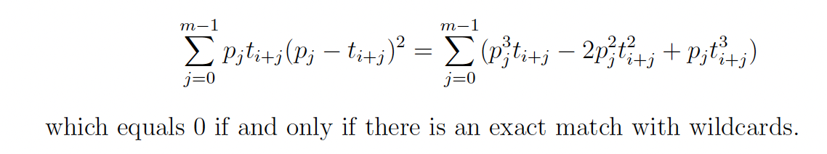
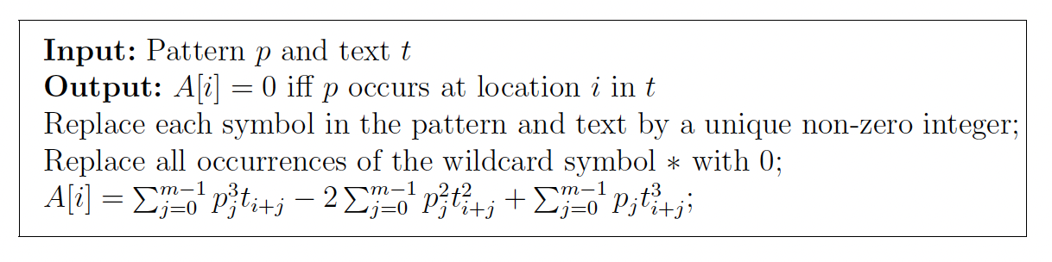
Extending this to Wildcard Matching
Consider the text and patten as vectors of non-negative numbers, where characters are positive numbers and wildcards are 0. Then
From Clifford, P., & Clifford, R. (2007). Simple deterministic wildcard matching. Information Processing Letters, 101(2), 53-54.

Slide 14
Pattern Matching w/ Wildcards using Multiplication
Each of the terms can be computed by multiplication:

Slide 15
Polynomials
Polynomial:
In general,

Slide 16
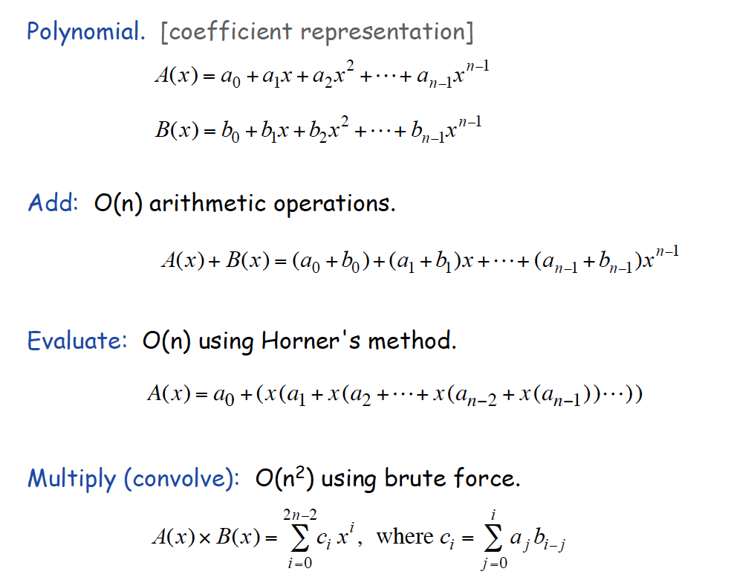
Coefficient Representation

Slide 17
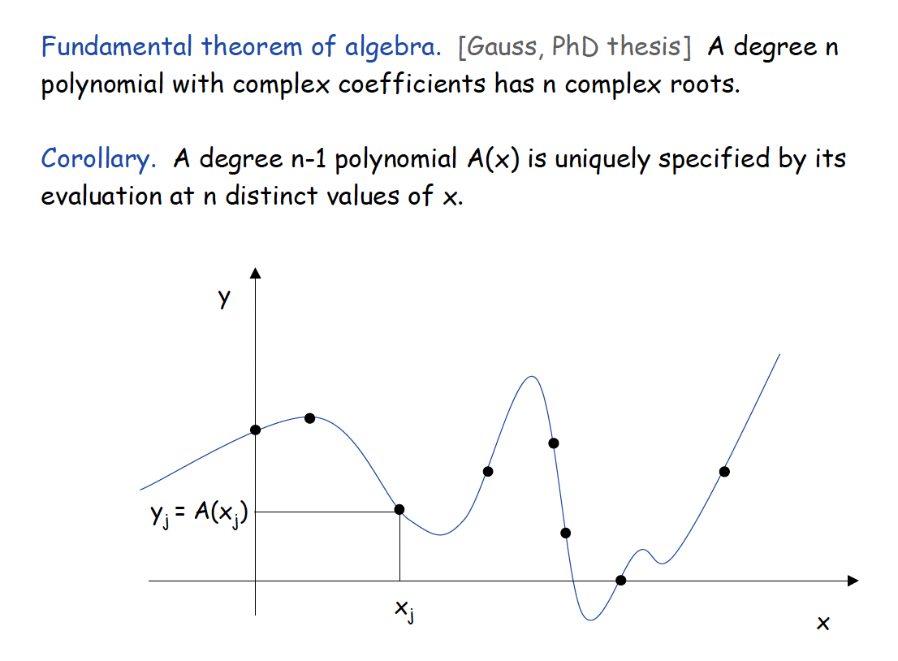
Point-Value Representation

Slide 18
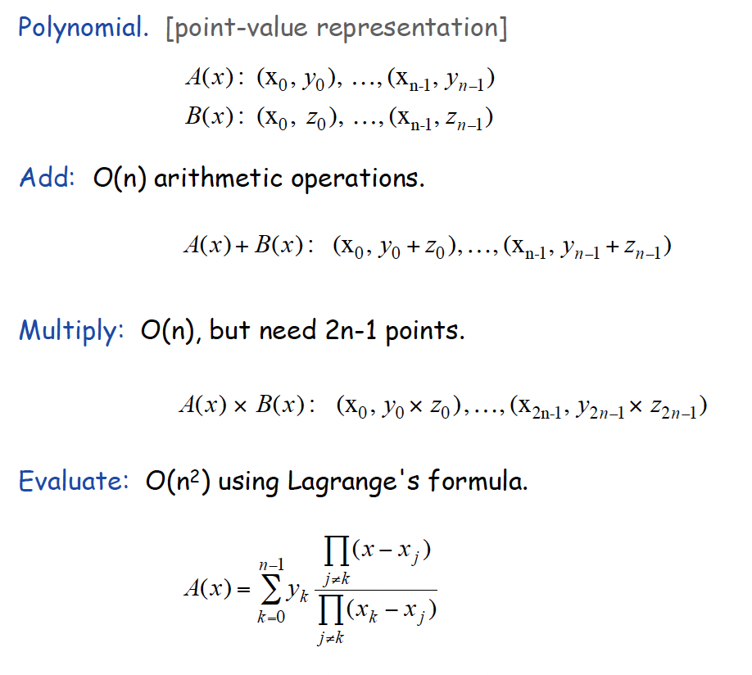
Point-Value Representation

Slide 19
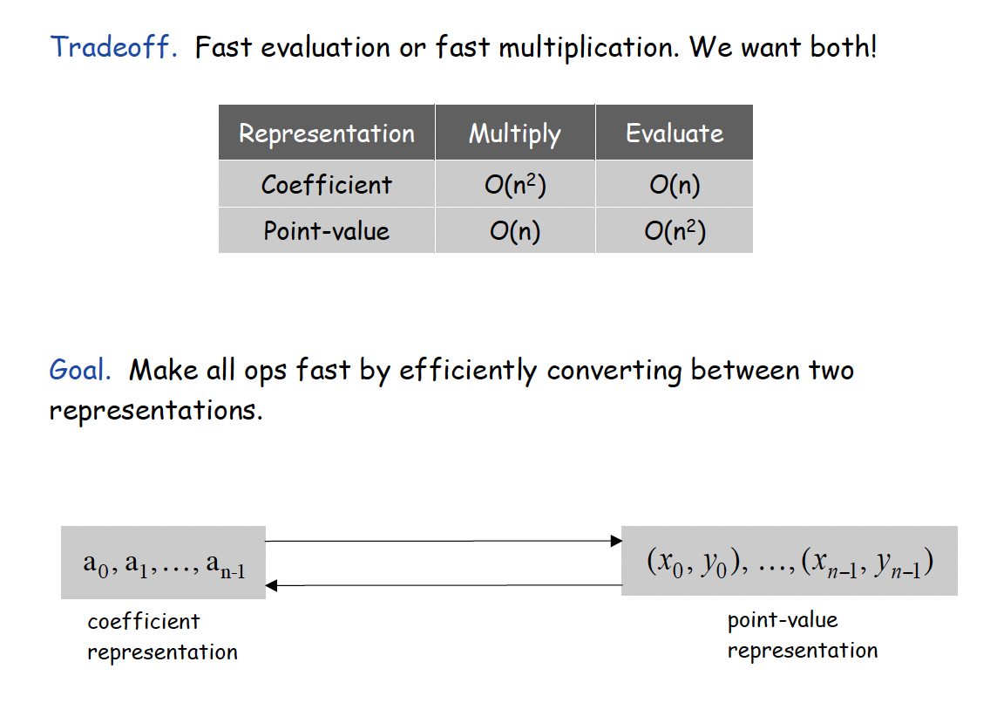
The Best of Both Worlds
We want to have our cake and eat it too.

Slide 20
Polynomial Multiplication Problem
Given coefficients (a₀,a₁,a₂,…,a_{n-1}) and (b₀,b₁,b₂,…,b_{n-1}) defining two polynomials, p() and q(), and number x, compute p(x)q(x).
Horner’s rule doesn’t help, since
  where
A straightforward evaluation would take O(n²) time. The “magical” FFT will do it in O(n log n) time.

Slide 21
Polynomial Interpolation & Polynomial Multiplication
Given a set of n points in the plane with distinct x-coordinates, there is exactly one (n-1)-degree polynomial going through all these points.
Alternate approach to computing p(x)q(x):
  Calculate p() on 2n x-values, x₀,x₁,…,x_{2n-1}.
  Calculate q() on the same 2n x values.
  Find the (2n-1)-degree polynomial that goes through the points {(x₀,p(x₀)q(x₀)), (x₁,p(x₁)q(x₁)), …, (x_{2n-1},p(x_{2n-1})q(x_{2n-1}))}.
Unfortunately, a straightforward evaluation would still take O(n²) time, as we would need to apply an O(n)-time Horner’s Rule evaluation to 2n different points.
The “magical” FFT will do it in O(n log n) time, by picking 2n points that are easy to evaluate…

Slide 22
Primitive Roots of Unity
A number ω is a primitive n-th root of unity, for n>1, if
  ω^{n} = 1
  The numbers 1, ω, ω², …, ω^{n-1} are all distinct
Example 1:
  Z*₁₁:
  2, 6, 7, 8 are 10-th roots of unity in Z*₁₁
  2²=4, 6²=3, 7²=5, 8²=9 are 5-th roots of unity in Z*₁₁
  2⁻¹=6, 3⁻¹=4, 4⁻¹=3, 5⁻¹=9, 6⁻¹=2, 7⁻¹=8, 8⁻¹=7, 9⁻¹=5
Example 2: The complex number e^{2πi/n} is a primitive n-th root of unity, where

Slide 23
Primitive Roots of Unity
Inverse Property: If ω is a primitive root of unity, then ω ⁻¹=ω^{n-1}
  Proof: ωω^{n-1}=ω^{n}=1
Cancellation Property: For non-zero -n<k<n,
  Proof:
Reduction Property: If w is a primitve (2n)-th root of unity, then ω² is a primitive n-th root of unity.
  Proof: If 1,ω,ω²,…,ω^{2n-1} are all distinct, so are 1,ω²,(ω²)²,…,(ω²)^{n-1}
Reflective Property: If n is even, then ω^{n/2} = -1.
  Proof: By the cancellation property, for k=n/2:
  Corollary: ω^{k+n/2}= -ω^{k}.

Slide 24
The Discrete Fourier Transform
Given coefficients (a₀,a₁,a₂,…,a_{n-1}) for an (n-1)-degree polynomial p(x)
The Discrete Fourier Transform is to evaluate p at the values
  1,ω,ω²,…,ω^{n-1}
  We produce (y₀,y₁,y₂,…,y_{n-1}), where y_{j}=p(ω^{j})
  That is,
  Matrix form: y=Fa, where F[i,j]=ω^{ij}.
The Inverse Discrete Fourier Transform recovers the coefficients of an (n-1)-degree polynomial given its values at 1,ω,ω²,…,ω^{n-1}
  Matrix form: a=F ⁻¹y, where F ⁻¹[i,j]=ω^{-ij}/n.

Slide 25
Correctness of the inverse DFT
The DFT and inverse DFT really are inverse operations
Proof: Let A=F ⁻¹F. We want to show that A=I, where
If i=j, then
If i and j are different, then

Slide 26
Convolution
The DFT and the inverse DFT can be used to multiply two polynomials
So we can get the coefficients of the product polynomial quickly if we can compute the DFT (and its inverse) quickly…

Slide 27

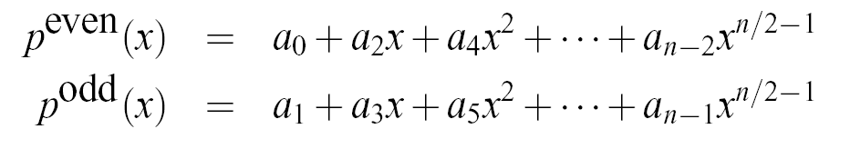

The Fast Fourier Transform
The FFT is an efficient algorithm for computing the DFT
The FFT is based on the divide-and-conquer paradigm:
  If n is even, we can divide a polynomial
  into two polynomials
  and we can write

Slide 28
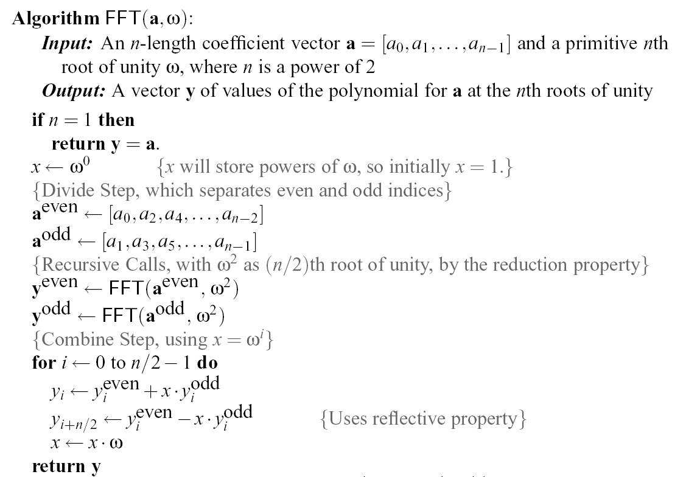
The FFT Algorithm
The running time is O(n log n). [inverse FFT is similar]

