Slide 1
Search Engine Indexing
Michael T. Goodrich
University of California, Irvine
Some slides adapted from slides by Chris Manning, Pandu Nayak, and Prabhakar Raghavan

Slide 2
Information Retrieval
Information Retrieval (IR) is finding material (usually documents) of an unstructured nature (usually text) that satisfies an information need from within large collections (usually stored on computers).
  These days we frequently think first of web search, but there are many other cases:
    E-mail search
    Searching your laptop
    Corporate knowledge bases
    Legal information retrieval

Slide 3
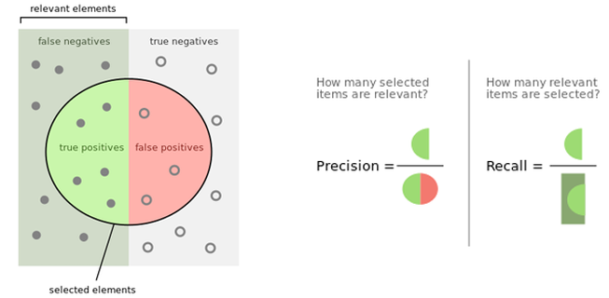
How good are the retrieved docs?
Sec. 1.1
Precision : Fraction of retrieved docs that are relevant to the user’s information need
Recall : Fraction of relevant docs in collection that are retrieved
Image from https://en.wikipedia.org/wiki/Precision_and_recall

Slide 4
Term-document incidence matrices
1 if play contains word, 0 otherwise
Brutus AND Caesar BUT NOT Calpurnia

Slide 5
Incidence vectors
So we have a 0/1 vector for each term.
To answer query: take the vectors for Brutus, Caesar and Calpurnia (complemented) ➔ bitwise AND.
  110100 AND
  110111 AND
  101111 =
  100100

Slide 6
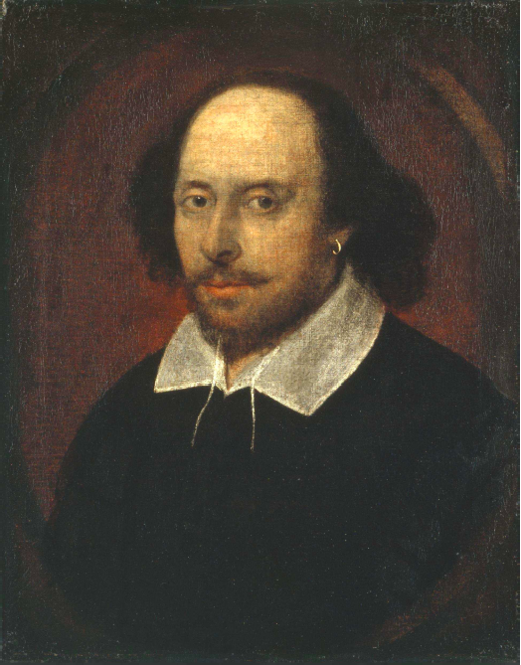
Answers to query
Antony and Cleopatra, Act III, Scene ii
Agrippa [Aside to DOMITIUS ENOBARBUS]: Why, Enobarbus,
When Antony found Julius Caesar dead,
He cried almost to roaring; and he wept
When at Philippi he found Brutus slain.
Hamlet, Act III, Scene ii
Lord Polonius: I did enact Julius Caesar I was killed i’ the
Capitol; Brutus killed me.
Notes:
Wikimedia commons picture of Shake

Slide 7
Bigger collections
Consider N = 1 million documents, each with about 1000 words.
Avg 6 bytes/word including spaces/punctuation
  6GB of data in the documents.
Say there are M = 500K distinct terms among these.

Slide 8
Can’t build the matrix
500K x 1M matrix has half-a-trillion 0’s and 1’s.
But it has no more than one billion 1’s.
  matrix is extremely sparse.
What’s a better representation?
  We only record the 1 positions.
Why?

Slide 9
Inverted index
For each term t, we must store a list of all documents that contain t.
  Identify each doc by a docID, a document serial number
Can we use fixed-size arrays for this?
Brutus
1
2
4
11
31
45
173
174
Caesar
1
2
4
5
6
16
57
132
Calpurnia
2
31
54
101
What happens if the word Caesar is added to document 14?

Slide 10
Inverted index
We need variable-size postings lists
  On disk, a continuous run of postings is normal and best
  In memory, can use linked lists or variable length arrays
    Some tradeoffs in size/ease of insertion
Posting
Brutus
1
2
4
11
31
45
173
174
Caesar
1
2
4
5
6
16
57
132
Calpurnia
2
31
54
101
Dictionary
Postings
Sorted by docID.
Notes:
Linked lists generally preferred to arrays
Dynamic space allocation
Insertion of terms into documents easy
Space overhead of pointers

Slide 11

Inverted index construction
Documents to
be indexed
Friends, Romans, countrymen.
Tokenizer
Token stream
Friends
Romans
Countrymen
Linguistic modules
Modified tokens
friend
roman
countryman
Indexer
friend
2
4
roman
1
2
Inverted index
countryman
13
16
Notes:
Document icons from free icon set: http://www.icojoy.com/articles/44/

Slide 12
Initial stages of text processing
Tokenization
  Cut character sequence into word tokens
    Deal with “John’s”, a state-of-the-art solution
Normalization
  Map text and query term to same form
    You want U.S.A. and USA to match
Stemming
  We may wish different forms of a root to match
    authorize, authorization
Stop words
  We may omit very common words (or not)
    the, a, to, of

Slide 13
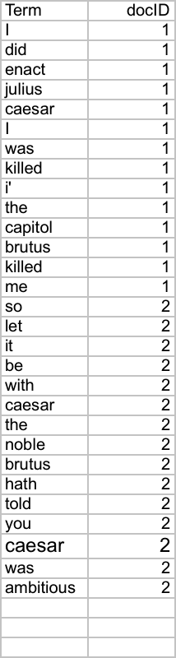
Indexer steps: Token sequence
Sequence of (Modified token, Document ID) pairs.
Doc 1
Doc 2
I did enact Julius
Caesar I was killed
i’ the Capitol;
Brutus killed me.
So let it be with
Caesar. The noble
Brutus hath told you
Caesar was ambitious

Slide 14
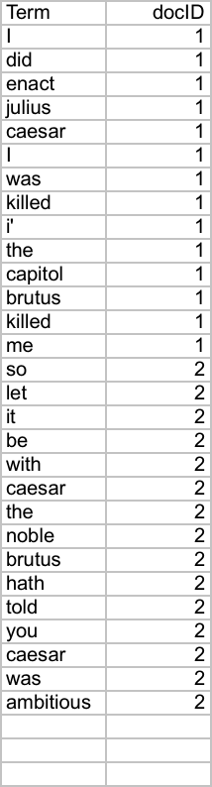
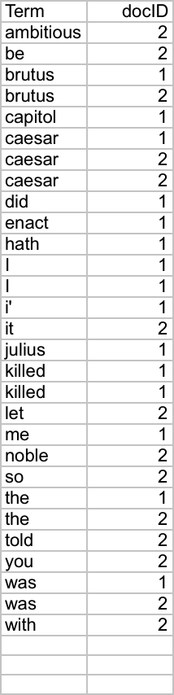
Indexer steps: Sort
Sort by terms
  And then docID
Core indexing step

Slide 15
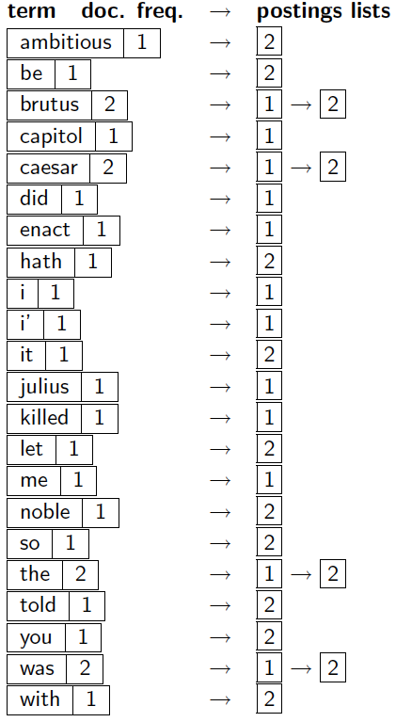
Indexer steps: Dictionary & Postings
Multiple term entries in a single document are merged.
Split into Dictionary and Postings
Doc. frequency information is added.
Why frequency?
Will discuss later.

Slide 16
Where do we pay in storage?
Lists of docIDs
Terms and counts
IR system implementation
How do we index efficiently?
How much storage do we need?
Pointers

Slide 17
Query processing: AND
Consider processing the query:
  Brutus AND Caesar
  Locate Brutus in the Dictionary;
    Retrieve its postings.
  Locate Caesar in the Dictionary;
    Retrieve its postings.
  “Merge” the two postings (intersect the document sets):
2
4
8
16
32
64
128
Brutus
1
2
3
5
8
13
21
34
Caesar

Slide 18
The merge
Walk through the two postings simultaneously, in time linear in the total number of postings entries
2
4
8
16
32
64
128
Brutus
1
2
3
5
8
13
21
34
Caesar
If the list lengths are x and y, the merge takes O(x+y)
operations.
Crucial: postings sorted by docID.

Slide 19
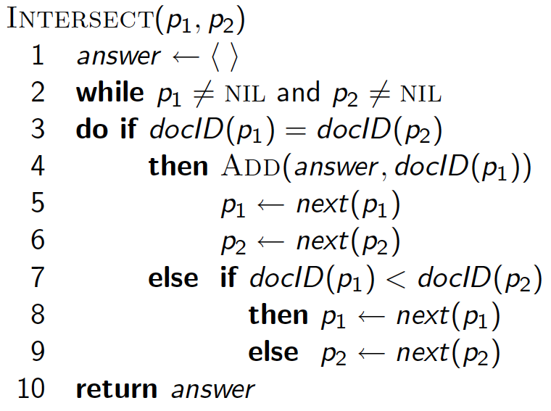
Intersecting two postings lists
(a “merge” algorithm)

Slide 20
Boolean queries: Exact match
The Boolean retrieval model is being able to ask a query that is a Boolean expression:
  Boolean Queries are queries using AND, OR and NOT to join query terms
    Views each document as a set of words
    Is precise: document matches condition or not.
  Perhaps the simplest model to build an IR system on
Primary commercial retrieval tool for 3 decades.
Many search systems you still use are Boolean:
  Email, library catalog, Mac OS X Spotlight

Slide 21
Example: WestLaw http://www.westlaw.com/
Largest commercial (paying subscribers) legal search service (started 1975; ranking added 1992; new federated search added 2010)
Tens of terabytes of data; ~700,000 users
Majority of users still use boolean queries
Example query:
  What is the statute of limitations in cases involving the federal tort claims act?
  LIMIT! /3 STATUTE ACTION /S FEDERAL /2 TORT /3 CLAIM
    /3 = within 3 words, /S = in same sentence

Slide 22
Example: WestLaw http://www.westlaw.com/
Another example query:
  Requirements for disabled people to be able to access a workplace
  disabl! /p access! /s work-site work-place (employment /3 place
Note that SPACE is disjunction, not conjunction!
Long, precise queries; proximity operators; incrementally developed; not like web search
Many professional searchers still like Boolean search
  You know exactly what you are getting
But that doesn’t mean it actually works better….

Slide 23
Boolean queries:
More general merges
Exercise: Adapt the merge for the queries:
Brutus AND NOT Caesar
Brutus OR NOT Caesar
Can we still run through the merge in time O(x+y)? What can we achieve?

Slide 24
Merging
What about an arbitrary Boolean formula?
(Brutus OR Caesar) AND NOT
(Antony OR Cleopatra)
Can we always merge in “linear” time?
  Linear in what?
Can we do better?

Slide 25
Query optimization
What is the best order for query processing?
Consider a query that is an AND of n terms.
For each of the n terms, get its postings, then AND them together.
Brutus
2
4
8
16
32
64
128
Caesar
1
2
3
5
8
16
21
34
Calpurnia
13
16
Query: Brutus AND Calpurnia AND Caesar
25

Slide 26
Query optimization example
Process in order of increasing freq:
  start with smallest set, then keep cutting further.
This is why we kept
document freq. in dictionary
Brutus
2
4
8
16
32
64
128
Caesar
1
2
3
5
8
16
21
34
Calpurnia
13
16
Execute the query as (Calpurnia AND Brutus) AND Caesar.

Slide 27
More general optimization
e.g., (madding OR crowd) AND (ignoble OR strife)
Get doc. freq.’s for all terms.
Estimate the size of each OR by the sum of its doc. freq.’s (conservative).
Process in increasing order of OR sizes.

Slide 28
Exercise
Recommend a query processing order for
Which two terms should we process first?
(tangerine OR trees) AND
(marmalade OR skies) AND
(kaleidoscope OR eyes)

Slide 29
Query processing exercises
Exercise: If the query is friends AND romans AND (NOT countrymen), how could we use the freq of countrymen?
Exercise: Extend the merge to an arbitrary Boolean query. Can we always guarantee execution in time linear in the total postings size?
Hint: Begin with the case of a Boolean formula query: in this, each query term appears only once in the query.

Slide 30
Phrase queries
We want to be able to answer queries such as “stanford university” – as a phrase
Thus the sentence “I went to university at Stanford” is not a match.
  The concept of phrase queries has proven easily understood by users; one of the few “advanced search” ideas that works
  Many more queries are implicit phrase queries
For this, it no longer suffices to store only
<term : docs> entries

Slide 31
A first attempt: Biword indexes
Index every consecutive pair of terms in the text as a phrase
For example the text “Friends, Romans, Countrymen” would generate the biwords
  friends romans
  romans countrymen
Each of these biwords is now a dictionary term
Two-word phrase query-processing is now immediate.

Slide 32
Longer phrase queries
Longer phrases can be processed by breaking them down
stanford university palo alto can be broken into the Boolean query on biwords:
stanford university AND university palo AND palo alto
Without the docs, we cannot verify that the docs matching the above Boolean query do contain the phrase.
Can have false positives!

Slide 33
Issues for biword indexes
False positives, as noted before
Index blowup due to bigger dictionary
  Infeasible for more than biwords, big even for them
Biword indexes are not the standard solution (for all biwords) but can be part of a compound strategy

Slide 34
Solution 2: Positional indexes
Sec. 2.4.2
In the postings, store, for each term the position(s) in which tokens of it appear:
  <term, number of docs containing term;
  doc1: position1, position2 … ;
  doc2: position1, position2 … ;
  etc.>

Slide 35
Positional index example
<be: 993427;
1: 7, 18, 33, 72, 86, 231;
2: 3, 149;
4: 17, 191, 291, 430, 434;
5: 363, 367, …>
Which of docs 1,2,4,5
could contain “to be
or not to be”?
For phrase queries, we use a merge algorithm recursively at the document level
But we now need to deal with more than just equality

Slide 36
Processing a phrase query
Extract inverted index entries for each distinct term: to, be, or, not.
Merge their doc:position lists to enumerate all positions with “to be or not to be”.
  to:
    2:1,17,74,222,551; 4:8,16,190,429,433; 7:13,23,191; ...
  be:
    1:17,19; 4:17,191,291,430,434; 5:14,19,101; ...
Same general method for proximity searches

Slide 37
Proximity queries
Sec. 2.4.2
LIMIT! /3 STATUTE /3 FEDERAL /2 TORT
  Again, here, /k means “within k words of”.
Clearly, positional indexes can be used for such queries; biword indexes cannot.
Exercise: Adapt the linear merge of postings to handle proximity queries. Can you make it work for any value of k?
  This is a little tricky to do correctly and efficiently
  See Figure 2.12 of IIR

Slide 38
Positional index size
A positional index expands postings storage substantially
  Even though indices can be compressed
Nevertheless, a positional index is now standardly used because of the power and usefulness of phrase and proximity queries … whether used explicitly or implicitly in a ranking retrieval system.

Slide 39
Positional index size
Need an entry for each occurrence, not just once per document
Index size depends on average document size
  Average web page has <1000 terms
  SEC filings, books, even some epic poems … easily 100,000 terms
Consider a term with frequency 0.1%
Why?
Document size
Postings
Positional postings
1000
1
1
100,000
1
100

