Slide 1
Signature Files
Michael T. Goodrich
University of California, Irvine
Some slides adapted from notes by Ben Horowitz and Guy Blelloch
and slides from Xiaoyan Li and https://slideplayer.com/slide/4975850/

Slide 3
Signature Files
Signature files are an alternative to inverted file indexing.
The main advantage of signature files is that they don’t require that a lexicon be kept in memory during query processing.
Signature files are a probabilistic metho d for indexing documents. Each term in a document is assigned a random signature, which is a bit vector.
These assignments are made by hashing.
The descriptor of document is the bitwise logical OR of the signatures of its terms.

Slide 4
(Similar to a Bloom filter.)

Slide 5
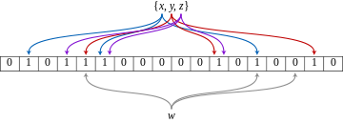
Bloom Filters
A Bloom filter is a space-efficient probabilistic data structure by Burton Howard Bloom (1970).
An empty Bloom filter is a bit array of m bits, all set to 0. There must also be k different hash functions.
To add an element, feed it to each of the k hash functions and set the bits at all their positions to 1.
To query for an element, feed it to each of the k hash functions to get k array positions. If any of the bits at these positions is 0, the element is definitely not in the set; if it were, then all the bits would have been set to 1 when it was inserted.
From https://en.wikipedia.org/wiki/Bloom_filter

Slide 6
In practice, use just one hash function, like MD5, and include the index, i, as an input:
MD5(i || term)

Slide 7
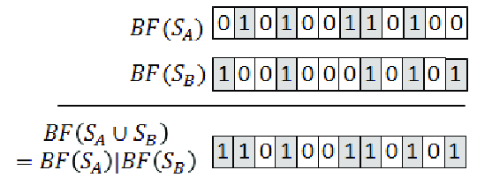
Logical Operations
To compute the intersection of two signatures (or Bloom filters), perform the logical AND of their respective bits.
To compute the union of two signatures (or Bloom filters), perform the logical OR of their respective bits.
Image from https://www.researchgate.net/figure/An-example-of-two-Bloom-filter-union-where-the-size-of-the-Bloom-filters-the-number-of_fig1_334972508

Slide 9
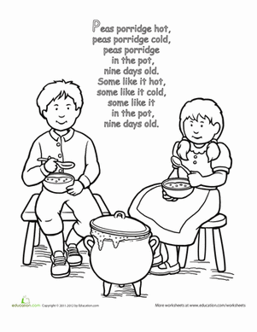
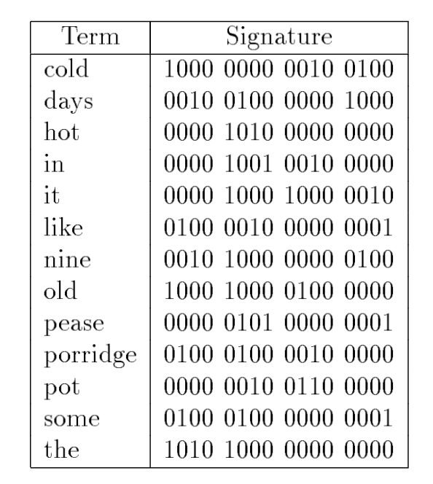
Lexicon Example
b=3 (but there might be collisions)
Image from https://www.education.com/worksheet/article/coloring-peas-porridge-hot/

Slide 10
Signature File Examples

Slide 11
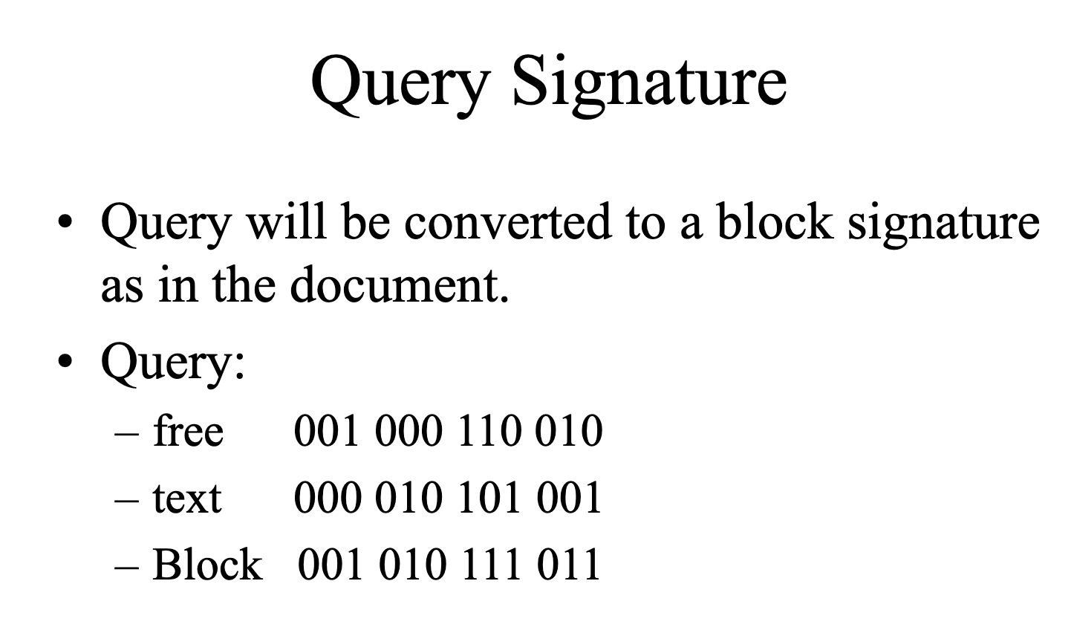

Slide 12
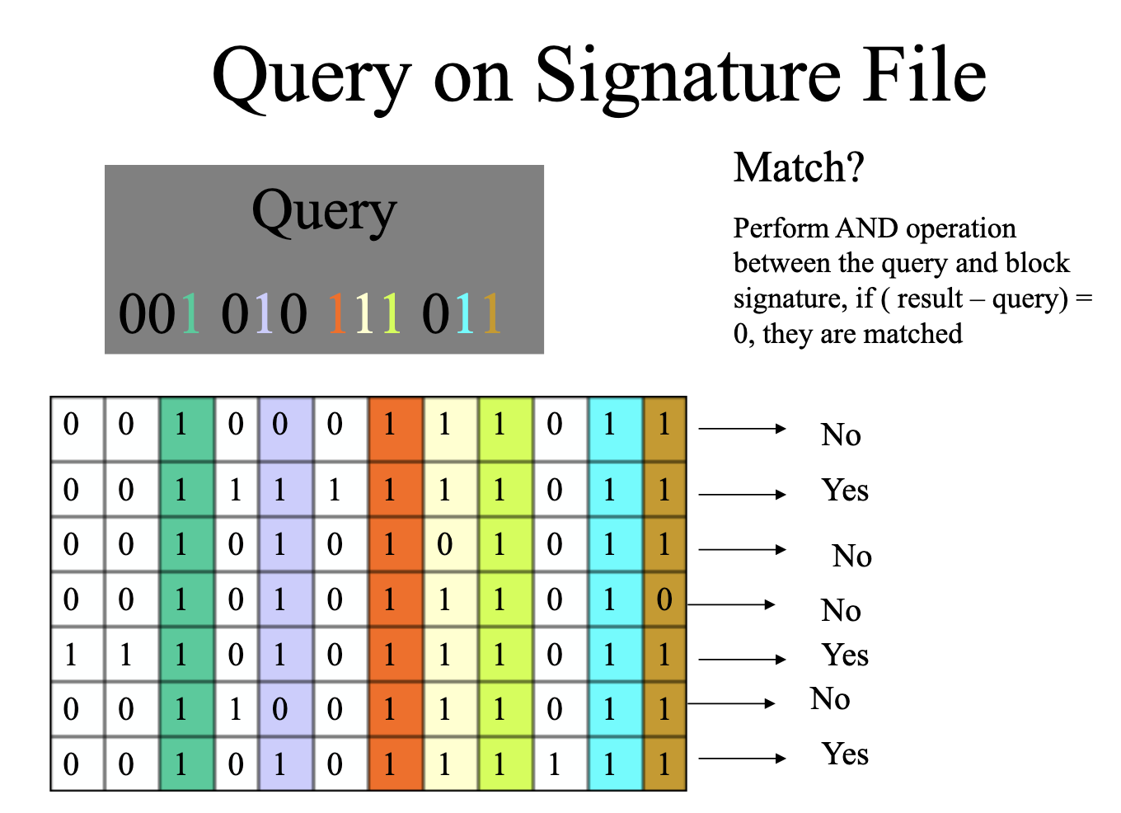

Slide 13
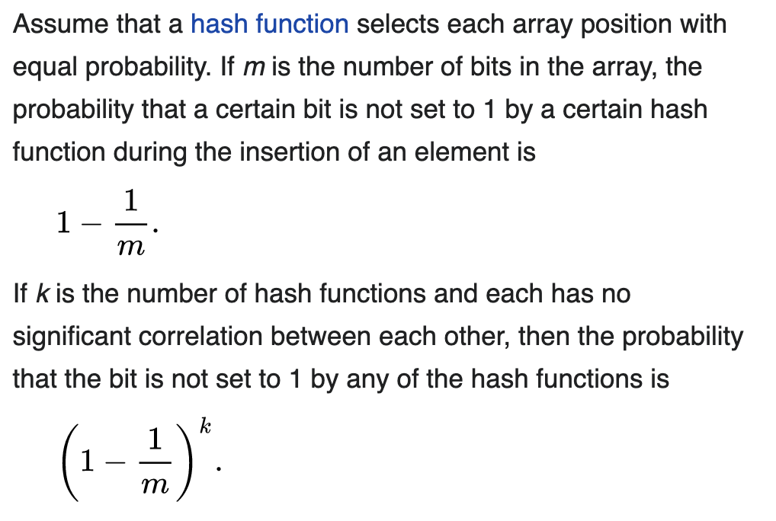
One-sided Errors
This is a probabilistic query method.
If the answer is “no”, there is no error
If the answer is “yes,” this might be a false positive, with error probability depending on the signature width, m.
From https://en.wikipedia.org/wiki/Bloom_filter

Slide 14
Error Probability (2)
From https://en.wikipedia.org/wiki/Bloom_filter

Slide 15
Error Probability (3)
From https://en.wikipedia.org/wiki/Bloom_filter

Slide 16
Optimal Number of Hash Functions
From https://en.wikipedia.org/wiki/Bloom_filter

Slide 17
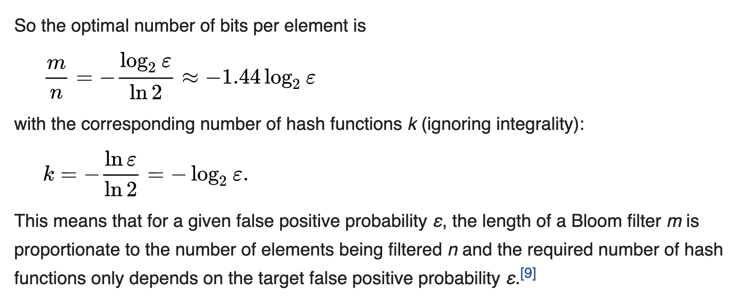
Optimal Number of Hash Functions (2)
From https://en.wikipedia.org/wiki/Bloom_filter

Slide 19
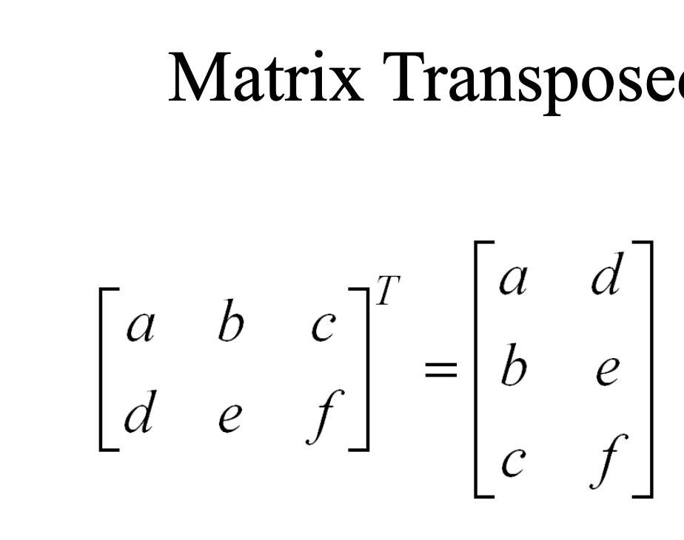

Slide 20
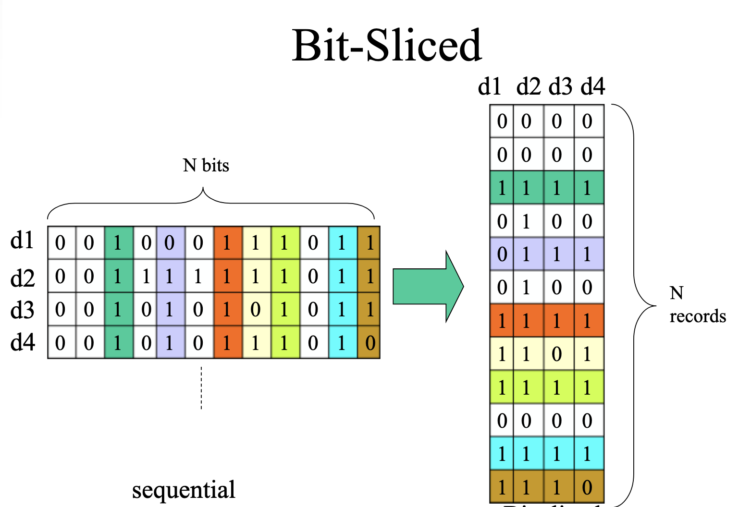

Slide 21
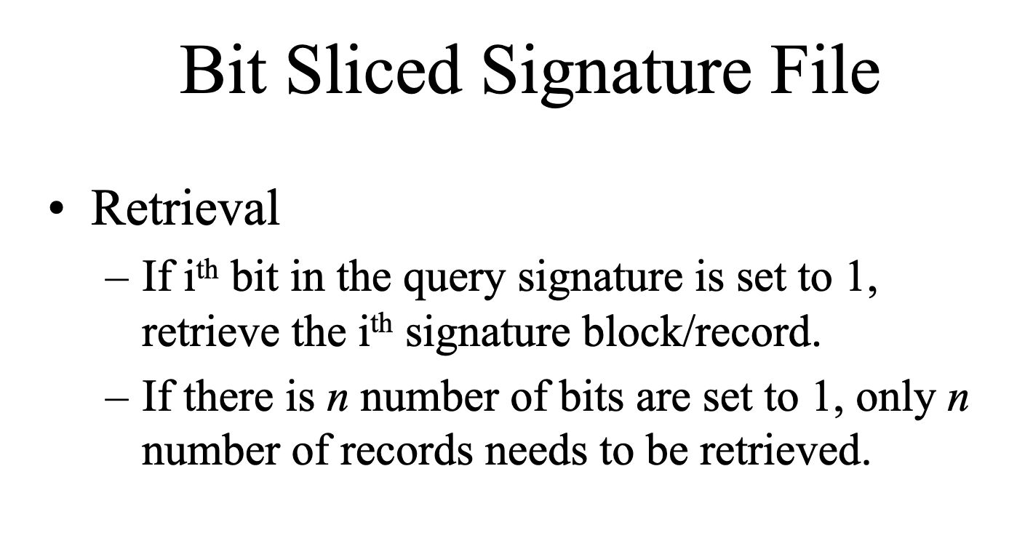

Slide 22
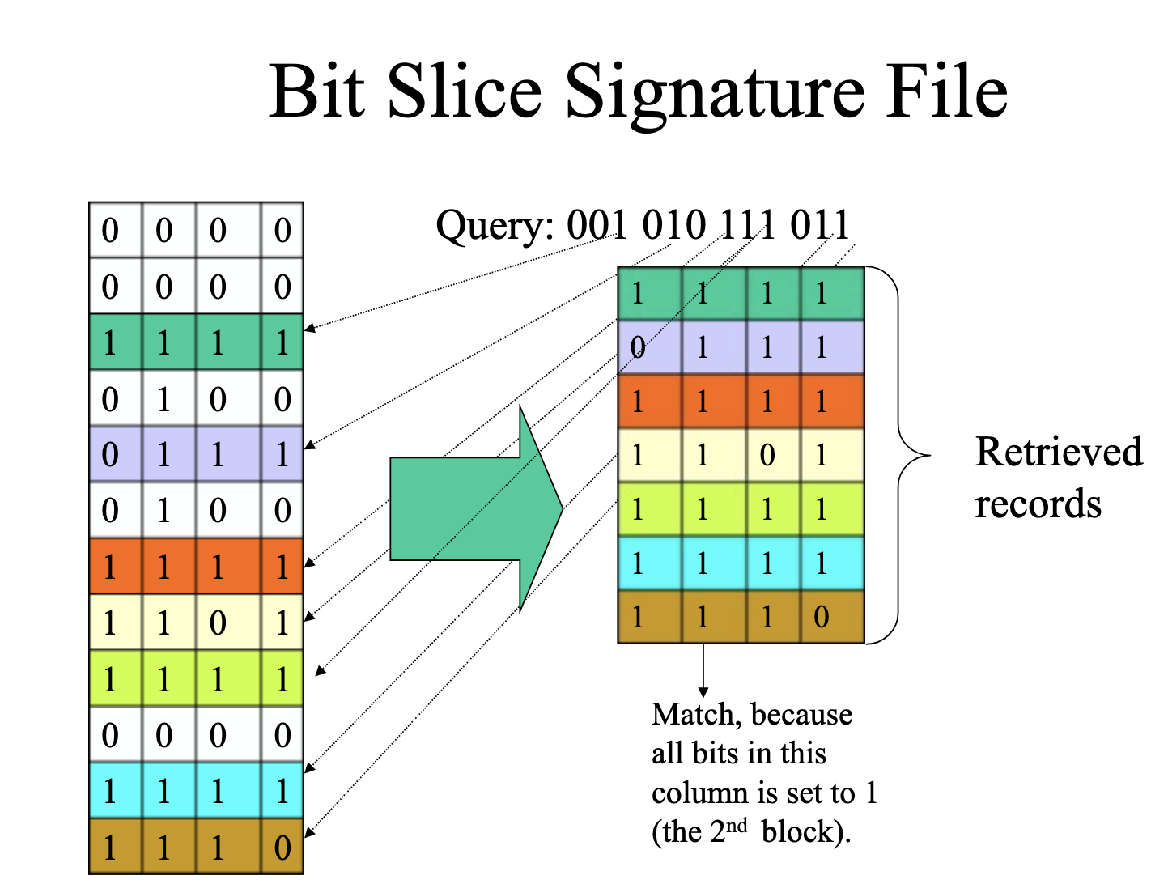

Slide 23
Comparing to Inverted Files
Source file: collection, organized by document
Inverted file: collection organized by term
one record per term, listing locations where term occurs
Searching: traverse lists for each query term
OR: the union of component lists
AND: an intersection of component lists
Proximity: an intersection of component lists
SUM: the union of component lists; each entry has a score

Slide 24
Recall Inverted Files
Contains inverted lists
one for each word in the vocabulary
identifies locations of all occurrences of a word in the original text
which ‘documents’ contain the word
Perhaps locations of occurrence within documents
Requires a lexicon or vocabulary list
provides mapping between word and its inverted list
Single term query could be answered by
scan the term’s inverted list
return every doc on the list

Slide 25
Inverted File Granularity
Index granularity refers to the accuracy with which term locations are identified
coarse grained may identify only a block of text
each block may contain several documents
moderate grained will store locations in terms of document numbers
finely grained indices will return a sentence, word number, or byte number (location in original text)

Slide 26
Comparing Inverted File Granularities
Data stored in inverted list:
The term, document frequency (df), list of DocIds
government, 3, <5, 18, 26,>
List of pairs of DocId and term frequency (tf)
government, 3 <(5, 2), (18, 1)(26, 2)>
List of DocId and positions
government, 3 <5, 25, 56><18, 4><26, 12, 43>
Note that signature files can only match granularity number 1.

Slide 27
Inverted Files: Coarse

Slide 28
Inverted Files: Medium

Slide 29
Inverted Files: Fine

Slide 30
Index Granularity
Can you think of any differences between these in terms of storage needs or search effectiveness?
coarse: identify a block of text (potentially many docs)
fine : store sentence, word or byte number
less storage space, but more searching of plain text to
find exact locations of search terms
more false matches when multiple words. Why?
Enables queries to contain proximity information
e.g.) “green house” versus green AND house
Proximity info increases index size 2-3x
only include doc info if proximity will not be used
Notes:
Multiple words generate false matches since all words may occur in the same block, but not necessarily in the same doc(s)

Slide 31
Alternative: Bitmaps
Bag-of-words index only: term x document array
For each term, allocate vector with 1 bit per document
If term present in document n, set n’th bit to 1, else 0
Boolean operations very fast
Extravagant of storage: N*n bits needed
2 Gbytes text requires 40 Gbyte bitmap
Space efficient for common terms as high prop. bits set
Space inefficient for rare terms (why?)
Not widely used

