Slide 1
Learning Strings from Queries
Michael T. Goodrich
University of California, Irvine

Slide 2
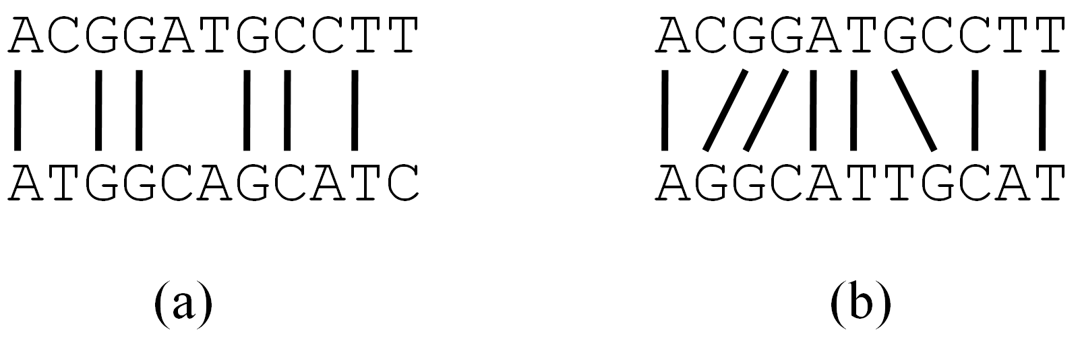
Two Types of String Queries
Query: A character string, Q.
Aligned matching: (a) We learn the number of matching (or nonmatching) aligned characters with an unknown string, S.
  This is known as Hamming distance.
Subequence-alignment: (b) We learn the length of a longest common subsequence (LCS) or other type of edit distance with an unknown string, S.

Slide 3
String Learning Algorithms
Input: An unknown string, S, of length n.
Goal: Learn S using a small number of queries of type (a) or (b).

Slide 4
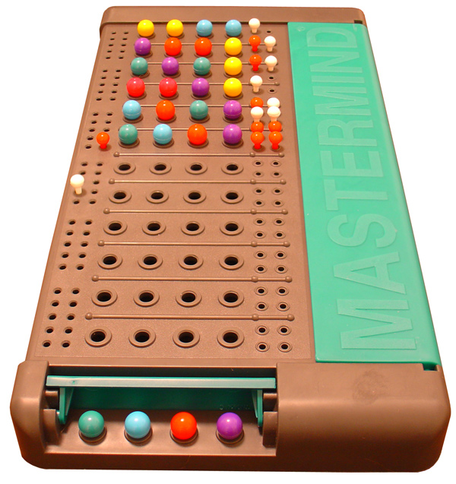
Mastermind
Mastermind is a two-player game
  A codemaker: creates a vector X of length N using an alphabet of size K (called “colors”)
  A codebreaker: guesses vectors Q₁, Q₂, …, of length N using same alphabet
Codemaker scores each guess:
  Black score: number of characters in right place
  White score: number of characters not in right place but with right color
Image by ZeroOne from http://commons.wikimedia.org/wiki/File:Mastermind.jpg, used under Creative Commons Attribution ShareAlike 2.0 License

Slide 5

Mastermind example
Turn number 1

Slide 6
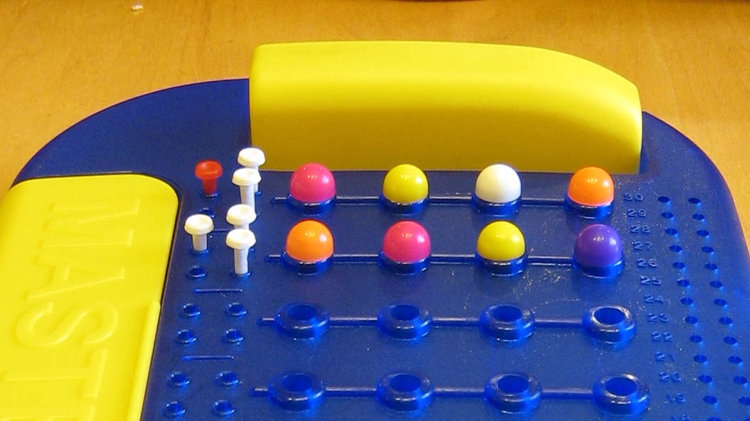
Mastermind example
Turn number 2

Slide 7
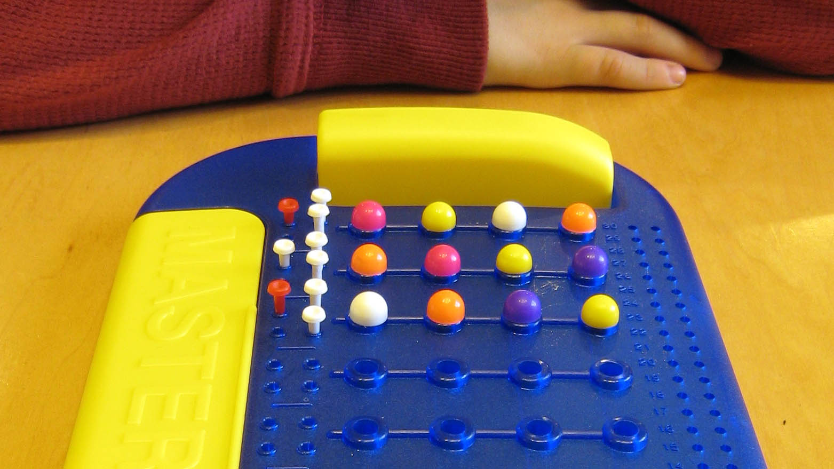
Mastermind example
Turn number 3

Slide 8
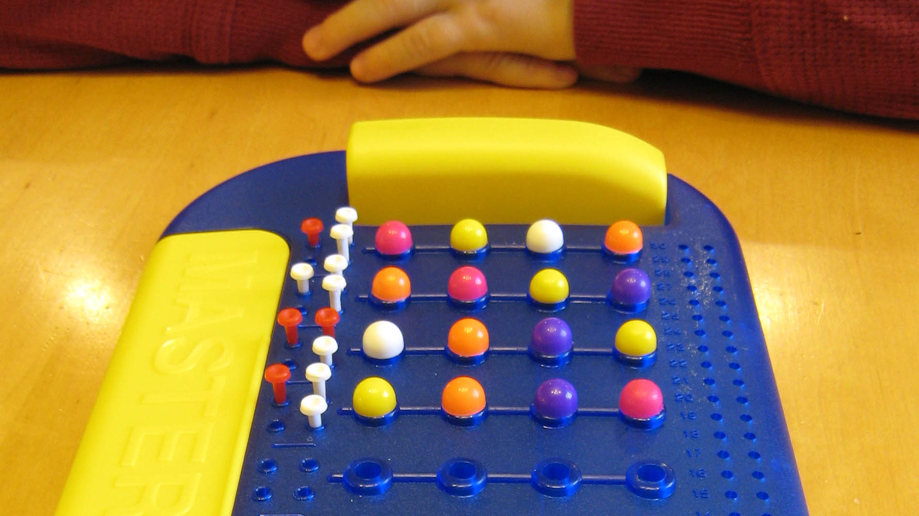
Mastermind example
Turn number 4

Slide 9
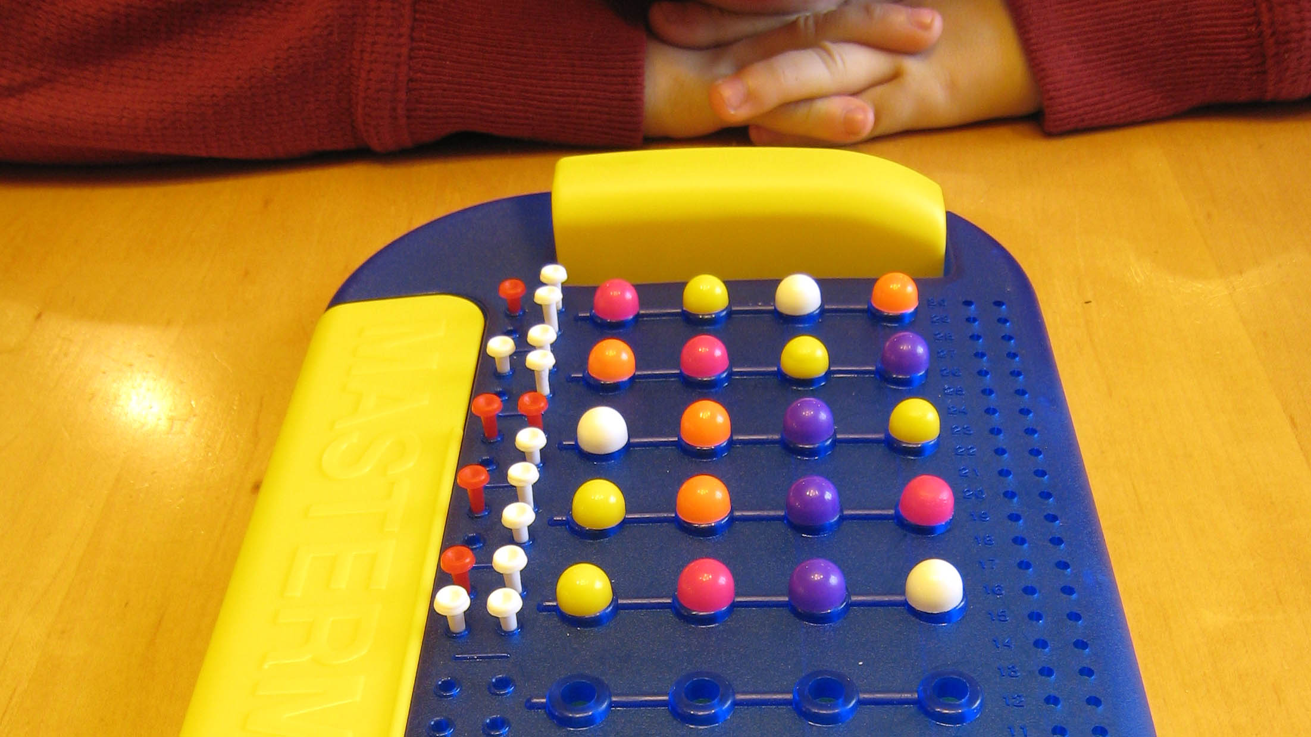
Mastermind example
Turn number 5

Slide 10
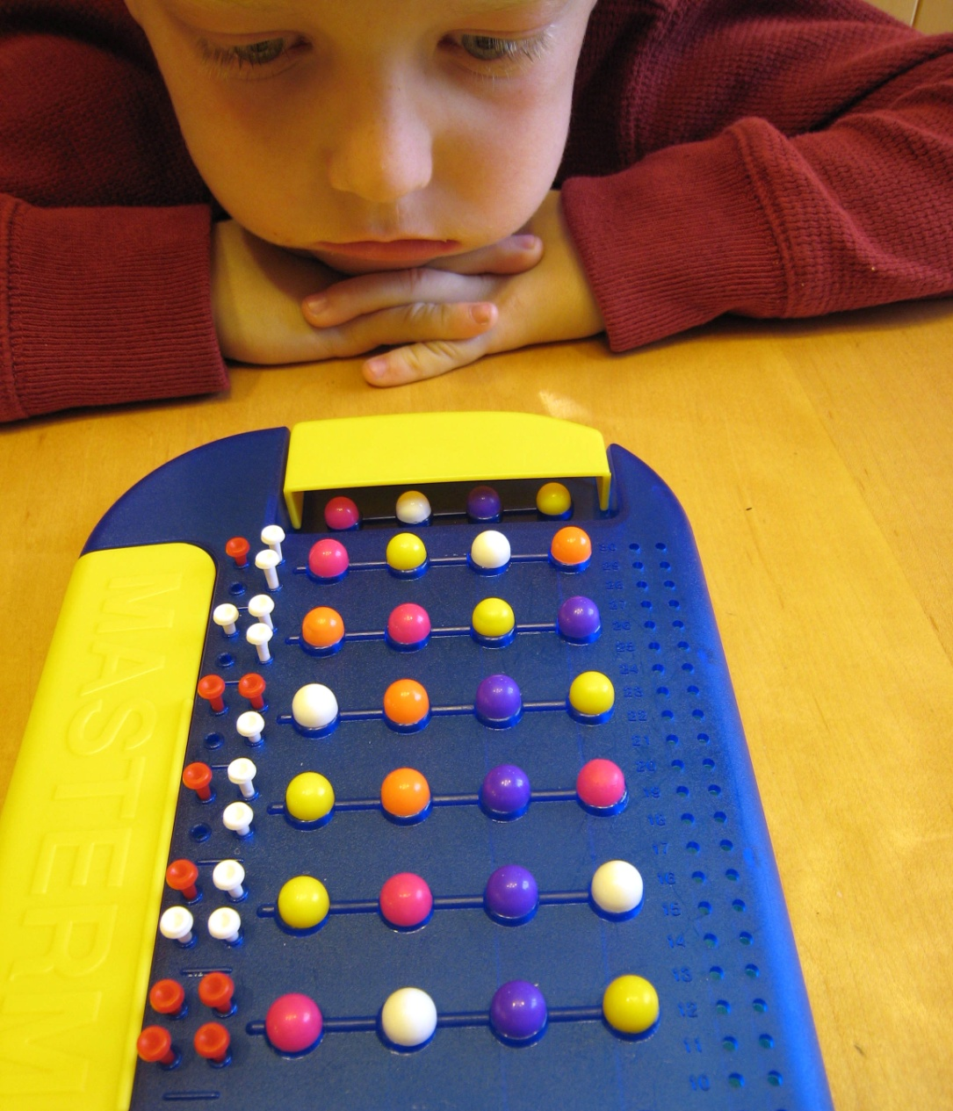
Mastermind example
Solved!

Slide 11

Restricted Mastermind
Goal: Try to guess the secret vector as quickly as possible, in terms of
  N = length of vector
  K = number of colors
Restriction: use only:
  Black score: number of characters in right place

Slide 12
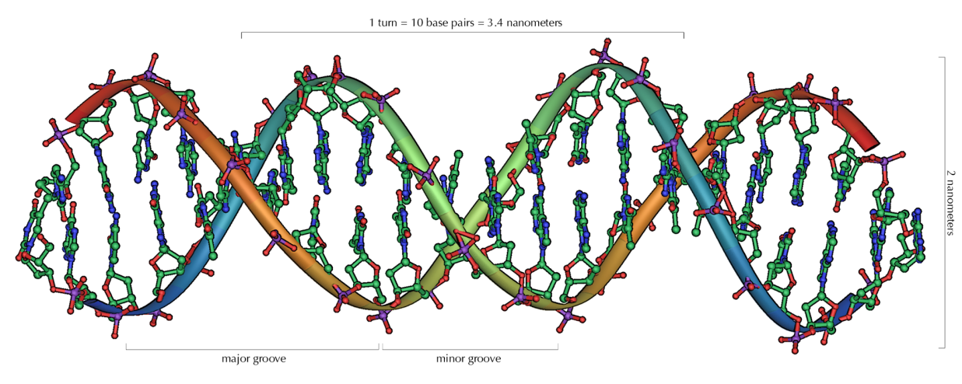
The Mastermind Learning Algorithm
Given a DNA string, S, owned by Alice.
Bob can repeatedly query S using DNA strings, Q₁, Q₂, …
Each query returns the number of places were S and Q_{i} are the same (and nothing more).
The Mastermind learning algorithm: Bob uses his queries to learn S.
Image by Michael Ströck from http://commons.wikimedia.org/wiki/File:DNA_Overview.png, used under GFDL 1.2

Slide 13

These Queries can be done Privately
Secure Multiparty Computations (SMC):
  Alice and Bob can use cryptographic functions that allow them to compute an aligned-matching score or a sequence-alignment score on their two DNA strings without revealing any other information.
      [Atallah et al., ‘03], [Du-Atallah, ‘01], [Freedman et al., ‘04]
But what if they’re repeated?
Image from https://www.bbc.co.uk/programmes/w3csvflc

Slide 14
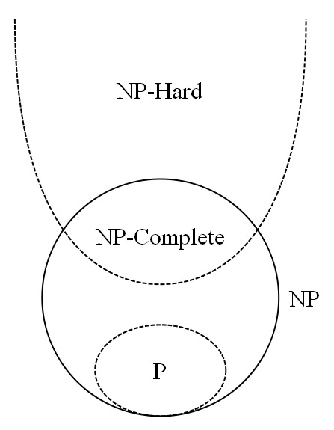
Mastermind Satisfiability is Hard
[Stuckman and Zhang, 2005] show that it is NP-complete to determine if a sequence of (general) Mastermind query-responses is satisfiable.
[Goodrich, 2009] shows that restricted Mastermind satisfiability is NP-complete.
We show that restricted Mastermind satisfiability is NP-complete even for sequence alignment queries.
Image by Behnam from http://commons.wikimedia.org/wiki/File:P_np_np-complete_np-hard.svg, used under GFDL 1.2

Slide 15
Proof Sketch
Reduction from 3-Dimensional Matching:
  Given triples (x,y,z) from sets X,Y,Z, find a set of triples such that each member of X, Y, and Z belong to exactly one triple.
Reduction: Form a vector with regions for the three sets and the set of triples, with a special separator color in between each real element
Perform three queries for each triple, which enforce the rule that this triple is either used to “cover” three elements or it is not used at all.

Slide 16
A False Sense of Difficulty
In spite of the difficulty of Mastermind satisfiability, we can solve Mastermind problems in polynomial time for any given unknown string, S.
N = length of the string, K = number of colors.
For aligned queries (Hamming distance):
  [Chvátal, ‘83]: 2N[log K] + 4N guesses
  [Chen et al., ‘96]: 2N[log N] + 2N + [K/N] + 2 guesses
  [Goodrich, ‘09]: N[log K] + [(2 – 1/K)N] + K guesses
For DNA sequence-alignment queries:
  (N+1)K queries in general, (N+1)K/H_{N,s} with Zipf’s Law

Slide 17
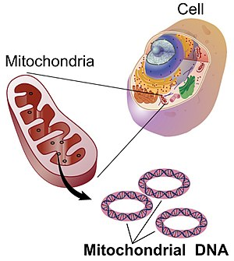
Mitochondrial DNA
DNA strings are sequences of A, C, G, and T
Mitochondrial DNA is the circular chromosome found inside the cellular organelles called mitochondria.
Located in the cytoplasm, mitochondria are the site of the cell's energy production and other metabolic functions.
Offspring inherit mitochondria DNA only from their mother.
Image from https://en.wikipedia.org/wiki/Mitochondrial_DNA

Slide 18
Mutations in Mitochondrial DNA
Human Mitochondrial DNA strings can be characterized in terms of their differences with a reference string, R.
Mitochondrial DNA can be used to identify race and/or ethnicity.
Human migration patterns and associated mitochondrial DNA haplotypes

Slide 19
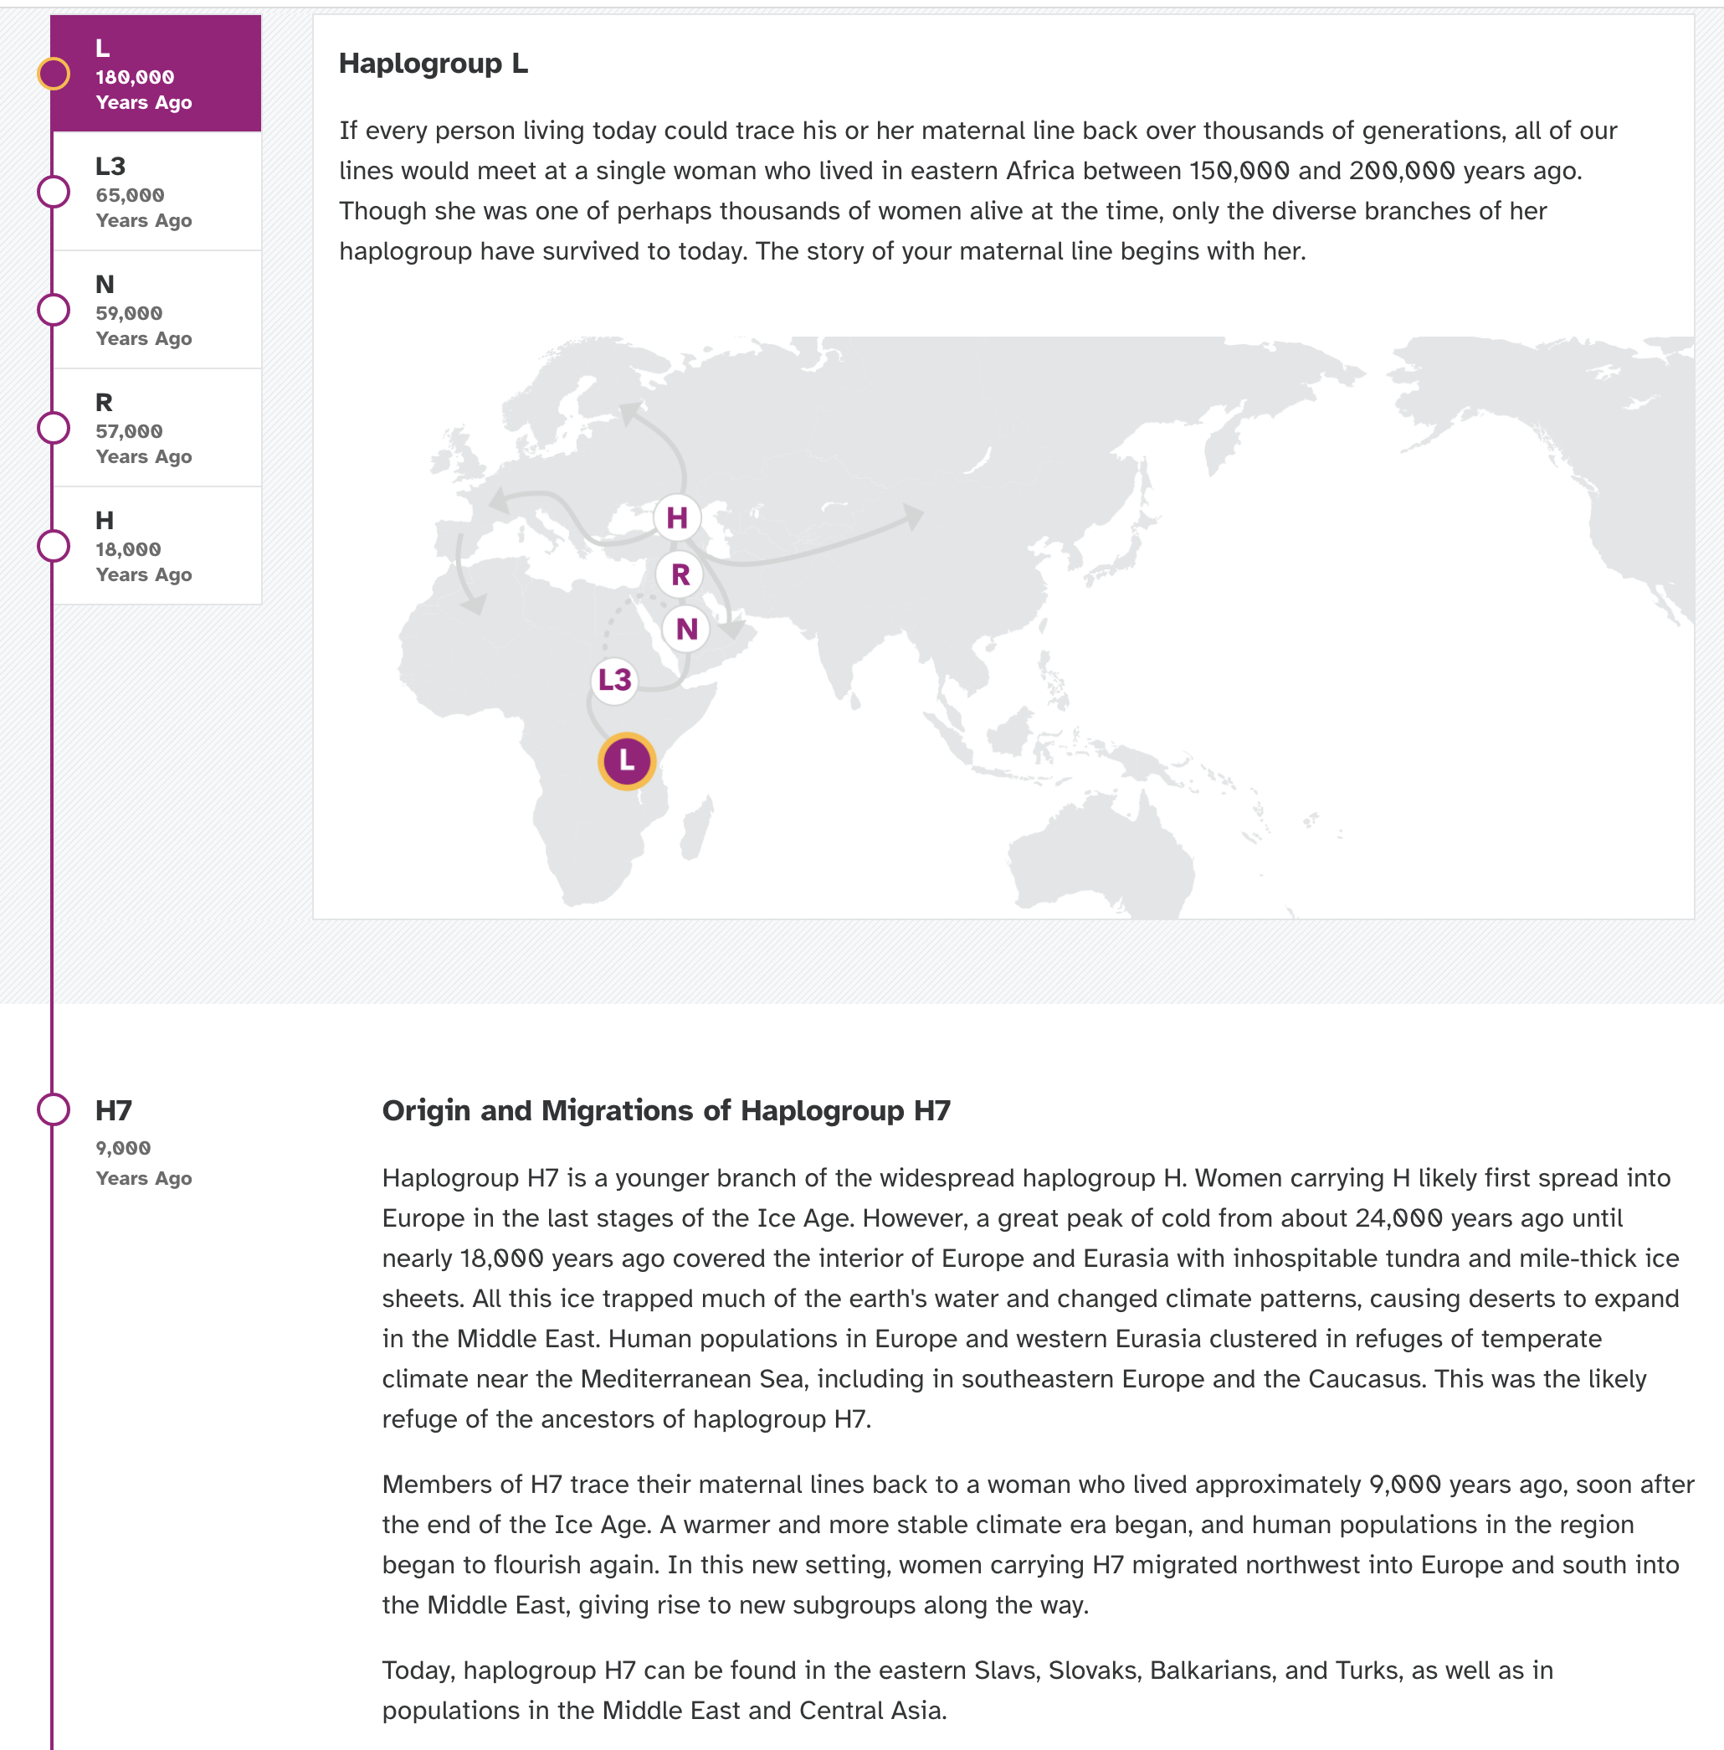
Example 1
An American with ancestors from England and Germany
From https://you.23andme.com/reports/maternal_haplogroup/

Slide 20
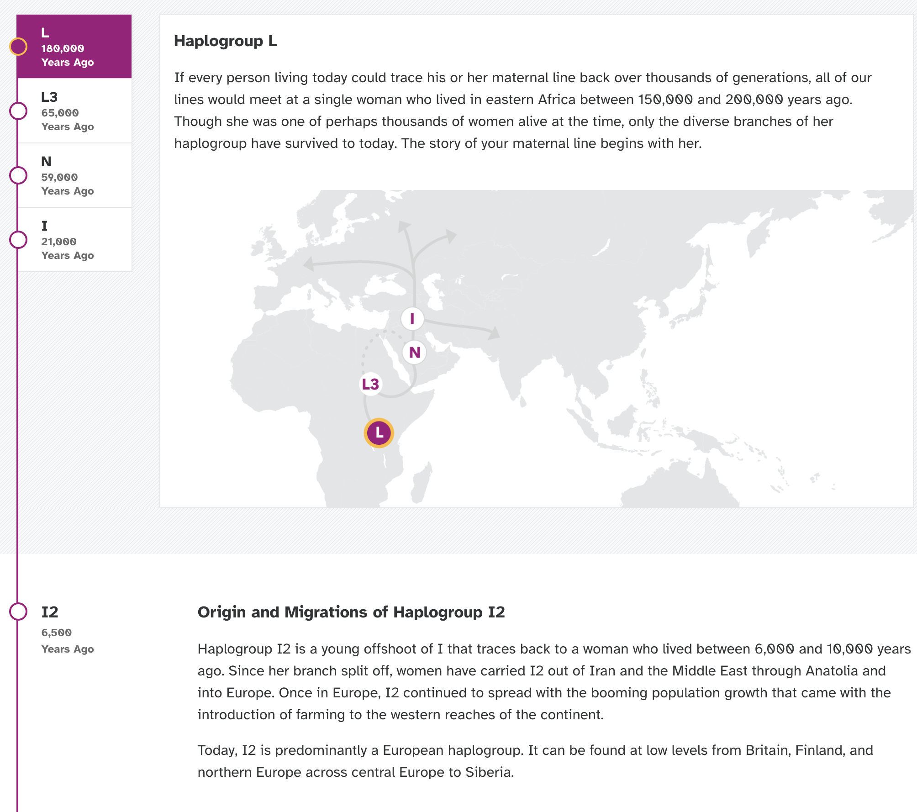
Example 2
An American with ancestors from England and the Netherlands.
From https://you.23andme.com/reports/maternal_haplogroup/

Slide 21
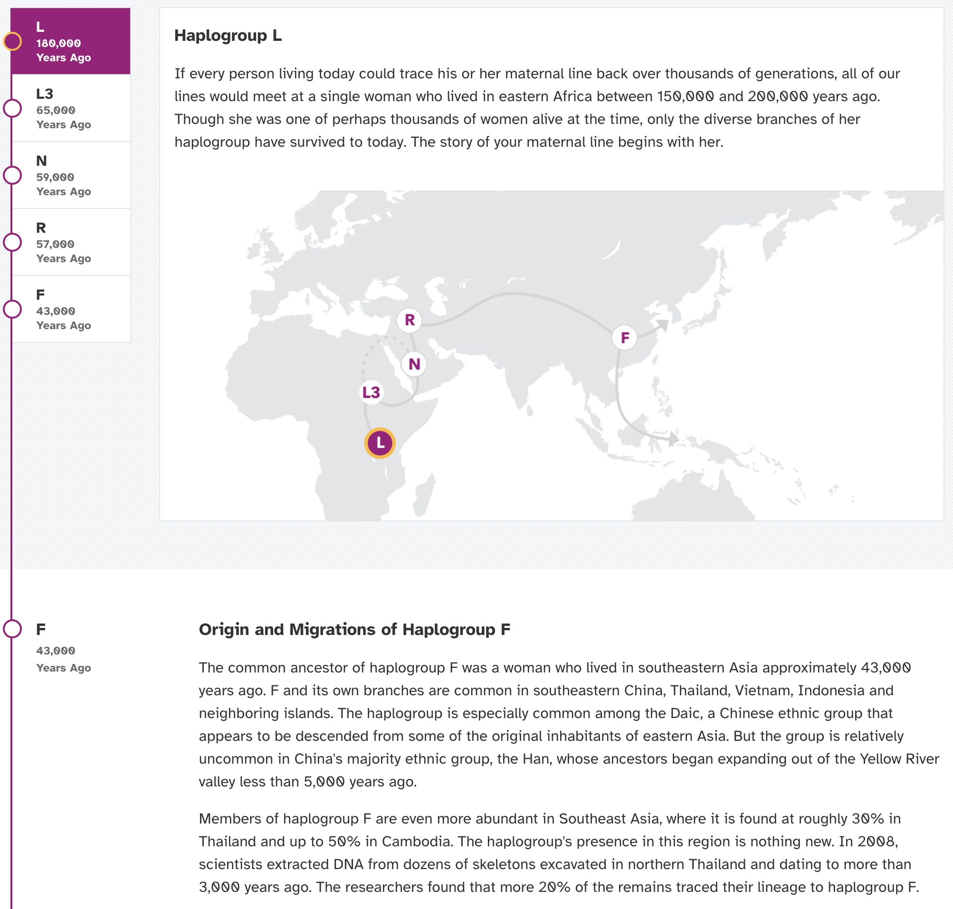
Example 3
An American with ancestors from Korea.
From https://you.23andme.com/reports/maternal_haplogroup/

Slide 22
Aligned-Match Queries
Start with K-1 queries to determine the number of each color in S.
  Here: a color at position i is a cyclical offset from the reference string, R. (If R is unknown, use R=000…)
Then do a divide-and-conquer algorithm
Do K more queries, which vary S₁, but keep S₂ unchanged, so as to determine the number of each color in S₁ (and S₂), since these will be determined by K equations in K unknowns
Recursively solve each side
S₁
S₂

Slide 23
Divide-and-Conquer (setup)
The generic problem is to determine the values of all the elements in a range Q[l:r], which initially is the entire vector Q = Q[0:N-1], assuming we know the values of c₁, c₂, …, c_{K}, of every color in Q[l:r], and each c_{i} > 0.
If K is at most 1, then we are done; so let us assume that K is at least 2. In addition, we assume inductively that we know d, the number of instances of color 1 outside of the range Q[l:r].
Initially, of course, d = 0.

Slide 24
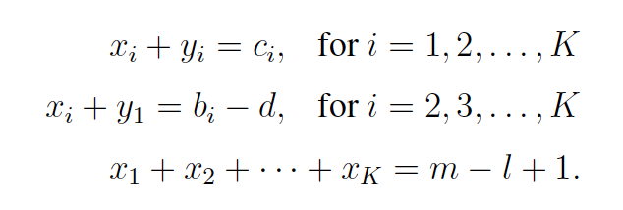
Divide-and-Conquer (divide step)
Split Q[l:r] into Q[l:m] and Q[m+1:r], where m is in the middle of the interval [l, r].
We want to determine the cardinalities, x₁, x₂, …, x_{K}, and y₁, y₂, …, y_{K}, of every color that respectively appears in Q[l:m] and Q[m+1:r].
We do K-1 additional queries, where we guess the elements in Q[l:m] are color i and the rest of Q is color 1. Let b₁, b₂, …, b_{K} denote these counts. Then
Thus we have 2K equations in 2K unknowns. Solve.

Slide 25
Aligned-Match Divide-and-Conquer Analysis
Let G(N,K) denote the number of queries, after the initial K-1.
Then
  G(N,K) = 2G(N/2, K) + min{N,K − 1}
  which implies
  G(N,K), plus the original K-1 queries, is at most
  N⌈log K⌉ + ⌈(2 − 1/K)N⌉ + K.
  That is, it is O(N log K).

Slide 26
Further Improvements
If we have a parameter, d, which upper bounds the number of differences with the reference string, R, and a parameter, M, which upper bounds the places where there can be differences, we can do even better.
Do the divide-and-conquer algorithm again, but this time only do non-trivial recursive calls.
At most d⌈log M⌉ + K−1 guesses:
At most d leaves

Slide 27


Sequence-Alignment Queries
Do K-1 queries to determine all the color frequencies. Renumber the colors sorted in non-decreasing order by frequency.
For the least-frequent color,1, determine the number of color-2 characters there are between each pair of color-1 characters.
Repeat for each remaining color.

Slide 28
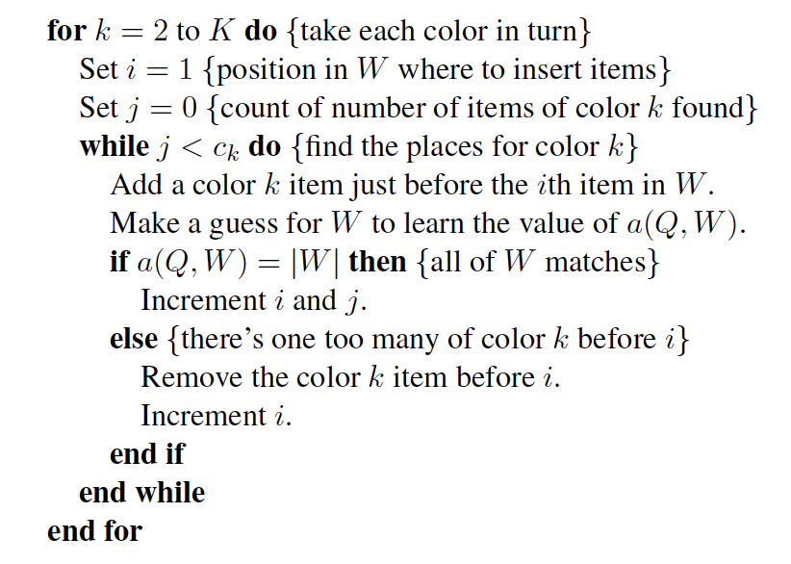
Details
Start with W=11…1 (according to number of 1’s)

Slide 29

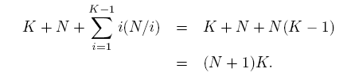
Analysis
Let d₁, d₂, …, d_{K} denote the cardinalities of the colors in non-increasing (reverse) order.
Then the number of queries is
Note that d_{i} is at most N/i, so number of queries is at most

Slide 30
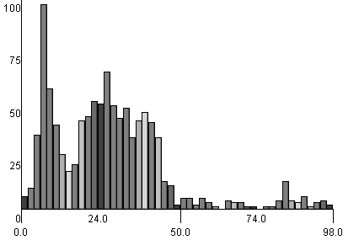
Distribution of Differences with R
The number of changes for mitochondrial DNA (mtDNA) from a standard reference string, R
M = 2700
N = 16500
d distribution:

Slide 31
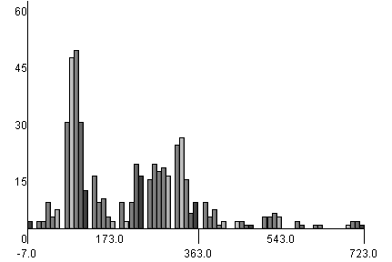
Aligned-Match Experiment
Simulated aligned-match Mastermind query lengths on mtDNA

Slide 32
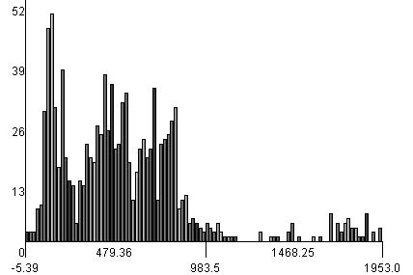
Sequence-Alignment Experiment
Simulated Mastermind query lengths for sequence-alignment queries on mtDNA

Slide 33
Adaptive vs Non-adaptive Learning
The above algorithms are adaptive
  Each query can use outcomes of previous queries.
What if we had to give all our queries in advance?
Then we would need a non-adaptive learning algorithm.
Image by ZeroOne from http://commons.wikimedia.org/wiki/File:Mastermind.jpg, used under Creative Commons Attribution ShareAlike 2.0 License

Slide 34
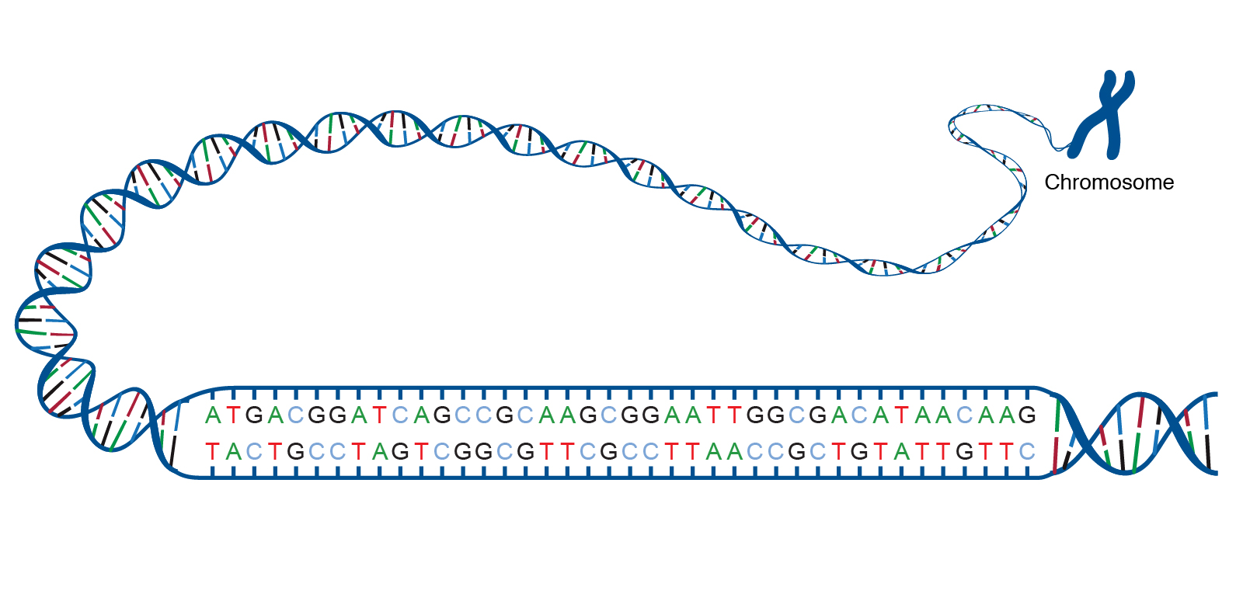
Non-adaptive Query DNA Application
DNA sequences are stored in a database, D.
For any sequence Q, the database returns a score for how close Q is to each sequence in D
We must use non-adaptive scheme to learn DNA strings in D.
Image from https://www.genome.gov/genetics-glossary/acgt

Slide 35
Non-adaptive Mastermind
Goal: Try to guess the secret vector as quickly as possible, in terms of
  N = length of vector
  K = number of colors
Restriction: use only:
  Black score: number of characters in right place
  Non-adaptive guesses

Slide 36
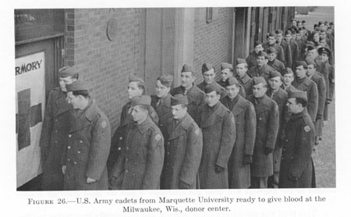
Group Testing
Input: n items, numbered 0,1, …, n-1, at most d of which are defective.
Output: the indices of the defective items.
Items can be grouped into subsets, each of which can be tested to see it contains a defective item or not.
Goal: minimize the total number of tests
Original problem: Testing blood samples.

Slide 37

Testing Schemes
Non-adaptive: All tests must be done in parallel.
Adaptive: Tests can be done sequentially.
  Adaptive is easier, but our framework requires a non-adaptive approach.
See [Du-Hwang] books for more background and previous results.
A hybrid (two-step) approach was recently used for testing for COVID-19.
Image from https://healthy.kaiserpermanente.org/southern-california/health-wellness/coronavirus-information

Slide 38
Main Theorem
With high probability, there exists a nonadaptive group-testing algorithm, which can discover each of g binary strings in X, using a number of tests that is at most:
g = number of strings in database
n = length of each binary string
d = max difference (across strings) from reference vector

Slide 39
Matrix View of Testing
A non-adaptive testing regimen can be viewed as a t x n binary matrix M:
  M[i,j] = 1 if and only if
  test i includes item j
M is d-disjunct if the Boolean sum of any d columns does not contain any other column.
  An item is defective iff all its tests are positive
M is d-separable if the Boolean sums of each set of at most d columns are distinct (harder analysis algorithm)
n
t
M

Slide 40
Randomized Approach
Use a randomized approach motivated by Bloom filtering.
Construct a matrix M, but relax requirements
Given a set D of d columns in M and a column j, say j is distinguishable from D if there is a row i such that M[i,j]=1 but M[i,j’]=0 for each j’ in D.
M is D-distinguishable if, for a particular collection D of subsets, the matrix M will find them distinguishable.

Slide 41

Constructing the Matrix
Given t (set in the analysis), let M be a 2t x n matrix defined randomly:
  For each column j, choose t/d rows of M at random and set these entries to 1.
  that is, we “inject” j into those t/d tests
Image from https://www.vectorstock.com/royalty-free-vector/matrix-of-binary-numbers-binary-computer-code-vector-39461329

Slide 42
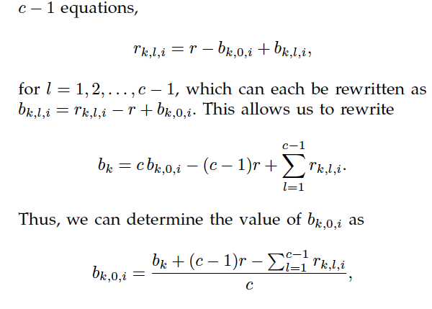
Extending to Non-binary strings
Think of each character as a “color”
Learn the number of each color as a binary vector, by using a simple set of linear equations
Reduce each group of C tests to a step in each colorized group test

Slide 43
Distance from Reference String
More tests are needed for vectors that are further from the reference R (but note most vectors are close to R):

