Slide 1
Invertible Bloom Lookup Tables
Michael T. Goodrich
University of California, Irvine
Joint work with David Eppstein and Michael Mitzenmacher

Slide 2
Hamming Distance
Problem: Compute the differences between two strings A and B that have Hamming distance at most d.
View A and B as sets of key-value pairs, where key=index and value=character.
A:
B:
Image from http://computationaltales.blogspot.com/2011/07/hamming-distance-option-part-3-of-peter.html

Slide 3
Related Problem: Stragglers Problem
Consider data streams that insert and delete many items, such that most items inserted are subsequently deleted.
Problem: Identify the stragglers
Examples:
Flows through a router
people entering and leaving a building.
Image from https://news.uci.edu/2021/12/07/uci-fall-2021-enrollment-data-shows-student-diversity-trending-upward/

Slide 4
Stragglers Problem
We want listing not at all times, but at “reasonable” or “off-peak” times, when the current working set size is bounded.
If we do all the N insertions, then all the N-M deletions, and want a list at the end, we want…
Data structure size should be proportional to listing size, not maximum size.
Proportional to M, not to N!
Proportional to size you want to be able to list, not number of pairs your system has to handle.

Slide 5
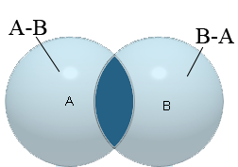
Bags-of-words Reconciliation Problem
Alice and Bob each hold a set of words, with a large overlap.
Example: Alice is your smartphone phone book, Bob is your desktop phone book, and new entries or changes need to be synched.
Want one/both parties to learn the (signed) set difference.
Goal: communication is proportional to the size of the difference, not the size of the sets.

Slide 6
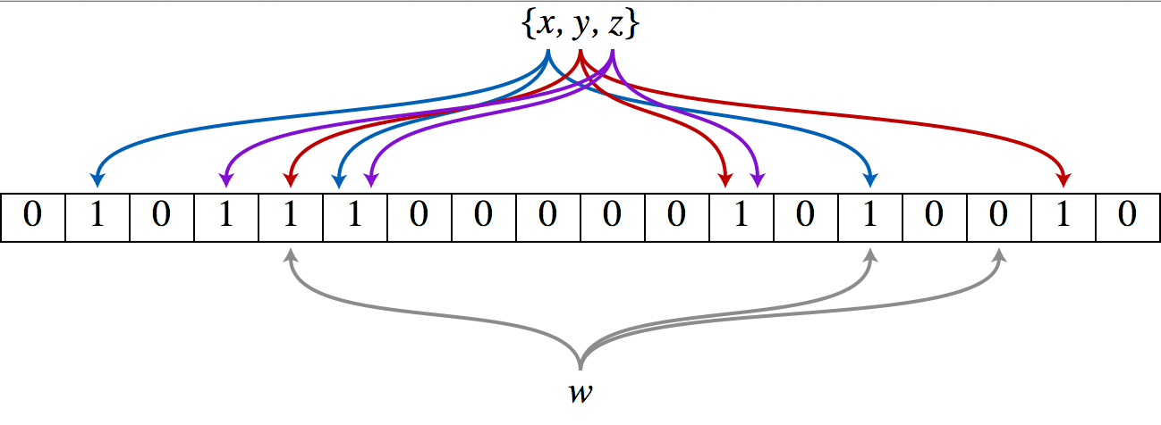
Bloom Filters
Bloom [1970] introduced a probabilistic set membership data structure.
An example of a Bloom filter, representing the set { x, y, z }. The colored arrows show the positions in the bit array that each set element is mapped to. The element w is not in the set { x, y, z }, because it hashes to one bit-array position containing 0. For this figure, m = 18 and k = 3.
http://en.wikipedia.org/wiki/Bloom_filter

Slide 7
Bloom Filters, + Values + Listing
Bloom filters useful for set membership.
But they don’t allow (key,value) lookups.
Bloomier filters, extension to (key,value) pairs.
They also don’t allow you to reconstruct the elements in the set.
Can we find something that does key-value pair lookups, and allows reconstruction?
Invertible Bloom Lookup Table (IBLT)

Slide 8
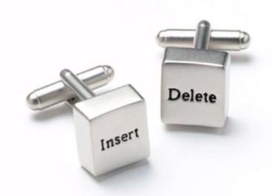
Functionality
IBLT operations
Insert (k,v)
Delete (k,v)
Get(k)
Returns value for k if one exists, null otherwise
Might return “not found” with some probability
ListEntries()
Lists all current key-value pairs
Succeeds as long as current load is not too high
Design threshold
http://www.geeky-gadgets.com/feature-21-cool-geek-cufflinks/

Slide 9
Possible Scenarios
A good system
Each key has (at most) 1 value
Delete only items that are inserted
A bad system
Deletions might happen for keys not inserted, or for the wrong value
An ugly system
Key-value pairs might be duplicated
© 1966 MGM Corp.

Slide 10
The Good System
(k,v) pair hashed to j cells
Count
KeySum
ValueSum
Insert : Increase Count,
Update KeySum and ValueSum
Delete : Decrease Count,
Update KeySum and ValueSum
Get : If Count = 0 in any cell, return null
Else, if Count = 1 in any cell and KeySum = key,
return ValueSum
Else, return Not Found

Slide 11
Get Performance
Bloom filter style analysis
Let m = number of cells, n = number key-value pairs, j = number of hash functions
Probability a Get for a key k in the system returns “not found” is
Probability a Get for a key k not in the system returns “not found is”

Slide 12
The Good System : Listing
While some cell has a count of 1:
Set (k,v) = (KeySum,ValueSum) of that cell
Output (k,v)
Call Delete(k,v) on the IBLT
© 1966 MGM Corp.

Slide 13
Listing Example
1
2
1
2
2
2
1
2
1

Slide 14
Listing Example
1
2
1
2
2
1
1

Slide 15
Listing Example
1
2
1
1
1

Slide 16
Possible Collision Scenario
2
2
2
No cell has only 1 entry, so listing terminates with
an incomplete set of items listed.

Slide 17
The Good System : Listing Analysis
While some cell has a count of 1:
Set (k,v) = (KeySum,ValueSum) of that cell
Output (k,v)
Call Delete(k,v) on the IBLT
Peeling Process.
This is the same process used to find the 2-core of a random hypergraph.
Same process used to decode families of low-density parity-check codes.

Slide 18
Listing Performance
Results on random peeling processes
Theoretical thresholds for complete recovery depend on number of hash functions:
J | 3 | 4 | 5 | 6
m/n | 1.222 | 1.295 | 1.425 | 1.570

Slide 19
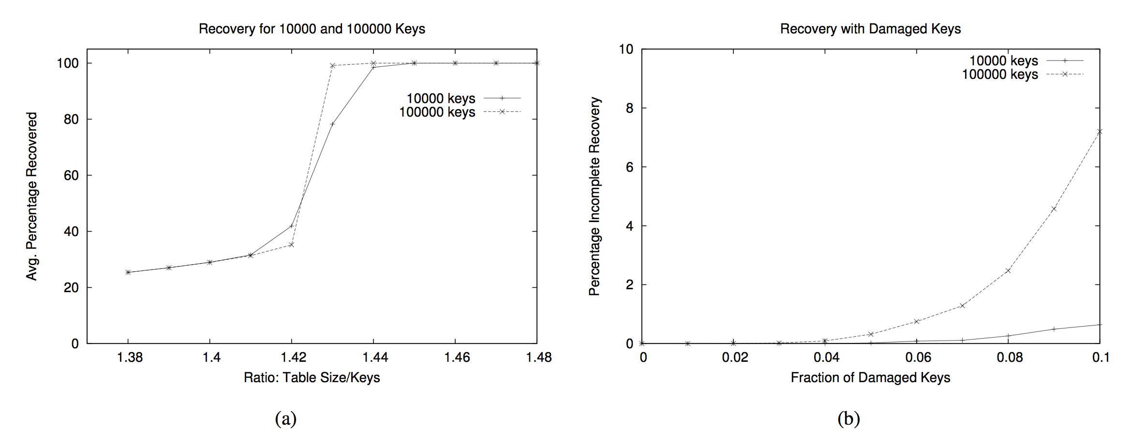
Experiments
Plot (a) gives the percentage of key-value pairs recovered around the threshold. Slightly over the theoretical asymptotic threshold, we obtain full recovery of all key-value pairs. Plot (b) gives the percentage of trials with incomplete recovery with “damaged” keys that have multiple values. Each data point represents the average of 20,000 simulations.

Slide 20
Hamming-Distance Reconciliation
Bob has a subset of Alice’s key-value pairs.
Alice sends Bob an IBLT of her key-value pairs.
Bob deletes his key-value pairs from the IBLT.
What remains in the IBLT is the set difference, A - B.
Bob lists elements of the IBLT to find the items in the difference, A - B.
IBLT size only needs to be proportional to size of the set difference.
Fast and space efficient solution.

Slide 21
Fault Tolerance: The Bad System
Extraneous deletions
Now a count of 1 does not mean 1 key in the cell.
Might have two inserted keys + one extraneous deletion.
Need an additional check: hash the keys, sum into HashKeySum.
If count is 1, and the hash of the KeySum = HashKeySum, then 1 key in the cell.
What about a count of -1?
If count is -1, and the hash of -KeySum = -HashKeySum, then 1 key in the cell.
© 1966 MGM Corp.

Slide 22
Fault Tolerance: The Ugly System
Keys with multiple values
Need another additional check; HashKeySum and HashValueSum.
Multiply-valued keys “poison” a cell.
The cell is unusable; it will never have a count of 1.
Small numbers of poisoned cells have minimal effect.
Usually, all other keys can still be listed.
If not, number of unrecovered keys is usually small, like 1.
© 1966 MGM Corp.

Slide 23
Symmetric Reconciliation
Alice and Bob each builds an IBLT, S and T, for their sets, A and B, of key-value pairs and sends these to each other or a third party.
The receiver computes S – T in an element-wise fashion.
The receiver perform fault-tolerant listing on this IBLT.
Each element removed with a count of -1 belongs to the set difference B – A, and each element removed with a count of 1 belongs to A – B.
The size of the IBLTs need only be proportional to the size of the symmetric difference .

Slide 24
Privacy-Enhanced Set Differences
Has applications to privacy-enhanced methods for comparing DNA sequences.
Main idea:
Bob and Alice encrypt their IBLTs with an additive homomorphic encryption scheme, using a public key for the trusted third party.
So we have an operation, “*”, such that E(X)*E(Y)=E(X+Y).
Alice and/or Bob performs the set difference using the operation “*” and sends result to the third party.
If the sets are close, the third party can list their difference. If they are far, the listing algorithm for the trusted third party will probably fail.

Slide 25
Conclusion
Inverse Bloom Lookup Table a simple solution for a number of basic problems.
Allows insertions, deletions, lookups, listing.
Size proportional to target “listing size”, not maximum number of pairs.
Robust to various types of faults.
More uses?
People in the Bitcoin community have discussed using IBLT for transaction resolution.

