Slide 1
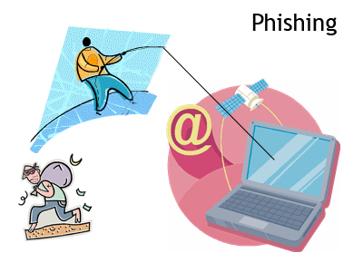
Learning to Detect Phishing Emails
Ian Fette
Norman Sadeh
Anthony Tomasic
Presented by – Bhavin Madhani

Slide 2
Authors
Ian Fette:
- Masters degree from Carnegie Mellon University.
- Product Manager at Google - works on the
Google Chrome team .
- Product manager for the anti-phishing and
anti-malware teams at Google.
Norman M. Sadeh:
- Professor in the School of Computer Science at
Carnegie Mellon University.
- Director, Mobile Commerce Lab.
- Director, e-Supply Chain Management Lab. - Co-Director, COS PhD Program.
Anthony Tomasic:
- Director of the Carnegie Mellon University.
- Masters of science in Information Technology,
Very Large Information Systems (MSIT-VLIS) Program..
Notes:
Ian Fette
Ian Fette is a Product Manager at Google, where he works on the Google Chrome team focusing on security and the browser infrastructure. He is also the product manager for the anti-phishing and anti-malware teams at Google, focused on discovering harmful sites online and making that data available for use, such as in Google Chrome and Mozilla Firefox. Ian holds a Masters degree from Carnegie Mellon University's School of Computer Science, as well a bachelor's degree in Computer Science Engineering from the University of Michigan.
Norman M. Sadeh is a Professor in the School of Computer Science at Carnegie Mellon University (CMU). He is director of CMU’s e-Supply Chain Management Laboratory, director of its Mobile Commerce Laboratory, and co-Director of the School’s PhD Program in Computation, Organizations and Society. Dr. Sadeh has been on the faculty at CMU since 1991. Norman received his Ph.D. in Computer Science at CMU with a major in Artificial Intelligence and a minor in Operations Research. He holds a MS degree in computer science from the University of Southern California. Over the past six years, Norman has conducted pioneering research in pervasive computing and semantic web technologies for privacy and context awareness and is currently extending these techniques to inter-enterprise collaboration scenarios.
Anthony Tomasic (tomasic@cs.cmu.edutomasic@cs.cmu.edu) is the Director of the Carnegie Mellon University Masters of Science in Information Technology, Very Large Information Systems (MSIT-VLIS) program. VIO The Virtual Information Officer is an intelligent assistant for processing natural language task requests for users. WbE The Workflow By Example is an intelligent assistant for user constructed workflows.

Slide 3
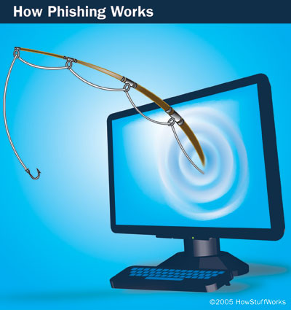
Introduction
PHISHING ?
Phishing through Emails
Phishing Problem – Hard.
An Machine Learning
approach to tackle this
online identity theft.
Image courtesy: http://images.google.com - 2005 HowStuffWorks
Notes:
This message and others like it are examples of phishing, a method of online identity theft.
Each month, more attacks are launched with the aim of making web users believe that they are communicating with a trusted entity for the purpose of stealing account information, logon credentials, and identity information in general. This attack method, commonly known as ``phishing,'' is most commonly initiated by sending out emails with links to spoofed websites that harvest information.

Slide 4
Popular Targets : March 2009
Top 10 Identified Targets |  | Valid Phishes
1 | PayPal | 9,605
2 | eBay, Inc. | 459
3 | Bank of America Corporation | 429
4 | HSBC Group | 265
5 | Google | 169
6 | Alliance Bank | 146
7 | Facebook | 104
8 | Internal Revenue Service | 96
9 | JPMorgan Chase and Co. | 73
10 | HSBC | 64
Table courtesy: http://www.phishtank.com/stats/2009/03/

Slide 5
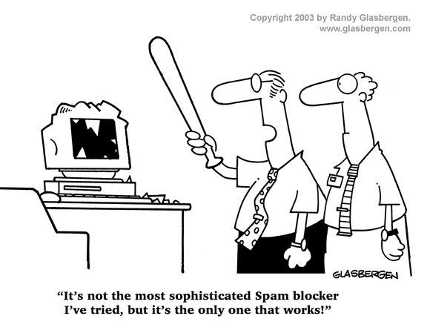
Background
Toolbars
SpoofGuard
NetCraft
Email Filtering
SpamAssassin
Spamato
Image courtesy: http://images.google.com - www.glasbergen.com
Notes:
The first disadvantage toolbars face when compared to email filtering is a decreased amount of contextual information. The email provides the context under which the attack is delivered to the user. An email filter can see what words are used to entice the user to take action, which is currently not knowable to a filter operating in a browser separate from the user's e-mail client.
The second disadvantage of toolbars is the inability to completely shield the user from the decision making process. Toolbars usually prompt users with a dialog box, which many users will simply dismiss or misinterpret, or worse yet these warning dialogs can be intercepted by user-space malware [2]. By filtering out phishing emails before they are ever seen by users, we avoid the risk of these warnings being dismissed by or hidden from the user.

Slide 6
Method
PILFER – A Machine Learning based approach to classification.
phishing emails / ham (good) emails
Feature Set
Features as used in email classification
Features as used in webpage classification

Slide 7
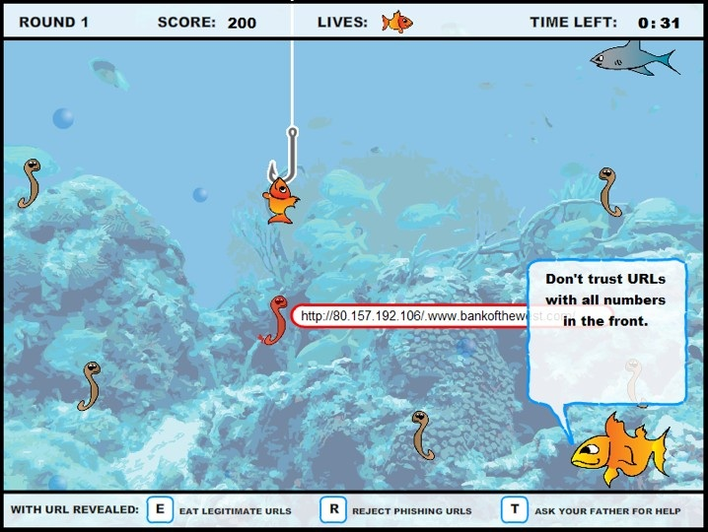
Features as used in email classification
IP-based URLs: http://192.168.0.1/paypal.cgi?fix_account
Phishing attacks are hosted
off of compromised PCs.
This feature is binary.

Slide 8
Age of linked-to domain names:
‘playpal.com’ or ‘paypal-update.com’
These domains often have a limited life
WHOIS query
date is within 60 days of the date the email was sent – “fresh” domain. This is a binary feature

Slide 9
Nonmatching URLs
This is a case of a link that says paypal.com but actually links to badsite.com.
Such a link looks like <a href="badsite.com"> paypal.com</a>. This is a binary feature.

Slide 10
“Here” links to non-modal domain
“Click here to restore your account access”
Link with the text “link”, “click”, or “here” that links to a domain other than this “modal domain”
This is a binary feature.
Image courtesy: http://www.bbcchannelpartners.com/worldnews/programmes/1000001/
Bhavin Madhani - UC Irvine - 2009

Slide 11
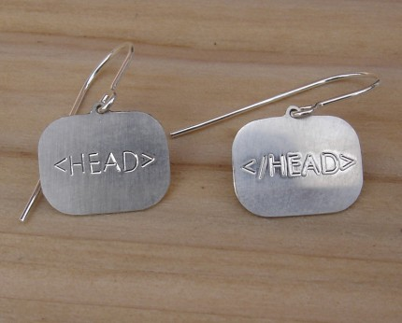
HTML emails
Emails are sent as either plain text, HTML, or a combination of the two - multipart/alternative format
To launch an attack without using HTML is difficult
This is a binary feature.
Image courtesy: http://srtsolutions.com/blogs/marinafedner/

Slide 12
Number of links
The number of links present in an email.
This is a continuous feature.
Eg. Bankofamerica statement.

Slide 13
Number of domains
Simply take the domain names previously extracted from all of the links, and simply count the number of distinct domains.
Look at the “main” part of a domain
https://www.cs.university.edu/
http://www.company.co.jp/
This is a continuous feature.

Slide 14
Number of dots
Subdomains like
http://www.my-bank.update.data.com.
Redirection script, such as http://www.google.com/url?q=http://www.badsite.com
This feature is simply the maximum number of dots (`.') contained in any of the links present in the email, and is a continuous feature.
Image courtesy: http://www.roslynoxley9.com.au/artists/49/Yayoi_Kusama/38/24460/

Slide 15
Contains javascript
Attackers can use JavaScript to hide information from the user, and potentially launch sophisticated attacks.
An email is flagged with the “contains javascript” feature if the string “javascript” appears in the email, regardless of whether it is actually in a <script> or <a> tag
This is a binary feature.
Image courtesy: http://webdevargentina.ning.com/

Slide 16
Spam-filter output
This is a binary feature, using the trained version of SpamAssassin with the default rule weights and threshold.
“Ham” or “Spam”
This is a Binary feature.
Image courtesy: http://www.suremail.us/spam-filter.shtml

Slide 17
Features as used in webpage classification
Most of the features discussed earlier can also be applied towards classifiying a webpage in a browser environment.
Other Features include:
Site in browser history
Redirected site
tf-idf

Slide 18
Empirical Evaluation
Machine-Learning Implementation
Run a set of scripts to extract all the features.
Train and test a classifier using 10-fold cross validation.
Random forest as a classifier.
Random forests create a number of decision trees and each decision tree is made by randomly choosing an attribute to split on at each level, and then pruning the tree.
Image courtesy: http://meds.queensu.ca/postgraduate/policies/evaluation__promotion___appeals

Slide 19
Datasets
Two publicly available datasets used.
The ham corpora from the SpamAssassin project (both the 2002 and 2003 ham collections, easy and hard, for a total of approximately 6950 non-phishing non-spam emails)
The publicly available phishingcorpus (approximately 860 email messages).

Slide 20
Testing SpamAssassin
For comparison against PILFER, we classify the exact same dataset using SpamAssassin version 3.1.0, using the default thresholds and rules.
“untrained” SpamAssassin
“trained” SpamAssassin

Slide 21
Additional Challenges
The age of the dataset
Phishing websites are short-lived, often lasting only on the order of 48 hours
Domains are no longer live at the time of our testing, resulting in missing information
The disappearance of domain names, combined with difficulty in parsing results from a large number of WHOIS servers
Image courtesy: http://illuminatepr.wordpress.com/2008/07/01/challenges/

Slide 22
False Positives vs. False Negatives
Misclassifying a phishing email may have a different impact than misclassifying a good email.
False positive rate (fp) : The proportion of ham emails classified as phishing emails.
False negative rate (fn) : The proportion of phishing emails classified as ham.

Slide 23
Classifier | False Positive Rate | False Negative Rate
PILFER, with S.A. feature | 0.0013 | 0.036
PILFER, without S.A. feature | 0.0022 | 0.085
SpamAssassin (Untrained) | 0.0014 | 0.376
SpamAssassin (Trained) | 0.0012 | 0.130

Slide 24
Feature | Non-Phishing Matched | Phishing Matched
Has IP link | 0.06% | 45.04%
Has “fresh” link | 0.98% | 12.49%
Has “nonmatching” URL | 0.14% | 50.64%
Has non-modal here link | 0.82% | 18.20%
Is HTML email | 5.55% | 93.47%
Contains JavaScript | 2.30% | 10.15%
SpamAssassin Output | 0.12% | 87.05%
Percentage of emails matching the binary features

Slide 25
Feature | Mean - phishing | Std Deviation - phishing | Mean –Non phishing | Std Deviation – Non phishing
Number of links | 3.87 | 4.97 | 2.36 | 12.00
Number of domains | 1.49 | 1.42 | 0.43 | 3.32
Number of dots | 3.78 | 1.94 | 0.19 | 0.87
Mean, standard deviation of the continuous features, per-class

Slide 26
Concluding Remarks
It is possible to detect phishing emails with high accuracy by using a specialized filter, using features that are more directly applicable to phishing emails than those employed by general purpose spam filters.
Image courtesy: http://images.google.com

Slide 27
Gone Phishing? Protect Yourself - Stop · Think · Click
THANK YOU
Image courtesy: http://images.google.com

Slide 28
Anti-Phishing Phil
http://cups.cs.cmu.edu/antiphishing_phil/
http://cups.cs.cmu.edu/antiphishing_phil/new/index.html
Image Courtesy: http://cups.cs.cmu.edu/antiphishing_phil/

