Slide 1
Some slides from CMPS 3130/6130 Computational Geometry, Spring 2015, by Carola Wenk
Line Segment Intersection
Michael Goodrich
Univ. of California, Irvine

Slide 2
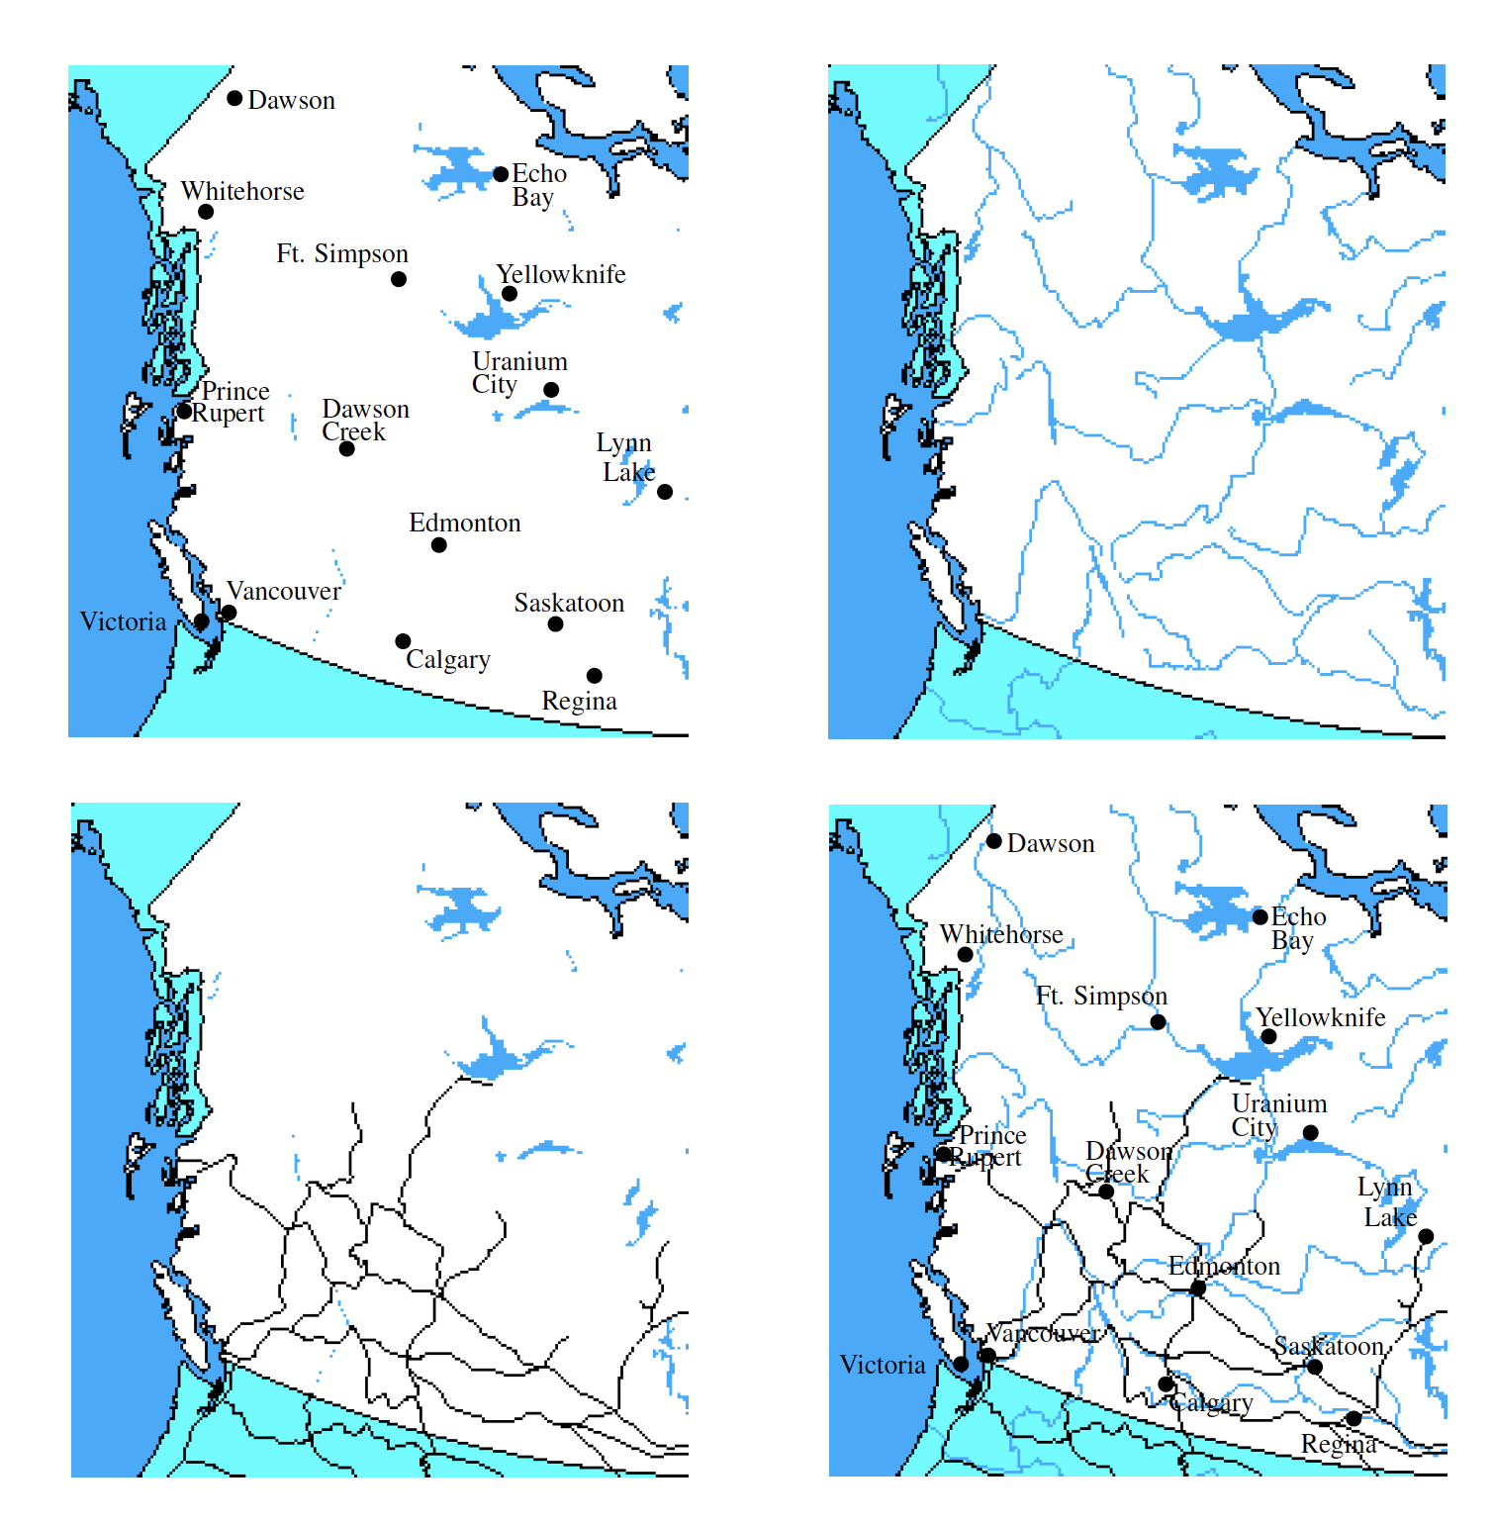
Geometric Intersections
Important problem in Computational Geometry
Solid modeling: Build shapes by applying set operations (intersection, union).
Robotics: Collision detection and avoidance
Geographic information systems: Overlay two subdivisions (e.g., road network and river network)

Slide 3
Line Segment Intersection
Input: A set S={s₁, …, s_{n}} of (closed) line segments in R²
Output: All intersection points between segments in S

Slide 4
Line Segment Intersection
n line segments can intersect as few as 0 and as many as =O(n²) times
Simple algorithm: Try out all pairs of line segments → Takes O(n²) time → Is optimal in worst case
Challenge: Develop an output-sensitive algorithm
Runtime depends on size k of the output
Here: 0 ≤ k ≤ n²
Our algorithm will have runtime: O( (n+k) log n)
This algorithm is due to Bentley and Ottmann
Best possible runtime: O(n log n + k) → O(n²) in worst case, but better in general
n 2

Slide 5
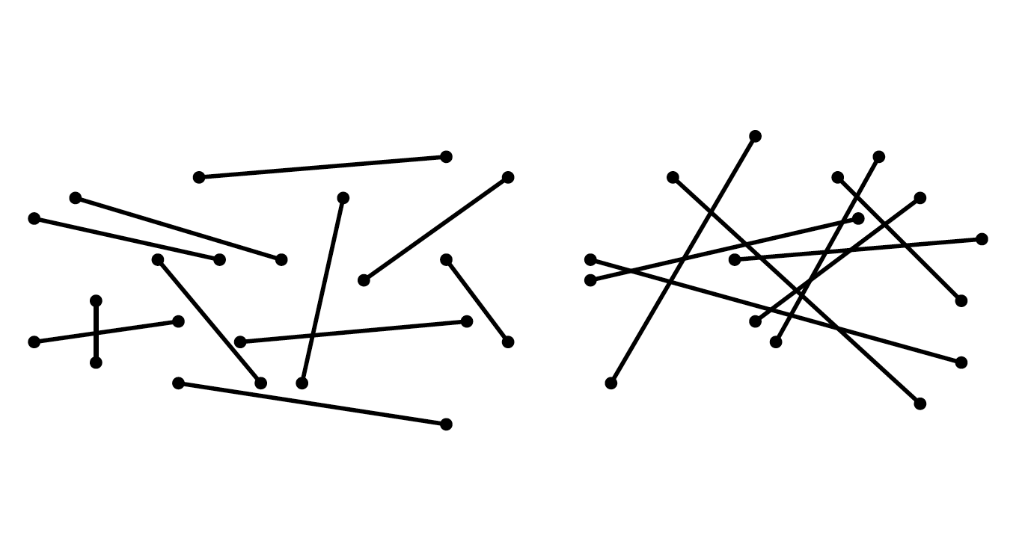
Output size for intersections
k = # of intersections
k = 2
k = 18

Slide 6
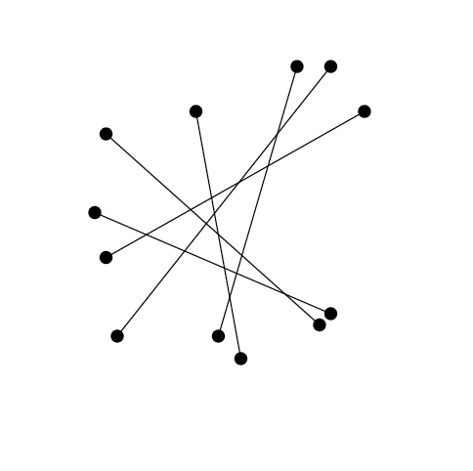
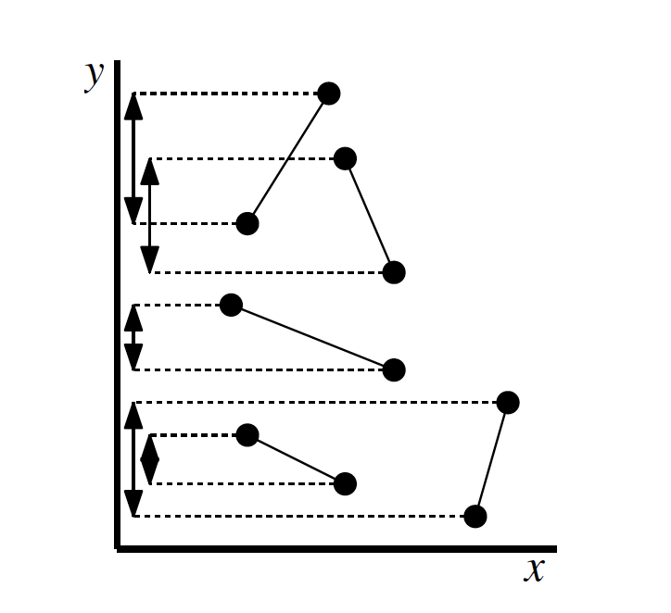
Output size for intersections
Range of k can go from 0 to n choose 2, i.e., n(n-1)/2, which is O(n²).
k = 0
k = 6(5)/2 = 15

Slide 7
Complexity
Why is runtime O(n log n + k) optimal?
The element uniqueness problem requires Ω(n log n) time in algebraic decision tree model of computation (Ben-Or ’83)
Element uniqueness: Given n real numbers, are all of them distinct?
Solve element uniqueness using line segment intersection:
Take n numbers, convert into vertical line segments. There is an intersection iff there are duplicate numbers.
If we could solve line segment intersection in o(n log n) time, i.e., strictly faster than Θ(n log n), then element uniqueness could be solved faster. Contradiction.

Slide 8
Plane sweep algorithm
Cleanliness property:
All intersections to the left of sweep line l have been reported
Sweep line status:
Store segments that intersect the sweep line l, ordered along the intersection with l .
Events:
Points in time when sweep line status changes combinatorially (i.e., the order of segments intersecting l changes)
→ Endpoints of segments (insert in beginning)
→ Intersection points (compute on the fly during plane sweep)

Slide 9
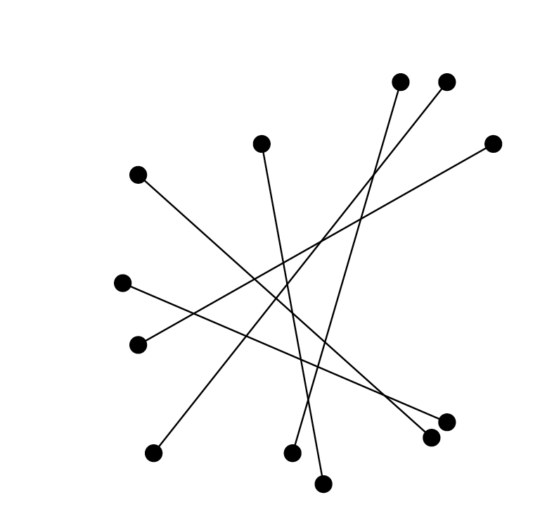
General position
Assume that “nasty” special cases don’t happen:
No line segment is vertical
Two segments intersect in at most one point
No three segments intersect in a common point

Slide 10
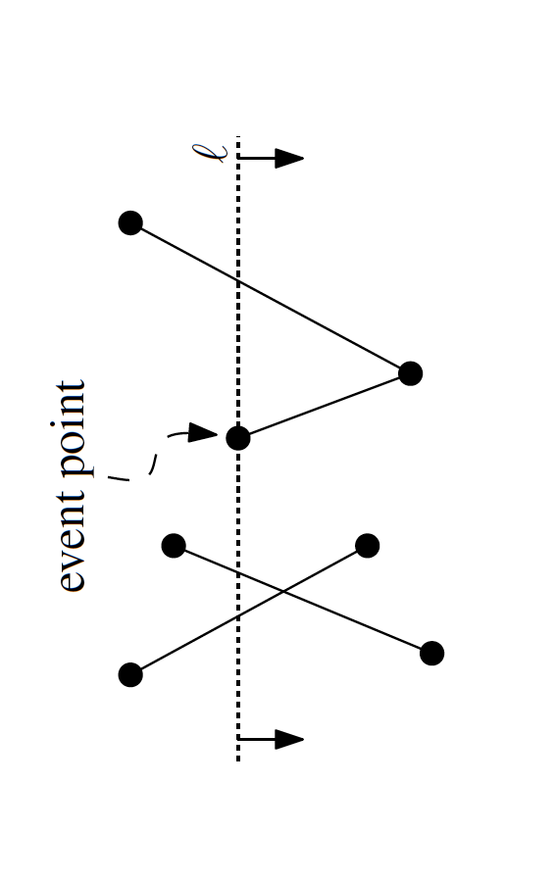
Event Queue
Need to keep events sorted:
Lexicographic order (first by x-coordinate, and if two events have same x-coordinate then by y-coordinate)
Need to be able to remove next point, and insert new points in O(log n) time
Use a balanced binary search tree (e.g., a WAVL tree)
The de Berg book sweeps top to bottom, but I like to sweep left-to-right.
So pictures from the book are “sideways”

Slide 11
Sweep Line Status
Store segments that intersect the sweep line l, ordered along the intersection with l .
Need to insert, delete, and find adjacent neighbor in O(log n) time
Use balanced binary search tree, storing the order in which segments intersect l in leaves
b
c
e
d
c b e d

Slide 12
Event Queue
The events in the event queue (sorted by x-coordinates):
Every line-segment endpoint (left and right)
The intersection point of every pair of line segments that are consecutive in the ordering along the sweep line.

Slide 13
Event Handling
Left segment endpoint
Add new segment to sweep line status
Test adjacent segments on sweep line l for intersection with new segment
Add new intersection points to event queue
b
c
a
e
d
c b d
c b e d

Slide 14
Event Handling
2. Intersection point
Report new intersection point
Two segments change order along l → Test new adjacent segments for new intersection points (to insert into event queue)
b
c
a
e
d
Note: “new” intersection might have been already detected earlier.
c b e d
c e b d

Slide 15
Event Handling
3. Right segment endpoint
Delete segment from sweep line status
Two segments become adjacent. Check for intersection points (to insert in event queue)
b
c
a
e
d
e c b d
e c d

Slide 16
Intersection Lemma
Lemma: Let s, s’ be two non-vertical segments whose interiors intersect in a single point p. Assume there is no third segment passing through p. Then there is an event point to the left of p where s and s’ become adjacent (and hence are tested for intersection).
Proof: Consider placement of sweep line infinitesimally left of p. s and s’ are adjacent along sweep line. Hence there must have been a previous event point where s and s’ become adjacent.
s’
p
s

Slide 17
Runtime
Sweep line status updates: O(log n)
Event queue operations: O(log n), as the total number of stored events is ≤ 2n + k, and each operation takes time O(log(2n+k)) = O(log n²) = O(log n)
There are O(n+k) events. Hence the total runtime is O((n+k) log n)
k = O(n²)

