Slide 1
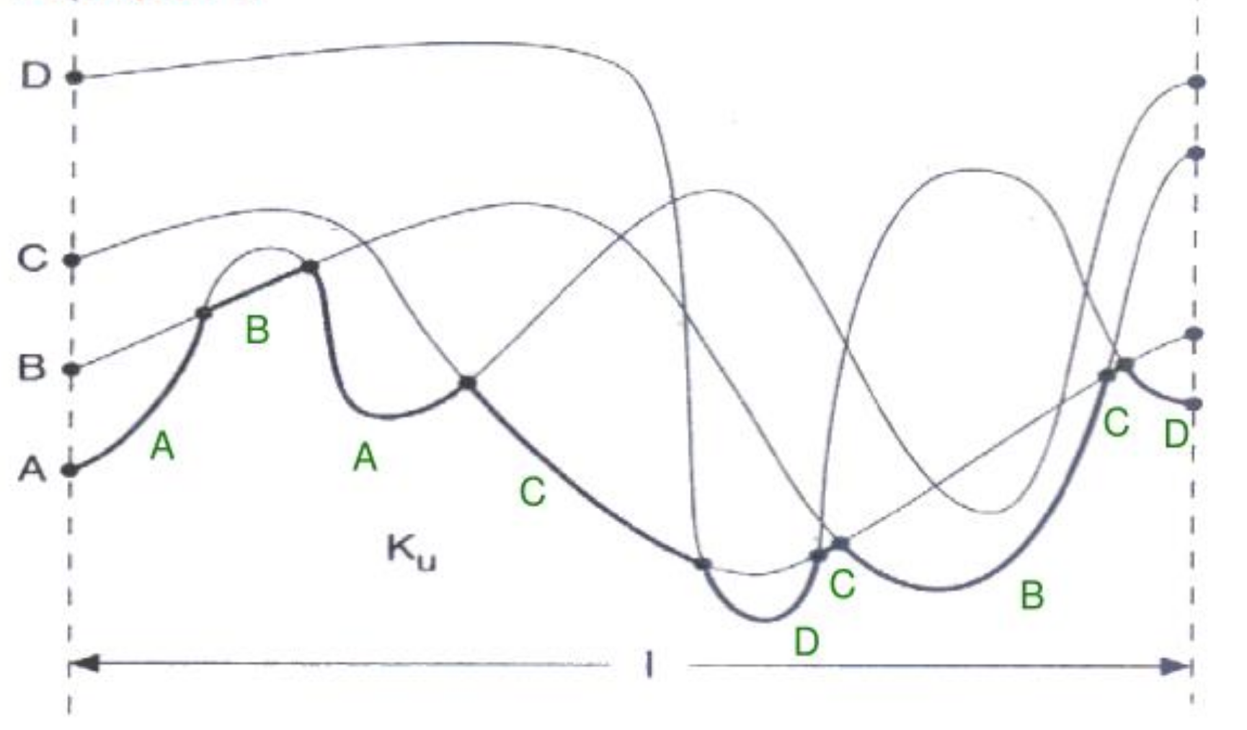
Computational Geometry
Lower Envelopes
Michael T. Goodrich
with some slides by Thomas Ottmann

Slide 2
Definition

Slide 3
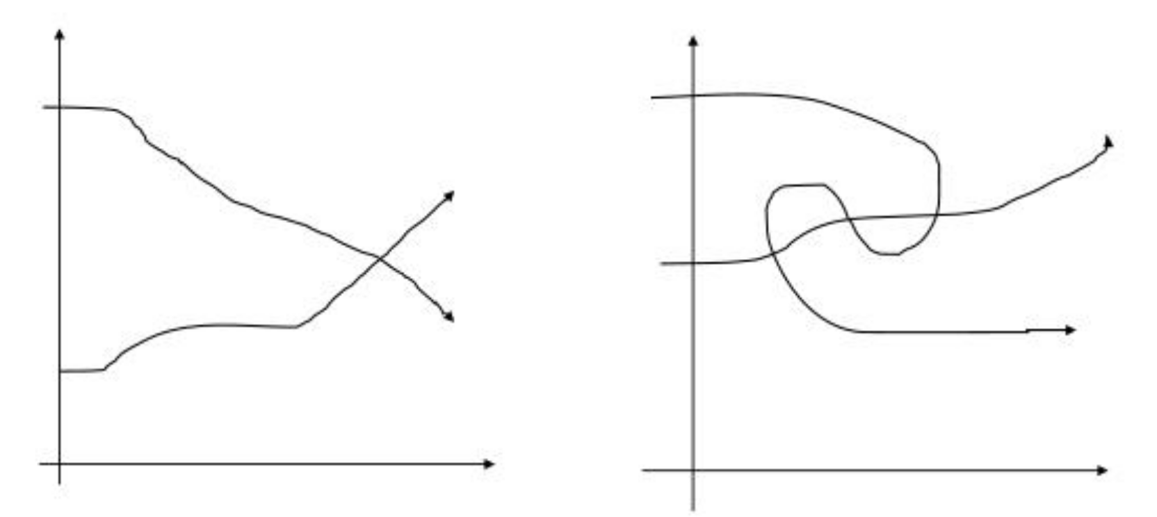
x-Monotone Curves
x-monotone:
Not x-monotone:

Slide 4
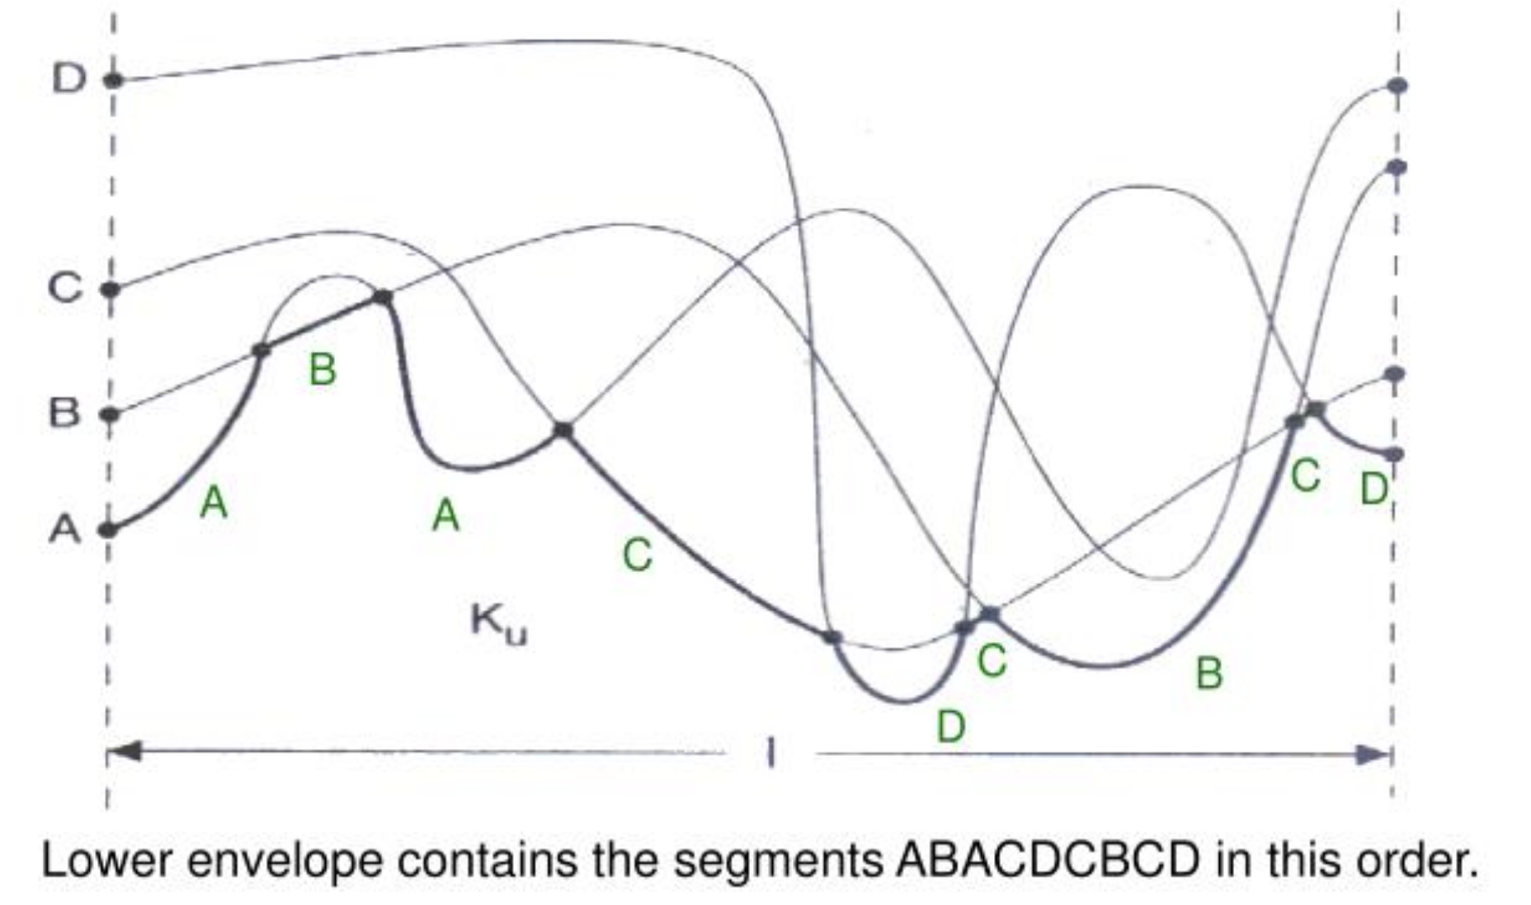
Representing a lower envelope
s = # times any pair of curves intersect
(6 pairs)

Slide 5
Divide-and-Conquer + Plane-sweep

Slide 6
The Merge Step (plane-sweep)

Slide 7
The Merge Step (plane-sweep)

Slide 8
Time Complexity

Slide 9
A Complexity Measure

Slide 10
Analyzing Divide-and-Conquer

Slide 11
Time Complexity
So we just need a good upper bound for λ_{s}(n)…

Slide 12
Davenport-Schinzel Sequences (DSS)
(it contains A..B..A..B..A)

Slide 13
Relationship to Lower Envelopes
Because s = 3, no pair of letters alternates more than 3 times.
Thus, this is a DSS of order 3.

Slide 14
“Almost” Linear Size

Slide 15
Line Segments

Slide 16
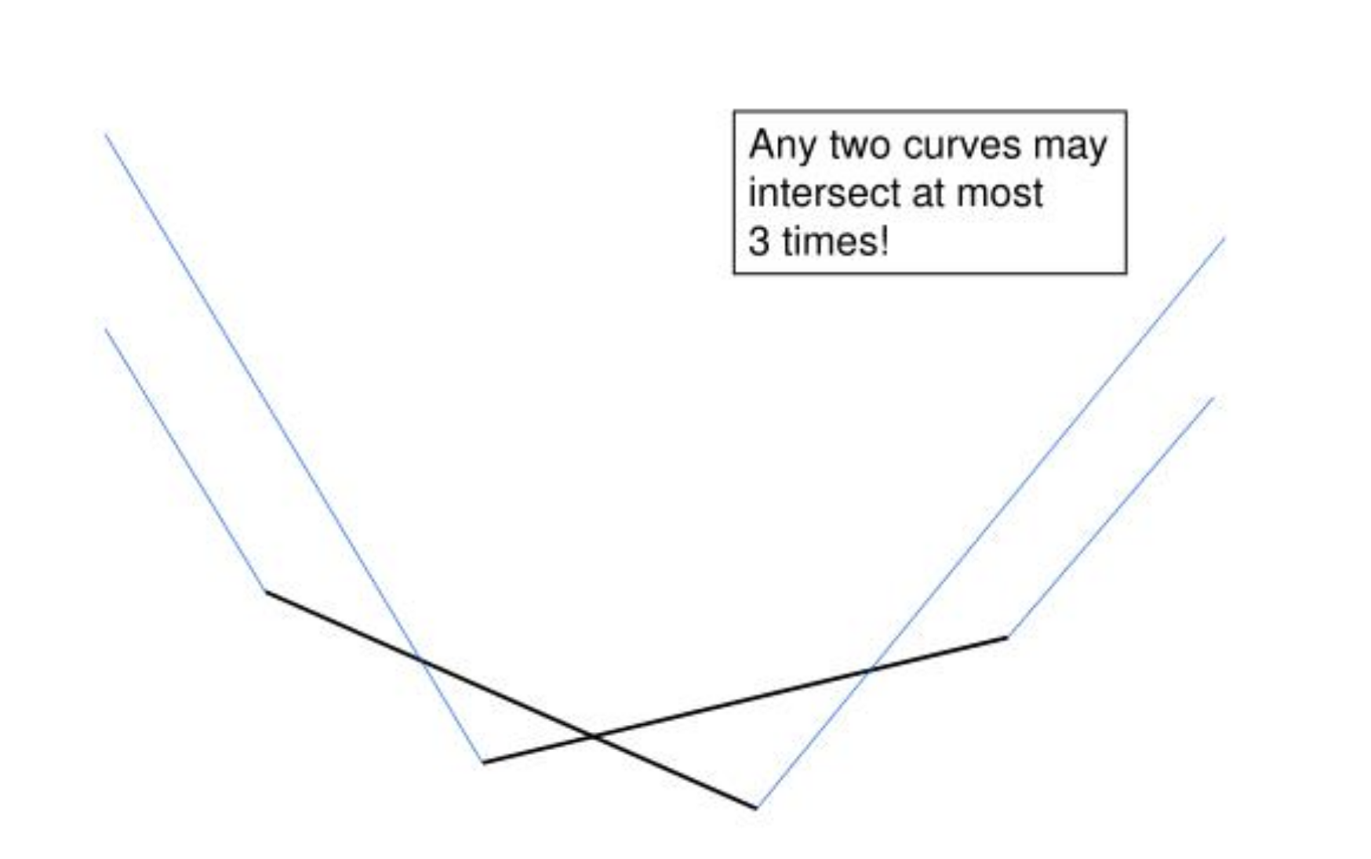
Line Segments
The lower envelope of line segments has size O(n log* n),
so it is almost linear, but not quite linear.

