Slide 1
Computational Geometry
p
Planar Point Location
Michael Goodrich
with some slides from Carola Wenk and Olivier Pirson

Slide 2
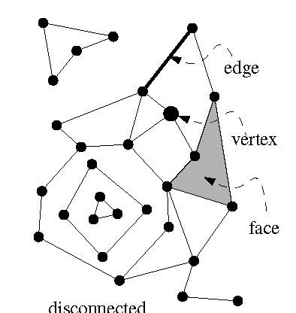
Planar Subdivision
Let G=(V,E) be an undirected graph.
G is planar if it can be embedded in the plane without edge crossings.
planar
K₅, not planar
K_{3,3}, not planar
A planar embedding (=drawing) of a planar graph G induces a planar subdivision consisting of vertices, edges, and faces.

Slide 3
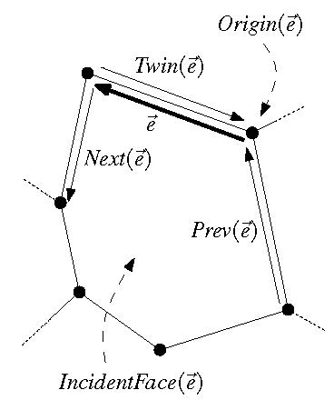
Review: Doubly-Connected Edge List
The doubly-connected edge list (DCEL) is a popular data structure to store the geometric and topological information of a planar subdivision.
It contains records for each face, edge, vertex
(Each record might also store additional application-dependent attribute information.)
It should enable us to perform basic operations needed in algorithms, such as walk around a face, or walk from one face to a neighboring face
The DCEL consists of:
For each vertex v, its coordinates are stored in Coordinates(v) and a pointer IncidentEdge(v) to a half-edge that has v as its origin.
Two oriented half-edges per edge, one in each direction. These are called twins. Each of them has an origin and a destination. Each half-edge e stores a pointer Origin(e), a pointer Twin(e), a pointer IncidentFace(e) to the face that it bounds (on its left), and pointers Next (e) and Prev(e) to the next and previous half-edge on the boundary of IncidentFace(e).
For each face f, OuterComponent(f) is a pointer to some half-edge on its outer boundary (null for unbounded faces). It also stores a list InnerComponents(f) which contains for each hole in the face a pointer to some half-edge on the boundary of the hole.

Slide 4
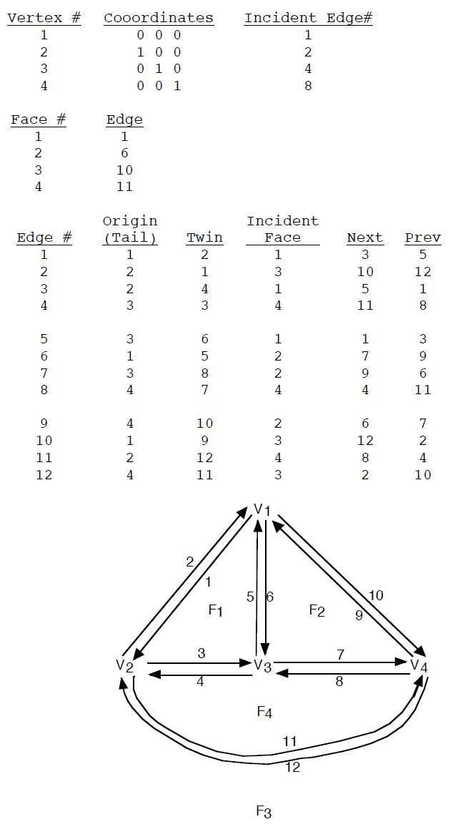
Review: Doubly-Connected Edge List
For each vertex v, its coordinates are stored in Coordinates(v) and a pointer IncidentEdge(v) to a half-edge that has v as its origin.
Two oriented half-edges per edge, one in each direction. These are called twins. Each of them has an origin and a destination. Each half-edge e stores a pointer Origin(e), a pointer Twin(e), a pointer IncidentFace(e) to the face that it bounds (on its left), and pointers Next (e) and Prev(e) to the next and previous half-edge on the boundary of IncidentFace(e).
For each face f, OuterComponent(f) is a pointer to some half-edge on its outer boundary (null for unbounded faces). It also stores a list InnerComponents(f) which contains for each hole in the face a pointer to some half-edge on the boundary of the hole.
(OuterComponent)
DCEL example from: http://ranger.uta.edu/~weems/NOTES5319/DCEL.pdf

Slide 5
Complexity of a Planar Subdivision
The complexity of a planar subdivision is: #vertices + #edges + #faces = n_{v} + n_{e} + n_{f}
Euler’s formula for planar (embedded) graphs:
n_{v} - n_{e} + n_{f} ≥ 2
n_{e} ≤ 3n_{v} – 6
Proof that 2) follows from 1):
Count edges. Every face is bounded by ≥ 3 edges.
Every edge bounds ≤ 2 faces.
⇒ 3n_{f} ≤ 2n_{e} ⇒ n_{f} ≤ 2/3n_{e}
⇒ 2 ≤ n_{v} - n_{e} + n_{f} ≤ n_{v} - n_{e} + 2/3 n_{e} = n_{v} – 1/3 n_{e}
⇒ 2 ≤ n_{v} – 1/3 n_{e}
Hence, the complexity of a planar subdivision is O(n_{v}), i.e., linear in the number of vertices.

Slide 6
Point Location
Point location task: Preprocess a planar subdivision to efficiently answer point-location queries of the type: Given a point p=(p_{x},p_{y}), find the face it lies in.
p
Important metrics:
Time complexity for preprocessing = time to construct the data structure
Space needed to store the data structure
Time complexity for querying the data structure

Slide 7
Slab Method
Slab method: Draw a vertical line through each vertex. This decomposes the plane into slabs.
p
p
p
In each slab, the vertical order of the line segments remains constant.
If we know in which slab p lies, we can perform binary search, using the sorted order of the segments in the slab.
Find slab that contains p by binary search on x among slab boundaries.
A second binary search in thr slab determines the face containing p.
Search complexity O(log n), but space complexity O(n²) .

Slide 8
Coherence
Data for close-by objects or time snapshots is often similar
A common theme in a lot of computer science
We can often achieve efficiencies in time and/or space by exploiting this similarity
Image by Kyprianidis and Kang. Used for educational purposes only.

Slide 9
Revisiting the Slab Method
Consider a plane-sweep of a planar subdivision:
Sweep a vertical line, stopping at each vertex as an event.
Maintain the edges intersecting the sweep line in a balanced binary search tree.
An event:
From one event to the next, the vertical order of the line segments changes little.
The only changes occur for the segments we add or remove because their endpoints occur at that event.
The slab method essentially stores a complete snapshot of the binary search tree that exists at each event
This is wasteful of time and space, because of the coherence of the binary search tree from one event to the next.

Slide 10
What if we could answer a point location query by going back in time to the place in the plane sweep when we crossed the query point, p?
We could just do a search for p in our binary search tree that existed at that time.
p
Image owned by Universal Studios. Used for educational purposes only.

Slide 11
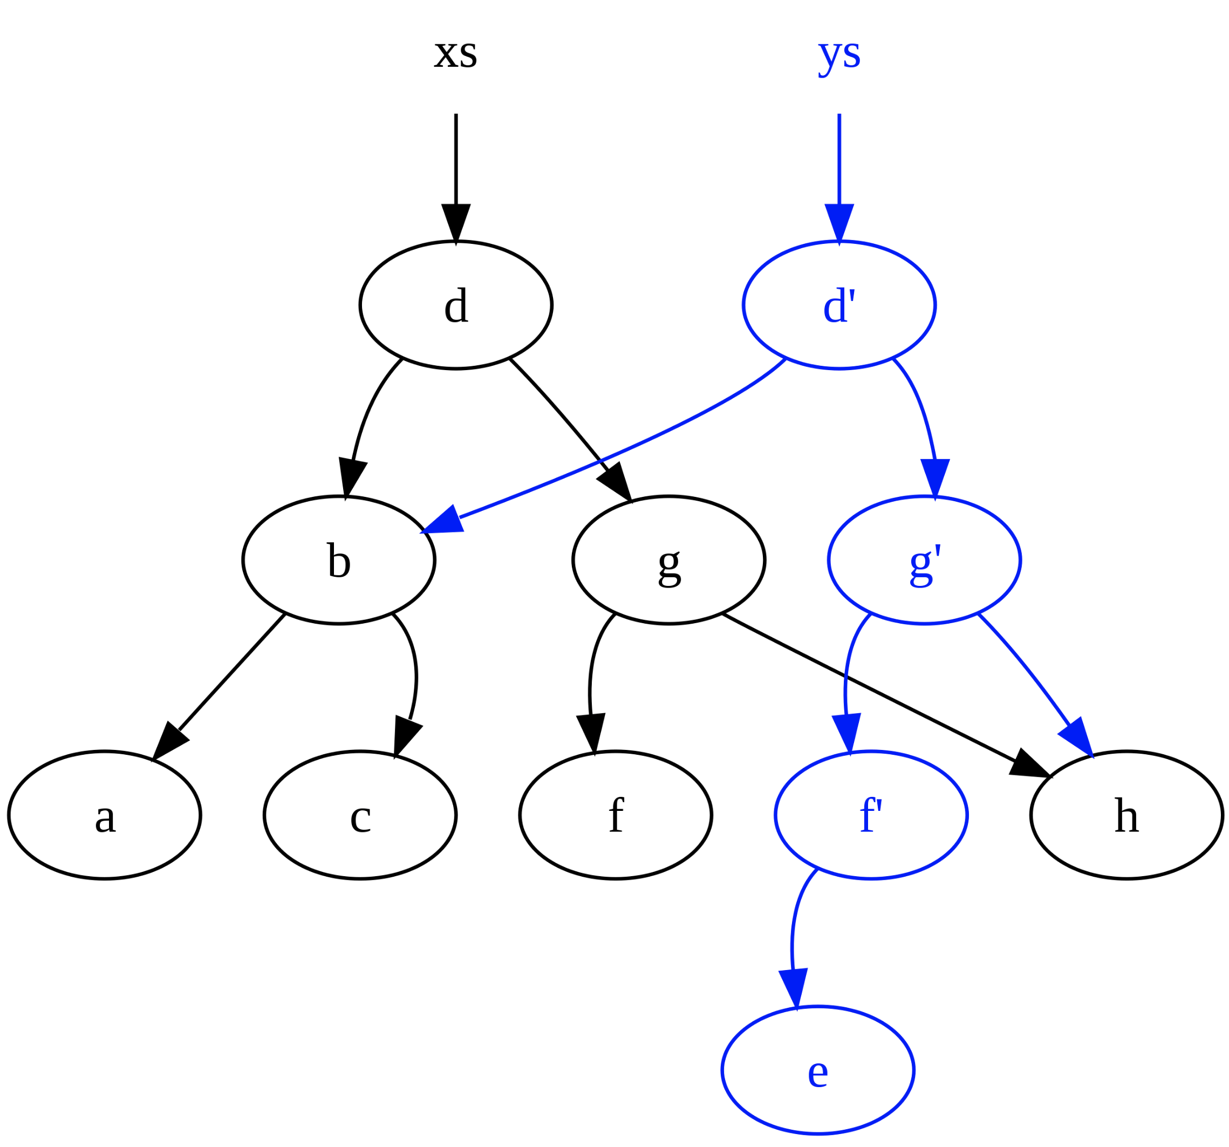
Persistent Data Structures
A data structure is persistent if it allows one to perform queries on past versions.
One way to do this for binary search trees is by path copying.
Leave the old nodes unchanged and create new nodes for the nodes that change.
Image by Magnus Manske and Xaonan, licensed under the Creative Commons Attribution-Share Alike 3.0 license.

Slide 12
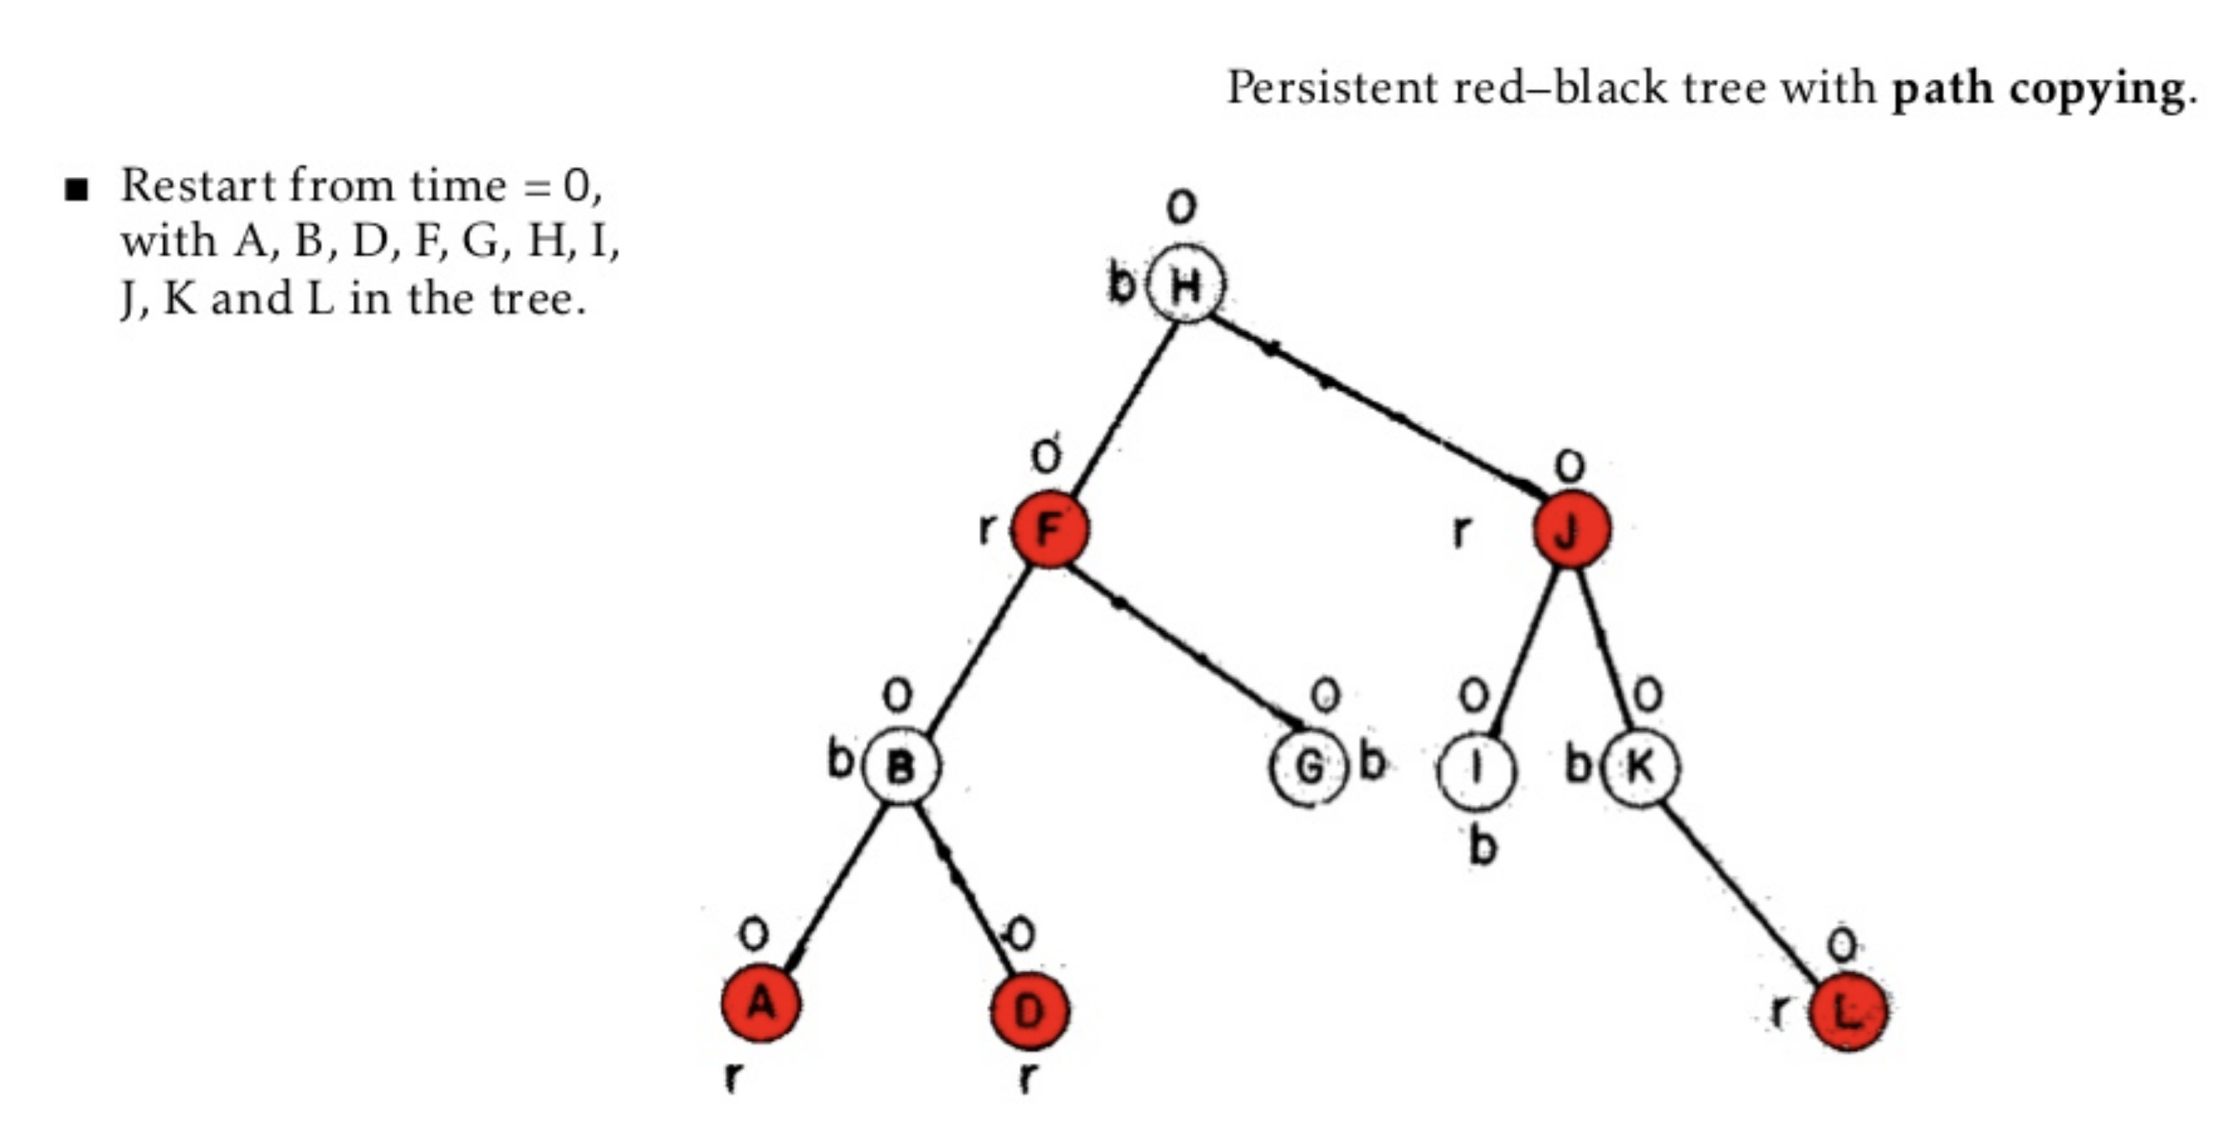
An Example of Path Copying

Slide 13
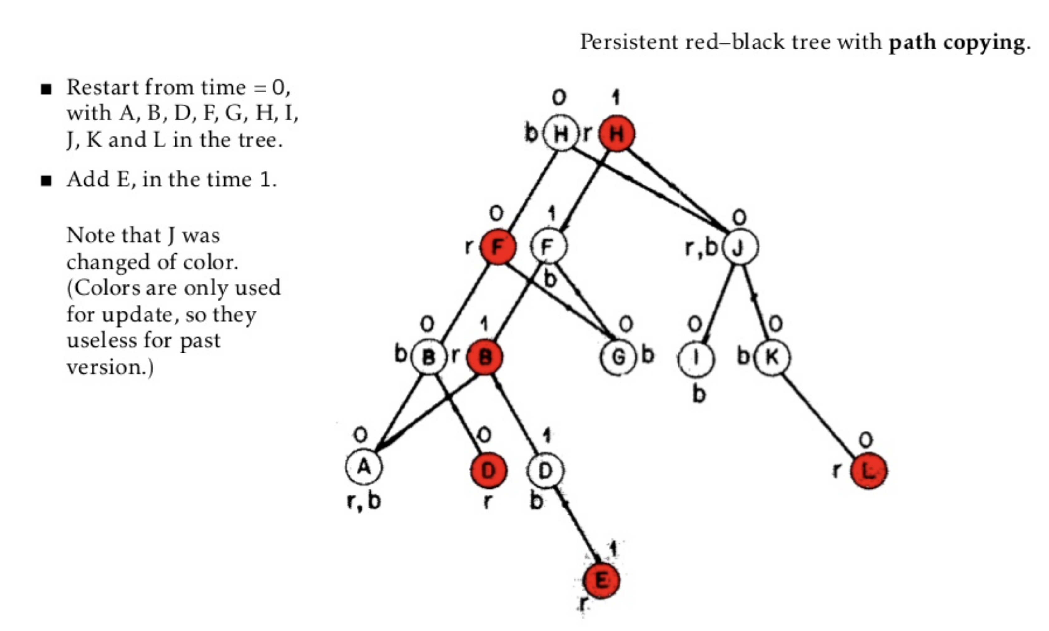
An Example of Path Copying

Slide 14
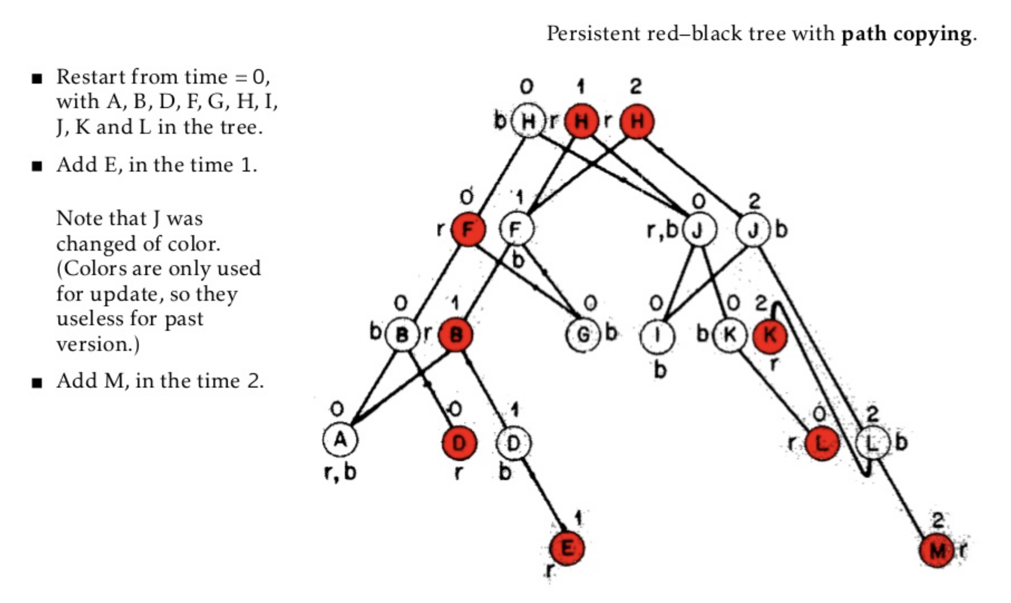
An Example of Path Copying

Slide 15
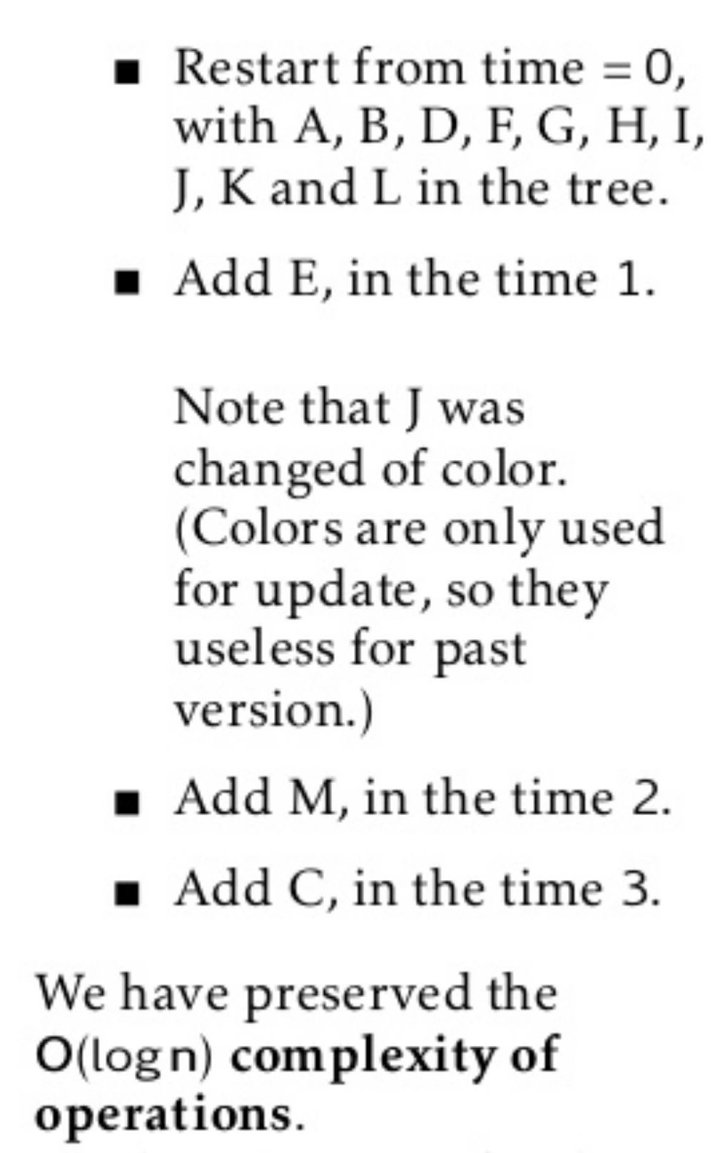
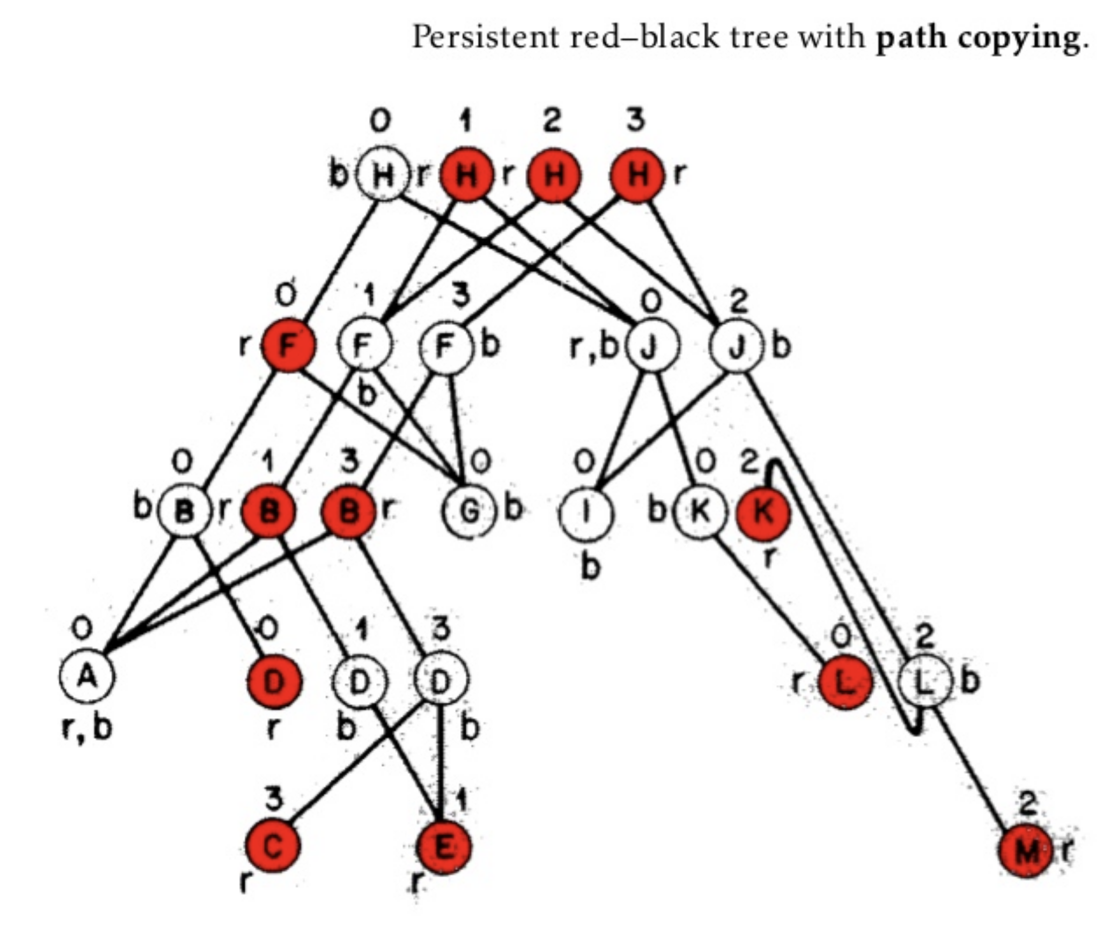
An Example of Path Copying

Slide 16
Analysis of Path Copying
Since each event in the plane sweep takes O(log n) time, we create O(log n) new nodes for each event. Thus, the total space and preprocessing time is O(n log n).
To perform a point-location query:
We first do a binary search of the root nodes to determine the root that was active for the x-coordinate of the query point, p.
Then we do a binary search in this tree for the y-coordinate of p, locating the face that contains p.
Query time: O(log n)
Sarnak and Tarjan show how to get the total space down to O(n) – read their paper at the notes site.

