Slide 1
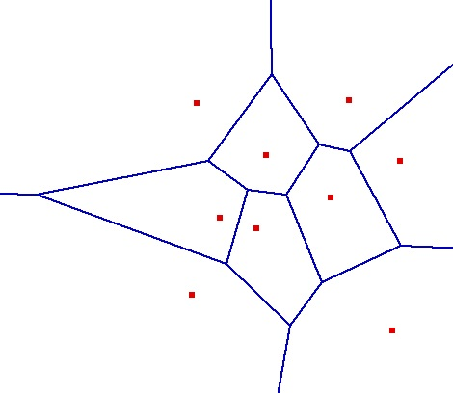
Computational Geometry
Voronoi Diagrams and Their Applications
Michael Goodrich
with slides from Carola Wenk and Rodrigo I. Silveira

Slide 2
Voronoi Diagram (Dirichlet Tesselation)
Given: A set of point sites $P=\left\{p_{1},…,p_{n}\right\}⊆R^{2}$
Voronoi cell: Partition $R^{2}$into Voronoi cells $V\left(p_{i}\right)=\left\{q∈R^{2}\right| d\left(p_{i},q\right)<d\left(p_{j},q\right)$ for all $j≠i\}$
Voronoi diagram: The planar subdivision obtained by removing all Voronoi cells from $R^{2}$.

Slide 3
Bisectors
Voronoi edges are portions of bisectors
For two points p, q, the bisector $b\left(p,q\right)$ is defined as $b\left(p,q\right)=\left\{r∈R^{2} \right| d\left(p,r\right)=d(q,r)\}$
Voronoi vertex:
r
q
p
s
q
p

Slide 4
Voronoi cell
Each Voronoi cell $V(p_{i})$ is convex and $V\left(p_{i}\right)= \bigcap{ h\left(p_{i},p_{j}\right)}$, where $h(p_{i},p_{j})$ is the halfspace that is defined by bisector $b(p_{i},p_{j})$ and that contains $p_{i}$
⇒ A Voronoi cell has at most $n−1$ sides
$$\begin{aligned}p_{j}∈P \\ j≠i\end{aligned}$$
p_{j}
p_{i}
$$h(p_{i},p_{j})$$

Slide 5
Voronoi Diagram
The Voronoi diagram is a planar, embedded, connected graph with vertices, edges (possibly infinite), and faces (possibly infinite).
Theorem: Let $P=\left\{p_{1},…,p_{n}\right\}⊆R^{2}$. Let $n_{v}$ be the number of vertices in $VD\left(P\right)$ and let $n_{e}$ be the number of edges in $VD\left(P\right).$Then
$n_{v}≤2n−5$, and
$n_{e}≤3n−6$
Proof idea: An application of Euler’s formula $n_{v}+1−n_{e}+n=2$ with “$=$“ because the planar graph is connected, and $2n_{e}=\sum_{v∈V}{\deg\left(v\right)≥3\left(n_{v}+1\right)}$.
Add vertex at infinity

Slide 6
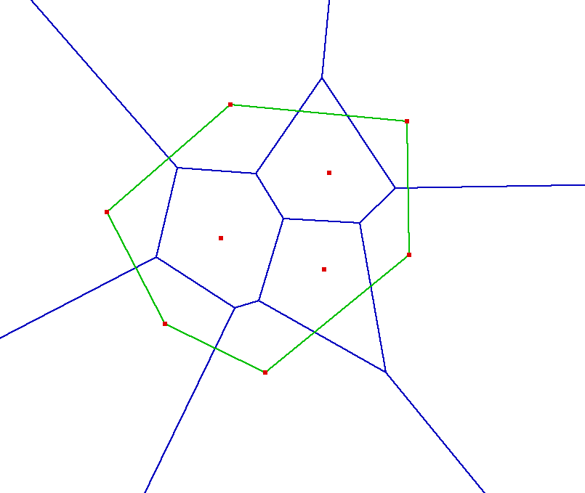
Properties
A Voronoi cell $V\left(p_{i}\right)$is unbounded iff $p_{i}$ is on the convex hull of the sites.
$v$ is a Voronoi vertex iff it is the center of an empty circle (disk) that passes through three sites.
Site with bounded Voronoi cell
Site with unbounded Voronoi cell
Smaller empty disk centered on Voronoi edge
Larger empty disk centered on Voronoi vertex

Slide 7
Applications of Voronoi Diagrams
Nearest neighbor queries:
Sites are post offices, restaurants, gas stations
For a given query point, locate the nearest point site in $O(\log{n)}$time
→ point location
Closest pair computation:
Naïve $O(n^{2})$ algorithm; sweep line algorithm in $O(n\log{n)}$time
Each site and the closest site to it share a Voronoi edge
Check all Voronoi edges (in $O(n)$ time)
Facility location: Build a new gas station (site) where it has minimal interference with other gas stations
Find largest empty disk and locate new gas station at center
If center is restricted to lie within $CH(P)$ then the center has to be on a Voronoi edge

Slide 8
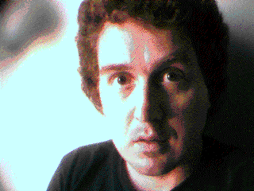
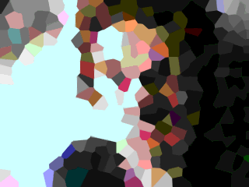
What can you do with a Voronoi diagram?
All sort of things!
Source: http://www.ics.uci.edu/~eppstein/vorpic.html
Notes:
Image processing / compression.

Slide 9
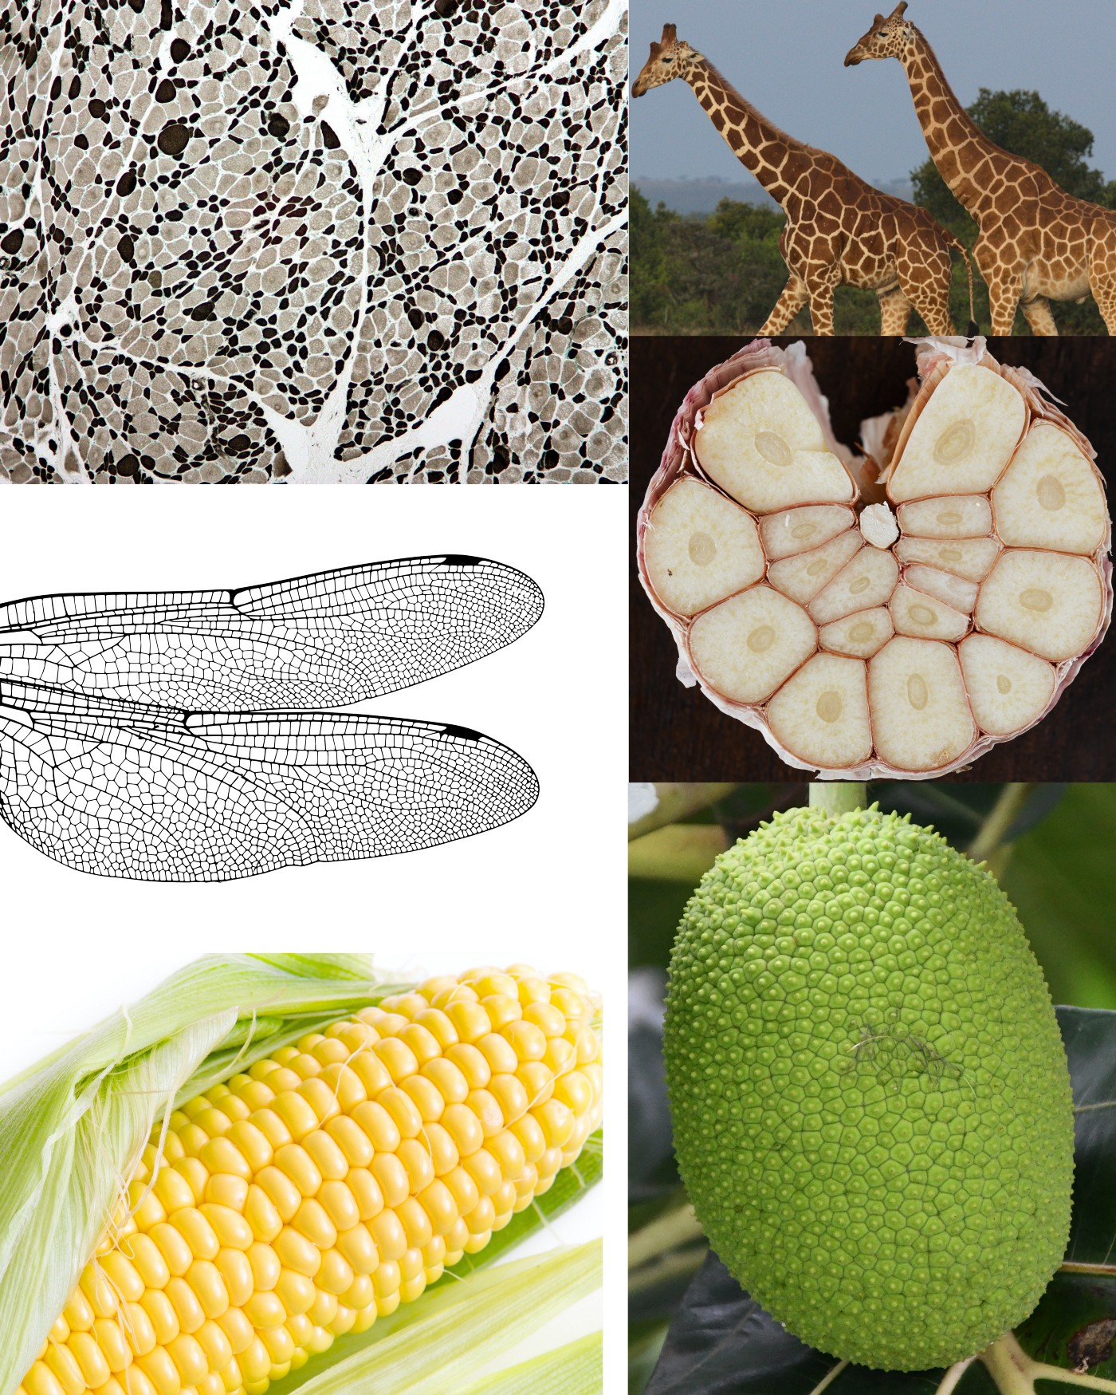
Voronoi Diagrams in Nature
Models for territories, spreading, or growth
From top-left to bottom-right:
muscle cross-section
giraffes coat patterns
wings of a dragonfly
garlic bulb
corn cob
jackfruits
Image from
https://towardsdatascience.com/the-fascinating-world-of-voronoi-diagrams-da8fc700fa1b

Slide 10
What other useful things can you do with a Voronoi diagram?
Already mentioned a few applications
Find nearest… hospital, restaurant, gas station,...
Notes:
Most traditional motivation in CG literature: find nearest post office

Slide 11
Facility location
Determine a location to maximize distance to its “competition”
Find largest empty circle
Must be centered at a vertex of the Voronoi
diagram
Notes:
Ask how the VD can help us to find the largest empty circle?
Simplification: I am assuming the center lies inside in the hull of the sites.
Otherwise, if it can lie on the hull boundary, we also have to consider placing the center of the circle on Voronoi edges.
Note that the circle shown is the largest one with center in the part of the VD shown… there is actually a larger one on the top left, but its center falls outside the picture.

Slide 12
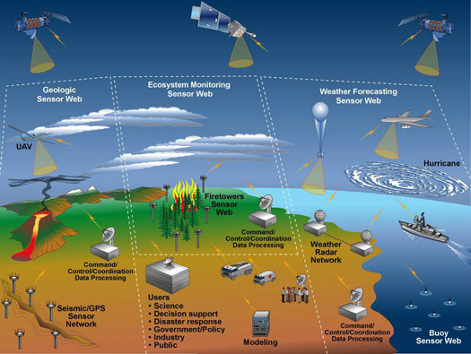
Coverage in sensor networks
Sensor network
Sensors distributed in an area to monitor some condition
Source: http://seamonster.jun.alaska.edu/lemon/pages/tech_sensorweb.html
Notes:
A wireless sensor network (WSN) consists of spatially distributed autonomous sensors to cooperatively monitor physical or environmental conditions, such as temperature, sound, vibration,pressure, motion or pollutants.^{[1][2]} The development of wireless sensor networks was motivated by military applications such as battlefield surveillance. They are now used in many industrial and civilian application areas, including industrial process monitoring and control, machine health monitoring^{[3]}, environment and habitat monitoring, healthcare applications, home automation, and traffic control.^{[1][4]}
^{About the picture:} A conceptual view of a large, multi-layer,multi-purpose, wireless sensor web.
UAV: Unmanned aerial vehicle

Slide 13
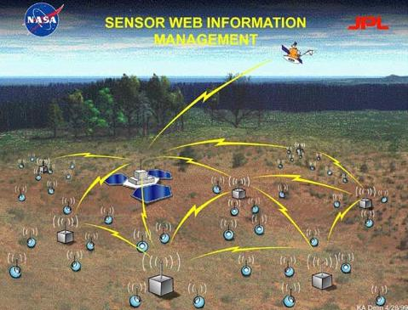
Coverage in sensor networks
Given: locations of sensors
Problem: Do they cover the whole area?
Assume sensors have a fixed coverage range
Solution: Look for largest empty disk, check its radius
Notes:
One important remark: in addition to checking the vertices of the VD, we must check:
Intersections of the VD with the black box (area of interset)
The corners of the black box
If sensors can have different range, we can use a weighted Voronoi diagram (the weight is the radius, or the squared radius, or something like that).
From Aurenhammer’s: These are also called power diagrams, and use the “distance function” pow(x,B(a, r)) = ||x − a||² − r².
A nice geometric interpretation is the following. For positive weights, a weighted site p can be viewed as a sphere with center p and radius
sqrt(w(p)). For a point x outside this sphere, pow(x; p) > 0, and Sqrt(pow(x; p)) expresses the distance of x to the touching point of a line tangent to the sphere and through x.

Slide 14
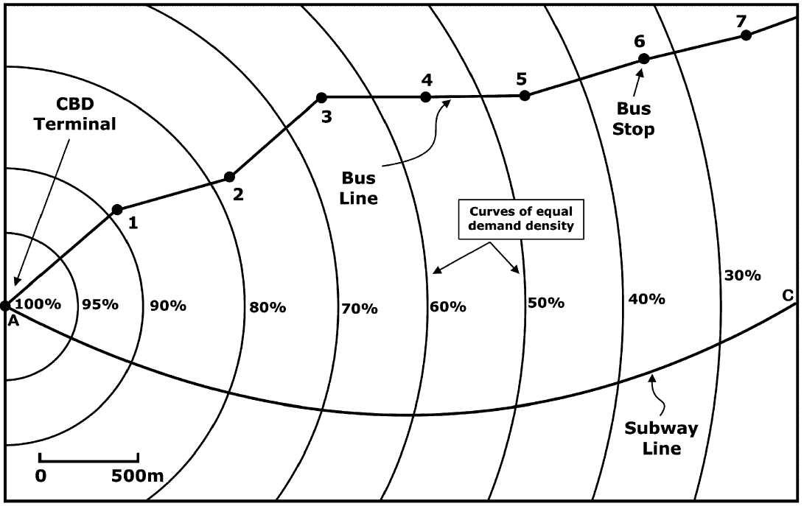
Building metro stations
Where to place stations for metro line?
People commuting to CBD terminal
People can also
Walk
4.4 km/h +
35% correction
Take bus
Some avg speed
Source: Novaes et al (2009). DOI:10.1016/j.cor.2007.07.004
Notes:
The context is more complicated, they actually want to find the best locations in order to maximize the area of the city that will use the metro.
They take into account that the more stations you have, the longer the metro journey takes, so people may prefer to walk or take a bus if there are too many stations on the way to the CBD terminal.
CBD=Center Business District

Slide 15
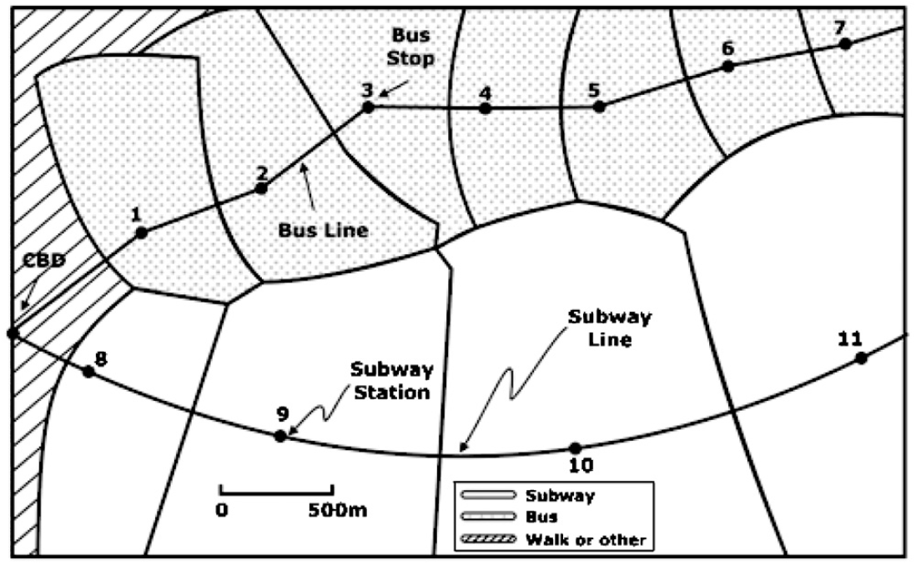
Building metro stations
Weighted Voronoi Diagram
Distance function is not Euclidean anymore
dist_{w}(p,site)=(1/w) dist(p,s)
Notes:
The higher the weight of a region, the heigher its dominance (the more points it attracts)
Recall that the region of a site s is all those points that have s as closest site.
Since in the problem setting all people are interested in traveling to the CBD, the distance between a site (bus or metro station) and a point is the walking distance to the station plus the time from that station to the CBD.

Slide 16
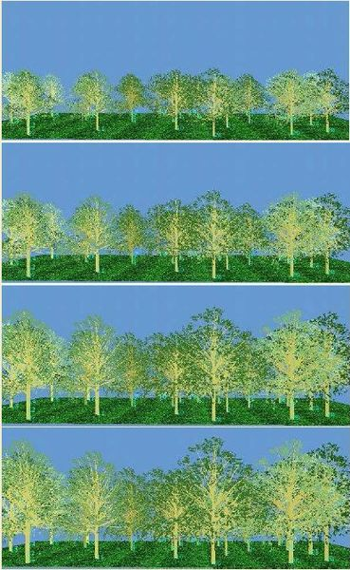
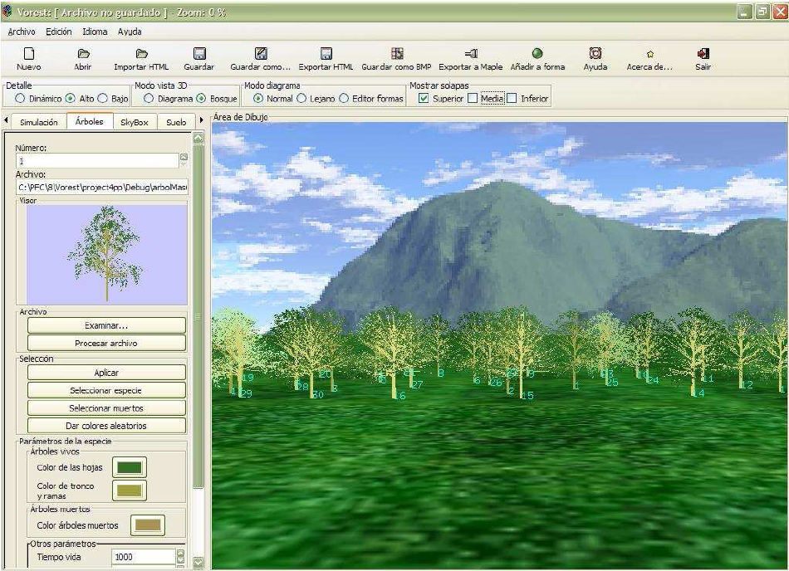
Forestal applications
VOREST: Simulating how trees grow
More info: http://www.dma.fi.upm.es/mabellanas/VOREST/

Slide 17
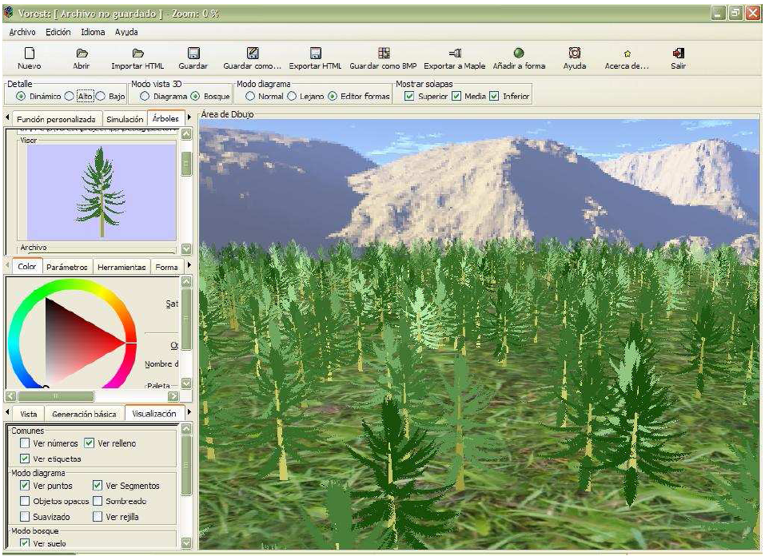
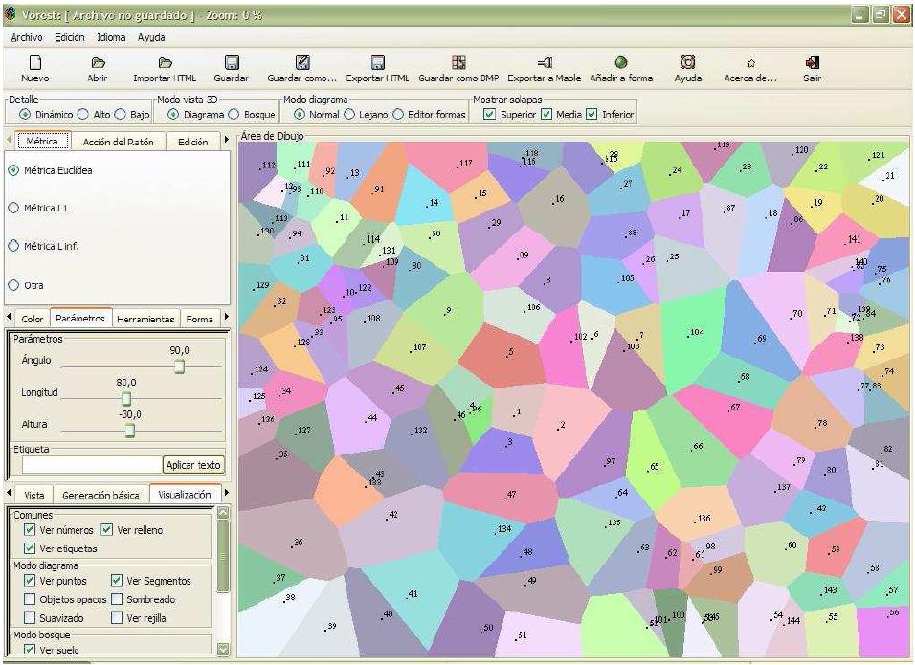
Simulating how trees grow
The growth of a tree depends on how much “free space” it has around it
Notes:
Not only the the space on the terrain, but also de space around its “copa”
“La competencia que se produce entre los ¶arboles por dominar el espacio para poder desarrollarse hace que estos sistemas biol¶ogicos est¶en directamente relacionados con los diagramas de Voronoi. En efecto, un diagrama de Voronoi puede verse como la partici¶on del espacio resultante de la expansi¶on de los sitios que lo generan”
Apparently this was modeled by biologists using Voronoi diagrams (although not using that name) something like 50 years ago.

Slide 18
Lower envelopes of cones
Alternative definition of Voronoi diagram:
2D projection of lower envelope of distance cones centered at sites

Slide 19
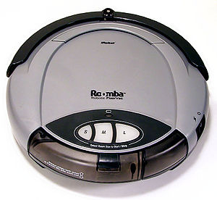
Robot motion planning
Move robot amidst obstacles
Can you move a disk (robot) from one location to another avoiding all obstacles?
Most figures in this section are due to Marc van Kreveld

Slide 20
Robot motion planning
Observation: we can move the disk if and only if we can do so on the edges of the Voronoi diagram
edges are (locally) as far as possible from sites

Slide 21
Robot motion planning
General strategy
Compute Voronoi diagram of obstacles
Remove edges that get too close to sites
i.e. on which robot would not fit
Locate starting and end points
Move robot center along VD edges
This technique is called retraction

