Slide 1
Computational Geometry
Windowing
Michael Goodrich
with slides from Carola Wenk and Kevin Buchin

Slide 2
Windowing
Input: A set S of n line segments in the plane
Query: Report all segments in S that intersect a given query window
Subproblem: Process a set of intervals on the line into a data structure which supports queries of the type: Report all intervals that contain a query point.
Interval trees
Segment trees

Slide 3
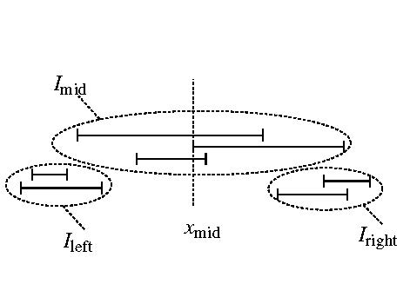
Interval Trees
Input: A set I of n intervals on the line.
.
.
disjoint union
Idea: Partition I into I_{left}∪ I_{mid} ∪ I_{right} where x_{mid} is the median of the 2n endpoints. Store I_{mid} twice as two lists of intervals: L_{left} sorted by left endpoint and as L_{right} sorted by right endpoint.
I_{mid} stored as L_{left} , L_{right}
interval tree for I_{left}
interval tree for I_{right}

Slide 4
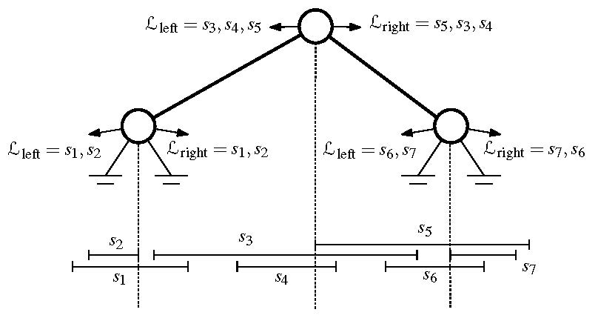
Interval Trees
Lemma: An interval tree on a set of n intervals uses O(n) space and has height O(log n). It can be constructed recursively in O(n log n). time.
Proof: Each interval is stored in a set I_{mid} only once, hence O(n) space. In the worst case half the intervals are to the left and right of x_{mid}, hence the height is O(log n). Constructing the (sorted) lists takes O(|I^{v}| + |I^{v}_{mid}| log |I^{v}_{mid}|) time per vertex v.

Slide 5
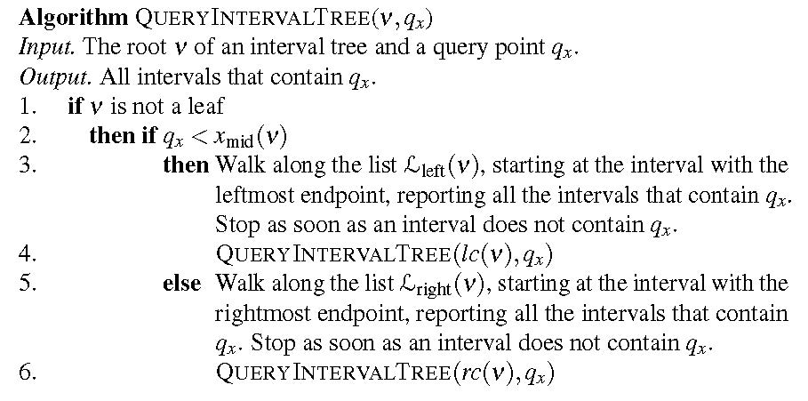
Interval Tree Query
Theorem: An interval tree on a set of n intervals can be constructed in O(n log n) time and uses O(n) space. All intervals that contain a query point can be reported in O(log n + k) time, where k = #reported intervals. Proof: We spend O(1+k_{v}) time at vertex v, where k_{v} = #intervals reported at v. We visit at most 1 node at any depth.

Slide 6
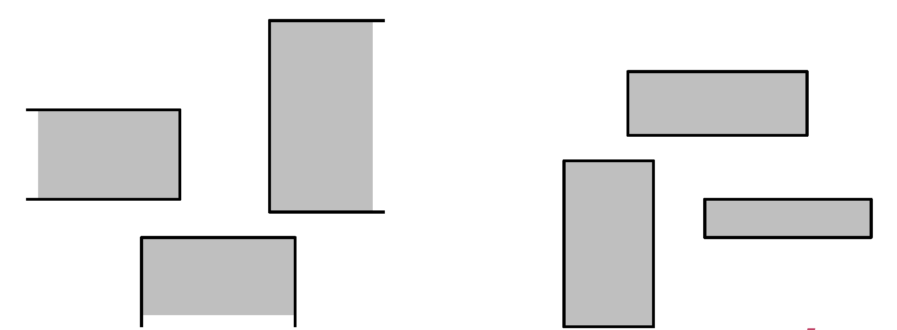
3-Sided Range Queries
3-sided range queries want all points in a range where one of the sides is unbounded.
3-sided ranges:
4-sided ranges:

Slide 7
Priority Search Trees

Slide 8
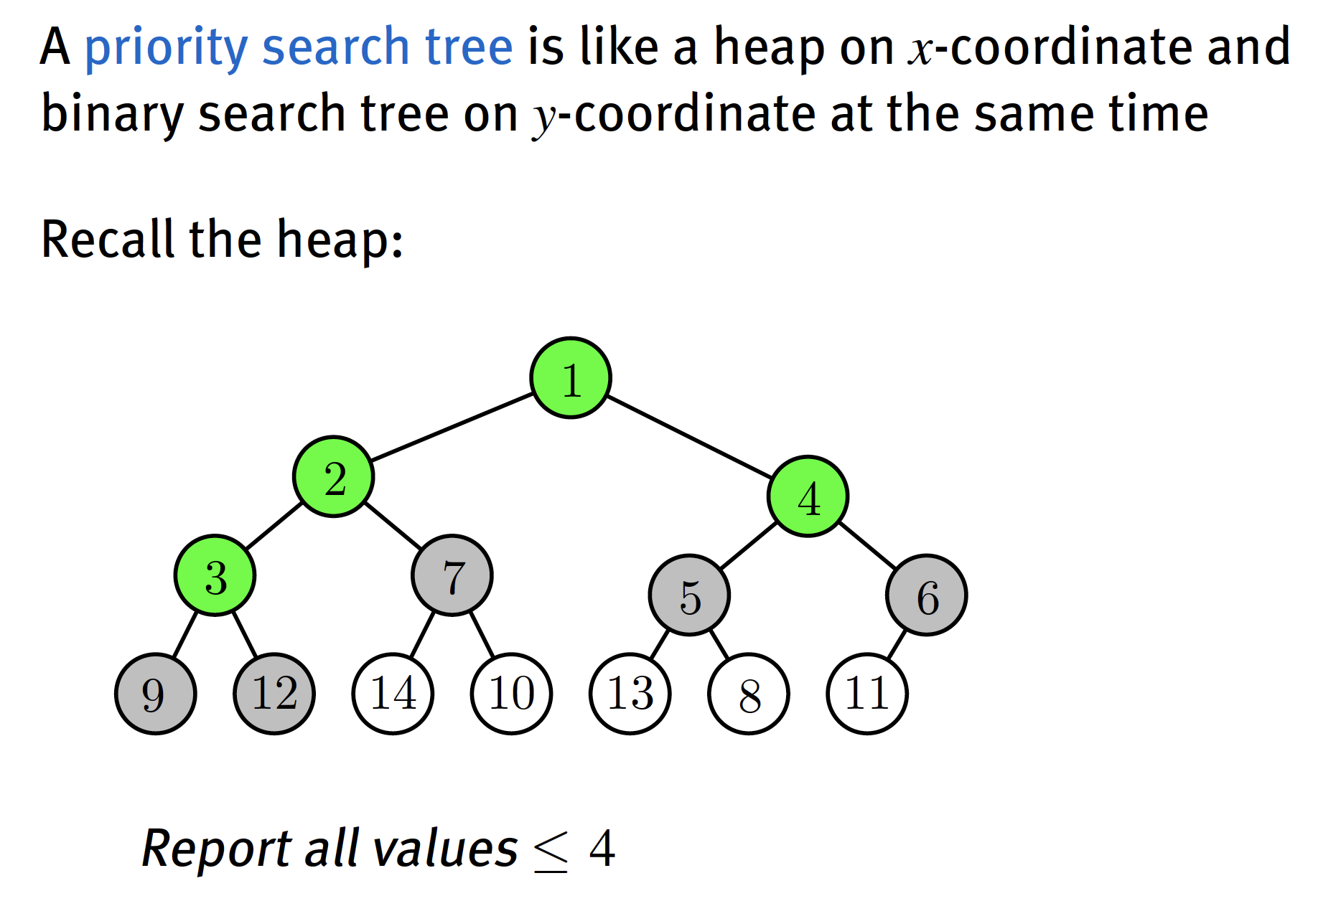
Priority Search Trees

Slide 9
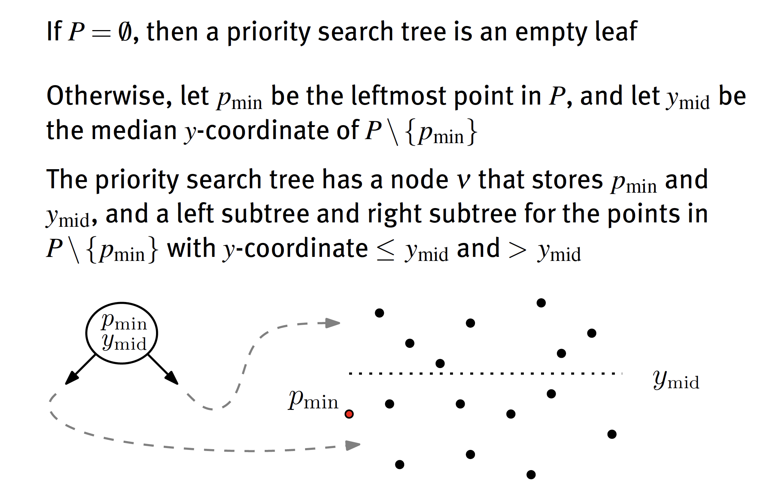
Priority Search Trees

Slide 10
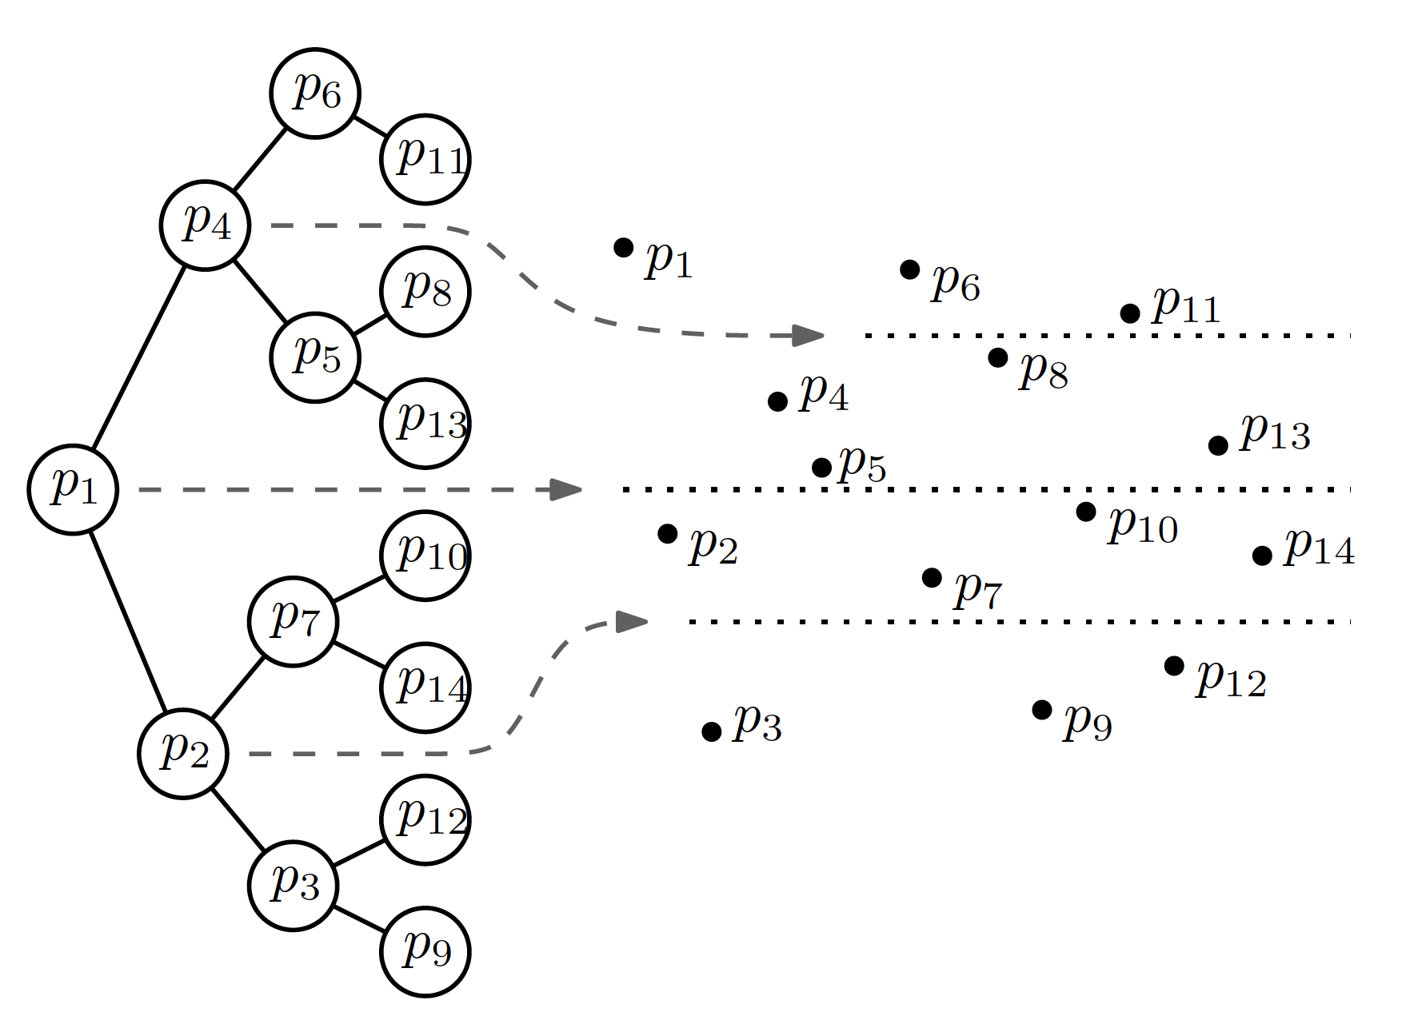
Can answer 3-sided range queries.
W.l.o.g., (-∞,x] x [y₁,y₂]

Slide 11
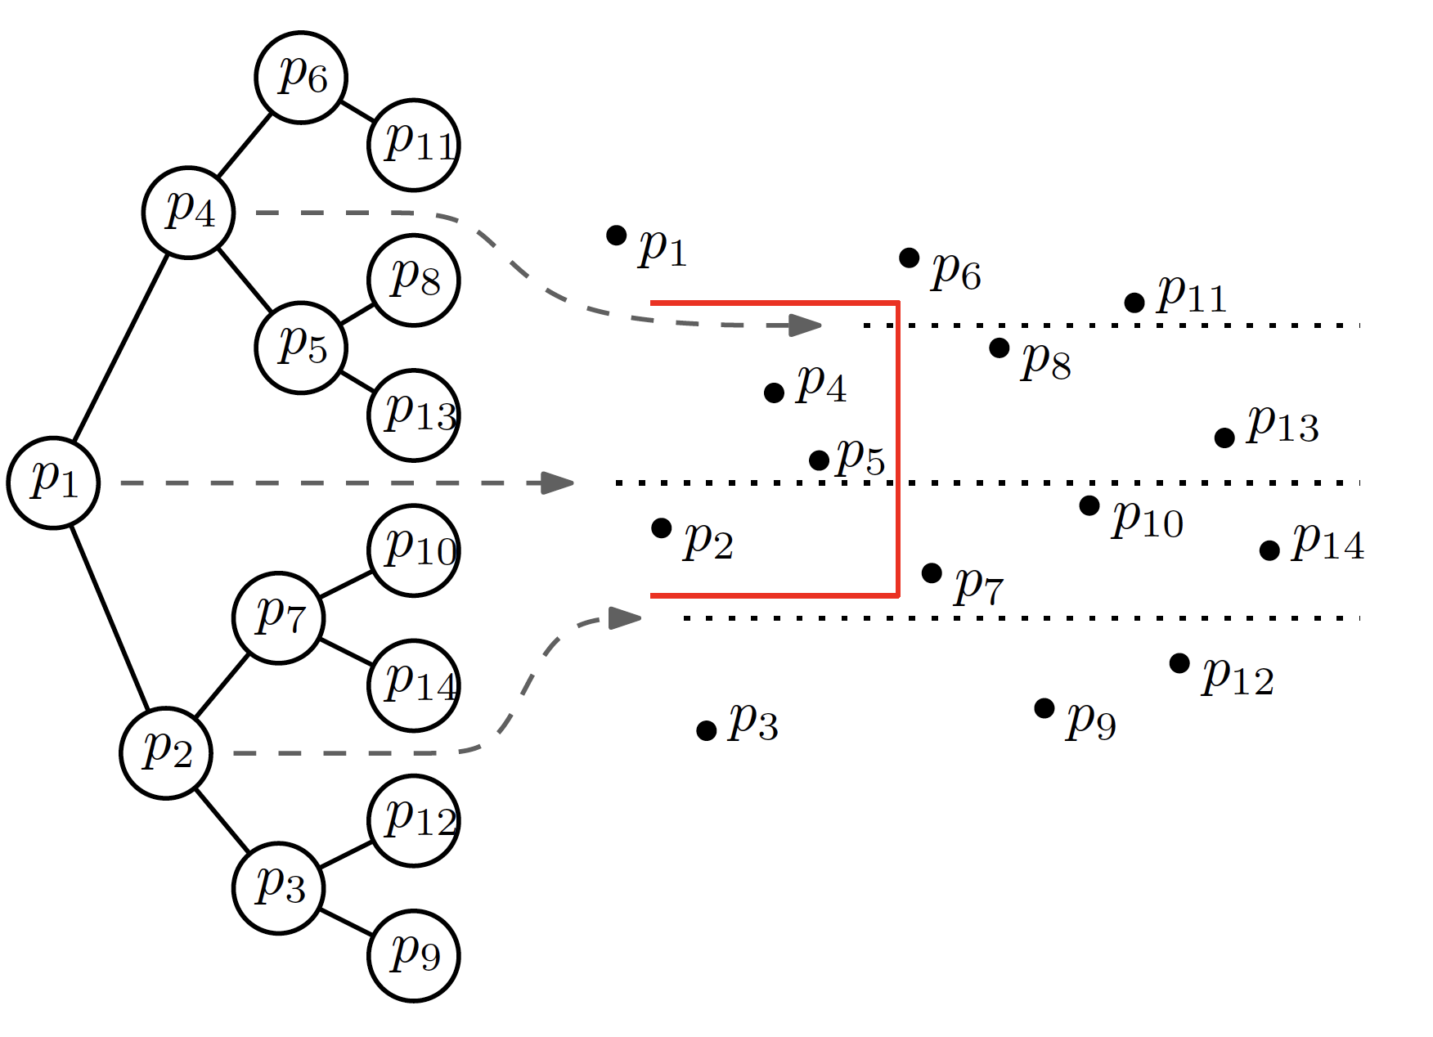
Can answer 3-sided range queries.
W.l.o.g., (-∞,x] x [y₁,y₂]

Slide 12
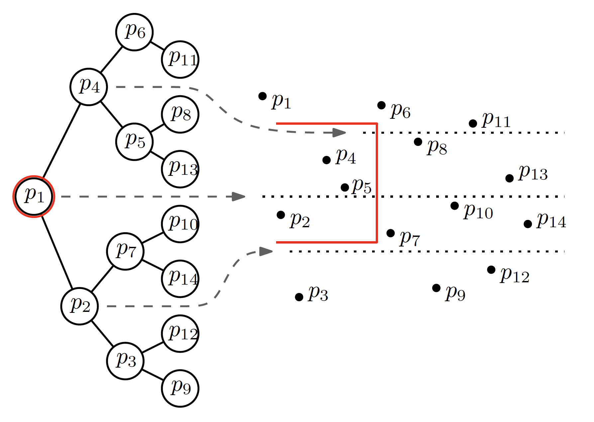

Slide 13
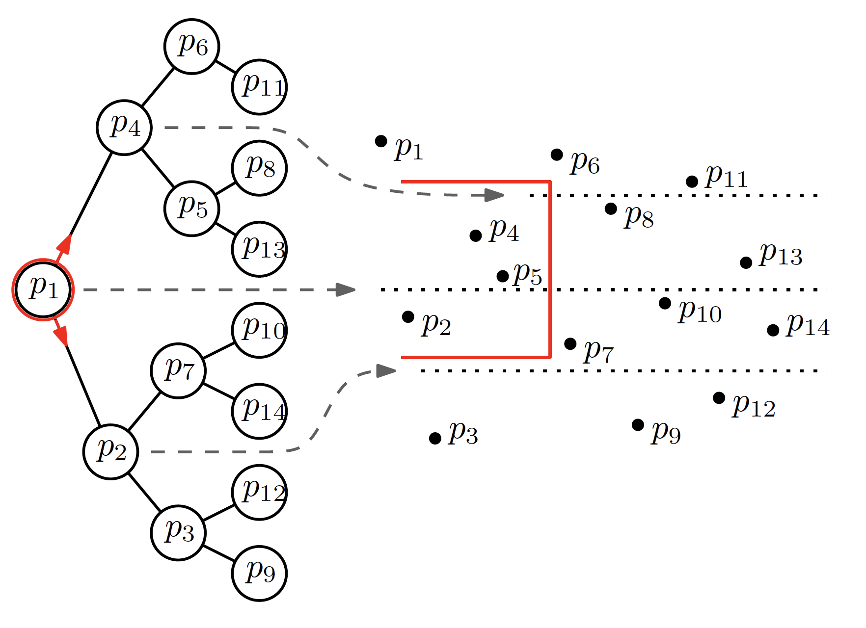

Slide 14
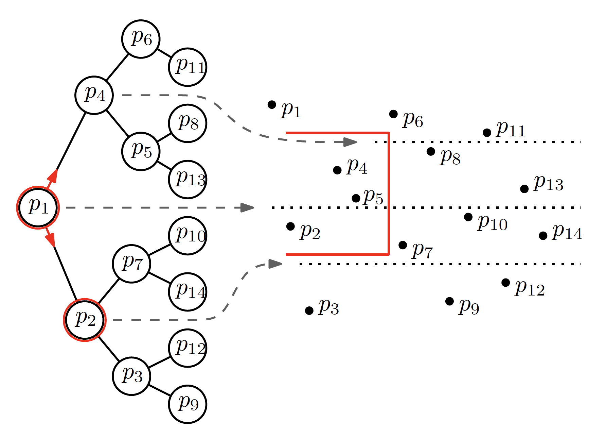

Slide 15
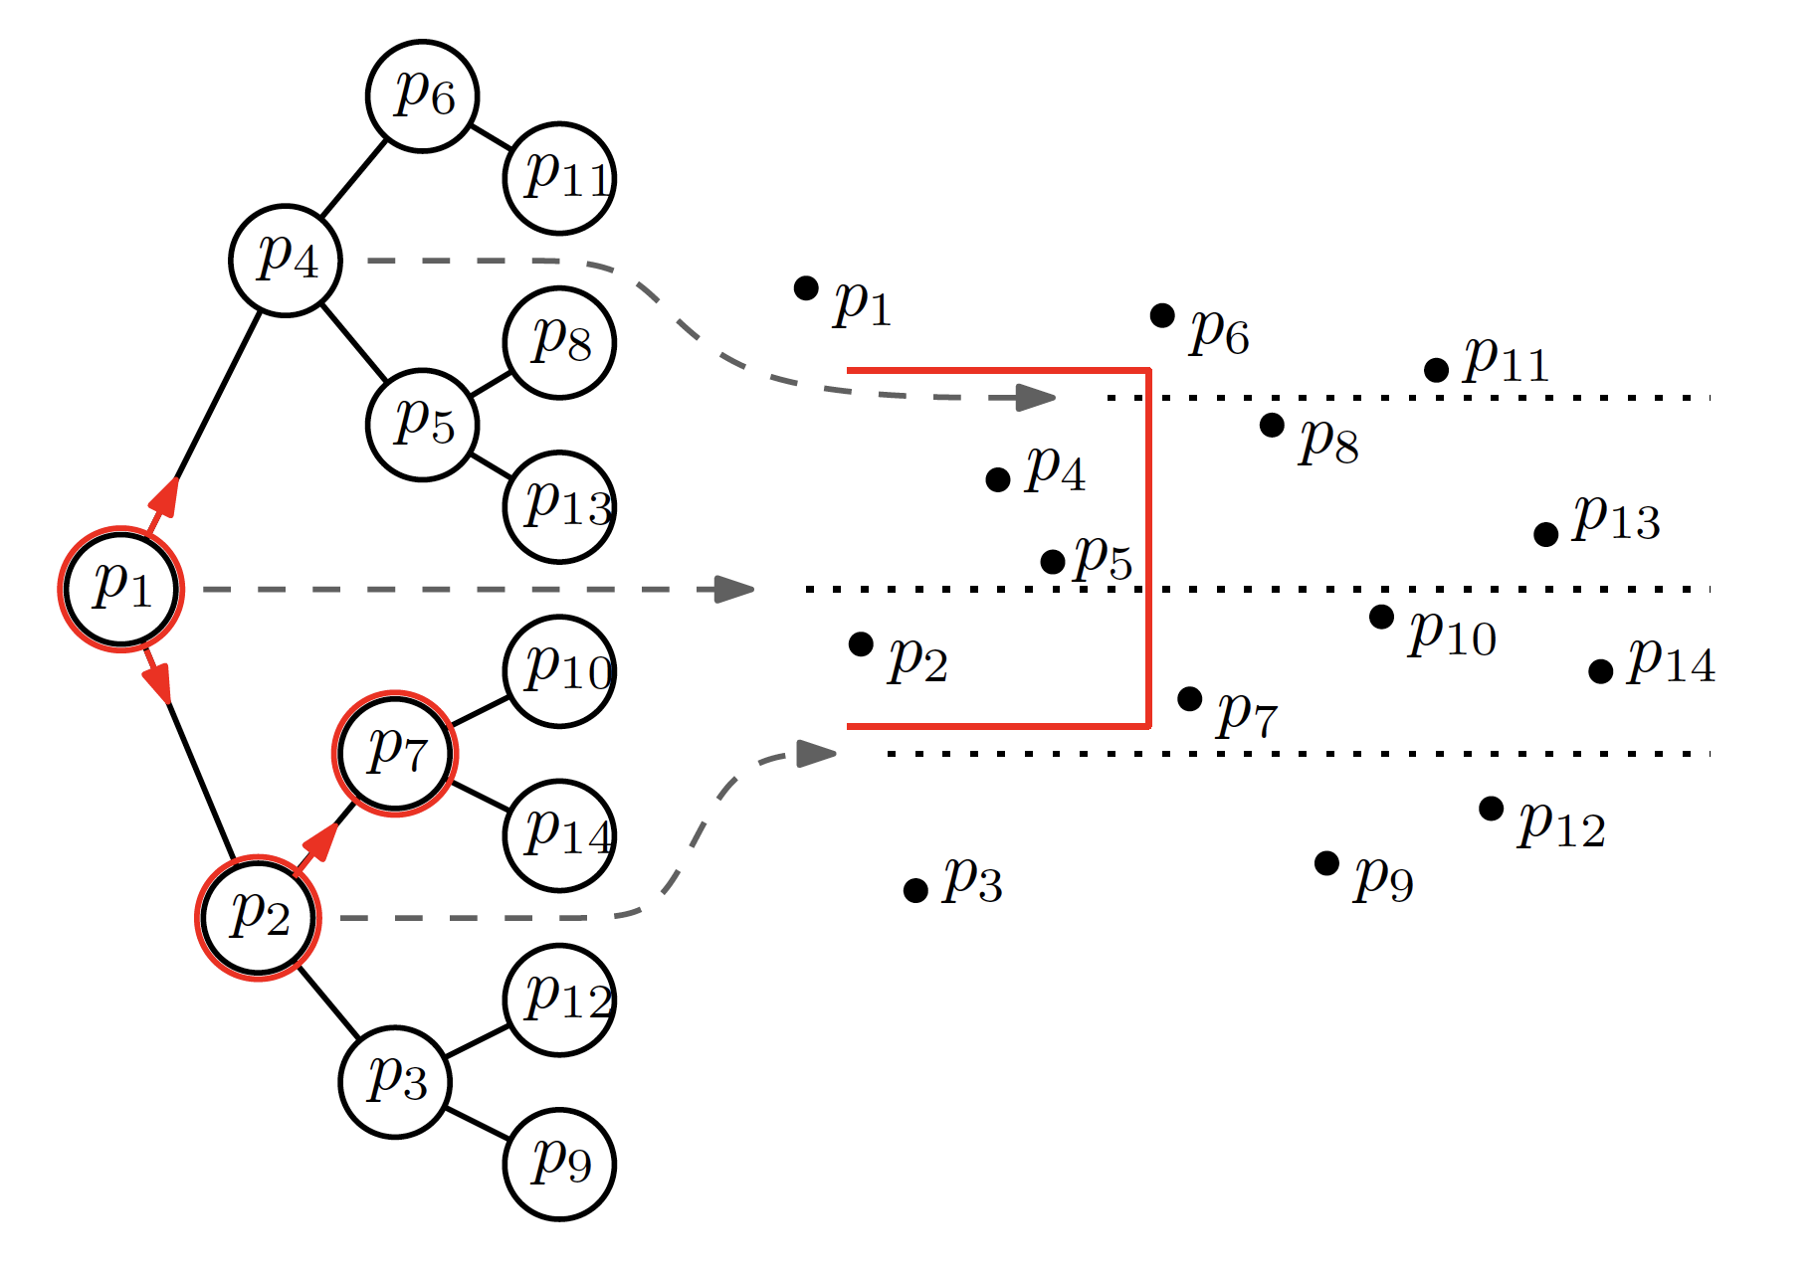

Slide 16
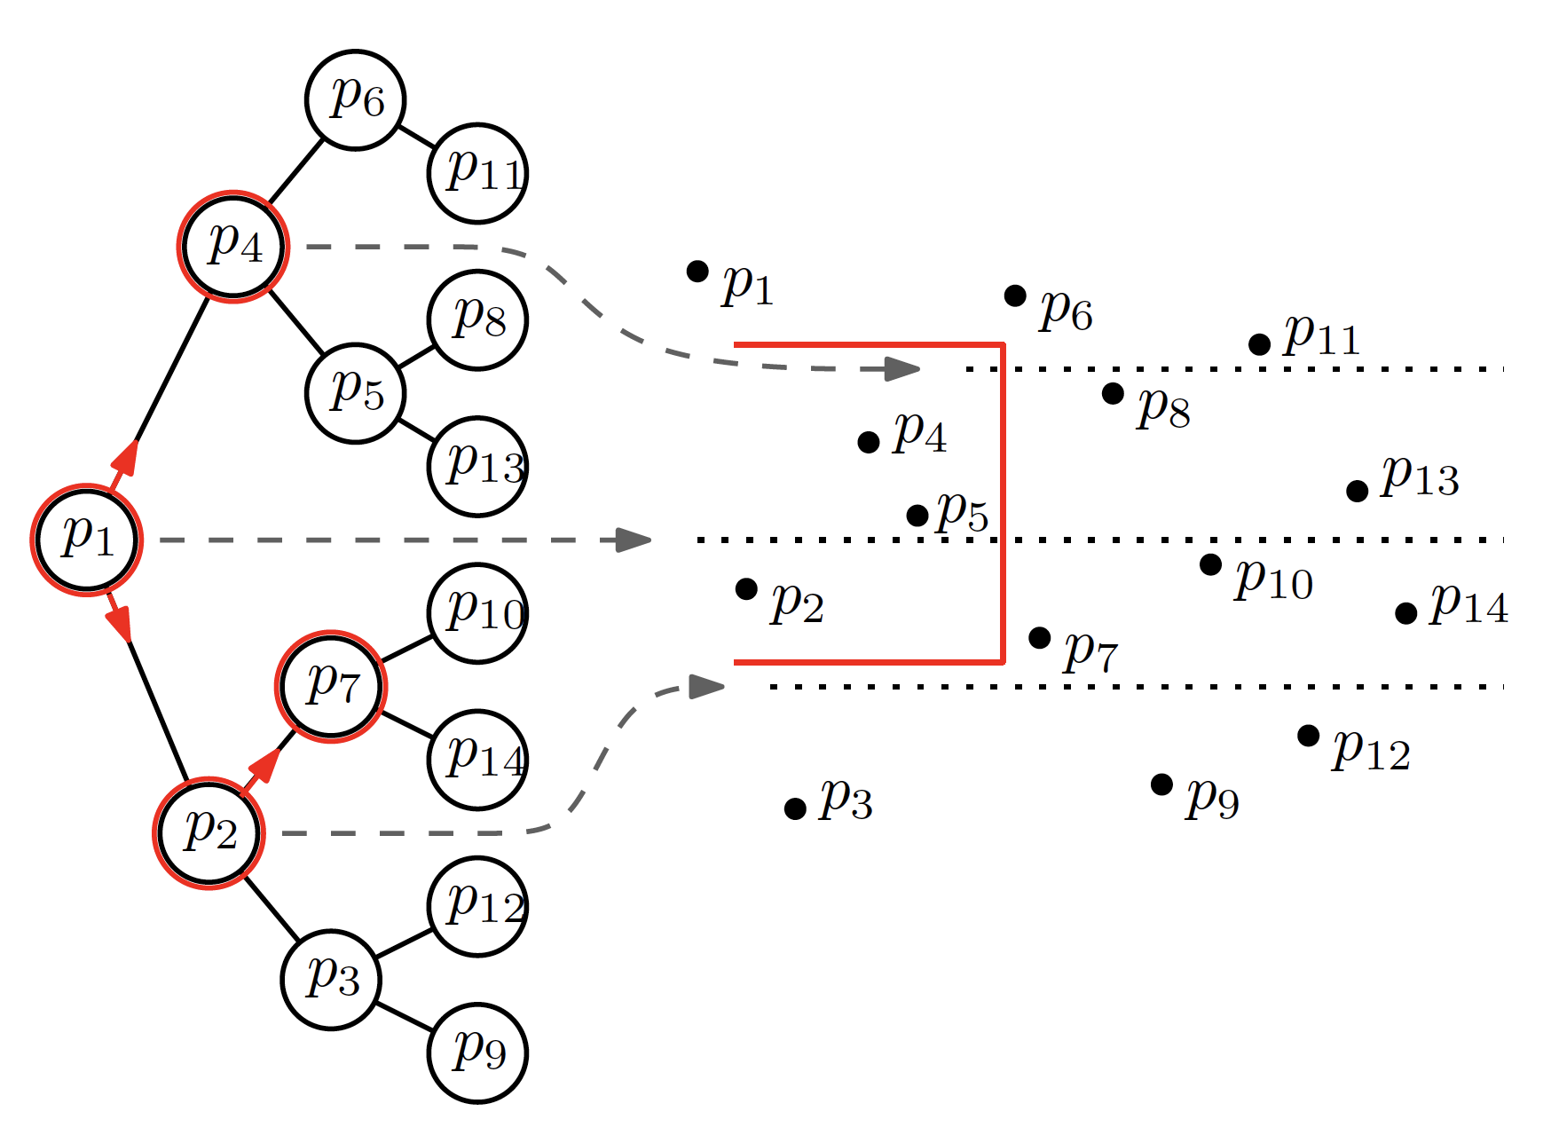

Slide 17
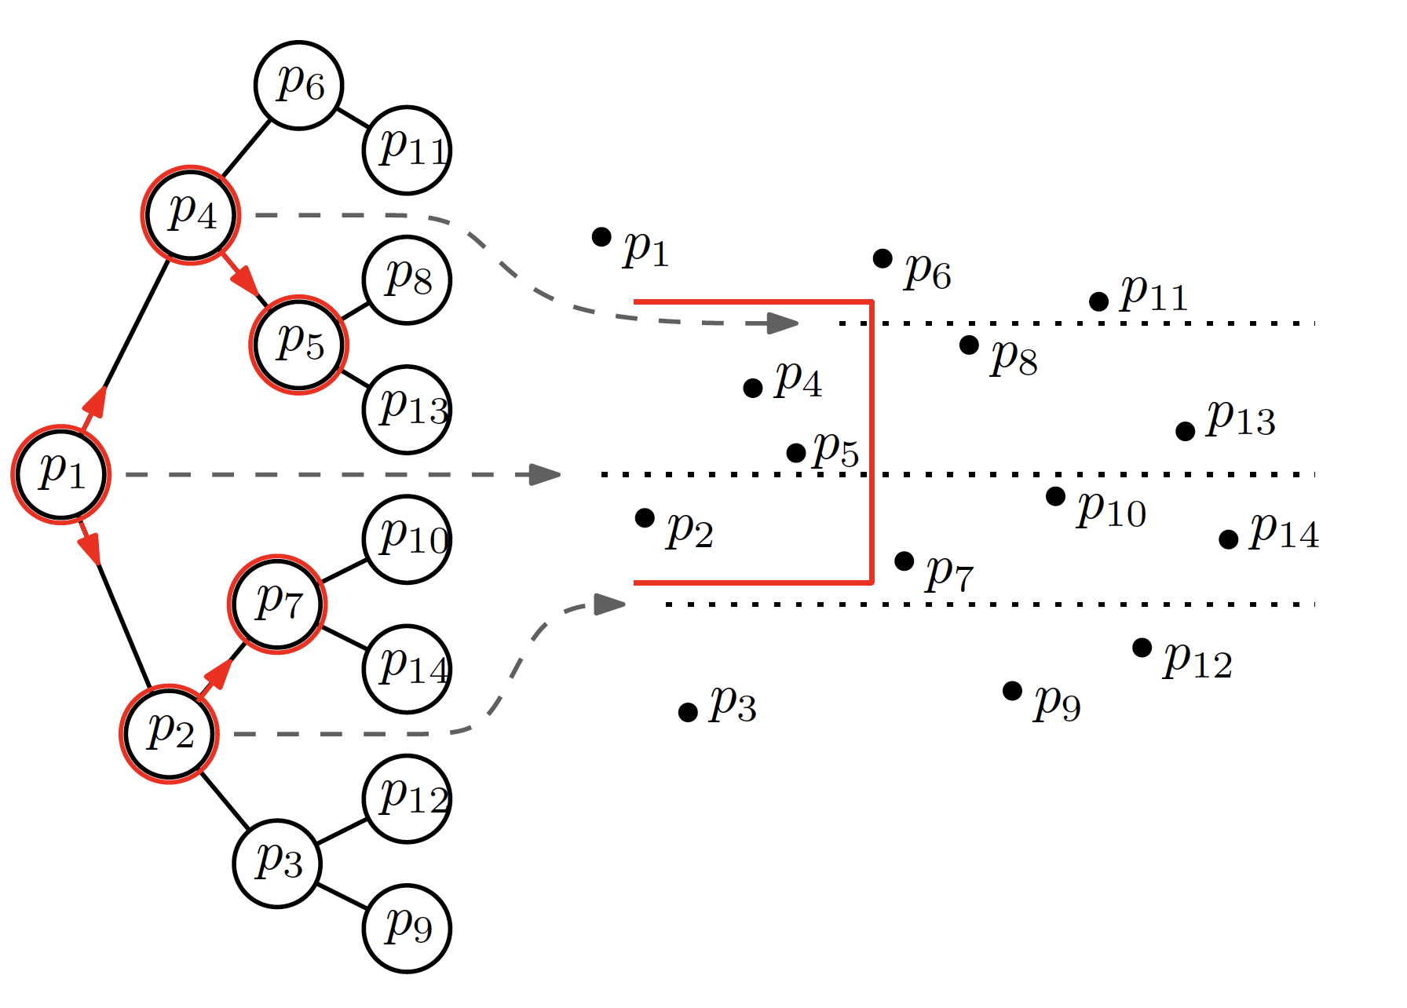

Slide 18
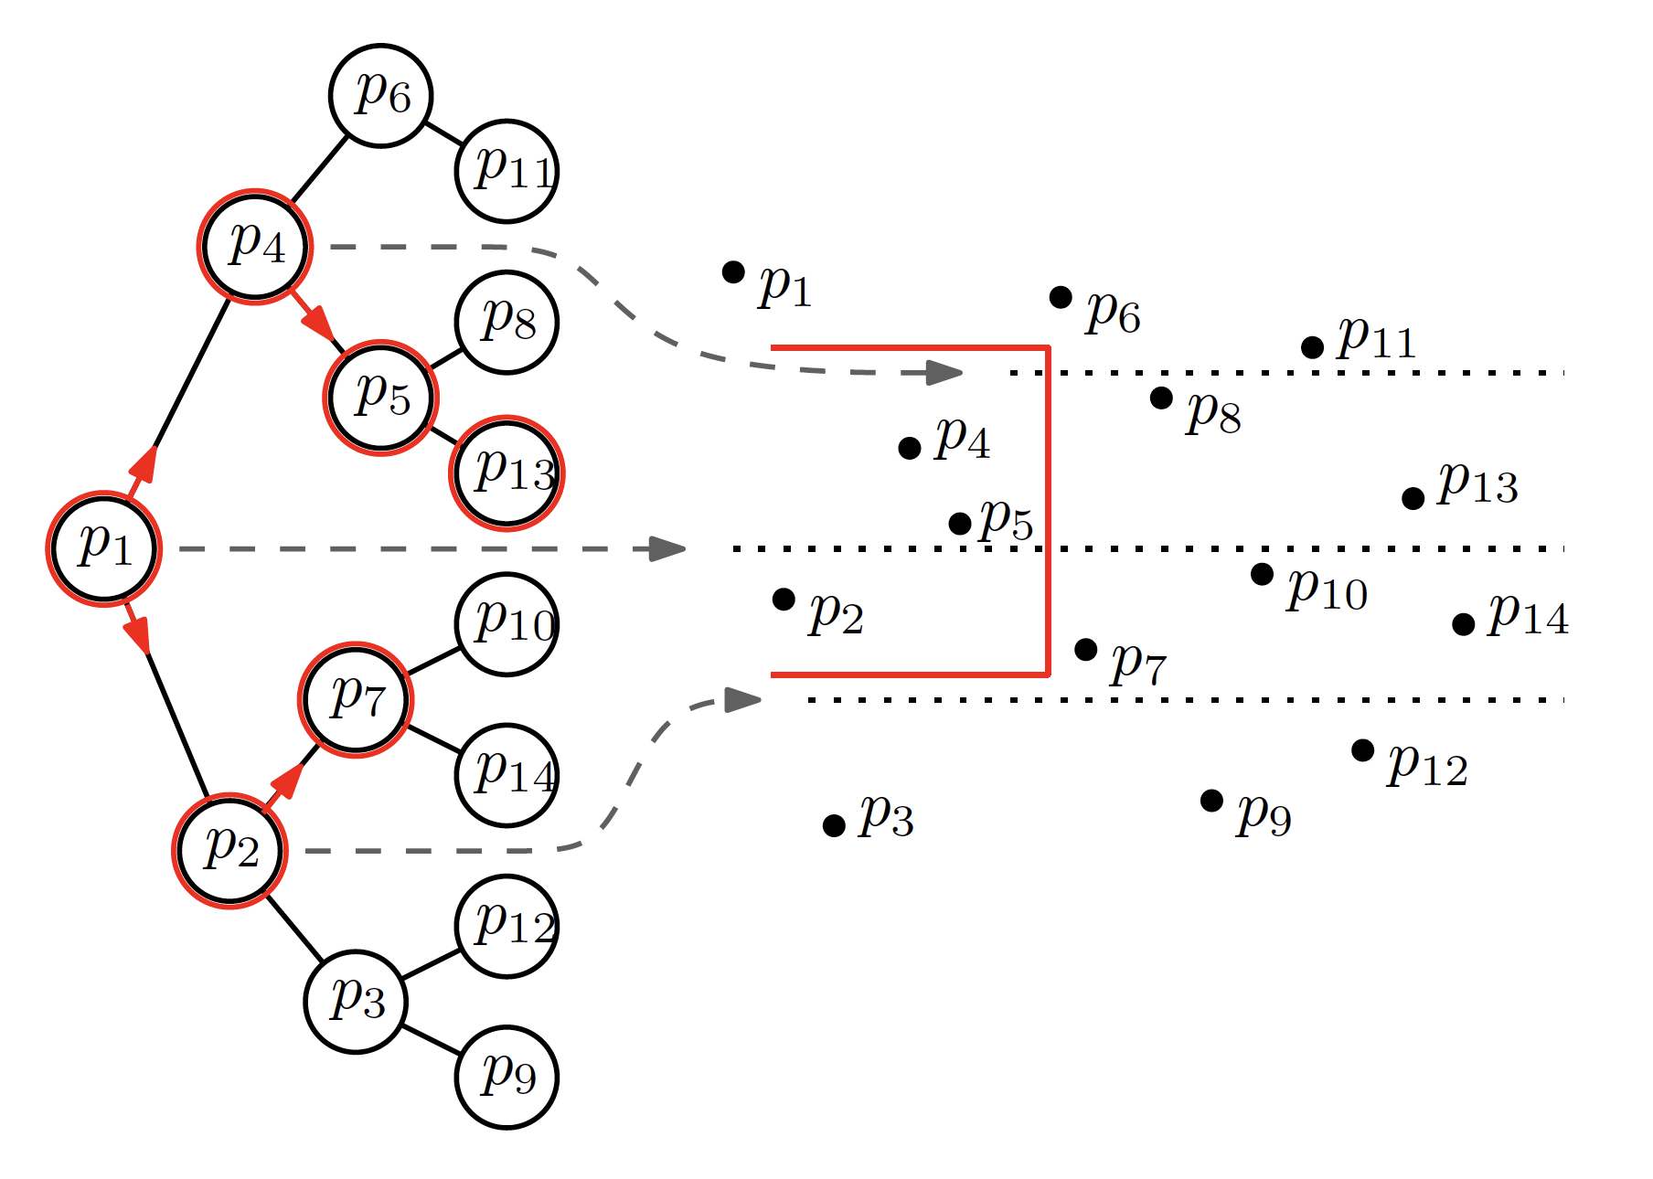

Slide 19
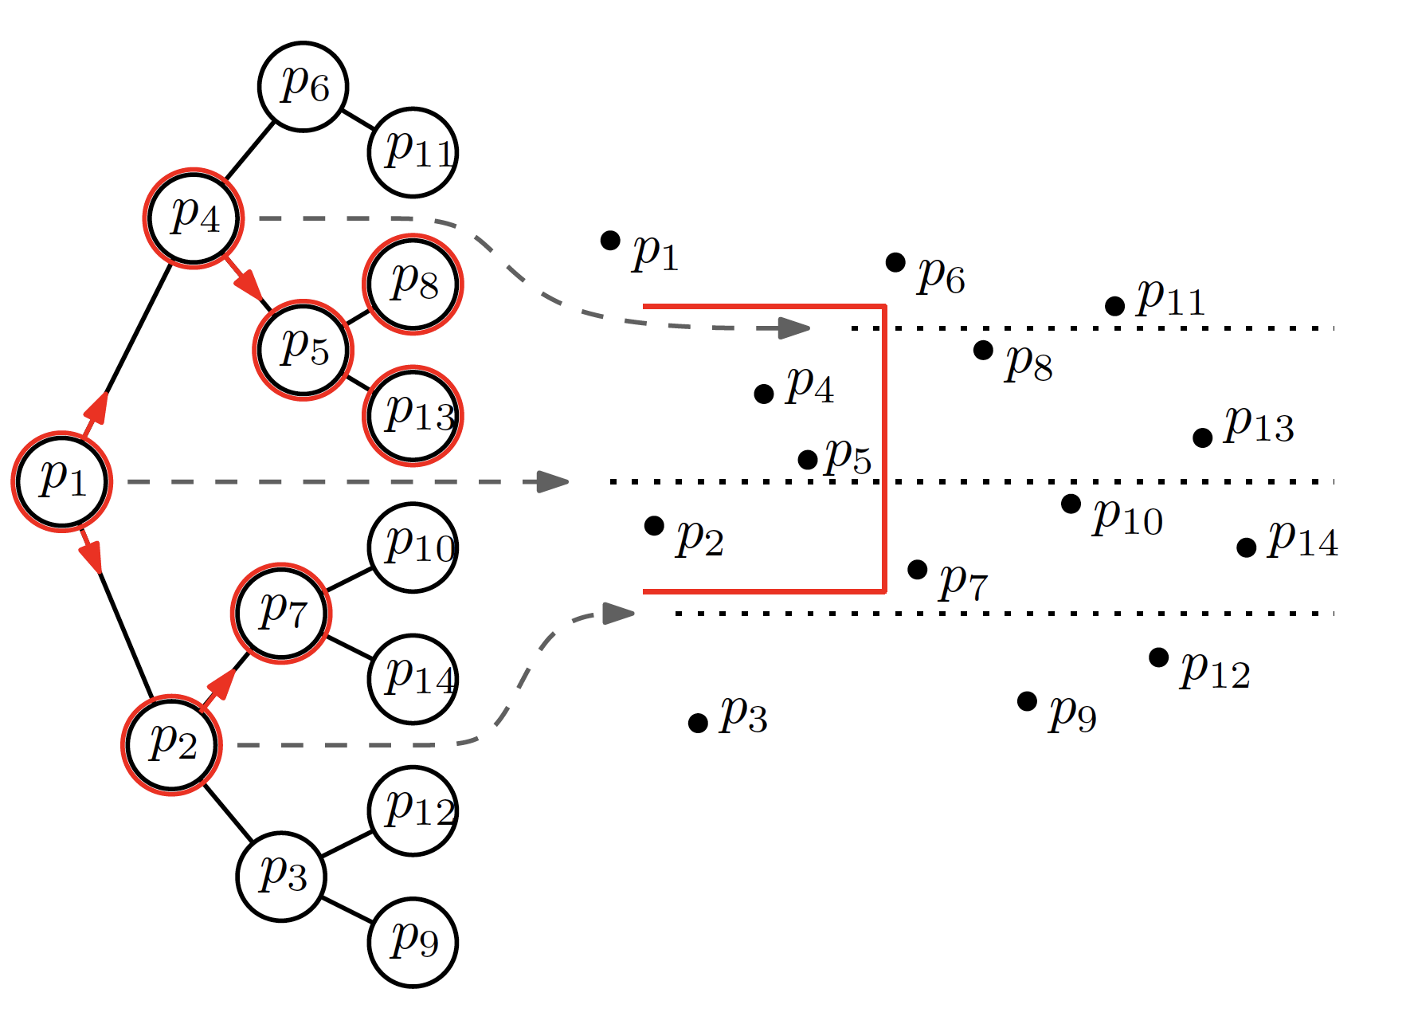

Slide 20
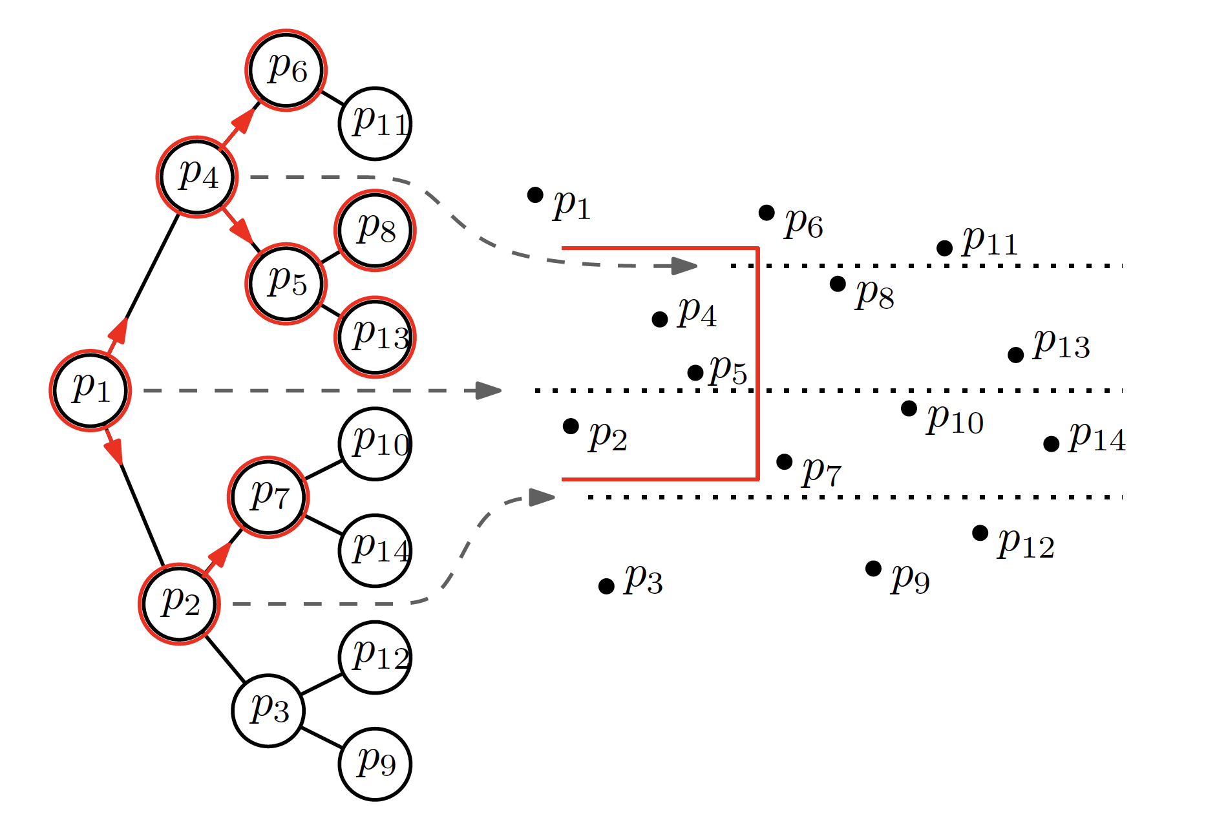

Slide 25
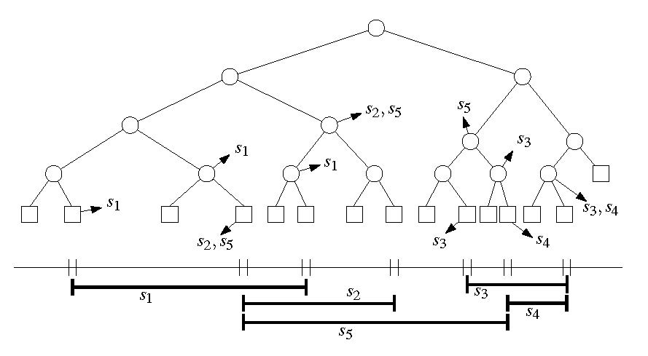
Segment Trees
Let I={s₁,…,s_{n}} be a set of n intervals (segments), and let p₁, p₂, …,p_{m} be the sorted list of distinct interval endpoints of I.
Partition the real line into elementary intervals:
$$\left(−∞,p_{1}\right),\left[p_{1},p_{1}\right],\left(p_{1},p_{2}\right),…,\left(p_{m−1},p_{m}\right),\left[p_{m},p_{m}\right],\left(p_{m},∞\right)$$
Construct a balanced binary search tree T with leaves corresponding to the elementary intervals
p₁
p₂
p₃
p₄
p₅
p₆
p₇

Slide 26
Elementary Intervals
Int(μ):=elementary interval corresponding to leaf μ
Int(v):=union of Int(μ) of all leaves in subtree rooted at v
v
Int(v)
p₁
p₂
p₃
p₄
p₅
p₆
p₇

Slide 27
Segment Trees
Store segments as high as possible
Each vertex v stores (1) Int(v) and (2) the canonical subset I(v)⊆I:
I(v):= {s∈I | Int(v) ⊆ s and Int(parent(v)) ⊄ s}
s₁
s₂
s₃
s₄
s₅
p₁
p₂
p₃
p₄
p₅
p₆
p₇

Slide 28
Segment Trees
Store segments as high as possible
Each vertex v stores (1) Int(v) and (2) the canonical subset I(v)⊆I:
I(v):= {s∈I | Int(v) ⊆ s and Int(parent(v)) ⊄ s}
p₁
p₂
p₃
p₄
p₅
p₆
p₇

Slide 29
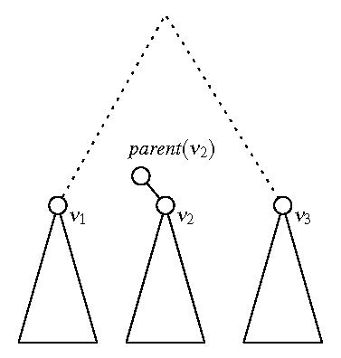
Space
Lemma: A segment tree on n intervals uses O(n log n) space.
Proof: Any interval s is stored in at most two sets I(v₁), I(v₂) for two different vertices v₁, v₂ at the same level of T. [If s was stored in I(v₃) for a third vertex v₃, then s would have to span from left to right, and Int(parent(v₂))⊆s, hence s is cannot be stored in v₂.] The tree is a balanced tree of height O(log n).
s

Slide 30
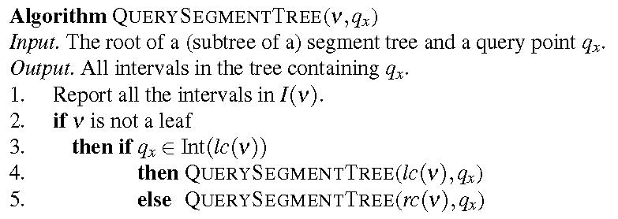
Segment Tree Query
Runtime Analysis:
Visit one node per level.
Spend O(1+k_{v}) time per node v.
⇒ Runtime O(log n + k)

Slide 31
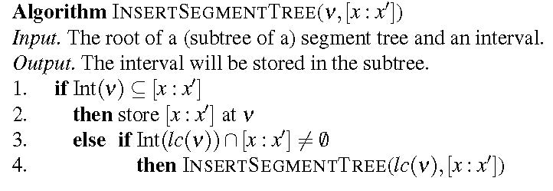
Segment Tree Construction
Sort interval endpoints of I. → elementary intervals
Construct balanced BST on elementary intervals.
Determine Int(v) bottom-up.
Compute canonical subsets by incrementally inserting intervals s=[x,x’]∈I into T using InsertSegmentTree:
O(n log n)
s )
s
s
s
s )
s
s )

Slide 32
Segment Trees
Runtime:
Each interval stored at most twice per level
At most one node per level that contains the left endpoint of s (same with right endpoint)
Visit at most 4 nodes per level
O(log n) per interval, and O(n log n) total
Theorem: A segment tree for a set of n intervals can be built in O(n log n) time and uses O(n log n) space. All intervals that contain a query point can be reported in O(log n + k) time.

Slide 33
2D Windowing Revisited
Input: A set S of n disjoint line segments in the plane
Task: Process S into a data structure such that all segments intersecting a
vertical query segment q:=q_{x} × [q_{y},q’_{y}] can be reported efficiently.
q’_{y}
q_{y}
q_{x}

Slide 34
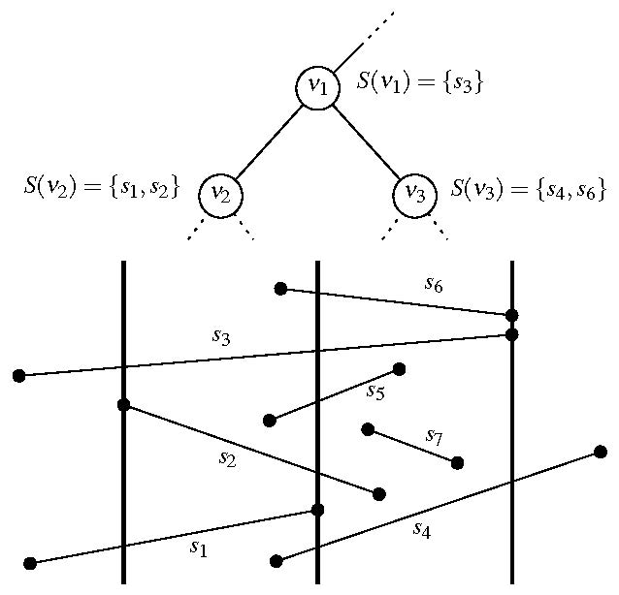
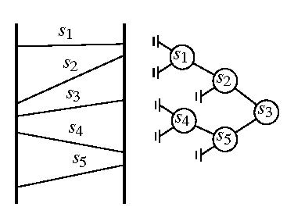
2D Windowing Revisited
Solution: Segment tree with nested range tree
Build segment tree T based on x-intervals of segments in S. → each Int(v)≅ Int(v)×(-∞,∞) vertical slab
I(v)≅S(v) canonical set of segments spanning vertical slab
Store S(v) in 1D range tree (binary search tree) T(v) based on vertical order of segments

Slide 35
2D Windowing Revisited
Query algorithm:
Search regularly for q_{x} in T
In every visited vertex v report segments in T(v) between q_{y} and q’_{y} (1D range query)
⇒ O(log n + k_{v}) time for T(v)
O(log²n + k) total
q’_{y}
q_{y}
q_{x}

Slide 36
2D Windowing Summary
Theorem: Let S be a set of (interior-) disjoint line segments in the plane. The segments intersecting a vertical query segment (or an axis-parallel rectangular query window) can be reported in O(log² n + k) time, with O(n log n) preprocessing time and O(n log n) space.
q’_{y}
q_{y}
q_{x}

