Slide 1
Embedded Systems
Computer-based systems which do not appear to be computers
Complexity is hidden from the user
Embedded systems are much more common than desktop/laptop systems
Interact with users via simple interface:
Digital camera, TV, cellphone, …
Interact with another device, invisible to user:
Disk drive, memory stick, anti-lock braking system, …

Slide 2
Tight Constraints
Embedded design methodology: Be Efficient!
Majority of embedded products are in cost critical markets (i.e. consumer electronics)
Other applications are in performance/power critical markets (i.e. military, medical)
Constraints include:
Maufacturing cost, Design cost, Performance, Power, Time-to-Market
Very different from traditional software engineering
Moore’s law will save you eventually
Embedded system designers should be control freaks
Need to have explicit control over timing, memory
Why trust a compiler/interpreter/OS?

Slide 3
Application Specificity
Embedded systems are generally application-specific
Perform one task or set of related tasks
Some devices blur the line (i.e. cell phones)
Allows design to be focused on one application
Unlike general-purpose systems (i.e. laptop)
Higher design efficiency is possible
Special-purpose vs. general purpose (i.e. video games)

Slide 4
Hardware/Software Codesign
Hardware and software are often designed together
General-purpose systems use HW and SW developed by different companies
Greatly improved optimization is possible
Include only HW/SW needed for your application
More work for the designers
Must understand both HW and SW

Slide 5
Generic ES Structure
sensors
ADC
microcontroller
DAC
actuators
IP
FPGA
Sensors receive data from the world
Actuators cause events in the world
Application-Specific Integrated Circuit (ASIC)- special-purpose hardware
Field Programmable Gate Array (FPGA) - reconfigurable hardware

Slide 6
Sensors
Receive data from the environment
Motion - IR/ultrasonic detectors, potentiometers, encoders
Light - Photoresistors, cameras
Touch - Capacitive touch, pressure sensors
Variety of physical principles used
Many sensors are analog

Slide 7
Actuators
Cause external events
Mechanical - motors
Audio – speakers, buzzers
Visual – LED, LCD, laser
May consider external communication to be actuation
Many actuators are analog

Slide 8
Analog/Digital Conversion
Analog-to-Digital Converter (ADC)
Converts analog data to digital data
Used to interface with analog sensors
Digital-to-Analog Converters (DAC)
Converts digital signals to analog signals
Used to interface with analog actuators

Slide 9
Intellectual Property (IP) Core
An integrated circuit which performs one function
Cheap in high volume
Very useful for common tasks
Network controllers (ethernet, CAN)
Audio/Video (audio codec, VGA controller)
Must interact with the microcontroller
Consider communication protocol

Slide 10
Field Programmable Gate Array (FPGA)
Hardware which can be reconfigured via RAM
Logic Block
Interconnect
Faster than SW, slower than ASIC
No fabrication needed

Slide 11
Microcontrollers
Microcontrollers are the center of the system
Accept input data, process it, make decisions, cause output events
Hardware/Software Interface
Write code, execute it on a microcontroller
Microcontroller interacts with hardware components

Slide 12
General-Purpose vs. DSP
General-Purpose
Used in for any application
Many features included
Digital Signal Processors (DSP)
Made to support DSP functions
Vector instructions
Cheaper but more limited

Slide 13
Software Translation
Machine language: CPU instructions represented in binary
Assembly language: CPU instructions with mnemonics
Easier to read
Equivalent to machine language
High-level language: Commonly used languages (C, C++, Java, etc.)
Much easier to use
All software must be translated into the machine language of the microcontroller

Slide 14
Compilation/Interpretation
Compilation: Translate instructions once before running the code
C, C++, Java (partially)
Translation occurs only once, saves time
Interpretation: Translate instructions while code is executed
Basic, Java (partially)
Translation occurs every execution
Translation can adapt to runtime situation

Slide 15
Why C for Embedded Systems?
Easier to use than Assembly language
Allows more control than higher-level languages (Java, Python, etc.
C example Python example
int a, b, c; a = b + c
a = b + c;
How much memory is used in each example?

Slide 16
Compilation Example
a = b + c;
Compiler
lw $r1, ($s1)
lw $r2, ($s2)
add $r3, $r2, $r1
sw $r3, ($s3)
Load b from memory
Load c from memory
Add b and c
Store result a in memory
Assembler
10010001000000110000001000000001
add
$r3
$r2
$r1

Slide 17
Microcontroller Components
Storage Elements
- Data is stored in different components
- Speed/Cost (area) tradeoff
Register: Stores a single value
- Like a single memory location
- Extremely fast
- Extremely expensive
Several special-purpose registers, used internally
General-purpose registers, used by the program

Slide 18
Storage Elements
Register File: Stores many values
- A set of registers, each has an address
- Acts just like a memory
- Extremely fast, expensive
Instruction operands are here
add $r3, $r2, $r1
Can only read one or two registers at a time
May contain ~32 registers

Slide 19
Memories
Cache: Stores many values
- Slower than a register file
- Cheaper than a register file
- Still fairly fast and expensive
Data cache holds data that the program operates on
Instruction cache holds program instructions

Slide 20
Main Memory
Very big, Gigabytes (Gb)
Not in the CPU
Connected to the CPU via a system bus
Memory access is slow
Von Neumann Bottleneck
Memory is much slower then the CPU
Memory access time greatly slows program execution

Slide 21
Arithmetic Logic Unit (ALU)
Performs arithmetic and logical functions on data
Many instructions use the ALU
Arithmetic operations: add, subtract, etc.
Logical Operations: AND, OR, XOR, etc.

Slide 22
Special-Purpose Registers
Program Counter (PC)
Stores the address of the next instruction
Drives the instruction cache
Incremented after most instructions
Updated after jump/branch instructions
Program Status Word
Contains various bits indicating operation status
Negative, zero, etc.
Contains privileged mode bit
Indicates higher security permission

Slide 23
Basic Processor Core
PC
Instruction
Cache
Register
File
Data
Cache
ALU
PC is updated after each instruction
Control logic needed to coordinate activity

Slide 24
Executing an Instruction
add $r3, $r2, $r1
Instruction Fetch – Get instruction from memory
Update Program Counter afterward
Instruction Decode, Register Fetch – Identify instructions, get input operands
Execute – Perform operation
Register Write – Put result operands in register file

Slide 25
Microcontroller Characteristics
Datapath Bitwidth
Number of bits in each register
Determines accuracy and data throughput
Input/Output Pins
Need enough pins to support your application
Performance
Clock rates are slower than desktop

Slide 26
Other μproc Features
Timers
Needed for real-time applications
Analog-to-Digital Converters
Used to read input from analog sensors
Low-power modes
Power saving is important
Communication protocol support
Interface with other Ics
UART, I2C, SPI, etc.

Slide 27
AVR ATmega2560
8-bit microcontroller
Up to 16MHz
256KB of flash memory
4KB EEPROM, 8KB SRAM
Peripherals
Timers, PWM, comparators, ADC, …

Slide 28
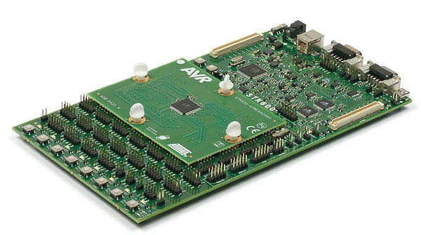
AVR STK600 Board
Allows many different Atmel AVR microcontrollers to be programmed and interfaced with
Comes with a Routing Card containing the ATmega2560
Allows direct access via board pins
Other interfaces: USB, CAN, RS-232

Slide 29
Facts about STK600
Has LEDs and buttons for experimentation
Headers are available to connect to microcontroller pins
Microcontroller I/O pin headers must be connected to board components manually using cables
Programming I/O must also be connected manually to board programming HW

Slide 30
Atmel Studio 6.1
Integrated Development Environment (IDE) provided by Atmel
Replaces Eclipse
Free download from www.atmel.com
Install everything that it tries to install
.NET, Visual Studio Shell, USB driver, etc.
GNU toolchain is automatically installed too

Slide 31
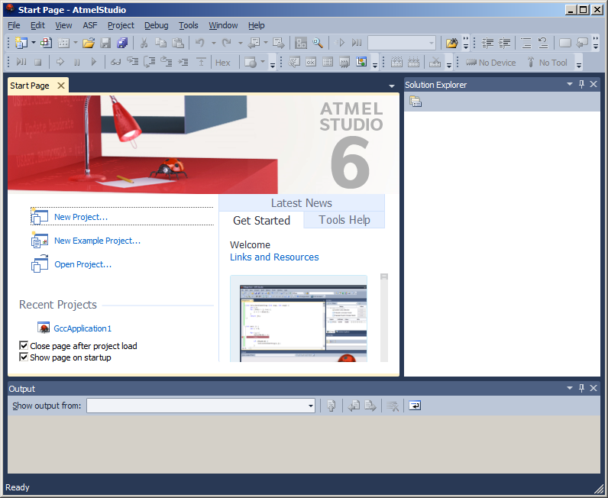
Atmel Studio 6.1 Example
Project – A single application
Can contain many files (.c, .h, etc.)
Solution – Contains all code on a single microcontroller
Can contain many projects
Solution Explorer – Contents of solution
Output – Results of operations

Slide 32
Make a New Project
File->New->Project
Select GCC C Executable Project
Name and Solution Name are the same
Note the location – a directory will be created
Click OK when done

Slide 33
Select Device
Window appears after new project is created
Select device ATmega2560

Slide 34
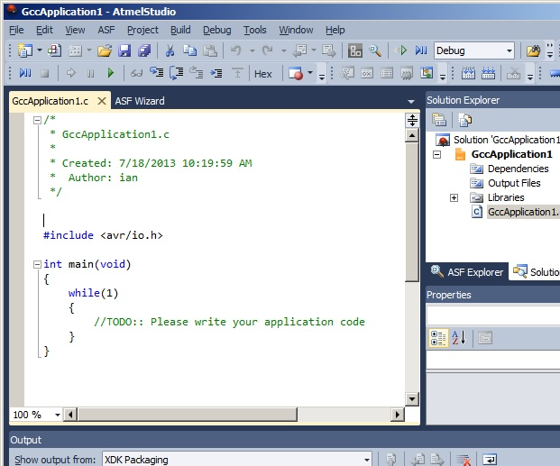
C Code Template
Text editor in upper left corner with program template
Solution Explorer lists all projects/files
Write the C code
Compile: Build->Build Solution
Build Succeeded message at bottom
Should create .elf file in Debug subdirectory of the project

Slide 35
Programming the Board
Plug in the board via USB
Turn on the board
May download drivers if it is the first time
May update firmware
Bring up programming window
Tools->Device Programming

Slide 36
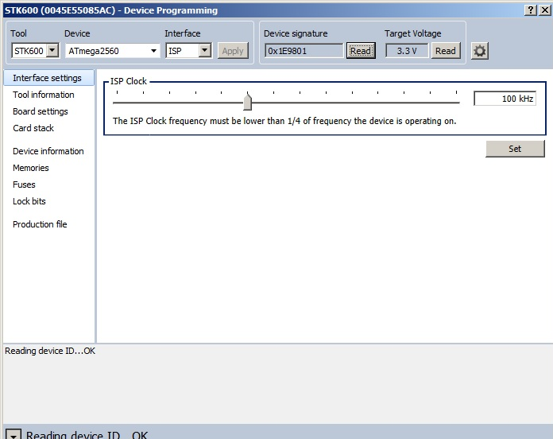
Interface Settings
Select Tool STK600
Select Device ATmega2560
Select Interface ISP
Click Apply
May upgrade firmware
Set ISP clock
100kHz is safe
Read Device ID and Target Voltage
Verifies communication

Slide 37
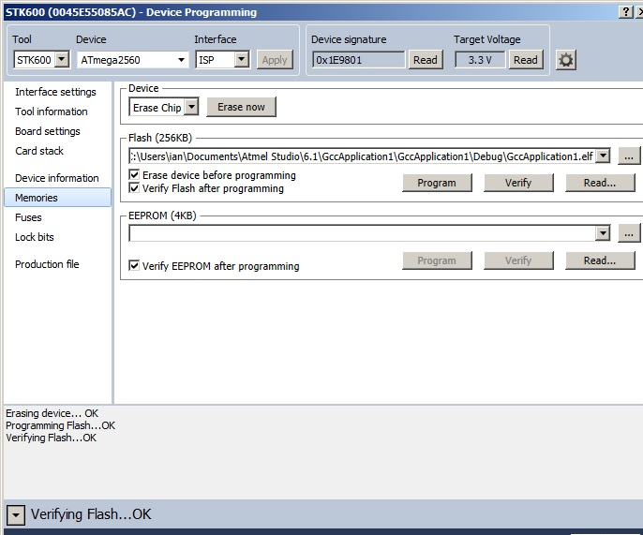
Programming Memory
Must program the .elf file into the Flash memory
Select Memories in left column
Browse to select the .elf file under Flash
In Debug directory
Click Program

Slide 38
Communication Problem
After board is connected, may get an error about “Cannot establish connection to debugging agent” or something like that
May be caused by a firewall
I had this problem with McAfee, not with Avast
Might occur with other anti-virus/firewall tools

