Slide 1
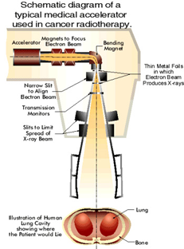
Therac-25
Computer-controlled radiation therapy machine
Massively overdosed 6 people, June 1985–January 1987
Medical linear accelerator
Radiation beam bent and spread using magnets
Controlled by a PDP-11
Dual-mode – electron setting (low energy) or X-ray photon (high energy)
Slides created by:
Professor Ian G. Harris

Slide 2
History of the Device
Therac-6
Photon mode only
Manual device, PDP-11 for convenience
Hardware safety features
Therac-20
Dual mode device
Manual device, PDP-11 for convenience
Hardware safety features
Therac-25
Dual mode device
Automatic device PDP-11 required
Some hardware safety features replaced by software
Slides created by:
Professor Ian G. Harris

Slide 3
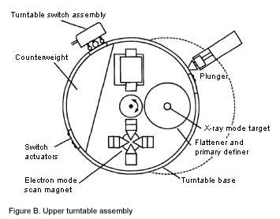
Turntable
Rotates equipment into the beam path
3 modes, 3 sets of equipment
Electron mode – scan magnets to spread beam
X-ray photon mode – flattener needed to focus and weaken beam
Very high energy beam
Field light position – mirror needed to pass light
Mirror
Turntable in the wrong position = Death
Slides created by:
Professor Ian G. Harris

Slide 4
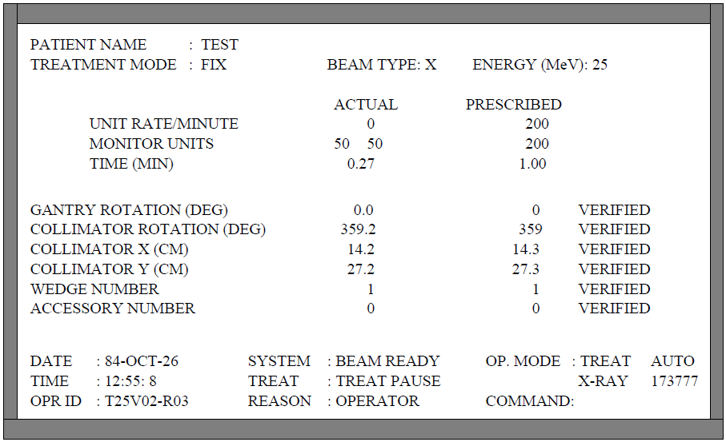
Basic Operation
Operator enters desired parameters
Each parameter is verified by sensors
After all parameters are verified, operator can type ‘p’ for ‘proceed’
Treatment Pause shutdown
Small parameter variation
Wait 5 secs, press ‘p’
Treatment Suspend shutdown
Major problem
Must reset system
Slides created by:
Professor Ian G. Harris

Slide 5
Therac-25 Software
Borrowed code from Therac-20
Assumed that the code was good
Ignored the fact that hardware safety had been removed
Written in PDP 11 assembly code
Real-time OS developed for this device
Preemptive, priority scheduling algorithm
0.1 second time quantum
Slides created by:
Professor Ian G. Harris

Slide 6
Software Tasks
Critical Tasks
Treatment Monitor – manages all stages of the setup and treatment process
Servo Task – controls gun emission, dose rate, beam steering, and machine motions
Housekeeper Task – performs checks of system status, limits, displays messages to CRT
Non-Critical Tasks
Keyboard processor
Screen processor
Hand task – set turntable to proper position for selected mode/power
Slides created by:
Professor Ian G. Harris

Slide 7
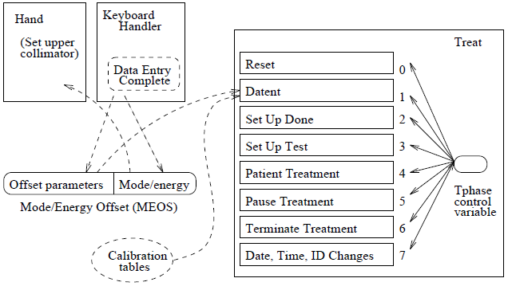
Data Entry Process
Treat task accepts data in the Datent state
Keyboard handler writes data to the MEOS structure
Hand task uses low byte of MEOS to rotate turntable
Keyboard handler assumes that: data entry is complete when the cursor is at the bottom of the page
Does not consider parameter corrections
Slides created by:
Professor Ian G. Harris

Slide 8
Data Entry Complete
When data entry is complete, Datent does the following
Calls MAGNET subroutine to adjust bending magnets
Move to Set Up Test state (apply radiation)
MAGNET subroutine takes time (8sec), calls Ptime for each magnet
Ptime exits if MEOS is changed, but only on the first call to Ptime
If MEOS changes during calls to Ptime (other than the first), the change is not registered by Hand
Possible Error
Operator sets field light mode by mistake
Turntable rotates to mirror
Operator quickly changes mode to photon mode
X-ray photons are emitted with no attenuation
Slides created by:
Professor Ian G. Harris

Slide 9
Software Problems
Bytes of MEOS can be non-correlated
Offset parameters byte can be updated while mode/energy byte changes are ignored
Access to MEOS should be mutually exclusive
No read access while data entry is not complete
Proper detection of Data Entry Complete
Solution
“the key for moving the back through the prescription sequence must not be used for editing or any other purpose.”
Slides created by:
Professor Ian G. Harris

Slide 10
Second Bug
Occurred during the Set Up Test phase, after Datent
Each pass through Set Up Test increments the turntable position check variable Class3
If Class3 is non-zero then the turntable position must be checked to match the parameters
Set Up Test is executed hundreds of times
Rescheduled waiting for other events
Class3 is 1 byte long
Every 256th pass through Set Up Test, checking is not performed
If the operator presses “set” on pass 256, turntable position can be in field light position
Slides created by:
Professor Ian G. Harris

Slide 11
Hardware Abstraction
A processor may use many types of I/O devices
Each device has a different interface
Look at the datasheets
Applications cannot handle variations in hardware
There are far too many
Operating systems abstract hardware details from user processes
Disk vs. USB flash – no difference
Slides created by:
Professor Ian G. Harris

Slide 12
Device Drivers
A uniform interface (mostly) for the interaction between SW and HW devices
User Application
“Hello, world.”
User
Space
Library Function
printf
System Call
vfprintf
Kernel
Space
Device Driver
HDMI or UART driver
HW
HDMI or UART port
Slides created by:
Professor Ian G. Harris

Slide 13
Functions of Device Drivers
Initialize the device
Accept read/write requests from the layer above
Check validity of input parameters
Add device-specific detail to requests
Disk write – track, sector, cylinder number
Check if device is in use
Control the device
Conform to device input protocol (SATA, I2C, …)
Respond to device
i.e. accept incoming network message
Slides created by:
Professor Ian G. Harris

Slide 14
Device Driver Implementation
System Call
HW Device
void vfprintf (…) {
open(device);
…
write(device,data);
Device Driver
I/O protocol
VGA Controller
IC
Interrupts
Interface to system calls is defined as a standard set of functions
Driver code must convert system requests into I/O signaling in the protocol of the device
Must respond to interrupts from the device
Driver may include interrupt service routines
Slides created by:
Professor Ian G. Harris

Slide 15
Device Driver Protocol
Structure for the behavior of a device driver
Each interface function in the driver should write appropriate data into the device registers
Most devices have registers to accept commands
Typically write to them using standard bus protocol (I2C, etc.)
After writing a command, verify that command is accepted
Check error conditions (ACK or NACK, etc.)
Synchronize with the device I/O
Block or not, wait for interrupt or not
Several options on this
Slides created by:
Professor Ian G. Harris

Slide 16
File System Interface
All devices look like files on a linux system
Special files are created, usually in the /dev directory
Device interaction is the same (mostly) as file interaction
User programs
System calls
fd=open(“/dev/abc”)
read(fd)
write(fd,dat)
close(fd)
Virtual File System Switch
Device driver routines
abc_open()
abc_read()
abc_write()
abc_close()
Hardware
Slides created by:
Professor Ian G. Harris

Slide 17
Driver Routine Execution
Execute as part of the operating system
Need highest access to interact with HW
Can be compiled into the kernel
Common on embedded systems
Drivers are fixed
Can be loaded dynamically
Loadable Kernel Modules (LKM) in linux
Bugs in drivers can be damaging
Same access as OS
Security vulnerabilities are an issue
Slides created by:
Professor Ian G. Harris

Slide 18
Types of Devices
Three types depending on how data is transferred
Character Device
Can read and write individual characters efficiently to this device
Block Device
More efficient to read/write blocks of data (i.e. disk drives)
I/O buffering is commonly used
Network Device
Device needs to be services periodically
Interrupts are needed
Slides created by:
Professor Ian G. Harris

Slide 19
Major and Minor Numbers
Each device is assigned a major number which indicates the device type and its driver
Minor number is the specific device within the major number
Name | Create/Owner | Permissions | Major | Minor
/dev/usbmon0 | root, root | crw------- | 252 | 0
/dev/usbmon1 | root, root | crw------- | 252 | 1
Slides created by:
Professor Ian G. Harris

Slide 20
Device Driver Interface
Each device must implement an interface according to its type
Character drivers implement the file_operations interface
struct file_operations {
ssize_t (*read) (struct file *, char *, size_t, loff_t *);
ssize_t (*write) (struct file *, const char *, size_t, loff_t *);
int (*ioctl) (struct inode *, struct file *, unsigned int, unsigned long);
int (*open) (struct inode *, struct file *);
int (*release) (struct inode *, struct file *);
…
};
open, release, read, write are the basics
Slides created by:
Professor Ian G. Harris

Slide 21
Driver Routine Example
Need a driver for an SRAM chip connected via I2C
We did this before
Philips PCF8570, 256 locations, 8-bit
Decide how to map device access to file access operations
Device is random access but files are sequential access
Solution: Make device sequential access
Maintain readPtr and writePtr for next read/write access address
Read operation reads from readPtr++
Write operation writes to writePtr++
Slides created by:
Professor Ian G. Harris

Slide 22
open and release
Note: This is a simplified version
Driver-specific data structure in the inode, mem_dev
int mem_open(struct inode *inode, struct file *file){
mem_dev->readPtr = 0;
mem_dev->writePtr = 0;
return 0;
}
int mem_release(struct inode *inode, struct file *fd){
return 0;
}
Slides created by:
Professor Ian G. Harris

Slide 23
write considerations
Write takes 4 arguments
struct file *fp: file pointer (not needed)
char *buf: buffer to write to device
size_t count: number of bytes to write to device
loff_t *ppos: Position in device to write to
Should be mem_dev->writePtr
Copying data requires special functions
User space and kernel space may have different memory mappings
May not trust pointers provided by user app
copy_to_user(), copy_from_user()
Slides created by:
Professor Ian G. Harris

Slide 24
write implementation
WriteMTSR writes a char to an I2C slave at the given address
MEM_I2C_ADDR is the I2C address of the memory
Must update *ppos
int mem_write(struct file *fp, char *buff, size_t cnt,
loft_t *ppos){
char data;
for (int i=0; i<cnt; i++) {
copy_from_user(&data, buff+cnt, 1);
WriteMTSR(MEM_I2C_ADDR, (*ppos)++, data);
}
return 0;
}
Slides created by:
Professor Ian G. Harris

Slide 25
init Function
init is called when the driver is loaded
Or during boot for a static driver
Responsibilities:
Associating a device major number with the driver
Allocating memory for the per-device structure
Connecting the entry points (open(), read(), etc.) with the driver
Initializing hardware
Check if it exists
Slides created by:
Professor Ian G. Harris

Slide 26
register_chrdev Function
Registers the driver with the virtual file system switch (VFS)
struct file_operations mem_fops = {
NULL, /* lseek() */
mem_read, /* read() */
mem_write, /* write() */
…
};
long mem_init(long kmem_start) {
printk("Sample Device Driver Initialization\n");
if (register_chrdev(22, “mem", &mem_fops))
printk("error--cannot register!\n");
TurnOnI2C();
return 0;
}
Slides created by:
Professor Ian G. Harris

Slide 27
Buffered I/O
Kernel copies the write data to a block of memory (buffer):
Allow the process to write bytes to the buffer and continue processing
Buffer does not need to be written to the disk … yet
Read operation:
When the device is ready, the kernel places the data in the buffer
Why is buffering important?
Deals with device burstiness
Rate mismatch between host and device
Caching (for block devices)
Alignment (for block devices)
Modified version of slide by Paul Krzyzanowski

Slide 28
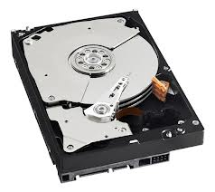
Buffer Cache
Pool of kernel memory to hold frequently used blocks from block devices
Minimizes the number of I/O requests that require device I/O
Allows applications to read/write from/to the device as a stream of bytes or arbitrary-sized blocks
fast
slow
User I/O Requests
Buffer Cache
Device Block I/O Requests
Modified version of slide by Paul Krzyzanowski

