Slide 1
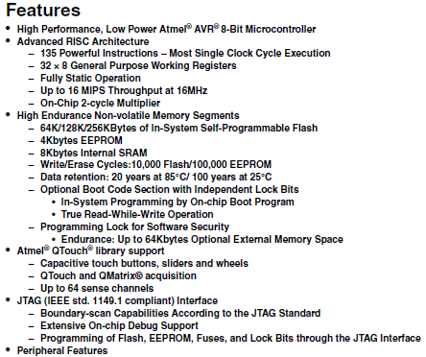
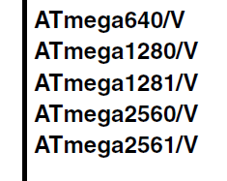
ATmega 2560 Datasheet
Main features are listed
Multiple similar parts described in one datasheet

Slide 2
ATmega 2560 Pins
Fixed-Use pins
VCC, GND, RESET
XTAL1, XTAL2 - input/output for crystal oscillator
AVCC - power for ADC, connect to VCC
AREF - analog reference pin for ADC
General-Purpose ports
Ports A-E, G, H, J, L
Ports F and K are for analog inputs
All ports are 8-bits, except G (6 bits)

Slide 3
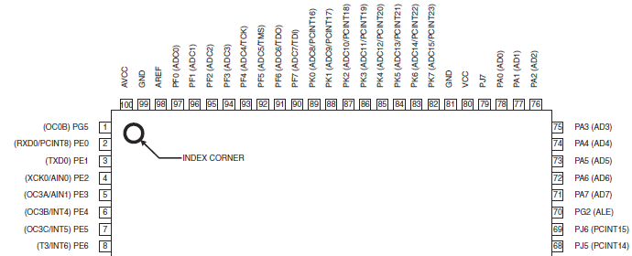
ATmega 2560 Pin Positions
Pin positions are always in the datasheet
Many pins have multiple functions/names

Slide 4
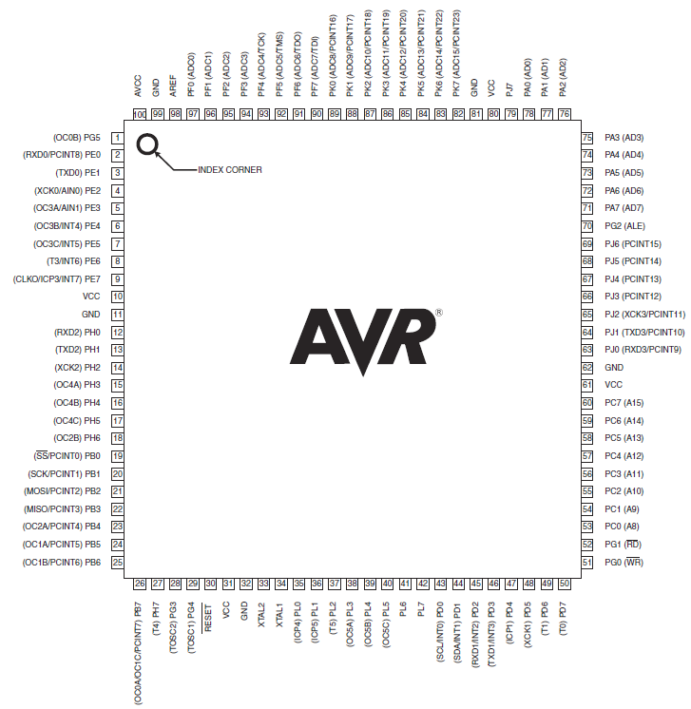
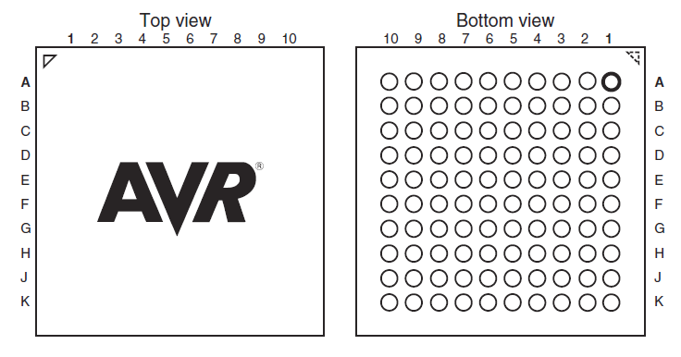
IC Packages
Thin quad flat pack (TQFP)
Ceramic ball grid array (CBGA)
Package determines IC dimensions, pin size/spacing
Surface mount packages are very small
ICs are often available in multiple packages

Slide 5
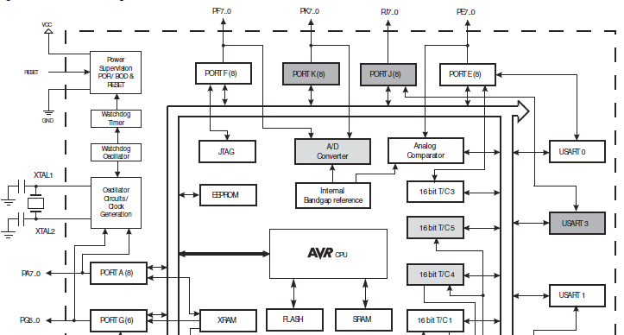
ATmega 2560 Architecture
Shows connectivity between peripherals, memory, I/O, bus
CPU core is in the center, executes instructions

Slide 6
Pin Descriptions
Function of each pin is described
Descriptions are brief, assuming an understanding of the part
Almost all pins can be accessed on the STK 600

Slide 7
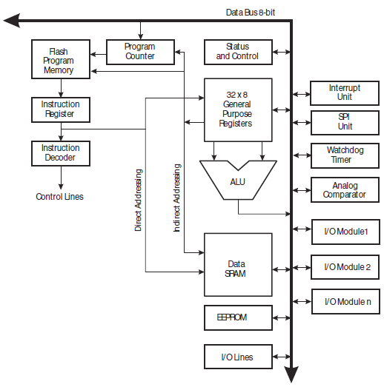
AVR CPU Core
Common CPU for all AVR parts
Ex. add $r1, $r2, $r3
Read instruction from program memory
Load instr. into instr. Register
Get source register numbers from instruction
Fetch source data from register file
Pass sources to ALU, add
Pass result to register file

Slide 8
AVR Status Register
Records “interesting events” which must be handled
Sign bit, carry flag, overflow flag, negative flag, zero flag, etc.
May be used as branch conditions or to trigger interrupts

Slide 9
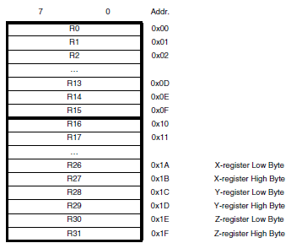
General Purpose Registers
32 8-bit registers
Used by the compiler
X, Y, and Z registers are 16-bits long
XH, XL, etc.
Used to address memory (64K)

Slide 10
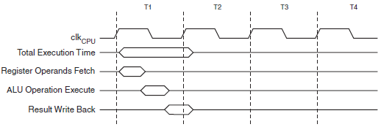
Instruction Execution Timing
Two-stage pipeline, fetch, and execute
Register fetch, execute, and write back, all in one clock cycle

Slide 11
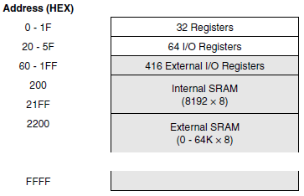
SRAM Organization
64K addressable memory
Registers mapped to beginning addresses
Internal SRAM mapped in the middle
External SRAM mapped at the end

Slide 12
I/O Pins, Output Path
DDRx
PORTx

Slide 13
I/O Pins, Input Path
PINx

Slide 14
I/O Control Registers
DDRx – Controls the output tristate for port x
DDRx bit = 1 makes the port x an output pin
DDRx bit = 0 makes the port x an input pin
Ex. DDRA = 0b11001100, outputs are bits 7, 6, 3, and 2
PORTx – Control the value driven on port x
Only meaningful if port x is an output
Ex. PORTA = 0b00110011 assigns pin values as shown
PINx – Contains value on port x
Ex. Q = PINC;

Slide 15
Typical Embedded C Program
#include <stdio.h>
main() {
// initialization code
while (1) {
// main code
}
}
#include is a compiler directive to include (concatenate) another file
main is the function where execution starts

Slide 16
C Syntax Basics
Comments: single line //, multiline /* … */
Semicolon used to terminate all statements
# indicates a compiler directive (include, define, etc.)
Brackets { … } group lines of code for execution
Blankspace between lines is not important in C
_{Still need to separate tokens}
int a, b, c;
a = b + c;
int a,b,c;a=b+c;
inta,b,c;a=b+c;
correct
correct
incorrect (inta)

Slide 17
Variables
All variables’ types must be declared
Memory space requirements known statically
Type checking can be performed at compile-time
Numerical Types: int, float, double
Other types: char, void
Type qualifiers: short, long, unsigned, signed, const
Specify alternate sizes, constrain use modes

Slide 18
Variable Declaration
Static allocation vs. Dynamic allocation
Static dedicates fixed space on the stack
int i;
Dynamic (malloc) allocates from the heap at runtime
ptr = malloc(32);
Type sizes depend on the architecture
On x86, int is 32 bits
On ATmega2560, int is 16 bits
char is always 8 bits

Slide 19
Volatile Variables
The value of a volatile variable may change at any time, not just at an explicit assignment
Also, may be read at any time
Compiler optimizations are not applied to volatile variables
for (i=0; i<10000; i++);
An optimizing compiler would delete this loop
i is not used anywhere in the code
i = 1; … i = 1;
If i is not modified in between, the second assignment is removed

Slide 20
Volatile Variables
When can variables be used without an explicit assignment?
1. Memory-mapped peripheral registers
2. Global variables modified by an interrupt service routine
3. Global variables accessed by other processors

Slide 21
Volatile Example
periph is the mapped address of the peripheral status info
*periph is assigned by peripheral directly
.
.
while (*periph != 1); // wait until data transfer
. // is complete
.
Compiled code will move memory contents to a register
Memory will only be moved once because *periph does not change

Slide 22
Base Representation
Base 10 is default
Base can be specified with a prefix before the number
Binary is 0b, Hexadecimal is 0x
Ex. char x = 0b00110011;
char x = 0x33;
Binary is useful to show each bit value
Hex is compact and easy to convert to binary
1 hex digit = 4 binary digits

Slide 23
Types of Statements
Assignment – =
Relational - <, >, ==, !=
Control Flow – if, for, while, do, switch
Arithmetic Operations - +, -, *, /, %
Logical Operations - &&, ||, !
Bitwise Logical Operations - &, |, ^

Slide 24
Logical Operators
These operators accept binary input and produce binary output
&&, ||, !
Non-binary inputs are cast to binary values
int a=1, b=0; c=56; d=-1, res;
res = a && b; // res = 0
res = a || b; // res = 1
res = c && d; // res = 1

Slide 25
Bitwise Operations
Treat the value as an array of bits
Bitwise operations are performed on pairs of corresponding bits
X = 0b0011, Y = 0b0110
Z = X | Y = 0b0111
Z = X & Y = 0b0001
Z = X ^ Y = 0b0101
Z = ~X = 0b1100
Z = X << 1 = 0b0110
Z = x >> 1 = 0b0001

Slide 26
Bit Masks
Need to access a subset of the bits in a variable
Write or read
Masks are bit sequences which identify the important bits with a ‘1’ value
Ex. Set bits 2 and 4 in X, don’t change other bits
X = 01010101, mask = 0010100
X = X | mask
Ex. Clear bits 2 and 4
mask = 11101011
X = X & mask

Slide 27
Bit Assignment Macros
#define SET_BIT(p,n) ((p) |= (1 << (n)))
#define CLR_BIT(p,n) ((p) &= (~(1) << (n)))
1 << (n) and ~(1) << (n) create the mask
Single 1 (0) shifted n times
Macro doesn’t require memory access (on stack)

Slide 28
Header Files
Files included at the top of a code file
Traditionally named with .h suffix
Include information to be shared between files
Function prototypes
externs of global variables
Global #defines
Needed to refer to libraries

Slide 29
Function Calls
Functions enable simple code reuse
Control moves to function, returns on completion
Functions return only 1 value
main() {
int x;
x = foo( 3, 4);
printf(“%i\n”, x);
}
int foo(int x, int y) {
return (x+y*3);
}

Slide 30
Function Call Overhead
Program counter value needs to be restored after call
Local variables are stored on the stack
Function calls place arguments and return address on
the stack
main() {
int x;
x = foo(2);
printf(“%i\n”, x);
}
20:
21:
22:
103: | 3 | local var
102: | 2 | argument
101: | 21 | return addr
100: | 2 | local var
int foo(int x) {
int y=3;
return (x+y*3);
}
30:
31:

Slide 31
Embedded Toolchain
A toolchain is the set of software tools which allow a program to run on an embedded system
Host machine is the machine running the toolchain
Target machine is the embedded system where the program will execute
Host has more computational power then target
We are using the GNU toolchain
Free, open source, many features

Slide 32
Cross-Compiler
A compiler which generates code for a platform different from the one it executes on
Executes on host, generates code for target
Generates an object file (.o)
Contains machine instructions
References are virtual
Absolute addresses are not yet available
Labels are used instead

Slide 33
Cross-Compiler Example
ABBOTT.c
int idunno;
…
whosonfirst(idunno)
…
COSTELLO.c
int whosonfirst(int x)
{
…
}
Cross- compiler
Cross- compiler
ABBOTT.o
…
MOVE R1, (idunno)
CALL whosonfirst
…
COSTELLO.o
…
…
whosonfirst:
…
Idunno, whosonfirst
Unknown addresses

Slide 34
Linker
Combines multiple object files
References are relative to the start of the executable
Executable is relocatable
Typically need an operating system to handle relocation

Slide 35
Linker Example
ABBOTT.o
…
MOVE R1, (idunno)
CALL whosonfirst
…
COSTELLO.o
…
whosonfirst:
MOVE R5, R1
…
Linker
HAHA.exe
…
MOVE R1, 2388
CALL 1547
…
MOVE R5, R1
…
(value of idunno)
Functions are merged
Relative addresses used
1547
2388

Slide 36
Linker/Locator
Links executables and identifies absolute physical addresses on the target
Locating obviates the need for an operating system
Needs memory map information
Select type of memory to be used (Flash, SRAM, …)
Select location in memory to avoid important data (stack, etc.)
Often provided manually

Slide 37
Segments
Data in an executable is typically divided into segments
Type of memory is determined by the segment
Instruction Segment - non-volatile storage
Constant Strings – non-volatile storage
Uninitialized Data – volatile storage
Initialized Data – non-volatile and volatile
Need to record initial values and allow for changes

Slide 38
AVR GNU Toolchain
Cross-Compiler: avr-gcc
Linker/Locator: avr-ld
Cross-Assembler: avr-as
Programmer: avrdude
All can be invoked via Atmel Studio 6

Slide 39
Controlling Pins
int main (void) {
DDRA = 0xFF; // Set pins to OUTPUT
while (1) {
PORTA = 0xFF;
}
}

