Slide 1
Interrupts
Embedded systems often perform some tasks which are infrequent and possibly unpredictable
Hang up a VOIP phone when receiver is dropped
Apply brakes when brake pedal is pressed
Regular tasks must be temporarily stopped to deal with the event
Interrupts are the unusual events
Interrupt handlers, or interrupt service routines, are programs which perform necessary tasks

Slide 2
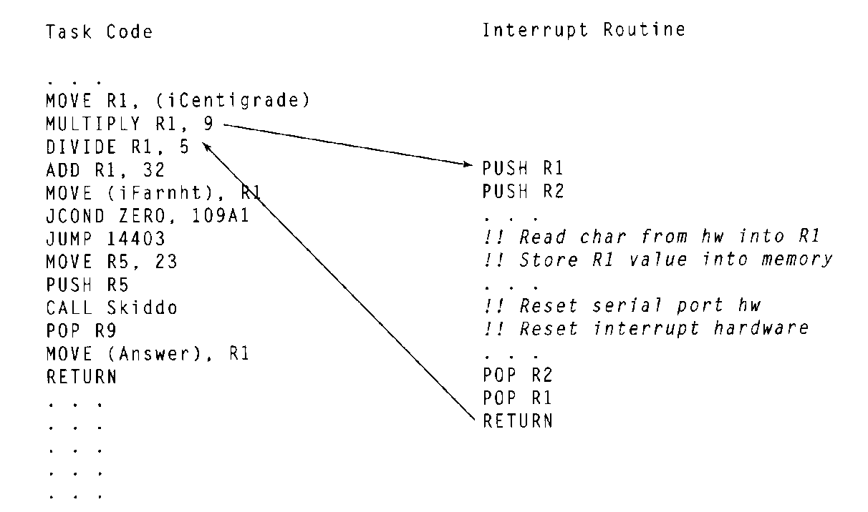
Interrupt Handling
Interrupt can be invoked at any time
Regular code must stop for a while

Slide 3
Saving and Restoring Context
Interrupt should not interfere with normal tasks
Need to save all used registers at the beginning and restore them at the end
Stack is typically used for temporary storage
Last in, first out (LIFO)
push, pop

Slide 4
Disabling Interrupts
Some events should be ignored completely
Some tasks are time-critical and should not be interrupted
X-ray emitter in radiation therapy
Interrupts can be disabled (usually by setting a register)
Nonmaskable interrupt cannot be disabled
For critical events (like loss of power)

Slide 5
Interrupt Vectors
Interrupt vector is a pointer to an interrupt in memory
Interrupt number is used to index the table
Interrupt vector table holds pointers to all interrupts
Table location may be fixed or placed in a known register

Slide 6
Shared-Data Problem
Interrupts should not change data that the another task is using
Main Task
Interrupt
R1 = 3 + 5;
R1 = R1 / 2;
print R1
R1 = R1 + 1
Saving and restoring registers helps
Cannot do the same for memory
- Hard to predict which locations to save

Slide 7
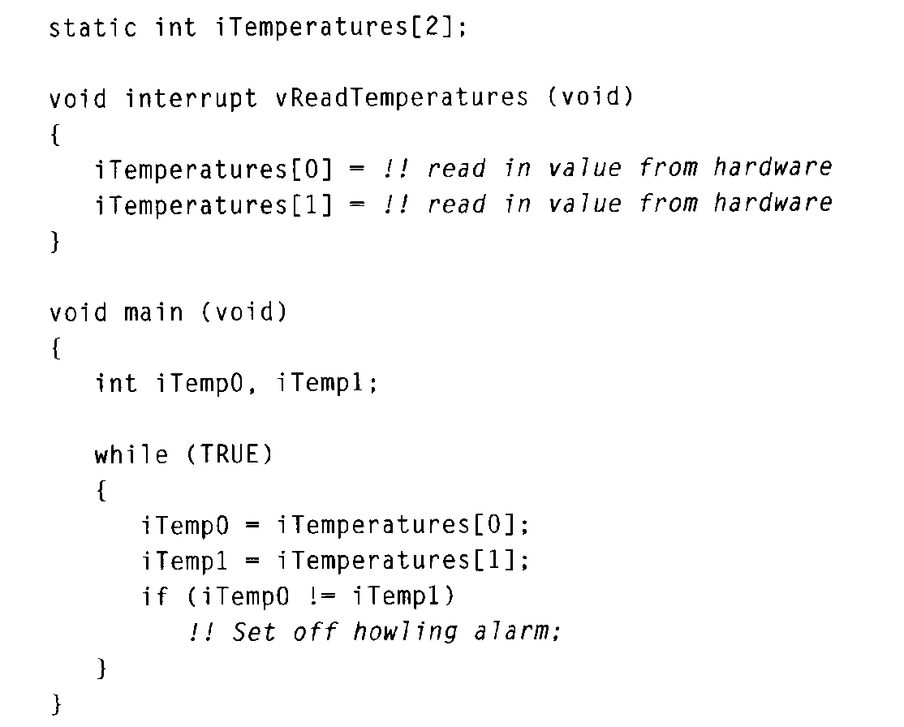
Shared-Data Example
Main task checks two temperatures to make sure they are equal
Interrupt reads the two temperatures periodically
Interrupt can make the temperatures seem out of sync
Bugs are intermittent

Slide 8
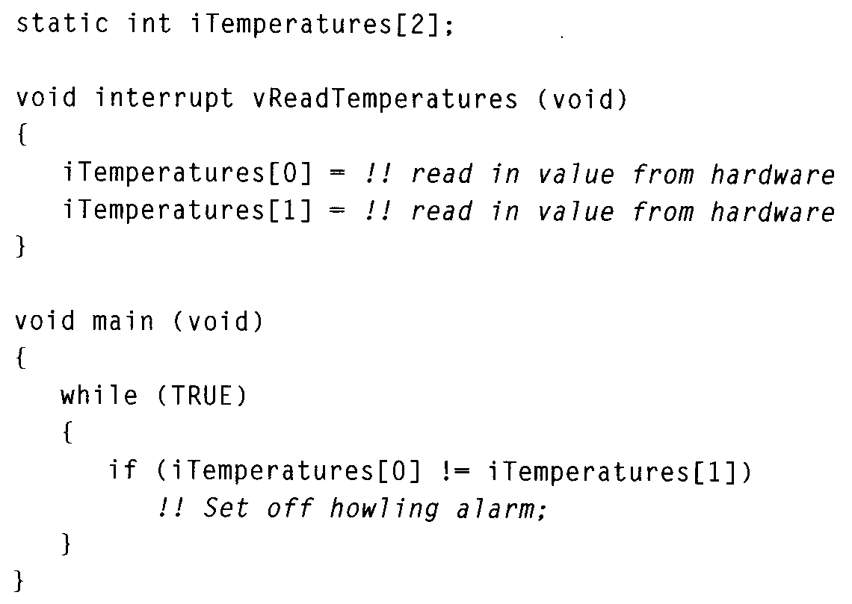
Shared-Data Fix?
Maybe problem can be fixed
Place read and compare on same line
No, assembly does not match C code

Slide 9
Shared-Data Solution
Identify each critical region where interrupts could be disruptive
Identify code regions that use memory written by an interrupt
Reading more than one address can lead to inconsistency
Disable interrupts before the region, enable interrupts after

Slide 10
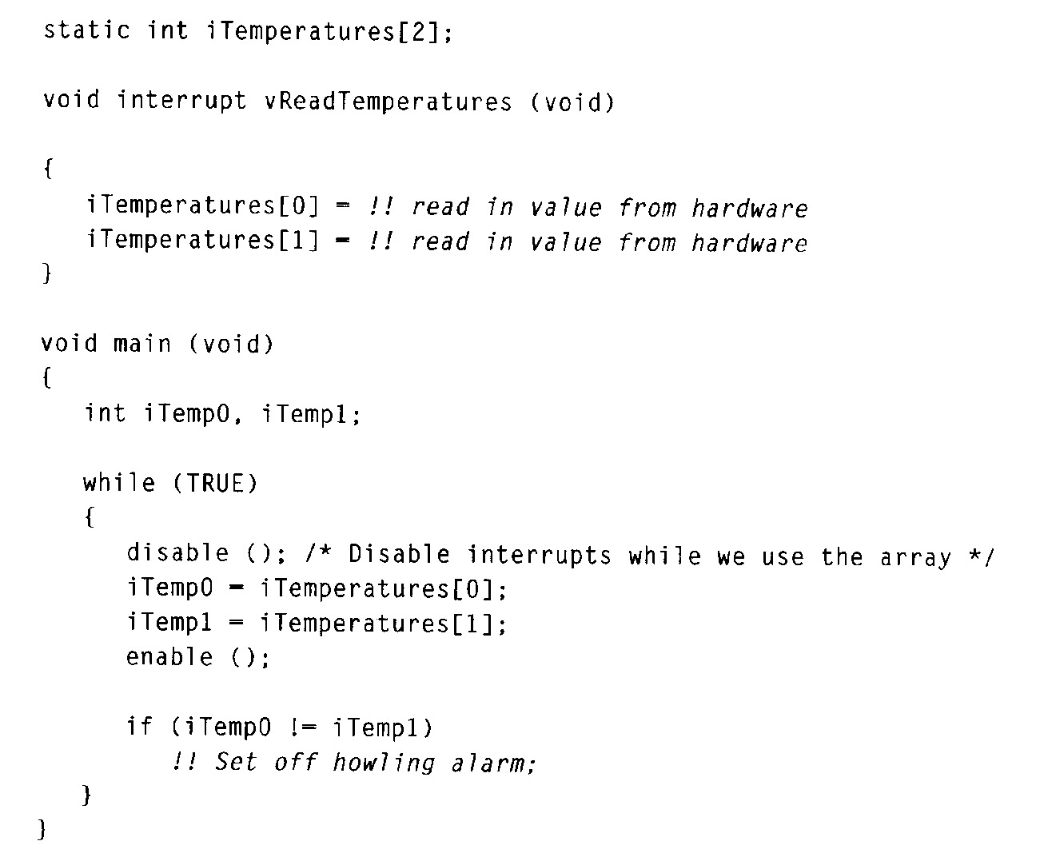
Shared-Data Solution Example
Critical region is where temps are both read by main task
Data reading is “atomic”

Slide 11
Nested Critical Regions
void functionA(void)
{
disableInterrupts( );
---
enableInterrupts( ); }
void functionB(void)
{
disableInterrupts( );
---
functionA( );
---
enableInterrupts( );
--- some code which may be interrupted
}
Critical regions inside function calls can conflict
functionA terminates the critical region of functionB early

Slide 12
Possible Nesting Solution
Code can check to see if interrupts are disabled before disabling and then enabling them.
void functionA(void)
{
if (InterruptsDisabled()) dis=0; else dis=1;
if (dis) disableInterrupts( );
--- some code which must not be interrupted
If (dis) enableInterrupts( );
}

Slide 13
Another Nesting Solution
int DisableCnt = 0;
void functionA(void)
{
MyDisable();
--- some code
MyEnable();
}
void MyDisable()
{
disableInterrupts();
DisableCnt++;
}
void MyEnable()
{
DisableCnt--;
If (DisableCnt == 0)
enableInterrupts();
}
Could use a counter in Enable/Disable routine keep track of “levels” of disabling.
Enabled only when all counts are zero.

Slide 14
Interrupt Latency
How quickly does the system respond to an interrupt?
Contributing Factors:
Maximum length of time when interrupts are disabled
Time required to execute higher priority interrupts
Time between interrupt event and running interrupt code
Time required to complete ISR code execution

Slide 15
Reducing Interrupt Latency
Make interrupt code short
Reduces ISR execution time and time for higher priority interrupts
Reduce time during which interrupts are disabled
Minimize size of critical regions

Slide 16
Interrupts in the ATmega
Many possible interrupt sources
One interrupt vector for each source
Interrupt vector table shown in datasheet, Table 13-1
Vector # | Address | Source | Defnition
10 | $0012 | PCINT0 | Pin change interrupt
25 | $0030 | SPI, STC | SPI serial transfer complete
30 | $003A | ADC | ADC conversion complete
Source+”_vect” is the interrupt name recognized by your compiler
Check notes on this (avr-libc manual)

Slide 17
Enabling/Disabling Interrupts
ATmega contains a status register called SREG
Bit 7 of SREG , the I bit, is the Global Interrupt Enable
Clearing I bit disables interrupts, setting I bit enables them
I bit is automatically cleared when an interrupt starts, set when interrupt is done
Interrupts are not interrupted
Use the SEI() and CLI() macros to set and clear in C

Slide 18
Defining Interrupts in C
ISR(vector_name)
- Defines an ISR for vector_name. Updates interrupt vector table automatically.
Ex. ISR(ADC_vect) {
printf(“Hello, world.”);
}
EMPTY_INTERRUPT(vector_name)
- Defines an interrupt which does nothing.
ISR_ALIAS(vector_name, target_vector_name)
- Makes the ISR for vector_name the same as the ISR for target_vector_name.
- Copies a pointer in the interrupt vector table

Slide 19
ATmega Timers
ATmega 2560 has 6 timers, 2 8-bit and 4 16-bit
Detailed descriptions found in the datasheet
Timers can be used to generate interrupts
Can be used to generate pulse width modulated (PWM) signals
PWM good for controlling motors (fake analog output)
We won't look at these functions

Slide 20
General Timer Control
Need to control:
1. Start point of the timer (initial value)
2. “End” point of the timer (when the interrupt is generated)
- May be just overflow event
3. Clock rate timer receives, to increase/decrease count speed
- Typically uses a prescalar
- Slows down clock by dividing down with another counter

Slide 21
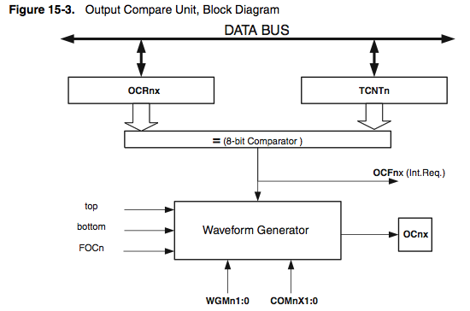
Output Compare Unit
TCNT0 – Value in the counter
OCR0A, OCR0B – Output compare registers
Interrupt can occur when TCNT0 == OCR0A

Slide 22
Interrupt Flags
When an interrupt occurs, a flag bit is set in a register
TIFR0 – Timer/Counter Interrupt Flag Register
- Contains the flags for Output Compare and Overflow
TOV0 – Indicates that timer 0 overflow occurred
OCF0A – Indicates that TCNT0 == OCR0A
OCF0B – Indicates that TCNT0 == OCR0B
All flags are cleared when the interrupt is executed
You should not need to access this register directly

Slide 23
Timer Interrupt Enable
TIMSK0 – Timer/Counter Interrupt Mask Register
- Select which timer interrupts are active
TOIE0 – Timer overflow enable
OCIE0A – Output compare “A” interrupt enable
OCIE0B – Output compare “B” interrupt enable
Need to enable the interrupt you want (in addition to GIE)

Slide 24
Timer Counter Control Registers
TCCR0A and TCCR0B control different aspects of timer function
Compare/Match Output Modes (COM0A1:0)
OC0A is an output pin of the Atmega 2560
Output comparison matching can drive the output pin
Typically used to generate regular waveforms (like PWM)
Can be used to synchronize system components
We will not use this feature

Slide 25
Timer Counter Control Registers
Waveform Generation Modes (WGM2:0)
Specify properties of PWM signals generated
Frequency, width, etc.
We will not use this feature

Slide 26
Timer Counter Control Registers
Force Output Compare (FOC0A, FOC0B)
Forces the output compare to evaluate true, even if it didn't occur
As if TCNT0 == OCR0A or TCNT0 == OCR0B
Used to alter waveform on OCOA or OCOB pins
We will not use this feature

Slide 27
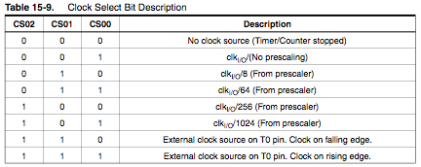
Timer Counter Control Registers
Clock Select (CS0 2:0)
Determine the speed of the clock received by the counter
You will need this

Slide 28
TCCR0A and TCCR0B Format
TCCR0A
Typical value: TCCR0A = 0b00000000;
Do not drive compare/match outputs (OC0A, OC0B)
TCCR0B
Typical value: TCCR0B = 0b00000001; // no prescalar
Last three bits are important, determine prescalar

Slide 29
ATmega Timer Example
#include <avr/interrupt.h>
#define TIMER0_CNT 1000
main( )
{
InitTimer0( ); // initialize hardware
sei( ); // enable interrupts
for ( ; ; )
{
// background code goes here
}
}
ISR(TIMER0_COMPA_vect)
{
// Interrupt handler here
}
Using Timer 0 Match Interrupt

Slide 30
Timer Initialization
void InitTimer0( void )
{
TCCR0A = 0b00000000;
// No compare output, no waveform gen
TCCR0B = 0b00000001;
// No forcing, No prescalar
OCR0A = TIMER0_CNT;
// Load Compare value for timer 0
TIMSK0 = _BV(OCIE0A);
// enable compare-match interrupt
// _BV(n) == (1 << n)
TCNT0 = 0;
// Initialize timer to 0
}

Slide 31
Setting a Specific Delay
Need to compute how many cycles are needed to match required delay
Need clock period T. T = 1/f
Generate a constant square wave of ½ Hz
16-bit timer
50 kHz clock
pre-scaler = up to divide-by-256
What delay is needed?
- 1/½ Hz = 2000ms
- 1000ms delay is needed (invert signal twice a period)

Slide 32
Setting Prescalar
How much prescalar is needed?
- Can the counter count for 1000ms?
- 16 bits, 65,536 is max value
- System clock period is 1/50kHz = 20 microseconds
- 65,536 * 20 microseconds = 1.31 seconds
- 1.31 sec > 1000ms, so no prescalar is needed

Slide 33
Setting Initial Timer Value
Assume that we will use the Timer 0 Overflow interrupt
Need counter to overflow after 1000ms
1000 ms / 20 microsec = 50,000 clocks
Initialize timer to 65,536 – 50,000 = 15,536

