Slide 1
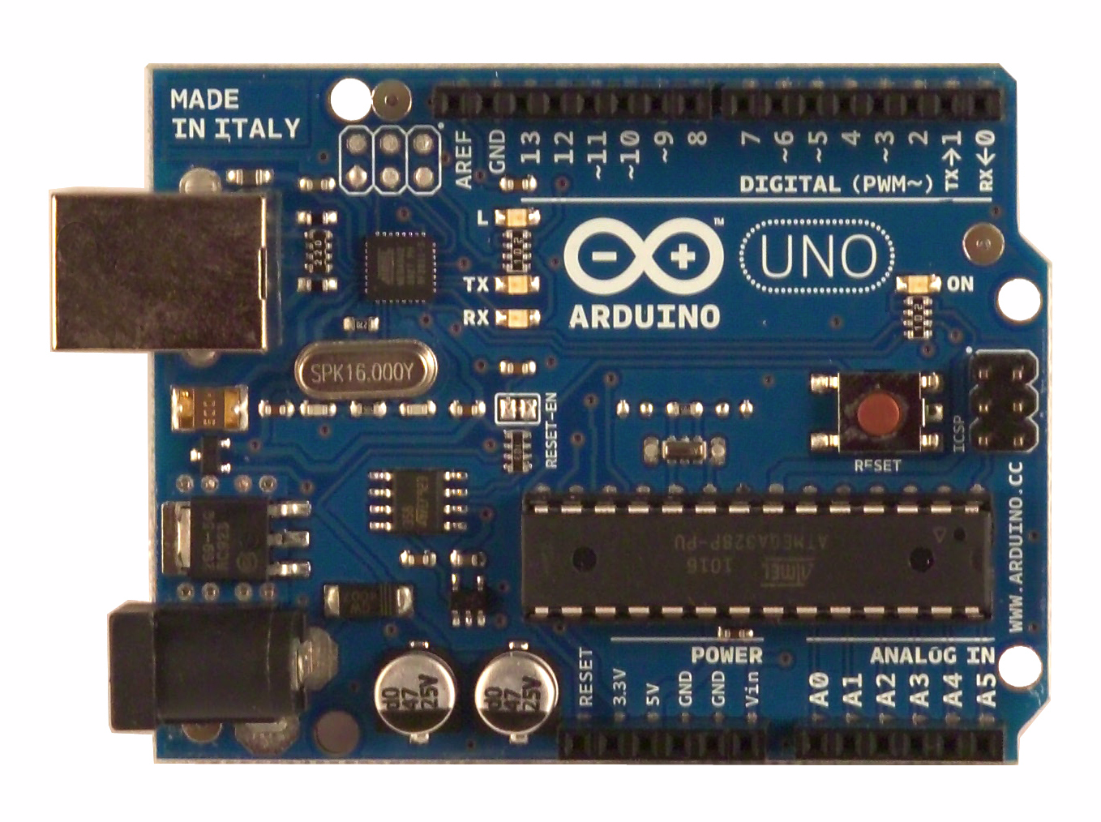
The Arduino Platform
A “development module”
A board with a microcontroller and USB interface to a PC
Large open source community

Slide 2
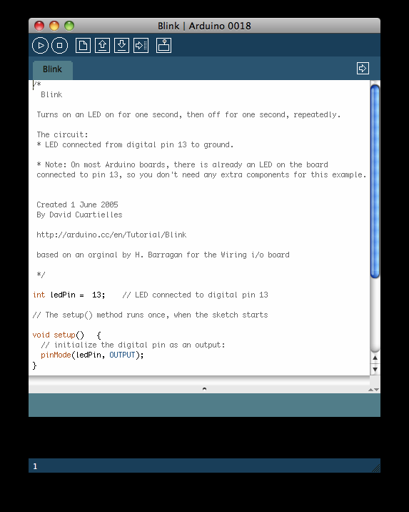
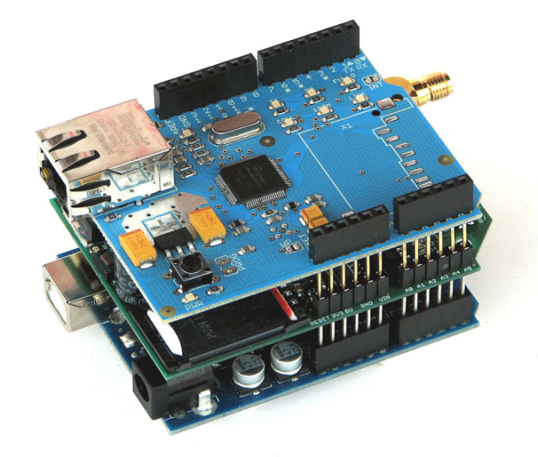
Arduino Environment
A development board
- 8-bit microcontroller
- programming hardware
- USB programming interface
- I/O pins
A software environment
- cross-compiler
- debugger
- simulator
- programmer
Special-purpose “shields”
- daughter boards
- unique functionalities
- easy to attach
- good libraries provided

Slide 3
Arduino Hardware
Microcontroller | ATmega328
Operating Voltage | 5V
Input Voltage (recommended) | 7-12V
Input Voltage (limits) | 6-20V
Digital I/O Pins | 14 (of which 6 provide PWM output)
Analog Input Pins | 6
DC Current per I/O Pin | 40 mA
DC Current for 3.3V Pin | 50 mA
Flash Memory | 32 KB (ATmega328) of which 0.5 KB used by bootloader
SRAM | 2 KB (ATmega328)
EEPROM | 1 KB (ATmega328)
Clock Speed | 16 MHz
Typical of an 8-bit processor
- low speed, low memory
- low cost ($1.50 for the microcontroller, $40 for the board)

Slide 4
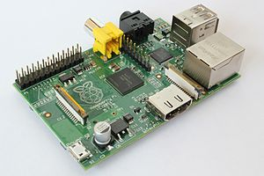
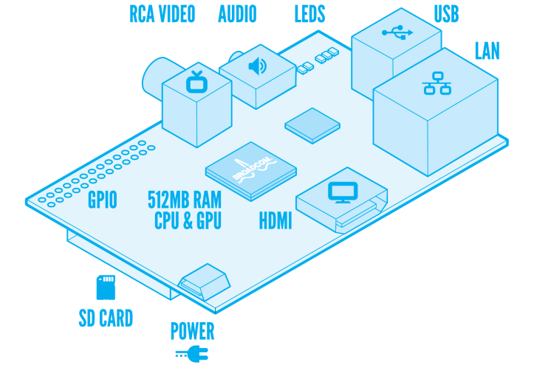
Raspberry Pi
32-bit processor
Broadcom BCM2838 SoC, ARM11
700 MHz clock
512 MB RAM
Broadcom VideoCore IV GPU
SD card slot, no flash built-in
Ports: USB (2), HDMI, RCA audio/video, SD, Ethernet, 2x13 pins
MIPI Camera Interface
Size of a credit card
$35

Slide 5
Raspberry Pi Software
32-bit machine, can support an operating system
Arch linux, Debian, Fedora, Slackware, etc.
A bit slow for development
Hard to run GUI, IDE
Cross compile with crosstool-ng toolchain or gcc-linaro-arm-linux
Easy Python programming interface is available

Slide 6
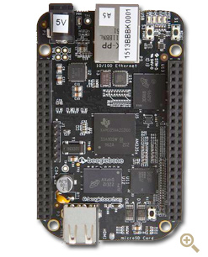
BeagleBone Black
TI Sitara AM3359 ARM Cortex-A8
32-bit processor
1 GHz clock
512 MB RAM
2GB on-board flash
3D graphics accelerator
Ports: USB, Ethernet, HDMI, 2x46 pins
$45 cost, almost the same as an Arduino

Slide 7
Beagle Software Environment
Several versions of linux are ported
Ubuntu, Angstrom, Android …
A bit slow for development
Hard to run GUI, IDE
Cross compile with gcc-arm toolchain
BoneScript (JavaScript) library is provided for simplicity
Uses an interpreter

Slide 8
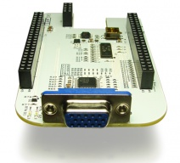
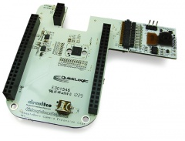
BeagleBone “Capes”
DVI-D Cape
VGA Cape
Camera Cape
Application-specific, stackable, daughter boards
Just like Arduino shields
Come with libraries

Slide 9
UART/USART
Universal Asynchronous Receiver/Transmitter
Used for serial communication between devices
UART is asynchronous, no shared clock
Asynchronous allows longer distance communication
Clock skew is not a problem
USART is the synchronous version of UART
Common clock is needed
NVIDIA® Tegra™ 250
NVIDIA® Tegra™ 250

Slide 10
Serial Protocols
Data is transmitted serially
Only 1 bit needed (plus common ground)
Parallel data transmitted serially
Original bytes/words regrouped by the receiver
Many protocols are serial to reduce pin usage
Pins are precious

Slide 11
UART Applications
Used by modems to communicate with network
Computers used to have an RS232 port, standard
Not well used anymore, outside of embedded systems
Replaced by USB, ethernet, I2C, SPI
Simple, low HW overhead
Built into most microcontrollers
Slides created by:
Professor Ian G. Harris

Slide 12
Simple UART Structure
Parallel In
Parallel Out
Tx
Serial Out
Serial In
Rx
status
status
Data is serialized by Tx, deserialized by Rx
Status indicates the state of the transmit/receive buffers
Used for flow control
Slides created by:
Professor Ian G. Harris

Slide 13
UART Timing Diagram
8 bits
1 bit
First bit is the Start Bit, initiates the transfer
Next bits are the data
Last are the Stop Bits
Slides created by:
Professor Ian G. Harris

Slide 14
Bit Duration
Each bit is transmitted for a fixed duration
The duration must be known to Tx and Rx
Baud Rate (f) determines the duration (T)
Baud Rate is the number of transitions per second
Typically measured in “bits per second (bps)”
T = 1/f
Ex. F = 9600 baud, T = ~104 microsec
Transmission rate is less than baud rate
Need start bit, stop bits, parity bit
Slides created by:
Professor Ian G. Harris

Slide 15
UART Synchronization
Receiver must know the exact start time
Imprecise start time corrupts data
Expected Bit, correct
bit 7
bit 8
stop
1
0
stop
Expected Bit, incorrect
bit 7
bit 8
stop
Slides created by:
Professor Ian G. Harris

Slide 16
Start Bit, Synchronization
Detection of the start bit is used to synchronize
Synchronization based on falling edge of start bit
Start bit is a falling edge
Following 0 must be long duration to screen out noise
Receiver samples faster than baud rate (16x typical)
Start bit is indicated by a 0 of at least half period
Just a glitch
Start bit detected
Slides created by:
Professor Ian G. Harris

Slide 17
Parity Bit
Transmission medium is assumed to be error-prone
E-M radiation noise, synchronization accuracy
Parity bit may be transmitted to check for errors
Even Parity: Number of 1’s is even
Odd Parity: Number of 1’s is odd
Parity bit is added to ensure even/odd parity
After data, before stop bit(s)
Ex. Assume Odd Parity, Data = 011011010
Parity bit = 0, total parity is odd
Slides created by:
Professor Ian G. Harris

Slide 18
Stop Bit
Stop Bit
8 bits
1 bit
Receiver expects a 1 after all data bits and parity bits
If 1 is not received, error has occurred
Slides created by:
Professor Ian G. Harris

Slide 19
Data Throughput vs. Baud
Every transmission involves sending signaling bits
Stop, start, parity
Data throughput rate is lower than baud rate
Signaling bits must be sent
Ex. 8 data bits, 1 parity bit, baud rate = 9600
Send 11 bits to send 8 data bits
Transmission efficiency = 8/11 = 73%
Data throughput rate = 9600 * 0.73 = 6981.8 bps
Slides created by:
Professor Ian G. Harris

Slide 20
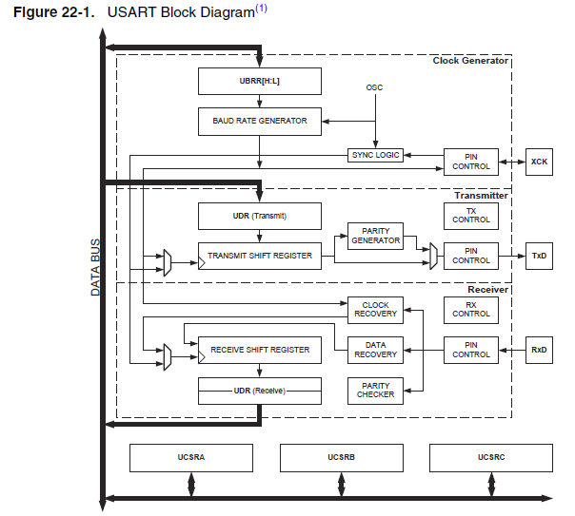
USART HW in ATmega
Clock Pin
For synchronous transfers
Output (input) for master (slave)
Transmit Pin
Receive Pin
Slides created by:
Professor Ian G. Harris

Slide 21
Clock Generation
Two (or 3) clocks may be needed
Internal Clock – Two internal clocks
High speed clock used by receiver to sample incoming signal
Slower baud rate clock used by transmitter to time transmission
External Clock – Only used in synchronous mode
Baud rate clock used to synchronize master and slave
Generated by master, read by slave
Slides created by:
Professor Ian G. Harris

Slide 22
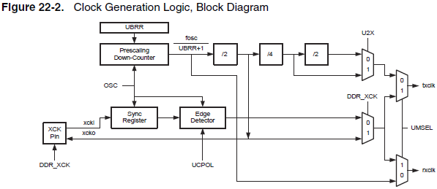
Clock Generation Logic
Internal Tx Clk
Internal Rx Clk
Rx clk in generated from internal fosc
UBRRn – Prescalar value used to generate Rx clk
UBRRn is two 8-bit registers, UBRRH and UBRRL
Slides created by:
Professor Ian G. Harris

Slide 23
Clock Operation Modes
Normal Asynchronous
Rx/Tx clk rate is 16x baud rate
Accurate sampling of signal, good synchronization
Double Speed Asynchronous
Rx/Tx clk rate is 8x baud rate
Double speed transmission, less accurate synchronization
Master Synchronous
Synchronous communication, generate clk
Slave Synchronous
Synchronous communication, receive clk
Slides created by:
Professor Ian G. Harris

Slide 24
Setting Clocks
High Speed Internal Clock
Internal Rate = fosc / (UBRRn + 1)
Baud Rate Clk, Normal Asynchronous
Baud = fosc / 16 (UBRRn + 1)
Baud Rate Clk, Double Speed Asynchronous
Baud = fosc / 8 (UBRRn + 1)
Slides created by:
Professor Ian G. Harris

Slide 25
Frame Formats
USART has several communication options to define how many bits are transmitted
Start bit: 1
Data bits: 5 – 9
Parity bit: none, even, odd
Stop bits: 1 or 2
Set using bits in the UCSRnB and UCSRnC registers
Format must match on both transmitter and receiver
Slides created by:
Professor Ian G. Harris

Slide 26
USART Register Summary
UBBR is the prescalar used to determine the clocks
Determines the BAUD rate
UCSRA indicates the status of communications
Transmit/Receive complete, errors, etc.
UCSRB enables interrupts and communications
Interrupt enable, Tx/Rx enable, data size, etc.
UCSRC sets parity bits, stop bits, USART mode, ...
UDR holds transmit data and received data
Slides created by:
Professor Ian G. Harris

Slide 27
UCSRA
Bit 7 – RXCn: USART Receive Complete
Bit 6 – TXCn: USART Transmit Complete
Bit 5 – UDREn: USART Data Register Empty
Bit 4 – FEn: Frame Error
Bit 3 – DORn: Data OverRun
Bit 2 – UPEn: USART Parity Error
Slides created by:
Professor Ian G. Harris

Slide 28
Typical USART Initialization
#define FOSC 1843200// Clock Speed
#define BAUD 9600
#define MYUBRR FOSC/(16*BAUD)-1
void main( void )
{ USART_Init ( MYUBRR ); }
void USART_Init( unsigned int ubrr){
/* Set baud rate */
UBRRH = (unsigned char)(ubrr>>8);
UBRRL = (unsigned char)ubrr;
/* Enable receiver and transmitter */
UCSRB = (1<<RXEN)|(1<<TXEN);
/* Set frame format: 8data, 2stop bit */
UCSRC = (1<<USBS)|(3<<UCSZ0);
} // USART_Init
Slides created by:
Professor Ian G. Harris

Slide 29
Transmitting Data
void USART_Transmit( unsigned char data )
{
// Wait for empty transmit buffer
while ( !( UCSRA & (1<<UDRE)) );
// Put data into buffer, sends the data
UDR = data;
}
Data is transmitted by placing it in the UDR register
Data Register Empty (UDRE) bit of the UCSRA register
Set to 0 while a transfer is going on
Need to wait for it before sending new data
Slides created by:
Professor Ian G. Harris

Slide 30
Receiving Data
void USART_Receive( void )
{
// Wait for data to be received
while ( !( UCSRA & (1<<RXC)) );
// Read data from UDRn buffer
return ( UDR );
}
Data is received by reading it from the UDRn register
Different from transmit UDRn register
Receive Complete flag (RXC) bit of the UCSRA register
Set to 1 when new data is received
Slides created by:
Professor Ian G. Harris

Slide 31
Communicating with a PC
Need a Terminal Emulator program which “speaks” UART (serial)
There are many free terminal emulators
Hyperterm (used to come with Windows)
Termite
Putty (which I use)
Need to select a COM port to find the USB-to-serial adapter
Need to match frame format to the ATmega
Slides created by:
Professor Ian G. Harris

Slide 32
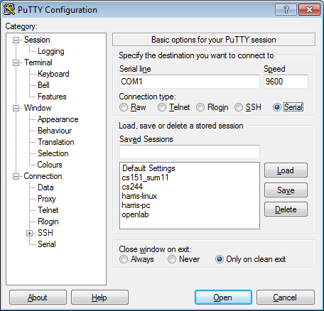
Putty Terminal Emulator
Can communicate in several protocols
Select “Serial”
Fill in baud rate
Adjust settings by selecting “Serial” in left column
Slides created by:
Professor Ian G. Harris

Slide 33
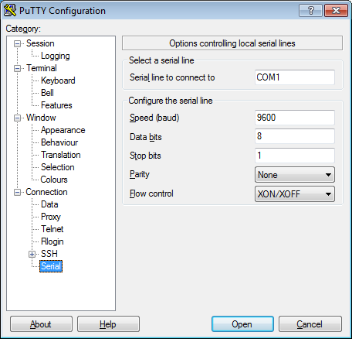
Putty Serial Settings
Flow control
Atmega does not seem to support any
Slides created by:
Professor Ian G. Harris

Slide 34
UART Uses
UART may be an extra (slow) communication channel
Useful if communication speed is not a problem
Debugging
Make a “print” statement
Note: will alter performance, but not much
Simple User Interface
Humans are slow, interface can be as well
Slides created by:
Professor Ian G. Harris

Slide 35
Synchronous Communication
Synchronous protocols share a common clock
More accurate, faster than asynchronous protocols
Sampling time is accurately known
Restricted to short range communication
Clock edge and data must have identical timing
Clock edge must arrive at all receivers simultaneously
Slides created by:
Professor Ian G. Harris

Slide 36
Synchronous Protocols
USART
Limited to communication between two devices (or broadcast)
Serial Peripheral Interface (SPI)
Multi-Drop Bus protocol, more than two devices
Single master, many slaves
Inter-Integrated Circuit (I2C)
Multi-drop, multi-master
Slides created by:
Professor Ian G. Harris

Slide 37
SPI
a.k.a Four Wire Interface
Master
Slave
MOSI
MISO
SCLK
SS’
MOSI
MISO
SCLK
CS’
Master Out Slave In (MOSI) –From Master to Slave
Master In Slave Out (MISO) –From Slave to Master
SCLK – Clock generated by Master
Slave Select (SS’) – Indicates communication w/ selected slave
Chip Select (CS’) – Alerts slave to communication
Slides created by:
Professor Ian G. Harris

Slide 38
SPI Data Transmission
Serial transmission synchronized by the clock
Many bytes may be sent in a single transfer
8-bits is what we will use
Bi-directional data transmission
MOSI transmits concurrently with MISO
Internal shift register may be used to hold both transmitted and received data
Shift in a received bit, shift out a transmitted bit
Slides created by:
Professor Ian G. Harris

Slide 39
Clock Polarity and Phase
Clock polarity and phase determine when data is made valid wrt the clock
Polarity = 0 or 1, Phase = 0 or 1
Data is valid on each clk rising edge or each clk falling edge
Data valid edge (V) = PHASE XOR POLARITY
Polarity = 0, Phase = 0: Rising edge sampling
Polarity = 1, Phase = 1: Rising edge sampling
Polarity = 0, Phase = 1: Falling edge sampling
Polarity = 1, Phase = 0: Falling edge sampling
Slides created by:
Professor Ian G. Harris

Slide 40
SPI Timing Diagrams
SCLK
MOSI
bit1
bit2
bit3
SS’/CS’
Polarity, Phase = 0, 0 or 1, 1
SCLK
MOSI
bit1
bit2
bit3
SS’/CS’
Polarity, Phase = 0, 1 or 1, 0
Slides created by:
Professor Ian G. Harris

Slide 41
Multiple Independent Slaves
Need a unique SS’ for each slave
Master
Slave
MOSI
MISO
SCLK
SS1’
SS2’
SS3’
MOSI
MISO
SCLK
CS’
MOSI
MISO
SCLK
CS’
MOSI
MISO
SCLK
CS’
Slides created by:
Professor Ian G. Harris

Slide 42
SPI on the ATmega
Only one SS’ line
SPDR
Reading accesses last received transmission
Writing automatically sends a the data
Do not directly access the SPI pins
Handled in hardware
Slides created by:
Professor Ian G. Harris

