Slide 1
SPI on the ATmega
SS’ line only used in Slave mode
SPDR
Reading accesses last received transmission
Writing automatically sends a the data
Do not directly access SPI pins
Handled in hardware
Except CS’, as Master
Slides created by:
Professor Ian G. Harris

Slide 2
SPI Pins on the ATmega
MISO, MOSI, and SCK are not explicitly accessed
HW handles pin access when SPDR is read/written
However, program must set directions on these pins
SS’ enables SPI in Slave mode
Slides created by:
Professor Ian G. Harris

Slide 3
SPI Registers
SPCR - SPI Control Register
Bit 7 - SPIE: SPI Interrupt Enable
Bit 6 - SPE: SPI Enable
Bit 5 - DORD: Data Order (1 = LSB)
Bit 4 - MSTR: Master/Slave Select (1 = master)
Bit 3 - CPOL: Clock Polarity
Bit 2 - CPHA: Clock Phase
Bits 1,0 – SPR1,SPR0: SPI Clock Rate Select
Slides created by:
Professor Ian G. Harris

Slide 4
SPI Registers
SPSR - SPI Status Register
Bit 7 - SPIF: SPI Interrupt Flag
Bit 6 - WCOL: Write Collision Flag
Bit 5:1 - Reserved
Bit 0: SPI2X: Double SPI Speed Bit
Slides created by:
Professor Ian G. Harris

Slide 5
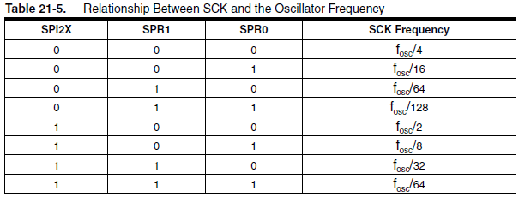
SPI Clock Speed
SPSR
Bit 0
SPCR
Bit 1
SPCR
Bit 0
Determines SCLK as a function of fosc
Slides created by:
Professor Ian G. Harris

Slide 6
SPI Master Example
void SPI_MasterInit(void)
{
// Set MOSI and SCK output, all others input
DDRB = (1<<DDB2)|(1<<DDB1);
// Enable SPI, Master, set clock rate fosc/16
SPCR = (1<<SPE)|(1<<MSTR)|(1<<SPR0);
}
void SPI_MasterTransmit(char cData)
{
/* Start transmission */
SPDR = cData;
/* Wait for transmission complete */
while(!(SPSR & (1<<SPIF)));
}
Slides created by:
Professor Ian G. Harris

Slide 7
SPI Slave Example
void SPI_SlaveInit(void)
{
// Set MISO output, all others input
DDRB = (1<<DDB3);
// Enable SPI
SPCR = (1<<SPE);
}
char SPI_SlaveReceive(void)
{
// Wait for reception complete
while(!(SPSR & (1<<SPIF)));
// Return Data Register
return SPDR;
}
Slides created by:
Professor Ian G. Harris

Slide 8
I2C Protocol
Synchronous, serial protocol
Multiple masters, multiple slaves
Bitwidth is fixed, independent of number of slaves
Two wires: SDA (serial data) and SCL (serial clock)
Both lines are open-drain
Pulled up to high by default
State of bus is always known
Slides created by:
Professor Ian G. Harris

Slide 9
I2C Terminology
Master – Initiates and terminates transmission. Generates SCL.
Slave – Addressed by the Master
Transmitter – Placing data on the bus
Receiver – Reading data from the bus
Slides created by:
Professor Ian G. Harris

Slide 10
I2C Network
Vcc
Vcc
SDA
SCL
Master
Slave
Master
Slave
Slave
SDA and SCL are bidirectional
Unlike SPI
Slides created by:
Professor Ian G. Harris

Slide 11
I2C Transaction Structure
Start Condition
Indicates the beginning of a transaction
Address/Direction Byte
Specifies slave for communication
Specifies read vs. write transaction
Data Byte(s)
Transmitted by either master or slave
Stop Condition
Indicates the end of a transaction
Slides created by:
Professor Ian G. Harris

Slide 12
Start and Stop Conditions
SDA
SDA
SCL
SCL
Start Condition
Stop Condition
Start Condition
Falling transition on SDA while SCL=1
Stop Condition
Rising transition on SDA while SCL=1
Slides created by:
Professor Ian G. Harris

Slide 13
Sending a Bit
SDA
SCL
SDA is sampled by receiver on the rising edge of SCL
SDA must be constant which SCL is high
Exception is Start/Stop Condition
Slides created by:
Professor Ian G. Harris

Slide 14
Acknowledge Bit
SDA
1
2
3
8
ACK
SCL
After each byte is sent, the receiver must acknowledge
Transmitter releases SDA, receiver must pull SDA low
Must be low for one pulse of SCL
If SDA is not pulled low, transmission is aborted
Slides created by:
Professor Ian G. Harris

Slide 15
Typical I2C Packet
Address (7 bits)
Data (8 bits)
Start
ACK
Stop
Direction
Bit
ACK
Each slave has an unique 7-bit address
Direction Bit: 0 indicates write, 1 indicated read
ACK bit after each byte
Slides created by:
Professor Ian G. Harris

Slide 16
I2C on ATmega
Two Wire Interface (TWI) is their name for it
Supports options which we will not consider
10 bit addressing
Multi-master arbitration
Packet format is the same
Data sent MSB first
Slides created by:
Professor Ian G. Harris

Slide 17
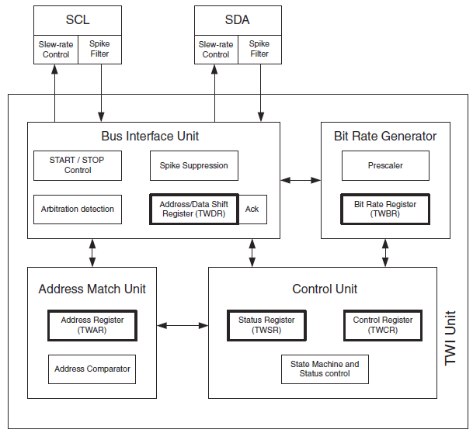
TWI Module on ATmega
Slides created by:
Professor Ian G. Harris

Slide 18
Bit Rate Generator Unit
Generates the clock on SCL
Used only if acting as a Master
Controlled by two registers:
TWI Bit Rate Register (TWBR)
Prescalar bits in the TWI Status Register (TWSR)
f_{SCL} = fosc / [16 + 2 (TWBR) * 4 ^{TWPS}]
fosc in slave >= 16 * f_{SCL}
Slides created by:
Professor Ian G. Harris

Slide 19
Bus Interface Unit
TWI Address/Data Register (TWDR)
Contains the byte to send, of the byte received
START/STOP Controller
Not directly accessed by programmer
ACK/NACK Bit Register
Not directly accessed by programmer
Bus Arbitration Logic
Not directly accessed by programmer
Slides created by:
Professor Ian G. Harris

Slide 20
Address Match Unit
TWI Address Register (TWAR)
Contains the address of this device (in slave mode)
Incoming address (in TWDR) is compared to TWAR
TWI General Call Recognition Enable (TWGCRE)
Bit in TWAR which indicates that general call address (0000000) should be recognized
General call recognition allows broadcasts
Slides created by:
Professor Ian G. Harris

Slide 21
Control Unit
TWI Control Register (TWCR)
Used to set various I2C communication options
TWCR contains TWI Interrupt Flag (TWINT)
TWINT is set when an interesting TWI event occurs
Transmit START condition
Transmit address
Receive data byte
TWI Status Register (TWSR)
Contains status byte after TWINT is set
Slides created by:
Professor Ian G. Harris

Slide 22
Controlling TWI
Each transaction is divided into stages (“bus cycles”)
Cycles for a Write Transaction:
1. Send START, 2. Send Address, 3. Send Byte, 4. Send STOP
TWINT is automatically set and at the end of each stage
TWSR is also loaded with status of the cycle
Clearing TWINT is required to trigger the next bus cycle
TWINT is cleared by setting TWCR bit to 1
Slides created by:
Professor Ian G. Harris

Slide 23
Write Transaction Example
Step 1: Send a START Condition
void SendStart() {
TWCR = (1<<TWINT)|(1<<TWSTA)|(1<<TWEN);
}
SendStart();
TWEN bit enables TWI logic
TWSTA bit indicates START condition is next cycle
TWINT = 1 clears flag, initiating bus cycle
Slides created by:
Professor Ian G. Harris

Slide 24
Write Transaction Example
Step 1.5: Wait for START to be sent, check result
void VerifyStatus(char code) {
while (!(TWCR & (1<<TWINT)));
if ((TWSR & 0xF8) != code) ERROR();
}
VerifyStatus (START);
While statement waits for completion of START
TWSR, high 5 bits, should contain START (0x08) to indicate correct transmission
Slides created by:
Professor Ian G. Harris

Slide 25
Write Transaction Example
Step 2: Send Address
void SendByte (char data) {
TWDR = data;
TWCR = (1<<TWINT) | (1<<TWEN);
}
SendByte (SLA_W);
SLA_W is the slave address + direction bit
Since TWSTA is not set, TWDR will be transmitted
Slides created by:
Professor Ian G. Harris

Slide 26
Write Transaction Example
Step 2.5: Wait for Address to be sent, check result
VerifyStatus(MT_SLA_ACK);
MT_SLA_ACK indicates that ACK was received
Slides created by:
Professor Ian G. Harris

Slide 27
Write Transaction Example
Step 3: Send Data, Wait for completion, Check result
SendByte(DATA);
VerifyStatus(MT_DATA_ACK);
Slides created by:
Professor Ian G. Harris

Slide 28
Write Transaction Example
Step 4: Send STOP Condition
void SendStop() {
TWCR = (1<<TWINT)|(1<<TWSTO)|(1<<TWEN);
}
SendStop();
Slides created by:
Professor Ian G. Harris

Slide 29
TWI Interrupts
Example used while loops to wait for cycle completion
TWINT is set at the end of each cycle
Could have used interrupts to execute each stage
No need to waste processor time waiting
Slides created by:
Professor Ian G. Harris

Slide 30
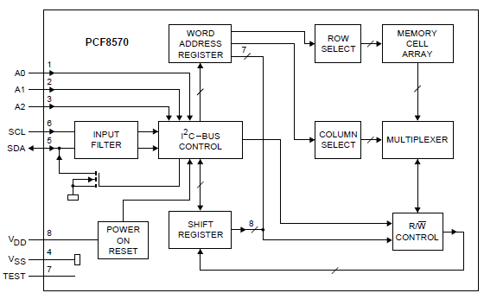
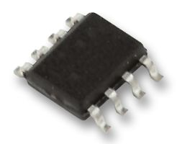
I2C System Example
Philips PCF8570
256 x 8-bit static low-voltage RAM with I2C-bus interface
Interface with a RAM IC
Slides created by:
Professor Ian G. Harris

Slide 31
Memory IC Wiring
Symbol | Pin | Description
A0 | 1 | Address In 0
A1 | 2 | Address In 1
A2 | 3 | Address In 2
Vss | 4 | Negative supply
SDA | 5 | Serial data
SCL | 6 | Serial clock
TEST | 7 | Tied to Vss
Vdd | 8 | Positive Supply
Address inputs are low bits of the address
High address bits are fixed
SDA, SCL attached to ATmega 2560 pins
Slides created by:
Professor Ian G. Harris

Slide 32
Memory Timing Diagrams
Timing diagrams are provided for transactions
WRITE transaction, Master Transmitter, Slave Receiver
Need to write code to match the timing diagrams
Slides created by:
Professor Ian G. Harris

Slide 33
Write Transaction
void WriteMTSR (char s_addr, char m_addr, char data) {
SendStart();
VerifyStatus(START);
SendByte(s_addr);
VerifyStatus(MT_SLA_ACK);
SendByte(m_addr);
VerifyStatus(MT_DATA_ACK);
SendByte(data);
VerifyStatus(MT_DATA_ACK);
SendStop();
}
WriteMTSR(SLA_ADDR, MEM_ADDR, DATA);
Slides created by:
Professor Ian G. Harris

Slide 34
Analog to Digital Conversion (ADC)
Converts an analog voltage to a digital value
Maps input voltage range of digital values
Ex. 0V – 5V -> 0x00 – 0xFF
Allows the digital μC to use analog data
Can read analog sensors
Commonly built into μControllers
ATmega 2560 ADC has 10-bit accuracy
Digital value range 0 – 1023
Slides created by:
Professor Ian G. Harris

Slide 35
Starting a Single Conversion
Set the AD Start Conversion (ADSC) bit in the AD Control and Status Register A (ADCSRA)
ADSC stays high as long as conversion is being performed
ADSC is cleared by HW when conversion is done
Use this to check for conversion completion
Slides created by:
Professor Ian G. Harris

Slide 36
Auto Triggering
May want to trigger conversion based on some event
Previous conversion completed
External interrupt
Timer interrupt
Set AD Auto Trigger Enable (ADATE) bit in ADCSRB register
Set AD Trigger Select (ADTS) bits to select trigger
Slides created by:
Professor Ian G. Harris

Slide 37
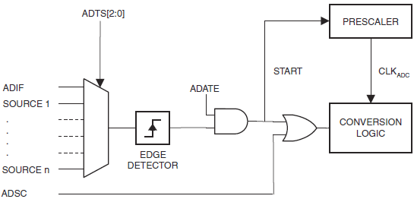
Auto Trigger Logic
AD Interrupt Flag (ADIF) enables “Free Running” mode
Slides created by:
Professor Ian G. Harris

Slide 38
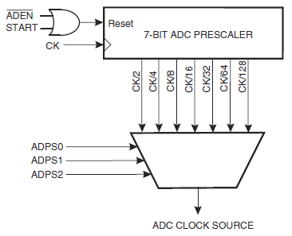
ADC Clock Generation
Fast ADC clock – low conversion time, less accuracy
Slow ADC clock – high conversion time, more accuracy
AD Prescalar Select (ADPS) bits in ADCSRA
50kHz – 200kHz is needed (up to 1000kHz)
Slides created by:
Professor Ian G. Harris

Slide 39
Channel/Reference Selection
Analog source can be any pin from PortF or PortK
Source channel selected by MUXn bits in ADMUX register
Reference voltage can be Vcc, 2.56V, 1.1V
Reference selected by REFS bits in ADMUX
Changes during a conversion take effect after the conversion
Slides created by:
Professor Ian G. Harris

Slide 40
ADC Conversion Result
Result is contained in ADCL and ADCH registers
10-bits contained in 2 registers, 6 bits ignored
ADLAR bit in ADMUX determines left (right) adjust
Left adjust – ignore low 6 bits of ADCL
Right adjust – ignore high 6 bits of ADCH
If 8-bit accuracy is enough, choose left adjust and ignore ADCL
Slides created by:
Professor Ian G. Harris

