Slide 1
ATmega System Reset
All I/O registers are set to initial values
PORT registers set to 0
DDR registers set to 0 (inputs)
Program execution set to the Reset Vector
Reset vector can point to regular program
Internal reset is stretched using a counter
Allows power to become stable
Slides created by:
Professor Ian G. Harris

Slide 2
Reset Sources
Power-on Reset - Triggered when voltage is below power-on reset threshold
External Reset - Triggered on the RESET’ pin
Watchdog reset - Triggered when watchdog timer expires
Brown-out Reset - Triggered when voltage is below brown-out threshold
JTAG AVR Reset - Triggered if there is a 1 in the JTAG Reset Register
Slides created by:
Professor Ian G. Harris

Slide 3
MCUSR
Indicates which reset has occurred
Must be cleared in Reset function
Bit 4 – JTRF: JTAG Reset Flag
Bit 3 – WDRF: Watchdog Reset Flag
Bit 2 – BORF: Brown-out Reset Flag
Bit 1 – EXTRF: External Reset Flag
Bit 0 – PORF: Power-on Reset Flag
Slides created by:
Professor Ian G. Harris

Slide 4
Watchdog Timer
Special-purpose timer
Has its own, slower clock source
Can set prescalar but not start value
Time out from 16ms to 8s
Interrupt mode
Can wake device from low power mode
System Reset Mode
Resets ATmega when it expires
Slides created by:
Professor Ian G. Harris

Slide 5
Watchdog Failsafe
Embedded software can erroneously enter an infinite loop
Waiting for an event that never happens
Watchdog expiration pulls the program out of an infinite loop
Watchdog must be reset regularly in correct program
WDR instruction resets timer
Use wdt_reset() macro in avr libc
Slides created by:
Professor Ian G. Harris

Slide 6
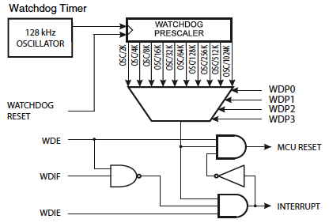
Watchdog Reset Logic
WDE is Watchdog Enable
WDIE is Watchdog Interrupt Enable
WDIF is Watchdog Interrupt Flag
Resets cannot be enabled if interrupts are enabled
Slides created by:
Professor Ian G. Harris

Slide 7
Watchdog Register
WDIF - Watchdog Interrupt Flag
WDIE - Watchdog Interrupt Enable
WDCE - Watchdog Change Enable
Allows prescalar and WDE to be changed
WDE - Watchdog Enable
WDP3:0 - Watchdog Timer Prescalar
Slides created by:
Professor Ian G. Harris

Slide 8
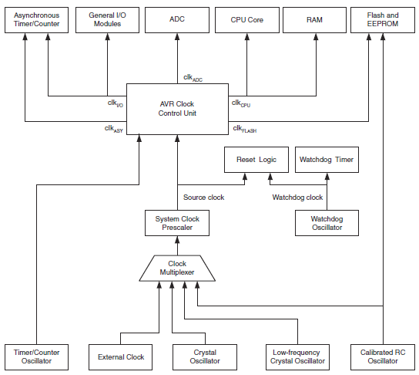
ATmega Clock Distribution
Several clocks and clock sources
System Clock Prescalar slows clocks
Several options set by fuses, not regs
Slides created by:
Professor Ian G. Harris

Slide 9
ATmega Clock Generation
Several different clock are generated on chip
Clk_{asy} - Drives asynchronous timer (in sleep modes)
Clk_{I/O} - Drives SPI, USART, I2C
Clk_{ADC} - Drives ADC
Clk_{CPU} -Drives main processor
Clk_{Flash} - Drives FLASH memory
Slides created by:
Professor Ian G. Harris

Slide 10
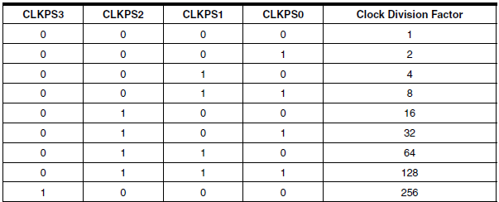
Clock Prescalar
CLKPR
Bit 7 – CLKPCE: Clock Prescaler Change Enable
Bits 3:0 – CLKPS3:0: Clock Prescaler Select Bits 3-0
Slides created by:
Professor Ian G. Harris

Slide 11
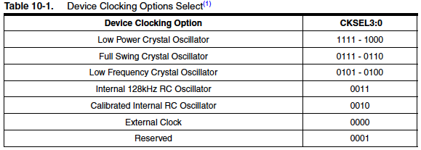
ATmega Clock Sources
Different clock sources selected using fuses
Default clock is internal RC clock, 8MHz
Clock div set to 8, producing 1MHz clock
Slides created by:
Professor Ian G. Harris

Slide 12
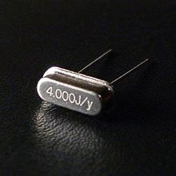
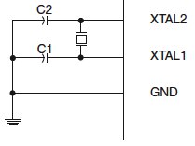
Crystal Oscillators
Crystal of piezoelectric material which vibrates at a precise frequency
Connected externally to the ATmega
Slides created by:
Professor Ian G. Harris

Slide 13
RC Oscillators
RC circuits designed to oscillate at a given frequency
Convenient, easy to build
Susceptible to temperature and process variation
ATmega has 128KHz and 8MHz RC oscillators
Slides created by:
Professor Ian G. Harris

Slide 14
Power Management
Dynamic power - consumed when transistors switch state
Static (Leakage) power - consumed whenever a device receives power, independent of switching
Low power modes shut off clocks, eliminating dynamic power consumption
Components can be completely shut down to eliminate static power
Slides created by:
Professor Ian G. Harris

Slide 15
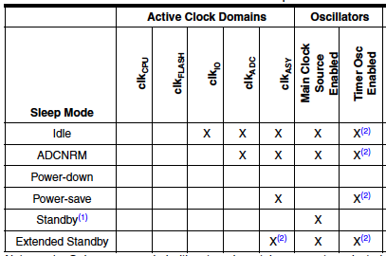
Low Power Modes
Power-down - Only asynchronous devices operational
Standby - Clock source operational. Only 6 cycles to return to normal power state
Slides created by:
Professor Ian G. Harris

Slide 16
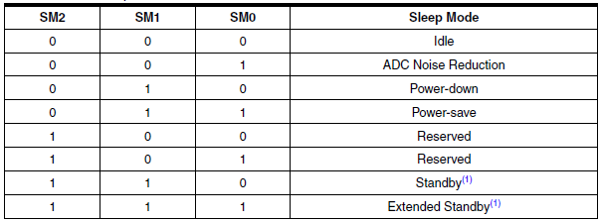
Sleep Mode Control Register
Bit 0 - SE – Sleep Enable
Bits 3:1 - SM? – Sleep mode select
Slides created by:
Professor Ian G. Harris

Slide 17
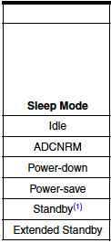
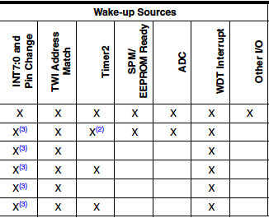
Wakeup Sources
INT 7:4 - only level interrupt
TWI Address - on receipt of message
Wakeup delays vary (i.e. standby vs. power-down)
Slides created by:
Professor Ian G. Harris

Slide 18
Disabling Devices
Additional power can be saved by disabling peripherals
Power Reduction Register
Bit 7 - PRTWI: Power Reduction TWI
Bit 6 - PRTIM2: Power Reduction Timer/Counter2
Bit 5 - PRTIM0: Power Reduction Timer/Counter0
Bit 3 - PRTIM1: Power Reduction Timer/Counter1
Bit 2 - PRSPI: Power Reduction Serial Peripheral Interface
Bit 1 - PRUSART0: Power Reduction USART0
Bit 0 - PRADC: Power Reduction ADC
Slides created by:
Professor Ian G. Harris

Slide 19
Security in Embedded Systems
Cybersecurity is clearly important today
Embedded systems are a new frontier for attackers
Many devices are networked
ES companies do not know security
Traditional defenses may not work on embedded systems
Ex. No ES Anti-Virus (maybe for cell phones)
Hardware is a current trend in security circles
Arduino helps with this

Slide 20
Common Attack Goals
Confidence Scams – Traditional scams performed via computer
Information Theft – Stealing valuable information
Denial of Service (DoS) – Shutting down a network-based service
Causing Physical Events – Embedded control systems
Co-opting CPU Resources – Executing code on another machine
Slides created by:
Professor Ian G. Harris

Slide 21
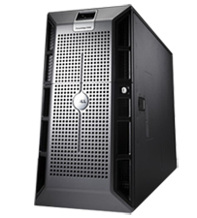
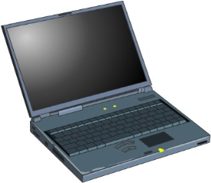
Points of Attack
Internet
Local
Computer
User
Network
Server
All four elements can be targeted by attacks
Slides created by:
Professor Ian G. Harris

Slide 22
Confidence Scams: Phishing
Internet
Local
Computer
User
Network
Server
Exploiting vulnerabilities in the user, not the network or device
Traditional scams using the computer (and/or the phone) as a vehicle
People trust official looking emails and websites
Often used to gain information for larger attacks
Slides created by:
Professor Ian G. Harris

Slide 23
Phishing Examples
Examples:
“Dear Honorable Sir, I need to transfer $10,000,000,000 to your account”
Required to pay a “small” transfer fee
This actually works “Oregon Woman Loses $400,000 to Nigerian E-Mail Scam” AP, 11/18/08
“You need to update your Paypal account …”
Directed to send personal information
Call computer support and masquerade as a technician
“Where is that TFTP server located again?”
Slides created by:
Professor Ian G. Harris

Slide 24
Spoofing
Making a fake version of something in order to trick a user
Often used as part of a phishing scam
Example:
You get an email saying something is wrong with your ebay account.
It provides a link to a website www.ebayaccounts.com
The website is fake but can look completely real
Can be done with email addresses and calling trees
Slides created by:
Professor Ian G. Harris

Slide 25
Preventing Phishing
Don’t trust anyone or any information that you can’t verify
Don’t give critical info to unverified websites/phone numbers
2. Don’t accept anything (i.e. programs) from unverified sources
This may be inconvenient
1. If Citibank calls, call them back at a known number
2. Can’t purchase online from unknown vendors
3. Be careful about freeware/shareware
Slides created by:
Professor Ian G. Harris

Slide 26
Information Theft
Internet
Local
Computer
User
Network
Server
Stealing data from a computer or the network
Targets local computer, server, and network
Slides created by:
Professor Ian G. Harris

Slide 27
Information Theft
Stealing data on your computer or on the network
Identity theft - Get social security #, home address, passwords, etc.
Credit cards, loans in your name
This happens to individuals
Corporate theft - Get information from organizations and steal their money
“Russian hackers stole Cape Cod Town’s money”
AP, 11/26/08
“Hundreds of Stolen Data Dumps Found”
WashingtonPost.com, 12/22/08
Slides created by:
Professor Ian G. Harris

Slide 28
Other Information Theft
Eavesdropping on Voice Over IP (VOIP) phone calls
VOIP data sent over the internet
Stalking/Cyberstalking
Find a home address, school, etc.
International Spying
“China trying to crack U.S. computers, buy nukes”
cnn.com, 3/3/08
Slides created by:
Professor Ian G. Harris

Slide 29
Preventing Information Theft
Use encryption as much as possible
Encrypted Communications
Website addresses starting with “https:” - automatic
Virtual Private Networks (VPN) – mostly automatic
Pretty Good Privacy (PGP) – manual interaction
Whole Disk Encryption
Protects data on your computer
Slows down your machine significantly
Servers are out of your control
You can only complain/sue
Slides created by:
Professor Ian G. Harris

Slide 30
Denial of Service (DoS)
Internet
Local
Computer
User
Network
Server
Attempt to shut down a network-based service
Only happens to servers (unless your machine is a server)
Slides created by:
Professor Ian G. Harris

Slide 31
Typical DoS Attacks
May be applied to any server
Webserver, bank, course registration, etc.
Might be a protest of some kind
“Estonia recovers from massive denial-of-service attack”
IDG News Service , 05/17/2007
Might be tactical warfare
“Before the Gunfire, Cyberattacks ”
8/12/08
Site of Georgia’s president taken offline
Slides created by:
Professor Ian G. Harris

Slide 32
Execution of DoS Attacks
Simply deluge a server with requests
- Requires many machines to do this
Exploit a bug in the server software
- Software always has many bugs
- Can be exploited if it can be triggered remotely
- Ex. VOIP phone crashes when if a call is ended at the wrong time
Slides created by:
Professor Ian G. Harris

Slide 33
Preventing DoS Attacks
Not much a user can do
- This is a server problem
Servers use network-based intrusion detection
- Check network activity for suspicious patterns
- Block suspicious traffic
Slides created by:
Professor Ian G. Harris

Slide 34
Causing Physical Events
Internet
Local
Computer
User
Network
Server
> Attack a computer which controls physical devices
- Building heating/cooling control, power grid control, etc.
> Server problem, but you may have a server
- Wifi printer, home automation, nannycam, etc.
Slides created by:
Professor Ian G. Harris

Slide 35
Cyber-Physical Attacks
Embedded Cyber-Physical Systems
- Special purpose computers with a simple interface
- Directly interact with the physical world
- Ex. Building control, wifi printer, cars, etc.
Vulnerabilities have been found in wireless medical devices
Daniel Halperin, Thomas S. Heydt-Benjamin, Benjamin Ransford, et al. “Pacemakers and Implantable Cardiac Defibrillators: Software Radio Attacks and Zero-Power Defenses,” May 2008, www.secure-medicine.org/icd-study/icd-study.pdf
Slides created by:
Professor Ian G. Harris

Slide 36
Preventing Cyber-Physical Attacks
User cannot do much, must trust the manufacturer
- Users cannot generally modify embedded devices
Large-scale cyber-physical systems need to be well protected
- Use firewalls, anti-virus, network-based intrusion detection, and physical security measures
Slides created by:
Professor Ian G. Harris

Slide 37
Co-opting CPU Resouces
Internet
Local
Computer
User
Network
Server
Taking over a computer, forcing it to do your bidding
Can occur to any machine, but home machines are most vulnerable
Slides created by:
Professor Ian G. Harris

Slide 38
Malware
Complete takeover of a machine requires the ability to execute arbitrary code on that machine
Malware – Generic term for malicious code that runs on a machine without permission
Typical malware functions:
- Steal critical data and send it back to a central repository
- Make a machine unbootable
- Force the machine to act as a zombie in a botnet
> botnet is used to perform larger attacks, spam, etc.
Slides created by:
Professor Ian G. Harris

Slide 39
Basic Malware Functions
Need to know this in order to understand defenses
1. Gets into the memory of your computer
2. Tricks your computer into executing it
3. Hides itself
4. Spreads itself to other machines
Slides created by:
Professor Ian G. Harris

Slide 40
Getting Into Your Computer
User-driven - User allows the malware in
Read your email
Click on an attachment
Click on a website link
File transfer (ftp)
Background traffic - Many programs communicate on the network in the background
Email, skype, automatic updates, etc.
Slides created by:
Professor Ian G. Harris

Slide 41
Executing on Your Machine
How can foreign programs run on my computer?
User Gives Permission
“Do you want to enable this macro?”
Bad default settings, (ex. Automatically enable all macros)
These vulnerabilities can be fixed fairly easily
Software Vulnerability
A networked application has a coding flaw which allows unauthorized code execution
Slides created by:
Professor Ian G. Harris

Slide 42
Rootkits
A rootkit is a program that uses stealth
- Sneaks onto your machine without you knowing
- Hides itself on your machine so that is can’t be removed
Rootkits change components of the operating system to hide their presence
Example of stealth
- A rootkit may attach itself to a good executable
- Detected by examining properties of the executable (i.e. size)
- Checking properties is a call to an OS program
- Rootkit may change the “check properties” program to print the
original size
Most malware is fundamentally a specialized rootkit
Slides created by:
Professor Ian G. Harris

Slide 43
Malware Propagation/Spread
Trojan Horse - Malware which is part of another program which the user believes is safe
Spread occurs when the user installs the “safe” program
Social engineering may be involved
Virus - Malware which is part of a larger program or file
Ex. Macro in an .xls spreadsheet
Self-replicates by inserting itself into new programs/files
Worm - Malware which is not attached to another program/file
Self-replicates over the network
Slides created by:
Professor Ian G. Harris

Slide 44
Stopping Malware
Keep you software updates current
Malware is often enabled by a bug in a networked application
Internet Explorer, Skype phone, Adobe Acrobat, World of Warcraft, etc.
Patches often fix known vulnerabilities
Slides created by:
Professor Ian G. Harris

Slide 45
Stopping Malware
Use a firewall to stop malware from entering your machine initially
- Firewall blocks incoming/outgoing network traffic
- Could block the traffic which delivers the malware
Problem: Firewalls only look at the message header, not the content
- Header contains message routing info
- Malware may be contained in the content
Problem: Firewalls are a blunt instrument
- Block all messages from a particular address or application
- Easy to block too much or too little
Slides created by:
Professor Ian G. Harris

Slide 46
Stopping Malware
Use anti-virus programs to detect malware in your memory or on your disk
- Anti-virus will scan all files for known malware
- Will flag suspicious behavior to detect unknown malware
Problem: Scans may miss unknown malware
Keep anti-virus signatures up-to-date
Problem: May produce annoying false alarms
Behavior may look suspicious but be OK
Slides created by:
Professor Ian G. Harris

Slide 47
Embedded System Security
May store important information
Health information (medical devices)
Personal information (cell phones)
Copyrighted information (movies, music)
May control life-critical/cost-critical devices
Human bodies (medical devices)
ATMs
Anti-lock braking systems
Slides created by:
Professor Ian G. Harris

Slide 48
Attack Goals
Steal information from the device
Personal data, passwords, copyrighted data
Denial of Service (DoS)
Shut down your device (malicious or prank)
Eavesdrop on the device
Stealing communications
Change the behavior
Jailbreaking an iphone
Include in a botnet
Slides created by:
Professor Ian G. Harris

Slide 49
How Are They Attacked?
Many embedded systems are networked
Wifi, ethernet, bluetooth, Irda, etc.
Direct physical access via I/O
USB
Memory cards (SD cards, etc.)
App. Specific protocols (VGA, “private” protocols)
Device may be opened
Inter-IC protocols (I2C, SPI, etc.)
IC-specific interfaces
Slides created by:
Professor Ian G. Harris

Slide 50
Methods of Attack, Remote
Remote attacks
Attacker does not need to be in close proximity to the device
Vast majority of attacks are remote
Remote attacks are launched via a network (internet)
Either wired (ethernet) or wireless (802.11?)
Bluetooth/IrDA possible, shorter range
Slides created by:
Professor Ian G. Harris

Slide 51
Methods of Attack, Remote
Attacker
HW
OS
Network
Apps.
Internet Msgs.
Attacker manipulates the device using TCP/IP messages
Bugs in Networked Applications allow messages to impact device behavior
Slides created by:
Professor Ian G. Harris

Slide 52
Buffer Overflow Example
int foo(int argc, char *argv[]) {
int i = 0;
char buff[128];
char *arg1 = argv[1];
while (arg1[I] != ‘\0’) {
buff[I] = arg1[I];
I++;
}
buff[I] = ‘\0’;
printf(“buff = %s\n”, buff);
}
User input copied into buff without checking length
Could come from the network as well
Slides created by:
Professor Ian G. Harris

Slide 53
Smashing the Stack
low address
local
local
Stack frame
frame
Stack
frame
foo
return
return
local
frame
main
return
high address
Buffer overflow allows malicious code to be written onto the stack
Overflowing local var can corrupt the return address
Return address can point to malicious code
Slides created by:
Professor Ian G. Harris

Slide 54
Defenses Against Remote Attacks
Update software regularly
Updates are not common with embedded systems
Network Intrustion Detection (NIDS)
Maybe if deep packet inspection is used
Anti-virus, Firewall, NIDS
Embedded systems do not have sufficient computational power
Slides created by:
Professor Ian G. Harris

