Slide 1
Advanced RISC Machine (ARM)
ARM designs and licenses 16/32-bit processor cores
ARM does not sell integrated circuits
ARM licenses their intellectual property (IP)
Hard core – complete layout is provided
Inflexible, no modifications are possible
less work for licensee
Soft core – synthesizable Verilog code
Optimizations can be performed
Synthesis must be performed by licensee

Slide 2
ARM-based Processors
ARM Processor Core
Internal Bus
Peripherals
Memory
I/O
ARM provides the processor core
Licensee designs the remainder of the system

Slide 3
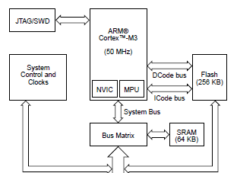
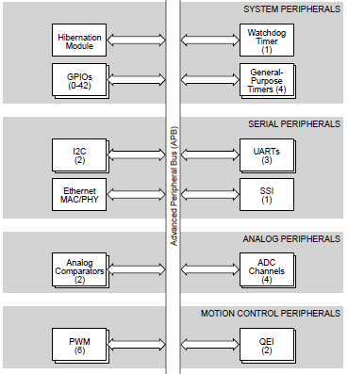
TI Stellaris LM3S6965
Nested Vector Interrupt Controller (NVIC)
Memory Protection Unit (MPU)
Other components are outside core

Slide 4
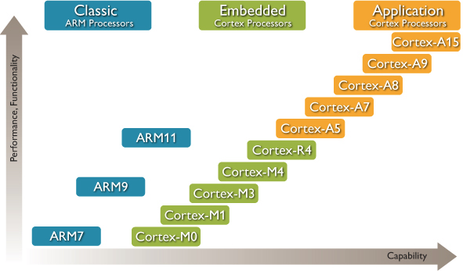
ARM Processor Families
“Classic” = old
“Embedded” = low end
“Application” = high end
ARM marketing material

Slide 5
ARM Processor Families
Cortex-M Series
Low-cost, embedded applications
Cortex-R Series
Designed for real-time embedded apps
Faster than Cortex M
Cortex-A Series
Highest performance, made for an OS
Designed for user-facing applications
SecureCore Series
Security functionality, not clearly specified
FPGA Core
Cortex-M1 mapped to FPGAs

Slide 6
Some Optional ARM Features
Memory Protection Unit (MPU)
Provides protected access to physical memory
Important to support multiple processes
Nested Vector Interrupt Controller (NVIC)
Supports interrupt nesting
Prioritized interrupts
Jazelle Direct Bytecode Execution (DBX)
Java bytecode executed directly on processor
Effectively, a new instruction set
On-chip Debug Support
CoreSight System Trace Macrocells
Debugging information extracted on-the-fly

Slide 7
Exceptions
Exceptions in ARM are similar to interrupts
Exception handlers must be defined for each exception
When exception occurs, processor mode is changed appropriately
Each processor mode has registers which are accessed only in that mode
Low-level security feature
Slides created by:
Professor Ian G. Harris

Slide 8
Processor Modes
Six operating modes:
• User (unprivileged mode under which most tasks run)
• FIQ (entered when a high priority (fast) interrupt is raised)
• IRQ (entered when a low priority (normal) interrupt is raised)
• Supervisor (entered on reset and when a Software Interrupt instruction is executed)
• Abort (used to handle memory access violations)
• Undef (used to handle undefined instructions)
ARM Architecture Version 4 adds a seventh mode:
• System (privileged mode using the same registers as user mode)
Slides created by:
Professor Ian G. Harris

Slide 9
Registers
General-Purpose Registers
R0 – R7 are unbanked registers, same in all modes
R8 – R14 are banked registers, different for each mode
R13 is normally the Stack Pointer
R14 is the Link Register
Return address of a subroutine call is here
R15 is the Program Counter (PC)
Program Status Registers
Current Program Status Register (CPSR)
Saved Program Status Register (SPSR) – holds value of CPSR before exception
Slides created by:
Professor Ian G. Harris

Slide 10
Instruction Sets
ARM Instruction Set
Standard 32-bit instructions
Thumb Instruction Set
16-bit instructions
Less robust, better code density
Dynamically switch between ARM and Thumb mode
T bit in CPSR
Thumb-2 Instruction Set
16-bit and 32-bit instructions
No switch between ARM/Thumb needed
Slides created by:
Professor Ian G. Harris

Slide 11
Thumb vs. ARM
Thumb instructions access only a subset of general-purpose registers
R0 – R7, only 3 bits needed
Branches are short range
Conditional branches offset is only 8-bits long
Instructions have fewer argument options
ADDS $r1, $r1, $r0
ADD $r1, $r0
No shift option on arithmetic instructions
Generally, more Thumb is more RISC than CISC
Slides created by:
Professor Ian G. Harris

Slide 12
ARM Instruction Set
An instruction set is the set of all machine instructions supported by the architecture
Load-Store Architecture
Data processing occurs in registers
Load and store instructions move data between memory and registers
[] indicate an address
Ex. LDR r0, [r1] moves data into r0 from memory at address in r1
STR r0, [r1] moves data from r0 into memory at address in r1

Slide 13
Data Processing Instructions
Move Instructions
MOV r0, r1 moves the contents of r1 into r0
MOV r0, #3 moves the number 3 into r0
Shift Instructions – inputs to operations can be shifted
MOV r0, r1, LSL #2 moves (r1 << 2) into r0
MOV r0, r1, ASR #2 moves (r1 >> 2) into r0, sign extend
Arithmetic Instructions
ADD r3, r4, r5 places (r4 + r5) in r3

Slide 14
Condition Flags
Current Program Status Register (CPSR) contains the status of comparison instructions and some arithmetic instructions
N – negative, Z – zero, C – unsigned carry, V – overflow, Q - saturation
Flags are set as a result of a comparison instruction or an arithmetic instruction with an 'S' suffix
Ex. CMP r0, r1 – sets status bits as a result of (r0 – r1)
ADDS r0, r1, r2 – r0 = r1 + r2 and status bits set
ADD r0, r1, r2 – r0 = r1 + r2 but no status bits set

Slide 15
Conditional Execution
All ARM instructions can be executed conditionally based on the CPSR register
Appropriate condition suffix needs to be added to the instruction
NE – not equal, EQ – equal, CC – less than (unsigned), LT less than (signed)
Ex. CMP r0, r1
ADDNE r3, r4, r5
BCC test
ADDNE is executed if r0 not equal to r1
BCC is executed if r0 is less than r1

Slide 16
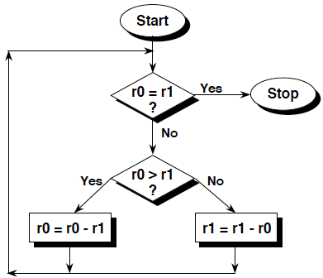
Benefits of Conditional Exec.
GCD Example
Greatest Common Divisor algorithm, between r0 and r1
Subtract smaller from larger until they are equal
Explicit branch instructions are not needed (as often)
Slides created by:
Professor Ian G. Harris

Slide 17
Higher Code Density
“Normal” Assembler
gcd: cmp r0, r1 ;reached the end?
beq stop
blt less ;if r0 < r1
sub r0, r0, r1 ;subtract r1 from r0
bal gcd
less: sub r1, r1, r0 ;subtract r0 from r1
bal gcd
stop:
ARM Conditional Assembler
gcd: cmp r0, r1 ; compare r0 and r1
subgt r0, r0, r1 ;subtract r1 from r0
sublt r1, r1, r0 ;else subtract r0 from r1
bne gcd ;reached the end?
Slides created by:
Professor Ian G. Harris

Slide 18
Endianess in ARM
The ARM can be set up to access its data in either little or big endian format.
Little endian:
Least significant byte of a word is stored in bits 0-7 of an addressed word.
Big endian:
Least significant byte of a word is stored in bits 24-31 of an addressed word.
This has no real relevance unless data is stored as words and then accessed in smaller sized quantities (halfwords or bytes).
Slides created by:
Professor Ian G. Harris

Slide 19
Efficient Coding
Important to be efficient in programming
RAM, FLASH, performance
Efficient C coding may require an understanding of the compiler
Compiler can erase your efficiencies for you
In the worst case, you can modify/write the assembly by hand
Slides created by:
Professor Ian G. Harris

Slide 20
Adding Contents of an Array
Program computes the sum of the first 64 elts in the data array
Variable i is declared as a char to save space
int checksum_v1 (int *data) {
char i;
int sum=0;
for (i=0; i<64; i++) {
sum += data[i];
}
return sum;
}
i always less than 8 bits long
May use less register space and/or stack space
i as a char does NOT save any space
All stack entries and registers are 32 bits long

Slide 21
Loops, Fixed Iterations
A lot of time is spent in loops
Loops are a common target for optimization
checksum_v1:
MOV r2, #0 ; sum = 0
MOV r1, #0 ; i = 0
checksum_v1_loop:
LDRSH r3, [r0], #4 ; r3 = *(data++)
ADD r1, r1, #1 ; r1 = i+1
CMP r1, #0x40 ; compare i, 64
ADD r2, r3, r2 ; sum += r3
BCC checksum_v1_loop ; if i<64 goto loop
MOV pc, r14 ; return sum
3 instructions implement loop: add, compare, branch
Replace them with: subtract/compare, branch
Result of the subtract can be used to set condition flags

Slide 22
Condensing a Loop
Current loop counts up from 0 to 64
i is compared to 64 to check for loop termination
Optimized loop can count down from 64 to 0
i does not need to be explicitly compared to 0
Add the 'S' suffix to the subtract so is sets condition flags
Ex. SUBS r1, r1, #1
BNE loop
BNE checks Zero flag in CPSR
No need for a compare instruction

Slide 23
Loops, Counting Down
checksum:
MOV r2, r0 ; r2 = data
MOV r0, #0 ; sum = 0
MOV r1, #0x40 ; i = 64
checksum_loop:
LDR r3, [r2], #4 ; r3 = *(data++)
SUBS r1, r1, #1 ; i-- and set flags
ADD r0, r3, r0 ; sum += r3
BCC checksum_loop ; if i!=0 goto loop
MOV pc, r14 ; return sum
One comparison instruction removed from inside the loop
25% less work in loop
Possible because ARM always compares to 0

Slide 24
Loop Unrolling
Loop overhead is the performance cost of implementing the loop
Ex. SUBS, BCC
For ARM, overhead is 4 clock cycles
SUBS = 1 clk, BCC = 3 clks
Overhead can be avoided by unrolling the loop
Repeating the loop body many times
Fixed iteration loops, unrolling can reduce overhead to 0
Variable iteration loops, overhead is greatly reduced

Slide 25
Unrolling, Fixed Iterations
checksum
MOV r2, r0 ; r2 = data
MOV r0, #0 ; sum = 0
MOV r1, #0x40 ; i = 32
checksum_loop
SUBS r1, r1, #1 ; i-- and set flags
LDR r3, [r2], #4 ; r3 = *(data++)
ADD r0, r3, r0 ; sum += r3
LDR r3, [r2], #4 ; r3 = *(data++)
ADD r0, r3, r0 ; sum += r3
BCC checksum_loop ; if i!=0 goto loop
MOV pc, r14 ; return sum
Only 32 iterations needed, loop body duplicated
Loop overhead cut in half

Slide 26
Unrolling Side Effects
Advantages:
Reduces loop overhead, improves performance
Disadvantages:
Increases code size
Displaces lines from the instruction cache
Degraded cache performance may offset gains

Slide 27
Register Allocation
Compiler must choose registers to hold all data used
- i, data[i], sum, etc.
If number of vars > number of registers, stack must be used
- very slow
Try to keep number of local variables small
- approximately 12 available registers in ARM
- 16 total registers but some may be used (SP, PC, etc.)

Slide 28
Function Calls, Arguments
ARM passes the first 4 arguments through r0, r1, r2, and r3
Stack is only used if 5 or more arguments are used
Keep number of arguments <= 4
Arguments can be merged into structures which are passed by reference
typedef struct {
float x;
float y;
float z;
} Point;
float distance (point *a, point *b) {
float t1, t2;
t1 = (a->x – b->x)^2;
t2 =(a->y – b->y)^2;
return(sqrt(t1 + t2));
}
Pass two pointers rather than six floats

Slide 29
Preserving Registers
Caller must preserve registers that the callee might corrupt
Registers are preserved by writing them to memory and reading them back later
Example:
Function foo() calls function bar()
Both foo() and bar() use r4 and r5
Before the call, foo() writes registers to memory (STR)
After the call, foo() reads memory back (LDR)
If foo() and bar() are in different .c files, compiler will preserve all corruptible registers
If foo() and bar() are in the same file, compiler will only save corrupted registers

Slide 30
Booting a System
Starting the OS (if there is one) or the application
Different for embedded vs. standard computers
In a simple system there may be very little to do
Just jump to the application
Having a boot process creates some uniformity to the system state
Code must exist in ROM (or flash, EEPROM)

Slide 31
Bootloader, Embedded
Small program, first thing executed
Main function is to allow the flash to be reprogrammed
Not the HW method (i.e. JTAG)
Enables firmware updates
Must interact with data interfaces to receive flash data (USB, ethernet, etc.)
Starts execution of application
May also copy application to SRAM

Slide 32
Bootloader Requirements
Ability to switch operating mode
Writing flash may not be possible in user mode
Access communication interfaces
Parse an executable format
S-Records, COFF, Intel, etc.
Read/Write flash and EEPROM
Compute a checksum of the application
Code security (if available)

Slide 33
Typical Control Flow
Enter Bootloader?
N
Execute Application
Y
Jump
N
Initialize
Command Received?
Y
Execute Command
Start by checking for bootloader entrance
May be connected to an input pin
Initialize system, service commands, start application
Use jump/branch to enter bootloader during application

Slide 34
Initialization, Commands
Initialize a minimum subset of peripherals needed to perform bootloader tasks
System clocks, ISRs, communications
Self-contained vs. Command-based
Self-contained bootloader takes no commands
i.e. Booting from an SD card
Command-based receives commands from outside
PC-based application, or networked app.

Slide 35
Standard Commands
Minimum set
Erase Flash
Write Flash
Restart – Soft reset, enter application code
Common set
Unlock Flash – enter security key to get write access
Lock Flash
Erase/Read/Write EEPROM
Read Flash – Verify that the image is correct
Image Checksum – Compute checksum of application

Slide 36
Memory Partitioning
Flash must be partitioned into at least 2 sections, bootloader section and application section
Partitioning features often built into the processor
Bootloader must be aware of the flash memory map
Must know where application should be loaded
Must know where bootloader is for firmware updates
Know the properties of the flash memory
Smallest erasable chunk size (4kB)
Smallest writable chunk size (8 bytes)
Flash write protection may be provided
No accidental (or intentional) overwrite

Slide 37
ATmega Bootloader Support
Read-While-Write Self Programming – Can read one section of flash while writing to another section
Ex. Read the Bootloader code while writing the application
Bootloader can write entire flash, including the bootloader
Region of flash is dedicated to the bootloader
Bootloader section of memory can be resized with the BOOTSZ fuses
Lock bits used to protect flash memory

Slide 38
Flash Sections
Application Section - Application code goes here
Boot Loader Section (BLS) – Bootloader goes here
Relative sizes defined by fuses BOOTSZ1, 0
BOOTSZ1 | BOOTSZ0 | Application | Bootloader
1 | 1 | 0x0000-0x7DFF | 0x7E00-0x7FFF
1 | 0 | 0x0000-0x7BFF | 0x7C00-0x7FFF
0 | 1 | 0x0000-0x77FF | 0x7800-0x7FFF
0 | 0 | 0x0000-0x6FFF | 0x7000-0x7FFF

Slide 39
Accessing Flash
LPM – Load Program Memory (read)
SPM – Store Program Memory (write)
SPM instruction only works if issued from the Boot Loader Section
Application cannot write to flash
Access allowed depends on the protection used

Slide 40
Flash Memory Protection
Boot Lock Bits (BLB) 0, 1 determine protection for application section and BLS, respectively.
BLB02 | BLB01 | Protection
1 | 1 | No restrictions for SPM/LPM accessing application
1 | 0 | SPM cannot write to application
0 | 0 | SPM cannot write to application and LPM from BLS cannot read application
0 | 1 | LPM from BLS cannot read application

Slide 41
Read-While-Write
Flash is divided into Read-While-Write (RWW) and No-Read-While-Write (NRWW)
Not the same as BLS vs. Application sections
When erasing or writing a page located inside the RWW section, the NRWW section can be read during the operation
When erasing or writing a page located inside the NRWW section, the CPU is halted during the entire operation
Bootloader is always in the NRWW section

Slide 42
Booting a PC
More complicated and more standardized
Must start an operating system, may give a choice
Execution starts with the Basic Input/Output System (BIOS)
Like a complicated version of the bootloader for an embedded system
Bootloader is invoked by the BIOS

Slide 43
Tasks of the BIOS
Power-on self-test (POST)
Detect and execute video card’s BIOS
Detect and execute other device’s BIOS
Display start-up screen
Memory test
Set memory/drive parameters
Configure Plug and Play Devices: PCIe, USB, SATA, SPI
Assign resources (DMA channels and IRQs)
Identify boot device, load Master Boot Record (MBR)
Bootloader is in MBR

Slide 44
Bootloader Example
GRUB (Grand Unified Boot Loader)
MBR contains GRUB Stage 1
Search through partition table for Volume Boot Record for the current partition
GRUB Stage 2 in VBR
GRUB Stage 2
Present user with choice of OS to load
Load selected kernel and run kernel

