Slide 1
Operating Systems
Allow the processor to perform several tasks at virtually the same time
Ex. Web Controlled Car with a camera
  Car is controlled via the internet
  Car has its own webserver (http://mycar/)
  Web interface allows user to control car and see camera images
  Car also has “auto brake” feature to avoid collisions
Fwd
Left
Right
Back
Web interface view

Slide 2
Multiple Tasks
Assume that one microcontroller is being used
At least four different tasks must be performed
Send video data - This is continuous while a user is connected
Service motion buttons - Whenever button is pressed, may last seconds
Detect obstacles - This is continuous at all times
Auto brake - Whenever obstacle is detected, may last seconds
Detect and Auto brake cannot occur together
3 tasks may need to occur concurrently

Slide 3
Process/Task Support
Main job of an OS is to support the Process (Task) Abstraction
A process is an instantiation of a program
  Must have access to the CPU
  Must have access to memory
  Must have access to other resources
    I/O, ADC, Timers, network, etc.
OS must manage resources
    Give processes fair access to the CPU
    Give processes access to resources

Slide 4
Controlled Resource Access
OS enforces rules on resource usage
  “Can’t use CPU more than 200 msec at a time”
  “Can’t use I/O pins without permission”
  “Can’t use memory of other processes”
  “High priority tasks get CPU first”
Processes can be written in isolation, without considering sharing
  Less work for the programmer

Slide 5
Processes vs. Threads
A process has its own private memory space
  Virtual memory allows transparent memory partitioning
  Memory protection is needed
Threads within a process share the same memory space
  Different program executions, same space
  Lower switching overhead

Slide 6
Context Switching
Context of a task is the storage, inside the processor core, which describes the state of the execution
  General-purpose registers
  Progam counter, stack pointer, status word, etc.
  Processes and threads have unique contexts
  Includes virtual memory tables
Context switch is saving context of current task and loading context of new task
  Time consuming (memory accesses)
  OS must minimize these for performance
Slides created by:
Professor Ian G. Harris

Slide 7
Programmer’s Perspective
Application
Application
Library Functions
Microconrtoller
System Calls
Microconrtoller
Programmer accesses OS via library functions
  Malloc, printf, fopen, etc.
OS details are mostly hidden from the programmer
Slides created by:
Professor Ian G. Harris

Slide 8
Real-Time Operating Systems
OS made to satisfy real-time constraints
Small “footprint” to run on an embedded system
  Low memory overhead
  Low performance overhead
Predictable scheduling algorithm
  Predictability is more important than speed
May not have “traditional” OS features
  No GUI, no dynamic memory allocation, no filesystem, no dynamic scheduling, etc.
Slides created by:
Professor Ian G. Harris

Slide 9
Cyclic Executive RTOS
Minimal OS services
  No memory protection (threads), etc.
Set of tasks is static
  All tasks known at design time
  No dynamic task creation
Task scheduling is static
  Task ordering is predetermined (periodic tasks)
  Task switching triggered by timer interrupt
Slides created by:
Professor Ian G. Harris

Slide 10
Example Cyclic Executive
setup timer
c = 0;
while (1) {
suspend until timer expires
c++;
do tasks due every cycle
if (((c+0) % 2) == 0) do tasks due every 2nd cycle
if (((c+1) % 3) == 0) {
do tasks due every 3rd cycle, with phase 1
}
...
}
Slides created by:
Professor Ian G. Harris

Slide 11
Cyclic Executive Properties
Can be used in low-end embedded systems
  8-bit processor, small memory
Peripheral access via library functions
Statically linked
  No dynamic linking overhead needed
Can be implemented manually
  Simple to code
Extremely low performance overhead
Slides created by:
Professor Ian G. Harris

Slide 12
Microkernel Architecture
More features
  Dynamic scheduling
  Dynamic process creation/deletion
  Inter-process communication and synchronization
  Memory protection
Uses a kernel process
  Process which implements OS features
Many scheduling options to support real-time
Simpler kernel than traditional OS
Slides created by:
Professor Ian G. Harris

Slide 13
Real-Time Scheduling
Given a set of processes, schedule them all to meet a set of deadlines
Properties of processes:
  Arrival Time: Time when the process requests service
  Execution Time: Time required to complete
Processes may have additional scheduling constraints
  Resource constraints: Peripherals required
  Dependency constraints: May need data from other processes
Slides created by:
Professor Ian G. Harris

Slide 14
Periodic vs. Aperiodic Tasks
Periodic tasks must be executed once every p time units
  Every execution of a periodic task is a job
Aperiodic tasks occur at unpredictable times
  Sporadic tasks have a minimum time between jobs
Periodic tasks are easier to schedule
  Can make strict timing guarantees
Aperiodic tasks ruin timing guarantees
Slides created by:
Professor Ian G. Harris

Slide 15
Preemptive vs. Non-preemptive
Non-preemptive schedulers allow a process to execute until it is done
  Each process must willingly give up the CPU or complete
  Response time for external events can be long
Preemptive schedulers will interrupt a running process and start a new process
  Supports task prioritization
  Helps reduce response time
  Increased context switching
Slides created by:
Professor Ian G. Harris

Slide 16
Static vs. Dynamic Scheduling
Static scheduling determines a fixed schedule at design time
  Timer is used to trigger context switches
  Schedule for context switches is fixed
  Cyclic Executive OS
  Very predictable
  Dynamic changes cannot be accommodated
Dynamic scheduling determines schedule at run-time
  More difficult to predict
  Changes can be handled
Slides created by:
Professor Ian G. Harris

Slide 17
Scheduling Algorithms
Consider average scheduling performance
Try to meet timing deadlines, but no guarantees
First Come First Serve Scheduling
Shortest Job First Scheduling
Priority Scheduling
Round-Robin Scheduling
Earliest Deadline First
Rate Monotonic
Slides created by:
Professor Ian G. Harris

Slide 18
First Come First Served (FCFS)
Tasks arrive when they are ready for execution
Arrival order determine execution order
Non-preemptive
Process Exec. Time
P1 24
P2 3
P3 3
P₁
P₂
P₃
0
24
27
30
Slides created by:
Professor Ian G. Harris

Slide 19
FCFS Average Waiting Time
Average waiting time sensitive to arrival time.
  Arrival order P1, P2, P3
  Waiting time for P1=0; P2=24; P3=27
  Average waiting time= (0+24+27)/3=17
  Arrival order P2, P3, P1
  Waiting time for P2=0; P3=3; P1=6
  Average waiting time= (0+3+6)/3=3
Slides created by:
Professor Ian G. Harris

Slide 20
Shortest Job First (SJF)
Each task is associated with an execution time
    Estimated by some method
Shortest execution time task is executed, chosen from waiting tasks
FCFS is used in a tie
SJF gives minimum average waiting time
  Assuming that execution time estimates are accurate
Slides created by:
Professor Ian G. Harris

Slide 21
Shortest Job First Example
Processes Execution time
P1 6
P2 8
P3 7
P4 3
FCFS average waiting time: (0+6+14+21)/4=10.25
SJF average waiting time: (3+16+9+0)/4=7
  Assume they arrive at almost same time
Slides created by:
Professor Ian G. Harris

Slide 22
SJF Preemptive v. Non-preemptive
SJF Non-preemptive
  Process cannot be preempted until it completes execution
  Arrival order is important
Preemptive
  Current process can be preempted if new process has less remaining execution time
  Shortest-Remaining-Time-First (SRTF)
Slides created by:
Professor Ian G. Harris

Slide 23
Priority Scheduling
FCFS ranks based on arrival order
SJF ranks based on execution time
Tasks with real-time deadlines may be ignored
  Late arrival, medium execution time
  Ex. Audio sampling and processing
A priority is associated with each process
The CPU is allocated to the process with the highest priority
  (smallest integer ≡ highest priority)
Sacrifices total waiting time to meet important timing deadlines
Slides created by:
Professor Ian G. Harris

Slide 24
Priority Scheduling Example
Processes Execution time Priority Arrival time
P1 10 3 0.0
P2 1 1 1.0
P3 2 4 2.0
P4 1 5 3.0
P5 5 2 4.0
Arrival time order: P1, P2, P3, P4, P5
Execution time order: P2, P4, P3, P5, P1
Priority order: P2, P5, P1, P3, P4
Scheduler should complete tasks in priority order
Slides created by:
Professor Ian G. Harris

Slide 25
Non-Preemptive, Priority
Processes Execution time Priority Arrival time
P1 10 3 0.0
P2 1 1 1.0
P3 2 4 2.0
P4 1 5 3.0
P5 5 2 4.0
P1
P2
P5
P3
P4
0
10
11
16
18
19
All processes are waiting when P1 is done
Completion order is priority order, after P1
Slides created by:
Professor Ian G. Harris

Slide 26
Preemptive Priority Scheduling
Processes Execution time Priority Arrival time
P1 10 3 0.0
P2 1 1 1.0
P3 2 4 2.0
P4 1 5 3.0
P5 5 2 4.0
P1
P2
P1
P5
P1
P3
P4
0
1
2
4
9
16
18
19
Completion order is exactly priority order
Slides created by:
Professor Ian G. Harris

Slide 27
Priority Scheduling Issues
Starvation: Low priority task may never complete
  Higher priority tasks may always interrupt it
Solution: Aging
  Increase priority of task over time
  Eventually the task is top priority
No hard guarantees on meeting deadline
  Best effort is made
Slides created by:
Professor Ian G. Harris

Slide 28
Time Quantum
A Time Quantum (q) is a the smallest length of schedulable time
Each scheduled task executes for only q time units at a time
New scheduling decision can be made every q time units
Changing time quantum size to trade between context switching vs. max. wait time
Slides created by:
Professor Ian G. Harris

Slide 29
Round Robin Scheduling
Processes Exec. Time Exec. Quantum
P1 53 3
P2 17 1
P3 68 4
P4 24 2
Time quantum = 20
Assume all arrive in first quantum
P1
P2
P3
P4
P1
P3
P4
P1
P3
P3
0
20
37
57
77
97
117
121
134
154
162
Final quantum not fully used by task
Slides created by:
Professor Ian G. Harris

Slide 30
Earliest Deadline First (EDF)
Attempts to meet hard deadlines
Each task must have a deadline, a time when it must be complete
Task with earliest deadline is scheduled first
New task may preempt running task if it has an earlier deadline
  Common to sort ready list and look at only first elt
Slides created by:
Professor Ian G. Harris

Slide 31
EDF Example
Process | Arrival | Exec. Time | Deadline
P1 | 0 | 10 | 33
P2 | 4 | 3 | 28
P3 | 5 | 10 | 29
P1
P2
P3
P1
0
4
7
17
23
P1
arrival
P2
Arr.
P3
Arr.
Slides created by:
Professor Ian G. Harris

Slide 32
Periodic Scheduling
Assume that all tasks are periodic
Possible to make guarantees about scheduling
Assumptions:
  p_{i} be the period of task T_{i},
  c_{i} be the execution time of T_{i},
  d_{i} be the deadline interval
  Time between arrival and required completion
  l_{i} be the laxity or slack, defined as l_{i} = d_{i} - c_{i}
Slides created by:
Professor Ian G. Harris

Slide 33
Accumulated Utilization
Accumulated execution time divided by period
Accumulated utilization:
Necessary condition for schedulability
  m = number of processors
Slides created by:
Professor Ian G. Harris

Slide 34
Rate Monotonic (RM) Scheduling
Periodic scheduling algorithm which guarantees to meet deadlines under certain conditions
  All tasks that have hard deadlines are periodic.
  All tasks are independent.
  d_{i}=p_{i}, (deadline = period) for all tasks.
  c_{i} (exec. time) is constant and is known for all tasks.
  The time required for context switching is negligible
Slides created by:
Professor Ian G. Harris

Slide 35
Schedulability Condition
  Single processor, n tasks, the following equation must hold for the accumulated utilization µ:
  Deadlines can be met, but cannot achieve full utilization
  Some slack is needed to guarantee schedulability
Slides created by:
Professor Ian G. Harris

Slide 36
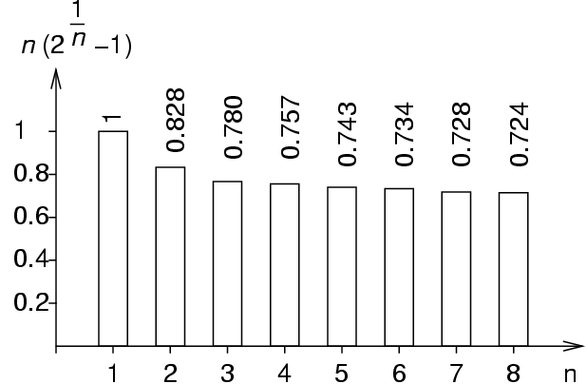
RM Scheduling Algorithm
  RM scheduling is priority scheduling
    Priorities are inversely proportional to deadline
    Low period = high priority
  Schedulability is guaranteed, with assumptions
  As number of tasks increase, utilization decreases
Slides created by:
Professor Ian G. Harris

Slide 37
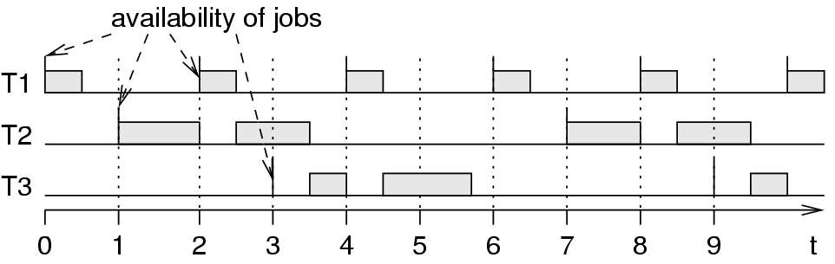
RM Scheduling Example
Task Period Exec. Arrival
T1 2 0.5 0
T2 6 2 1
T3 6 1.75 3
T1 preempts T2 and T3.
T2 and T3 do not preempt each other.
Slides created by:
Professor Ian G. Harris

Slide 38
Communication/Synchronization
Processes need to communicate and share data
Many ways to accomplish communication
  Shared memory, mailboxes, queue, etc.
Problem: When should data be shared?
  Tasks are not synchronized
  OS can switch tasks at any time
  State of shared data may not be valid
  Ex. P1: x = 5; P2: if (x == 5) printf (“Hi”);
  Which line is executed first?
Slides created by:
Professor Ian G. Harris

Slide 39
Atomic Updates
Tasks may need to share global data and resources
For some data, updates must be performed together to make sense
Ex. Our system samples the level of water in a tank
tank_level is level of water
time_updated is last update time
tank_level = // Result of computation
time_updated = // Current time
These updates must occur together for the data to be consistent
Interrupt could see new tank_level with old time_updated

Slide 40
Mutual Exclusion
While one task updates the shared variables, another task cannot read them
Task 1
Task 2
tank_level = ?;
time_updated = ?;
printf (“%i %i”, tank_level,
time_updated);
Two code segments should be mutually exclusive
If Task 2 is an interrupt, it must be disabled

Slide 41
Semaphores
A semaphore is a flag which indicates that execution is safe
May be implemented as a binary variable, 1 continue, 0 wait
TakeSemaphore():
If semaphore is available (1) then take it (set to 0) and continue
If semaphore is note available (0) then block until it is available
ReleaseSemaphore():
Set semaphore to 1 so that another task can take it
Only one task can have a semaphore at one time

Slide 42
Critical Regions
Task 1
Task 2
TakeSemaphore();
tank_level = ?;
time_updated = ?;
ReleaseSemaphore();
TakeSemaphore();
printf (“%i %i”, tank_level,
time_updated);
ReleaseSemaphore();
Semaphores are used to protect critical regions
Two critical regions sharing a semaphore are mutually exclusive
Each critical region is atomic, cannot be separated

Slide 43
POSIX Threads (Pthreads)
IEEE POSIX 1003.1c: Standard for a C language API for thread control
All pthreads in a process share,
  Process ID
  Heap
  File descriptors
  Shared libraries
Each pthread maintains its own,
  Stack pointer
  Registers
  Scheduling properties (such as policy or priority)
  Set of pending and blocked signals

Slide 44
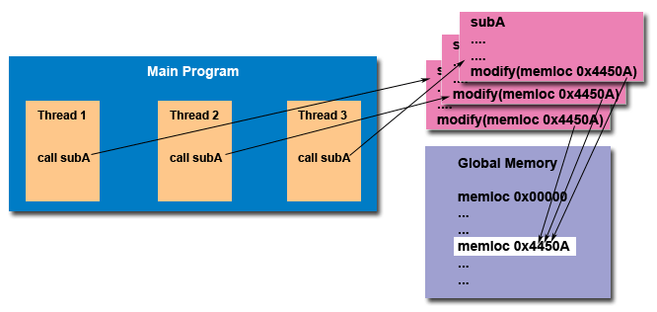
Thread-safeness
Ability to execute multiple threads concurrently without making shared data inconsistent
Don’t use library functions that aren’t thread-safe

Slide 45
Pthreads API
Four types of functions in the API
Thread management: Routines that work directly on threads - creating, detaching, joining, etc.
Mutexes: Routines that deal with synchronization
Condition variables: Routines that address communications between threads that share a mutex.
Synchronization: Routines that manage read/write locks and barriers.
pthreads.h header file needs to be included in source file
gcc –pthread to compile it

Slide 46
Thread Management
pthread_create
  Creates a new thread and makes it executable
  Arguments
    Thread: pthread_t pointer to return result
    Attr: Initial attributes of the thread
    Start_routine: Code for the thread to run
    Arg: Argument for the code (void *)
pthread_exit
  Terminate a thread
  Does not close files on exit

Slide 47
Thread Management
int main (int argc, char *argv[]) {
pthread_t threads[NUM_THREADS];
int rc;
long t;
for(t=0; t<NUM_THREADS; t++){
printf("In main: creating thread %ld\n", t);
rc = pthread_create(&threads[t], NULL, PrintHello, (void *)t);
if (rc){ printf("ERROR; return code is %d\n", rc);
exit(-1);
}
}
pthread_exit(NULL);
}
Creates a set of threads, all running PrintHello
Takes an argument, the thread number

Slide 48
Thread Management
void *PrintHello(void *threadid) {
long tid;
tid = (long)threadid;
printf("Hello World! It's me, thread #%ld!\n", tid);
pthread_exit(NULL);
}
Code run by each thread
Prints its own ID number

Slide 49
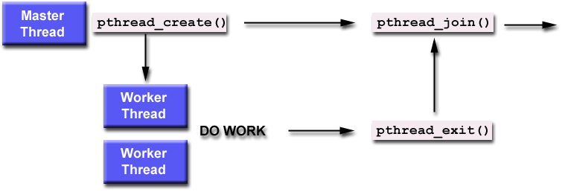
Joining Threads
Joining threads is a way of performing synchronization
Master blocks on pthread_join until worker exits
Worker must be made joinable via its attributes

Slide 50
Joining Example
int main (int argc, char *argv[]) {
pthread_t aThread;
pthread_attr_t attr;
int rc, *t=0;
void *status;
pthread_attr_init(&attr);
pthread_attr_setdetachstate(&attr, PTHREAD_CREATE_JOINABLE);
rc = pthread_create(&thread[t], &attr, BusyWork, (void *)t);
pthread_attr_destroy(&attr);
… // Do something
rc = pthread_join(thread[t], &status);
pthread_attr_* define attributes of the thread (make it joinable)
pthread_attr_destroy frees the attribute structure

