Slide 1
ICS 6D Discrete Math for Computer Science Spring 2016

Slide 2
Course Instructors
Instructor: Prof. Sandy Irani
Teaching Assistants:
Siddharth Gupta
Nayanika Upadhyay
Readers
Tanmay Khema
Zahra Montazeri
Siripen Pongpaichet
Bojun Wang

Slide 3
Course Meeting Times
Lectures: MWF 3:00-3:50
PSLH 100
Discussion
Four different groups
MW 4PM, MW 5PM, MW 6PM, T-Th 8PM (new time)
Two hours per week
Lead by teaching assistants
No new material presented
Question and answer format
No discussion this Monday, March 28 or Tuesday March 29

Slide 4
Course Web Page
www.ics.uci.edu/~irani/s16-6D/6D
Office hours, contact info
Course administration
Schedule
Topics
Reading assignments
Homework/solutions
Test schedule

Slide 5
Text (zyBook)
Web-based, interactive text
Subscription for the quarter ($48)
zyBooks.com to sign up.
zyBook code: UCIICS6DSpring2016
Required for the course:
Data on activities is recorded and counts for a small portion of course credit.
You get credit if you eventually get the question correct.

Slide 6
Text (zyBook)
Two types of interactive activities:
Participation activities
Due at the time the reading is due.
Shorter and easier.
Reinforce/teach concepts
Challenge activities
Due at the time the homework is due.
More challenging
Test mastery

Slide 7
Text (zyBook)
Student activities automatically time-stamped
Your progress visible on your dashboard
Reading for the first week is not for credit.
Reading for the second week is due Monday April 11 at 3PM
After the first two weeks, the reading for each lecture is due by 3PM on the day of the lecture.

Slide 8
Text (zyBook)
Provide feedback:
Technical issues with your subscription:
support@zyBooks.com
Small bugs in the text
“Feedback” buttons in the text
support@zyBooks.com
Technical problems that prevent understanding material:
support@zyBooks.com
CC me: irani@ics.uci.edu
General ideas on how to improve the text
Come talk to me.

Slide 9
Homework
Homework consist of two parts:
Electronic: challenge activities in your zyBook
Written: problems given on course web page.
Both parts are due at 3:00PM:

Slide 10
Homework
Homework must be in dropbox on the first floor of DBH by 3:00PM
No late homework accepted.
Solutions posted right after they are turned in.
Pick up graded homework from the reader who graded them (will be posted on Piazza)
Scores posted on EEE (HW and Tests)

Slide 11
Homework Dropboxes
First floor of Bren Hall
Go in front entrance
Go through lobby
Past restrooms on the right
Dropboxes are around the corned to the left
Wooden cabinets with locks: one will be labelled “ICS 6D”

Slide 12
Schedule
Mon
Wed
Fri
Topic A
In lecture:
Reading and Participation Activities for Topic A are due.
Topic B
In lecture:
Reading and Participation Activities for Topic B are due.
Topic C
In lecture:
Reading and Participation Activities for Topic C are due.
Week x:
HW on topics ABC posted on Monday
Mon
Wed
Fri
Written homework
and Challenge Activites from zyBook on topics
ABC due by 3:00PM
Week x+1:

Slide 13
Course Grades
Homework: (total of 8 out of 9) 5%
Reading: 4%
3 Tests (all mandatory) 60%
Final Exam: 30%
Completing Course Evaluation: 1%
(Anonymous)

Slide 14
Course Grades
Homework: (total of 8 out of 9) 5%
Reading: 4%
3 Tests (all mandatory) 60%
Final Exam: 30%
Completing Course Evaluation: 1%
(Anonymous)

Slide 15
3 Tests
Three tests (all on Mondays):
April 25 (week 5)
May 9 (week 7)
May 23 (week 9)
Given during regular lecture time.
Material covered is posted on class web page for each test.
Test format is short answer or multiple choice.
Corrected tests with be distributed via Rapid Returns.

Slide 16
3 Tests and Final Exam
All three tests and the final exam are mandatory.
There are only two ways to miss a test and not get a 0:
Preapproved absence
Not a work commitment or family vacation
You must send me an email at least one week in advance – or as soon as you are aware of the problem.
Unforeseeable emergency – documented
e.g., medical
In either case, I will ask you to come see me in person so we can discuss your reason and a plan for your score
There will be no make up tests.

Slide 17
Questions on Grading?
After each test or HW score is posted the person who graded it will post a note on Piazza
Questions on grading should first go to the person who graded it
Office hours preferred
By appointment as needed
Come see me about unresolved grading questions.

Slide 18
Board notes
After each lecture, I will post the contents of the board generated from lecture
Purpose: reduce the amount of writing you need to do in class (not eliminate the need to take notes).
Posted board notes are NOT a complete record of what happened in class
You are responsible for whatever is said in lecture.
If you can not read anything written during lecture, please ask!

Slide 19
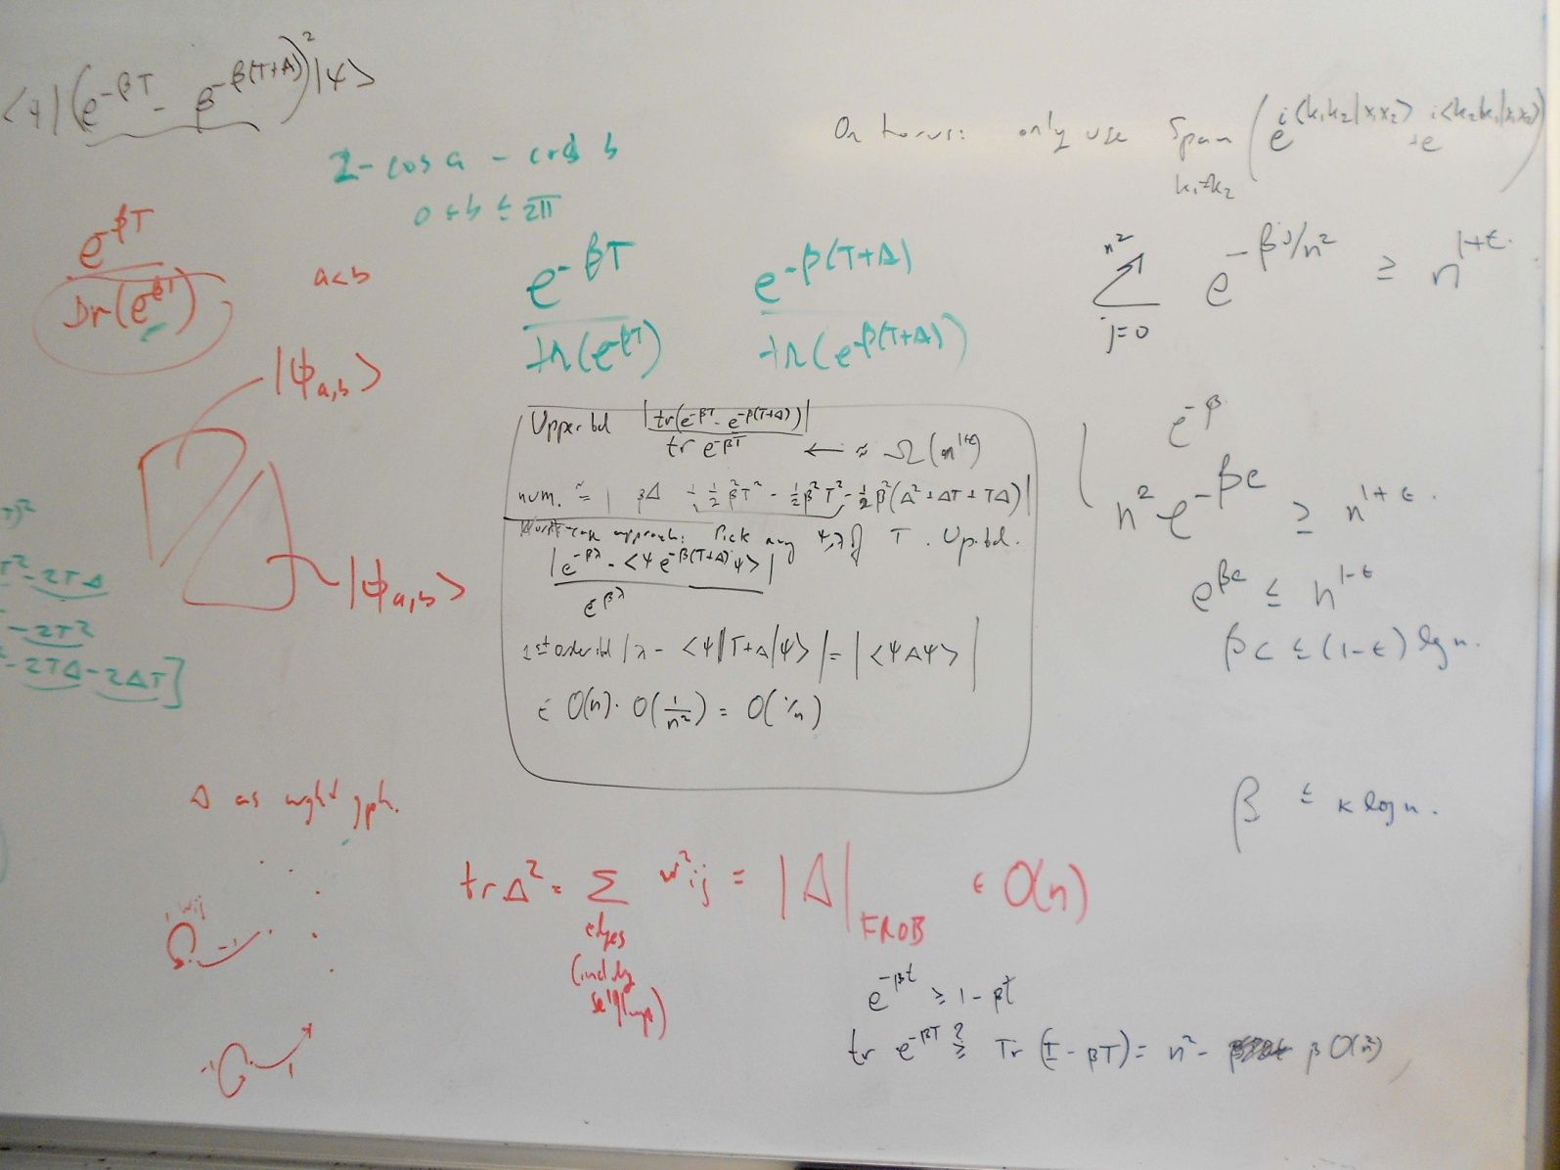
Board notes

Slide 20
Piazza
Online forum/”wiki”
All questions related to course content should be posted on Piazza (not asked by email).
Students can post anonymously
Collectively written/edited student solution
Instructor can mark “good question”/”good solution”
Instructors can add their own solution.
The TAs and I will each check Piazza at least once a day.

Slide 21
Piazza
Post general administrative questions on Piazza
e.g., What does quiz 1 cover?
Routine announcements will be posted on Piazza
Time sensitive announcements will generate an email to the class.
Check Piazza at least twice per week.

Slide 22
Piazza Questions
Questions/comments can be posted anonymously to Piazza, but they are only anonymous to other students.
Instructors see the identity of any individual who posts on Piazza
Before posting an administrative question to Piazza:
Check the course web page or Piazza announcements for an answer
Before posting a question to Piazza about course content:
Check the text for an explanation

Slide 23
Questions
The best way to get questions answered:
Discussion section
My office hours
TA office hours

Slide 24
Office Hours
Highly under-utilized resource
If space is limited, priority given to students asking questions
OK to sit an listen to answers asked by other stidents if there is room.
Office hours are not “study hall”.

Slide 25
Academic Honesty
It’s important!
Read the school policy.
Write up your homework solutions on your own
Keep your eyes on your own test/quiz.

Slide 26
Class attendance
If you need to miss a class, ask a friend for notes.
If you do not understand an example or idea presented in class
Ask a question
Write down your question and bring it to discussion section.

Slide 27
Statistics from Spring Offering of ICS 6D
383 students enrolled and showed up for the final exam
Attendance taken during every lecture in weeks 3-10, except on test days
(19 lectures total)
“High attenders” (at least 75% attendance)
108 students (28% of the class)
“Low attenders” (less than 75% attendance)
275 students (72% of the class)

Slide 28
Statistics from Spring Offering of ICS 6D
High attenders (at least 75%) | Low attenders (less than 75%)
Median grade: B+ | Median grade: C+
7.5% received D+ or lower | 28.4% received D+ or lower
42.6% received an A+/A/A- | 21.1% received an A+/A/A-

Slide 29
Statistics from Spring Offering of ICS 6D

