Slide 1
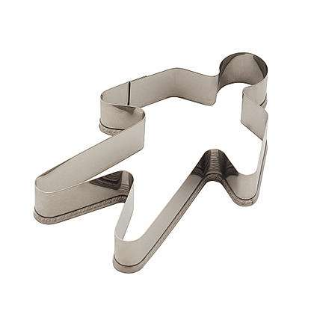
Project 3: Library Guides Final Presentation
Cookie Cutters
Kevin Huynh Sean Tsusaki Jordaniel Wolk

Slide 2
Quick Summary of Project
Library Subject and Course Guides
User Base Considerations
Methods
Notes:
Kevin

Slide 3
What We Have Done
We have already analyzed user data and have completed our proposed prototype.
We are finishing feedback collection through follow-up sessions with previous usability interviewees.
We have already started the Final Report: Estimated completion time is this Friday, June 5th.
Notes:
Sean

Slide 4
What is Left:
The completion and finalization of the Report:
  Sean:
    Discussion and Research Discussion
    Design Decisions
    Review of Data from Interviewees
  JD:
    Research Methods
    Ideal Design Decisions
    Alternative Suggestions/ Related Ideas/ Conclusion
  Kevin:
    Introduction
    Design Decisions
    Review of Data from Interviewees
Notes:
JD

Slide 5
Results
The current Library Guides are overwhelming to both first-time and experienced users.
Inconsistency with peripheral content.
Inconsistent tab size and layout
Redundancy of tab content
Tags under-used, but assumed required
Use of drop-down menus
Lack of guidance for new users
Inconsistent sorting of data
Notes:
Kevin/Sean/JD

Slide 6
The Prototype…
Notes:
Kevin + Sean, Commentary by JD

Slide 7
Questions and Answers (and any Suggestions)
Notes:
Free for all

